Slide 1
Digital Archaeological Data: Curation, Preservation, and Reuse
SAA 75th Annual Meeting, April 3-7, 2013
Honolulu, Hawaii
Elizabeth Yakel, Ph.D.
Eric Kansa. Ph.D.
Professor University of Michigan
yakel@umich.edu
Open Context and University of California, Berkeley
ekansa@ischool.berkeley.edu
Ixchel M. Faniel, Ph.D.
Sarah Kansa, Ph.D.
Postdoctoral Researcher OCLC Research
fanieli@oclc.org
Executive Director
Alexandria Archive Institute
skansa@alexandriaarchive.org

Slide 2
An Institute for Museum and Library Services (IMLS) funded project led by Dr. Ixchel Faniel and Dr. Elizabeth Yakel.
Studying data reuse in three academic disciplines to identify how contextual information about the data that supports reuse can best be created and preserved.
Focuses on research data produced and used by quantitative social scientists, archaeologists, and zoologists.
The intended audiences of this project are researchers who use secondary data and the digital curators, digital repository managers, data center staff, and others who collect, manage, and store digital information.
For more information, please visit http://www.dipir.org

Slide 3
The Research Team
DIPIR Project
Nancy McGovern
ICPSR/MIT
Ixchel Faniel
OCLC Research
(PI)
Eric Kansa Open Context
William Fink UM Museum of Zoology
Elizabeth Yakel University of Michigan (Co-PI)

Slide 4
Methods Overview
 | ICSPR | Open Context | UMMZ
Phase 1: Project Start up
Interviews Staff | 10 Winter 2011 | 4 Winter 2011 | 10 Spring 2011
Phase 2: Collecting and analyzing user data
Interviews data consumers | 43 Winter 2012 | 22 Winter 2012 | 27 Fall 2012
Survey data consumers | 2000 Summer 2012
Web analytics data consumers |  | Server logs Ongoing
Observations data consumers |  |  | 10 Ongoing
Phase 3: Mapping significant properties as representation information

Slide 5
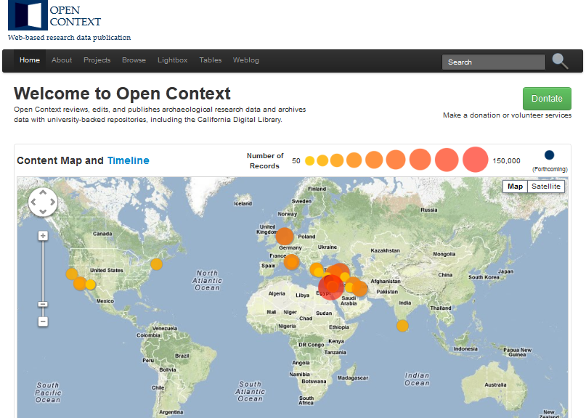

Slide 6
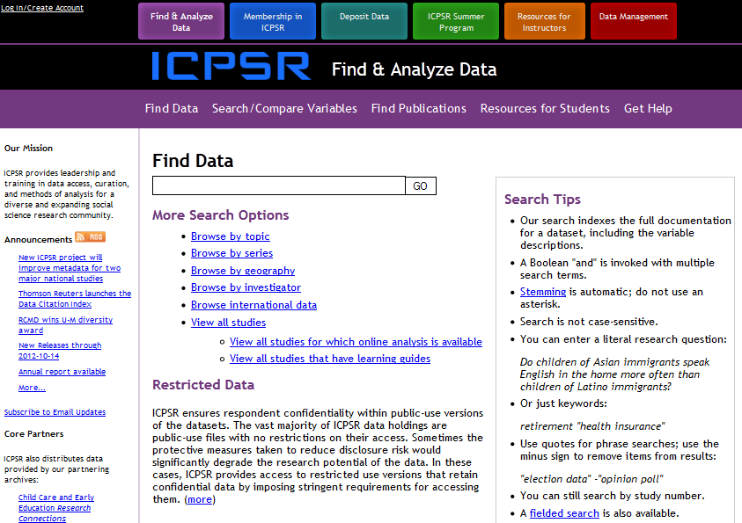

Slide 7
The Study
Research Question
In what ways do the dynamics of data creation and sharing differ between quantitative social scientists and archaeologists and how does this affect reuse and preservation?
Data Collection
65 Interviews
22 archaeologists
43 quantitative social scientists
Data Analysis
Code set developed and expanded from interview protocol
http://www.english.sxu.edu

Slide 8
Findings
Data creation / Documentation practices
Data reuse issues
Digital preservation

Slide 9
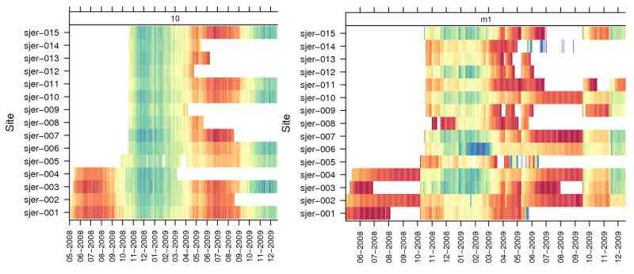
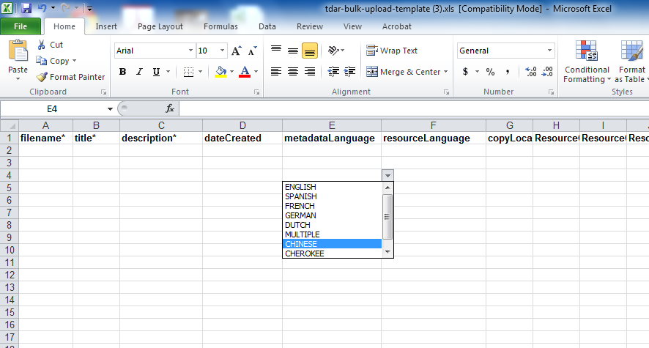
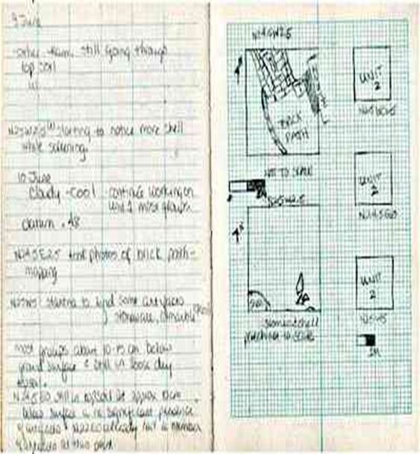
Data Creation: Diversity
Quantitative social scientists
Data
CSV, SPSS, Stata
Codebook
Methodology / Research Design
Archaeologists
Data
Fieldnotes
Images
Spreadsheet
CAD, GIS, etc…

Slide 10
Archaeologists and Data Diversity
It's a very interdisciplinary collection method that we use … and draws on gross geological techniques and zoological techniques and architecture… So, the kinds of ways that I record data are first and foremost paperwork. We have notebooks in the field that are either pencil and paper version or digital format...The next step would be photography; a lot of digital photography. Both, say, publishable and stuff that's more of record keeping but doesn't have the resolution to be published. We also use high-resolution survey equipment like total station so we are collecting say a lot of spatial data. So, that is recorded in spreadsheet files and CAD files that we can then use to reconstruct in a CAD-like environment, GIS/CAD environments...We also catalogue all the artifacts that we find, we assign everything a unique identification number, and build databases to keep that information together. And we do a lot of what we call post-excavation processing, in which that material is processed in a field laboratory, and then it's prepared, oftentimes prepared either to be stored for the long term in the Middle East, or a portion of it is shipped to the United States for laboratory analysis, and there, a whole other level of recording takes place (CCU15).

Slide 11
Data Documentation: Standardization and Openness
Quantitative social scientists
Standardization
Codebooks in DDI (Data documentation initiative)
Expectation by users
Open
Data in CSV
Archaeologists
Standardization
Proprietary and open
ICPSR Codebook rendered with DDI

Slide 12
Documentation Practices: Establishing the Data-Codebook Link
Quantitative social scientists
One issue we have in Political Science is that people... No one can agree on how to measure democracy. It's like a very ambiguous concept and... I think what would be an important thing for me in the future is to be able to justify my decision as to why I chose to use that data because there are lots of different data measuring this... people give responses like, "How did you choose this coding scheme, or this sequence?" And they say, "It's the best available out there." And that is not a sufficient response for why you choose what you choose (CBU11).
Archaeologists
And that's a huge change because in …the original expedition, they were much different and of course more primitive archaeological approach. It was clearance work, it wasn't strati-graphic levels every few centimeters. It wasn't GPS recordings, and digital photography, and analysis of bones, and sheep turds, and all that sort of thing. And that's what's happening now. So, there's a whole different dataset and different types of fields of things that would be tough to mesh a new excavation with an old one. That will be a challenge that we'll face later (CCU05).

Slide 13
Data Reuse: Salience
Scarcity versus abundance
Creating new data
Archaeologists primarily create new data
Reuse is usually supplementary to original data collection
Most quantitative social scientists do not create their own datasets
High cost of conducting a large scale survey, etc.

Slide 14
Data Reuse : Discovery Sites
Museums
Colleagues
Digital Data Repositories
SHPO
Archaeologist
Personal archives
Government Antiquities Authorities
Journals / Published Reports

Slide 15
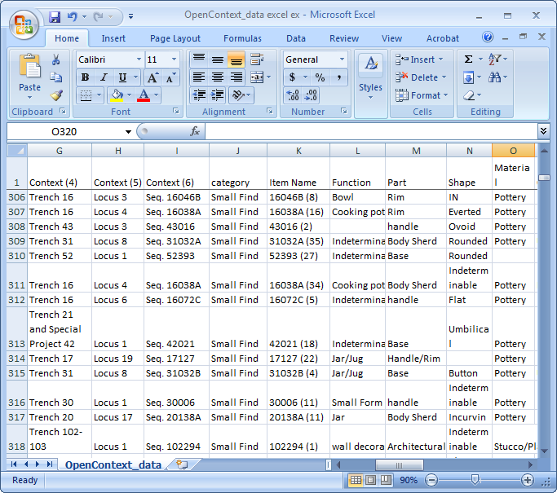
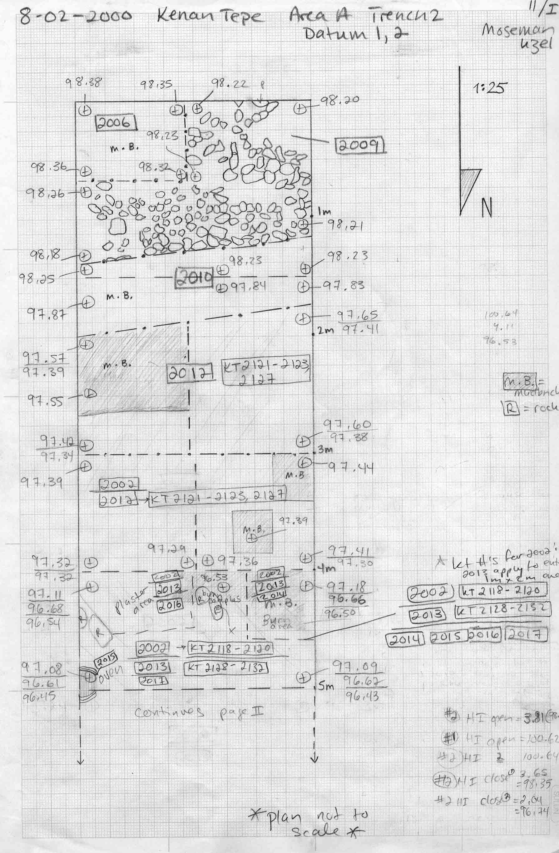
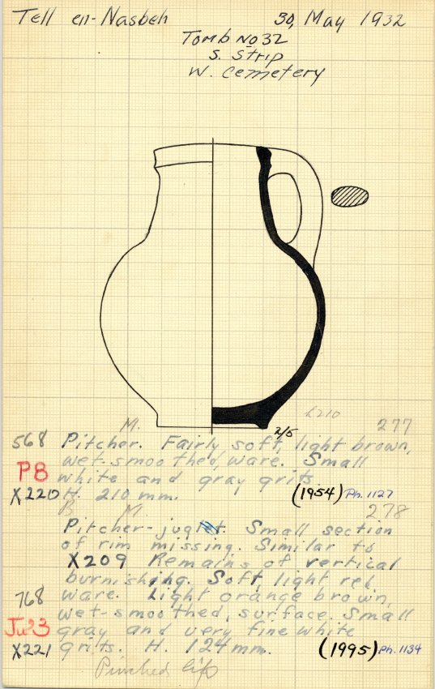
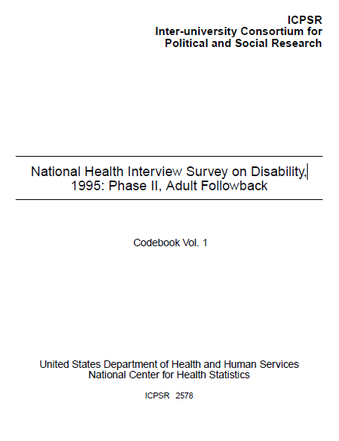
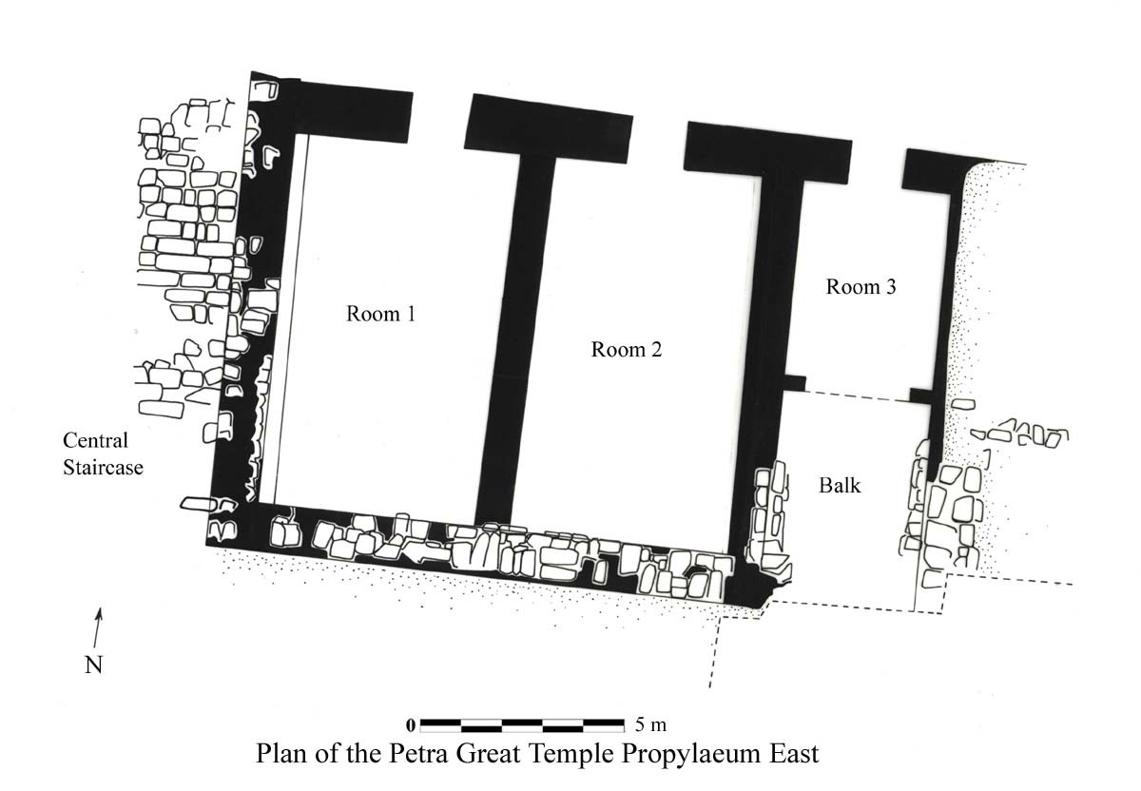
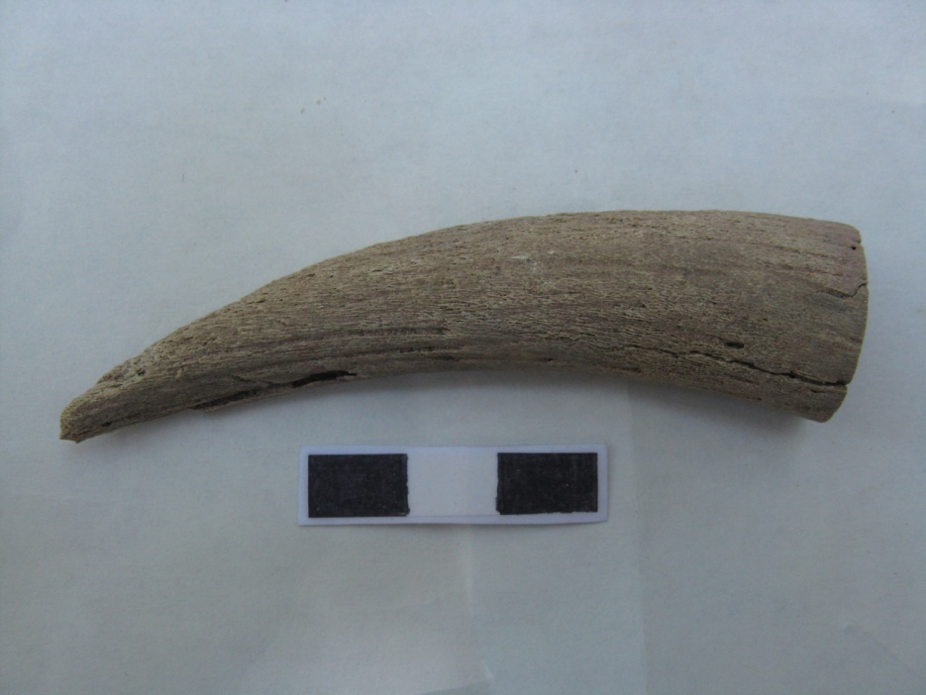
Data Reuse Flows: Centrifugal versus Centripetal
study description
datasets
variable definitions
sampling
survey instrument
codes & coding procedures
Web of Discovery for Context
Archaeologists rely on a web of many sources to provide context for the data.
Centralized Hub for Context
Social scientists use a central codebook which acts as a hub of information.

Slide 16
Data Reuse: Data Selection
Quantitative Social Scientists | Archaeologists
Methodology | Methodology
Reputation of Repository | Reputation of Repository
Theory | Research question
Codebook | Documentation (Contextual information)
Completeness | Consistency/Comparable
Publications | Data producer (contact)
Availability (Satisficing) | Availability (Satisficing)
Variables (presence of absence)
Representativeness
Mentors
Reputation of Data Producer
Measurement
Experience with dataset
Post-analysis
Disciplinary practice
Question construction

Slide 17
Data Reuse: Data Selection
Codebook / Documentation
Identifying, locating, and understanding the data is more complicated in a centrifugal than a centripetal environment
Increased number of “contexts” work against centralization of all information
Publications / Data Producer
Ease of access, stability and locatability of publications
In quantitative social science the repository acts as a filter (through data processing as well as reuse)

Slide 18
Digital Preservation
File formats
Open versus proprietary
Number of file formats
Metadata
DDI
ArchaeoML

Slide 19
Discussion / Conclusions
Amount and diversity of data/documentation
Preserving data descriptions (ICPSR) versus preserving the context of the data (Open Context)
Records duality as data and metadata (context)
Information flows
Dispersion of data/documentation
Repository versus network solutions
Interoperability

Slide 20
Changing the Information Flow from Centripetal to Network
Relieving the archaeologist of some of the burden of integration

Slide 21
Discussion: Preservation
Preservation
Meaning
Bits
Collaborative
Many different sites (libraries, archives, museums, governments, individuals) needed to preserve one project
File formats
Proprietary
Understand the affordances of different formats
Library of Congress, Sustainability of Digital Formats site
http://www.digitalpreservation.gov/formats/

Slide 22
Acknowledgements
Institute of Museum and Library Services,
LG-06-10-0140-10
PI: Ixchel Faniel, Ph.D.
Partners: Nancy McGovern, Ph.D. (MIT), Eric Kansa, Ph.D. (Open Context), William Fink, Ph.D. (University of Michigan Museum of Zoology)
OCLC Fellow: Julianna Barrera-Gomez
Students: Morgan Daniels, Rebecca Frank,, Adam Kriesberg, Jessica Schaengold, Gavin Strassel, Michele DeLia, Kathleen Fear, Mallory Hood, Molly Haig, Annelise Doll, Monique Lowe

Slide 23
Questions?
Elizabeth Yakel yakel@umich.edu
Notes:
23
23
23

