Slide 1
The Challenges of Digging Data: A Study of Context in Archaeological Data Reuse
Joint Conference on Digital Libraries (JCDL), July 22-25, 2013
Indianapolis, Indiana
Ixchel M. Faniel, Ph.D.
Eric Kansa. Ph.D.
Sarah Whitcher Kansa, Ph.D.
OCLC Research
fanieli@oclc.org
Open Context and University of California, Berkeley
ekansa@berkeley.edu
The Alexandria Archive Institute
skansa@alexandriaarchive.org
Julianna Barrera-Gomez
Elizabeth Yakel, Ph.D.
OCLC Research
barreraj@oclc.org
University of Michigan
yakel@umich.edu
Twitter @DIPIR_Project

Slide 2
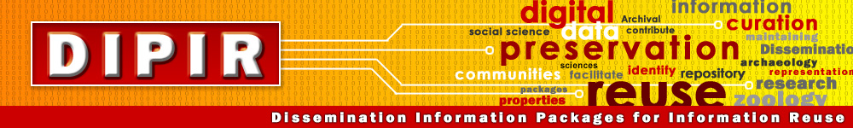
An Institute for Museum and Library Services (IMLS) funded project led by Dr. Ixchel Faniel and Dr. Elizabeth Yakel.
Studying data reuse in three academic disciplines to identify how contextual information about the data that supports reuse can best be created and preserved.
Focuses on research data produced and used by quantitative social scientists, archaeologists, and zoologists.
The intended audiences of this project are researchers who use secondary data and the digital curators, digital repository managers, data center staff, and others who collect, manage, and store digital information.
For more information, please visit http://www.dipir.org

Slide 3





The Research Team
DIPIR Project
Nancy McGovern
ICPSR/MIT
Ixchel Faniel
OCLC Research
(PI)
Eric Kansa Open Context
William Fink UM Museum of Zoology
Elizabeth Yakel University of Michigan (Co-PI)

Slide 4
Methods Overview
 | ICSPR | Open Context | UMMZ
Phase 1: Project Start up
Interviews Staff | 10 Winter 2011 | 4 Winter 2011 | 10 Spring 2011
Phase 2: Collecting and analyzing user data
Interviews data consumers | 43 Winter 2012 | 22 Winter 2012 | 27 Fall 2012
Survey data consumers | 2000 Summer 2012
Web analytics data consumers |  | Server logs Ongoing
Observations data consumers |  |  | 10 Ongoing
Phase 3: Mapping significant properties as representation information

Slide 5
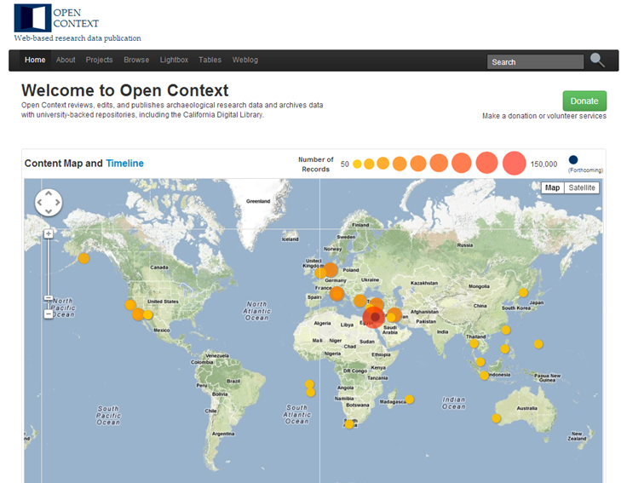
Motivation
The Challenges of Digging Data: A Study of Context in Archaeological Data Reuse
Social and economic forces pushing toward digital archaeological data publication
No robust set of standards exist for field archaeology
Data reuse studies can inform standards development, but there are few outside of science and engineering disciplines

Slide 6

The Study
Research Question
How does contextual information serve to preserve the meaning of and trust in archaeological field research over time?
How can existing cultural heritage standards be extended to incorporate these contextual elements?
Data Collection
22 interviews with archaeologists
Data Analysis
Code set developed and expanded from interview protocol
http://www.english.sxu.edu

Slide 7
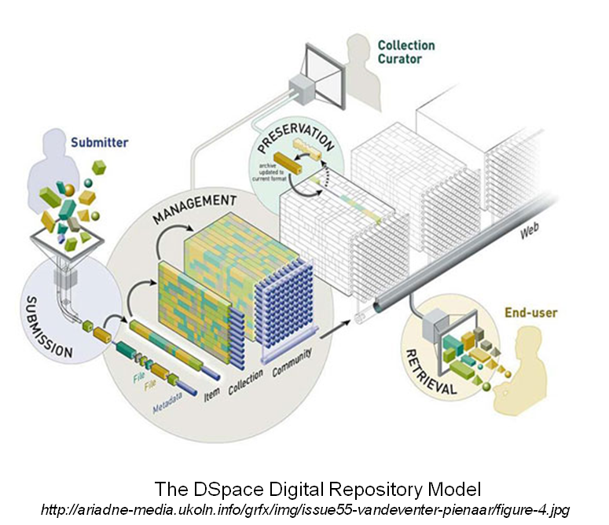
Findings
The lack of context was a persistent problem.
Data collection procedures were highly sought during data reuse.
Additional context also played a role during data reuse.

Slide 8
Findings
The lack of context was a persistent problem during data reuse.
MUSEUM COLLECTONS
“…There was less concern about provenance information or context information. So objects are treated as objects and not as objects within their contextual world…”
(CCU20).
EARLY FIELD STUDIES
So we did not have access to critical information, such as archaeological contexts, excavation methods, sampling methods, even identification methods. We didn't know if the analysts actually used comparative collections or just published manuals to identify specimens or how did she sample... She didn't mention or detail those things.” (CCU16).
CONTEMPORARY FIELD STUDIES
“You need to do a lot of cleaning and translating to make things work. But the concepts in the archaeological ontologies that are being used to describe are still professionally the same, but they’re recorded in various scales. They may use different terminologies, different data types” (CCU12).

Slide 9
Findings
Data collection procedures were highly sought during data reuse.
Accounting for Interpretations of Context Made in the Field
“We make a sort of series of interlocking assumptions about the certificate of a finding and the material that I’m processing ...” (CCU18).
Accounting for Different Approaches in the Field
“We have to look at their field methods and that's, for example, did they walk with spacing close enough so that they were picking up…They'll hit a site, but they'll walk by little tiny sherd scattered things…So you kind of need to know that. I've heard of things like shoulder surveys, where they literally walk side by side and pick those little things, but then, again, you've only, you're doing a very narrow tract. So there are procedures” (CCU01).
Accounting for Context Destroyed in the Field
“Just knowing an object is there is nothing. You have to know all about it. You need to know where it comes from, how it was acquired, how it was excavated. Everything we know has to be tied to that object, otherwise, it’s useless” (CCU11).

Slide 10
Findings
Additional context that also played a role in data reuse.
DATA RECORDING PROCEDURES
“If somebody was writing about, say, a loci that they were digging and they were talking about some of the major finds before they were talking about the dirt, the matrix, and kind of its relationship to the other squares around it, I was more wary...” (CCU10).
REPUTATION AND SCHOLARY AFFILIATION
“there are individuals that I have a lot of respect for, and I really respect their training. If it's somebody whose training I don't know about, I'm going to be less likely to use their dataset because I'm not sure how reliable it is” (CCU06).
REPUTATION OF THE DATA REPOSITORY
“They're very keen on producing the comprehensive metadata. And it's not that I trust each research [study]... but I trust that the metadata is there for me to go back and check out each file on my own. I don't give [the repository] a sort of blanket trust that all the data in there is correct, but...I sort of trust going there because I know that I can find the information I need to validate it” (CCU02).

Slide 11
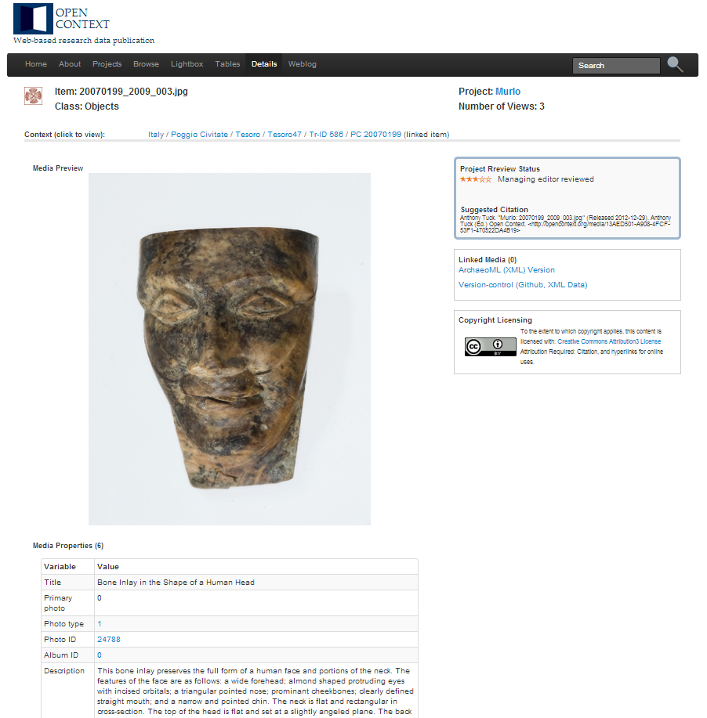
Implications: Documenting Context is Challenging
What: typology & description of finds
Who: institutional, personal (training, reputation)
Where & When: stratigraphic / positional, chronology
How: methods, sampling strategies, identification procedures, instruments, etc.
Why: research, preservation, and documentation goals

Slide 12
Implications: Documenting Context is Challenging
What: typology & description of finds
Who: institutional, personal (training, reputation)
Where & When: stratigraphic / positional, chronology
How: methods, sampling strategies, identification procedures, instruments, etc.
Why: research, preservation, and documentation goals
CIDOC-CRM
Ontology for “cultural heritage” (mainly museum) data, recently extended for archaeology:
- Complex (dozens of classes & properties)
- Abstract (models historical “events” relating people, places, things, and actions). Needs to be used in conjunction with controlled vocabularies

Slide 13
Implications: Documenting Context is Challenging
What: typology & description of finds
Who: institutional, personal (training, reputation)
Where & When: stratigraphic / positional, chronology
How: methods, sampling strategies, identification procedures, instruments, etc.
Why: research, preservation, and documentation goals
Can use general controlled vocabularies & thesauri (British Museum, EOL, UBERON & others)
But! Expertise required (“Data Editors” in Open Context case)
Specific classification can be controversial / disputed (research / interpretive goal)

Slide 14
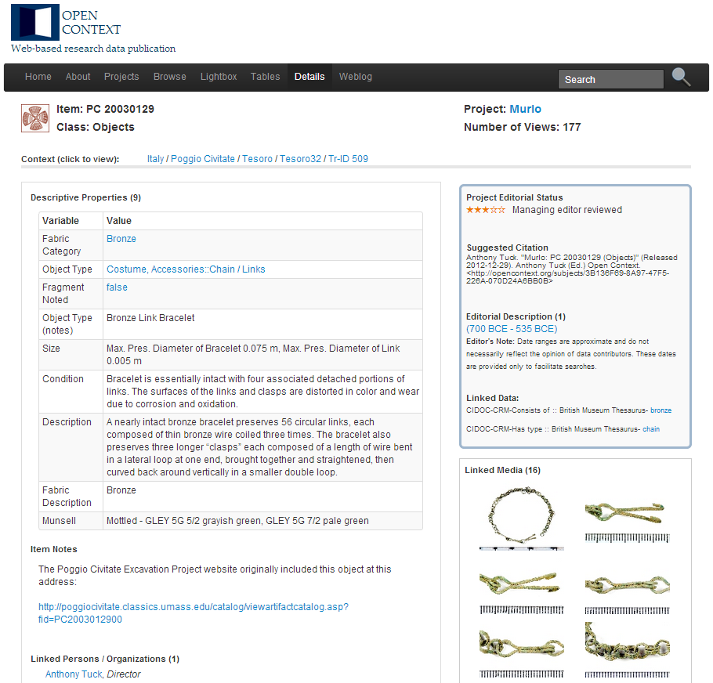


Slide 15
Implications: Documenting Context is Challenging
What: typology & description of finds
Who: institutional, personal (training, reputation)
Where & When: stratigraphic / positional, chronology
How: methods, sampling strategies, identification procedures, instruments, etc.
Why: research, preservation, and documentation goals
Name authorities, researcher identity systems (VIAF, ORCID)

Slide 16
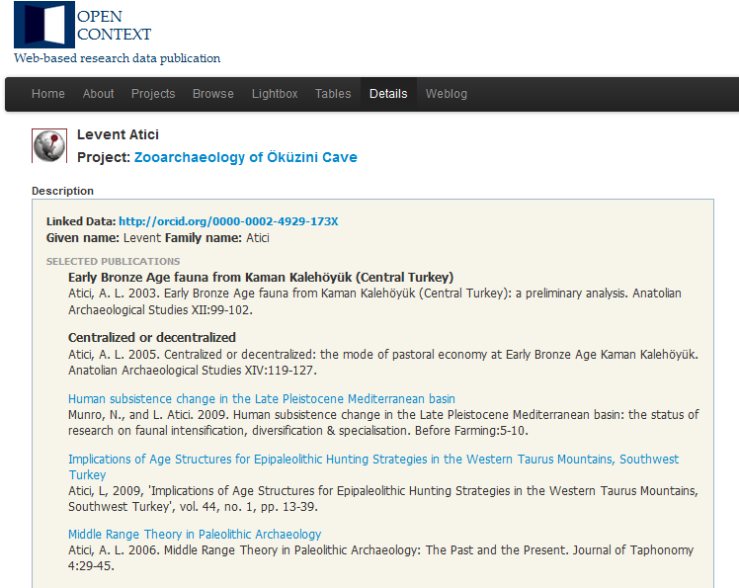

Slide 17
Implications: Documenting Context is Challenging
What: typology & description of finds
Who: institutional, personal (training, reputation)
Where & When: stratigraphic / positional, chronology
How: methods, sampling strategies, identification procedures, instruments, etc.
Why: research, preservation, and documentation goals
Standards either under-developed or not widely applied and understood.
Challenges:
(1) Interpretive (chronology is a research outcome, not a given)
(2) Multidisciplinary breadth (zoology, soil science, chemistry, geology, botany, genetics...)

Slide 18
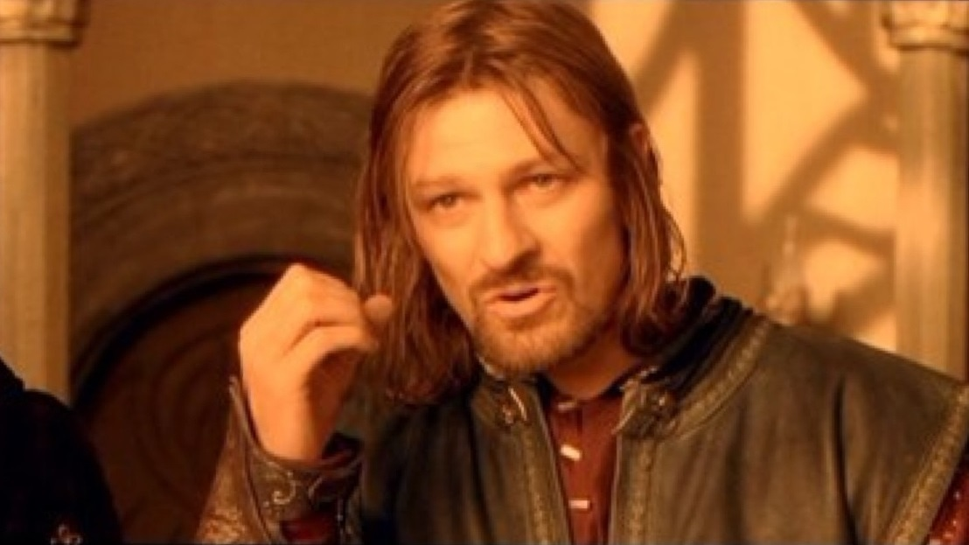
Conclusions
Researchers have an interest in the entire data life-cycle (data collection preparation through repository)
Need more studies involving data integration and reuse to help guide standards development (CIDOC-CRM not sufficient)

Slide 19
Conclusions
Researchers have an interest in the entire data life-cycle (data collection preparation through repository)
Need more studies involving data integration and reuse to help guide standards development (CIDOC-CRM not sufficient)
One does not simply share usable data…

Slide 20

Acknowledgements
Institute of Museum and Library Services,
  LG-06-10-0140-10
Our co-authors: Sarah Whitcher Kansa, Ph.D., Julianna Barrera-Gomez, M.S.I., Elizabeth Yakel, Ph.D.
Partners: Nancy McGovern, Ph.D. (MIT), Eric Kansa, Ph.D. (Open Context), William Fink, Ph.D. (University of Michigan Museum of Zoology)
Students: Morgan Daniels, Rebecca Frank, Adam Kriesberg, Jessica Schaengold, Gavin Strassel, Michele DeLia, Kathleen Fear, Mallory Hood, Molly Haig, Annelise Doll, Monique Lowe

Slide 21
Questions?
Ixchel M. Faniel Eric Kansa
fanieli@oclc.org ekansa@berkeley.edu
Notes:
21
21
21

