Slide 1
Three Perspectives on Data Reuse: Producers, Curators, and Reusers
Library of Congress (LOC), Digital Preservation 2014, July 22-23, 2014
Washington, DC
Ixchel M. Faniel, Ph.D.
Elizabeth Yakel, Ph.D.
Associate Research Scientist OCLC Research fanieli@oclc.org
Professor University of Michigan yakel@umich.edu
Twitter @DIPIR_Project

Slide 2
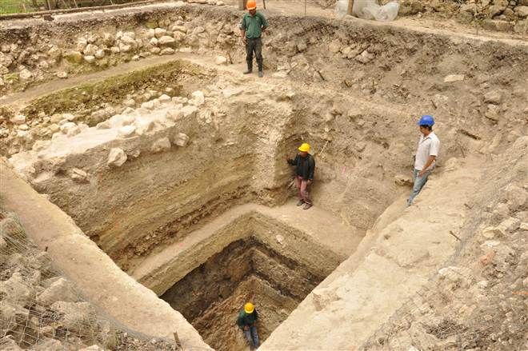
Archaeological Practice
Changing nature of research questions
More reliance on documentation as artifacts can often not be removed from sites
Data reuse tradition mixed
http://cosmiclog.nbcnews.com/_news/2013/04/25/17914746-where-did-maya-culture-come-from-archaeologists-dig-into-tangled-roots?lite

Slide 3
The data lifecycle from 3 perspectives
Our project
Data Collection
Data Producer
Data Sharing
Data Producer
Data Curation
Repository Staff
Data Reuse
Data Reuser

Slide 4
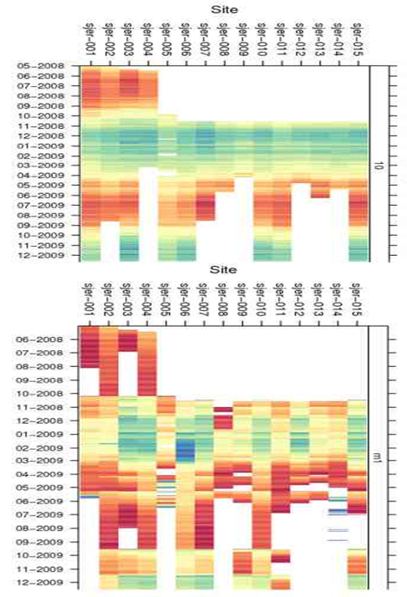
Research Question
How do actions in one part of the data lifecycle create challenges or facilitate work at another point in the lifecycle?

Slide 5
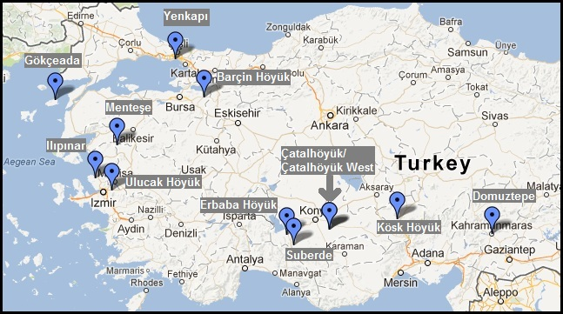
Underlying Case

Slide 6
Research Design
Data collected over 1.5 years (2012 – 2014)
9 data producers
2 repository staff
7 data reusers
Culminated in several conference presentations and 1 publication
Data Collection
Interviews
Email exchanges with data producers, repository staff, and data reusers
Focus group
Observations at conference presentations
Data Analysis
Code set developed and expanded from previous interview protocol

Slide 7
Findings
Data sharing
Data curation
Data reuse
Data curation
Data sharing
Data reuse
Data documentation
Repository policy
Data reuse
http://www.robinisfossilised.co.uk/pottery/bones.jpg

Slide 8
Findings
Repository processing had positive benefits for data reusers and producers
STANDARDIZATION
Everything is turned into intentionally difficult codes... hundreds of lines …you have to translate, such as what is a 1 or 1.5, what's that mean? It was really important to streamline that translation process (Data Producer 3).
INTEGRATION
[Repository staff] did a great job integrating it…I don't know what kind of format the datasets had before they got integrated…Integrated to the extent that it’s comprehensible, but I believe there was a lot of work because I know that different zooarchaeologists did things in a number of different ways and coming from different traditions. (Data Reuser 9).
SAVING TIME AND EFFORT
It was great that [repository staff] did a lot of the cleaning…you can't do that on your own…you can do it,…you will have to change a lot to integrate it into yours [database] and that will take a lot of time (Data Producer 4).

Slide 9
Findings
Repositories often can’t reverse data producers’ collection/documentation practices
DATA COLLECTION PRACTICES
I just keep getting stuck on exactly what I am supposed to do with my excel spreadsheets and with issues like that fact that in some cases I have sampled assemblages for just caprine specimens…so those data cannot be used to calculate NISP [Number of Identified or Number of Individual Specimens] frequencies for the total site (Data Producer 3)
DATA DOCUMENTATION: UNDERSPECIFIED STANDARDS
We do have tooth wear data, but it just wasn't in a format that could be clearly integrated. Some sites have clear A, B, C phases, while others have number codes by tooth. We could provide all of that to the analysts, but it will be a lot of columns of pretty disparate data (Repository Staff 2).

Slide 10
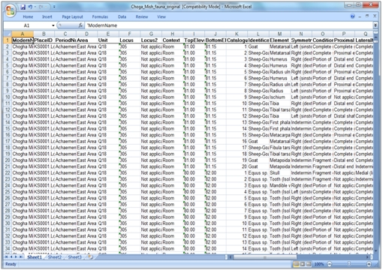
Findings
Data sharing factors influence data repositories
DATA FORMAT
In addition to the project info attached, I'll need your datasets, preferably as Excel tables. If you export them from a database, please indicate the key(s) for us so we can stitch them back together again! Since you've already published on these data, feel free to send the entire datasets (Repository Staff 2).
DATA CONDITION
It took 10 times longer to deal with those [coded] datasets but if it helped the researcher to get their stuff in …
(Repository Staff 2)
http://visiblepast.net/see/wp-content/uploads/2011/03/fig3.jpg

Slide 11
Findings
Data sharing factors influence data reuse
DATA PRODUCERS’ SELECTION
I did think quite carefully about…those …big subjective descriptions we write about the units...before including that, but I decided to... I mean obviously different people write in different styles. It's not exactly like your personal diary entry, but it... Can be quite informal. I always write them in quite formal prose myself, but some people are a little bit less formal...I couldn’t really be sure if people …would necessarily want them out but they are an important part of the data set (Data Producer 10).

Slide 12
Findings
Data reuse influences future actions of repository staff and data producers
REPOSITORY PROCEDURES
There are some inherent issues with CSV as it is a very simple text-based format…the simplicity is why it is preferred for interoperability and longevity …we need to give users a few tips on working with CSV. I'm also looking into other open spreadsheet formats, but Excel…gets these wrong (Repository Staff 1).
DATA PRODUCERS’ DOCUMENTATION
In my case it changed already…I had a completely different recording system for [teeth]…just using…Payne… (Data Reuser 6).
Two things that I would now do differently: One of them is writing down with my data what exactly all those criteria are…I always kind of had a few notes …but…writing down more systematically exactly what those criteria have been. And second one is just dropping numeric codes, not doing …numeric codes anymore (Data Reuser 10).

Slide 13
Tightly vs. Loosely Coupled Activities
Implications
The data lifecycle is a tightly coupled activity
Archaeological data management is loosely coupled
Don’t think about data sharing or reuse outside and sometimes inside the group
Consider all stages of data lifecycle during data production and documentation

Slide 14
Short and Long Term Benefits
Implications
Individual rewards
Data reusers: Publication of the article
Data producers: Data archiving / data publication
Repository staff: Better data submitted
Science: gaining new knowledge
Data producers
Data reusers
Designated community

Slide 15
Short and Long Term Benefits
Implications
Persistence: Data now in repository that anyone can use
Repository staff: Building repository reputation as a trusted source
Designated community: Increasing the visibility of new archaeological data sharing and reuse practices

Slide 16
Acknowledgements
Post-doctoral researcher: Anthea Josias, Ph.D.
Doctoral students: Rebecca Frank, Adam Kriesberg
Study participants for allowing us to collect data for this research.

Slide 17
Questions?
Ixchel M. Faniel fanieli@oclc.org
Elizabeth Yakel
yakel@umich.edu
©2014 OCLC, Elizabeth Yakel. This work is licensed under a Creative Commons Attribution 3.0 Unported License. Suggested attribution: “This work uses content from “Three Perspectives on Data Reuse: Producers, Curators, and Reusers” © OCLC, Elizabeth Yakel, used under a Creative Commons Attribution license: http://creativecommons.org/licenses/by/3.0/”
Notes:
17
17
17

