Slide 1
Notes:
At a Tipping Point: Education, Learning & Libraries (an accompanying slide deck)
In June 2014, OCLC published its latest membership report, At a Tipping Point: Education, Learning & Libraries. OCLC produced this slide deck, using artwork and text from the report, for librarians to use in your own presentations. You may use as many (or as few) of the slides in the deck as you wish; the slides themselves, however, are not editable.
ALL RIGHTS RESERVED. Graphics appearing in the report and excerpts of text from the report may be reproduced by library organizations and OCLC member libraries for their noncommercial use without the prior written permission of OCLC, provided that such use is accompanied by clear and full attribution to OCLC (see format below) and proper acknowledgment of any works cited by OCLC in the graphics or excerpts used.
Form of attribution to OCLC: “OCLC, At a Tipping Point: Education, Learning and Libraries, 2014.”

Slide 2
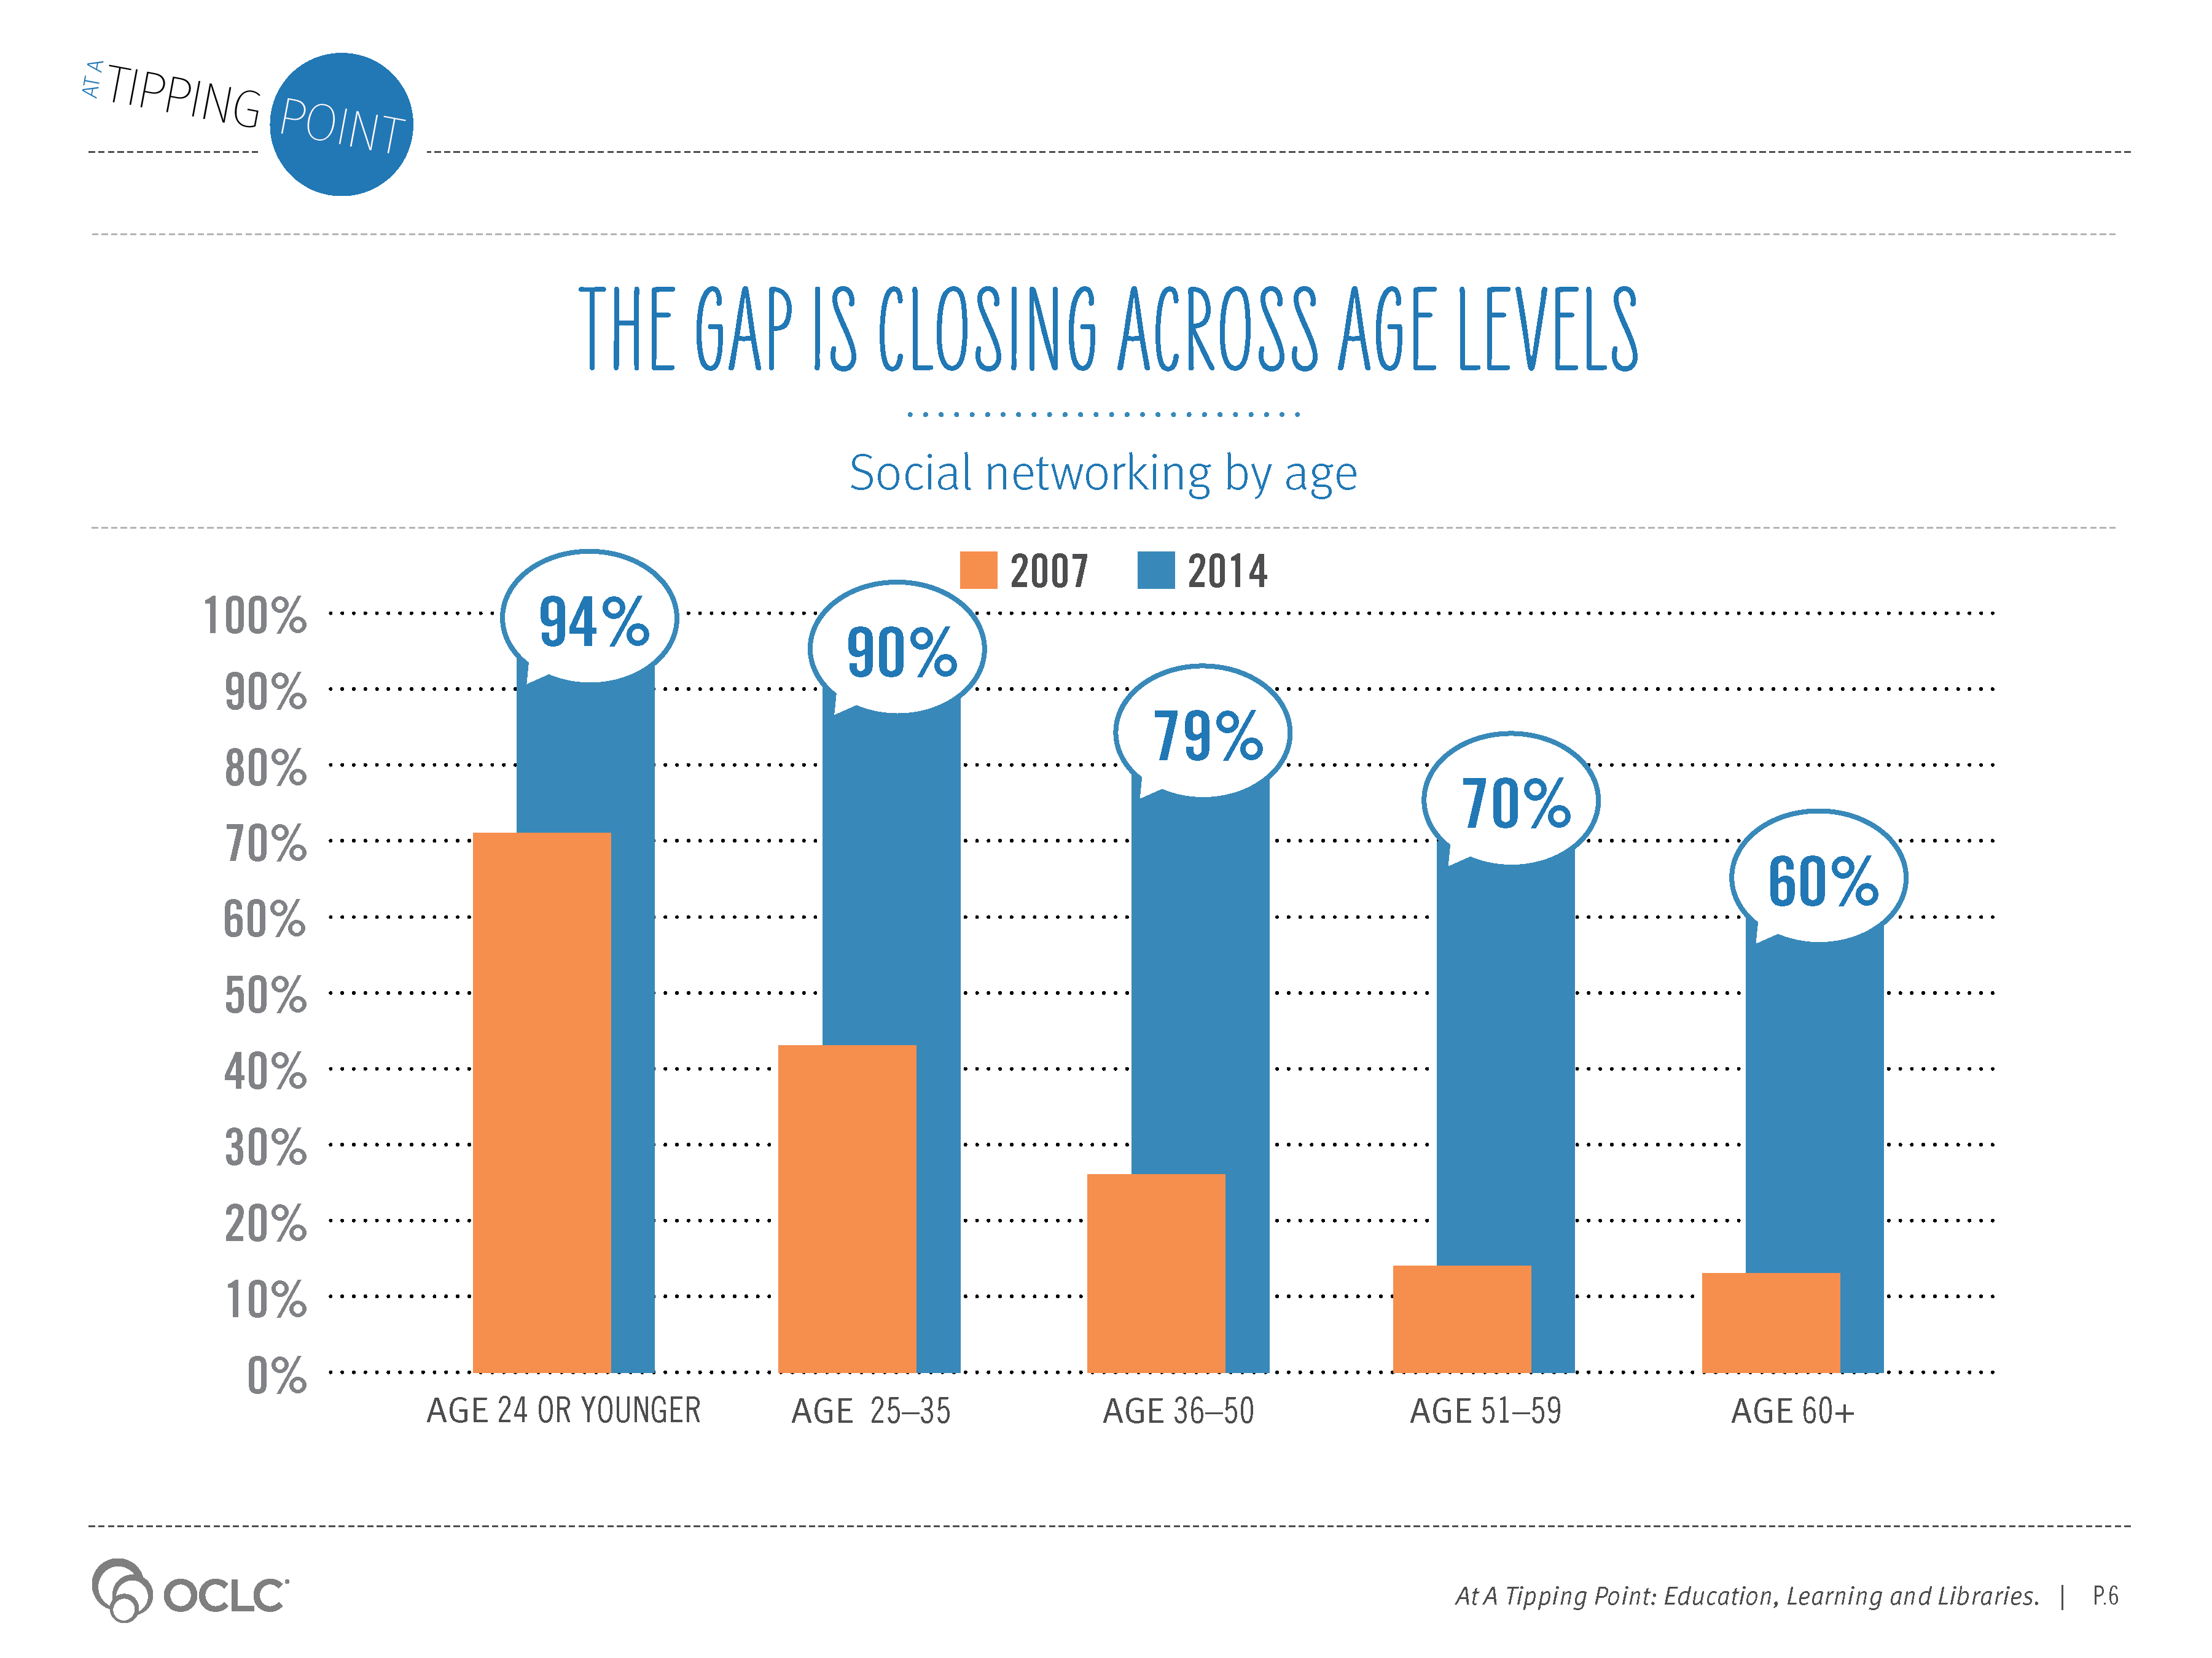
Notes:
Supporting Text From P.6
In 2007, when OCLC published Sharing, Privacy and Trust in our Networked World, 71% of those under 25 were already using social networking sites, most logging on daily to their favorite site. But only 13% of those age 60+ were engaged in social networking activities.
Today, 94% of those under 25 use social networking sites; so do 60% of the 60+ age group, with 32% visiting Facebook daily.

Slide 3
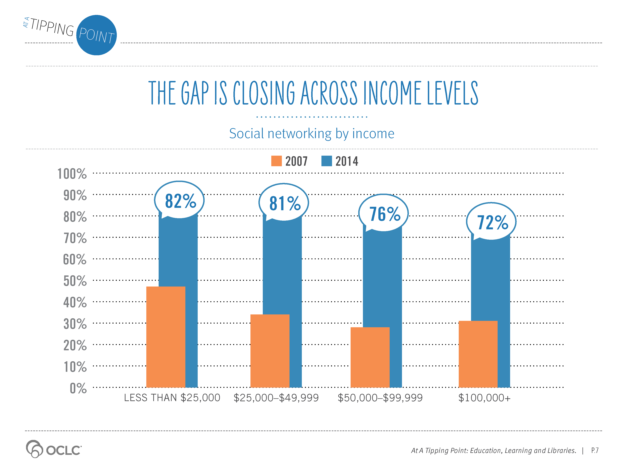
Notes:
Supporting Text From P.7
The gap is also closing across income levels.
In 2007, those with household incomes of less than $25,000 had higher social networking participation rates than other income levels. That trend continues in 2014, but the gap in participation rates between income levels has gotten smaller.

Slide 4
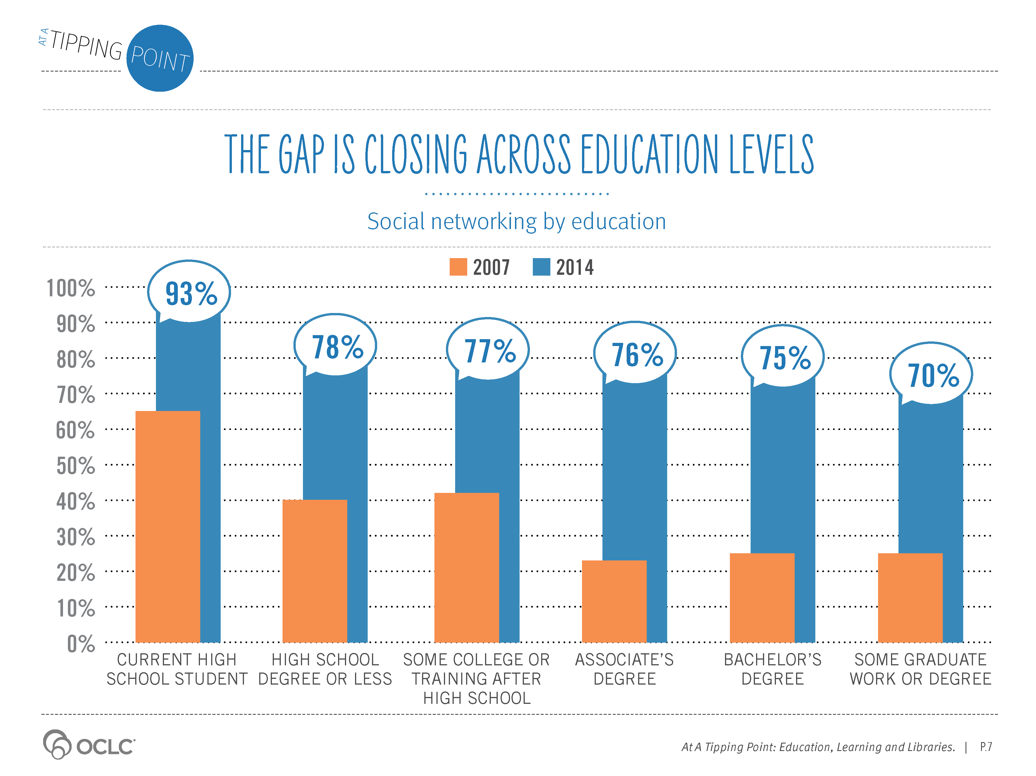
Notes:
Supporting Text From P.7
The gap is also closing across education levels.
In 2007, education level said a lot about who was on social networking sites—much less so today. High school students in 2007 were by far the segment who were most likely to use social networking sites. Today, high school student use exceeds 90%. Roughly three quarters of adults with or without any post-high school education are now participating in online social networks.

Slide 5
Notes:
Supporting Text From P.6
Equipped with mobile and tablet technology and thousands of social sites, all ages, income and education levels are now connected and active participants on the social Web. They are prepared and eager to embrace more online services and lifestyle changes.

Slide 6
Notes:
Supporting Text From P.10
Forces of Change
Behavior
Information consumers have amassed significant online and self-service skills. Internet use is nearly ubiquitous across ages, income and education levels. Information consumers spend 5+ hours online every day, shopping, socializing and learning (eMarketer, April 2014). The do-it-myself, at-my-pace, on-my-device approach to service has already supplanted many traditional face-to-face services from depositing checks to renewing automobile license plates. Online recommendations from a trusted source, a friend or a colleague are fueling new product trials and accelerating adoption of services and new buying behaviors.
Technology
Prices for smartphones and tablets have been reduced, leading to mass market adoption. Since 2010, the average price of an iPad has dropped 48% (Newman, 2013). Tablet ownership is expected to grow by nearly 40% this year (Attard, 2014). Robust Internet access has helped to make YouTube the second most-used (46% visiting daily or weekly) online social networking service behind Facebook (67% visiting daily or weekly). The learning platforms fueling the rise of MOOCs are still in early stages, but today are able to support class sizes of 20,000 and hundreds of course offerings. The technologies required to power online education are here or on the horizon.
Economics
The average annual price (including tuition, fees, room and board) for a U.S. four-year, in-state public college education was $17,474 in 2012-13 (NCES, Table 330.20, 2014). Assuming it takes four years to graduate, that is nearly a $70,000 investment. Over the last ten years, increases in college costs outpaced the inflation rate. Cost is the first thing that parents think of when they think about a college education. Affordability is the top factor for parents and students when choosing a college. College students are concerned about costs and most believe online education will decrease the cost of higher education.

