Slide 1
Notes:
At a Tipping Point: Education, Learning & Libraries (an accompanying slide deck)
In June 2014, OCLC published its latest membership report, At a Tipping Point: Education, Learning & Libraries. OCLC produced this slide deck, using artwork and text from the report, for librarians to use in your own presentations. You may use as many (or as few) of the slides in the deck as you wish; the slides themselves, however, are not editable.
ALL RIGHTS RESERVED. Graphics appearing in the report and excerpts of text from the report may be reproduced by library organizations and OCLC member libraries for their noncommercial use without the prior written permission of OCLC, provided that such use is accompanied by clear and full attribution to OCLC (see format below) and proper acknowledgment of any works cited by OCLC in the graphics or excerpts used.
Form of attribution to OCLC: “OCLC, At a Tipping Point: Education, Learning and Libraries, 2014.”

Slide 2
Notes:
Supporting Text From P.59-60
Many things go into making a college campus experience – from dorm life, to classrooms, student centers, sporting events and the library. Understanding the unique, distinctive role the campus library serves provides important strategic insight.
The college campus experience has evolved over hundreds of years of tradition and innovation. How do today’s education consumers view the college life experience?
In partnership with the University of Kansas Libraries and the Baker Library at the Harvard Business School, OCLC developed a study to help find some answers. The study explores the perceptions of two groups of education consumers – parents with a child or children enrolled in a four-year university or college, and alumni who had graduated from a four-year university of college.
While no two campuses are the same – each is unique in style, architecture, services and setting – most campuses contain common elements. They have faculty, classrooms, libraries, student unions, sports arenas, alumni programs, career centers, etc. Each element has a role in the overall education experience; the study provided a better understanding of the perceptions, interdependencies and distinctive roles of these elements.

Slide 3
Notes:
Supporting Text From P.61
Parents and alumni were asked to evaluate a subset of 17 elements common across most campuses against 60 different attributes (e.g., is convenient, offers access to latest technology, builds character, etc.), indicating the degree to which the attributes describe each element. The results were analyzed using correspondence analysis mapping to understand the emotional and functional dimensionality of the elements tested. Because some campus elements that are more popular or well-known tend to score higher overall, perceptual mapping allows researchers to rank not popularity, but rather distinctions, to better understand which attributes best describe each of the campus elements.
The location of the elements and attributes on the map is meaningful. The distance from the center of the map indicates how distinct a point is. The larger the distance a point is from the center of the map, the more distinct that attribute or element is. Points closer to the center have more in common or are more similar.
For example, in the sample perception map, Element A (farther from the map’s center) is more distinct than Element B. Element A is more associated with Attribute 1 because it is plotted farther along Attribute 1’s attribute line (the blue dotted line).

Slide 4
Notes:
Supporting Text From P.62-64
The Campus Perception Map helps us understand the perceptions, commonalities and distinctive brand characteristics of 17 campus elements, from the student union, to sports arenas, fraternities and sororities, and the library. The map can best be studied by dividing it into quarters and analyzing the unique characteristics of each quadrant in turn.
The Individual/Extracurricular Campus Experience
Elements in the upper left quadrant represent those campus services and facilities that provide extracurricular experiences such as campus coffee shops, student unions and recreation centers which are associated with attributes such as “important part of everyday life,” “convenient,” “indispensable,” places to “blow off steam” and places where “student-to-student learning occurs.”
The Academy/Extracurricular Campus Experience
The lower left quadrant of the Campus Perception Map includes elements such as university clubs, performing and creative spaces, fraternities and sororities, and sports teams which are associated with such items as “builds teamwork skills,” helps students “find themselves,” “find their passions” and “form relationships that will last a lifetime.”
The Academy/Academic Campus Experience
University research and grants, international studies, alumni programs and faculty are found in the academic/academy quadrant. Respondents believe these elements of the campus experience are most closely associated with “university status,” “rankings and reputation,” “greater good of humanity” and “legacy.”
The Individual/Academic Campus Experience
The upper right quadrant includes the campus elements that bring together individual and academic pursuits. This quadrant includes classrooms, labs, lecture halls, the career placement center and the library. This set of services is most strongly associated with attributes such as “grounds knowledge,” “enables great thinking,” “explores interests” and “current, relevant information.”

Slide 5
Notes:
Supporting Text From P.65
The library shares the individual/academic quadrant with other services, including classrooms and lecture halls, the career placement center and campus support communities, such as religious or ethnic groups.
Attributes that alumni and parents associate with this quadrant identify such beliefs as helping students “seek truth,” “access latest technology,” “support and guidance” and “provide a place to think philosophically.” These perceptions are associated with the library but are also shared by other services.
Analysis revealed attributes that the library uniquely owns: the library is the place “to get work done,” the library provides “access to technology tools to get work done,” and the library provides “current, relevant and historical information.”

Slide 6
Notes:
Supporting Text From P.66
The campus library’s most unique attribute is that it is the place that helps students get work done. Of the 60 attributes studied in this research, the parents and alumni surveyed most strongly associate the library with “getting work done,” with 83% agreeing that this attribute describes the library.
“Access to basic technology tools allowing students to get work done” is another distinctive attribute defining the campus library. Three-quarters (78%) of parents and alumni believe that the library is the place on campus that equips students with the tools they need.
While not as uniquely associated with the library, 74% of parents and alumni agree “providing a space for groups to meet and work together” describes the library.

Slide 7
Notes:
Supporting Text From P.66
Providing relevant, timely and historical information is most strongly associated with the campus library. Just over three-quarters of respondents agree that “access to information generated by past generations” and “access to current, relevant and extensive information” describe their perceptions of the library.

Slide 8
Notes:
Supporting Text From P.67
Along with the library (83%), classrooms (71%) and faculty (50%) are also associated with “getting work done.”

Slide 9
Notes:
Supporting Text From P.67
“Access to basic technology allowing students to get work done” describe both the library (78%) and classrooms (75%). The next strongest association was with faculty (54%).

Slide 10
Notes:
Supporting Text From P.67
The library (74%) and the student union (74%) both share positions as the place to “meet and work as groups.” Classrooms also rated highly (72%).

Slide 11
Notes:
Supporting Text From P.68
The libraries and classrooms are the two campus elements most associated with providing students with information.
Finding “best access to current, relevant and extensive information” is highly associated with the library (76%). Classrooms are also rated highly on this dimension of campus life.

Slide 12
Notes:
Supporting Text From P.68
The libraries and classrooms are the two campus elements most associated with providing students with information.
Finding “information generated by past generations” is highly associated with the library (79%). Classrooms are also rated highly on this dimension of campus life.

Slide 13
Notes:
Supporting Text From P.68
A decade of research into the beliefs of the information consumer identifies one attitude that is very clear—convenience trumps almost every other service attribute. Libraries (74%) ranked well as a convenient on-campus service. Classrooms (70%) and student unions (65%) are also described as “convenient.”

Slide 14
Notes:
Supporting Text From P.68
Libraries also garnered the highest agreement scores for being “something students can rely on.”

Slide 15
Notes:
Supporting Text From P.69
Alumni and parents of college students also perceived libraries as being “a safe haven” for students (62% agree).
The library, campus support communities (e.g., religious, ethnic or diversity groups) and classrooms all ranked well as places where students can feel safe and can explore and reflect.

Slide 16
Notes:
Supporting Text From P.69
Alumni and parents of college students also perceived libraries as being a service that “allows students to be introspective” (61% agree).
The library, campus support communities (e.g., religious, ethnic or diversity groups) and classrooms all ranked well as places where students can feel safe and can explore and reflect.

Slide 17
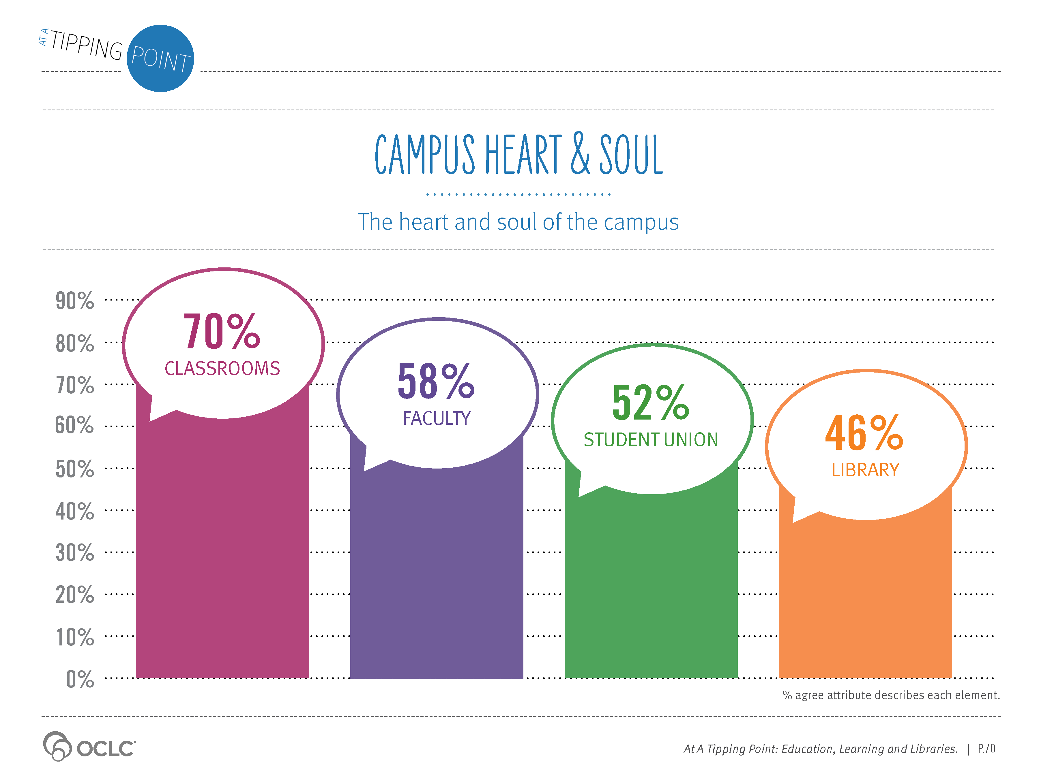
Notes:
Supporting Text From P.70
Library marketing literature and fund-raising campaigns often include language about the important role of the library as the “heart and soul” of the campus, yet this attribute is not seen as a distinctive attribute for any campus element tested. While the phrase “the library is the heart and soul of the campus” did resonate with some respondents, the majority of parents and alumni surveyed thought otherwise.
Just under half (46%) agree that the library is the heart and soul of the campus. Respondents perceive classrooms (70%) as the campus element most likely to be the heart and soul of the campus life, followed by faculty (58%) and the student union (52%).

Slide 18
Notes:
Supporting Text From P.70
Another attribute often promoted in library marketing materials is that the campus library is the space that “connects all of the campus together.” The data suggest that no individual element is strongly associated with this perception. Slightly more than half of respondents agree the student union (59%), classrooms (55%) and the library (52%) are the services that they view as the campus connector.

Slide 19
Notes:
Supporting Text From P.71
The research provided evidence that alumni and parents see the library as an enduring and prestigious part of universities, and, if given an opportunity, would value associating their name with the campus library building.
Parents and alumni were presented with a list of 15 campus locations and were asked to respond to the following question: “Imagine that a substantial gift was made in your name. You have been given the opportunity to have a building or location on campus named in your honor or your student’s honor. How interested would you be to have a campus building named after your or your student?”
Two places rose to the top: a discipline-based building and the library. Student unions, performing arts centers and sports arenas all were of interest, but in far lower percentages.

Slide 20
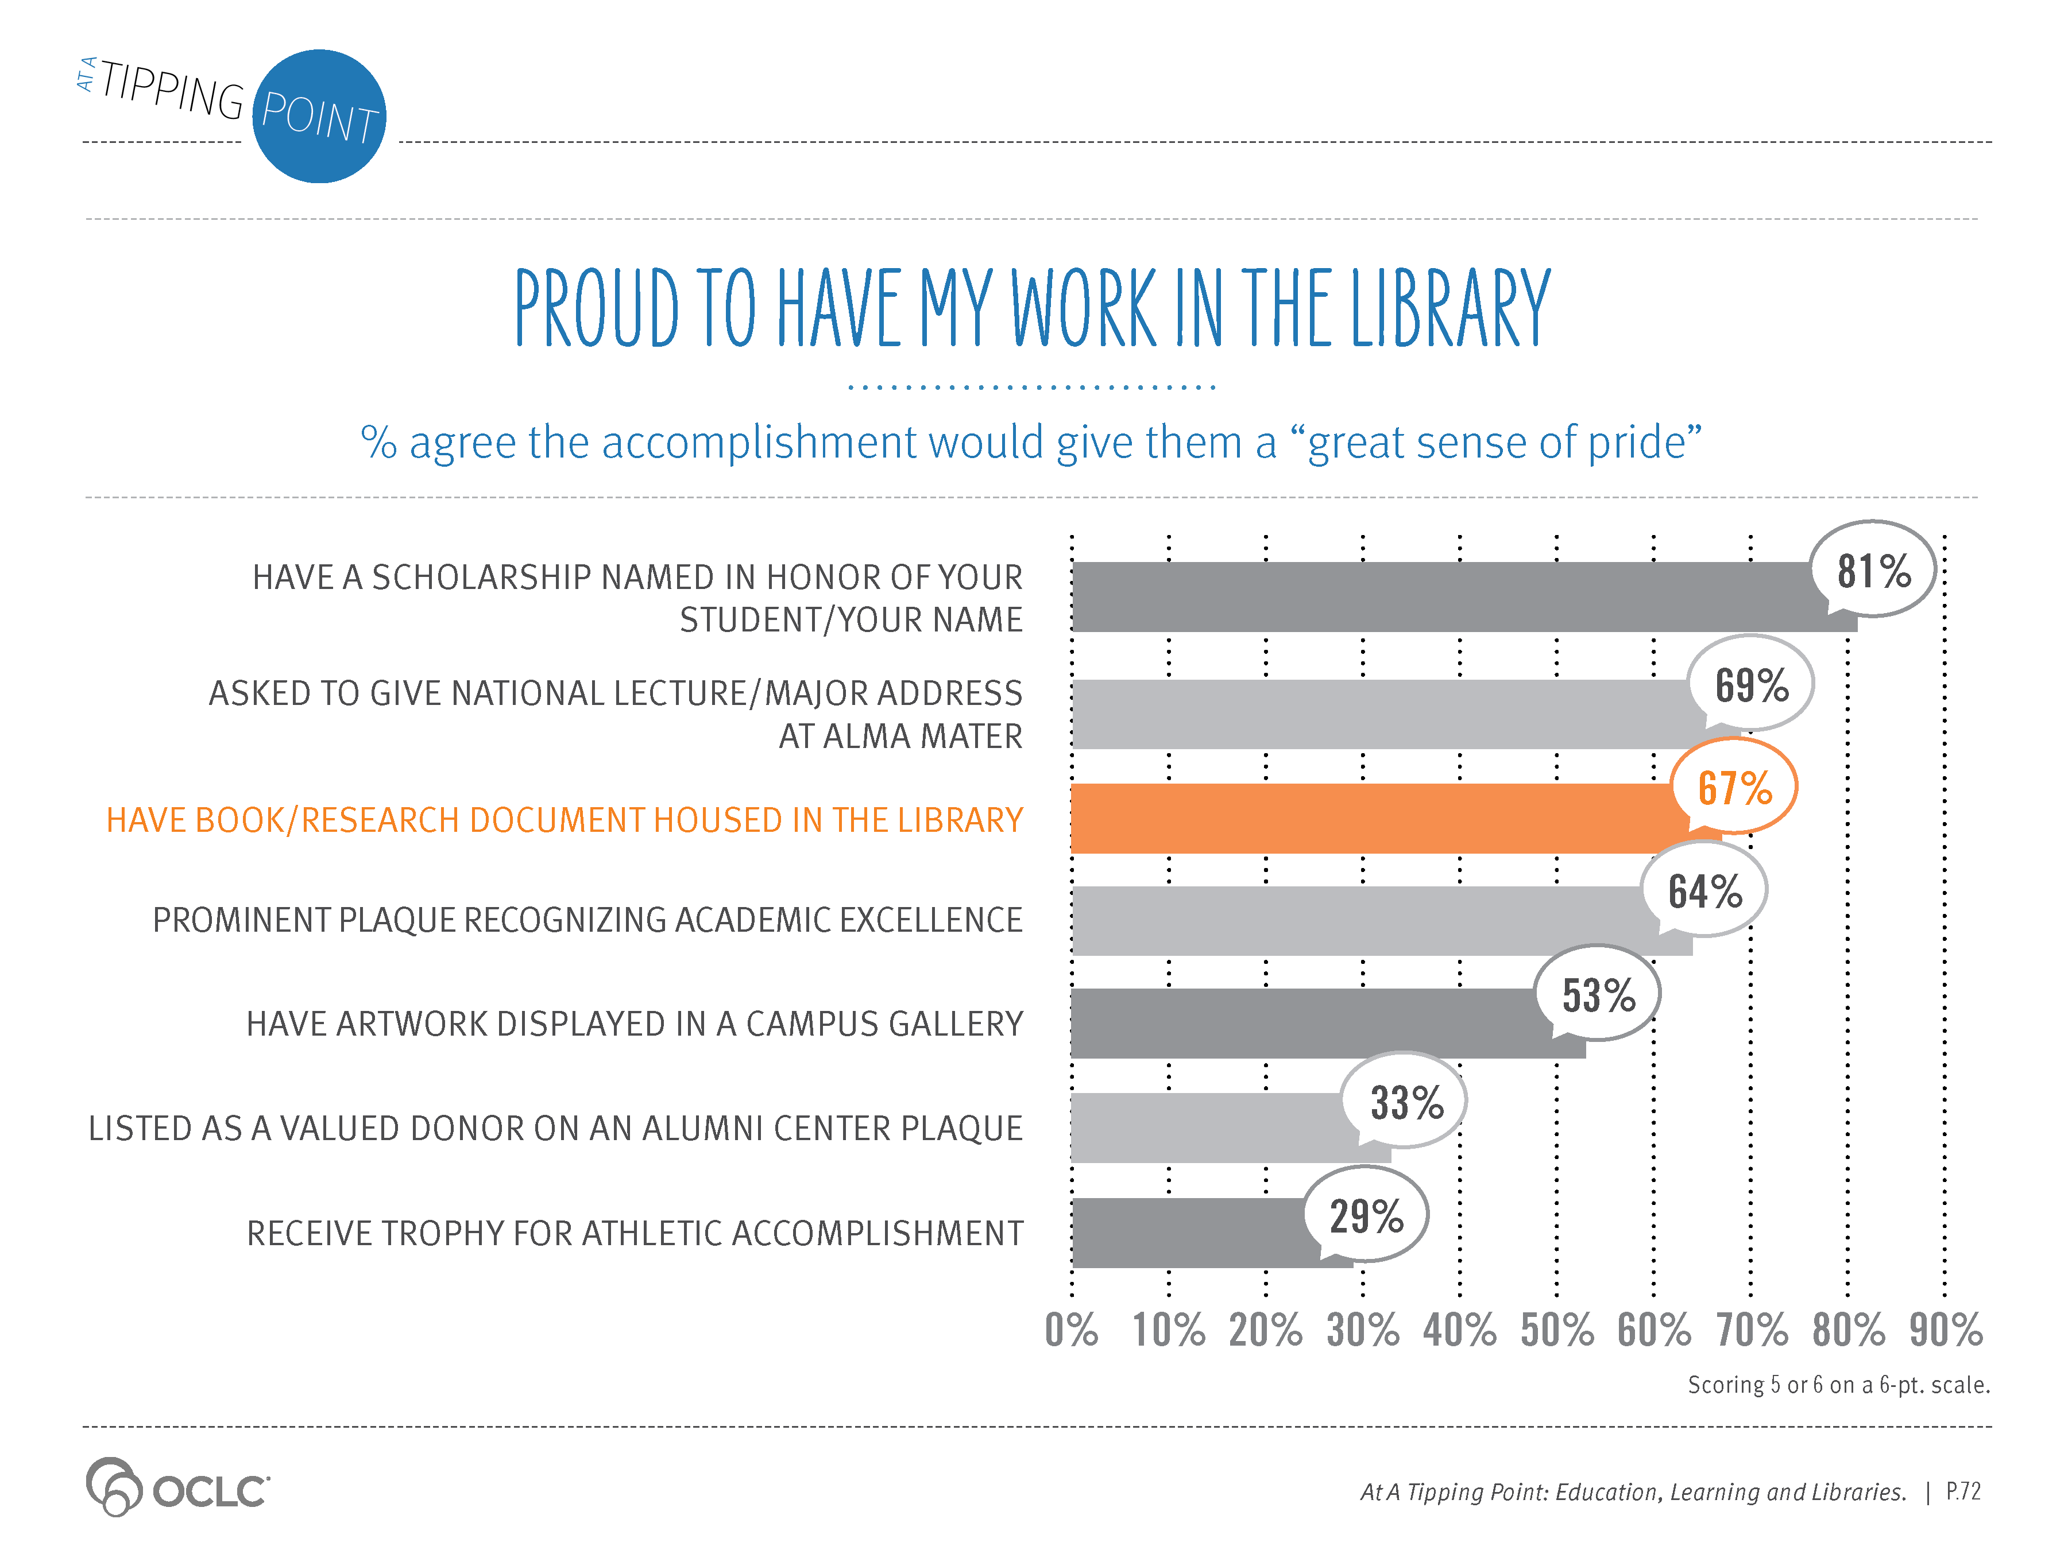
Notes:
Supporting Text From P.72
Similarly, two-thirds of parents and alumni said it would provide a great sense of pride to have their work included in a library collection. Those surveyed were asked, “How much of a sense of pride would you have if any of the following opportunities were provided to you or your student (if parent)?” A list of options were provided and participants were asked to rank attitudes from it “would provide no pride at all” to it “would instill a great sense of pride.”
Having a scholarship in their name (or in the name of their child for the parents) ranked highest, with 81% saying it would instill a great sense of pride. The opportunity to give a lecture (69%) and have their books or research housed in the library (67%) were also seen as great honors.

Slide 21
Notes:
Supporting Text From P.73
A third (39%) of learners who have taken an online class toward a degree used the library or library services. For learners looking to online classes or tutorials to advance learning when not pursuing a degree, a quarter (27%) had used the library or library services to support their work.
Degree seekers were far more likely to use online library resources (28%). While the rates are low, both degree seekers (14%) and non-degree learners (12%) use the physical library at roughly the same rate.

Slide 22
Notes:
Supporting Text From P.74
The majority of online learners are not using the library. The most frequently cited reason for not considering or not choosing to use a library to assist with degree classes: “the library just didn’t come to mind.” Others felt the library would not be helpful to them, that it would be too inconvenient or thought it would take too long.
Online learners who were not seeking a degree were less likely to consider using the library; 55% said it just didn’t come to mind compared to 43% of learners taking an online degree class.

Slide 23
Notes:
Supporting Text From P.74
Online learners who use the library and library resources have great success.
Eighty-three percent (83%) of degree seekers who used the library said that the library was valuable in helping them meet their goals. Three-quarters (75%) of learners who used the library to assist with their non-degree classes also said the library was valuable.

Slide 24
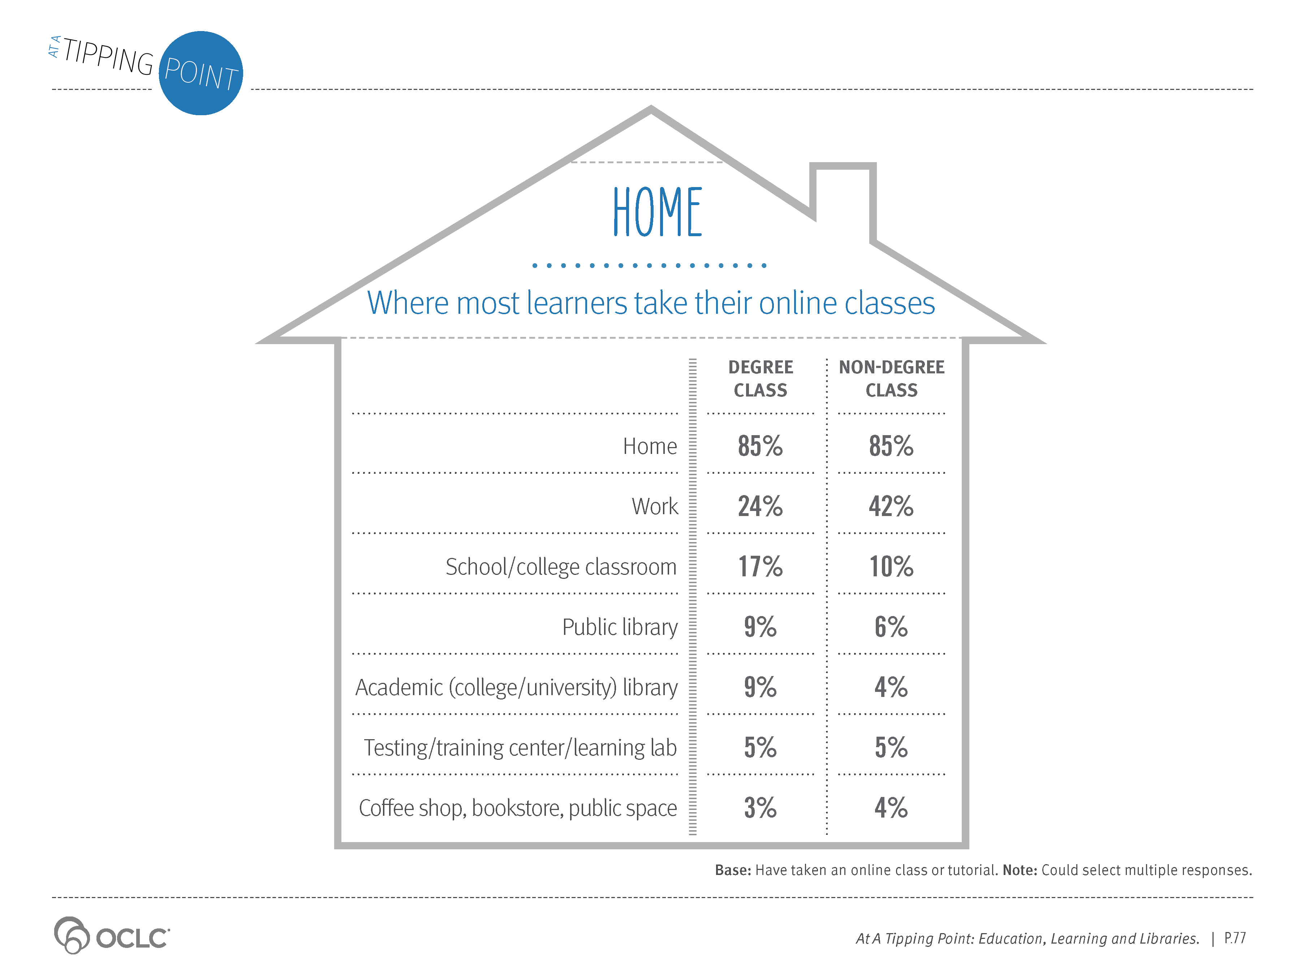
Notes:
Supporting Text From P.77
The vast majority of learners take their online classes or tutorials from home. Work is a distant second.
About 10% of online learners have taken an online degree class while in a public or academic library.

Slide 25
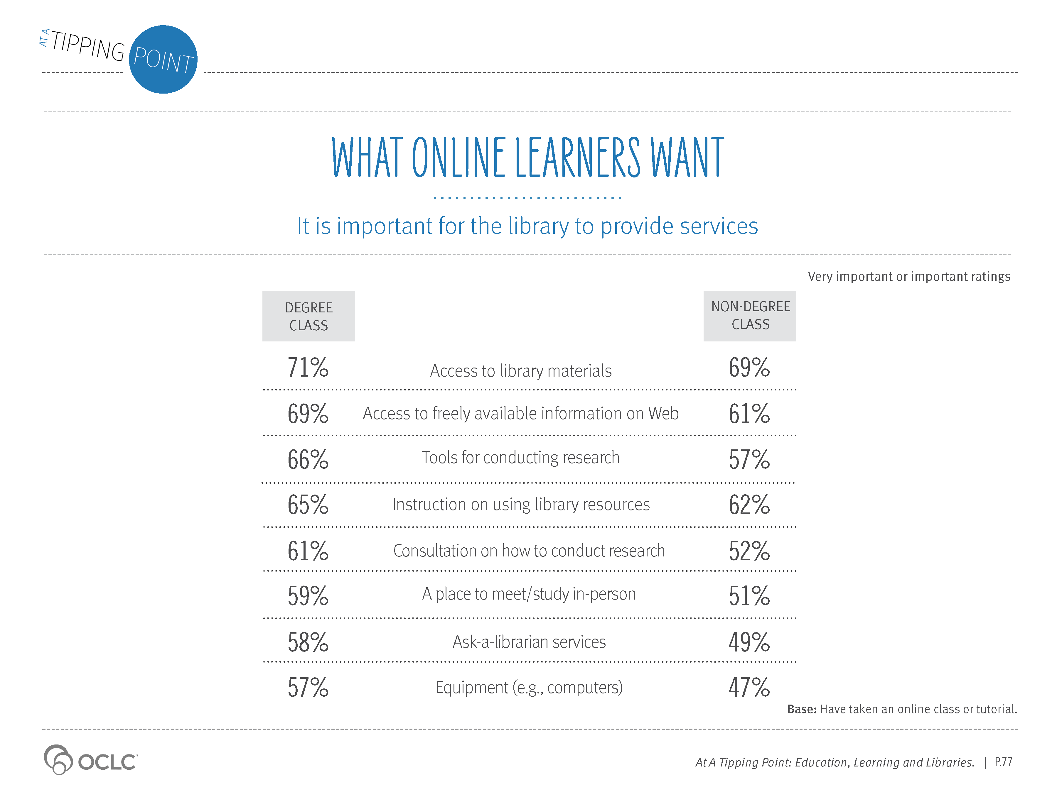
Notes:
Supporting Text From P.77
What do online learners want from their libraries? Mirroring what we learned about the perceptions and the distinct role of the campus libraries, online learners want libraries to provide the spaces and access to tools to get their work done.
Half or more of online learners, whether they have taken a degree or non-degree online class, say it is important for the library to provide access to and instructions on how to use the library’s materials and resources. Access to freely available information on the Web, as well as tools, consultation and instructions on how to conduct research topped the list of needs.
Even though the majority of online learners are taking their classes at home, more than half say a place to meet/study in-person is needed. Equipment to take online classes, librarians and research support are more important for online degree class learners.

