Slide 1
Notes:
At a Tipping Point: Education, Learning & Libraries (an accompanying slide deck)
In June 2014, OCLC published its latest membership report, At a Tipping Point: Education, Learning & Libraries. OCLC produced this slide deck, using artwork and text from the report, for librarians to use in your own presentations. You may use as many (or as few) of the slides in the deck as you wish; the slides themselves, however, are not editable.
ALL RIGHTS RESERVED. Graphics appearing in the report and excerpts of text from the report may be reproduced by library organizations and OCLC member libraries for their noncommercial use without the prior written permission of OCLC, provided that such use is accompanied by clear and full attribution to OCLC (see format below) and proper acknowledgment of any works cited by OCLC in the graphics or excerpts used.
Form of attribution to OCLC: “OCLC, At a Tipping Point: Education, Learning and Libraries, 2014.”

Slide 2
Notes:
Supporting Text From P.38
For many people, when they think about a college education, they think about the cost!
More options and a rapid rise of alternatives to the on-campus, four-year postsecondary education model are being fueled by the economics of higher education.
The inflation-adjusted average annual costs for tuition and required fees (excluding room and board) at U.S. colleges and universities have increased by 40% over the last ten years (NCES, Table 330.10, 2014), significantly outpacing wage growth (21%) (Bureau of Labor Statistics, 2014). The increase in inflation-adjusted college prices is even higher for four-year public, in-state institutions at 57% (NCES, Table 330.20, 2014). Personal savings and current household incomes have not been able to fund these growing fees. Student loan debt has funded the imbalance. As of April 2014, the student loan debt in the U.S. was a staggering $1.2 trillion (Douglas, April 2014).
It is no surprise, then, that parents and students indicated that cost is the top criterion for evaluating and weighing their education options. Location, convenience and quality are all considerations that go into the decision of if, and where, to pursue a postsecondary education, but cost is the top determinant. Students and parents are “education consumers,” shopping and evaluating price alternatives in much the same way they make other major purchasing decisions—cars, homes and vacations.

Slide 3
Notes:
Supporting Text From P.39
What is the first thing parents and students think of when they think of a college education? We posed this open-ended question to college freshmen and sophomores, high school juniors and seniors, and parents of college and high school students.
Top of mind for parents: cost/debt. Top of mind for students: road to a job/career.
Parents’ perceptions of college included such things as career opportunities, jobs, hard work and campus life; but the most commonly cited perception—cost/debt (30%). As one mother put it, “A lot of money hopefully well spent!” Another simply said, “Very costly.”
Money, cost, expense and debt were also on the minds of high school and college students, but students were most likely to indicate that “a road to a job/career” (26%) was their first impression of a college education.
“Expensive but increases likelihood of better employment in the future,” was how one college student said it. And in the words of a high school student, “A place to get the experience you need to have a successful career.”
The perception of a college education as the road to self-enrichment, if it ever existed, is not a primary view among parents and students today. Expressions such as “better way of life” or “brighter futures” were expressed as top-of-mind for some students (14%) and parents (11%), but these impressions were a minority view.
Obtaining a job or career, and the cost to do so, are the top-of-mind perceptions of college for today’s education consumers.

Slide 4
Notes:
Supporting Text From P.40
The inflation-adjusted cost of tuition and required fees (excluding room and board) has increased by 40% over the last ten years for U.S. degree-granting postsecondary institutions. Ten years ago, the average annual cost for tuition and required fees at four-year private institutions was about $17,000. For the 2012-13 school year, the cost had risen to $24,525, an increase of 15% after adjusting for inflation. The average annual cost at four-year public institutions increased from $4,046 to $8,070 for in-state students, an increase of 57% in inflation-adjusted dollars. Two-year public, in-state inflation-adjusted costs increased by 48%, from just under $1,500 to $2,792 (NCES, Table 330.10, 2014).
Both enrollment and costs have increased over the past decade. Annual enrollment has increased 50% for four-year private and 25% for four-year public institutions from 2002 to 2012.
Growth in both the number of institutions and enrollment has also occurred for online-only colleges. Total numbers reported vary as there is no comprehensive source of data on online-only colleges today. We do know that there is a far greater proportion (62.4%) of higher education institutions offering fully online degree programs in 2012 than in 2002 (34.5%) (Allen & Seaman, 2013).

Slide 5
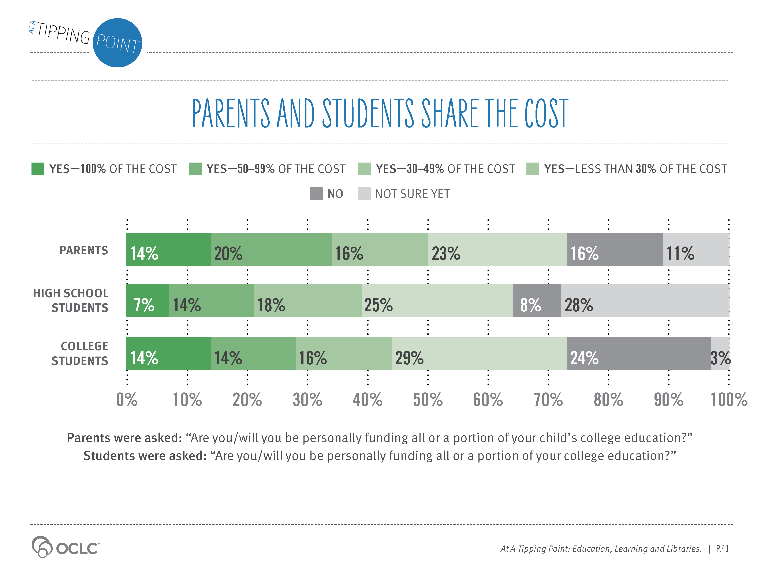
Notes:
Supporting Text From P.41
The high cost of education has made it difficult to fully fund all education expenses. Only 14% of parents expect to fund the total cost of their child’s college education. About a third expect to cover 50% or more.
Sixteen percent (16%) of parents do not fund or plan to fund any part of their child’s postsecondary education—the balance will be funded by the students, by loans or other forms of financial support. Three-fourths of current college students also contribute funding toward their college costs.
Two-thirds of high school students expect to help pay their college tuition bills.

Slide 6
Notes:
Supporting Text From P.42-43
The perceived value received from a higher education is out of balance with the cost paid. Our survey results revealed that just 23% of parents who are funding a college education feel that the value of a public in-state, four-year college education equals the costs.
This cost/value imbalance is even greater for four-year public, out-of-state and private institutions; 8% of parents who are funding the cost believe that four-year, out-of-state public institutions are correctly priced; just 4% for private institutions.
Community colleges fared the best. Half of parents who are helping to or plan to help pay for their child’s education feel the cost and value for an in-state community college education are fairly aligned.
Online-only universities rated about as well as four-year, public in-state institutions; 19% of parents believe the cost and value trade-off are in alignment.

Slide 7
Notes:
Supporting Text From P.42-43
The perceived value received from a higher education is out of balance with the cost paid. Our survey results revealed that just 23% of parents who are funding a college education feel that the value of a public in-state, four-year college education equals the costs.
This cost/value imbalance is even greater for four-year public, out-of-state and private institutions; 8% of parents who are funding the cost believe that four-year, out-of-state public institutions are correctly priced; just 4% for private institutions.
Community colleges fared the best. Half of parents who are helping to or plan to help pay for their child’s education feel the cost and value for an in-state community college education are fairly aligned.
Online-only universities rated about as well as four-year, public in-state institutions; 19% of parents believe the cost and value trade-off are in alignment.

Slide 8
Notes:
Supporting Text From P.43
Why do parents and students continue to fund or borrow to pursue college educations when the cost/value imbalance is so great? Many parents and students indicated that while costs are clearly out of balance, value remains. Forty-three percent (43%) of parents and 39% of college students who fund college expenses see a four-year, in-state public education as expensive, but worth the investment. Private education did not fare as well; 29% of parents and 26% of college students who fund college expenses indicated that while they believe that private education is expensive, it is still valued as a worthy investment.
“An over-priced necessity” would be a good summary of funders’ views.

Slide 9
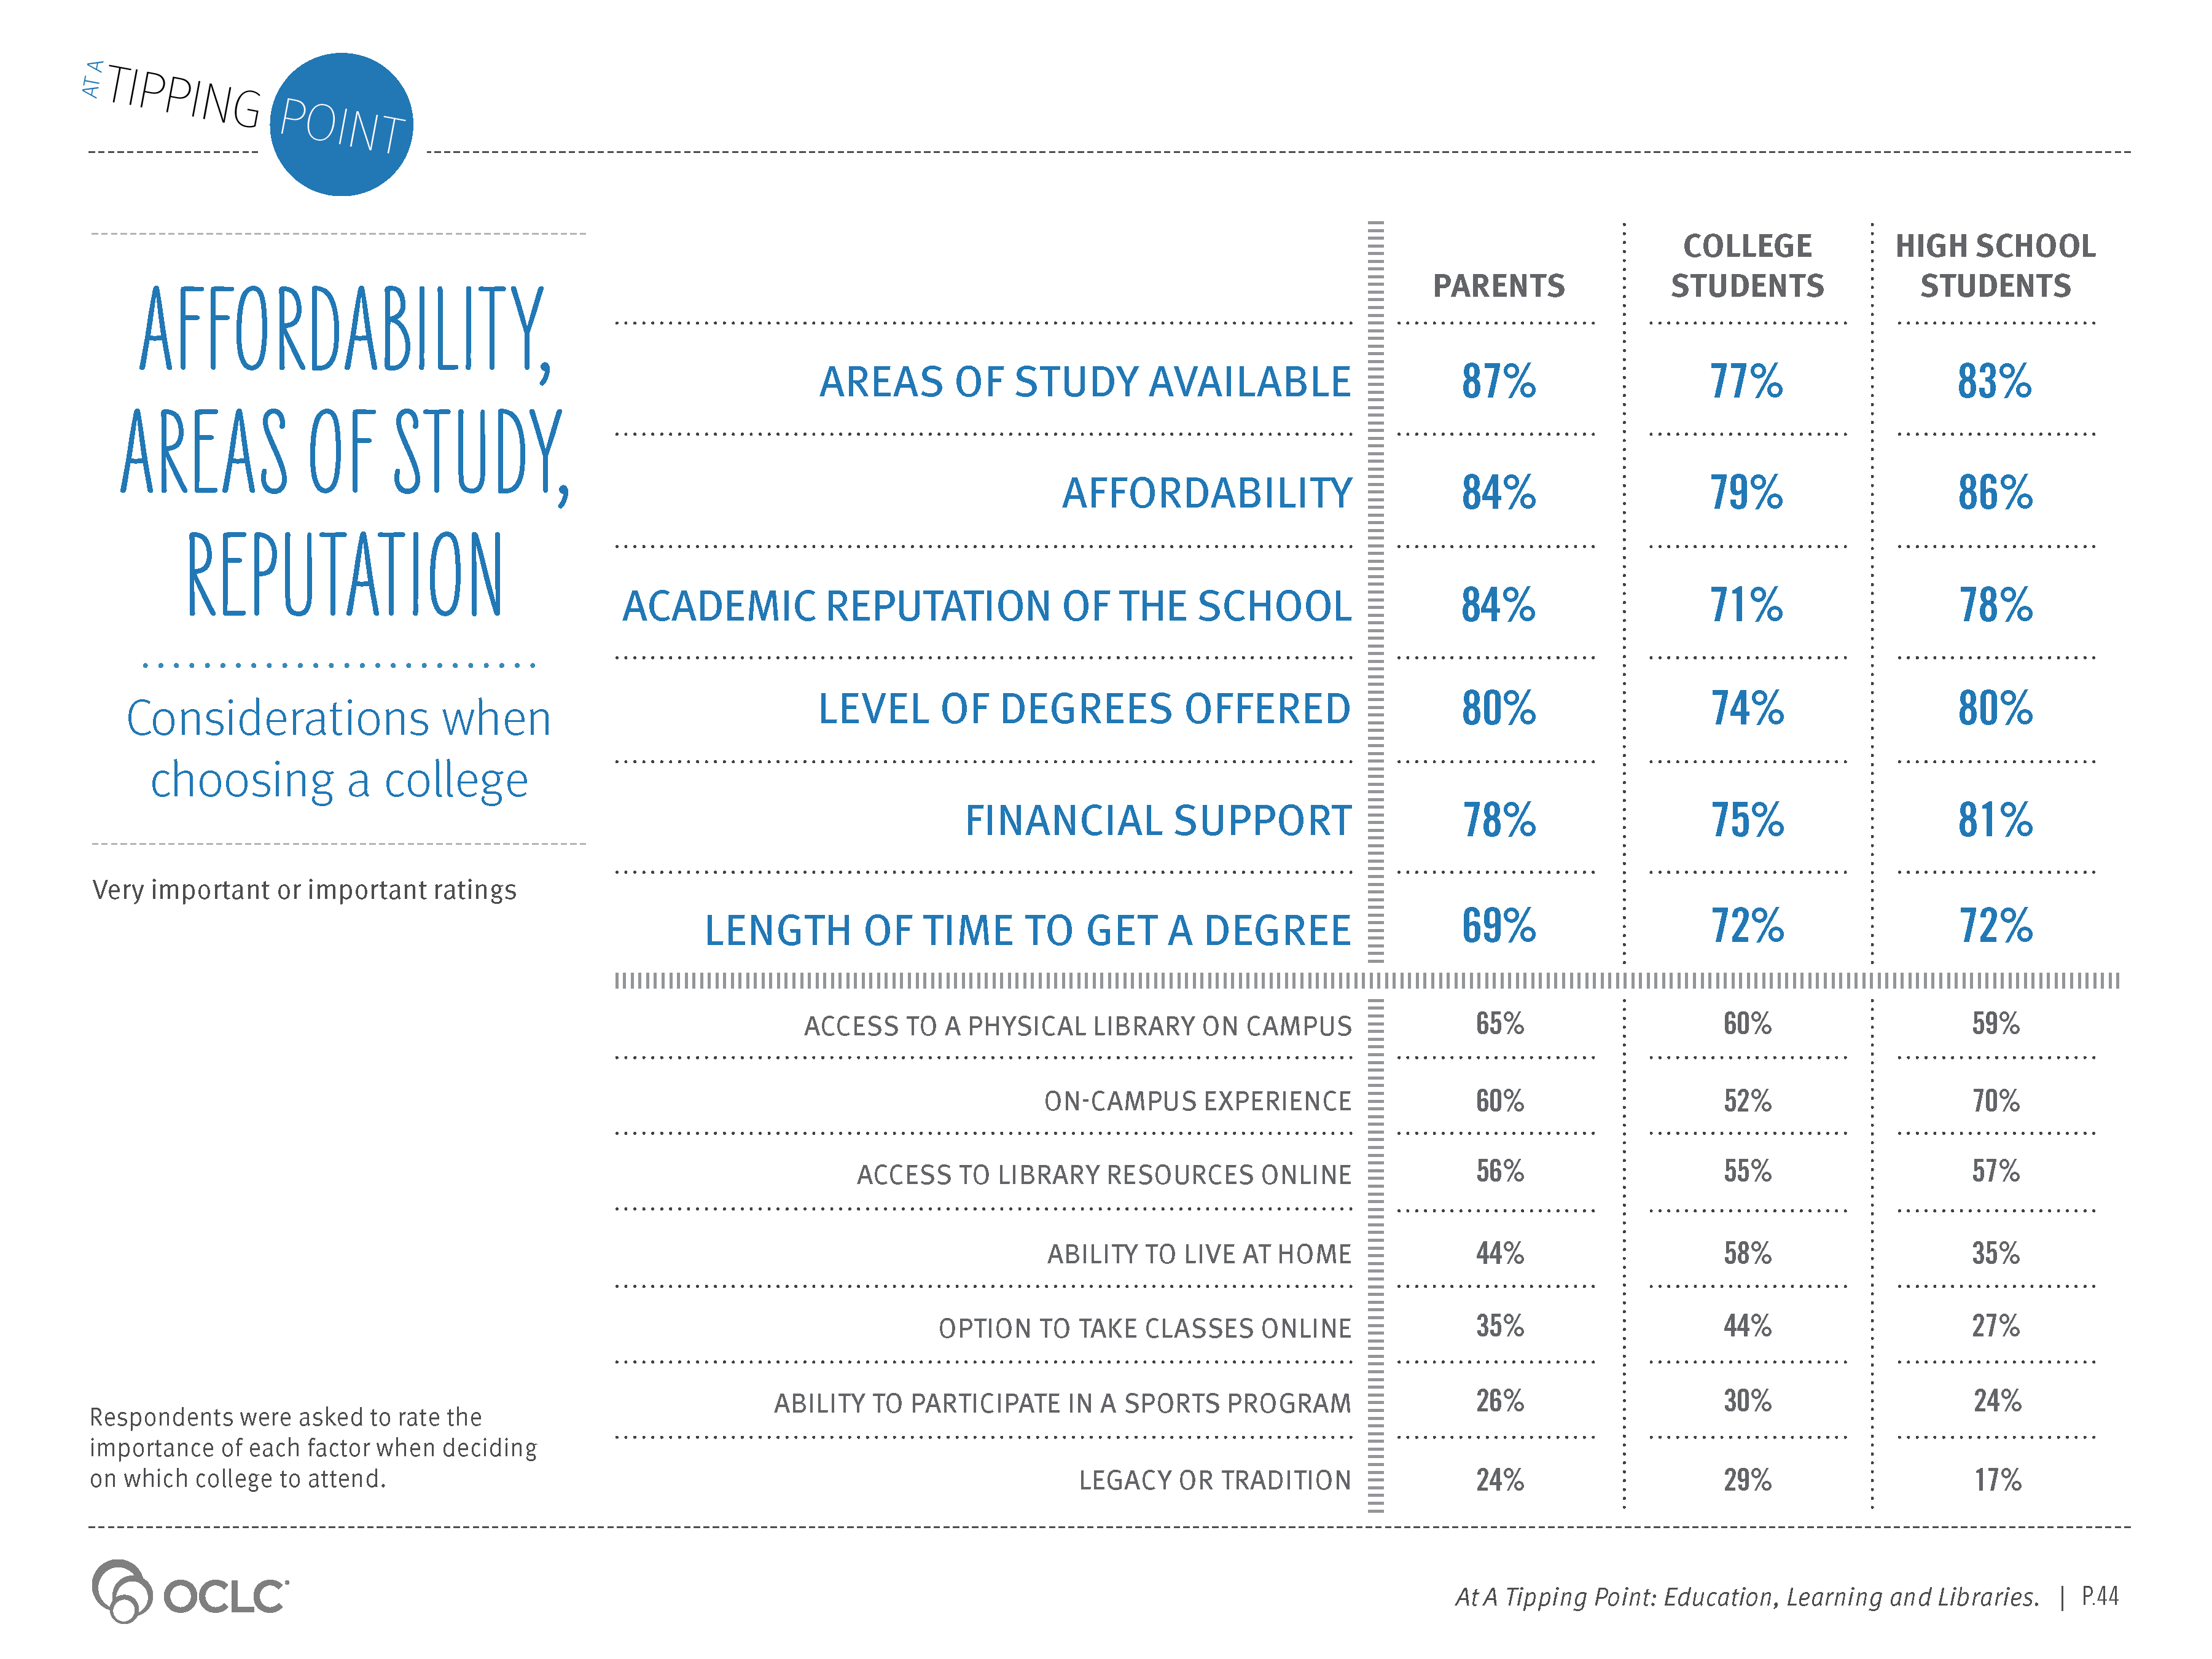
Notes:
Supporting Text From P.44
Given the financial investments required, how are potential students and parents deciding which institutions to evaluate and eventually attend?
Parents and students were asked to rate the importance of factors that were considered when making a college selection. Respondents evaluated a set of factors ranging from academic reputation, affordability, areas of study available and financial support available, to legacy or tradition, library access, on-campus experience, sports programs, etc.
Three-quarters of parents and students indicated that six factors were the most important to their evaluation: areas of study available, affordability, academic reputation, degrees offered, financial support available and length of time to get a degree.
Access to the physical library and to online library resources were both important to the majority of parents and students.

Slide 10
Notes:
Supporting Text From P.45
Because many factors weigh into the evaluation and selection of higher education options, respondents were asked an open-ended question to identify their single most influential factor.
Across all respondent groups—parents, college students and high school students—affordability was identified as the most influential factor in school selection.
The degree programs offered, location/proximity to home and quality were also ranked highly.
The majority of parents and students identified the on-campus experience as an important evaluation criterion, but when evaluated against other considerations, it was not a top decision criterion.

Slide 11
Notes:
Supporting Text From P.46
Living on campus, living at home and commuting, learning online—these are all options for students and parents to consider. The majority, 60% of parents, 52% of college students and 70% of high school students indicated that having an on-campus experience is an important evaluation criterion in deciding on a college. The desire for “a full experience” was mentioned fairly frequently by parents and students, particularly high school students, in deciding what college to attend. But as noted earlier, affordability—not an on-campus experience—topped the list as the deciding factor.

Slide 12
Notes:
Supporting Text From P.47
How does on-campus or online factor into the college evaluation? The desire for an on-campus experience was the primary reason that parents and students indicated for not evaluating an online-only university. Three-fourths (76%) of high school students, two-thirds (67%) of parents and more than half (56%) of current college students who took the survey said an online-only option was not evaluated primarily because of the desire for an on-campus experience.

Slide 13
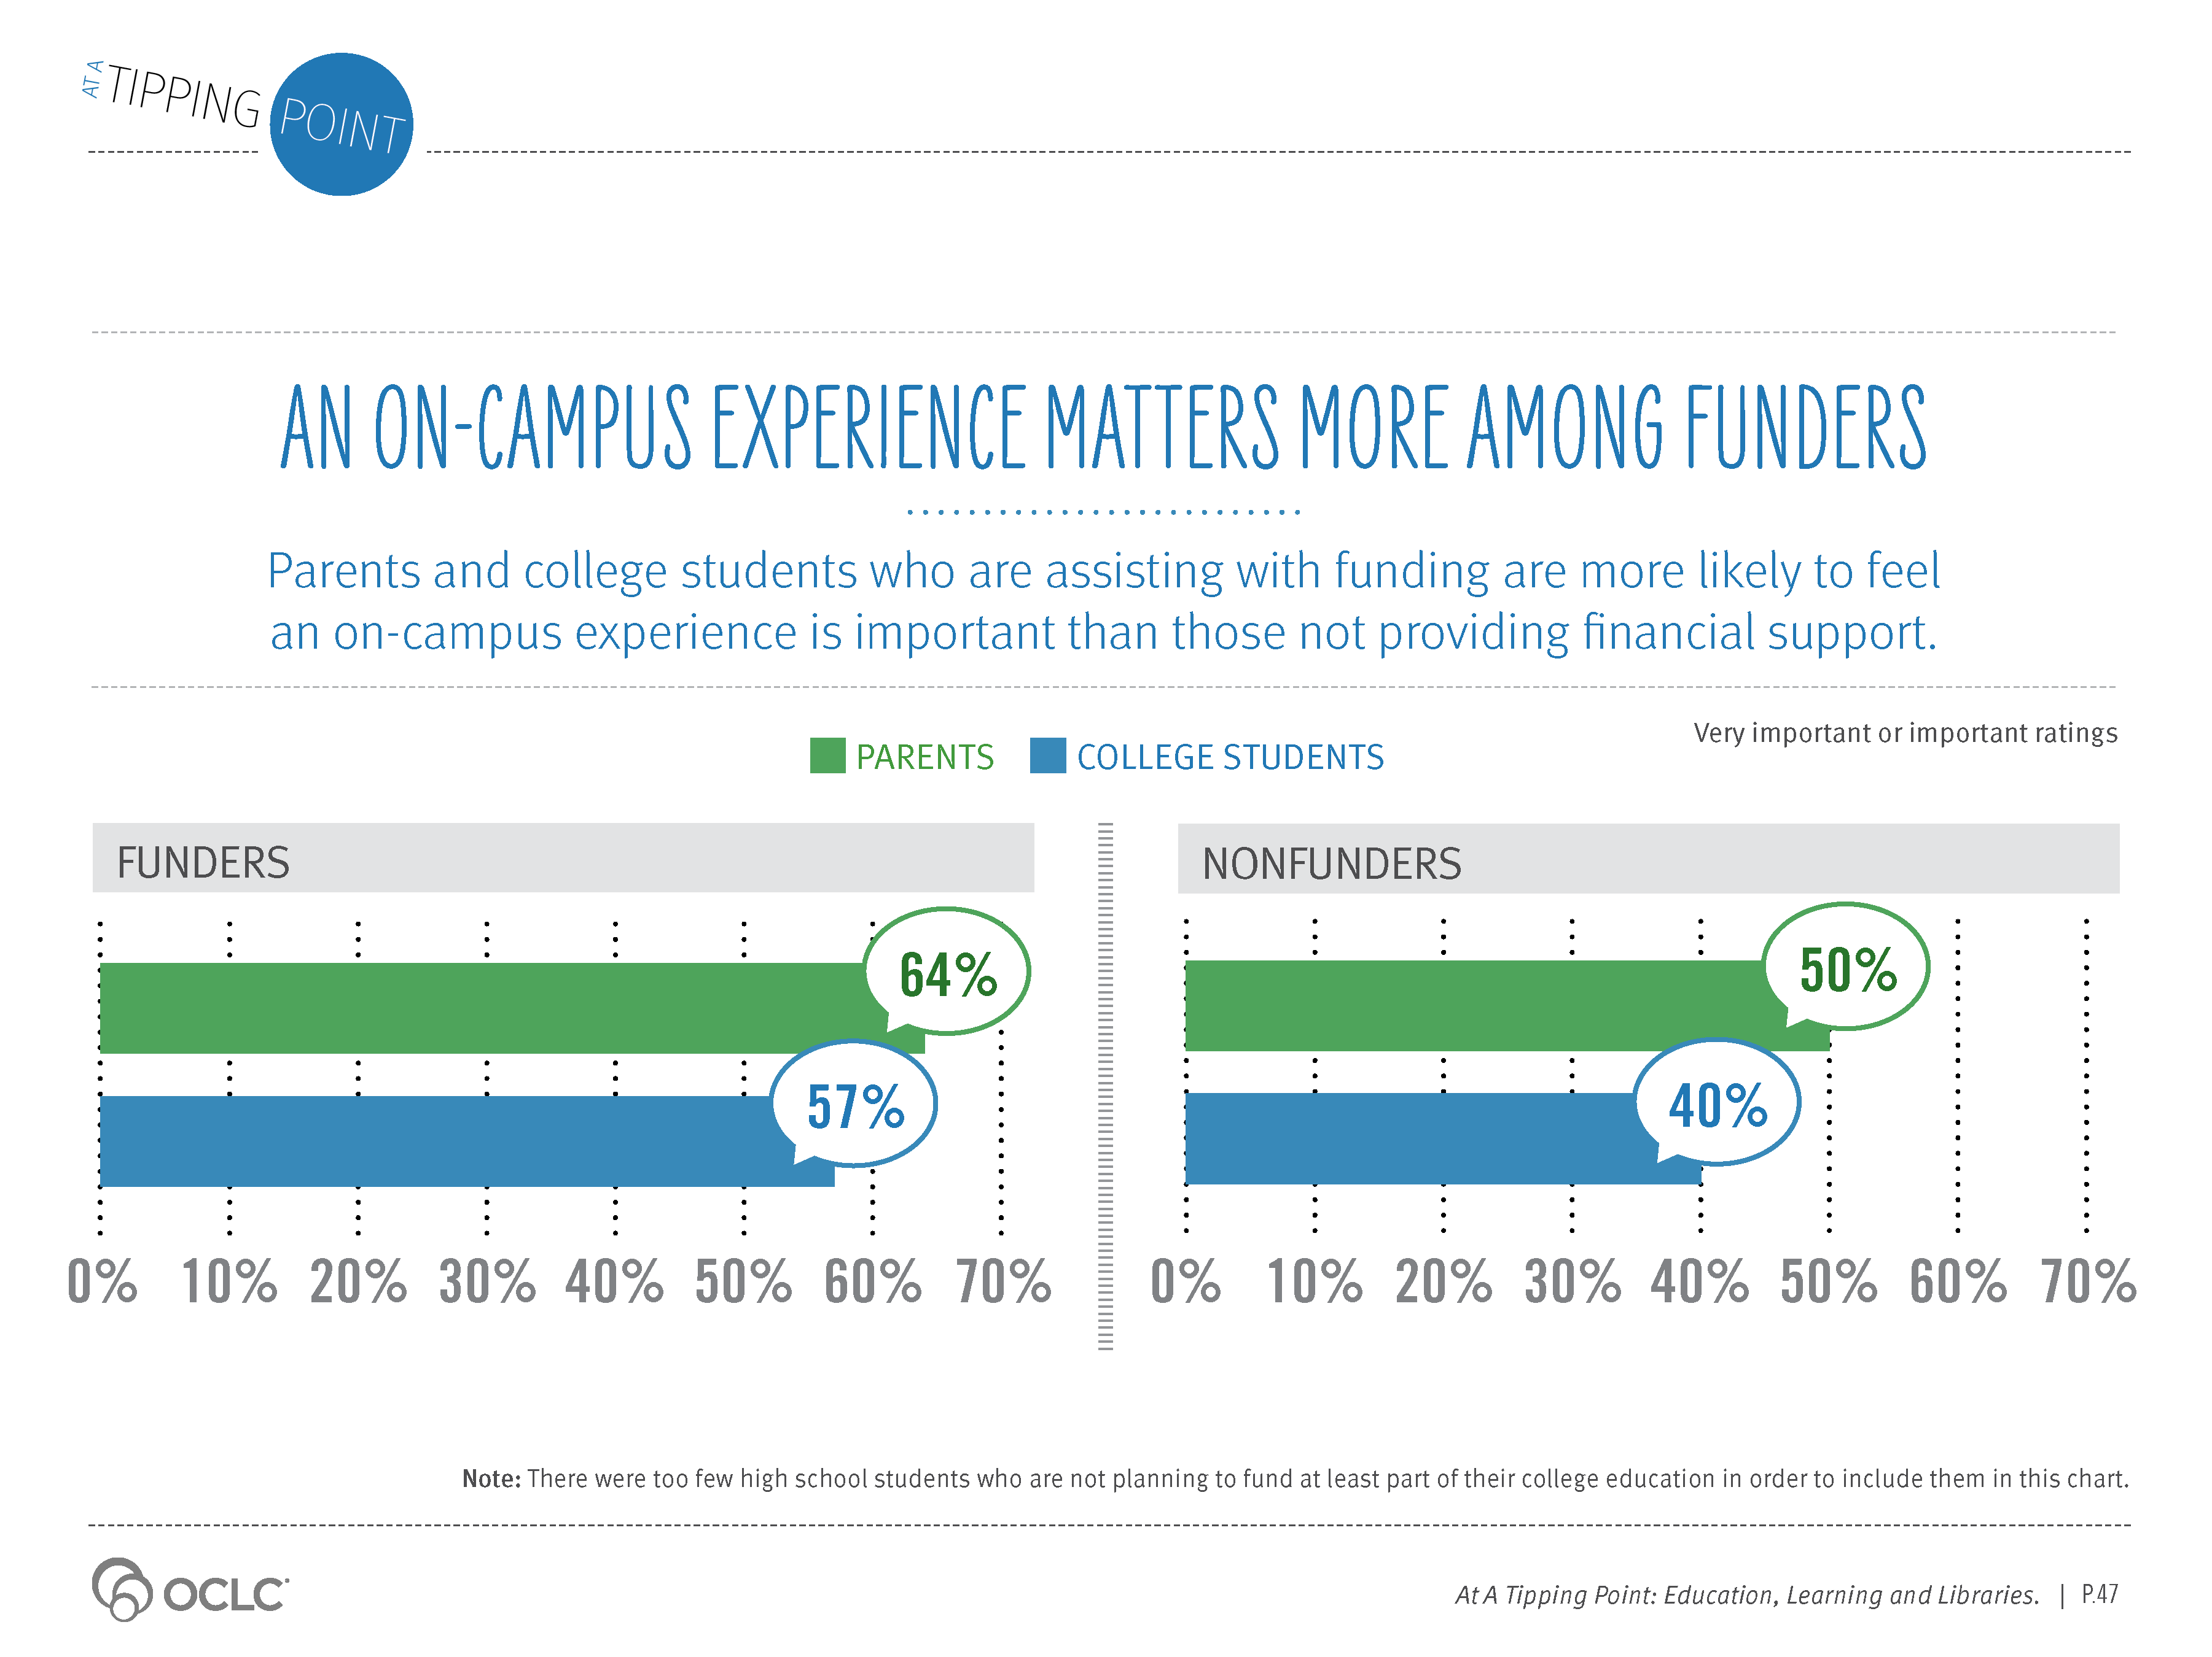
Notes:
Supporting Text From P.47
Parents and college students who are assisting with funding are more likely to feel an on-campus experience is important than those not providing financial support.

