Slide 1
Notes:
At a Tipping Point: Education, Learning & Libraries (an accompanying slide deck)
In June 2014, OCLC published its latest membership report, At a Tipping Point: Education, Learning & Libraries. OCLC produced this slide deck, using artwork and text from the report, for librarians to use in your own presentations. You may use as many (or as few) of the slides in the deck as you wish; the slides themselves, however, are not editable.
ALL RIGHTS RESERVED. Graphics appearing in the report and excerpts of text from the report may be reproduced by library organizations and OCLC member libraries for their noncommercial use without the prior written permission of OCLC, provided that such use is accompanied by clear and full attribution to OCLC (see format below) and proper acknowledgment of any works cited by OCLC in the graphics or excerpts used.
Form of attribution to OCLC: “OCLC, At a Tipping Point: Education, Learning and Libraries, 2014.”

Slide 3
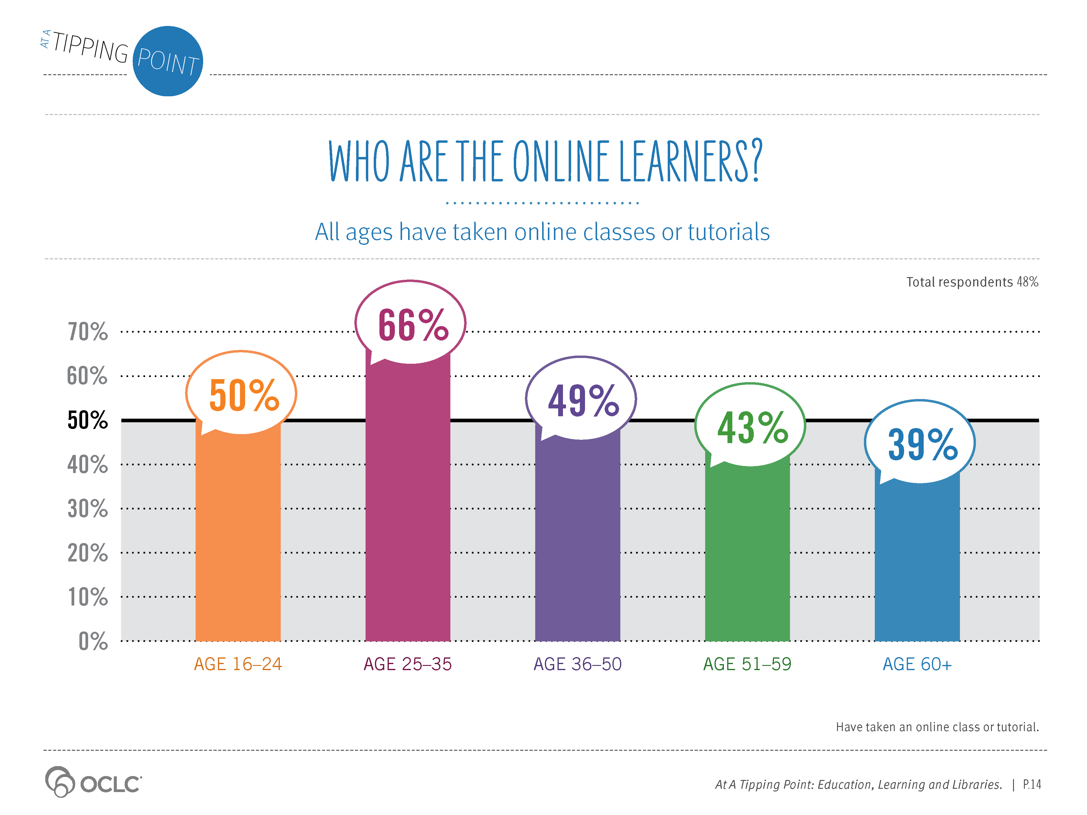
Notes:
Supporting Text From P.14
Nearly half (48%) of the online population ages 16 and older have participated in online learning. They are participating in multiple online learning opportunities, using a variety of tools. Participation ranges from taking an online class for degree credit at a traditional or online-only college, or taking online non-degree classes or tutorials for work, continuing education or for personal growth (e.g., learning a language, developing computer skills, taking up a new hobby, etc.).
Online learners cannot be characterized by age demographics. Our survey revealed that while the 25–35 age group has the highest percentage of online learners, all ages have participated in online learning. Some 40% of respondents ages 51 or older have taken a class online.

Slide 4
Notes:
Supporting Text From P.15
Adoption of online learning is strong across all income levels. Top-end income earners have the highest percentage who are learning online, but very little difference in participation is noted across income levels less than $100,000 annually. Individuals in households earning less than $25,000 are just slightly less likely to participate in online learning than those earning $25,000 to $100,000.

Slide 5
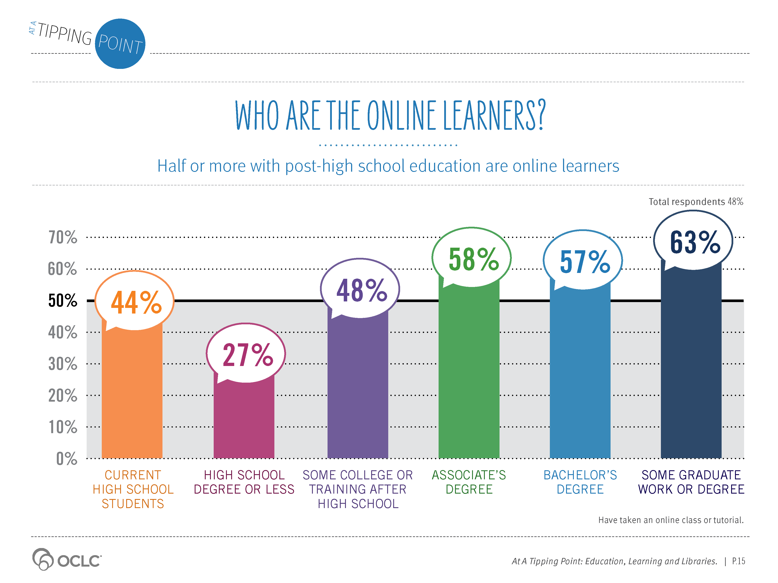
Notes:
Supporting Text From P.15
Learners across all education levels are using online learning to continue to build their skills or strengthen their interests. Forty-four percent (44%) of high school students have taken an online class. Half or more of adults who have at least some post-high school education have taken an online class, and 27% of adults with a high school education or less are also participating in online learning.

Slide 6
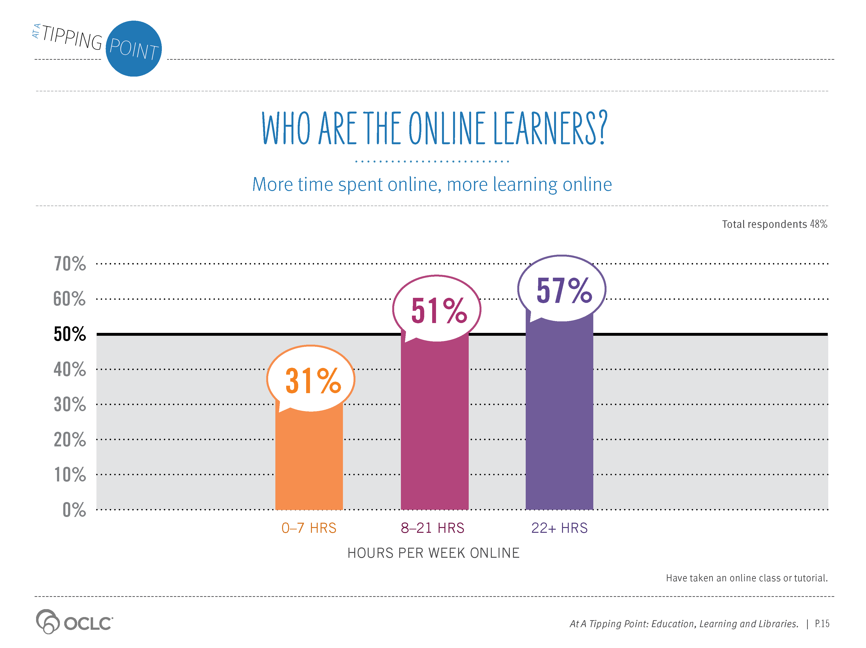
Notes:
Supporting Text From P.15
At least a third of the online population—even those who are online the fewest hours each week—are taking online classes. Not surprisingly, the more time they spend online, the more likely they are to participate in online learning. Experience breeds comfort, skills and usage.

Slide 7
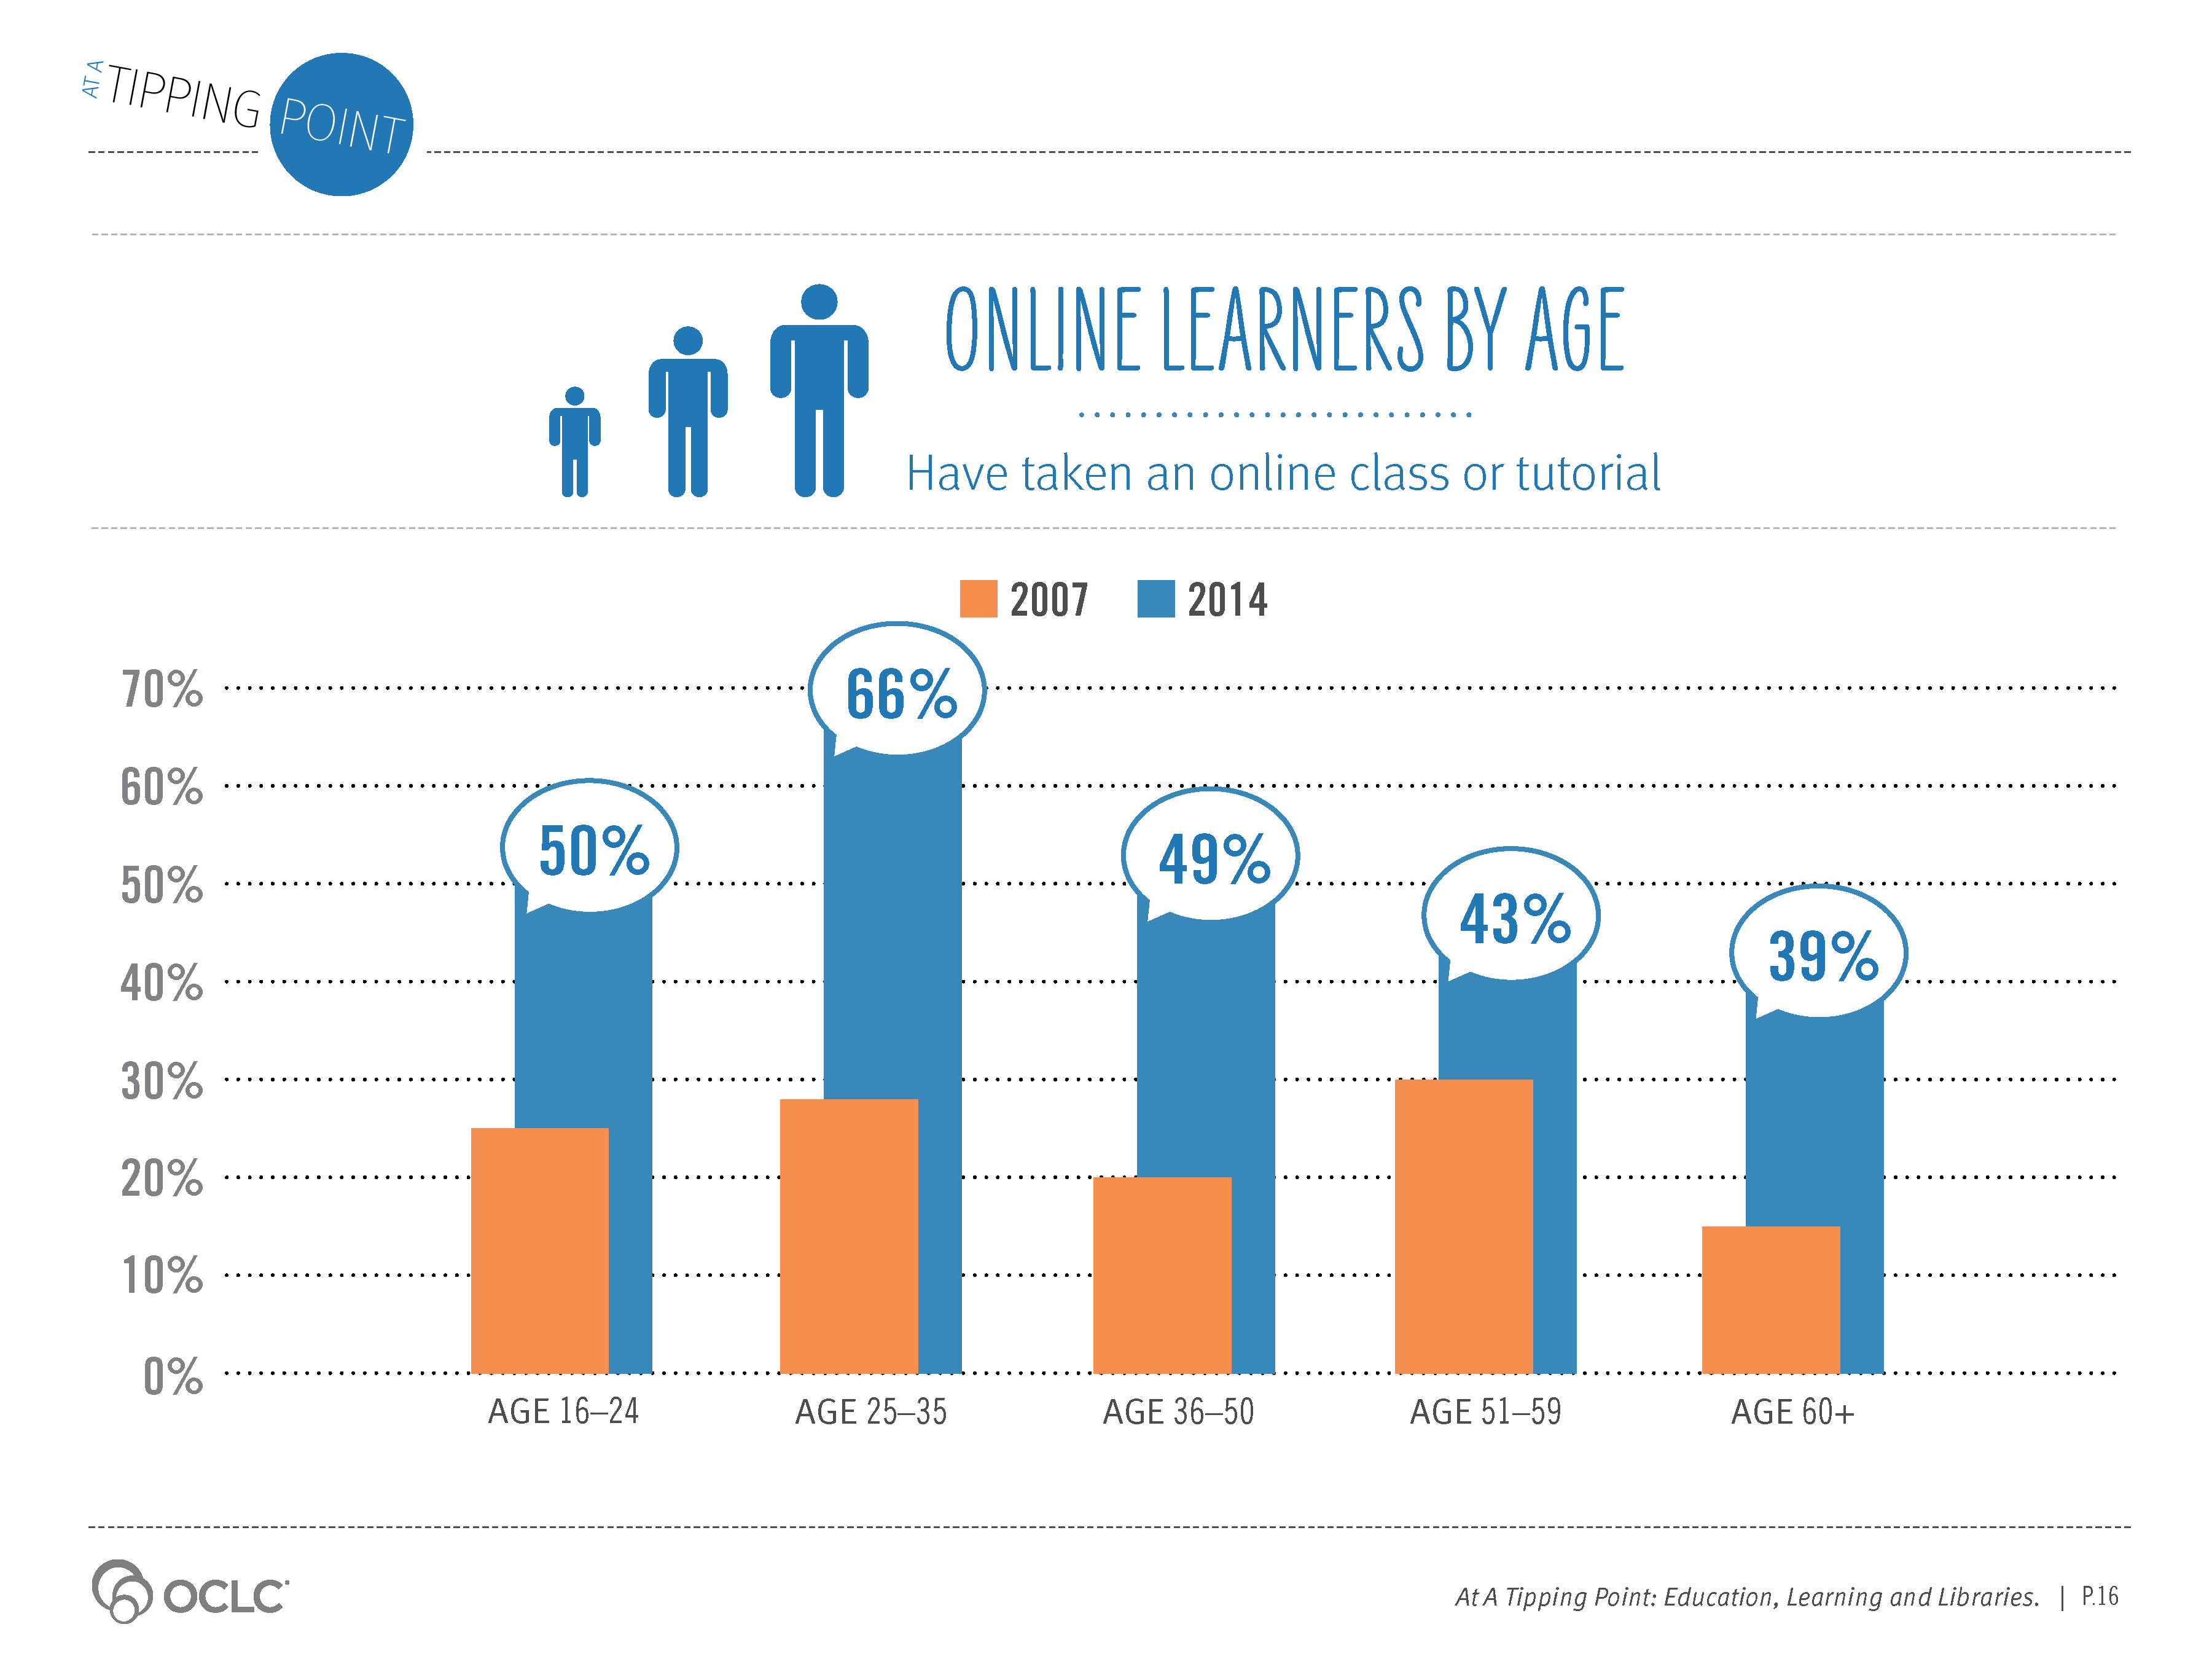
Notes:
Supporting Text From P.16
Early adoption patterns of online learning show some interesting differences when compared with the adoption patterns of other online services such as social networking. Our research identified wide differences in participation rates across age and income levels in social networking use in 2007. Not so for early online learning.
While overall usage rates for online learning were low in 2007 (driven in part by fewer online learning opportunities), Americans gained experience in online learning together, at similar participation rates across age, household income and education levels. With the exception of the highest income level ($100,000+), the appetite to try online learning has been much more equally distributed across demographics than social networking.
The rise of new learning platforms, such as MOOCs, is likely leading to higher participation rates by degree-seeking learners in the 25–35 age group in 2014.

Slide 8
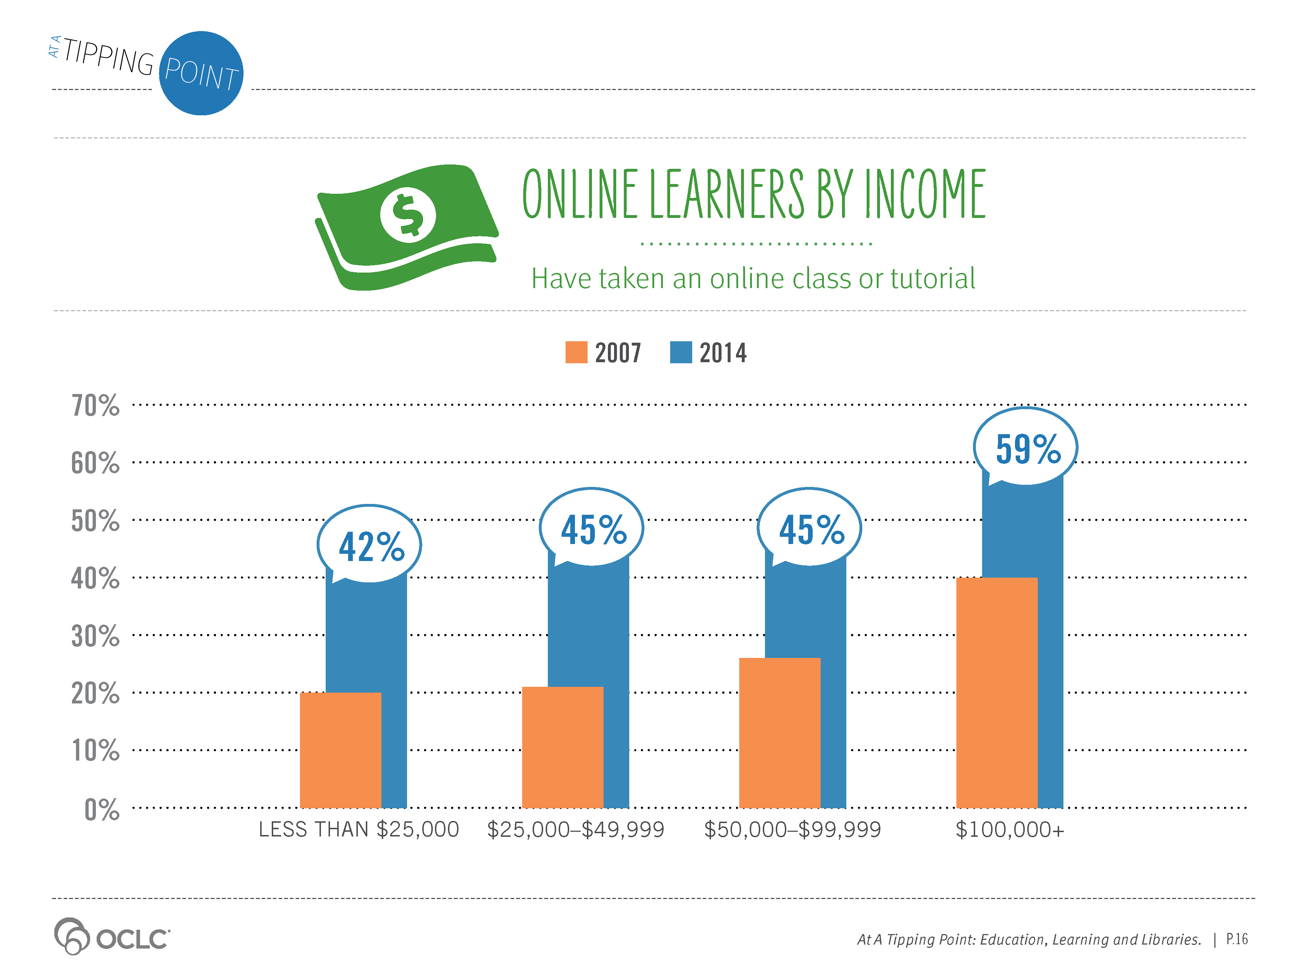
Notes:
Supporting Text From P.16
Early adoption patterns of online learning show some interesting differences when compared with the adoption patterns of other online services such as social networking. Our research identified wide differences in participation rates across age and income levels in social networking use in 2007. Not so for early online learning. While overall usage rates for online learning were low in 2007 (driven in part by fewer online learning opportunities), Americans gained experience in online learning together, at similar participation rates across age, household income and education levels. With the exception of the highest income level ($100,000+), the appetite to try online learning has been much more equally distributed across demographics than social networking. The rise of new learning platforms, such as MOOCs, is likely leading to higher participation rates by degree-seeking learners in the 25–35 age group in 2014.

Slide 9
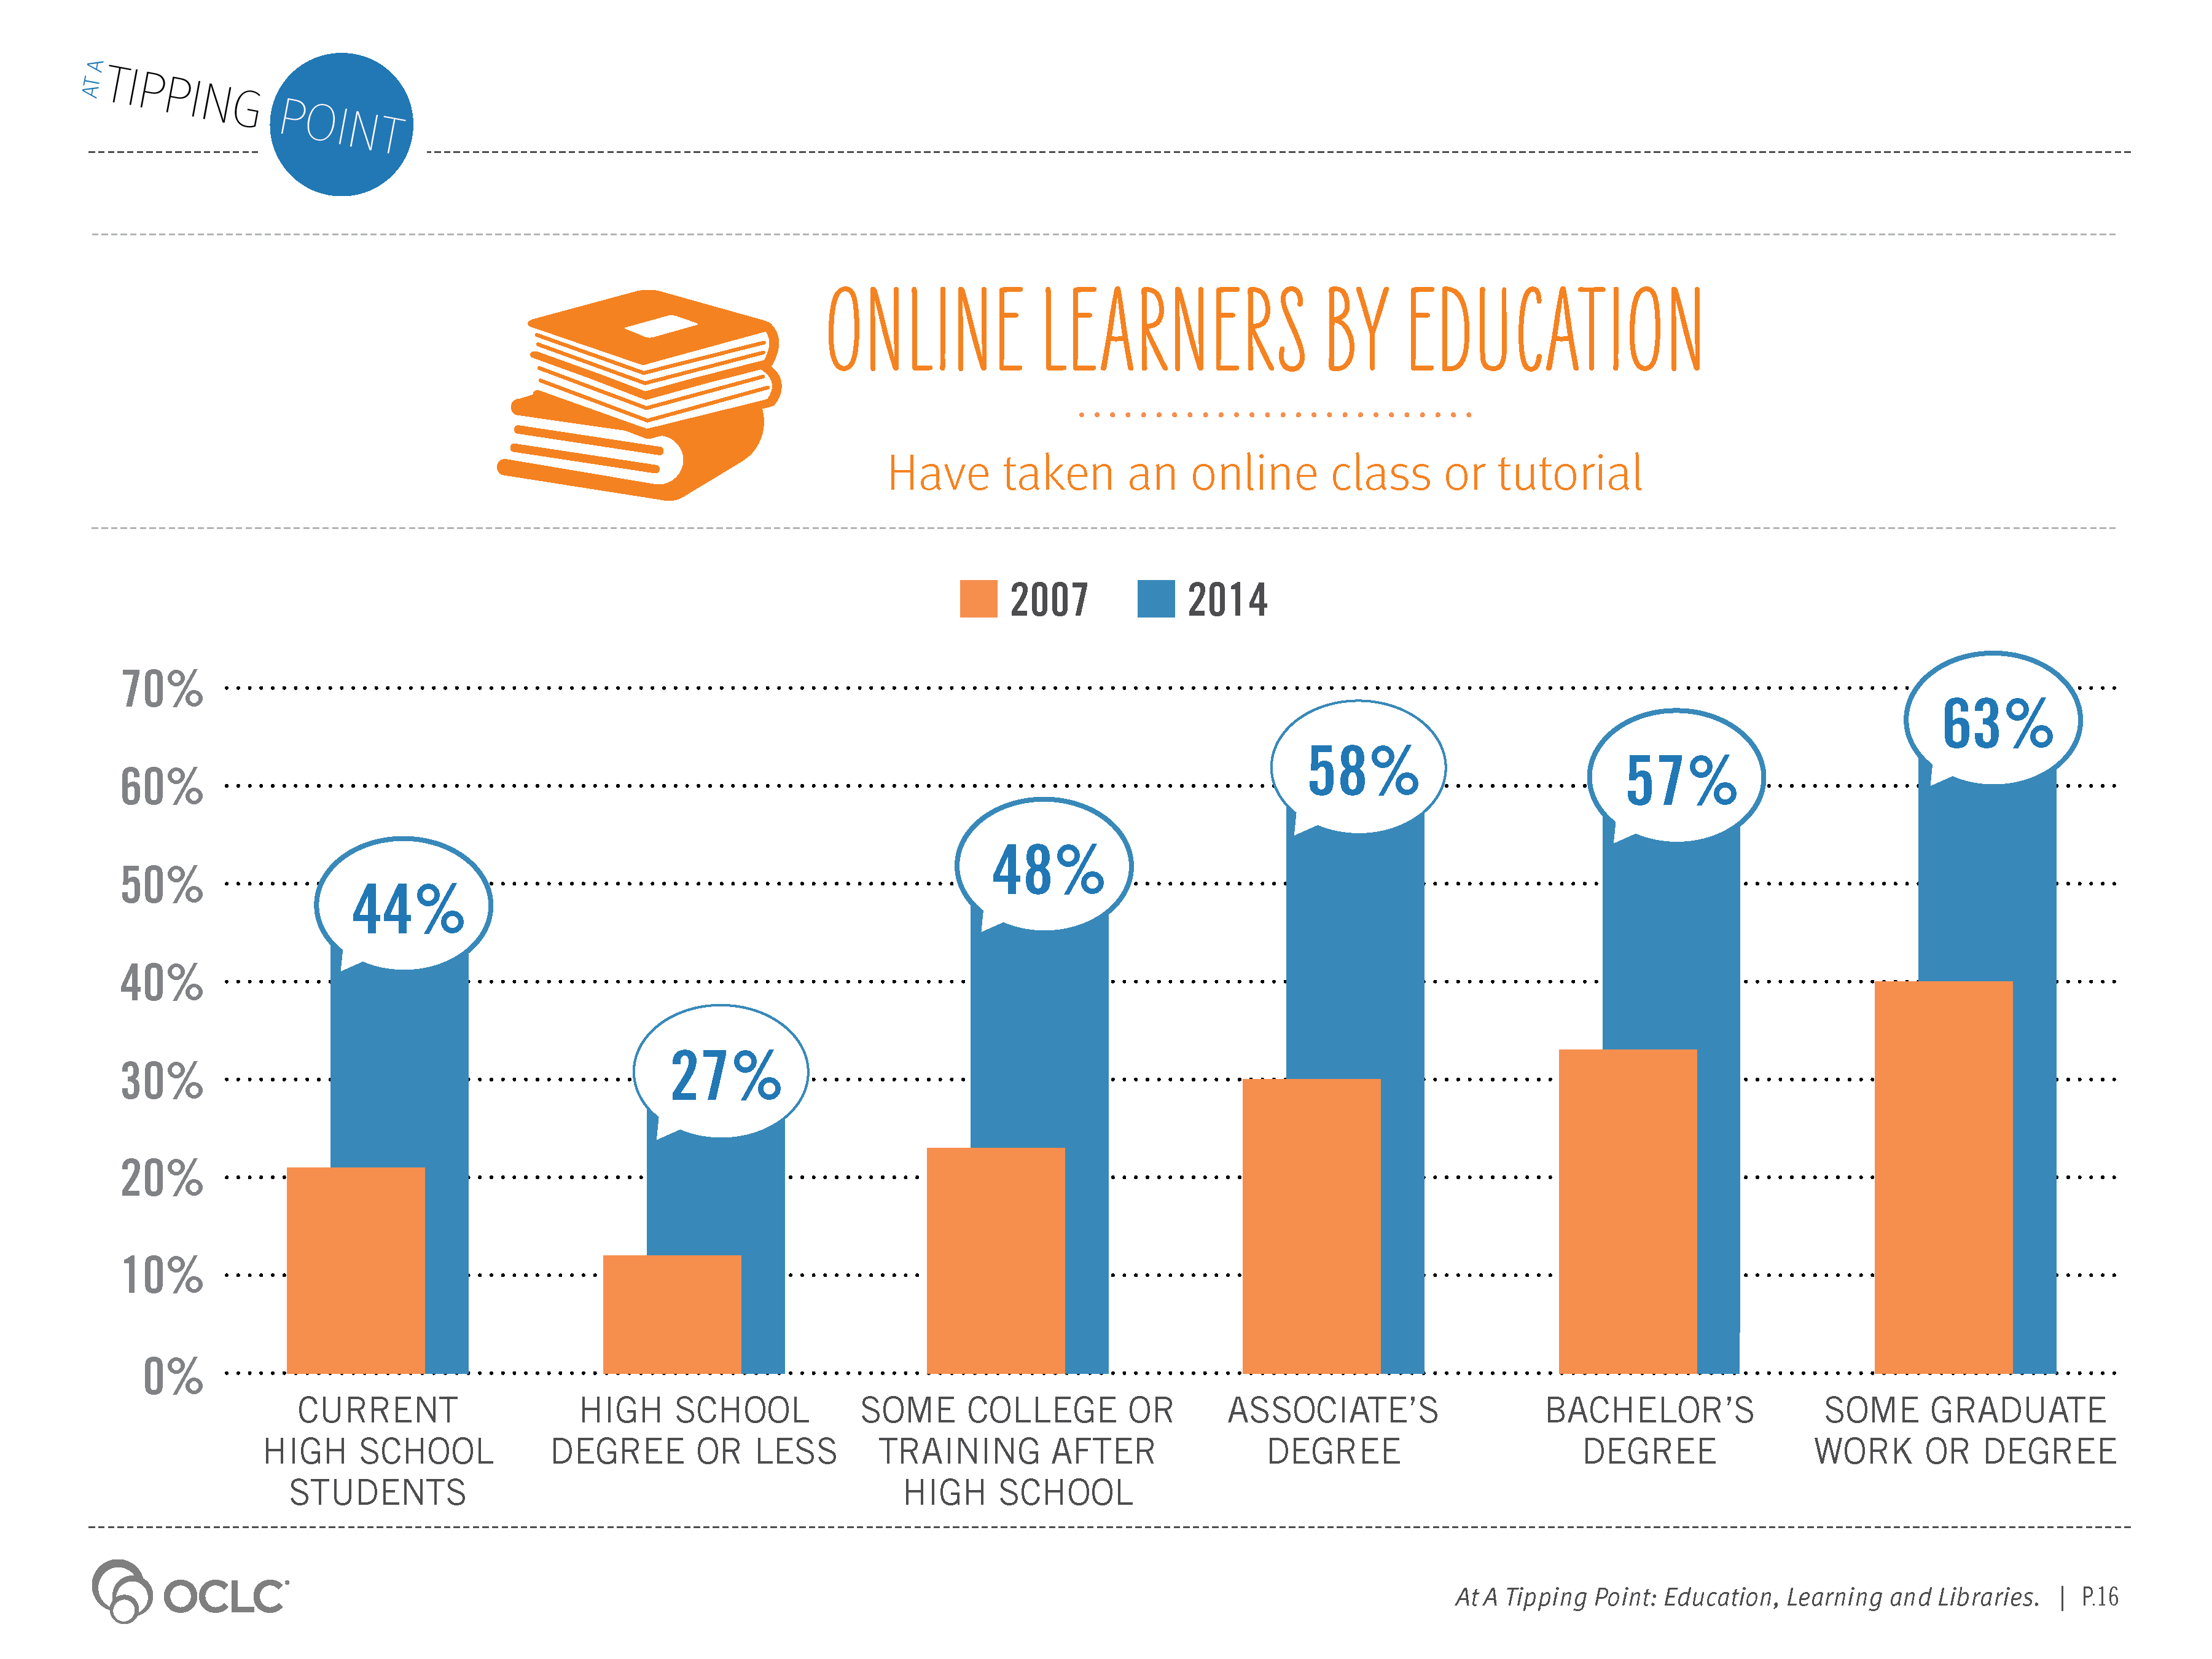
Notes:
Supporting Text From P.16
Early adoption patterns of online learning show some interesting differences when compared with the adoption patterns of other online services such as social networking. Our research identified wide differences in participation rates across age and income levels in social networking use in 2007. Not so for early online learning.
While overall usage rates for online learning were low in 2007 (driven in part by fewer online learning opportunities), Americans gained experience in online learning together, at similar participation rates across age, household income and education levels. With the exception of the highest income level ($100,000+), the appetite to try online learning has been much more equally distributed across demographics than social networking.
The rise of new learning platforms, such as MOOCs, is likely leading to higher participation rates by degree-seeking learners in the 25–35 age group in 2014.

Slide 10
Notes:
Supporting Text From P.17
Smartphones, tablet computers and e-readers are experiencing dramatic growth. In the last four years, tablet ownership rose from less than 3% of adults owning one to 42% in 2014 (Pew, January 2014b). And, increasingly more time is spent on digital devices. Adults will spend 23% more time on mobile devices in 2014 than they did in 2013, according to forecasts (eMarketer, April 22, 2014). As they become more mobile, so too will learning activities.
While the majority of online learners use a laptop or desktop to take online classes, nearly a quarter of our survey respondents (21%) used a smartphone, tablet or e-reader to take an online class or tutorial. Age plays a factor with a larger percentage of online learners age 35 or younger using a mobile device to take an online class than older age segments. This pattern mimics the demographics of smartphone owners: the younger age groups are more likely to own a smartphone (Pew, January 2014a).

Slide 11
Notes:
Supporting Text From P.18
Just under a quarter (22%) of the online population have taken an online class toward a degree from a traditional or online-only college. The 25–35 age group has the highest participation rate, with 50% who have taken an online degree class.
Just under half (45%) of current college students have taken an online degree class.

Slide 12
Notes:
Supporting Text From P.18
Household income level is not a differentiating factor for participation in online degree classes. The online learning participation rates for degree classes are steady at just under a quarter across all income levels.

Slide 13
Notes:
Supporting Text From P.19
About a quarter (22%) of adults with some college or training after high school (but no degree) have taken an online class toward a degree, as have a quarter (24%) of those with a bachelor’s degree. Participation rates are highest for learners who have an associate’s degree or some graduate work or degree. Just under one-tenth (7%) of current high school students have also taken an online degree class.

Slide 14
Notes:
Supporting Text From P.19
It is not surprising that the top reasons cited for taking an online degree class are to further education or for credit toward a degree. More illuminating is the data on the very high levels of learners who report they are successfully meeting their goals. Overall, 87% of those who have taken an online degree class indicated that their top goals were met. This high satisfaction level held constant for all age levels.

Slide 15
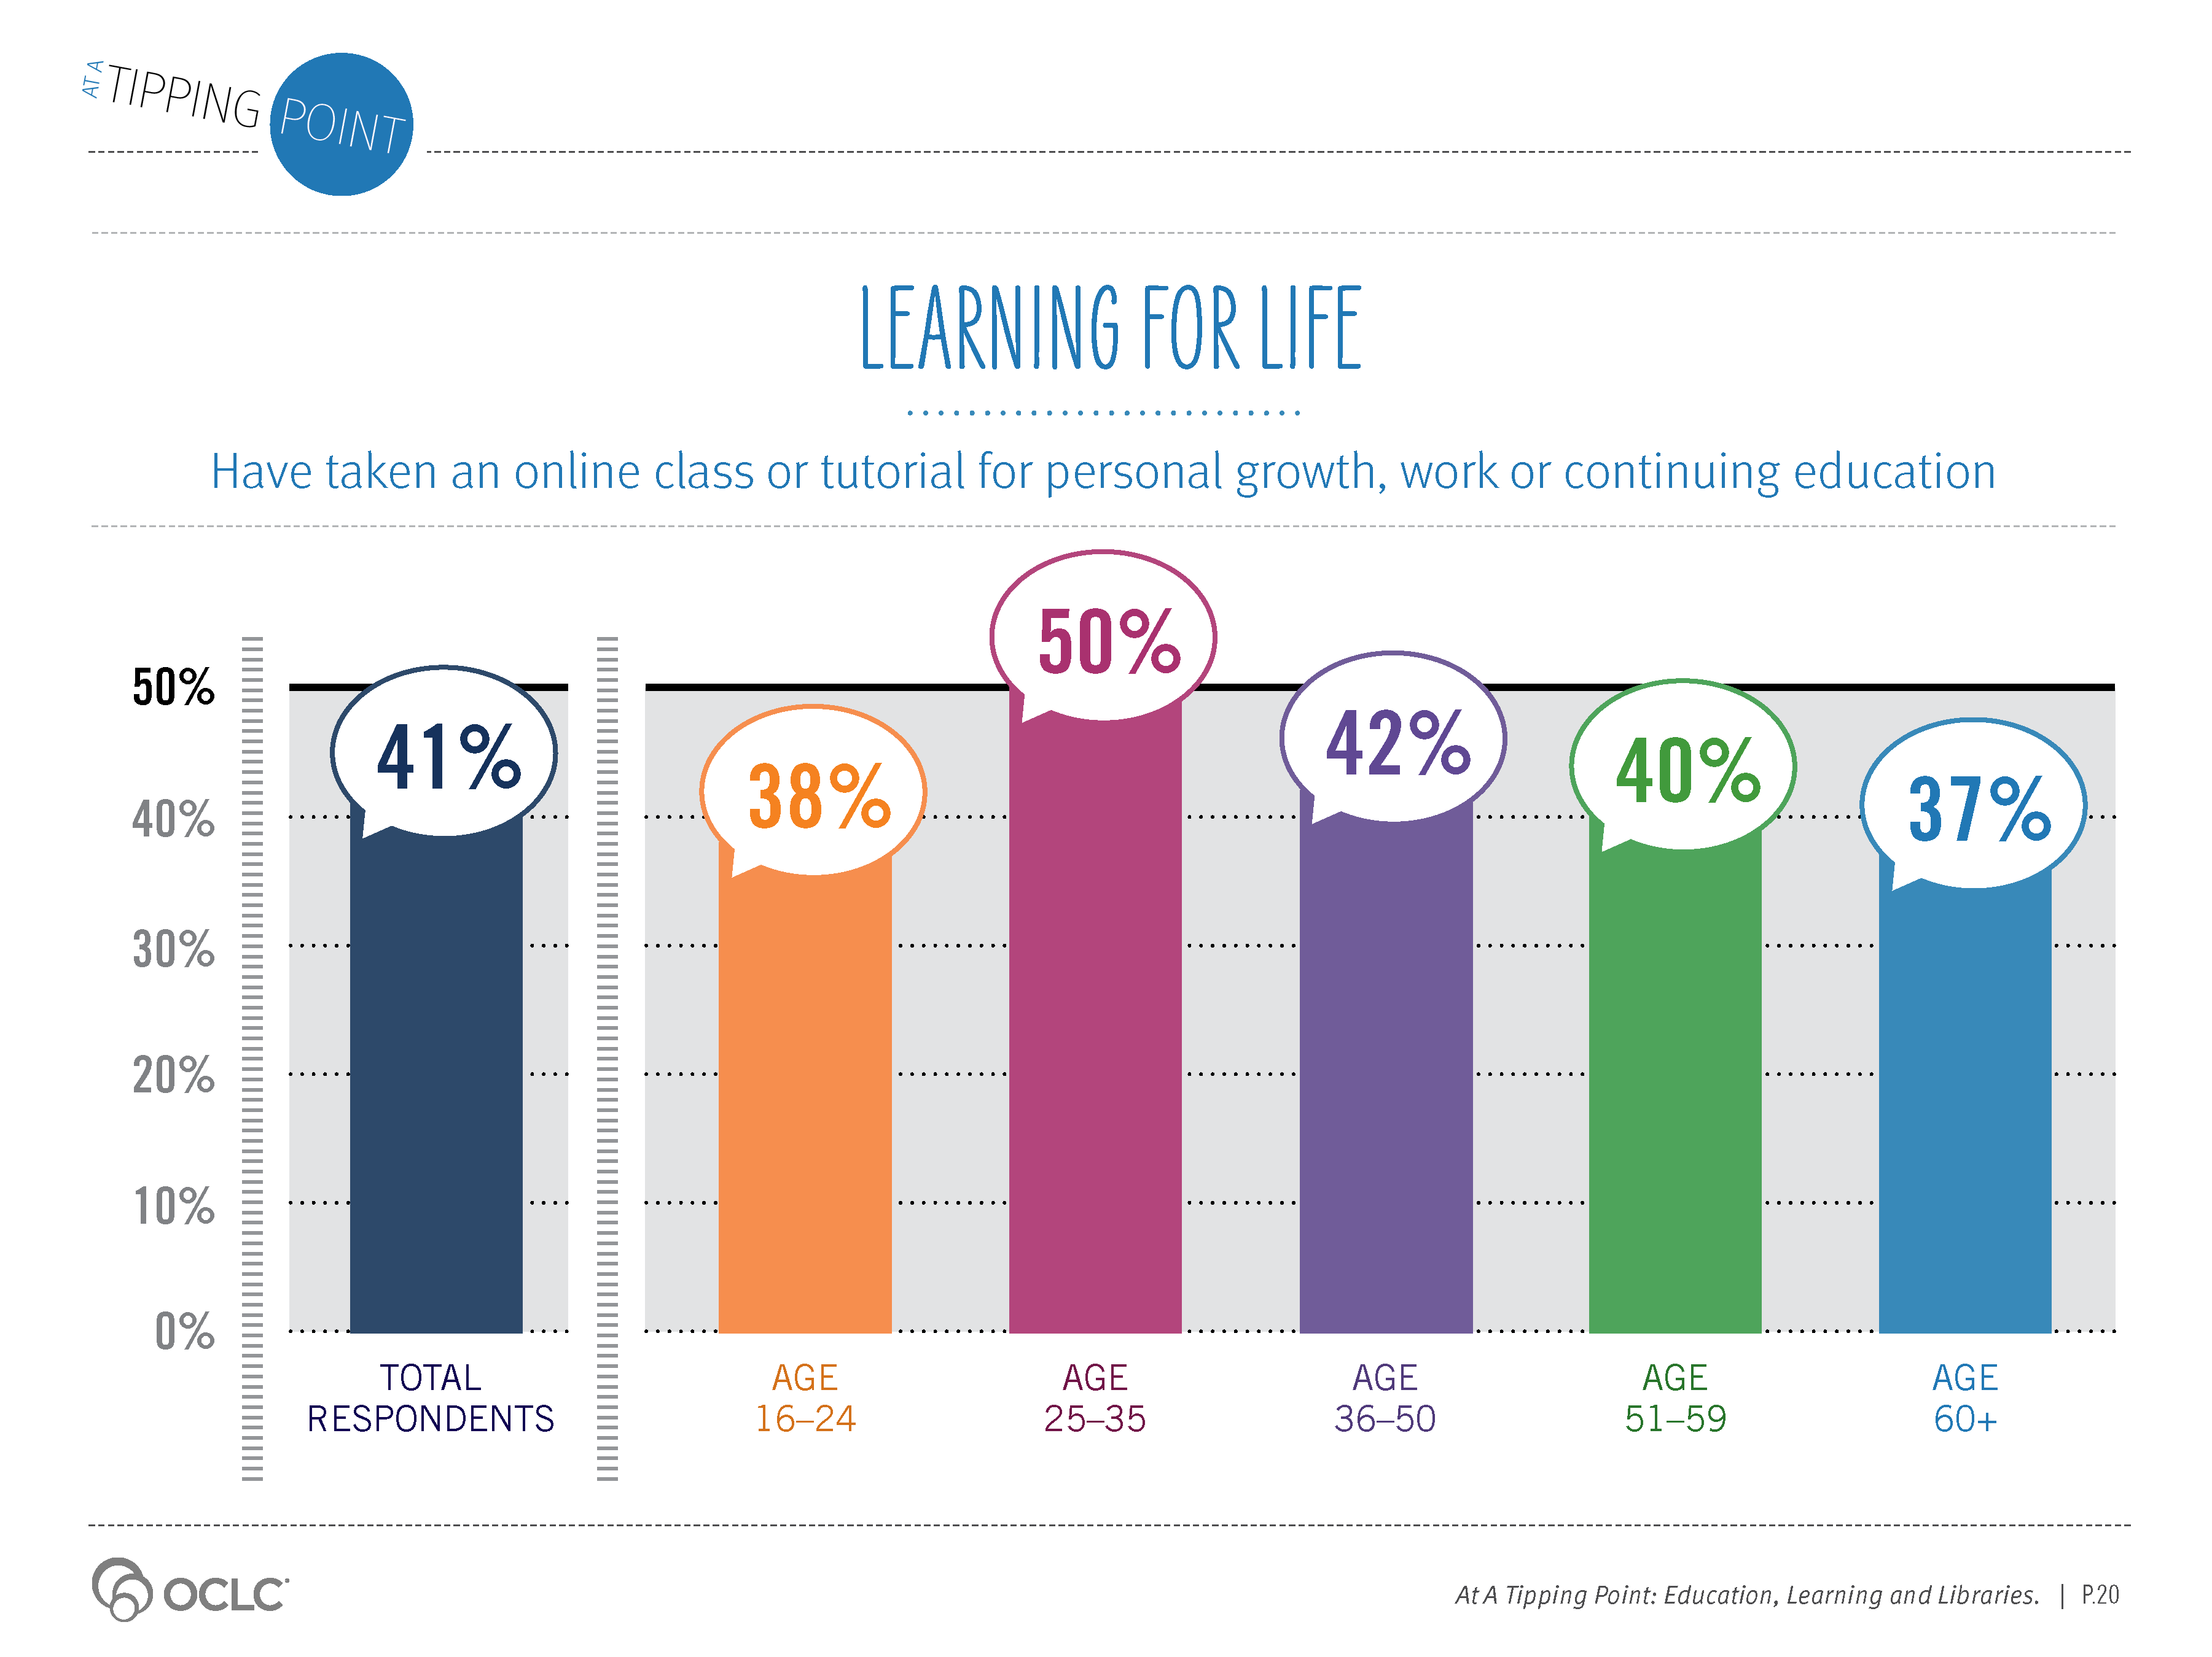
Notes:
Supporting Text From P.20
Nearly a quarter (22%) of online users have taken an online class toward a degree. Almost twice as many (41%) are using online education for learning for life.
They are taking online classes or tutorials to grow their skills for work, to pursue their educational interests or for personal skill enhancement (e.g., learning a new language) and hobbies. A few are taking online classes to learn more about health and well-being.
Adults between the ages of 25 and 35 have the highest percentage of participation, but online use for lifelong learning is evident.

Slide 16
Notes:
Supporting Text From P.20
Personal growth is the primary aim for taking online non-degree classes for most online learners. Whether recreation or hobby-related, to enhance a skill or for a do-it-yourself project, online learning is meeting a need.

Slide 17
Notes:
Supporting Text From P.21
Participation rates of online classes for personal growth, work or continuing education range from just over a tenth to more than a third, based on age. Those between the ages of 25 and 35 have the highest participation in all types of online non-degree classes or tutorials.

Slide 18
Notes:
Supporting Text From P.21
Adults at the highest income level, over $100,000, are most likely to have taken online classes for continuing education, personal growth or work, but learners at all income levels are active online participants.

Slide 19
Notes:
Supporting Text From P.22
Learners across all education levels, with the exception of adults with a high school degree or less, are taking online classes for personal growth at roughly equal rates.

Slide 20
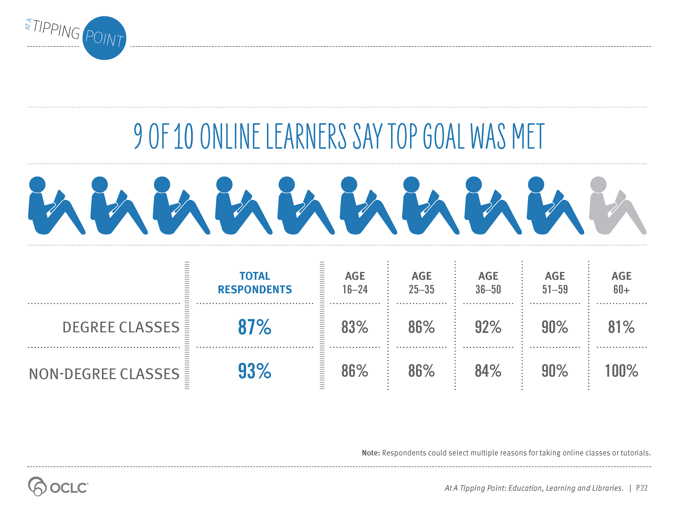
Notes:
Supporting Text From P.22
Online learners are having success. Overwhelmingly, learners taking online classes or tutorials for work, continuing education or personal growth or to pursue a degree say their top goal has been achieved. Success rates are roughly equal, and equally outstanding, across age and across the range of personal goals for learning online. From youth (83%) to seniors (81%), learners are advancing their education with online degree classes. Top goals for non-degree classes—learning about a topic of interest and furthering one’s education and profession—are also being met at high levels.

Slide 21
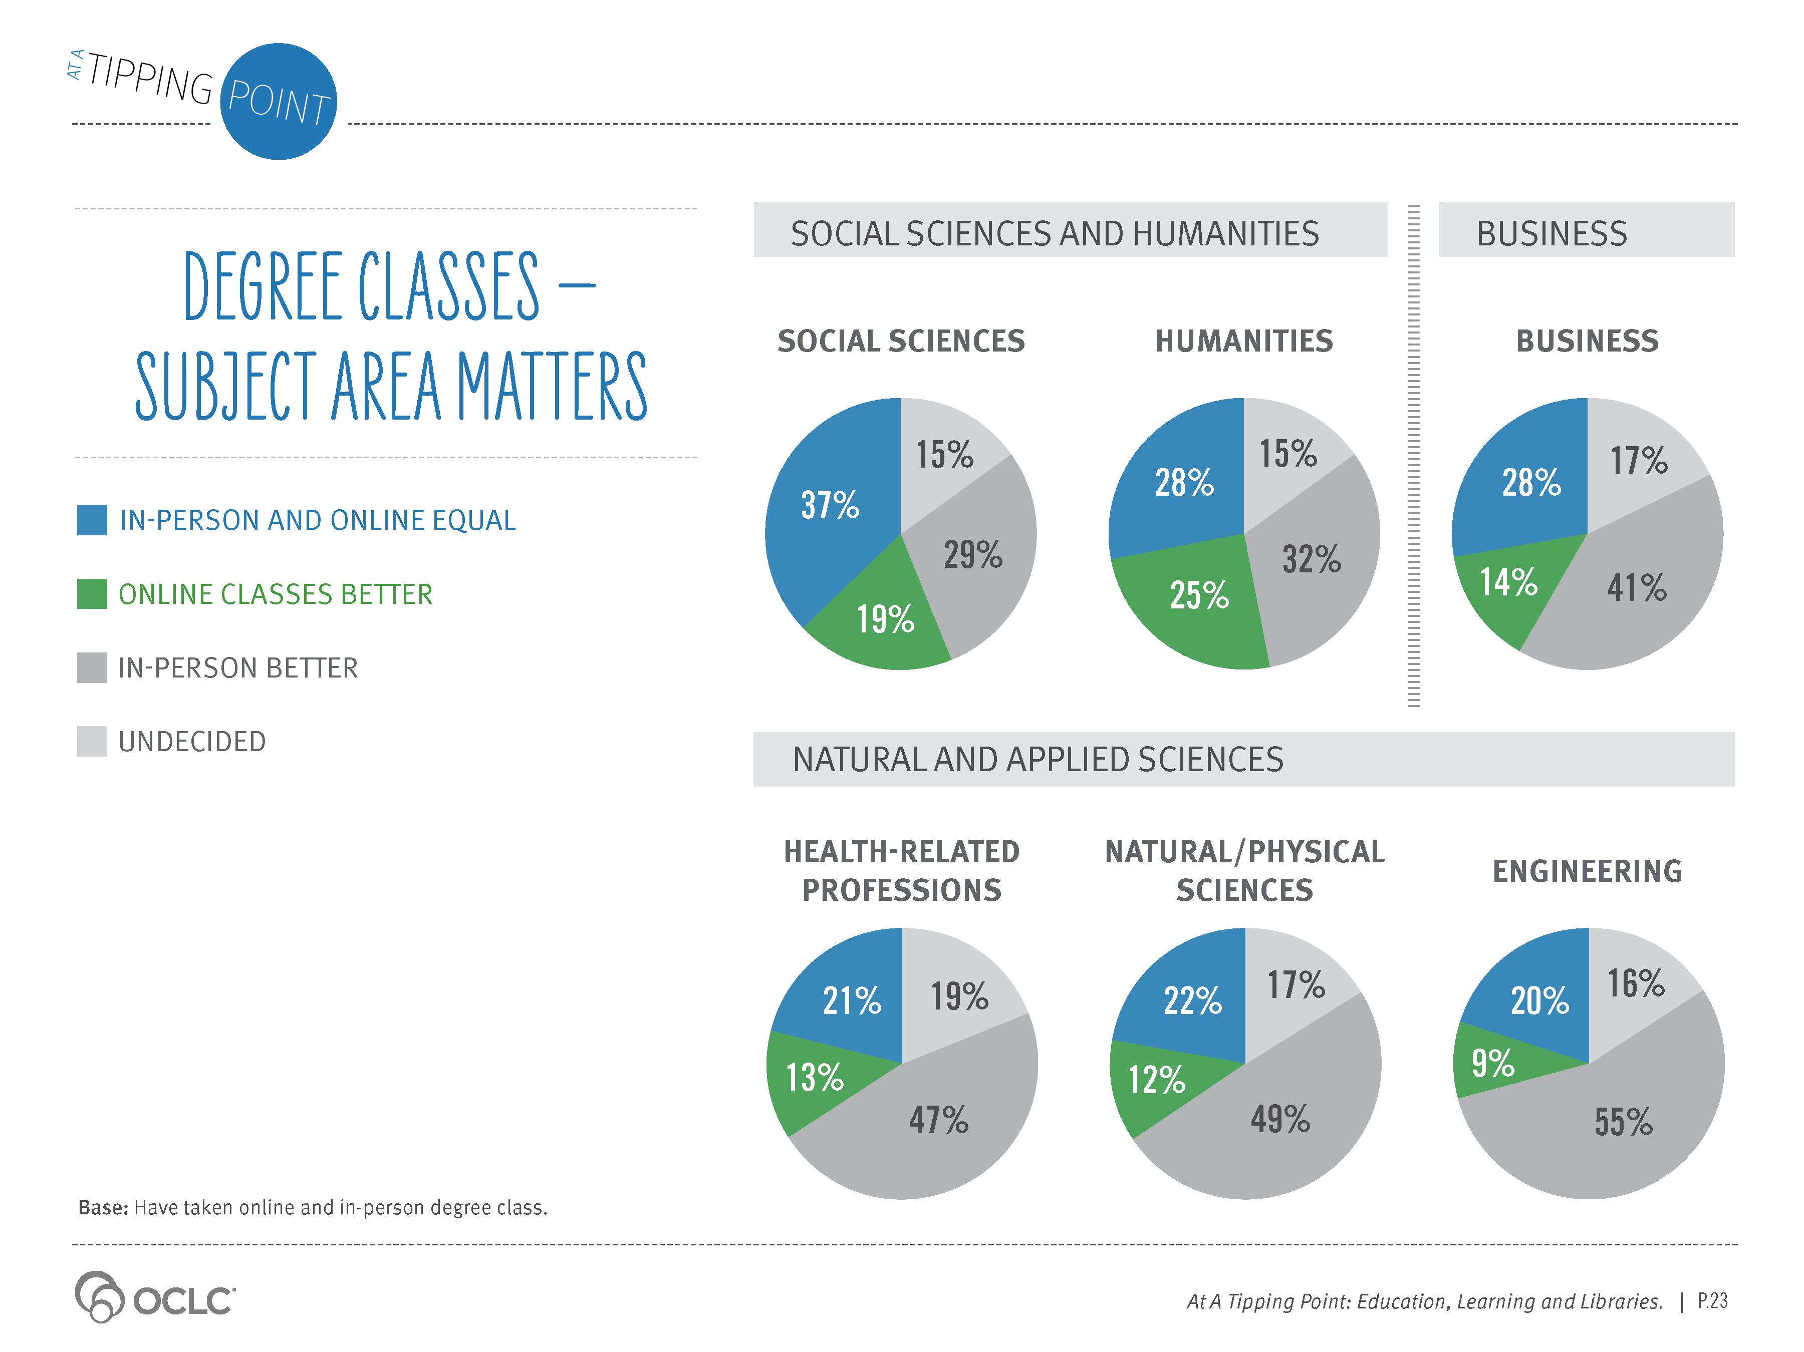
Notes:
Supporting Text From P.23
For learners seeking a degree, differences in effectiveness are subject-dependent. Degree seekers believe classes in the humanities and social sciences, such as psychology or history, are equally effective online or in-person. But online learners see classes in business and natural and applied sciences as more effective in-person.

Slide 22
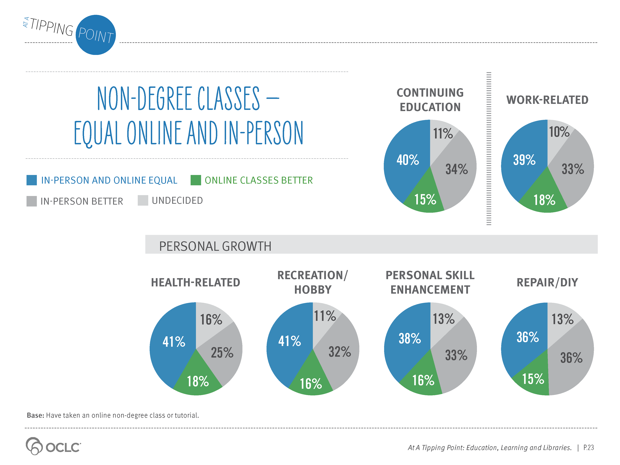
Notes:
Supporting Text From P.23
Around 40% of learners taking online classes for personal growth, work or lifelong learning see either method—online or in-person—as equally effective.

Slide 23
Notes:
Supporting Text From P.24
Massive open online courses, or MOOCs, are courses of study offered over the Internet, often for free, to large numbers of learners.
The attention on MOOCs has risen steadily. MOOC fans and critics are vocal about the potential for this latest online learning model. Some have hailed MOOCs as “the next great technological disruption in education” and as “a shiny new toy in the toolbox [of] online education offerings” (Straumsheim, 2014). The New York Times called 2012 “The Year of the MOOC” (Pappano, 2012).
MOOC critics, on the other hand, are less enthusiastic. The sustainability of the economic model for the larger MOOC providers is questioned. Low completion rates for students enrolled in MOOCs and the quality of the learning experience are often cited as concerns about the long-term viability of MOOCs. A May 2014 study found that students do not retain or apply the knowledge learned from their often passive involvement in MOOCs (Perez-Hernandez, 2014).
But as critics and advocates continue their debates, more learners are signing up and new MOOC courses are being added. Leading MOOC providers report millions have used MOOCs and hundreds of courses are available in online catalogs.
Our survey indicated, however, that MOOCs are still relatively unknown and unexplored by the majority of online users. Just 13% of survey respondents indicated that they were familiar with the term “MOOC,” and only 3% have participated in a course. College students are more familiar with the term. A quarter of college students are familiar with “MOOCs,” and 8% have taken one.

Slide 24
Notes:
Supporting Text From P.25
MOOC participation (3%) is significantly smaller than reported participation in online degree (22%) or non-degree (41%) classes. The age, income and education distribution patterns, though, are very similar. The younger are more aware of MOOCs, and income levels have little differentiation. Higher Internet use aligns with higher MOOC awareness and use, as it does for online learning in general.
Similar to other recent studies focused on the demographics of MOOCs (Ho et al., 2014, Christensen et al., 2013), our findings indicate those who already have a college degree are more likely to have taken a MOOC.

Slide 25
Notes:
Supporting Text From P.25
MOOC participation (3%) is significantly smaller than reported participation in online degree (22%) or non-degree (41%) classes. The age, income and education distribution patterns, though, are very similar. The younger are more aware of MOOCs, and income levels have little differentiation. Higher Internet use aligns with higher MOOC awareness and use, as it does for online learning in general.
Similar to other recent studies focused on the demographics of MOOCs (Ho et al., 2014, Christensen et al., 2013), our findings indicate those who already have a college degree are more likely to have taken a MOOC.

Slide 26
Notes:
Supporting Text From P.25
MOOC participation (3%) is significantly smaller than reported participation in online degree (22%) or non-degree (41%) classes. The age, income and education distribution patterns, though, are very similar. The younger are more aware of MOOCs, and income levels have little differentiation. Higher Internet use aligns with higher MOOC awareness and use, as it does for online learning in general.
Similar to other recent studies focused on the demographics of MOOCs (Ho et al., 2014, Christensen et al., 2013), our findings indicate those who already have a college degree are more likely to have taken a MOOC.

Slide 27
Notes:
Supporting Text From P.25
MOOC participation (3%) is significantly smaller than reported participation in online degree (22%) or non-degree (41%) classes. The age, income and education distribution patterns, though, are very similar. The younger are more aware of MOOCs, and income levels have little differentiation. Higher Internet use aligns with higher MOOC awareness and use, as it does for online learning in general.
Similar to other recent studies focused on the demographics of MOOCs (Ho et al., 2014, Christensen et al., 2013), our findings indicate those who already have a college degree are more likely to have taken a MOOC.

Slide 28
Notes:
Supporting Text From P.26
What are the reasons for taking a MOOC? Our survey results indicate that the top reason users are taking MOOCs is not to complete a course for degree credit, but to learn about a topic of interest. Much criticism of MOOCs has been around the low completion rates. While thousands, or even tens of thousands, register for some MOOCs, completion rates are low, usually less than 10% (Ho et al., 2014). If the primary goal for taking a MOOC, however, is not about getting credit for having completed the course, completion rates are only one measure of user success.
Consistent with online learning success rates for degree and for personal enrichment, the satisfaction rates among MOOC users in our study are high. Eighty-one percent (81%) of MOOC participants indicate that their top goal—to learn about a topic of interest—was met. Other reasons to take a MOOC include to train for a career, to increase work skills or to satisfy a curiosity.
Degree-seekers also report success. College students’ top goal for taking a MOOC was to obtain personal recognition or certification—84% said that their top goal was met.
Our findings suggest that more exploration around the goals of MOOC users will offer valuable insight into the potential of these new learning platforms. As a recent study on the expectations and realities of MOOCs concludes, “Educators must get beyond the notion that course completion per se equates with learning and consider how to allow learners to demonstrate valuable competencies...that may be acquired through MOOC participation” (Hollands & Tirthali, 2014).

Slide 29
Notes:
Supporting Text From P.27-28
Online learners reported, loudly and clearly, that convenience is the most beneficial aspect of their online learning experience. It topped the list of benefits across every age group, education and income level.
The convenience of taking classes online, where and when learners want, makes online learning powerful. Flexible scheduling, being able to take the class at home and learning at the exact moment they need to were given high marks by users. As one high school student stated, “Being able to listen to lessons on my own time without being on a strict schedule allowed me to enjoy other activities as well.” Or, in the words of a 67-year-old woman, “Being able to study on my own, in my own time and space” was the most beneficial aspect of online learning.
The information and knowledge gained are other beneficial aspects of online learning. Comments included phrases such as “furthering my education” and “expanding my knowledge” or as one 30-year-old man wrote, “DIY websites—I never knew I could do 75% of this stuff!” A 57-year-old man explained it simply as, “I learned how to learn.”
The ability to learn at one’s own pace and to review the content as often as needed are also important benefits of online learning. One 53-year-old learner explained, “Most were video-based, where I go at my own pace. That aspect is nice, because I could go back and review things I might have missed, or didn’t quite get the first time.”
While affordability is not ranked as the primary benefit for learning online, respondents commented enthusiastically about the economic value. A 36-year-old woman said, “I’m able to learn a variety of subjects without the cost.” A 20-year-old female college student shared, “Being able to have a free college-level education. I did not have to pay a cent and still could learn topics related directly to my courses.”

Slide 30
Notes:
Supporting Text From P.28
Many benefits of online learning were cited. Users also shared that challenges exist as well. Self-discipline topped the list. Challenges that students may have with their in-person classes, such as meeting deadlines and juggling course work with other responsibilities, are also challenges with online learning. A 19-year-old college student described her challenge as, “Making sure I pace everything correctly and don’t overburden myself with work at the end.”
The lack of personal interaction with both peers and instructors was a challenge expressed by 27% of the online learners in our study. A 52-year-old man found it challenging that he “didn’t have face-to-face interaction with the instructor or other students to ‘dig deeper’or share experiences.” A similar sentiment was mentioned by a 49-year-old woman who said, “I miss the student interaction—it can be as helpful as the actual class.” Four percent (4%), however, mentioned the lack of personal interaction as a benefit of online learning; limiting distractions is helpful to them.
Eleven percent (11%) of online learners said that they did not encounter any challenges in their online learning experiences.

Slide 31
Notes:
Supporting Text From P.29
Online learners say that their goals are being met, they like the convenience of learning at their own pace, on their own schedule, and they would recommend this experience to others.

Slide 32
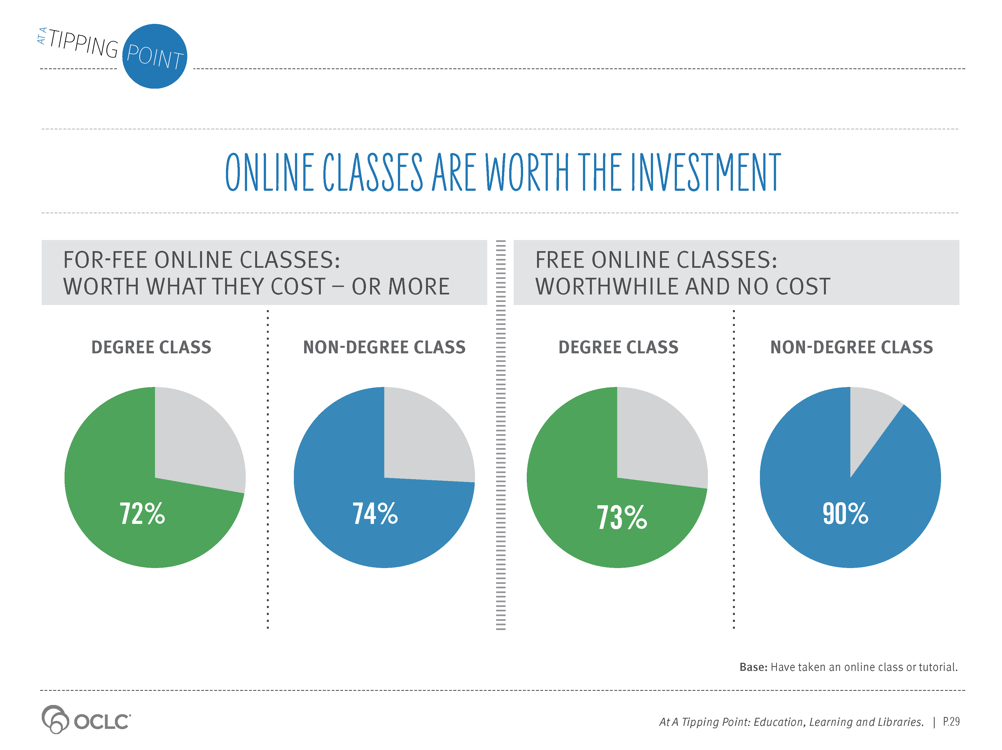
Notes:
Supporting Text From P.29
Whether free, or for a fee, about three-quarters or more of online learners feel that online learning is worth the investment of their time and their dollars.

Slide 33
Notes:
Supporting Text From P.30
Online learners are not only positive about their recent experiences but also believe that online learning will only continue to improve.
Perhaps influenced by the steady flow of improvements and advances experienced in other online services, such as commerce and social sites, the majority of the online learners surveyed expect both the quality and the popularity of online learning to continue to advance over the next three years.
Among just those who have taken a MOOC, 75% expect the quality of MOOCs will improve and 77% feel the popularity will increase in three years.

Slide 34
Notes:
Supporting Text From P.30
Even those who indicated that they have not participated in any online learning activities expressed optimism about the future of online learning. Nearly half or more of non-users expect online degree and non-degree classes to improve in both quality and popularity. Online classes toward a degree represent the group of classes most expected to increase in popularity and quality. Even though respondents indicated they were not too familiar with MOOCs, many also expect this new online learning format to grow in popularity and quality.

Slide 35
Notes:
Supporting Text From P.31
Nearly half (46%) of online learners expect that online learning will decrease the overall cost of higher education. The belief that online access will lower cost held consistent across age groups and income levels.

Slide 36
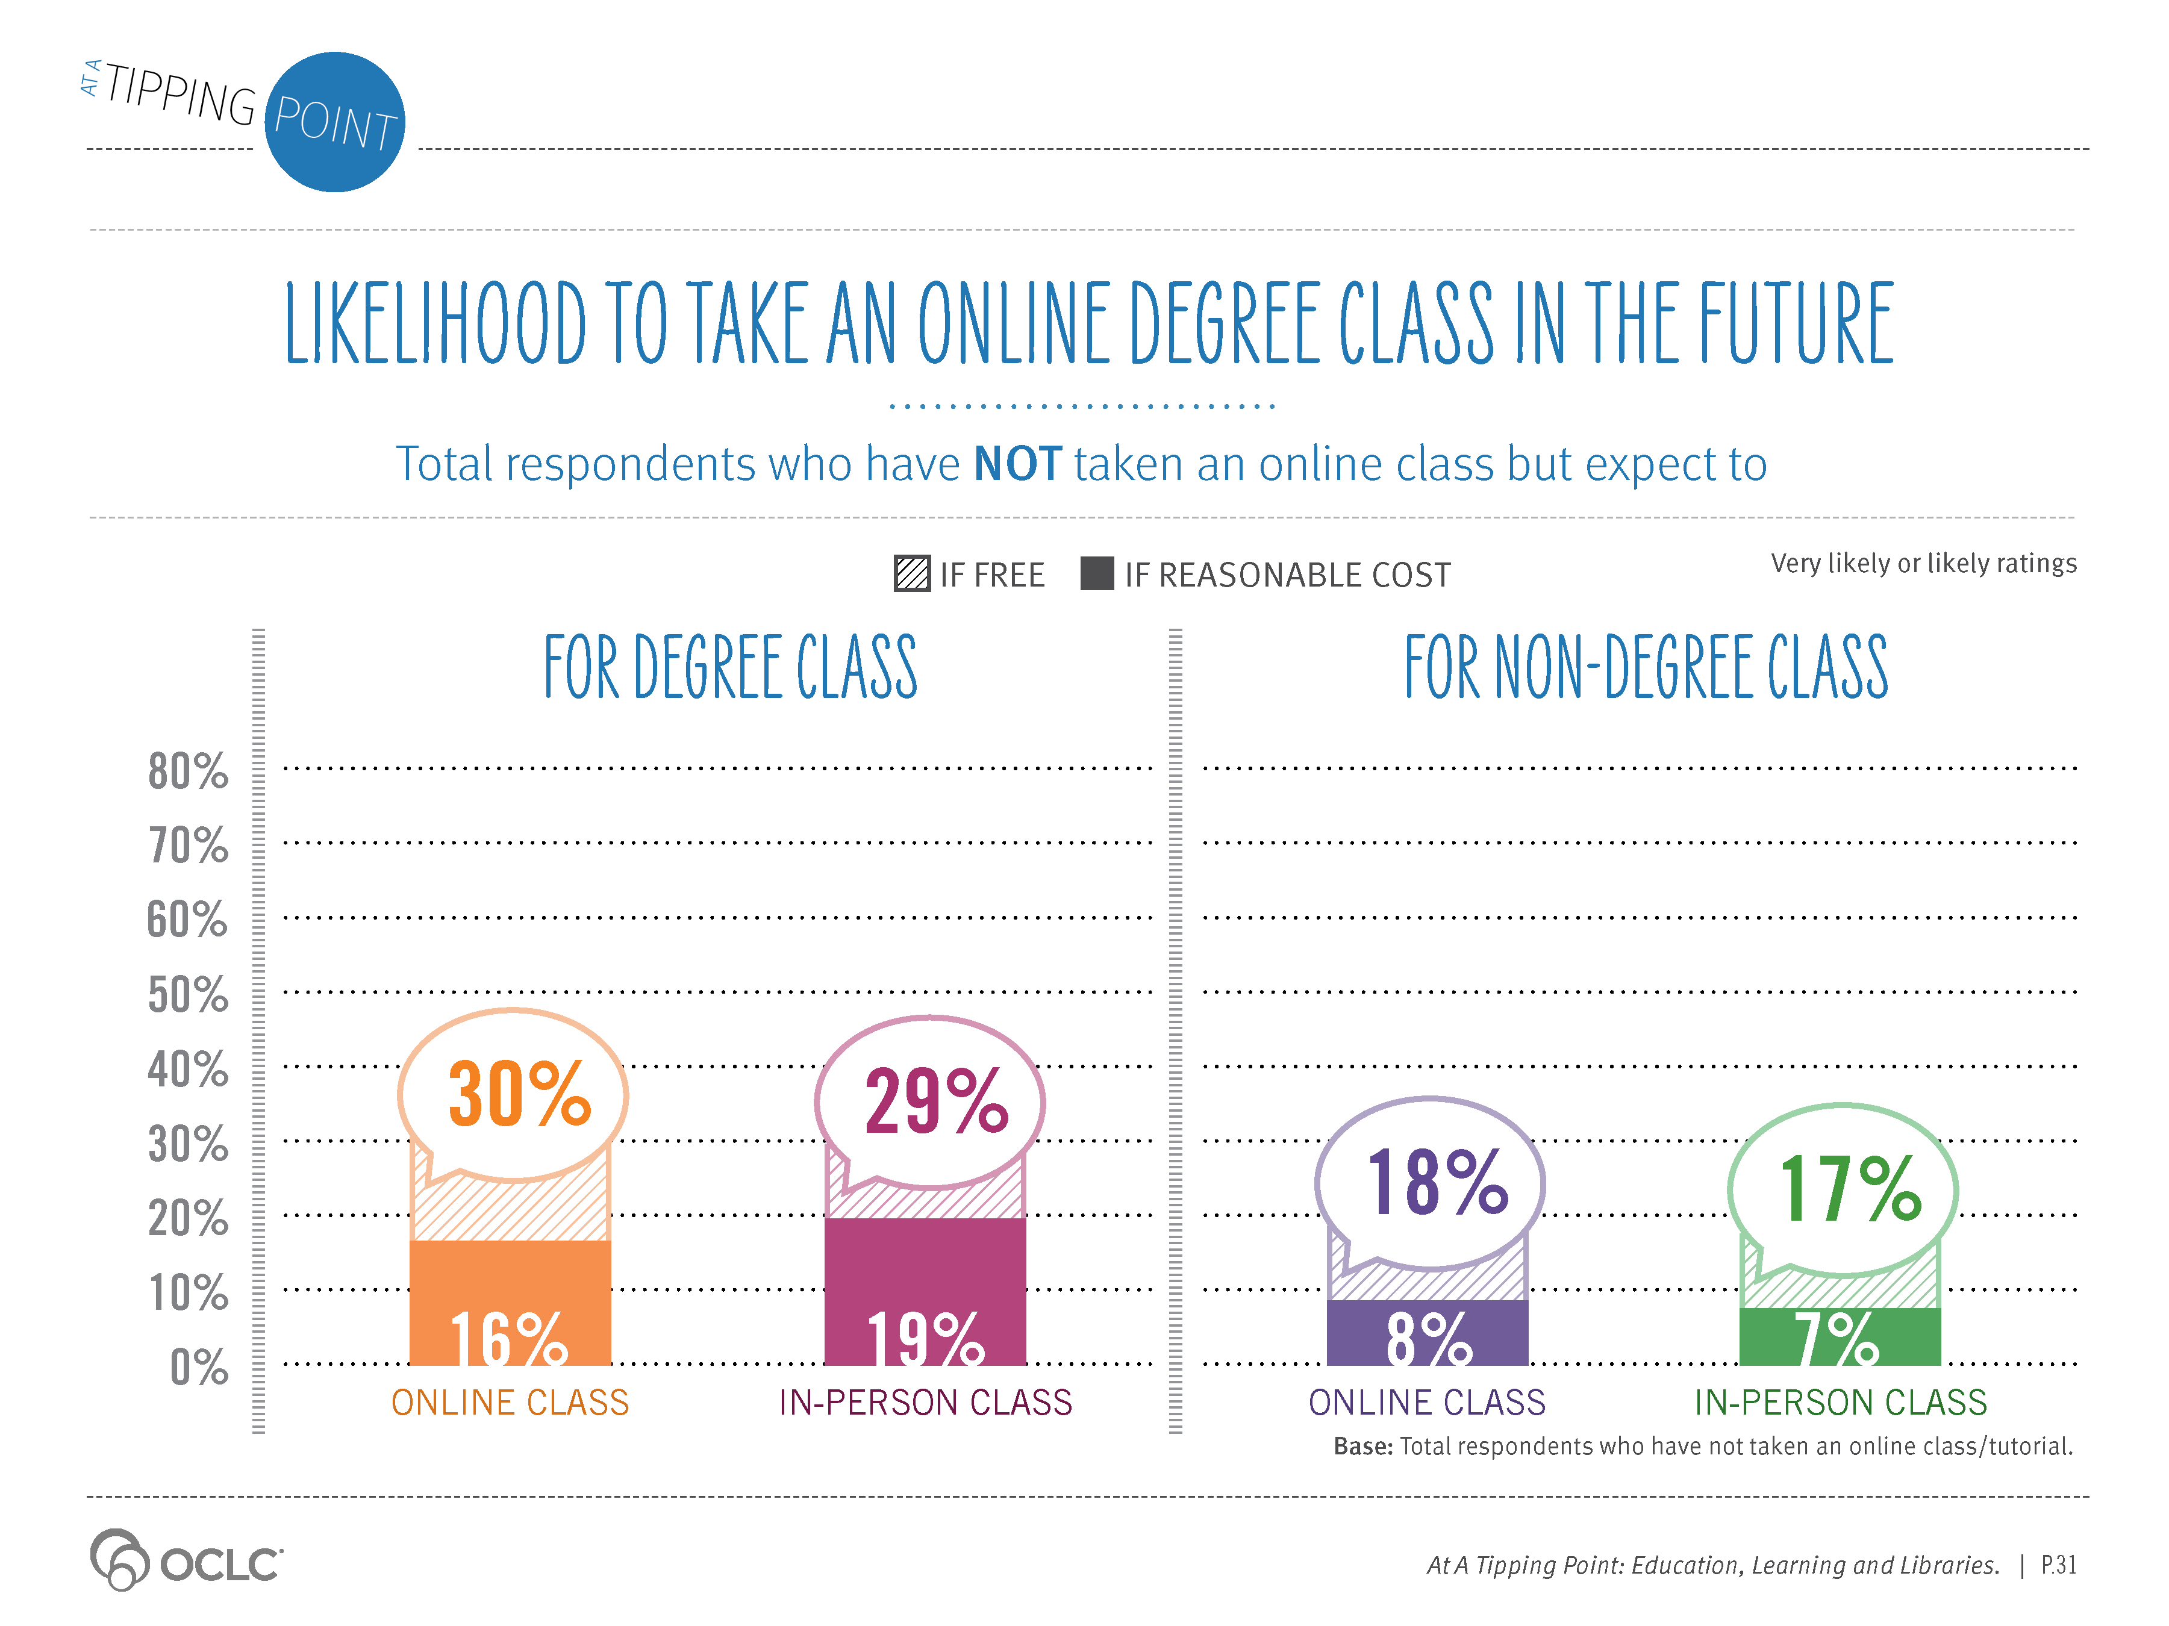
Notes:
Supporting Text From P.31
Respondents who have not yet tried taking online classes indicated that they are not too likely to take a college-level class for credit in the future. About a third anticipate trying one if offered for free; just under a fifth said they would participate if offered for a fee. These respondents were equal in their appetite for education via online and in-person classes.

Slide 37
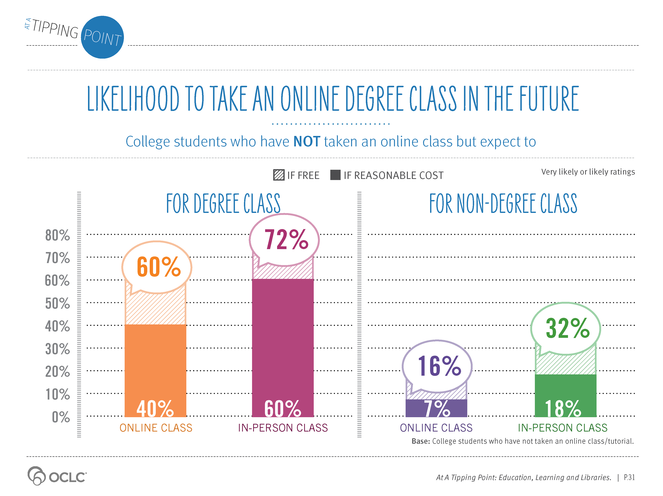
Notes:
Supporting Text From P.31
College students who have not yet taken any online classes were enthusiastic. Sixty percent (60%) indicate that they would take an online class for college credit if offered for free, and 40% would take one for a fee. They are less likely to take a class if not offered for credit.

Slide 38
Notes:
Supporting Text From P.32
Online learners predict that online classes will continue to grow in popularity and quality. In fact, almost half (46%) of current college students believe students will be taking at least half of their classes online within the next five years. And 68% of college students believe at least half of college classes will be online in the next decade.
Even those not currently enrolled in college believe online classes will soon be a significant part of the college experience. A third (35%) believe college students will take at least half of their classes online within the next five years.

Slide 39
Notes:
Summary view reflecting perceptions of all respondents

Slide 40
Notes:
Views of parents who are funding or planning to fund some portion of their child’s college education

Slide 41
Notes:
Views of college students who are funding some portion of their education

