Slide 1
WebDewey Number Building User Terms
November 2016

Slide 2
Overall workflow
Find starting number/span with add instruction, else find base number
Click Start/Add
System displays notation specified by add instruction or displays Table 1 (in final step)
As needed, user navigates to next number/span with add instruction or base number
Number building complete?
No
Yes
Verify the number is correct, click Save
User term box appears, select user terms
Edit term, click Update
User term needs to be changed?
Yes
Additional term needed?
No
No
Yes
Create additional term, click Add
Select term to set as caption
Save as institutional or personal visibility
Verify presence in the hierarchy
Contribute to Dewey Editors (optional)
If not contributed to Dewey Editors, new number visible only to institution or person

Slide 3
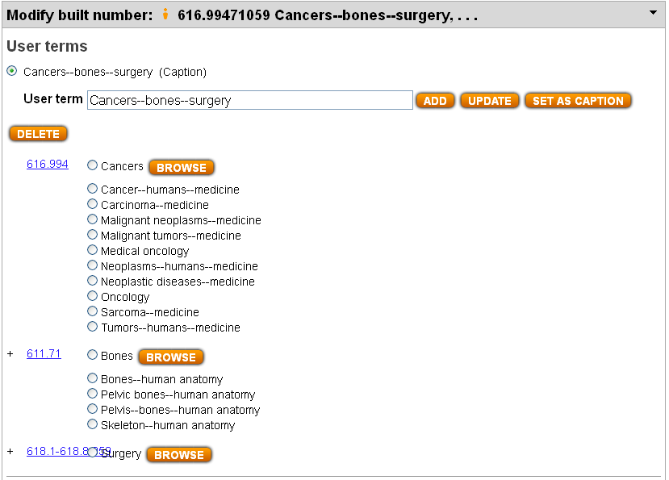
Default user term for 616.99471059 Bone cancer—surgery

Slide 4
Edit user term for 616.99471059 Bone cancer—surgery
Review default user term, which is based on captions.
Edit User term to match predominant pattern in Relative Index for similar works: Bone cancer—surgery
Click Update.
Edit User term again to match alternate pattern in Relative Index for similar works: Bone neoplasms—surgery
Click Add.

Slide 5
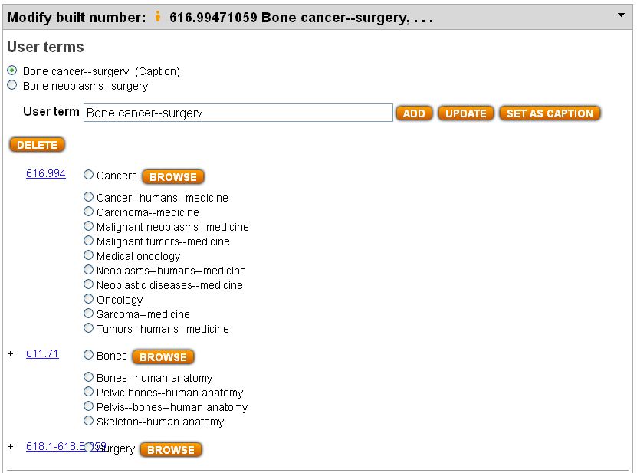
Result of editing user term for 616.99471059 Bone cancer—surgery

Slide 6
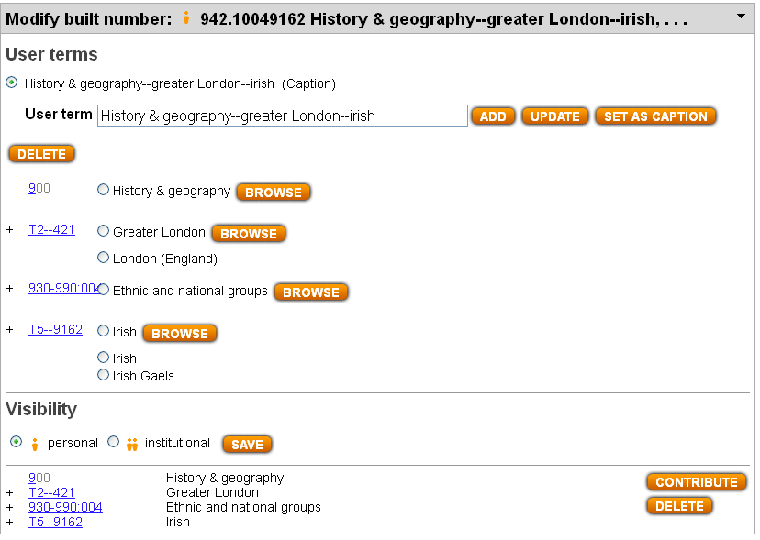
Default user term for 942.10049162 Irish in London (history, interdisciplinary treatment)

Slide 7
Edit user term for 942.10049162 Irish in London
Review default user term, which is based on captions.
Edit User term to match predominant pattern in Relative Index for similar works: Irish—London (England)
Tip for editing: use radio button for Relative Index entry “London (England)” to get correct MARC coding for geographic term; then place cursor at far left of User terms box and type: Irish--
Click Update.

Slide 8
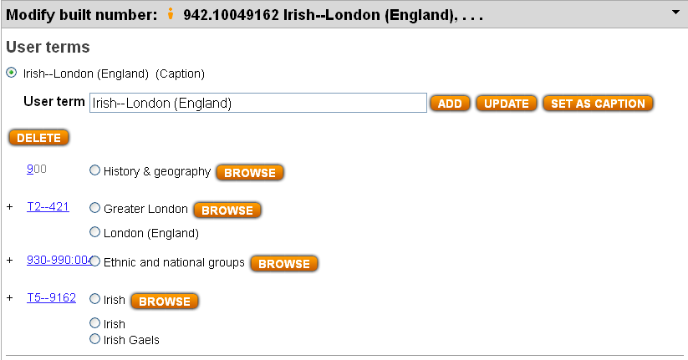
Result of editing user term for 942.10049162 Irish in London

Slide 9
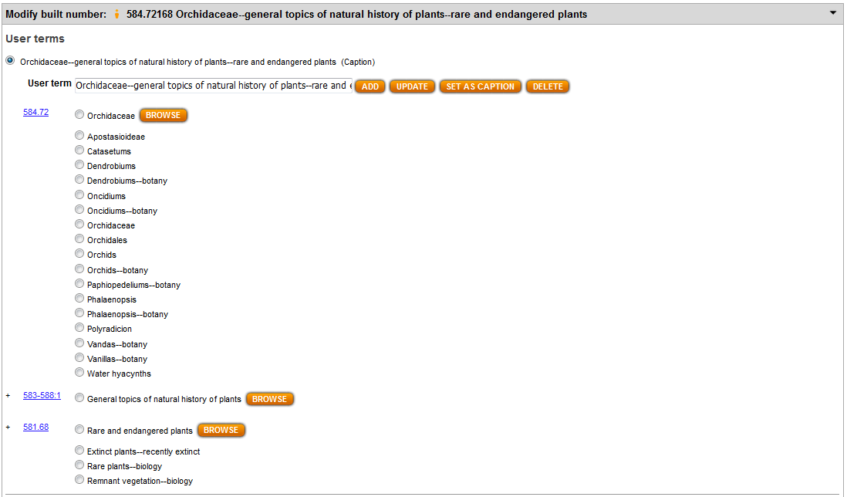
Default user term for 584.72168 Rare and endangered orchids

Slide 10
Edit user term for 584.72168 Rare and endangered orchids
Review default user term, which is based on captions.
Edit User term to match pattern in Relative Index for similar works: Rare Orchidaceae
Click Update.
Edit User term again to match pattern in Relative Index for similar works: Rare orchids
Click Add. Now let’s say you have changed your mind and want “Rare orchids” to be caption. Use radio button to select that term and click Set as Caption.

Slide 11
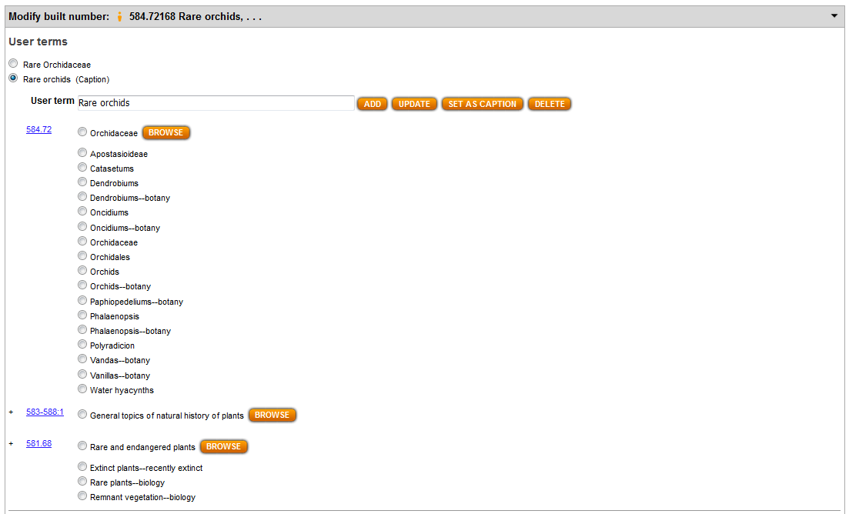
Result of editing user term for 584.72168 Rare and endangered orchids

