Slide 1
WebDewey Number Building Social science examples
November 2012

Slide 2
Overall workflow
Find starting number/span with add instruction, else find base number
Click Start/Add
System displays notation specified by add instruction or displays Table 1 (in final step)
As needed, user navigates to next number/span with add instruction or base number
Number building complete?
No
Yes
Verify the number is correct, click Save
User term box appears, select user terms
Edit term, click Update
User term needs to be changed?
Yes
Additional term needed?
No
No
Yes
Create additional term, click Add
Select term to set as caption
Save as institutional or personal visibility
Verify presence in the hierarchy
Contribute to Dewey Editors (optional)
If not contributed to Dewey Editors, new number visible only to institution or person

Slide 3
Process of building 305.831081 German Brazilians
Navigate to this number/span | Click | Number built so far | Caption of last number/notation added
305.81-305.89 | Start | 305.8 | Specific . . . national groups
T5—31 | Add | 305.831 | Germans
T2—81 | Add | 305.831081 | Brazil

Slide 4
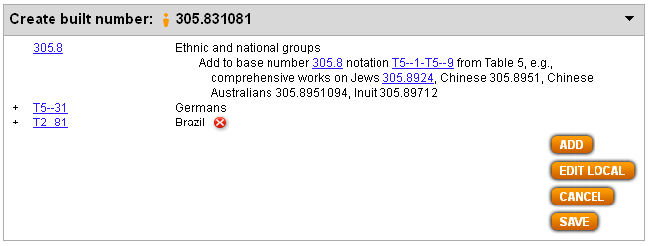
Results of process of building 305.831081 German Brazilians

Slide 5
Process of building 333.73616 Conservation of arid lands
Navigate to this number/span | Click | Number built so far | Caption of last number/notation added
333.736 | Start | 333.736 | Arid lands
333.7-333.9:16 | Add | 333.73616 | Conservation and protection

Slide 6
Results of process of building 333.73616 Conservation of arid lands

Slide 7
Process of building 363.19464 Inspection and testing of drugs and medicines
Navigate to this number/span | Click | Number built so far | Caption of last number/notation added
363.194 | Start | 363.194 | Drugs and medicines
362-363:64 | Add | 363.19464 | Inspection and testing

Slide 8
Results of process of building 363.19464 Inspection and testing of drugs and medicines

