Slide 1
WebDewey Number Building Law examples
November 2012

Slide 2
Overall workflow
Find starting number/span with add instruction, else find base number
Click Start/Add
System displays notation specified by add instruction or displays Table 1 (in final step)
As needed, user navigates to next number/span with add instruction or base number
Number building complete?
No
Yes
Verify the number is correct, click Save
User term box appears, select user terms
Edit term, click Update
User term needs to be changed?
Yes
Additional term needed?
No
No
Yes
Create additional term, click Add
Select term to set as caption
Save as institutional or personal visibility
Verify presence in the hierarchy
Contribute to Dewey Editors (optional)
If not contributed to Dewey Editors, new number visible only to institution or person

Slide 3
Process of building 346.71086 Insurance law of Canada
Navigate to this number/span | Click | Number built so far | Caption of last number/notation added
346.3-346.9 | Start | 346 | Specific jurisdictions and areas
T2—71 | Add | 346.71 | Canada
346.3-346.9:01-09 | Add | 346.71 | Topics of private law
346.086 | Add | 346.71086 | Insurance

Slide 4
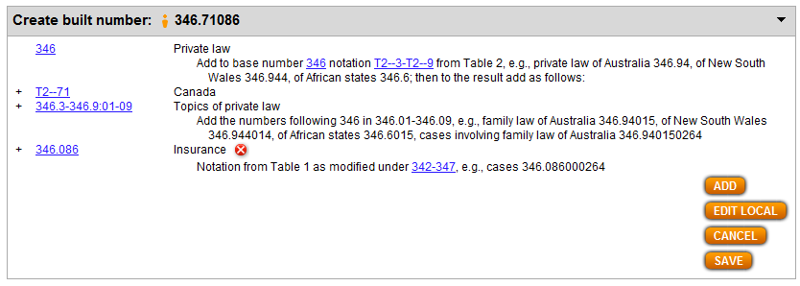
Results of process of building 346.71086 Insurance law of Canada

Slide 5
Process of building 343.08710261 Foreign trade—law—agricultural products—treaties
Navigate to this number/span | Click | Number built so far | Caption of last number/notation added
343.0871-343.0875 | Start | 343.087 | Specific commodities
381.41 | Add | 343.0871 | Products of agriculture
342-347:0261 | Add | 343.08710261 | Treaties

Slide 6
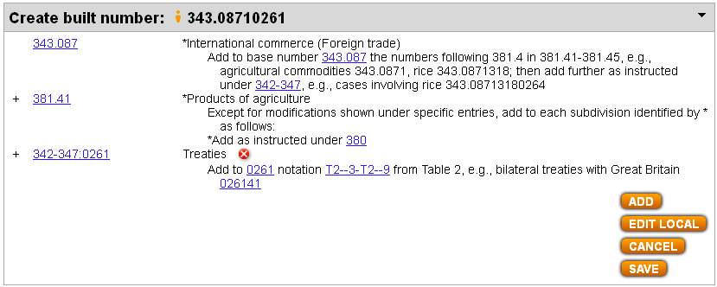
Results of process of building 343.08710261 Foreign trade—law—agricultural products—treaties

Slide 7
Process of building 344.017613875 International labor law for ocean transportation
Navigate to this number/span | Click | Number built so far | Caption of last number/notation added
344.011-344.018 | Start | 344.01 | Specific aspects of labor
331.761001-331.761999 | Add | 344.01761 | Subdivisions for industries and occupations . . .
387.5 | Add | 344.017613875 | Ocean transportation

Slide 8
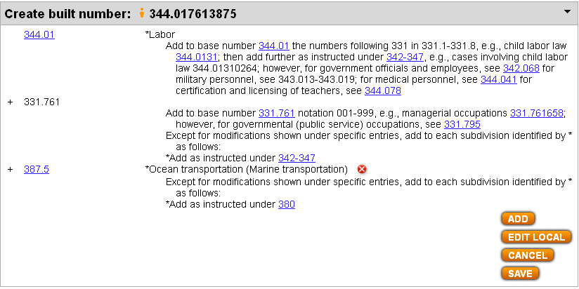
Results of process of building 344.017613875 International labor law for ocean transportation

