Slide 1
WebDewey Number Building History and travel examples
November 2012

Slide 2
Overall workflow
Find starting number/span with add instruction, else find base number
Click Start/Add
System displays notation specified by add instruction or displays Table 1 (in final step)
As needed, user navigates to next number/span with add instruction or base number
Number building complete?
No
Yes
Verify the number is correct, click Save
User term box appears, select user terms
Edit term, click Update
User term needs to be changed?
Yes
Additional term needed?
No
No
Yes
Create additional term, click Add
Select term to set as caption
Save as institutional or personal visibility
Verify presence in the hierarchy
Contribute to Dewey Editors (optional)
If not contributed to Dewey Editors, new number visible only to institution or person

Slide 3
Process of building 941.203 History of Northeastern Scotland during the 14th century
Navigate to this number/span | Click | Number built so far | Caption of last number/notation added
941.201-941.208 | Start | 941.20 | (Northeastern Scotland) Historical periods
941.103 | Add | 941.203 | (Scotland ) 1314-1424

Slide 4
Results of process of building 941.203 History of Northeastern Scotland during the 14th century

Slide 5
Process of building 918.10466 Travel in Brazil in 2012
Navigate to this number/span | Click | Number built so far | Caption of last number/notation added
913-919 | Start | 91 | Geography of and travel in . . .
T2—81 | Add | 918.1 | Brazil
913-919:041-049 | Add | 918.104 | (Travel) Historical periods
981.066 | Add | 918.10466 | 2011-

Slide 6
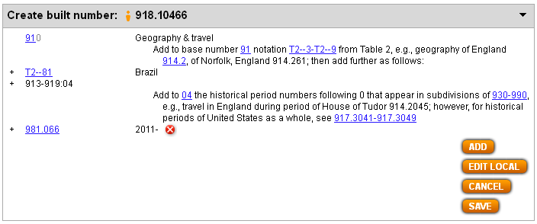
Results of process of building 918.10466 Travel in Brazil in 2012

Slide 7
Process of building 949.8004924 History of Jews in Romania
Navigate to this number/span | Click | Number built so far | Caption of last number/notation added
930-990 | Start | 9 | History . . .
T2—498 | Add | 949.8 | Romania
930-990:0041-0049 | Add | 949.8004 | Specific ethnic and national groups
T5—924 | Add | 949.8004924 | Hebrews, Israelis, Jews

Slide 8
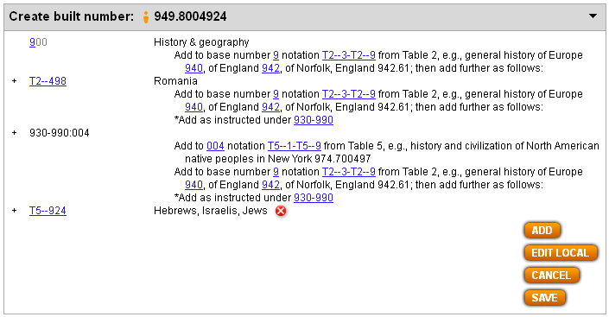
Results of process of building 949.8004924 History of Jews in Romania

