Slide 1
Amplifying Metadata as Entities to Support Multilingualism
Karen Smith-Yoshimura, OCLC

Slide 2
Linked Data Wikibase Prototype:
“Project Passage”

Slide 3
About the Passage Pilot
Ran from December 2017 through September 2018
16 OCLC Member libraries participated
The objective was to evaluate a framework for reconciling, creating, and managing bibliographic and authority data as linked data entities and relationships
The pilot Wikibase instance included 1.2M entities, mostly data representing overlaps between Wikidata, VIAF, and WorldCat

Slide 4
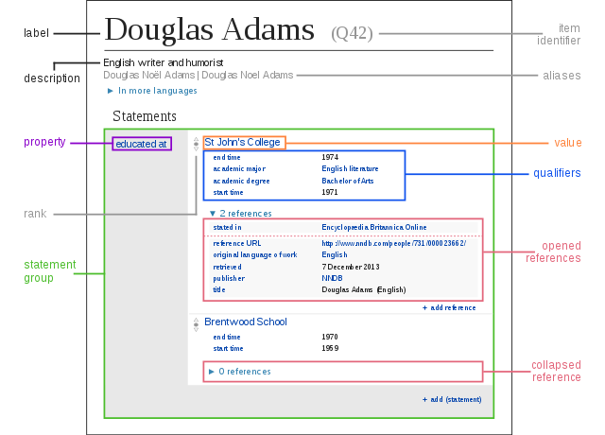
Entity-based
Create linked data without
needing to learn its technical underpinnings

Slide 5
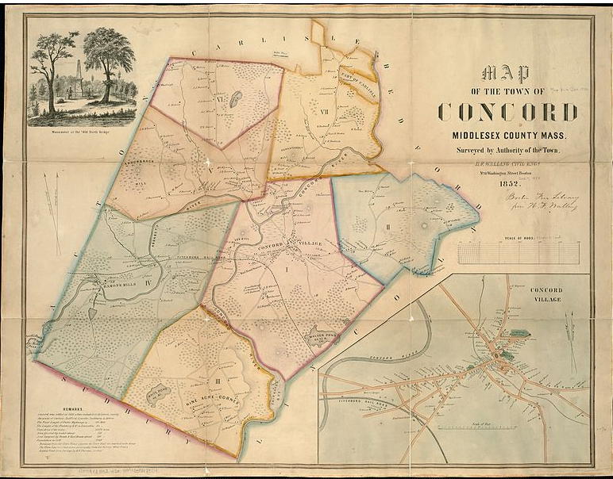
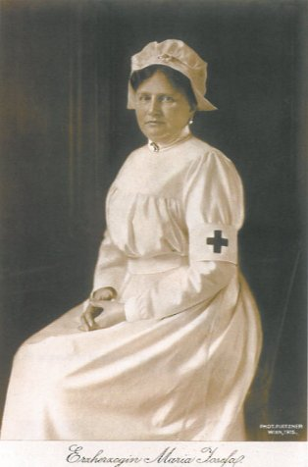

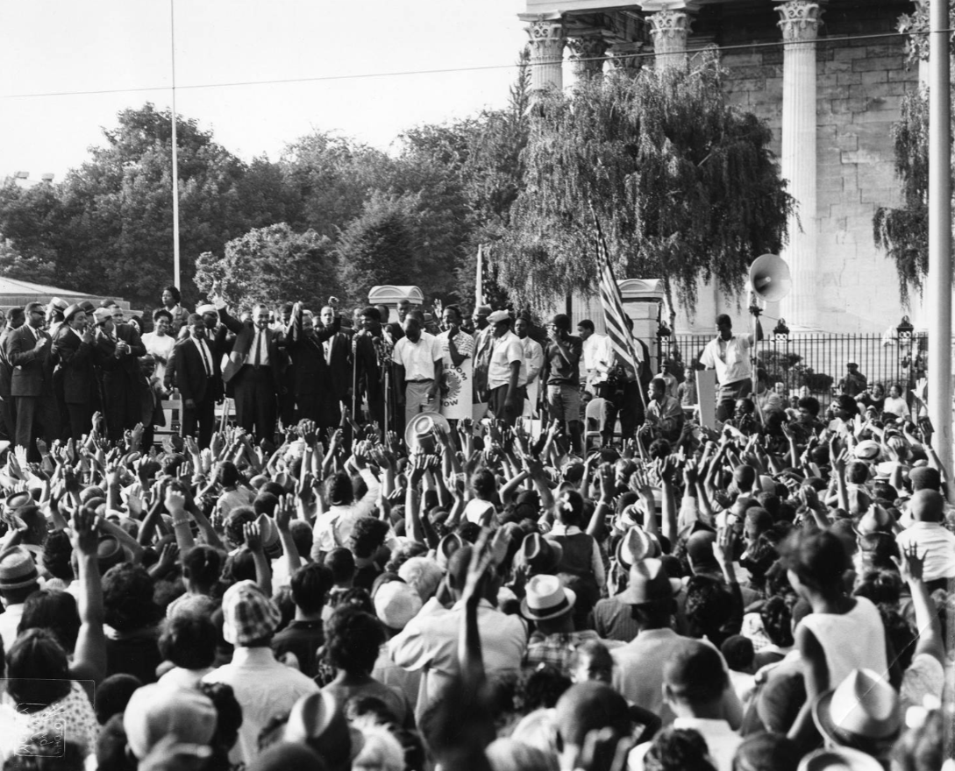
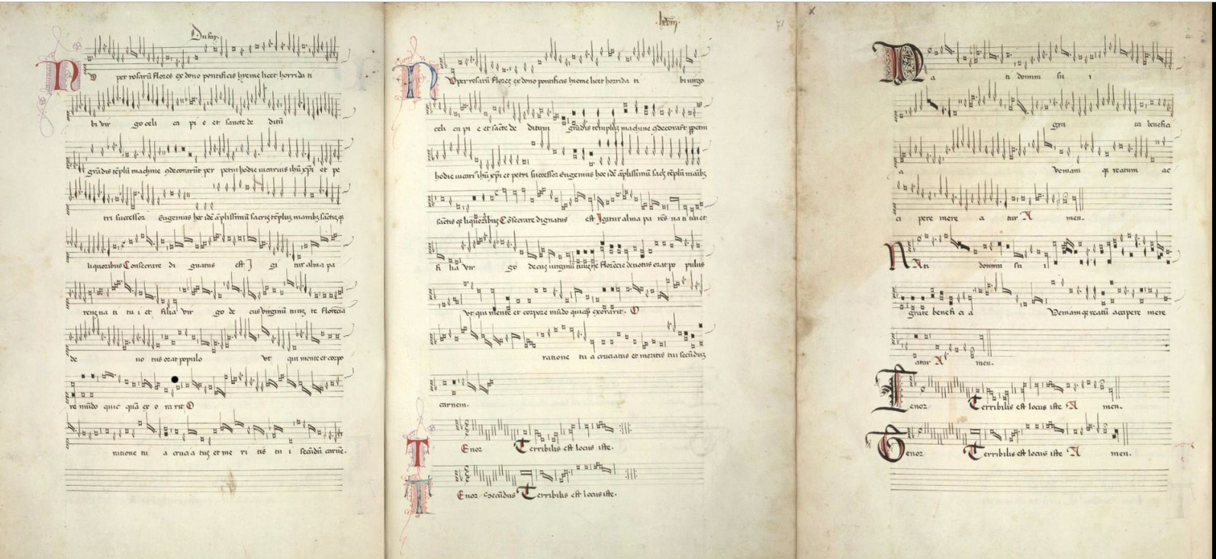
Passage Pilot Partners Case Studies
Notes:
During weekly “office hours”, Passage Pilot Partners showcased some of the case studies they were working on in describing resources in the Wikibase structure, highlighting the issues they encountered which often led to additional features or properties. These are some of them: digitized map, a poster for an event, a musical work associated with an event, a digitized postcard, and a photo within an archival collection. We all learned a lot! And it was so much fun!

Slide 6
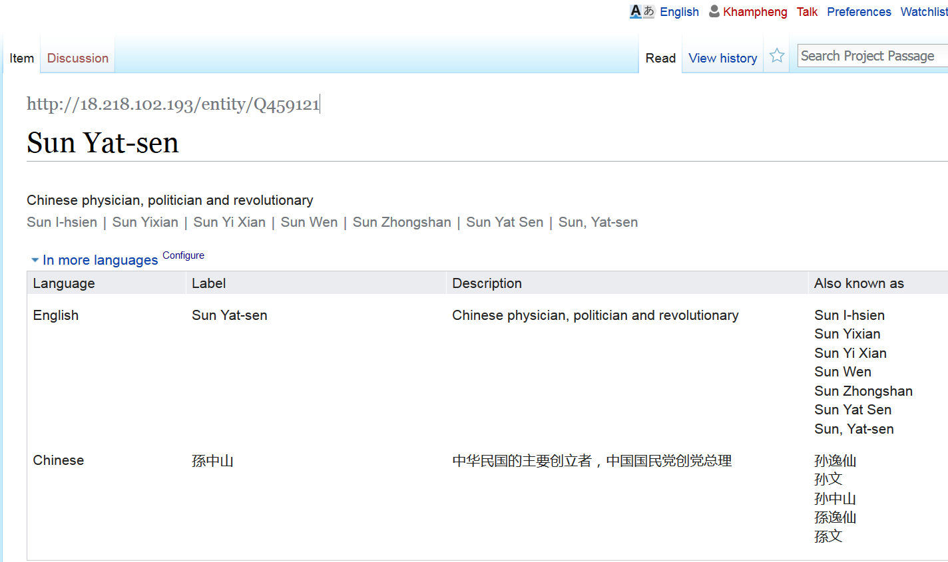
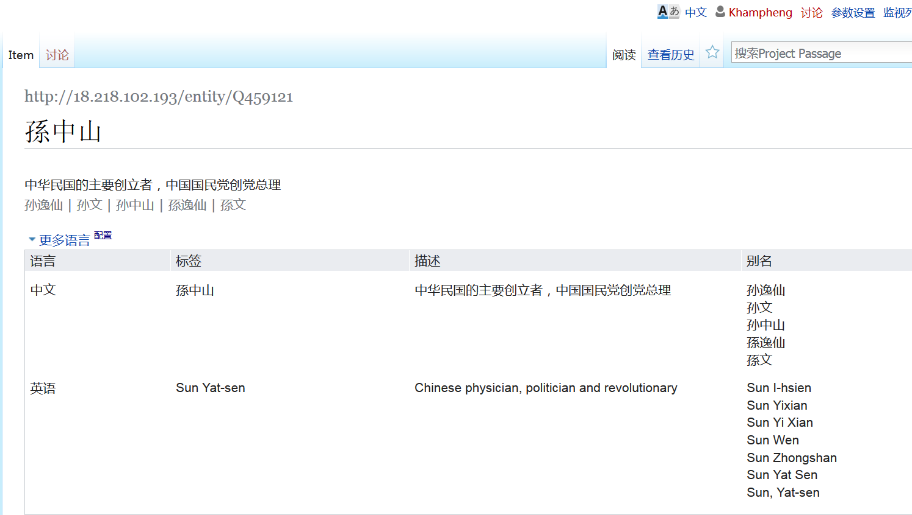
Embeds multilingualism
Courtesy of Xiaoli Li, UC Davis
Notes:
The same entity—with the same identifier—can be described and displayed in different languages, in this case simplified Chinese. No need for someone adding Chinese descriptions to add transliterations as they would be handled by the descriptions created in other languages.

Slide 7
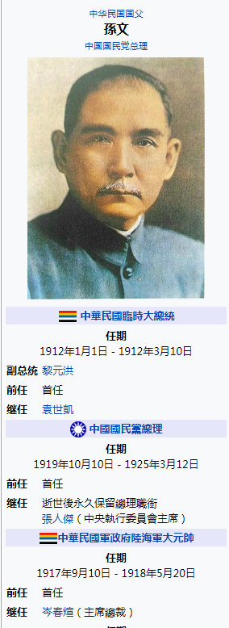
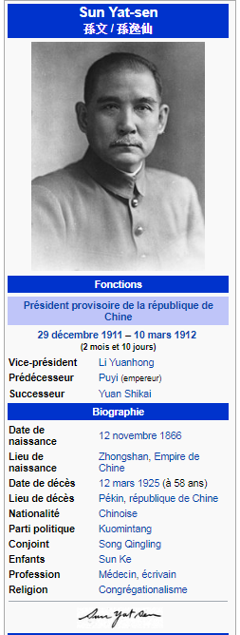
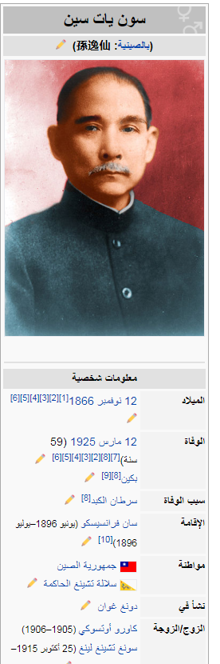
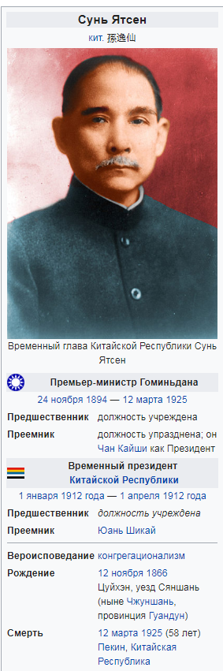
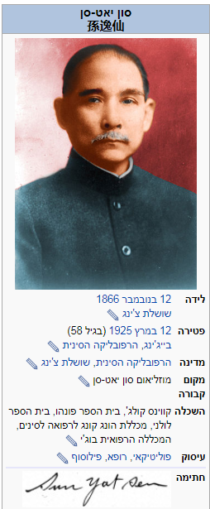
Notes:
Here we can see the effects of structured metadata associated with the same entity. These are Wikipedia information boxes with the data represented in Wikidata – Chinese, French, Russia, Arabic, and Hebrew. All are tied to the same Wikidata identifier--representing the same entity—but the information is presented in the preferred language and script of the user.

Slide 8
Translations
Notes:
I’d like to focus on the case studies we did on translations. The cream of the world’s cultural and knowledge heritage is shared by being translated – it’s how we learn about other cultures and how other cultures learn about us. WorldCat contains many rich cataloguing records for these translations, and our Project Passage participants had “homework assignments” to enter works and their translations into our Wikibase sandbox.

Slide 9
源氏物語
Ιλιάδα
紅樓夢
The Iliad
Dream of the Red Chamber
زقاق المدق
Midaq Alley
ঘরে বাইরে
The Tale of Genji
The Home and the World
Война и миръ
דער בעל-תשובה
War and Peace
The Penitent
સત્યના પ્રયોગો અથવા આત્મકથા
The Story of My Experiments with Truth
[Gandhi autobiography]
Notes:
Translations are a time-tested channel for learning about other cultures – a key method for “knowledge transfer.”. Only 7% of the unique authors in WorldCat have works that have been translated into at least one other language. This is the “short head” [as opposed to the “long tail” ] of works that have the most impact on readers worldwide.
I’ve listed here a few titles—some classic, some written by Nobel Prize laureates of literature— in the original language and script. Likely you’ve heard of all or most of them? But probably in another language. (click).

Slide 10
A work and its translations: a model
Title: Sein und Zeit
Language: German
Author: Martin Heidegger
Created: 1927
Title: 존재 와 시간 Language: Korean
Translator: 전 양범
Date: 1989
IsTranslationOf:
Title: 存在와時間
Language: Korean
Translator: 鄭明五, 鄭淳喆
Date: 1972
IsTranslationOf:
Title: Being and Time
Language: English
Translator: Joan Stambaugh
Date: 2010
IsTranslationOf:
schema:translationOfWork
Title: Время и бытие
Language: Russian
Translator: Владимир Вениамович
Бибихин
Date: 1993
IsTranslationOf:
Title: 存在と時間
Language: Japanese
Translator: 細谷貞雄
Date: 1997
IsTranslationOf:
Notes:
This is the model we used for representing a work and its associated translations with some translations of Heidegger’s Sein und Zeit, along with a few key properties. Each translation has a “translationOfWork” relationship to the original German work, indicated by the red arrows. There can be multiple translations into the same language. In this case, we’ve shown two Korean translations, one with hangul only and one with hangul and hanja, published in different years and with different translators. The earlier translation has two translators.
We identified 570 translations in 33 languages for Heidegger’s Sein und Zeit in WorldCat.

Slide 11
Wikibase Statements
Work
Title (original title)
Language (of original)
Instance of: (Book)
Author(s) (of original)
Earliest known publication date
Translation
Title (translated title)
Language (of translation)
Instance of: (Translation)
Translator(s)
Earliest known publication date
Translated from
Notes:
We translated that model into a desired minimum set of statements for our Project Passage participants.

Slide 12
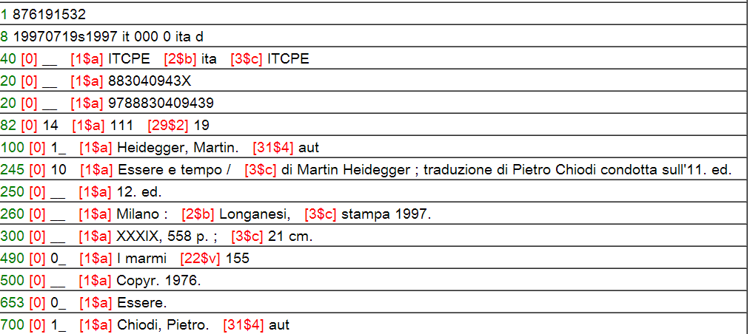
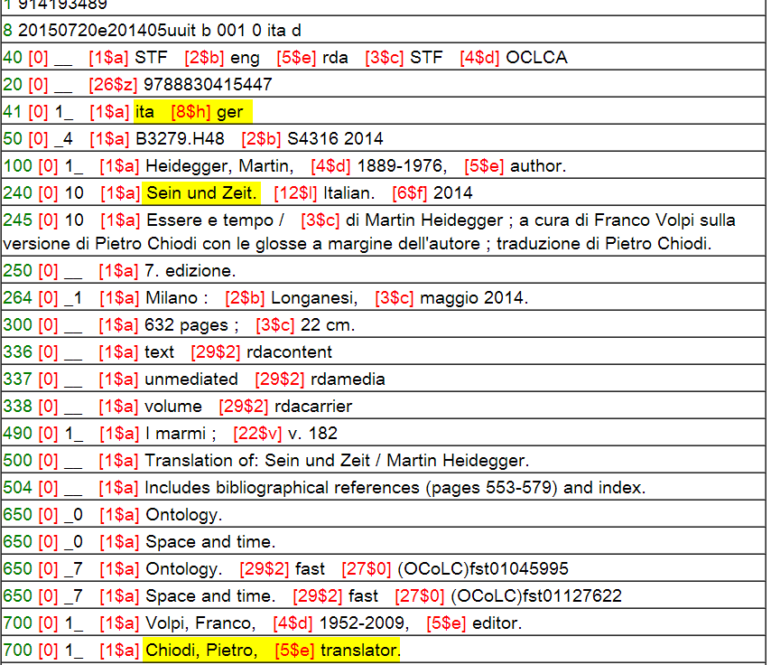
No original language
No original title
Chiodi translator, not author
Notes:
I mentioned earlier that we imported entities from WorldCat to populate our Project Passage Wikibase. WorldCat’s metadata can identify translations of works. But it’s often not easy. In this first record, there is no indication what the original language was, or the original title. And although Chiodi is identified as a translator in the statement of responsibility, the added entry incorrectly identifies him as an author. <click> This is a much richer record for a later Italian translation, also by Chiodi. Here the original language is identified, as well as the original title. There is an added entry for Chiodi, correctly identified as the translator. We can consider this a “gold standard” for representing a translation in MARC.
As long as some records accurately reflect this information, then we can assert the correct relationships for the records that lack the information. However, there are many translations where we are not able to do this from WorldCat alone.

Slide 13
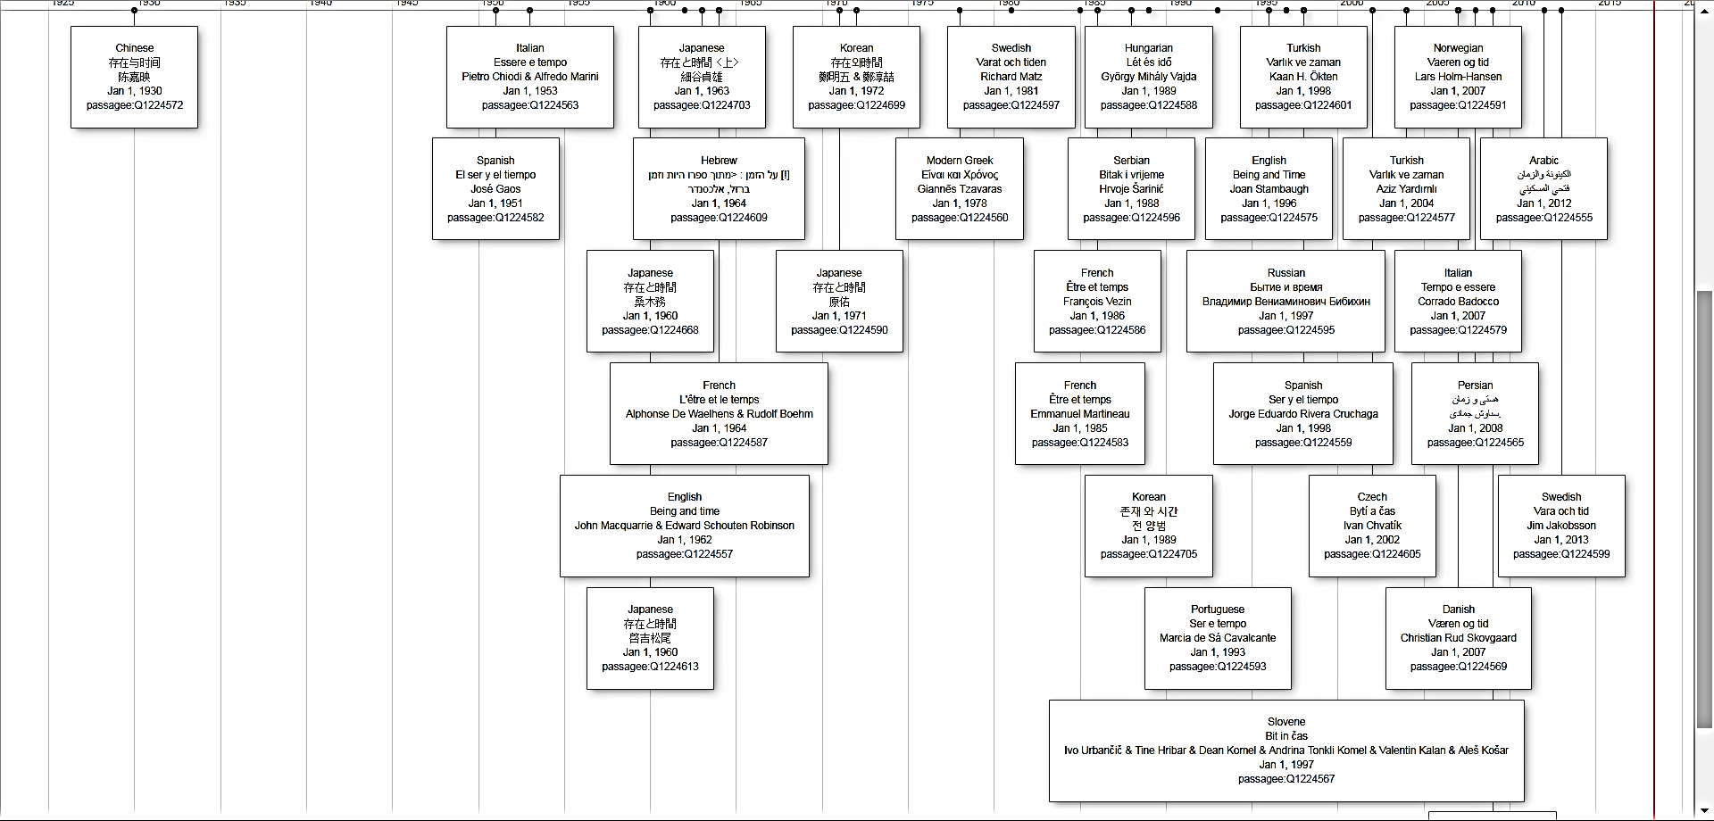
Translations of Sein und Zeit
Notes:
These are all the Passage entities retrieved by a SPARQL query that had a “ “Translated from:” statement for Sein und Zeit displayed in a timeline.. I chose to display in a timeline the statements for Language of the translation, the translated title, the translators, and the date. <click> The three circled here are for French translations, each by a different translator. Some translations are better than others, which is why it’s so crucial to identify the respective translators. This visualization far exceeds what we can accomplish with raw MARC records.

Slide 14
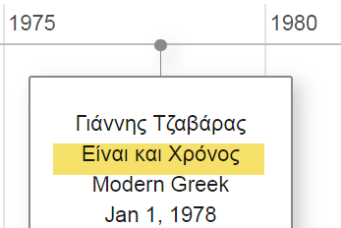

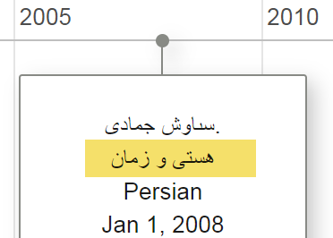
Non-Latin scripts imported from Wikidata
Notes:
Currently there are over 30 million records in WorldCat with non-Latin scripts for 34 different languages. But 76% of them are for Chinese-Japanese-Korean; 29 non-Latin script languages combined total only 1% of the total. Romanization only predominates in WorldCat records for most languages written in non-Latin scripts.
Two of those languages are Greek and Persian. WorldCat has records for these translations of Sein und Zeit, but only in romanization. The two entries we saw on the earlier slide have Greek and Persian scripts because we ingested them from Wikidata.

Slide 15
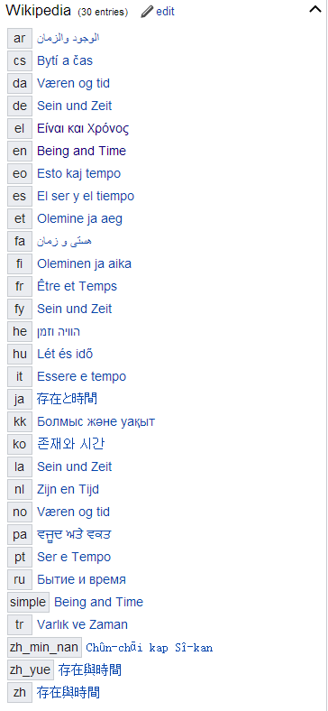
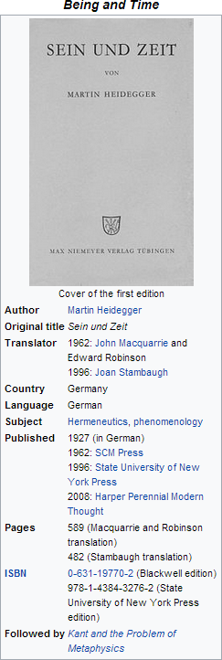
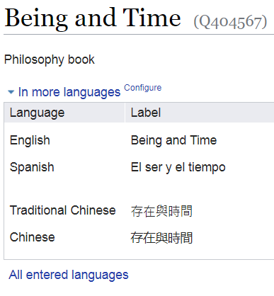

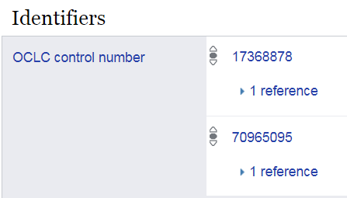
These strings represent
Wikipedia entries in multiple
languages. They imply the
existence of translations.
So the Greek title…
can be issued as a search
against WorldCat to discover a
translation. Since one was
found, the Greek script can replace the transcription…
…
Einei kai chronos
…which isn’t useful to Greek readers.
Wikipedia “work”
…in Wikidata
Multilingual info
Extractable knowledge
Notes:
The Wikidata page for Heidegger’s Sein und Zeit includes the labels for each translation in the writing system of that language. We can infer with high confidence these are all “TranslationOfWork” even if the WorldCat record does not include the original title. The “quick facts” are included in some of the Wikipedia pages, including the date of the original publication, the original title (in the original script) and sometimes a few translators.
We can enrich the information we extract from WorldCat by including the original scripts of translations that are in WorldCat only in romanized form, and find translations that lack the original title but are represented in Wikidata.
But WorldCat has far more titles – and more translators identified – than Wikidata does.
For the subset of the often-translated titles represented in Wikidata, our goal: is to line up the corresponding Wikidata and WorldCat descriptions.
Slide from Jean Godby.

Slide 16
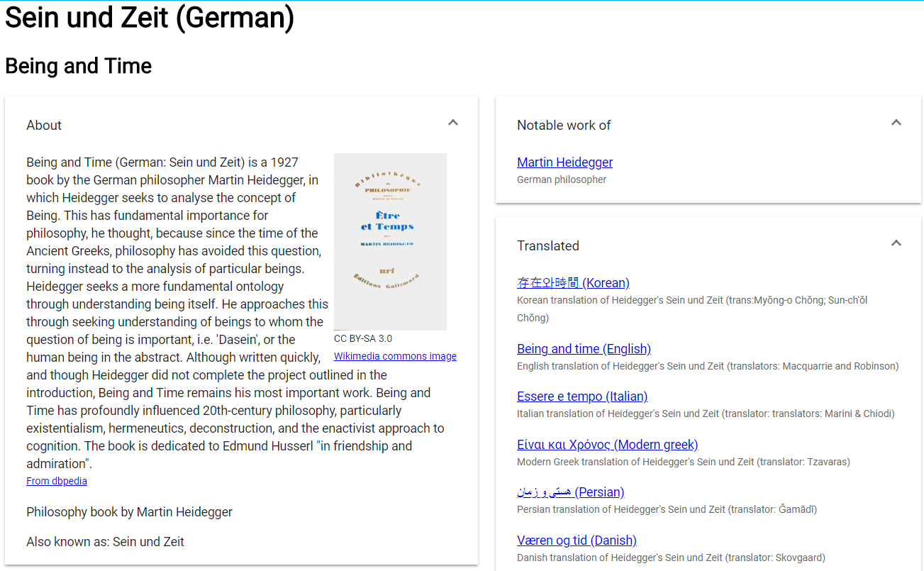
Discovery layer crucial
Notes:
During the Passage Project we learned how crucial a discovery layer was – not just for end users, but to the metadata creators to verify all the inverse relationships were indeed represented. In this case, we show that the original work, Sein und Zeit was translated into other languages. The discovery layer we created during the Passage project also pulled in images from Wikimedia commons and descriptions from DBpedia. And it served to remind us that the free text descriptions we’re used in putting into our MARC records could be pulled in from other sources instead in a linked data environment.

Slide 17
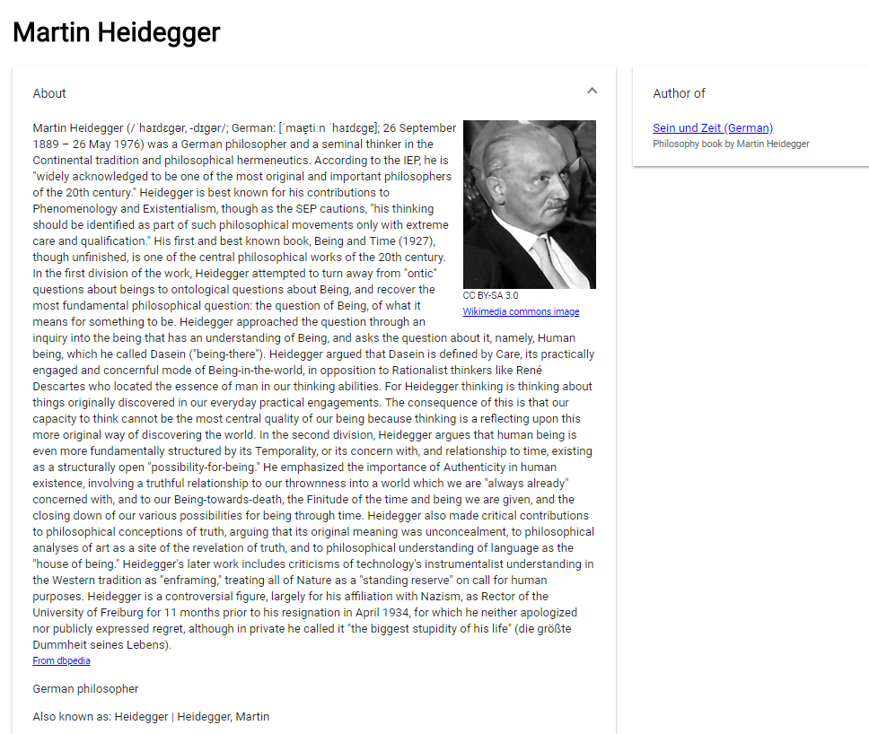
Notes:
The Wikibase structure that underlies both Wikidata and our Project Passage provides a way to store structured data as liked data entities and their relationships. So from the earlier entry I can click on the author, Martin Heidegger, and retrieve this biography from DBpedia and this photo from Wikimedia commons. Another example of “knowledge transfer.”

Slide 18
Karen Smith-Yoshimura
OCLC
smithyok@oclc.org
@KarenS_Y

