Slide 1
Research Libraries –
A global system
A shared future
James Michalko
Vice President, OCLC Research
RLUK Meeting, Edinburgh
12 November 2010
With thanks to OCLC colleagues Lorcan Dempsey and Constance Malpas

Slide 2
Two words
"Stressfully
heartening"

Slide 3
Disclaimer
Simplistic
This presentation
Content
Time is short.
Perspective is research libraries
All examples are U.S.A perspective

Slide 4
Stipulated
The network has reconfigured whole industries
  Travel, News, Book Retailing
The network is now the first option for researchers and learners
Don’t yet know how it will reconfigure the University
The library is a service unit whose success is tied to its impact on the university’s mission and goals
The network has already impacted the university library
  changed the value of physical book collections and library space
  changed the relevance of the library assets and services to the University’s outputs
What it will mean to reconfigure the library within the University?

Slide 5
the stage set – Diamond (Cannell)
Library as central service for University goals
  Needs of students and researchers control
  Sharing of services dictated
  Availability in 21st century timetables expected
Provide books wherever desk happens to be
Journals – licensing and open access
Special Collections – digital and physical
Grey literature – critical and needs shared service
Data – specialist area that needs shared service and expertise

Slide 6
the stage set – Sykes
Cost cutting or greater investment?
  cut what? from where?
Work together to achieve efficiency and effectiveness
  Shared Services
  Benchmarking
Stay the same
  Preservation
    of what?
  Special Collections
  Equity of access

Slide 7
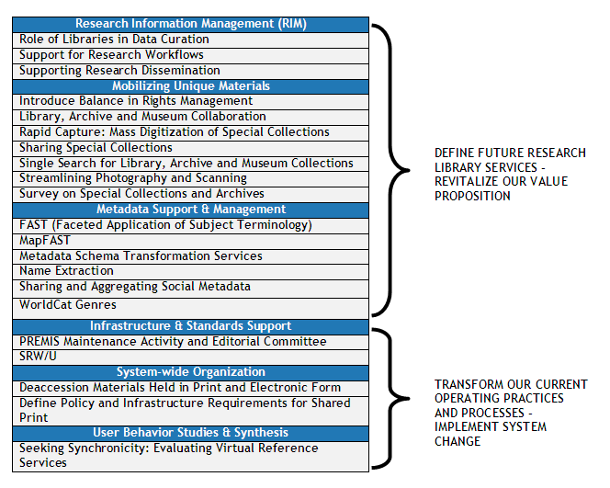
OCLC Research

Slide 8
Reconfiguration
Dictated
by change in academic print collections
accelerated by fiscal exigencies
Impact bounded by
what gets done where
mutual changes in traditional processes and practices
overt reliance on shared structures and services

Slide 9
Academic Collections
Disclaimer
  Based on USA – the forecast here may be very different
Notes:
Now let me turn to the focus of my talk. Once again note that my perspective is from academic libraries and the USA.

Slide 10
Change in Academic Collections
Shift to licensed electronic content is accelerating
  Research journals – a well established trend
  Scholarly monographs – in progress
Print collections delivering less (and less) value at great (and growing) cost
  Est. $4.25 US per volume per year for on-site collections
  Library purchasing power decreasing as per-unit cost rises
Special collections marginal to educational mandate at many institutions
  Costly to manage, not (always) integral to teaching, learning
Notes:
10

Slide 11
An Equal and Opposite Reaction
As an increasing share of library spending is directed toward licensed content . . .
Pressure on print management costs increases
Fewer institutions to uphold preservation mandate
Stewardship roles must be reassessed
Shared service requirements will change
Notes:
11

Slide 12
What’s driving this change?
Erosion of library value proposition in the academic sector
institutional reputation no longer determined (or even substantially influenced) by scope, scale of local print collection
Changing nature of scholarly record
research, teaching and learning embedded in larger social and technological networks; new set of curation challenges for libraries
Format transition; mass digitisation of legacy print
Web-scale discoverability has fundamentally changed research practices; local collections no longer the center of attention
Notes:
12

Slide 13
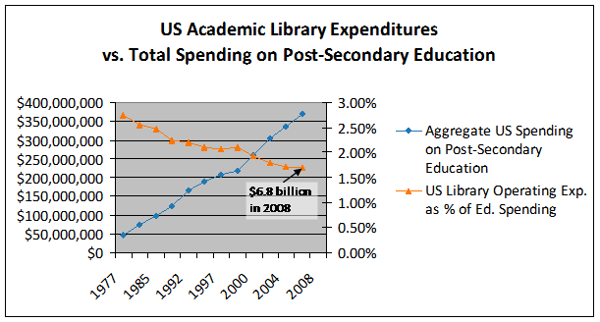
Declining Investment in Academic Libraries (US)
If this trend continues library allocations will fall below 0.5% by 2015.
Derived from : US Dept of Education, NCES, Academic Libraries Survey, 1977-2008

Slide 14
Attention Switch: from Print to Electronic (US)
You are here
Derived from US Dept of Education, NCES, Academic Libraries Survey, 1998-2008
Notes:
14

Slide 15
In the US, a tipping point …
Majority of research libraries shifting toward
e-centric acquisitions, service model
center of gravity
Harvard
Yale
Shrinking pool of libraries with mission and resources
to sustain print preservation as ‘core’ operation
Derived from ARL Annual Statistics, 2007-2008
Notes:
15

Slide 16
… the books have left the building
In North America, +70M volumes off-site (2007)
~30-50% of print inventory at many major universities
Growth in library storage infrastructure
Derived from L. Payne (OCLC, 2007)
Notes:
16

Slide 17
A global change in the library environment
The US academic print book collection already substantially duplicated in mass digitised book corpus
June 2010
Median duplication: 31%
June 2009
Median duplication: 19%
Data current as of June 2010
Notes:
17

Slide 18
E-books plus stored print =
With the exception of a small number of large research libraries,
retrospective print collections will be managed as a shared resource and
physically consolidated in large regional stores
Library materials spending in the academic sector will be
80+% directed toward licensed electronic content
distributed by a small number of large aggregators
Strong downward pressure on costs will
push towards library consolidation,
more resource sharing,
move to outsourced services.
Notes:
Will read the bullets

Slide 19
Opportunity space
Academic libraries change the way they manage print collections
releases space for new uses and facilitates a redirection of library resources;
enables rationalization of aggregate print collection and renovation of library service portfolio
But impact bounded by
change in spending contours
what gets done where
mutual changes in traditional processes and practices
overt reliance on shared structures and services

Slide 20
US Library Spending
ARLs | Print | Elec | Digital
End User Services | .25% | .25% | 0%
Meta Data Services | .70% | .05% | 0%
Content | 20% | 19.5% | 0%
Lib Mgmt Services | 2.45% | .025% | .001%
Salaries | 44%
Other | 11%
Academic Libraries | Print | Elec | Digital
End User Services | .25% | .25% | 0%
Meta Data Services | 1.6% | .07% | 0%
Content | 19.5% | 17% | 0%
Lib Mgmt Services | 2% | .28% | .02%
Salaries | 49%
Other | 9%
Public Libraries | Print | Elec | Digital
End User Services | .025% | .025% | 0%
Meta Data Services | .28% | .02% | 0%
Content | 9% | 1.5% | 0%
Lib Mgmt Services | 2% | .75% | .25%
Salaries | 65%
Other | 17%
85% staff+stuff
15% service infrastructure
1st Budget Priority to Cut?
1st Budget Priority to Save?
Notes:
20

Slide 21
Specific Gravity – what gets done where
Scholarly record
  Shared management of print collections?
    Digitization
    Offsite storage
  Licensed Journals
  Special Collections
  Grey literature
  Curation of institutional assets?
    Data
Systems – internal or externalize?
  New digital infrastructure
  ‘Classic back-room systems’
Research and learning engagement
  Space
  Systems
  Expertise – some kinds
Local?
National?
Trans-national?
Shared Services?
Common Processes?
Pooled Expertise?
New Resources?

Slide 22
Reconfiguring
- the library and the system itself
Our shared future - will require a shared system
new regime of reliance
overt agreements and understandings
new supra-institutional structures
redefined relations among library types
attention to local, regional, national and trans-national relations
Result
  – individual institutional success as a valued local service provider
Notes:
Will read bullets

Slide 23
THANK YOU
MICHALKJ@OCLC.ORG
comments, questions and observations are very welcome via email…
with thanks to Lorcan Dempsey, David Lewis, and Constance Malpas for their contributions…

