Slide 1
E-books and E-Journals in US University Libraries: Current Status and Future Prospects
James Michalko
Vice President, OCLC Research
Symposium Keio University
6 October 2010
Thanks to Lorcan Dempsey, David Lewis, Constance Malpas for their contributions…

Slide 2
collection trends switch to e-books implications

Slide 3
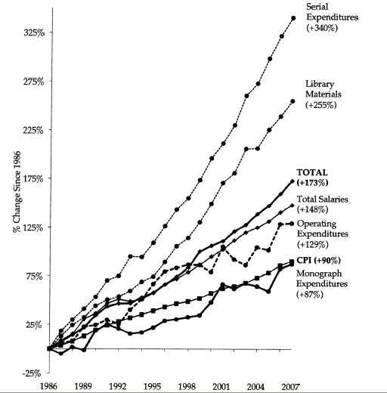
ARL Expenditures, 1986-2007
An unsustainable
pattern of growth
Source: “Expenditure Trends in ARL Libraries, 1986–2007”ARL Statistics 2006–2007, Association of Research Libraries, Washington, DC

Slide 4
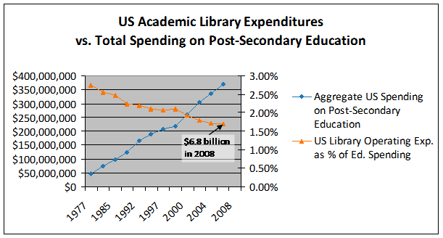
Less investment in libraries
Analysis based on NCES data: Constance Malpas
If this trend continues library allocations would fall below 0.5% by 2015. Growth
in for-profit sector, concerns about infrastructure costs in the ‘middle’ and budget
issues in the research sector all support this trend.

Slide 5
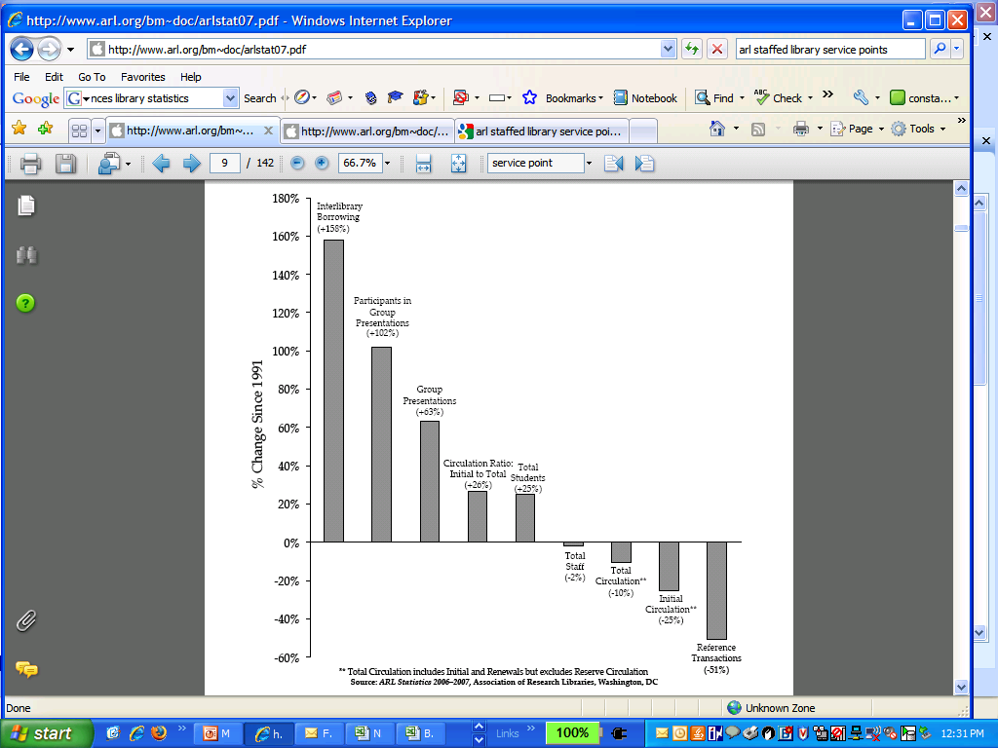
In the last 15 years . . .
While student enrollment has increased (+25%) . . .
use of onsite library collections/services has decreased (-10 to -50%). . .
and reliance on external collections has more than doubled (+150%)
Students and researchers reliance
on library has changed
Source: “Service Trends in ARL Libraries, 1991–2007 ”ARL Statistics 2006–2007, Association of Research Libraries, Washington, DC

Slide 6
What Do We Know About Print Book Use
The 80/20 rule applies
Past use predicts future use (better than anything else)
Use declines with age
In academic print collections users fail to find owned known items 50% of the time
Cost to the user is largely in the uncertainty of finding what they want
The are no longer using what we have. The value of our print collections to the University has declined rapidly.
© 2010 David W. Lewis.

Slide 7
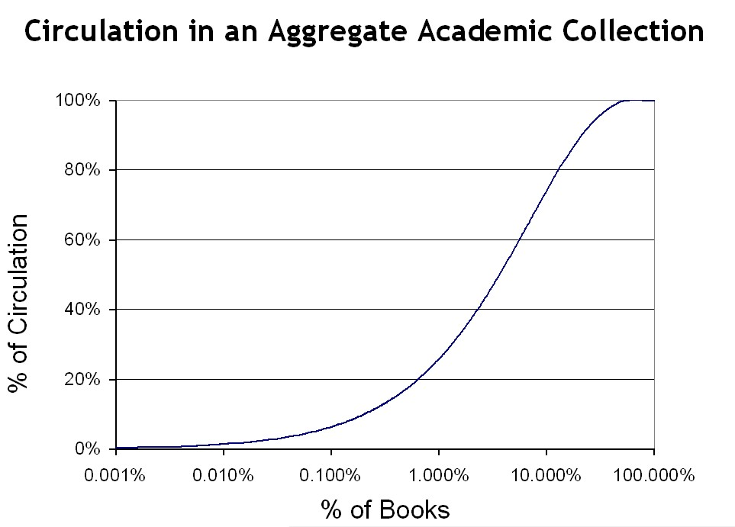
12.9%

Slide 8
switch to e-books

Slide 9
Move from Print to Electronic Collections
© 2010 David W. Lewis.

Slide 10
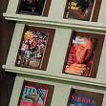
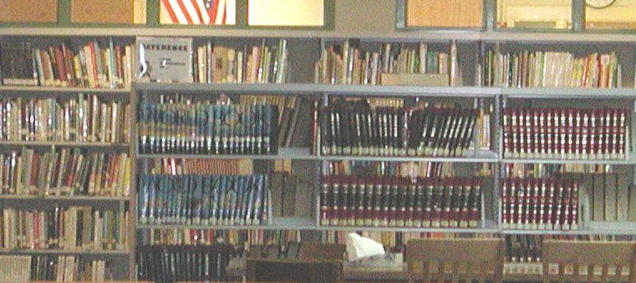
Move from Print to Electronic Collections
© 2010 David W. Lewis
Complete for journals
  But we’re still shelving unused paper
Nearly complete for reference works
  But we’re still buying paper reference works

Slide 11
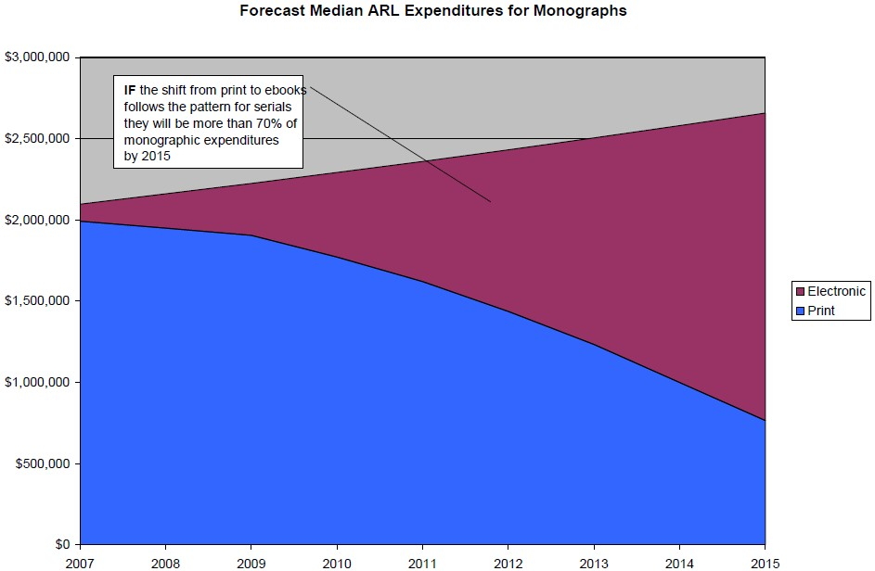
and the switch to primarily e-book purchasing will happen soon

Slide 12
Forecasts – Digital Availability of e-books
- the publishers expect this switch
Current*
Segment
Five Years*
Ten Years#
Front
Back
25%
Trade:
85%
50%
100%
10%
Acad/Prof:
75%
30%
100%
Text books:
20%
College:
90%
10%
100%
1%
H/S:
20%
5%
50%
Memo:
*Assumes top tier publishers – 1,000 active publishers
# Assumes any active publisher selling on Amazon.com
OCLC work commissioned from Michael Cairns.
Based on interviews with selection of industry experts.
Notes:
12

Slide 13

Status of the switch to e-publications
Complete for e-journals
Will be primarily electronic for books soon
Combine with
Mass digitization of legacy print collections
  Google in USA – digitizing everything regardless of copyright status
  Google participating libraries creating a joint platform to store, preserve and ultimately access their copies of the Google digital versions. The platform is run by the University of Michigan and called the Hathi Trust
www.hathitrust.org

Slide 14
Hathi Trust - current members
California Digital Library
Indiana University
Michigan State University
Northwestern University
The Ohio State University
Penn State University
Purdue University
UC Berkeley
UC Davis
UC Irvine
UCLA
UC Merced
UC Riverside
UC San Diego
UC San Francisco
UC Santa Barbara
UC Santa Cruz
The University of Chicago
University of Illinois
University of Illinois at Chicago
The University of Iowa
University of Michigan
University of Minnesota
University of Wisconsin-Madison
University of Virginia
MOST OF THE US GOOGLE BOOK PARTNERS
Notes:
14

Slide 15
Moving from Print to Electronic Books
IF
E-book publishing will be the norm and
Legacy print will be digitized (Google, Hathi, the Digitizing Academic Books in Japanese project)
THEN
We can change the management of our existing print collections
We can retire our legacy print collections

Slide 16
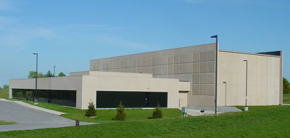
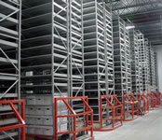
Retire Legacy Print Collections
Under way at many institutions
Discussions in process on collaborations and national programs
© 2010 David W. Lewis.

Slide 17


Retiring Legacy Print Collections
- digital is much cheaper than the library or a storage facility
$5.00 to $13.10
$28.77
$50.98 to $68.43
Life cycle cost based on 3% discount rate. From Paul N. Courant and Matthew “Buzzy” Nielsen, “On the Cost of Keeping a Book,” in The Idea of Order: Transforming Research Collections for 21st Century Scholarship, CLIR, June 2010, available at: http://www.clir.org/pubs/abstract/pub147abst.html

Slide 18
implications

Slide 19
US Investment in Academic Print Collections
You are here
Source: US Dept of Education, NCES, Academic Libraries Survey, 1998-2008
Notes:
19

Slide 20
A global change in the library environment
Academic print book collection already substantially duplicated in mass digitized book corpus
June 2010
Median duplication: 31%
June 2009
Median duplication: 19%
Data current as of June 2010
Notes:
20

Slide 21
Issues with Mass Digitization of Legacy Print materials
Legal issues
  Copyright
  Orphan Works
  Open Access
Financial
Technical
Organizational
National and trans-national obstacles

Slide 22
Thank you.
Jim Michalko
michalkj@oclc.org
comments, questions and observations are welcome via email
Thanks to Lorcan Dempsey, David Lewis, Constance Malpas for their contributions…

