Slide 1
Rapidly Developing Mass Digitization and the Future of the University Library
James Michalko
Vice President, OCLC Research
Keio University
6 October 2010
with thanks to Lorcan Dempsey, Brian Lavoie, David Lewis and Constance Malpas for their contributions

Slide 2
Disclaimer
Simplistic
This presentation
Content
Time is short, language is a barrier
All examples are U.S.A perspective

Slide 3
Overview
The changing place of the Library within University
Collection trends (within US research libraries)
Mass Digitization and the switch to e-books
Implications – some Keio statistics

Slide 4
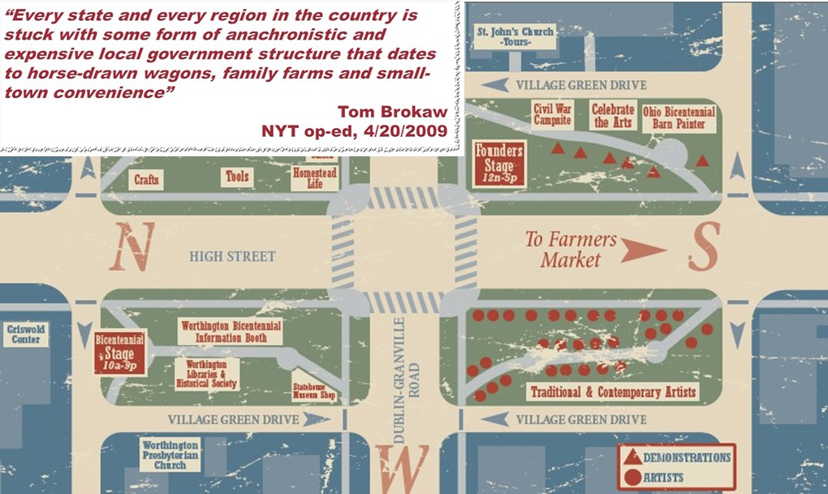
Place of the Library in University
Why do Universities have libraries?
It was more economical to have a physical collection than to send researchers or students to the information.
It was useful to locate all the needed information resources for research and learning physically close to the work.
Local collections were assets and contributed competitively to scholarly output
Consider the town square
in the United States…

Slide 5
The network changes everything
The network has reconfigured whole industries
  Travel, News, Book Retailing
The network is now the first option for researchers and learners
Impact on the university library
  changed the value of physical book collections and library space
  changed the relevance of the library assets and services to the University’s outputs
We do not yet know what it will mean to reconfigure the library within the University

Slide 6
collection trends

Slide 7
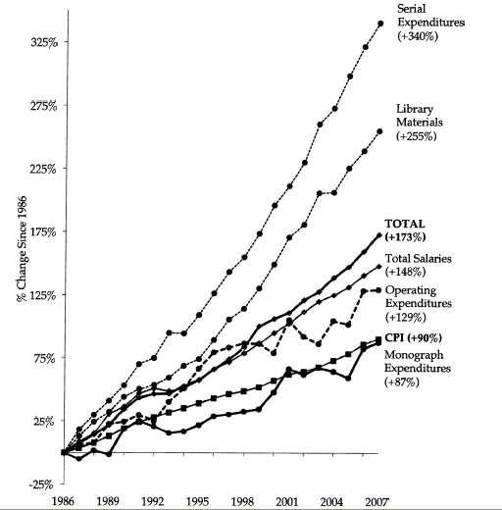
ARL Expenditures, 1986-2007
An unsustainable
pattern of growth
Source: “Expenditure Trends in ARL Libraries, 1986–2007”ARL Statistics 2006–2007, Association of Research Libraries, Washington, DC

Slide 8
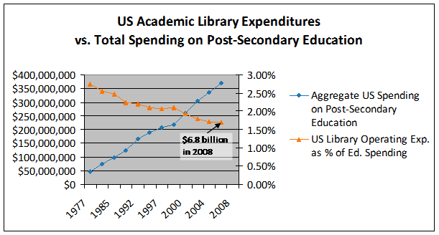
Less investment in libraries
Analysis based on NCES data: Constance Malpas
If this trend continues library allocations would fall below 0.5% by 2015. Growth
in for-profit sector, concerns about infrastructure costs in the ‘middle’ and budget
issues in the research sector all support this trend.

Slide 9
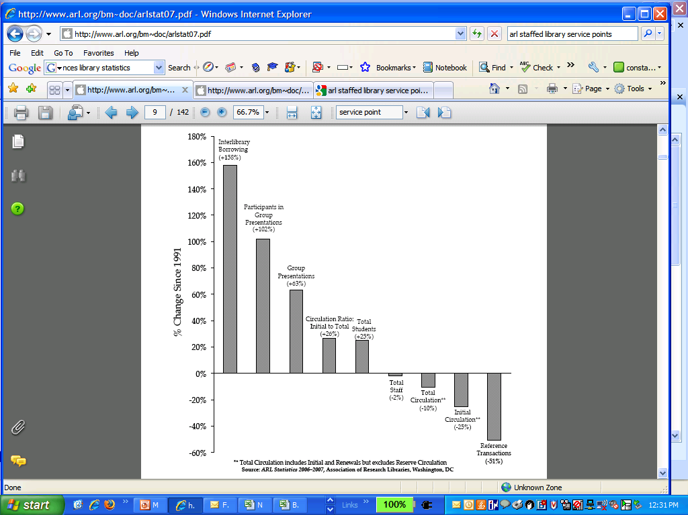
In the last 15 years . . .
While student enrollment has increased (+25%) . . .
use of onsite library collections/services has decreased (-10 to -50%). . .
and reliance on external collections has more than doubled (+150%)
Students and researchers reliance
on library has changed
Source: “Service Trends in ARL Libraries, 1991–2007 ”ARL Statistics 2006–2007, Association of Research Libraries, Washington, DC

Slide 10
What Do We Know About Print Book Use
The 80/20 rule applies
Past use predicts future use (better than anything else)
Use declines with age
In academic print collections users fail to find owned known items 50% of the time
Cost to the user is largely in the uncertainty of finding what they want
The are no longer using what we have. The value of our print collections to the University has declined rapidly.
© 2010 David W. Lewis.

Slide 11
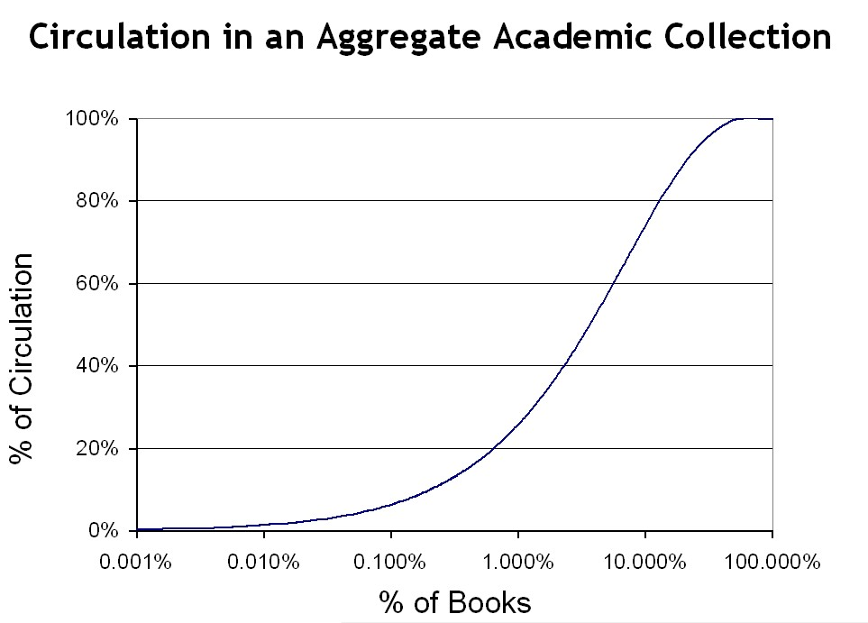
12.9%

Slide 12
switch to e-books

Slide 13
Move from Print to Electronic Collections
© 2010 David W. Lewis.

Slide 14
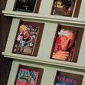
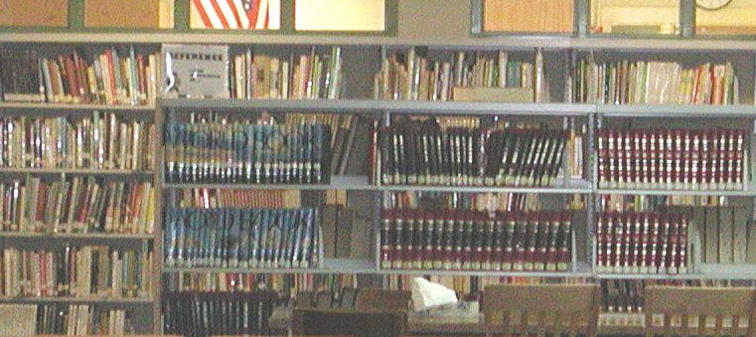
Move from Print to Electronic Collections
© 2010 David W. Lewis
Complete for journals
  But we’re still shelving unused paper
Nearly complete for reference works
  But we’re still buying paper reference works

Slide 15
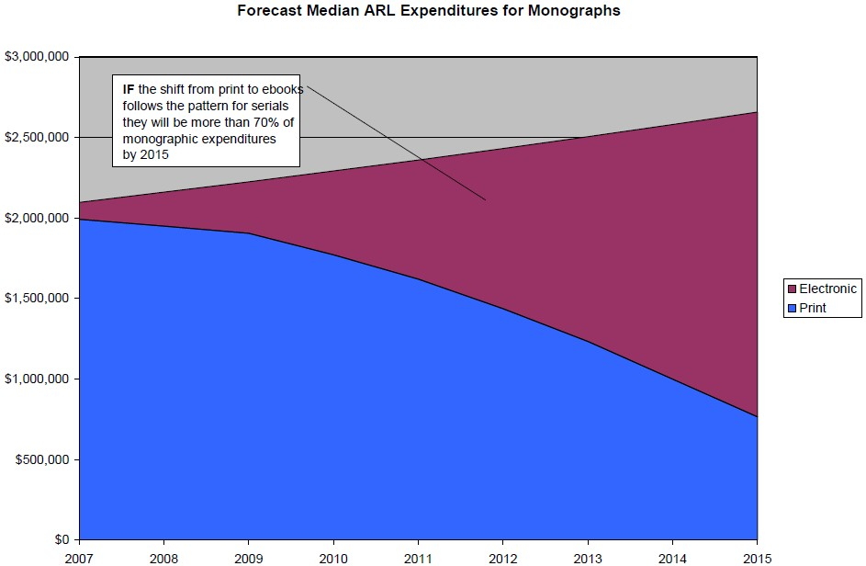
and the switch to primarily e-book purchasing will happen soon

Slide 16
Move from Print to Electronic Collections
© 2010 David W. Lewis.
Just beginning for books
Treated early e-books collections like print books
  Most important thing about e-books is that you don’t have to buy then until you need them
  User-driven purchasing becomes possible
  If you want it we have it

Slide 17
Forecasts – Digital Availability of e-books
- the publishers expect this switch
Current*
Segment
Five Years*
Ten Years#
Front
Back
25%
Trade:
85%
50%
100%
10%
Acad/Prof:
75%
30%
100%
Text books:
20%
College:
90%
10%
100%
1%
H/S:
20%
5%
50%
Memo:
*Assumes top tier publishers – 1,000 active publishers
# Assumes any active publisher selling on Amazon.com
OCLC work commissioned from Michael Cairns.
Based on interviews with selection of industry experts.
Notes:
17

Slide 18

Status of the switch to e-publications
Complete for e-journals
Will be primarily electronic for books soon
Combine with
Mass digitization of legacy print collections
  Google in USA – digitizing everything regardless of copyright status
  Google participating libraries creating a joint platform to store, preserve and ultimately access their copies of the Google digital versions. The platform is run by the University of Michigan and called the Hathi Trust
www.hathitrust.org

Slide 19
Hathi Trust - current members
California Digital Library
Indiana University
Michigan State University
Northwestern University
The Ohio State University
Penn State University
Purdue University
UC Berkeley
UC Davis
UC Irvine
UCLA
UC Merced
UC Riverside
UC San Diego
UC San Francisco
UC Santa Barbara
UC Santa Cruz
The University of Chicago
University of Illinois
University of Illinois at Chicago
The University of Iowa
University of Michigan
University of Minnesota
University of Wisconsin-Madison
University of Virginia
MOST OF THE US GOOGLE BOOK PARTNERS
Notes:
19

Slide 20
Moving from Print to Electronic Books
IF
E-book publishing will be the norm and
Legacy print will be digitized (Google, Hathi, the Digitizing Academic Books in Japanese project)
THEN
We can change the management of our existing print collections
We can retire our legacy print collections

Slide 21
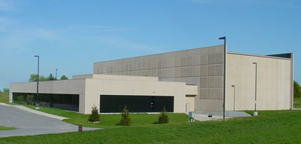
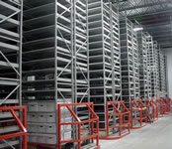
Retire Legacy Print Collections
Under way at many institutions
Discussions in process on collaborations and national programs
© 2010 David W. Lewis.

Slide 22


Retiring Legacy Print Collections
- digital is much cheaper than the library or a storage facility
$5.00 to $13.10
$28.77
$50.98 to $68.43
Life cycle cost based on 3% discount rate. From Paul N. Courant and Matthew “Buzzy” Nielsen, “On the Cost of Keeping a Book,” in The Idea of Order: Transforming Research Collections for 21st Century Scholarship, CLIR, June 2010, available at: http://www.clir.org/pubs/abstract/pub147abst.html

Slide 23
implications

Slide 24
US Investment in Academic Print Collections
You are here
Source: US Dept of Education, NCES, Academic Libraries Survey, 1998-2008
Notes:
24

Slide 25
A global change in the library environment
Academic print book collection already substantially duplicated in mass digitized book corpus
June 2010
Median duplication: 31%
June 2009
Median duplication: 19%
Data current as of June 2010
Notes:
25

Slide 26

Keio University Library Holdings in Hathi Digital Library
68K titles
4250 linear feet
Data current as of June 2010
Notes:
26

Slide 27
Of the 190K Keio library holdings in WorldCat,
at least 35% are duplicated in mass-digitized corpus
Represents . . .
Est. 4,250 linear feet of library space
Est. ¥ 24M p/a in management costs
Data current as of June 2010
Notes:
27

Slide 28
70% of mass-digitized titles in Keio libraries are also held by >99 other repositories
Target for cooperative management?
Data current as of June 2010
Notes:
28

Slide 29
A ‘global’ library?
>30% of titles in Hathi Library are US imprints
3% are Japanese imprints
Titles
Data current as of June 2010
Notes:
29

Slide 30
Coverage of Japanese literature in mass-digitized corpus is growing
Data current as of June 2010
Notes:
30

Slide 31
. . . but digitized Japanese literature still largely inaccessible
Data current as of June 2010
Notes:
31

Slide 32
A limited view of Japanese culture
Titles in modern Japanese literature (1867-) predominate
Japanese Literature
Japanese Language
Data current as of June 2010
Notes:
32

Slide 33
In conclusion
The switch to e-publications and digital delivery presents the opportunity to reconfigure the library
The library can use its resources to
become the most efficient unit that adds local value
By moving beyond its past and its tradition as a physical storehouse of texts the library will
become a bundle of services that adds value to the University’s output – scholarship and research

Slide 34
THANK YOU
MICHALKJ@OCLC.ORG
comments, questions and observations are very welcome via email…
Thanks to Lorcan Dempsey, David Lewis, Constance Malpas for their contributions…

