Slide 1
Observations on the Future Nature of Library Collecting
Libraries Australia
Forum
20 October 2010
Constance Malpas
Program Officer
OCLC Research

Slide 2
Overview
A picture (made in America)
… for thinking about library collections
A story (based on trends in the US)
… about why, how and where collections are changing
A gloss (by an outsider)
… on what these changes are likely to mean
for Australian libraries

Slide 3




Collections Grid
Purchased materials
Licensed E-Resources
In many collections
Open Web Resources
Licensed
Purchased
High Stewardship
Low Stewardship
Special Collections
Local Digitization
Research & Learning Materials
In few collections
Notes:
This is a model we have used to frame some discussions about library collections and operations in the past. The horizontal axis is a measure of the stewardship or curation efforts that have traditionally been needed to manage these materials in libraries. The vertical axis is a measure of how widely held the materials are in the library system: at the top are resources that are abundant in the library community, at the bottom are materials that relatively rare.
In the upper left quadrant are the materials that libraries traditionally purchased and increasingly are leasing. Below that are special collections, rare books and manuscripts. The bottom right includes research outputs and teaching materials. The upper right includes a wide variety of resources found on the Open Web – web sites, discussion lists, blogs etc.
Libraries may be interested in all of these areas, but not equally.
Traditionally, library acquisitions and operations have focused on the upper left quadrant: published materials in print. Licensed resources were a secondary focus. And, except for research and academic libraries, there was limited attention to managing rare books and manuscripts, instructional course materials, or Web archiving.
Increasingly, [click] we have seen this attention shift to licensed electronic materials, which are now more ubiquitous and also require less local management effort.

Slide 4
Library attention and investment are shifting
In many collections
Less attention
Licensed
High attention
Purchased
Occasional
High Stewardship
Low Stewardship
Limited
Limited
Aspirational
Intentional
In few collections
Notes:
Increasingly, [click] we have seen this attention shift to licensed electronic materials, which are now more ubiquitous and also require less local management effort.
At the same time, we have seen academic libraries shift attention into the lower right quadrant, developing IR infrastructure and data curation capacity.
In the academic sector in the US, we have not seen much change in investment in special collections nor in mgt of open Web resources.

Slide 5
Academic institutions are driving this change
In Many Collections
Redirection of library resource
Licensed
Purchased
High Stewardship
today
+5 yrs
Low Stewardship
University library spending on e-resources in 2008:
CAUL = $170M AUS (28% total library exp.)
US ARL = $627M US (41% total library exp.)
In Few Collections

Slide 6
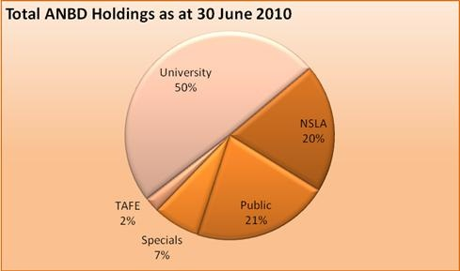
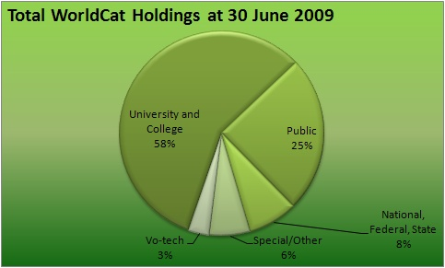
Shared Library Infrastructure:
Academic Influence
~45 million holdings
22.3M (50%) in university libraries
7.9M (18%) in G8 university libraries
~1.45 million holdings
83.5M (58%) in university libraries
est. ~20% in ARL university libraries
Change in academic libraries affects system as a whole

Slide 7
Change in Academic Collections
Shift to licensed electronic content is accelerating
  Research journals – a well established trend
  Scholarly monographs – in progress
Print collections delivering less (and less) value at great (and growing) cost
  Est. $4.25 US per volume per year for on-site collections
  Library purchasing power decreasing as per-unit cost rises
Special collections marginal to educational mandate at many institutions
  Costly to manage, not (always) integral to teaching, learning

Slide 8
An Equal and Opposite Reaction
As an increasing share of library spending is directed toward licensed content . . .
Pressure on print management costs increases
Fewer institutions to uphold preservation mandate
Stewardship roles must be reassessed
Shared service requirements will change

Slide 9
What’s driving this change?
Erosion of library value proposition in the academic sector
institutional reputation no longer determined (or even substantially influenced) by scope, scale of local print collection
Changing nature of scholarly record
research, teaching and learning embedded in larger social and technological networks; new set of curation challenges for libraries
Format transition; mass digitisation of legacy print
Web-scale discoverability has fundamentally changed research practices; local collections no longer the center of attention

Slide 10
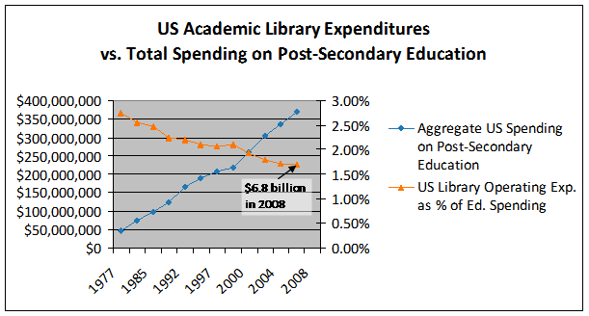
Declining Investment in Academic Libraries (US)
If this trend continues library allocations will fall below 0.5% by 2015.
Derived from : US Dept of Education, NCES, Academic Libraries Survey, 1977-2008

Slide 11
Resourcing of Higher Education is Shifting (US)
Distribution of Post-Secondary Educational Institutions
in the United States by Source of Funding
Derived from : US Dept of Education, NCES, Academic Libraries Survey, 1977-2008

Slide 12
Attention Switch: from Print to Electronic (US)
You are here
Derived from US Dept of Education, NCES, Academic Libraries Survey, 1998-2008

Slide 13
In the US, a tipping point …
Majority of research libraries shifting toward
e-centric acquisitions, service model
center of gravity
Harvard
Yale
Shrinking pool of libraries with mission and resources
to sustain print preservation as ‘core’ operation
Derived from ARL Annual Statistics, 2007-2008

Slide 14
… the books have left the building
In North America, +70M volumes off-site (2007)
~30-50% of print inventory at many major universities
Growth in library storage infrastructure
Derived from L. Payne (OCLC, 2007)

Slide 15
It’s not about space, but priorities
If the physical proximity of print collections had a demonstrable impact on researcher productivity, no university would hesitate to allocate prime real estate to library stacks
In a world where print was the primary medium of scholarly communication, a large local inventory was a hallmark of academic reputation
We no longer live in that world.

Slide 16
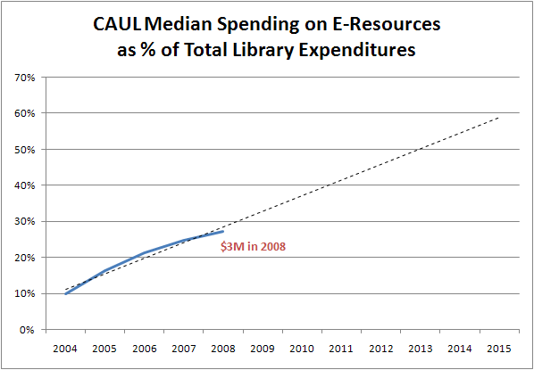
In Australia, a similar (if slower) trend
50% of expenditures by 2013?
Derived from CAUL Annual Statistics, 2004-2008

Slide 17
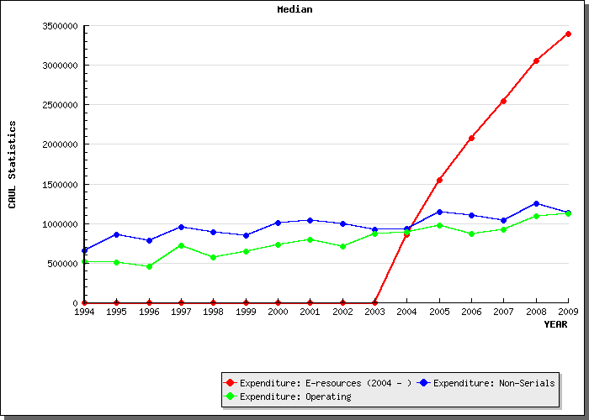
. . . print continues to drive operating costs
CAUL Annual Statistics, 1994-2009

Slide 18
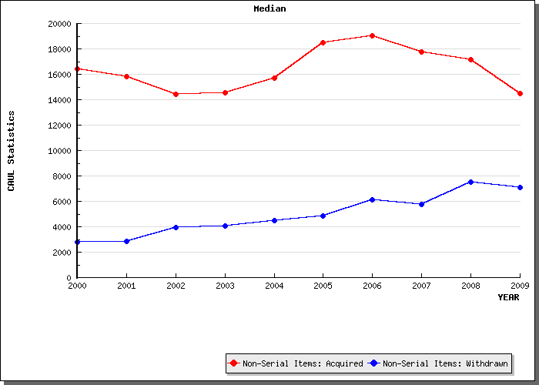
Libraries adding less, withdrawing more print
7,532 vols.
846 titles
withdrawn in 2008
Derived from CAUL Annual Statistics, 2000-2008

Slide 19
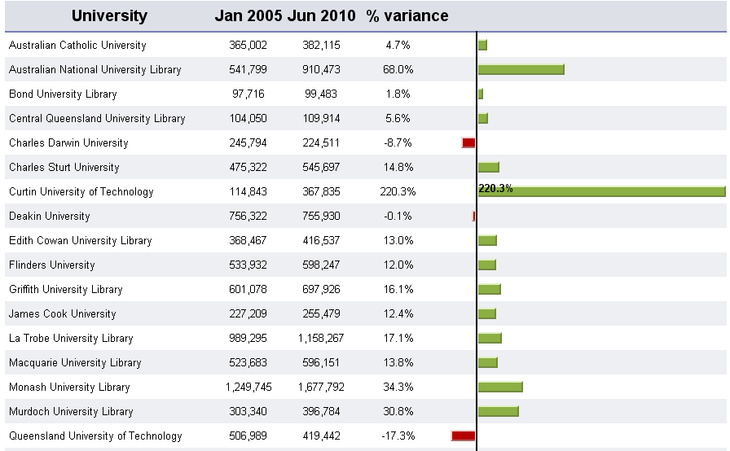
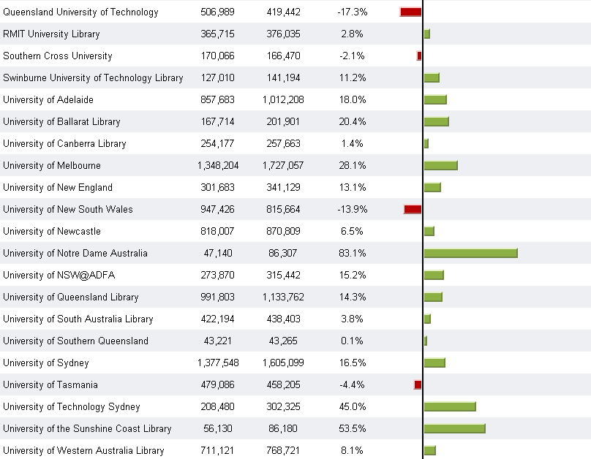
Impact on Library Infrastructure?
6 university libraries have deleted
>250K ANDB holdings in the past 5 years
G8 library
ANBD Statistics, University Library Holdings

Slide 20

What if:
Academic libraries could “outsource” management of
low-use legacy print collections to shared service
providers
  Cooperative management of print inventory
  Joint curation of digitised library content
Key elements of infrastructure already exist:
  Off-site library storage collections
  Shared digital repository (HathiTrust)

Slide 21
Moving Collections “to the Cloud” (2009/10)
Premise: emergence of large scale shared print and
digital repositories creates opportunity for strategic
externalization* of core library operations
  Reduce costs of preserving scholarly record
  Enable reallocation of institutional resources
  Model new business relationships among libraries
* increased reliance on external infrastructure and service platforms in response to economic imperative (lower transaction costs)

Slide 22
What’s it Worth?
IF shared print provision for mass-digitised monographs were already in place . . .
Average US university library space savings of ~46K ASF
[based on 1 copy/vol. per title; .08 ASF per volume]
= new research commons, learning collaboratory
Annual cost avoidance of ~$470K for off-site management
[based on 1 copy/vol. per title * $.86 for high-density store]
= resource for redeployment, new library service model
Requires re-organisation of library system; emergence of new shared service providers

Slide 23
Our Starting Point: June 2009
US library off-site storage
0101010101010
1010101010101
0101010101010
1010101010101
0101010101010
1010101010101
0101010101010
25 years
+70M vols.
9 months
+3M vols.
HathiTrust
Will this intersection create new operational efficiencies?
For which libraries?
Under what conditions?
How soon and with what impact?

Slide 24
A global change in the library environment
The US academic print book collection already substantially duplicated in mass digitised book corpus
June 2010
Median duplication: 31%
June 2009
Median duplication: 19%
Data current as of June 2010

Slide 25
Mass-digitised Books in Shared Print Repositories
(US)
~3.6M titles
~75% of mass digitised corpus in HathiTrust is ‘backed up’ in one or more shared print repositories
~2.5M
Data current as of June 2010

Slide 26
Prediction
Within the next 5-10 years, focus of shared print archiving and service provision will shift to monographic collections
large scale service hubs will provide low-cost print management on a subscription basis;
reducing local expenditure on print operations, releasing space for new uses and facilitating a redirection of library resources;
enabling rationalization of aggregate print collection and renovation of library service portfolio
Mass digitization of retrospective print collections will drive this transition

Slide 27
In the US, interests are aligned (for now)
Several major initiatives developing regional print archives for scholarly journal back-files
Western Regional Storage Trust, Center for Research Libraries
Federally funded effort to re-examine models for managing legacy print book collections
Nat’l Framework for Print Monographic Collections workshop
OCLC developing infrastructure to support network disclosure of print archives in WorldCat
Pilot implementations planned for FY2011

Slide 28
Is this feasible in Australian context?
Maybe. . . depends upon:
imperative to reconfigure academic print collections
strong or weak?
surrogate value of mass-digitised resource
supports externalisation of legacy print management?
regional infrastructure
extant shared print providers (CARM, others)
Web-scale discovery (Trove)
robust resource-sharing network (Libraries Australia)
From US vantage point, Australian prospects look promising

Slide 29
A View from Down Under
“Australia's $17 billion export education industry is one of the nation's few green exports, one of the few sources of national income that does not leave the country in cargo containers … Our public discussion of higher education's larger purpose is rarely cast in humanistic terms. Nor, for the past two decades, has there been any real institutional mooring for the liberal arts within the postmodern megaversity.”
Luke Slattery “Soul-searching for a liberal curriculum”
The Australian 30 June 2010
[via Lorcan Dempsey]
So: greater pressure on academic libraries . .. (compared to US)

Slide 30
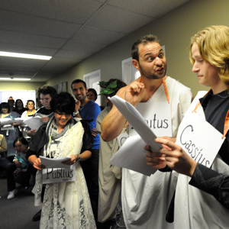
A Vocal Minority in Dissent
This man
is not your friend
Disdain for “…a culture of managerialism that threatens the quality of research and puts extra pressure on academic staff to increase their output”
loss of power, prestige embodied in dislocation of library print collection
ANU students demonstrate against the reorganising of humanities courses and increasing pressure on academic staff. Photo: RICHARD BRIGGS, Canberra Times (May 2010)

Slide 31




Judgment of Peers
… and fewer institutions with mandate/resources to assume stewardship for scholarly record

Slide 32



Australian National Presence in Mass-digitised Library Corpus
6,288 publications about Australia
History, literature, geography, flora & fauna
17,859 publications produced in Australia
15,706 (88%) held by one or more of NLA, G8
877 (5%) available as public domain in USA
1,104 rare Australian imprints (held by <5 libraries)
855 (77%) not held by NLA or G8 libraries
Data current as of June 2010, based on analysis of 3.64M titles in HathiTrust Digital Library.

Slide 33
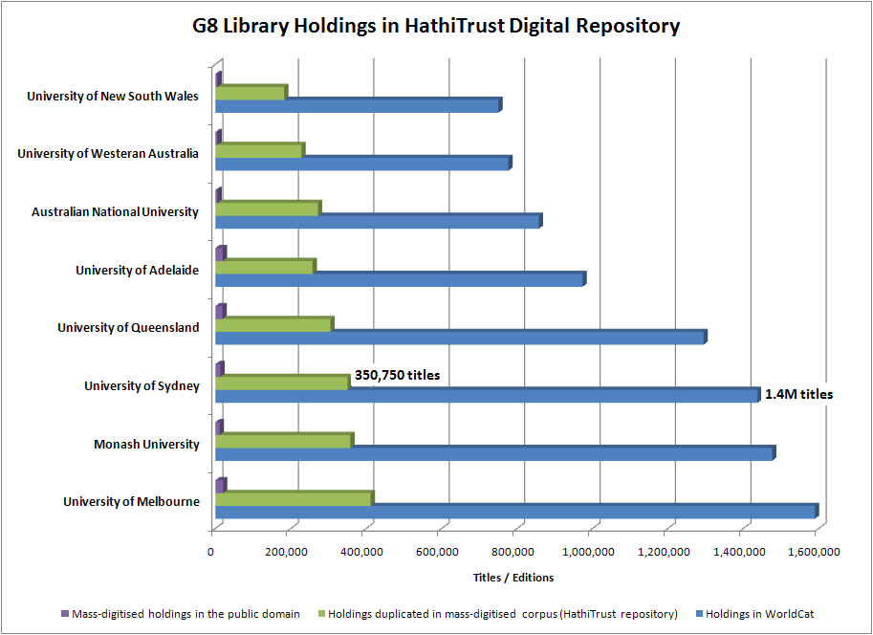

Australian Academic Collections
As of June 2010, 25% of titles in G8 libraries are duplicated in mass-digitised corpus
Data current as of June 2010

Slide 34
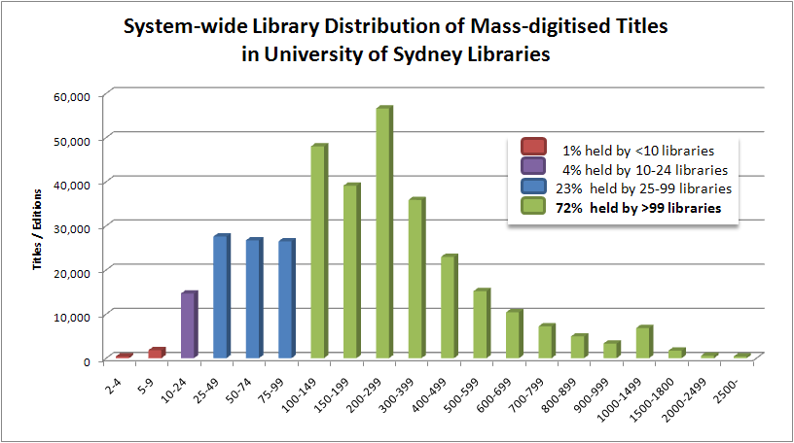
Revisiting Local Print Stewardship Priorities
… and significant opportunity for space savings, cost avoidance
Data current as of June 2010

Slide 35
A Compelling Scenario for Change
Powerful imperatives to deploy university library resources in support of new research assessment regimes
Ambivalence about institutional responsibility to the traditional (print) scholarly record
Mass-digitised resource offers adequate surrogate value
Substantial space savings, cost avoidance is achievable
IF: Viable shared print service providers emerge
Management, discovery/delivery infrastructure adapts

Slide 36
Implications for NLA / Libraries Australia
Increased expectation for shared infrastructure to support cooperative management of academic print collections
New pressures on resource sharing as fulfillment of in-copyright, mass-digitised content is concentrated on a smaller number of providers
Redistribution of print stewardship may require coordination by NLA, NSLA or other agent

Slide 37
Thanks for your attention
Constance Malpas
malpasc@oclc.org
Comments, questions & corrections are welcome via email.

