Slide 1
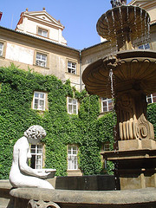
Winning Researchers Back to the Library
November 17, 2008
  John MacColl
European Director, RLG Partnership, OCLC Research
8 December 2008

Slide 2
Recent risk analysis
In a rapidly evolving information environment, what are the greatest risks to research libraries?
  Individually – as local service providers
  Collectively – as a distributed enterprise
Which of these risks is susceptible to mitigation?
  Feasibility – controllable risk?
  Impact – worth the investment?
Where should local effort be directed?
Where can collective action make a difference?
Notes:
Work done by RLG and Ithaka recently. Continuous with “What’s keeping you up at night” RLG podcast interview series – but directed at library management.

Slide 3
Risk Clusters
Value Proposition
… a reduced sense of library relevance from below, above, and within
Human Resources
… uncertainties about adequate preparation, adaptability, capacity for leadership in face of change
Durable Goods
… changing value of library collections and space; prices go up, value goes down – accounting doesn’t acknowledge the change
Legacy Technology
… managing and maintaining legacy systems is a challenge; replacement parts are hard to find
Intellectual Property
… losing some traditional assets to commercial providers (e.g. Google Books) and failing to assume clear ownership stake in others (e.g. local scholarly outputs)
Notes:
We identified five thematic risk clusters that seemed to us to reflect the most important classes of risk.

Slide 4
What is a research library these days?
The research library draws its power increasingly from the aggregated wealth of libraries
It receives but must also contribute (currently in ways which are dysfunctional and inefficient)
Aggregations provides switches from network to group and local levels
They are in a process of ‘unlearning’ traditional roles: we see several inversions of traditional functional arrangement
How do we design, engineer and lubricate this vision?
Notes:
Libraries work in collaboration to provide their services. This has been true for some decades of cataloguing and resource sharing (interlibrary loan). Today, it is being realised in other areas: digitisation of collections; registries; knowledgebanks; resolver services; digital repositories. And for catalogue records, the model of buying in a selection of shared records from a shared database to be modified and displayed in a local OPAC is being transformed into a model in which libraries hold their records in the shared database and buy a ‘trusted view’ of them (eg in WorldCat Local). This is what we call ‘the collective collection’. The web is a new medium, and its architecture implies, for libraries, aggregation and diffusion via a switch. Worldcat.org is that switch. This is a form of contracting out - not to a 3rd party vendor, but to the cooperative resource. It reduces local costs and should result in higher quality, maintained records. We now talk about ‘cloud data’ and ‘cloud computing’.

Slide 5
Scale matters
Network level
Concentration
A web-scale presence
Mobilise data
Web-scale
Diffusion
Disclosure of links,
data and services
Notes:
These are themes which will be familiar to those of you who read Lorcan Dempsey’s weblog. This is a simple and effective way to concentrate the attention of library directors on the realities of the environment in which our services now play. We need to be thinking about how to push our content, our data, to the network level; and we need to think about the implications of web-scale. Data needs to be pushed up to the surface of the web, and diffused from there. That goes for archival data as well as library metadata and digital materials.

Slide 6
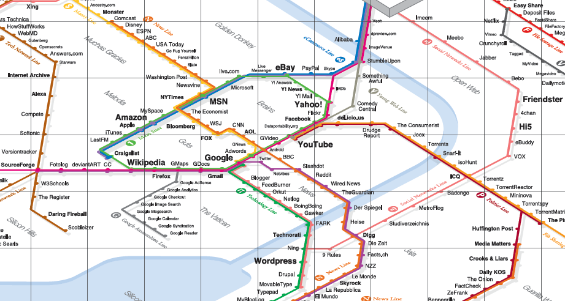
Be where the users are
Image: informationarchitects.jp/web-trend-map-2008-beta/
Notes:
This is the map our users use to navigate today’s information landscape. It’s the 300 most visited sites on the web, mapped onto the Tokyo train map. It shows where our users are going.
Amazon, Yahoo, Google, Wikipedia, and YouTube are dominant, but they’re not overwhelmingly dominant.
Is your library or archive in this picture? There are no libraries in this picture. No OCLC, no JISC, no TEL…
What does their absence tell us?
Libraries deliver services in an environment increasingly dominated by large-scale information hubs. Users bypass the authoritative offerings of libraries in favour of just-in-time information from sources more conveniently embedded in their daily networked lives.
DISCOVERY HAPPENS ELSEWHERE – we need to position supply where the demand is.
So, ‘winning researchers back to the library’ really means ‘putting the library in front of researchers’ - wherever they might be on this train map!

Slide 7

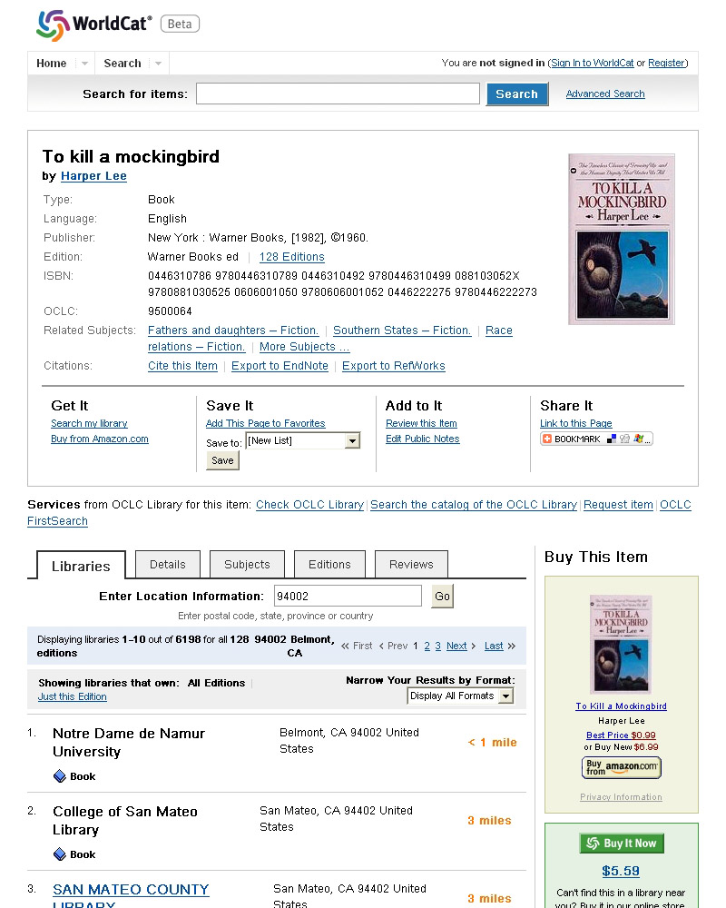
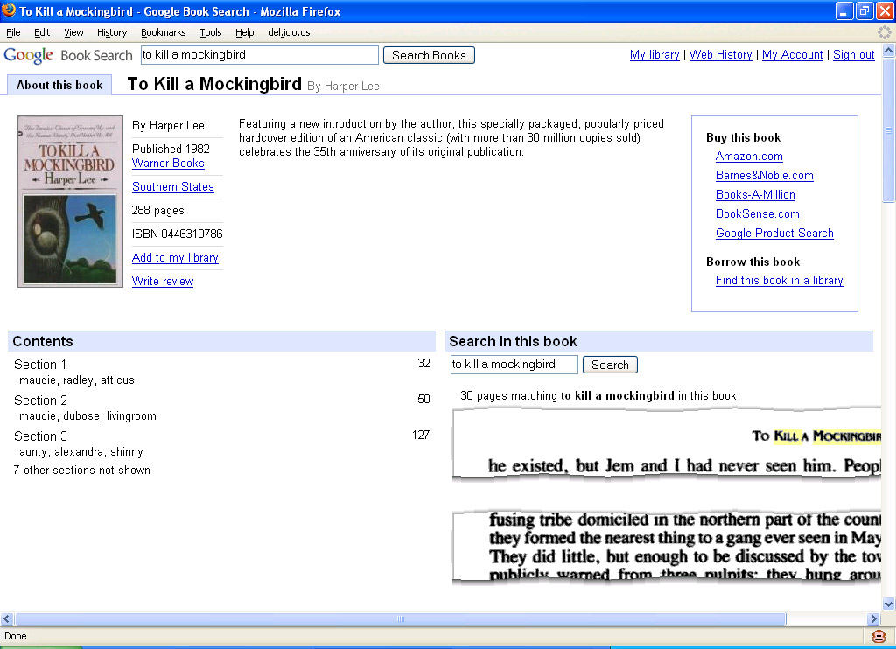

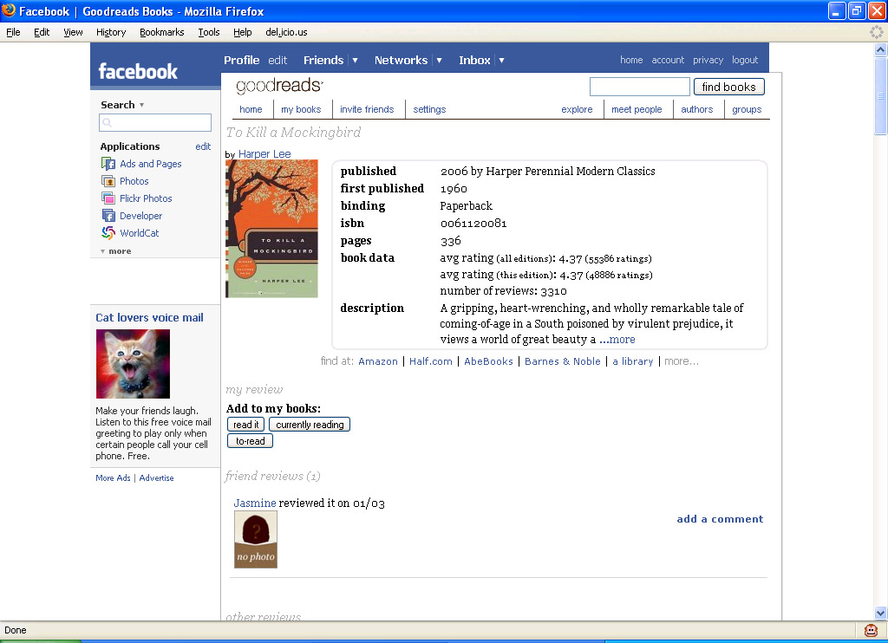

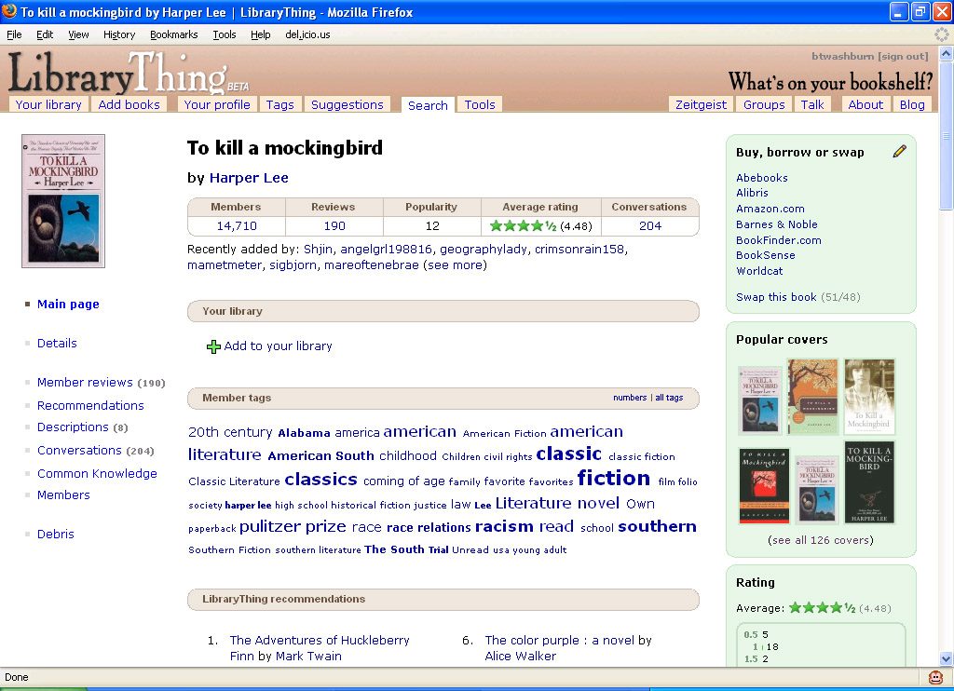
Get into the users’ flow
Notes:
WorldCat.org is not only making member library records discoverable on the web, but we’re embedded into some of those other environments where our users spend a lot of time. Users may discover a book there, but they can link directly to Worldcat to find a library near them where they can borrow the book. Or request it online. Or read a digital copy (increasingly). The point is that the research library community wants to give researchers - in the broadest sense of the word - an alternative to purchase. At the heart of libraries’ mission is the idea of shared resources. Since the world of resources began its journey to go digital, librarians have wondered how to do sharing of virtual resources. This is how. The aggregated resource becomes a switch which takes a user from the point at which they discover a resource they want, to a local delivery option on the web. This demands precision engineering!

Slide 8
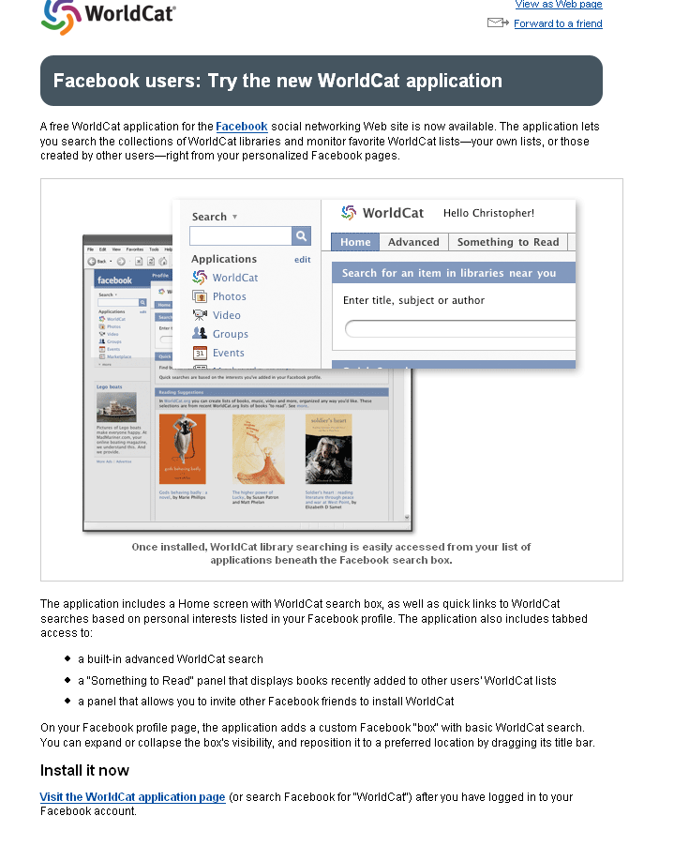
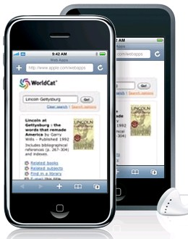

Granular diffusion
(worldcat.org widgets)
Small applications for WorldCat for:
  Browsers
  Blogs/Web sites
  Facebook
  iPhone
Notes:
This is what we mean by diffusion of an aggregated resource. The library is in the the browser, on the blog page, in Facebook, on on the iPhone.

Slide 9
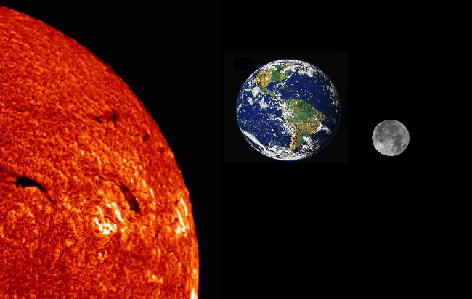
Gravitational pull: University model
Google (Worldcat?)
Library
Archives
Notes:
Research libraries are being transfomed by forces outwith their control. This might represent the new bibliographic universe. Libraries are increasingly dependent on large bibliographic aggregations, such as Google and Worldcat (and Europeana?). They are pulled round them. In their turn, archives - in universities at least - are more and more pulled into the orbit of libraries. In the UK, there is a growing trend to bring the archives under the management of the library, even if the relationship goes no deeper. Though often it does.

Slide 10
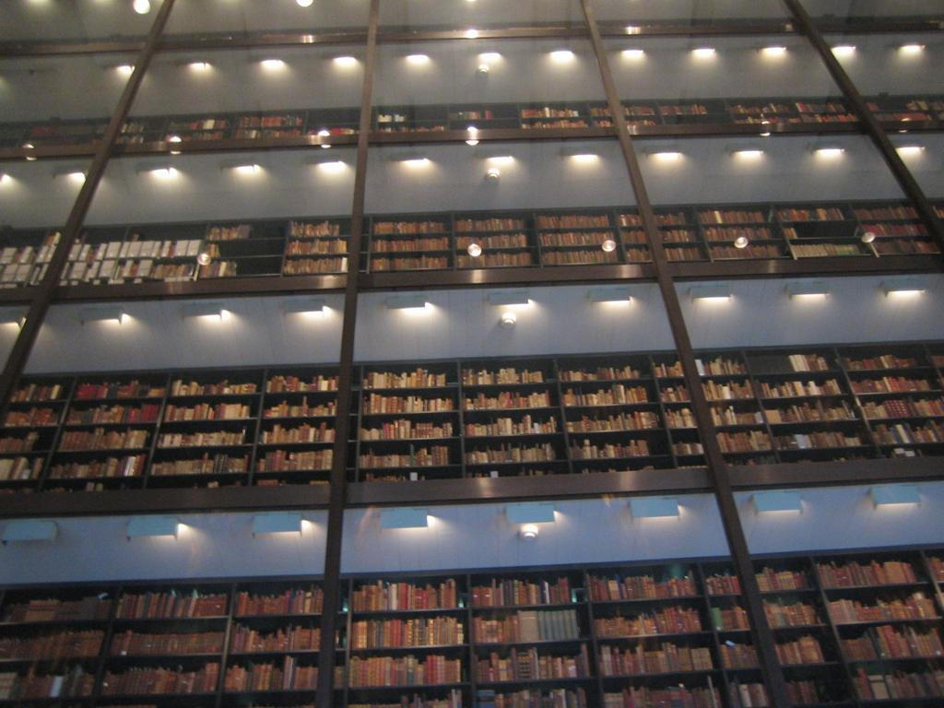

Yale University
Notes:
Google is of course one of these transforming forces. Google has completely changed the way libraries have thought about the digitisation of books. We used to think books were the hardest part of library digitisation (with their sequence and hierarchy, hundreds of images, text conversion …) – we didn’t imagine we’d ever digitise all the books. By focusing on quantity over quality, Google has made the seemingly impossible begin to happen. A UK colleague sometimes comments that history will criticise libraries for having let this initiative be taken by a private company. But how could libraries ever have afforded it? Or did we just lack the imagination?
Google supplied and changed demand.
Now, with millions of books flying off the shelves and ‘into the flow’, research libraries also need to change the way they think about digitisation of special collections. Soon students will only look online -- what’s not there, will not be considered.
As we increasingly share a collective collection of books, it is the special collections that will distinguish our institutions. Yet ironically they run the risk of being marginalised. If they aren’t accessible, they aren’t used; if they aren’t used, they go away. Neglect leads to obsolescence.
It is our job to offer up these materials to the demand Google has created.

Slide 11
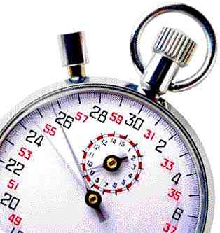
We are now in a race to remain relevant to researchers
‘Cataloguing is a function which is not working’
Forget item level description
“Insanity is when you do things the way you’ve always done them, but expect a different result” (Einstein and/or Emerson)
‘Good enough’ beats perfection
Hail ‘the demise of the completeness syndrome’ (Ross Atkinson)
Notes:
The Greene-Meissner paper, More product, less process: pragmatically revamping traditional processing approaches to deal with late 20th-century collections, has deeply influenced our thinking in OCLC Research. The priority has become disclosure, creation of proxies via digitisation, and process acceleration. But it is very difficult for libraries - and archives - to change the way they operate, even if they agree with these priorities.

Slide 12
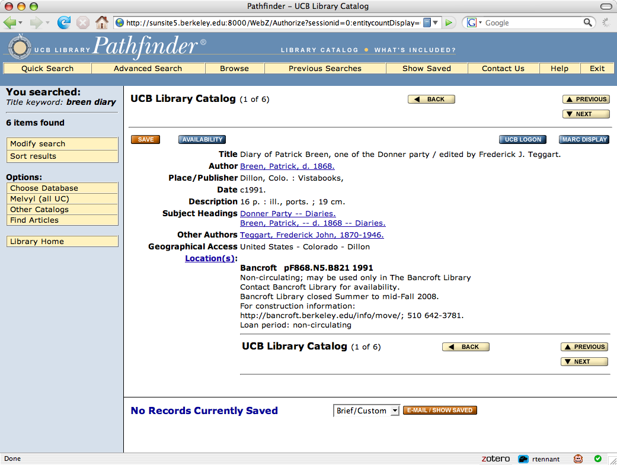
Fulfilment?
Notes:
Ultimately, users don’t care where the material for their research is housed, as long as they can get access to it. Similarly, they are only interested in metadata as means of confirmation that they are on the trail of the item they want. A record by itself does not produce fulfilment. Especially if access is as constrained as it is here.

Slide 13
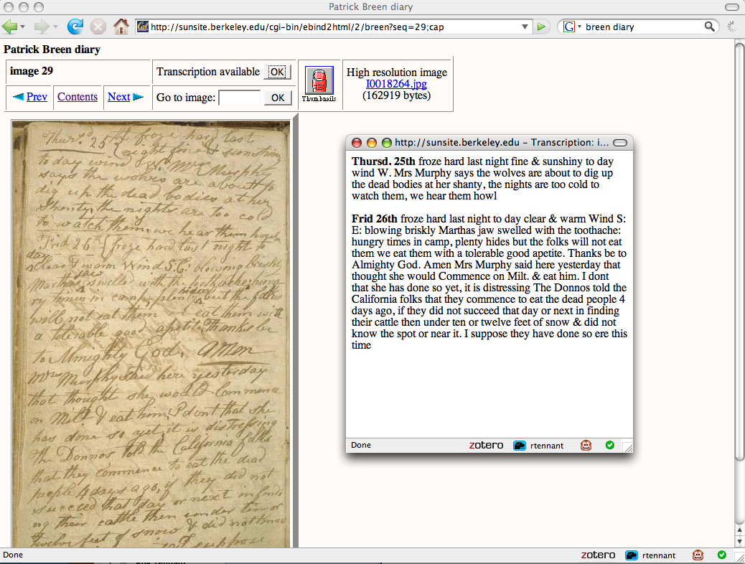
Fulfilment!
Notes:
This is much better. An image of the original source document, and searchable text. Listen to my recent podcast interview with Robert Crawford, who talks - as a researcher - about the value to him of digitised archives, and particularly, searchable digitised archives.

Slide 14
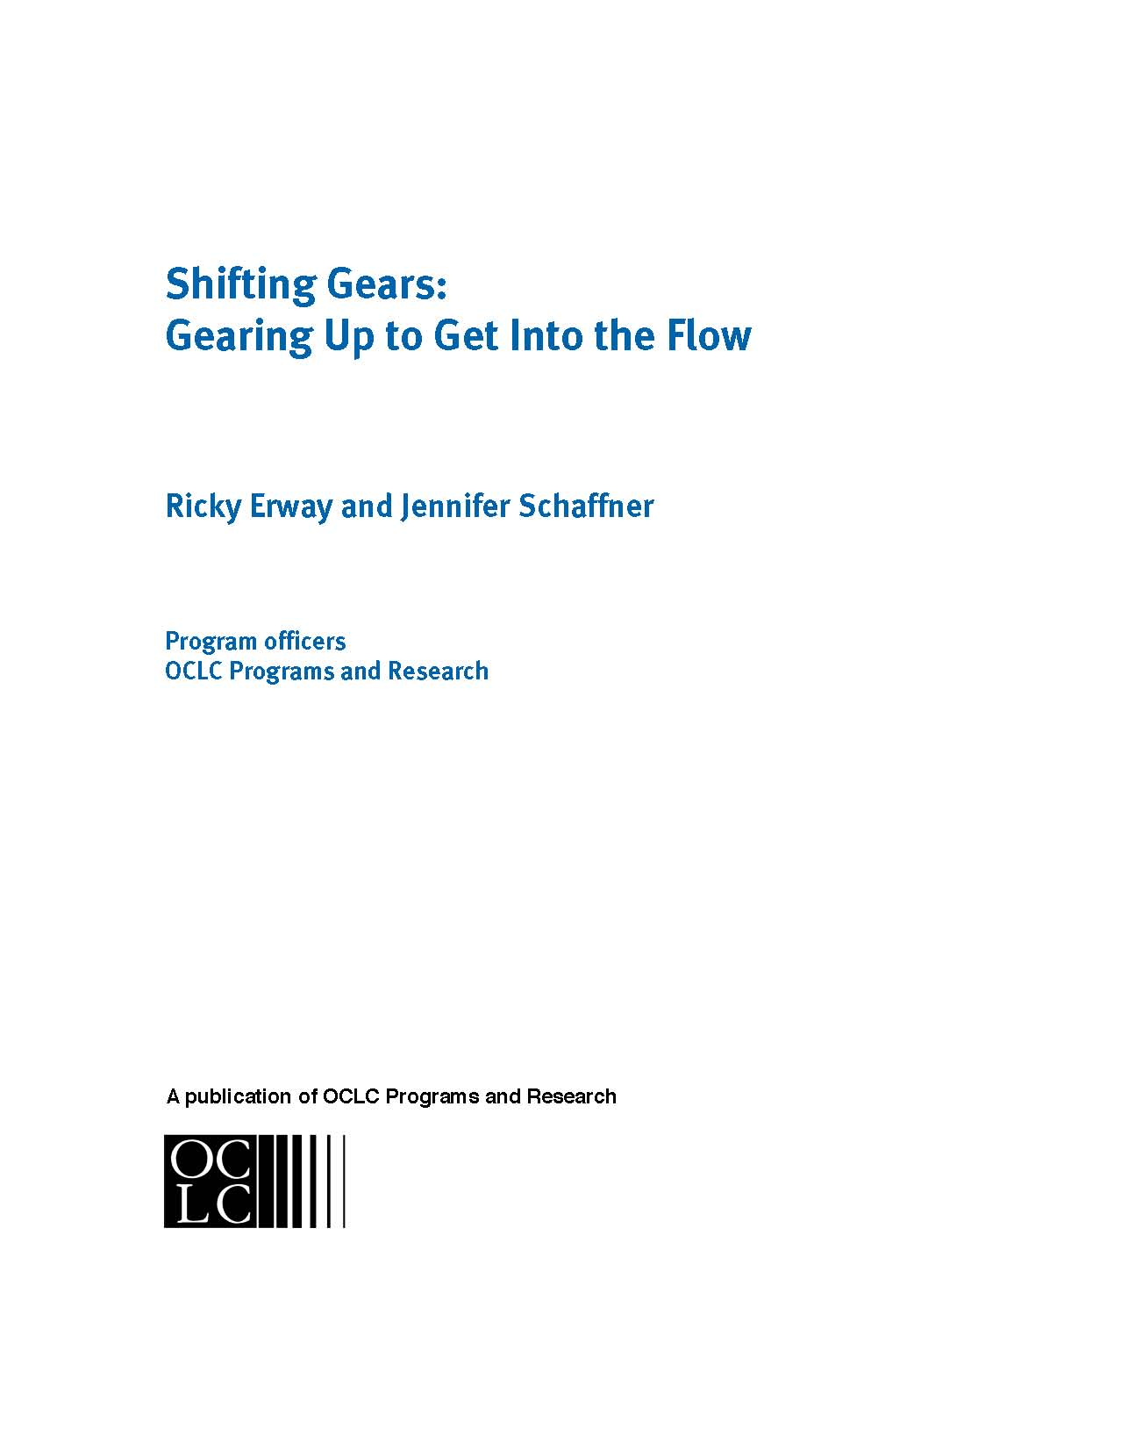
Access vs preservation …
Notes:
A challenging paper which poposed ways to apply mass digitisation to special collections.

Slide 15
Access wins!
No one has been throwing away originals … so preservation needs are best served by them
Only by surfacing presently ignored collections can we justify their preservation
Our brave new world shows we can (usually) go back and do it again
Notes:
We took some particular stances, including this one: digitisation should be In service to access rather than preservation. Heresy?

Slide 16
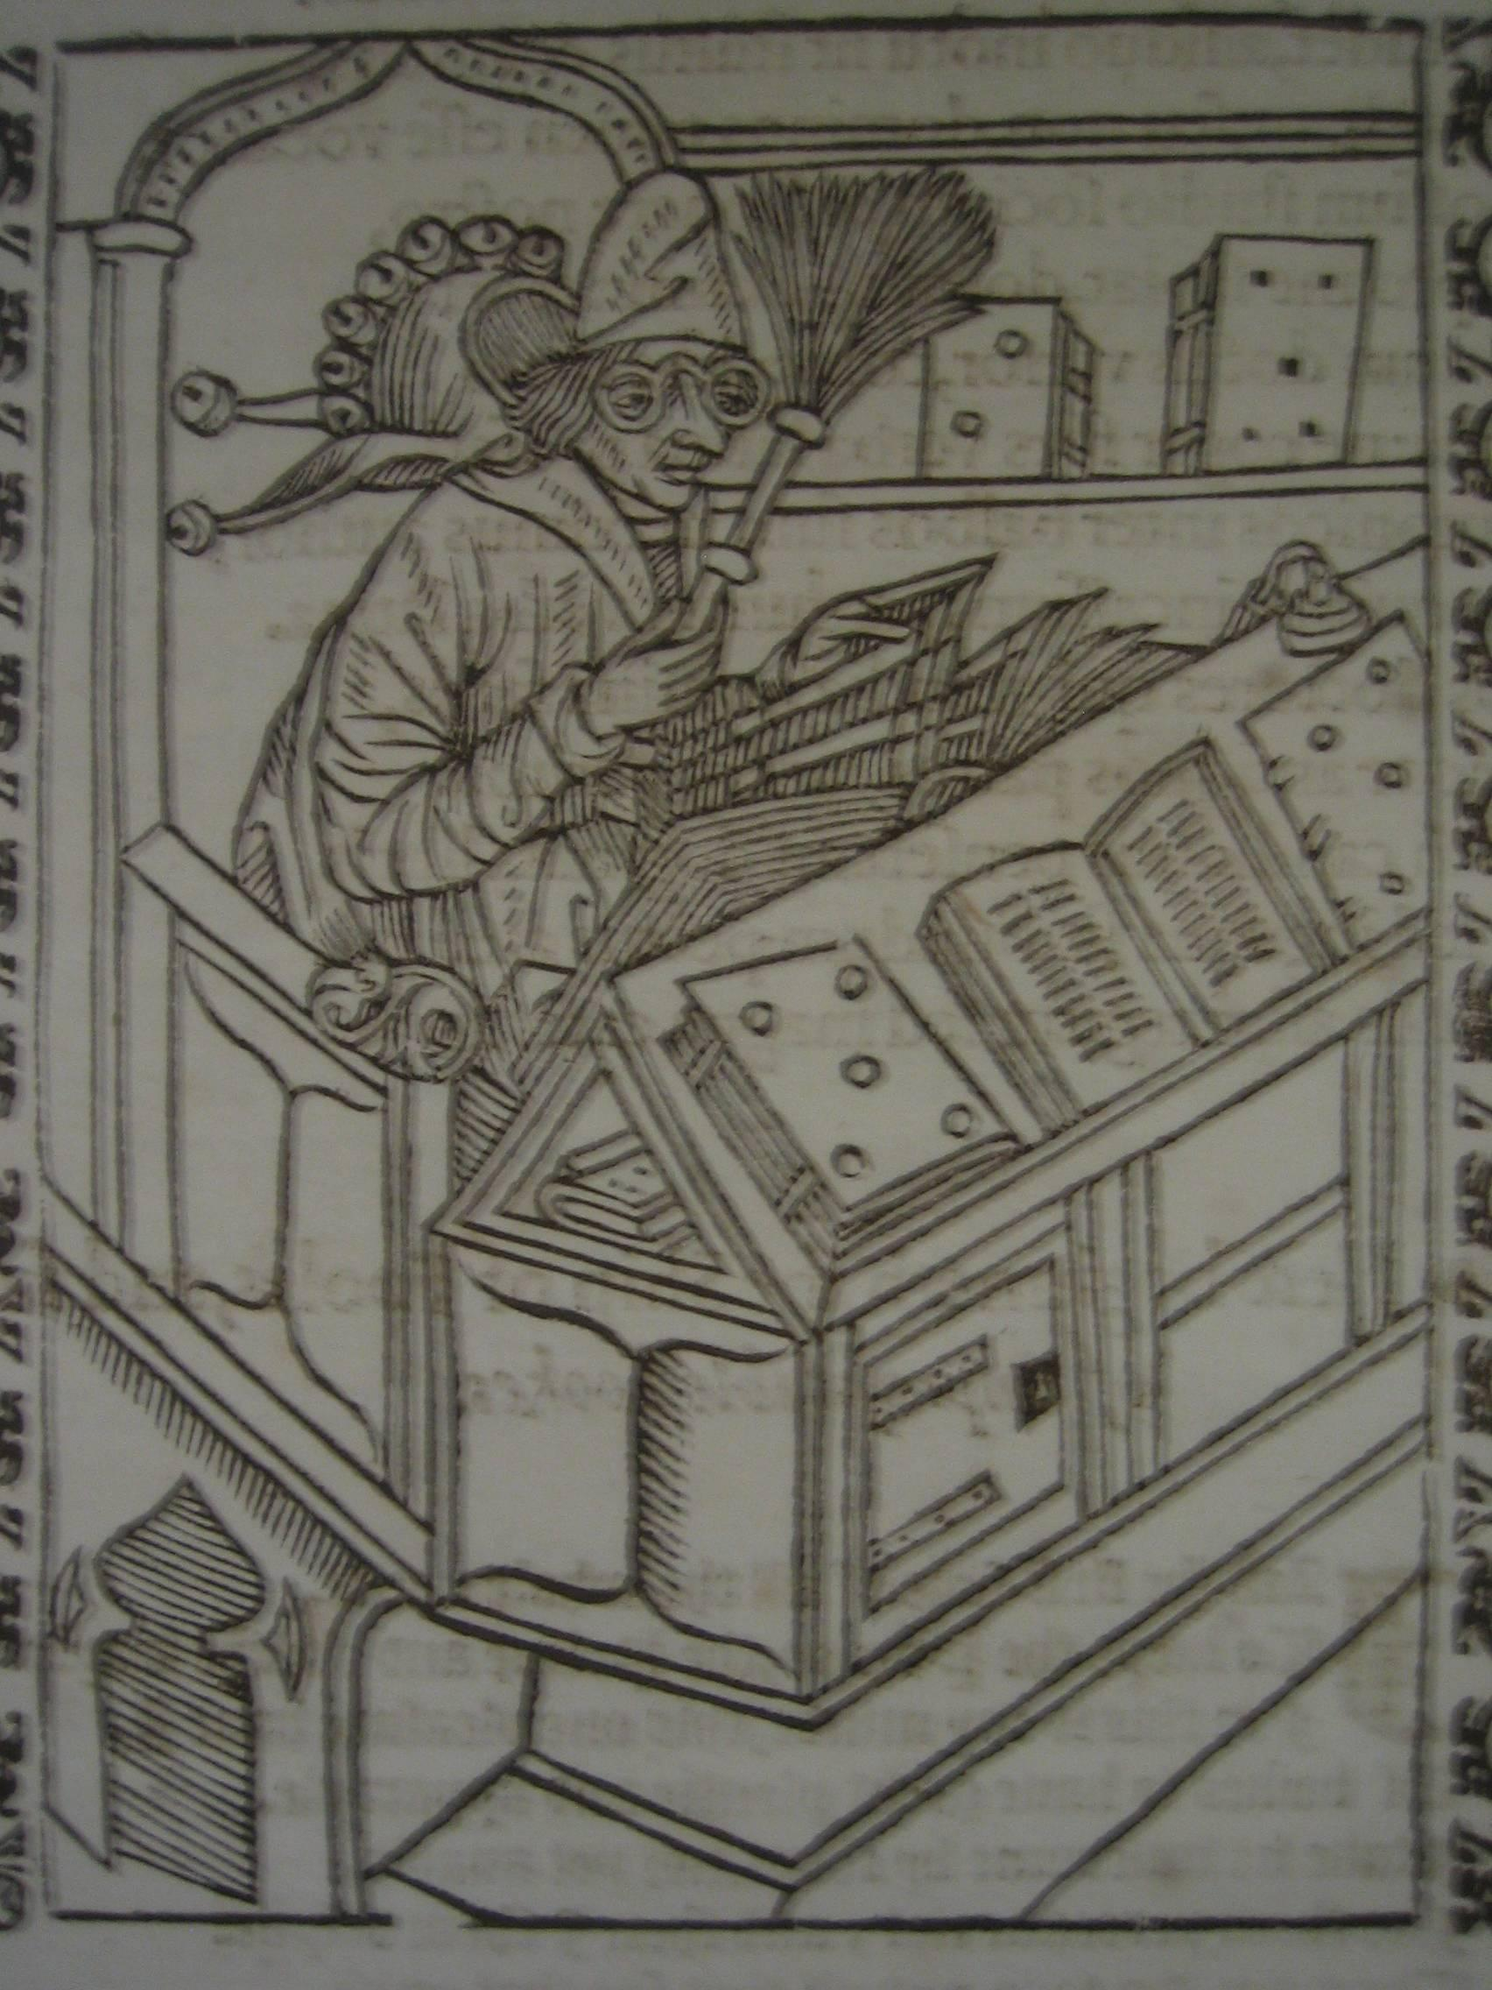
Selection has already been done
Don’t spend time selecting items to digitise
Capture materials as accessioned
  For important collections, capture it all
  For others, sample and allow user interest to guide your choices
Capture on demand
Capture ‘signposts’ and devote more attention when/where warranted
Woodcut from Sebastian Brant,
“Stultifera…” The ship of fooles… 1570
University of Edinburgh Library

Slide 17
Handle once (then iterate)
Handle incoming items once for both description and digitisation
Compromise on image resolution and metadata as needed to achieve throughput requirements
Create a single unified process
Let usage guide further efforts
Notes:
Aim to collapse decisions.

Slide 18
Have programmes not projects
Forget ‘special projects’ — it’s long past time to make this a basic part of our everyday work!
Digital capture must be embedded in our basic procedures, budgeting, etc.
Figure out a way to fund it yourself and you’ll figure out a way to do it cheaper

Slide 19
Engage your community
Do not describe everything in painstaking detail
Start with basic description, then…
…allow serious researchers to contact you for more detail, and…
…engage your user community with adding to the descriptions
Encourage them to submit their content too

Slide 20
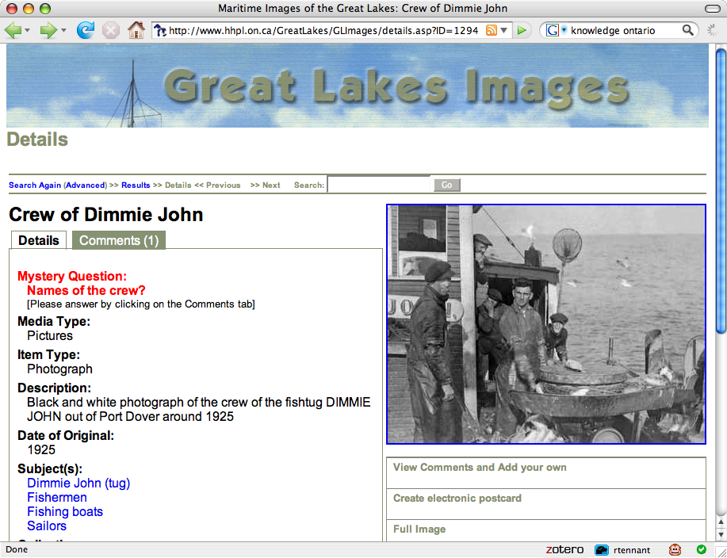
Notes:
Here’s an example from Ontario,

Slide 21
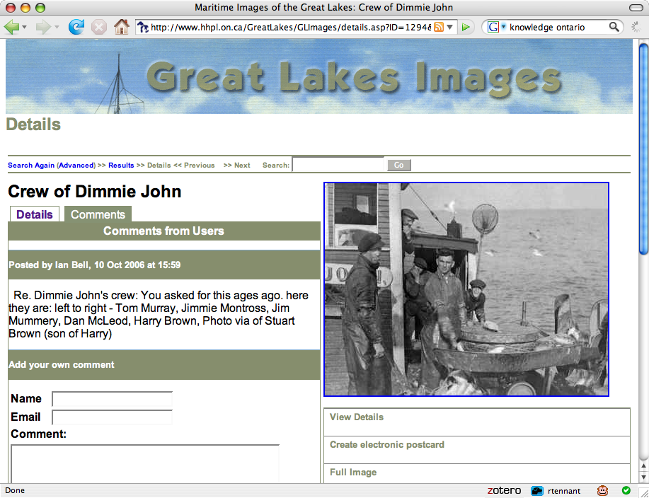
Notes:
An archive which uses a wiki to encourage contributions.

Slide 22
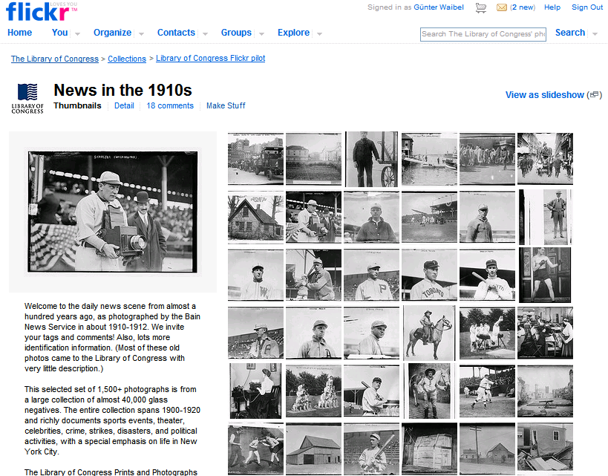
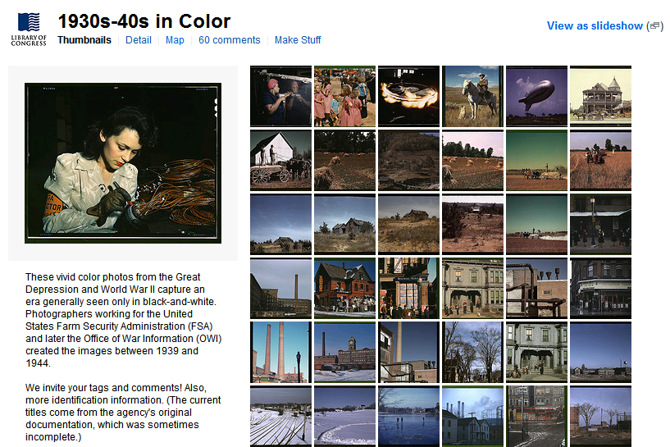
January 16th 2008: LC photographs on Flickr
Notes:
22

Slide 23
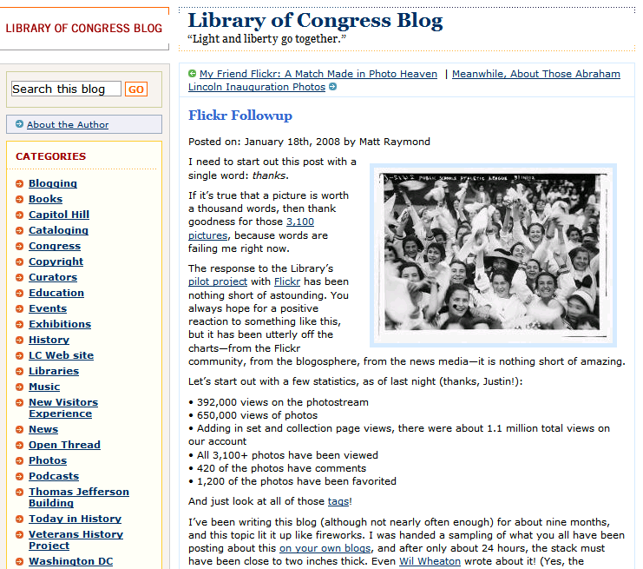
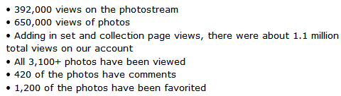
24 hours later
Exposure
Notes:
23

Slide 24
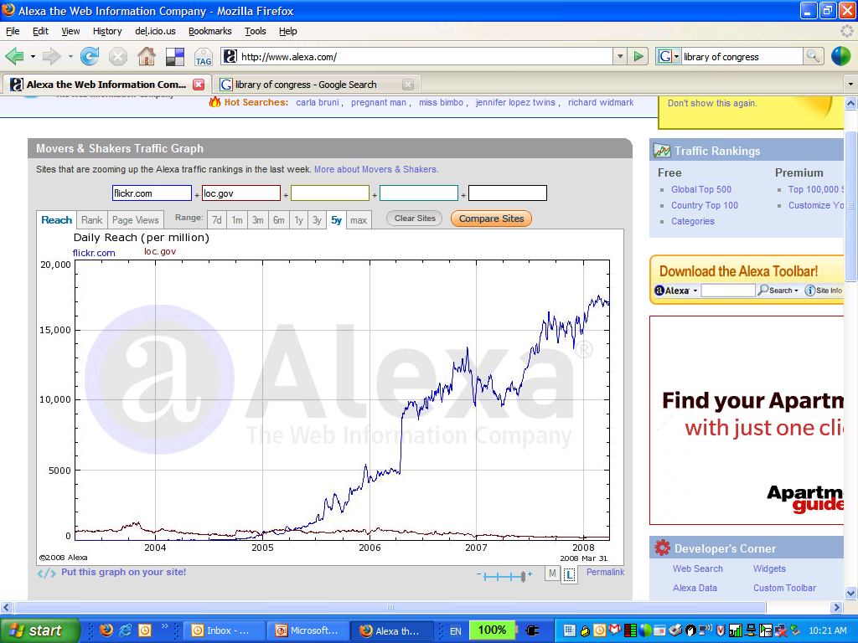
Impact: exposure
Flickr: Top 50
LC: Top 6000
Notes:
24

Slide 25
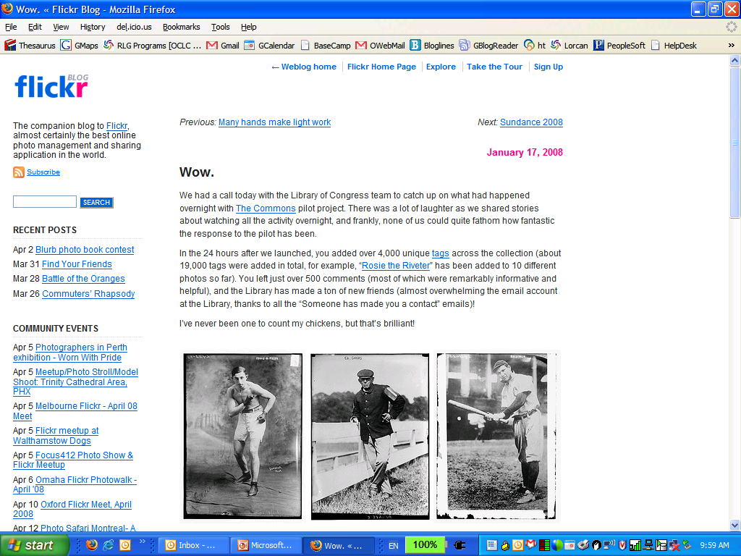
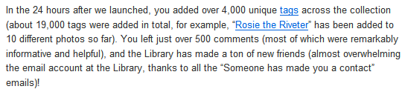
How to lose control
Contributions
Notes:
25

Slide 26
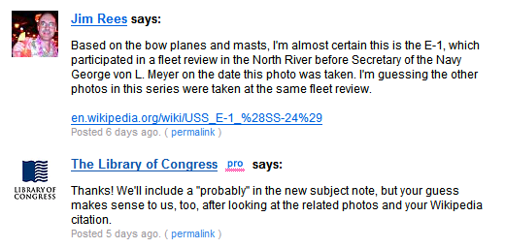
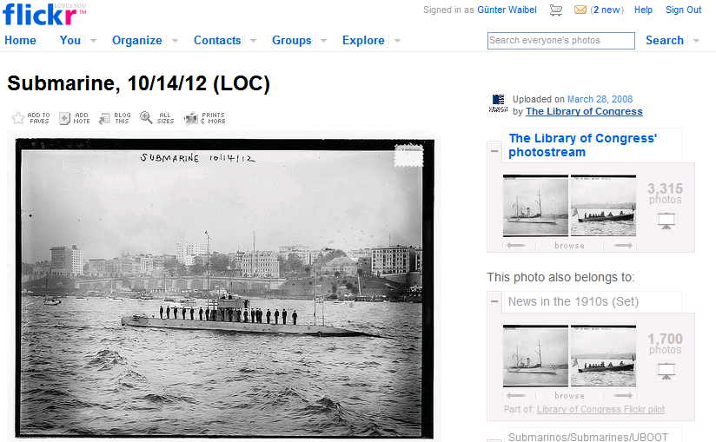
Go with it
Notes:
26

Slide 27
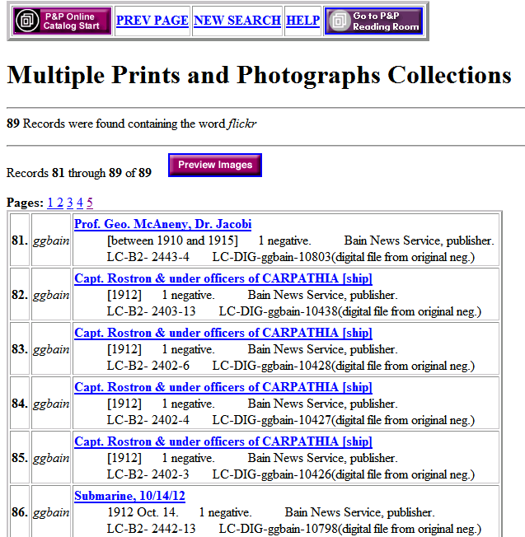
Feeding back into our work
89 records updated
Notes:
27

Slide 28
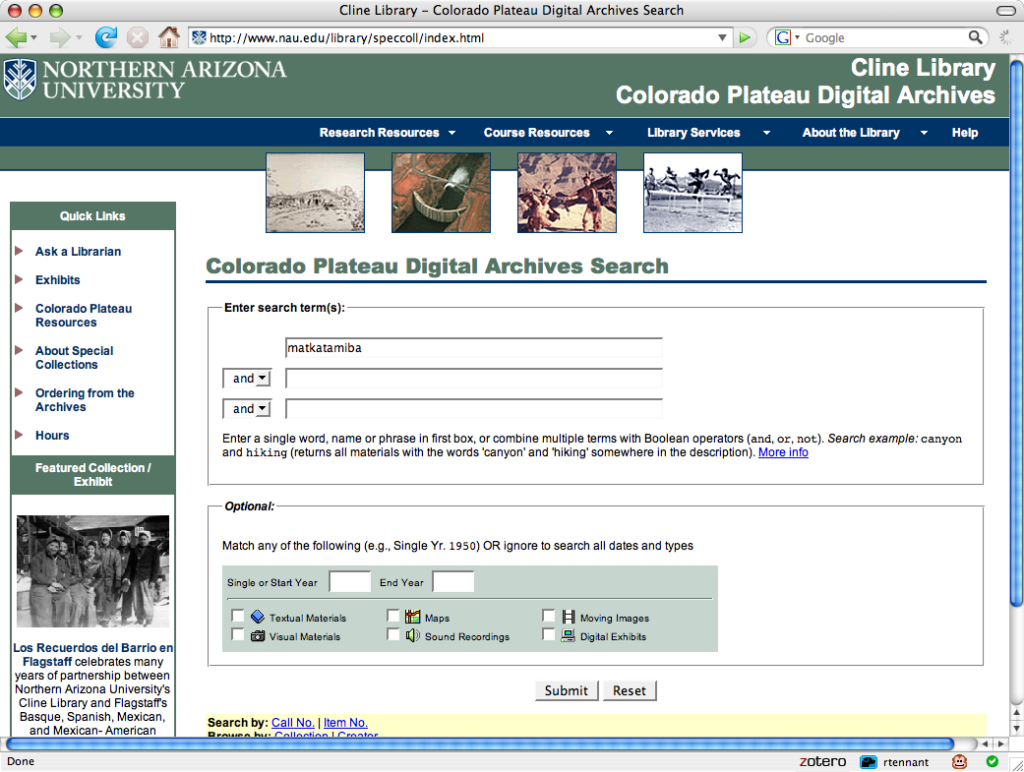
Notes:
Here is a worthy library effort.

Slide 29
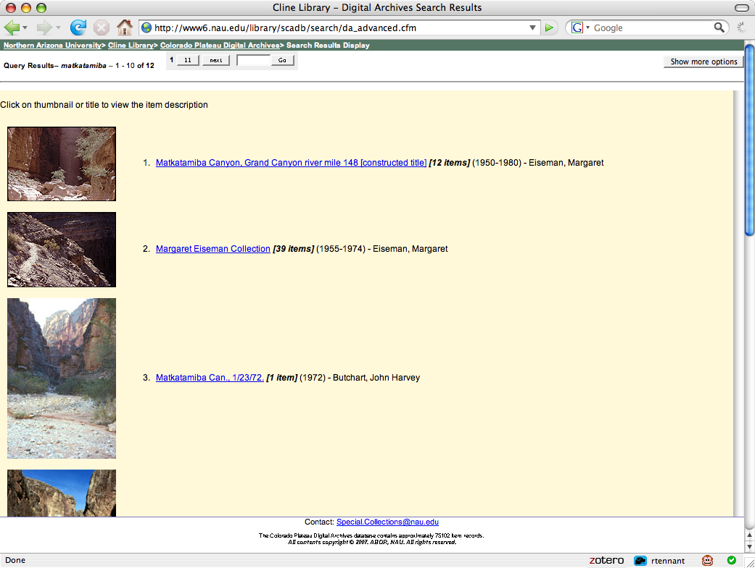

Slide 30
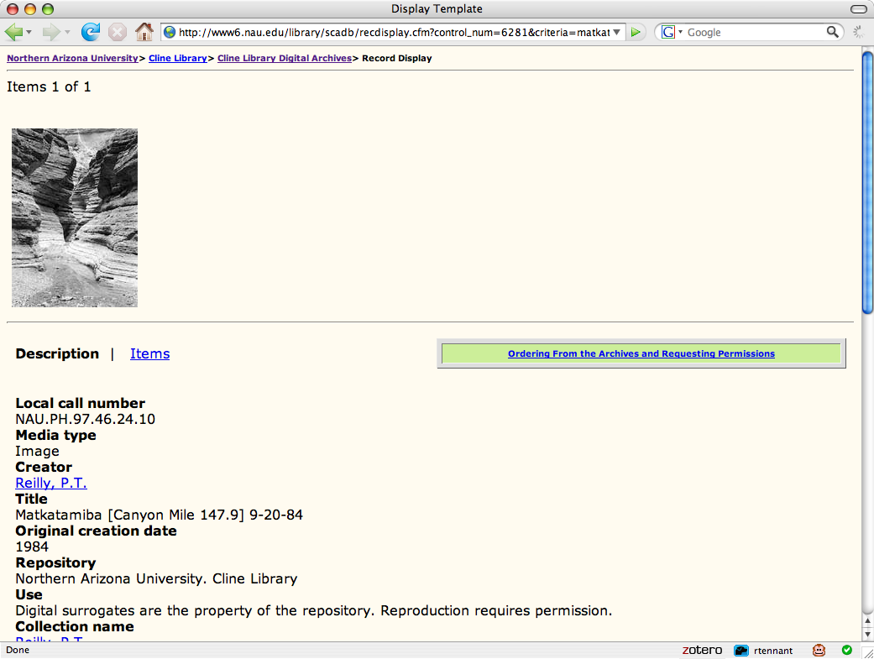

Slide 31
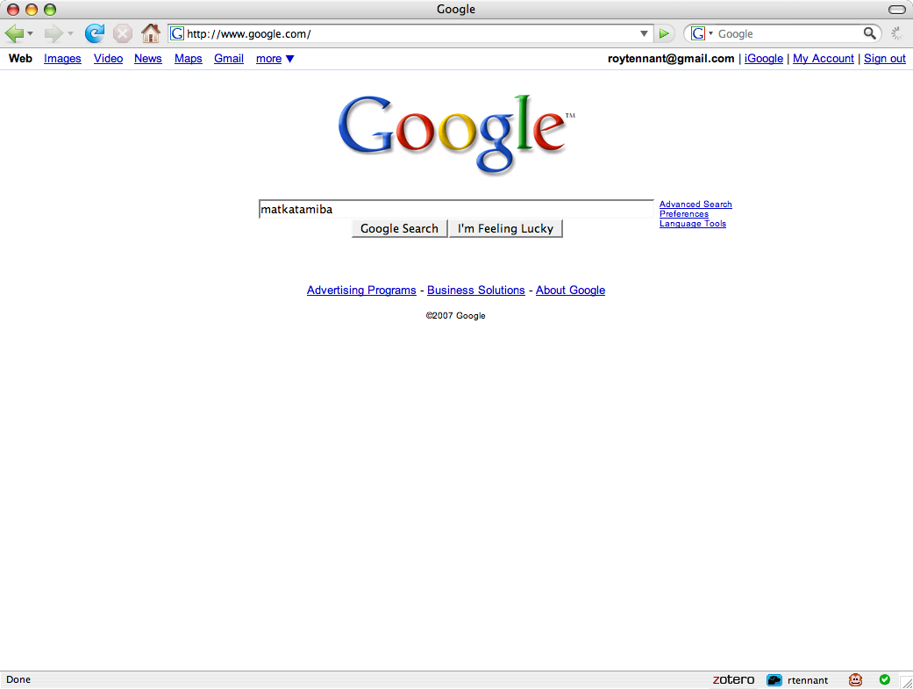
Notes:
Here’s the approach of choice.

Slide 32
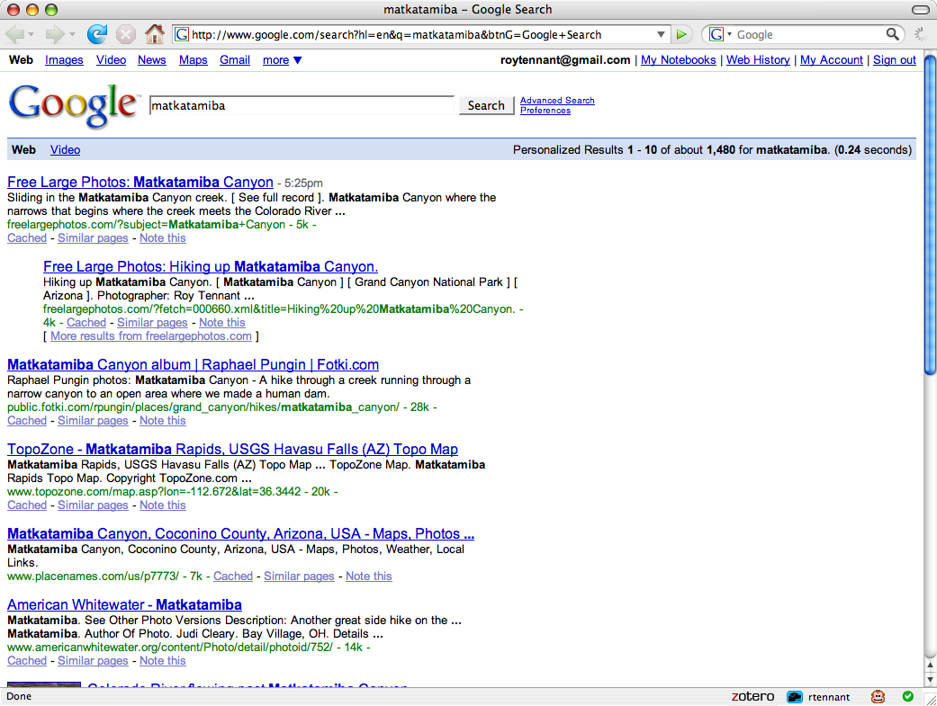

Slide 33
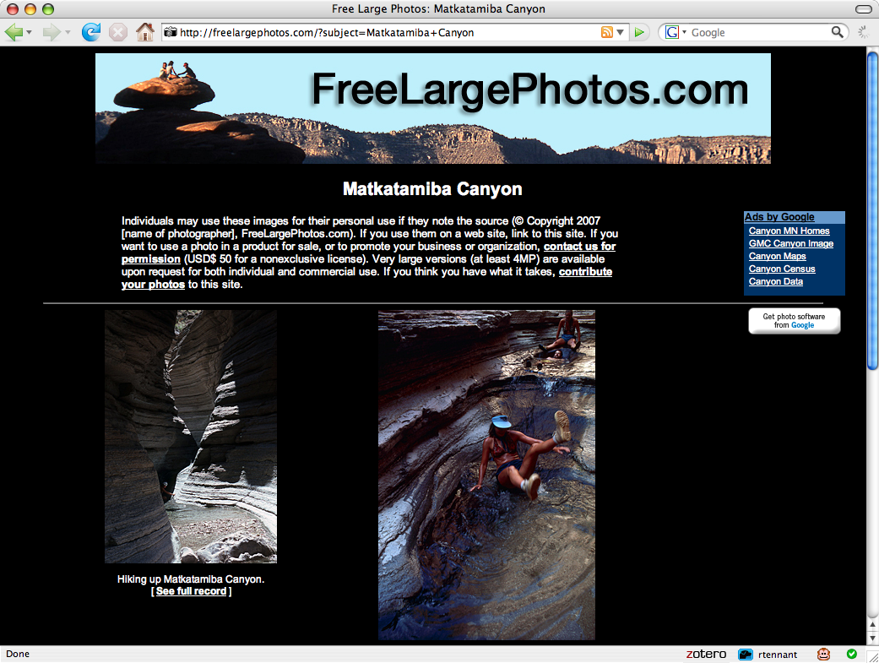
Notes:
Our community needs to take some lessons. We have the lead on the possession of content, but others have - or have had - the lead on innovation for content.

Slide 34
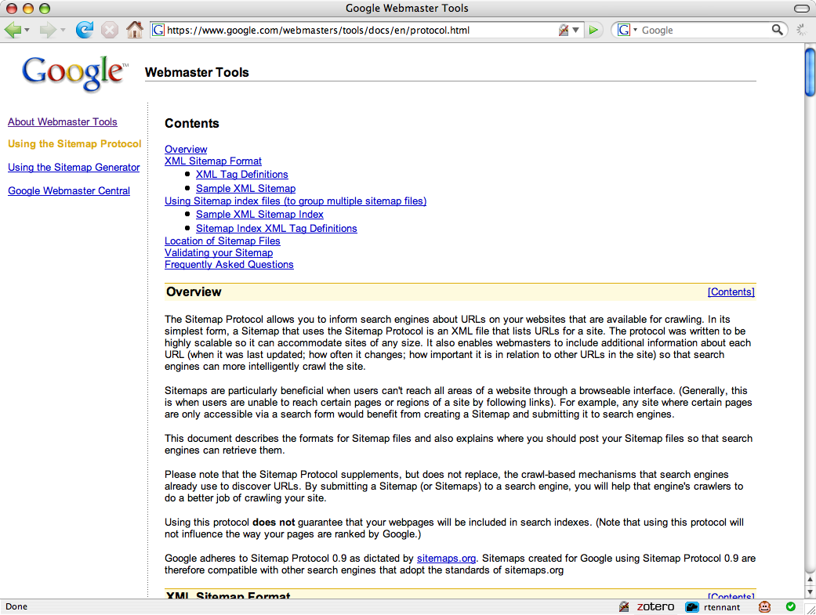
Notes:
We need to get smart, use SEO as required, and ensure that our sites are trawled to the appropriate levels. Google is the helicopter that the drowning man waved away …

Slide 35
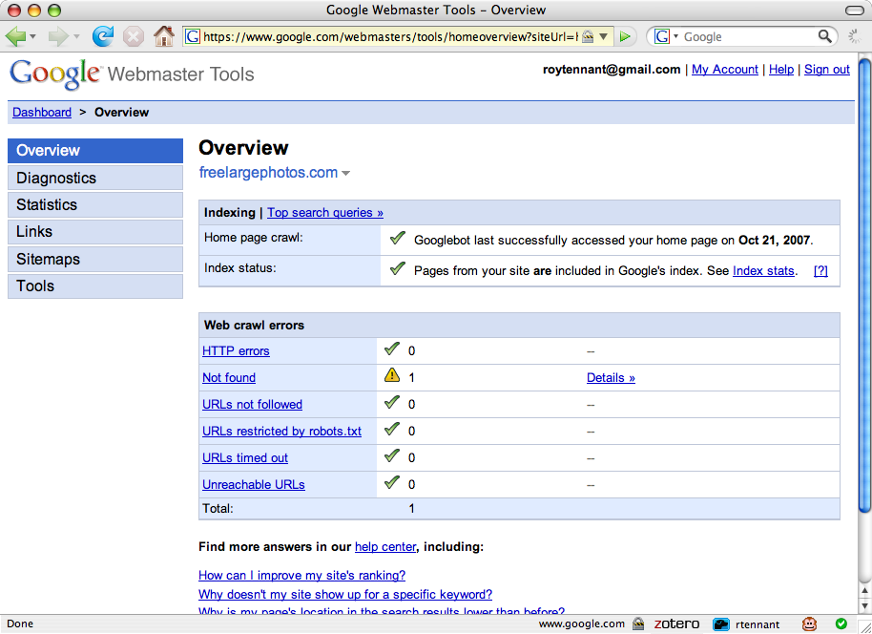
‘Gaming’, or good sense?

Slide 36
Quality vs quantity: quantity wins!
The perfect has been the enemy of the possible
Achieving excellence can have a substantial cost
Any access is better than none at all
Instead of measuring cataloguer/archivist output we should be measuring impact on users
Notes:
We tend to measure the wrong things. Measurement now should be all about usage. Our productivity measures should be shown in relation to usage. We have a lot to do in this area.

Slide 37
Discovery happens elsewhere
People don’t discover our content by coming to our lovingly crafted web sites
We must expose our content to web search engines and hubs like Flickr
Notes:
We can’t successfully emulate Flickr or Google. We must be present to them. By ‘learning from’ Google, Flickr and Yahoo!, we really mean ‘learning to’ use them.

Slide 38
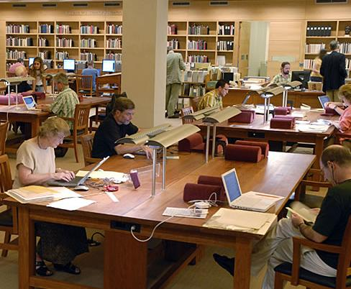
Example: Scan on demand
Change in Photoduplication Policy
As of March 17, 2008, the Ransom Center's policy regarding research copies of items from its collections will change. We will no longer furnish photocopies. For all requests received on or after March 17, our default procedure will be to make digital scans of the originals and furnish PDF files (72 dpi) either by email or on CD-ROM. For patrons who are unable to make use of PDFs, printouts will be available in lieu of digital files.
For publication purposes, high-resolution images will still be furnished on the same terms as before.
Harry Ransom Center, UT Austin
Notes:
38
A good tactic: scan on demand. But the Ranson Center has gone further, by collapsing routines - reducing ‘decision friction’ - and compromising on quality. Theirs is a lead for others to follow.
Scan when requested for research – HRC
Announcement:
Scan the whole thing
No matter what has been selected
Hand the scan to their digital library
(72 dpi and a pdf?)
With whatever metadata they happen to have
No new metadata
Also, preserves the originals, save them from repeated copying.

Slide 39
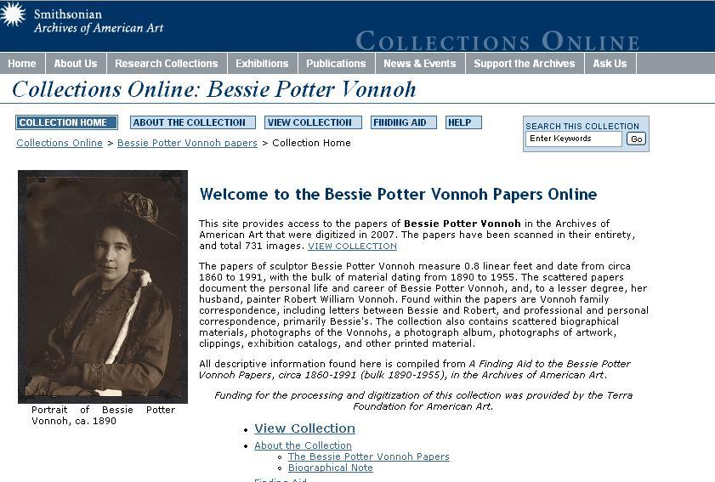
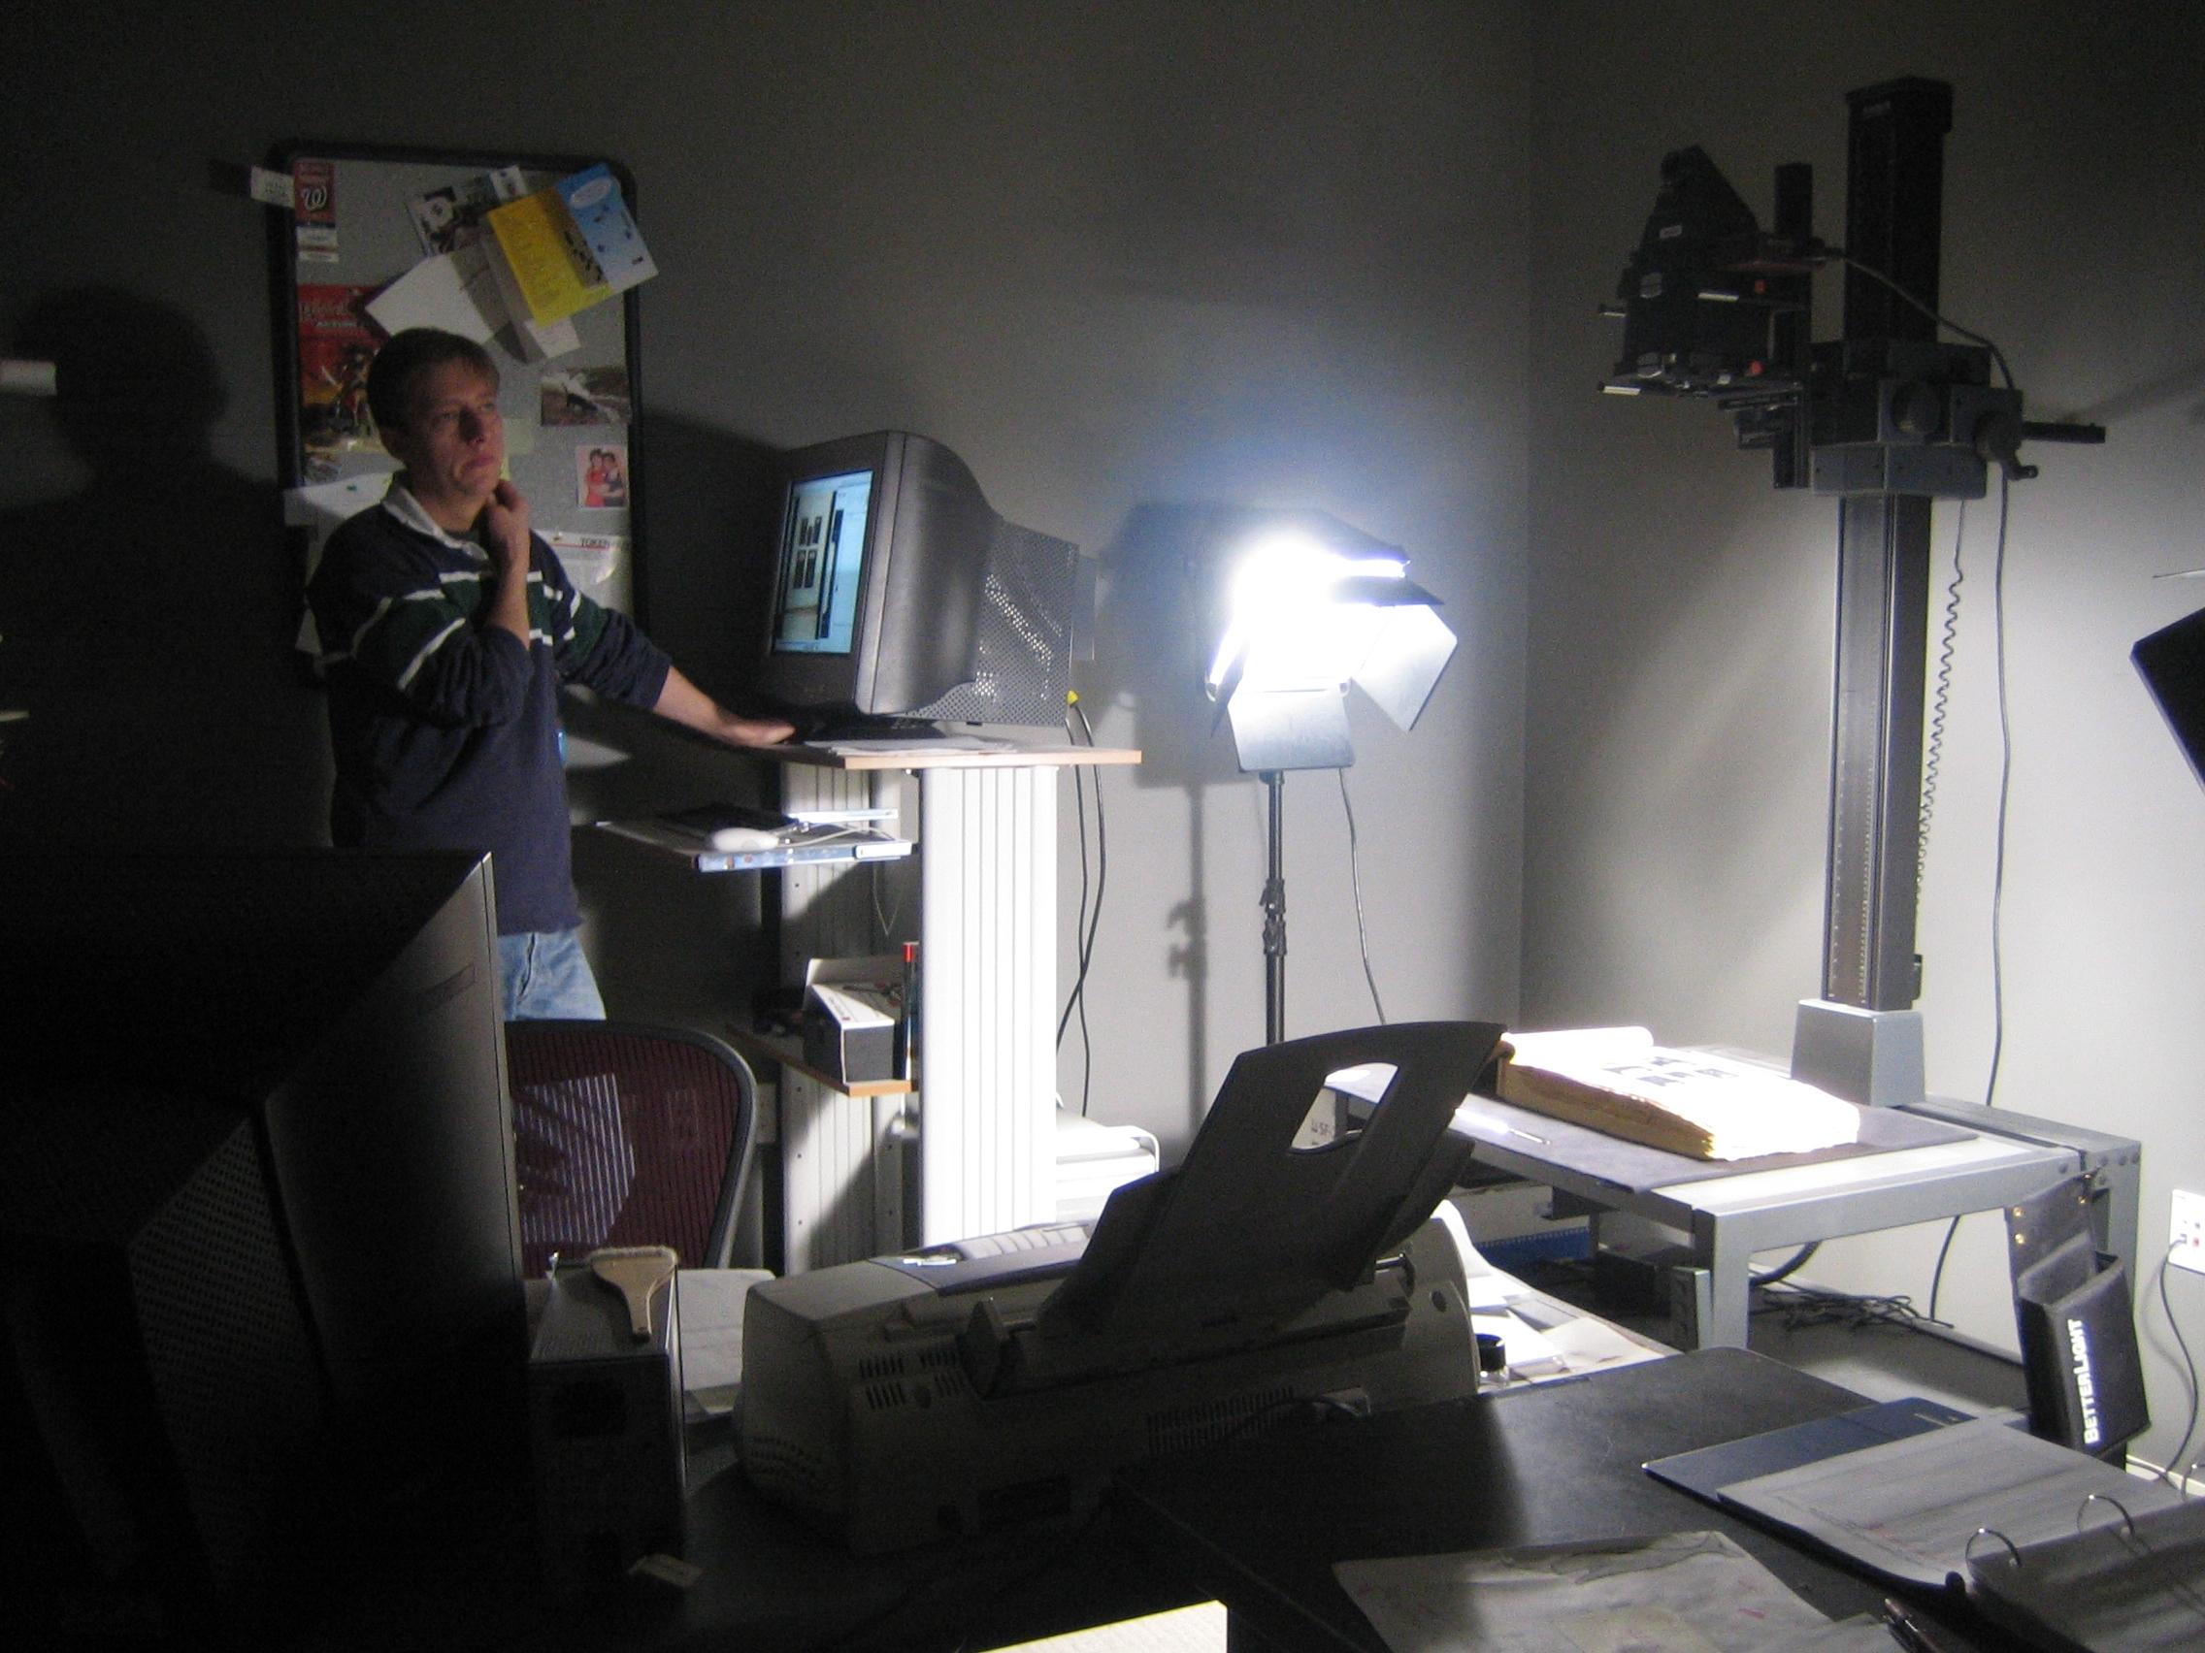
Combine approaches
Notes:
The Archives of American Art at the Smithsonian is using two tactics at one time
They’re scanning on demand for reading room requests – if they touch it, they scan it (as at the Ransom Center). Even if the request is only for a page, they scan the whole thing (an entire book or an entire folder of correspondence). They are building quite a resource of materials that, having been requested, are likely to be of interest again.
And they’re methodically scanning entire collections according to their archival arrangement – no cherry-picking, no decisions. The result is unprecedented access to the content and context of thousands of documents, photographs, diaries, sketches, writings, and rare published materials.

Slide 40
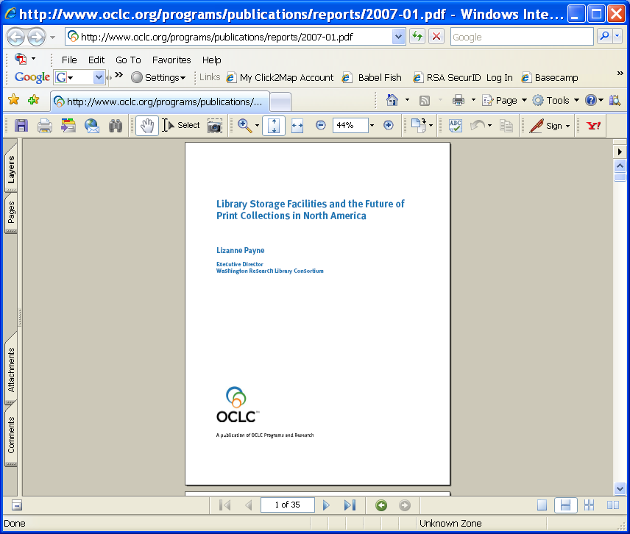
Library storage facilities
Recommendations for current storage institutions
  Aggressively archive print journals
  Implement last copies policies
  Disclose holdings
  Explore subscription models
Recommendations for the academic library community
  Define mechanisms for disclosure and associated services
  Consider a formal print repository network
  Develop sustainable business models
Notes:
Shared Print Program – Current Projects – these are working groups
Deaccession materials held in print and electronic form
Define policy and infrastructure requirements for building and managing shared print collections
Journal Preservation Project
Monograph Preservation Project

Slide 41
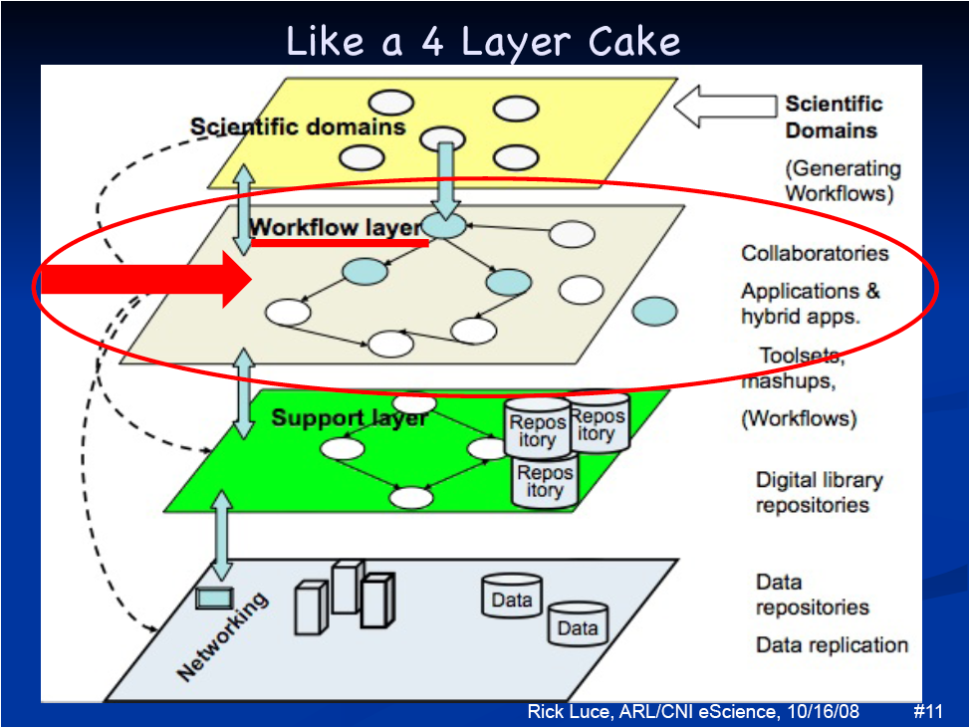
Research Information Management
Image: Rick Luce, Emory University
Notes:
Understand workflows in research assessment
Survey the academic research excellence landscape
Cultural variables
Funding regimes
Geographic impact
Technological infrastructures
Institutional adaptations

Slide 42
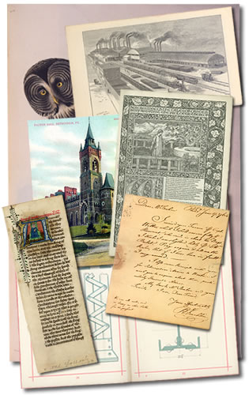
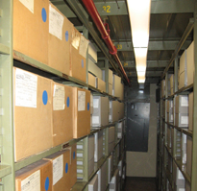
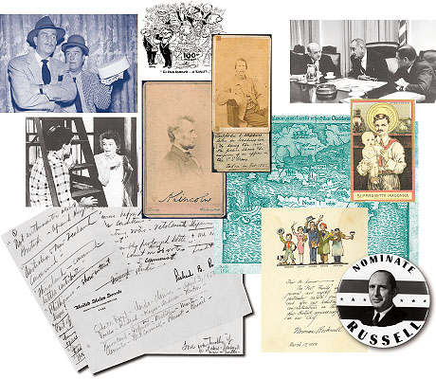
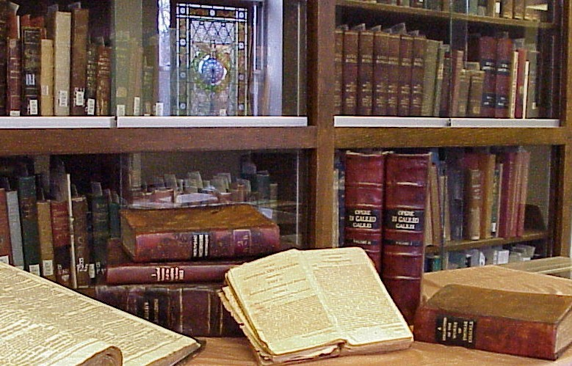
Mobilising Unique Materials
Assess current state of tools for archival description
Understand discovery behaviours
Increase scale of digitisation
Analyse delivery options for digitised content
Recommend future directions
Notes:
Projects:
[examples here of gathering evidence, working groups, collecting evidence, perhaps down the road some prototyping]
Assess backlog survey tools [working group]
Analyze EAD Tools [working group]
Define the state of holdings and description for archives [evidence?]
Define the state of “Hidden Collections” [evidence?]
Analyze archival discovery Environments [evidence?]
Synthesize delivery practices [best practices]

Slide 43
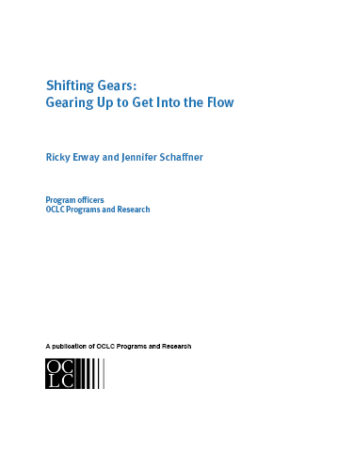
Effectively Disclosing Archives and Special Collections
While the mass digitisation partnerships have focused largely on published works, our approaches to archives and special collections can evolve to make a significant contribution
Notes:
Increase the scale of special collections digitization [best practices]

Slide 44
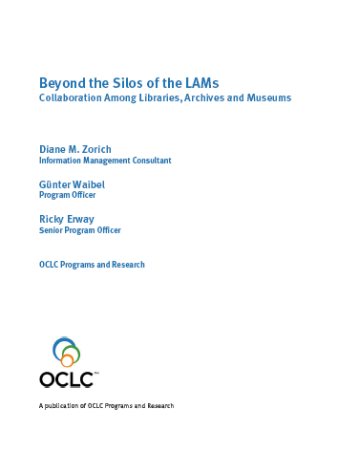
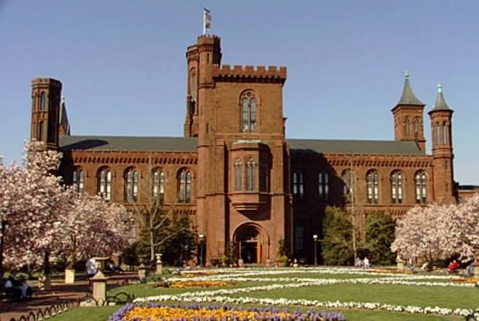
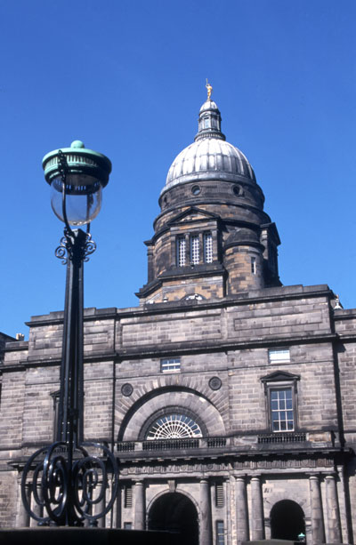
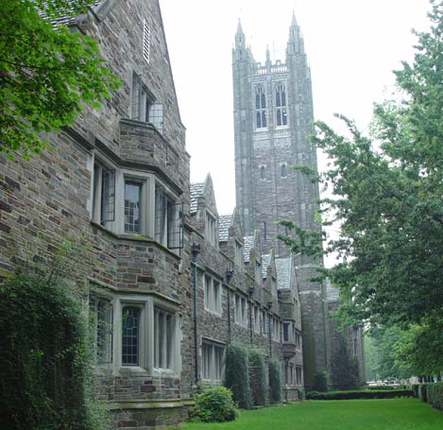
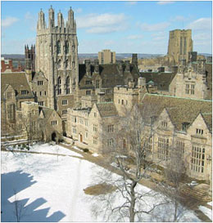

Unifying fragmented memories
Organisational and service relationships in multi-type institutions
Intention: bring about greater collaboration among libraries, archives and museums by surfacing models for sharing data, services and expertise
Smithsonian Institution
Princeton University
Edinburgh University
Yale University
V&A Museum

Slide 45

The power of datamining
(2005)
Rareness is common …
Notes:
Last copies – characterizing content and distribution of unique book holdings
Examining system-wide holdings for shared collection and community profiles
This is a good example of datamining for evidence
This research was done in 2005, and there are many more holdings in the database now.
This kind of work is a good example of the RLG partnership getting the advantage of the full force of OCLC Research.
Economics 101: Asset valuation (Courant)
Balance sheet:
print collections = an institutional asset
digital collections = liability
In reality, digital collections deliver greater value to users; print collections represent a continuing cost with little direct return
Must recalibrate the university administration’s understanding of how collections deliver value to research institutions and users
Value of collections will be maximized when they are effectively concentrated (jointly owned and managed) and diffused (into the network)
Assessing overlap and characterizing uniqueness in system-wide holdings, enabling institutions to make better informed
decisions about the disposition of local holdings
Source: Books without Boundaries: A Brief Tour of the System-wide Print Book Collection
Roger C. Schonfeld, Brian F. Lavoie
Ann Arbor, MI: Scholarly Publishing Office, University of Michigan, University Library
vol. 9, no. 2, Summer 2006
URL: http://hdl.handle.net/2027/spo.3336451.0009.208

Slide 46

Knowledge Structure: structure for controlled data: metadata workflows
Notes:
WorldCat Identities leverages both the vocabularies that catalogers have been including in bibliographic records and OCLC Research’s datamining techniques to provide much richer information about persons and organizations than you can find in the LC/NACO Authority File – or the national authority files from other countries.
WorldCat Identities is mined from all the names in catalog records, not just the controlled names, linked to and from the publications.
The number of different works and titles in different languages and worldwide holdings at the top comes from WorldCat. The publication timeline differentiates works by the person (including those published posthumously) and works about the person. Note that in the “Alternate Names” section in the right frame we have a number of names represented in non-Latin scripts – Sun Yat-sen’s name as it appears in Chinese, Japanese, and Hebrew-language publications. These are alternate forms not yet in the LC/NACO Authority file – we will be using these forms datamined from WorldCat to pre-populate the LC/NACO Authority files when all NACO nodes start supporting non-Latin scripts in April 2008.
This is also an example of RLG Programs working with OCLC Research colleagues – 95 staff from 21 RLG Programs partners beta-tested an earlier version of WorldCat identities in February – April 2007, and made good suggestions that were incorporated.
A version of WorldCat Identities is being incorporated into WorldCat.org. Programs and Research is looking at what else is needed to make the Identities resource available as a Web service that other applications can use.

Slide 47

Multilingual authorities
Notes:
VIAF: Virtual International Authority File
The Deutsche Nationalbibliothek, the Library of Congress, the Bibliothèque nationale de France, and OCLC are jointly conducting a project to match and link the authority records for personal names in their retrospective personal name authority files . This relates to (and builds on?) earlier TEL LEAF work. Recently, a number of additional national libraries have decided to join: the Czech Republic, Portugal, Sweden, Spain, Italy, Denmark, Norway, Slovenia, China, Japan and Israel.

Slide 48

Terminology Services architecture
Notes:
The Terminology Services Prototype has three main components:
Content (controlled vocabularies)
Web services
Applications (created by software developers internal & external to OCLC)

Slide 49

Web-scale, Grids and Clouds …
Notes:
How to make Worldcat a worldwide library switch.

Slide 50


Registries: ‘the intelligence in the network’
This registry will ultimately lead to the creation of a consistent, accepted process for libraries, archives and museums to provide access to high-risk or special collection materials.
Notes:
Work undertaken by the RLG Partnership was an early step in contributing to the development of the Copyright Evidence Registry. Current work focuses on developing best practices for dealing with published “orphan works.” The CER acts as a repository for evidence gathered in the course of copyright investigations, and includes information resident in WorldCat, user input data, and data from other sources (such as the Stanford Copyright Renewals Database).
What possibilities with Google Books deal?

Slide 51

“It is not the strongest of the species that survives, nor the most intelligent
that survives.
It is the one that is the most adaptable to change.”
—Charles Darwin
Image: Auckland Museum

Slide 52

Residual Risks (High)
Availability of online information resources (Google, etc.) weakens visibility and value of library.
User base erodes because library value proposition is not effectively communicated.
Conservative nature of library inhibits timely adaptation to changed circumstances.
Impact
12
Effective network disclosure
1
6
14
Move new services ‘into the flow’
Conservative nature of library inhibits timely adaptation to changed circumstances.
Recruitment and retention of resources is difficult due to reduction in pool of qualified candidates.
Value Proposition
Articulate compelling new vision to
attract a new generation of library
professionals
Human Resources
Durable Goods
Legacy Technology
These risks will remain high but can be managed.
Notes:
The high risks that remain after mitigation.
Can some coordinated action change these residual risks, or make them less threatening to individual libraries?
1 – [click] Our best strategy is to focus on more effective disclosure of library assets
6 – [click] Must develop new services that are “in the flow” of research practices; this will require reallocation of resources that is only possible after changes in library operations are tackled
12 – our culture won’t change until our organizations do
14 – this is a problem for library schools, not libraries – but the solution requires a new library value proposition capable of attracting a new generation of professional.

Slide 53


Connect to a think-tank!
Notes:
OCLC Research does research into research (libraries)! W have been called a ‘community think-tank’. We have an advantage over other such organisations in that what we think about, collaboratively with our Partners, can be translated into real services built upon a web-scale cooperatively-built dataset.

Slide 54

Děkuji
Thank You
John MacColl
maccollj@oclc.org
OCLC Research

