Slide 1
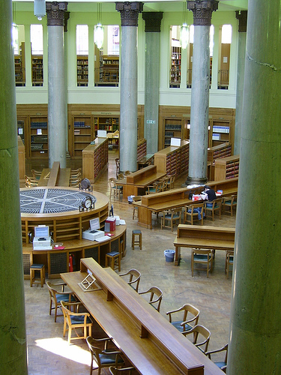
Scaling up Digitisation of Special Collections
John MacColl, European Director
RLG Programs
OCLC Research
University of Leeds
23 October 2008
Brotherton Library, Leeds University. flickr image by isemantics

Slide 2
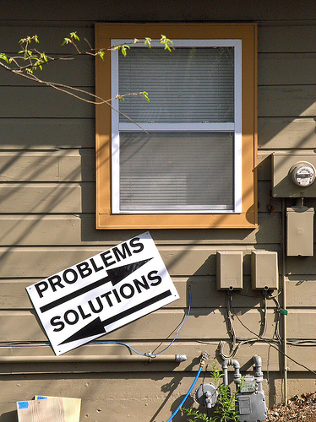
A presentation in two halves
Problems -> solutions <- flickr image by Eisenvater

Slide 3

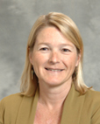


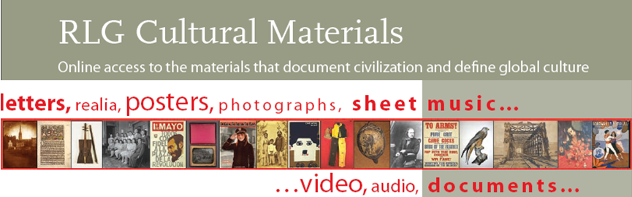
Ricky’s Chequered Past
Notes:
Ricky Erway has worked on a number of digitisation initiatives.
--CLICK At the Library of Congress in the early 1990s, she worked on American Memory, a large digitisation initiative. They determined the best quality possible for digitising the Library’s special collections -- and then did it, assuming they’d only have one chance, so they’d better get it right.
--CLICK Her first project at RLG in the mid-1990s, was a collaborative text digitisation project. She determined the highest quality they could capture and required it, assuming they’d only have one chance, so they’d better get it right.
--CLICK She was then product manager for RLG Cultural Materials, an aggregation of a quarter of a million items from 117 collections contributed by 36 libraries, archives, and museums from the US, Canada, the UK, Europe, Japan, and Australia. She issued quality standards for metadata and for digitisation, helping others to get it right.
These digitisation initiatives focused on both preservation and access.
But today she says that that approach no longer makes sense.

Slide 4
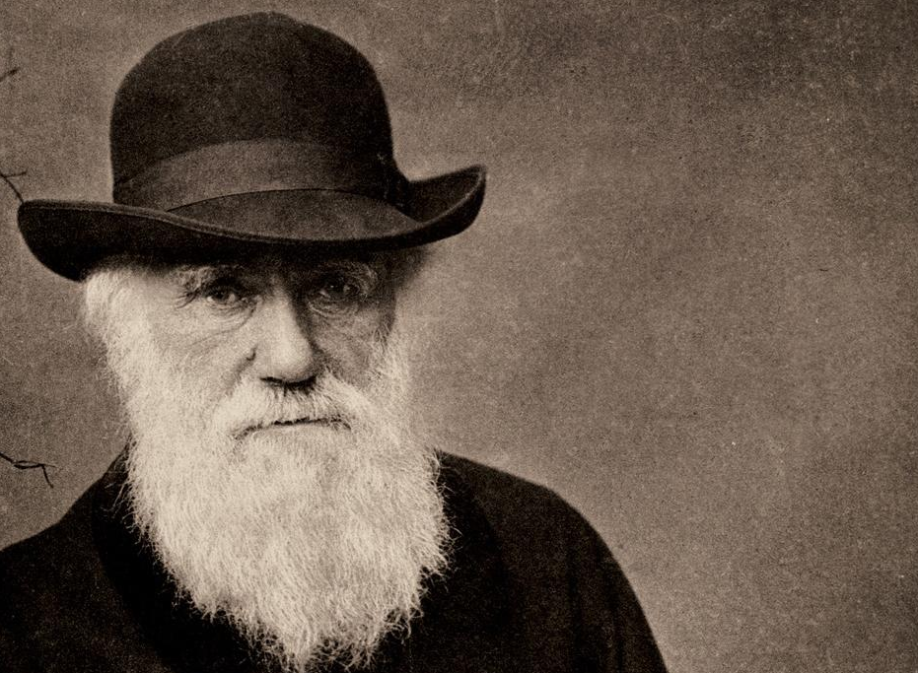
“It is not the strongest of the species that survives, nor the most intelligent
that survives.
It is the one that is the most adaptable to change.”
—Charles Darwin
Image: Auckland Museum
Notes:
In her defence, she liks to share what Darwin actually said about who survives – those who are most adaptable to change.
So let’s think about change.

Slide 5
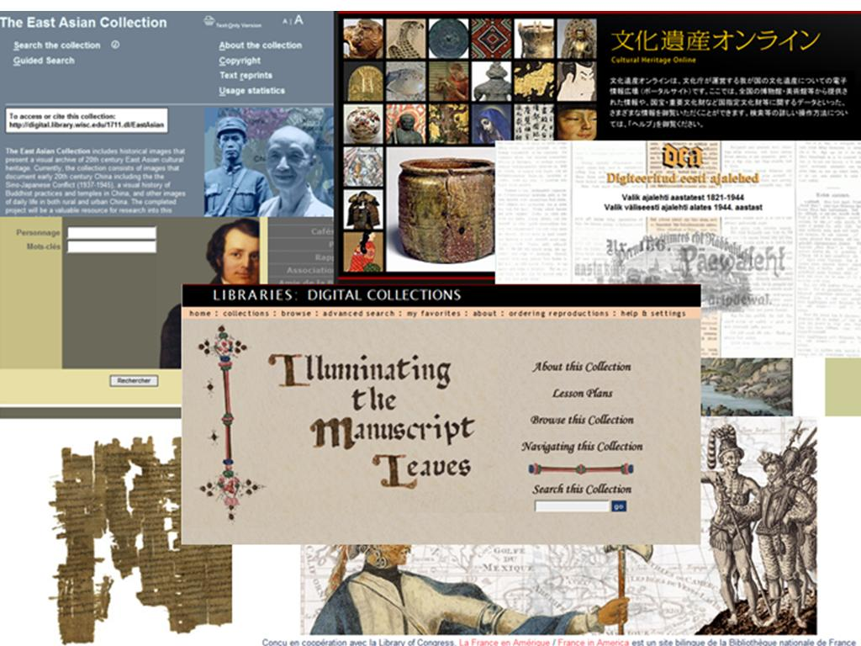
Notes:
Those careful, high-quality capture projects many of us were involved in resulted in some nice digital collections. But we really weren’t getting anywhere. We have lovely little collections of content here and there – and very few users. We supplied; they did not demand.
Our gorgeous, expensive, hand-crafted websites were innovations at the time.
But things have changed.

Slide 6
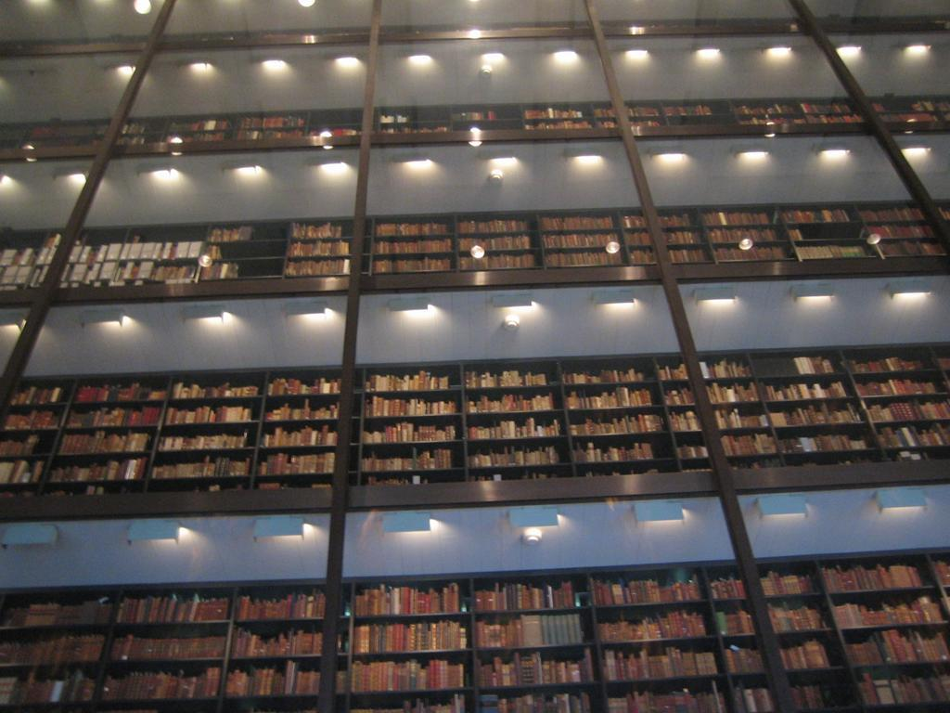

Yale University
Notes:
Along comes Google and they’ve completely changed the way we’re thinking about digitisation of books. We used to think books were the hardest part of library digitisation (with their sequence and hierarchy, hundreds of images, text conversion …) – we didn’t imagine we’d ever digitise all the books. By focusing on quantity over quality, Google has made the seemingly impossible quite doable.
Google supplied and changed demand.
Now, with millions of books flying off the shelves and “into the flow,” we need to change the way we think about digitisation of special collections. Soon students will only look online -- what’s not there will not be considered.
As we increasingly share a collective collection of books, it is the special collections that will distinguish our institutions. Yet ironically they run the risk of being marginalised. If they aren’t accessible, they aren’t used; if they aren’t used, they go away. Neglect leads to obsolescence.
It is our job to offer up these materials to the demand Google has created.
People want scale. Why do you choose amazon.com over waterstones.com? In case you miss something. We want to give ourselves the best possible chance of finding what we are after. Watersones.com is analogous to the library catalogue; it’s used for ‘conveneience searching’ (like the corner shop). When we know it’s likely to have what we need, we’ll look there. See recent study at U California (Melvyl).

Slide 7
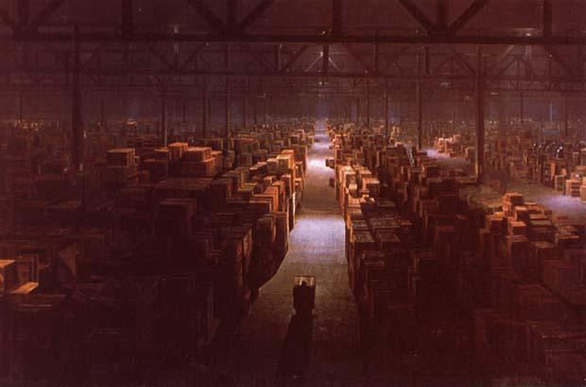
Image: Raiders of the Lost Ark
Notes:
Manuscripts, archives, ephemera, photographs, postcards, scrapbooks, clippings files, maps, architectural records -- so many of our special collections are hidden in boxes in warehouses. No one knows what’s there.

Slide 8
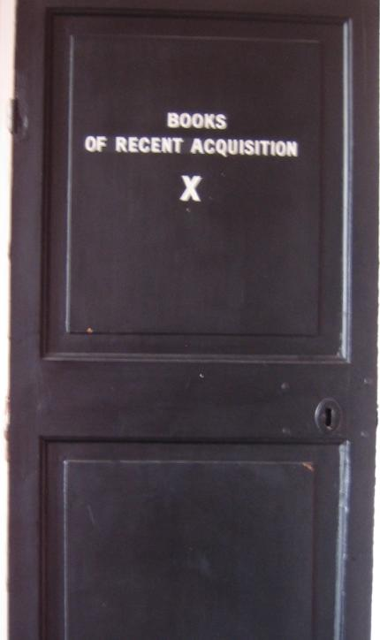
Marsh’s Library, Dublin
Notes:
Unprocessed materials are absolutely hidden from view.
No one is demanding to look in our supply rooms, because they have no idea what is there.

Slide 9
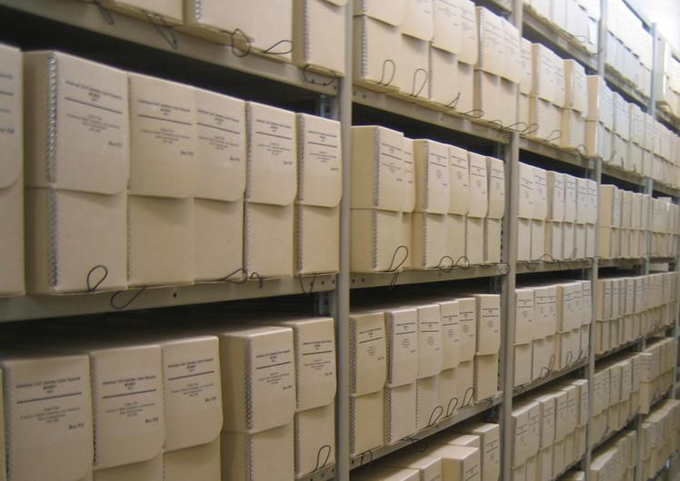
Princeton University Archives
Notes:
But even processed materials can remain hidden. Our first order of business is to describe them, and then to push the descriptions to the surface of the web where people can discover them.
We can hide those treasures in our stacks or we can push them out into the light of day.
And describing them is just the start.

Slide 10
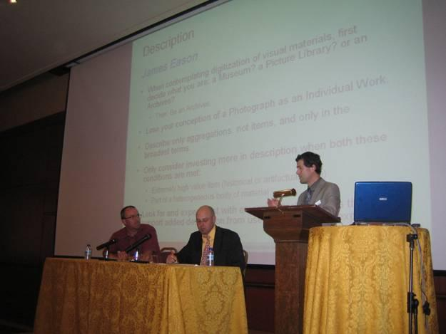
Digitization Matters Symposium
Notes:
RLG held an event last fall to discuss ways to increase the scale of digitisation of special collections.
We challenged our speakers to make very provocative suggestions. The audience, of over 200 people, discussed their relative merits. Jennifer Schaffner and Ricky Erway wrote the Shifting Gears essay, based on the outcomes of that event.
This presentation will highlight some of those ideas. They won’t all make sense in every situation, but some of them will be applicable for your collections.
The second half of the presentation will provide examples of places where the principles are being put into practice.

Slide 11
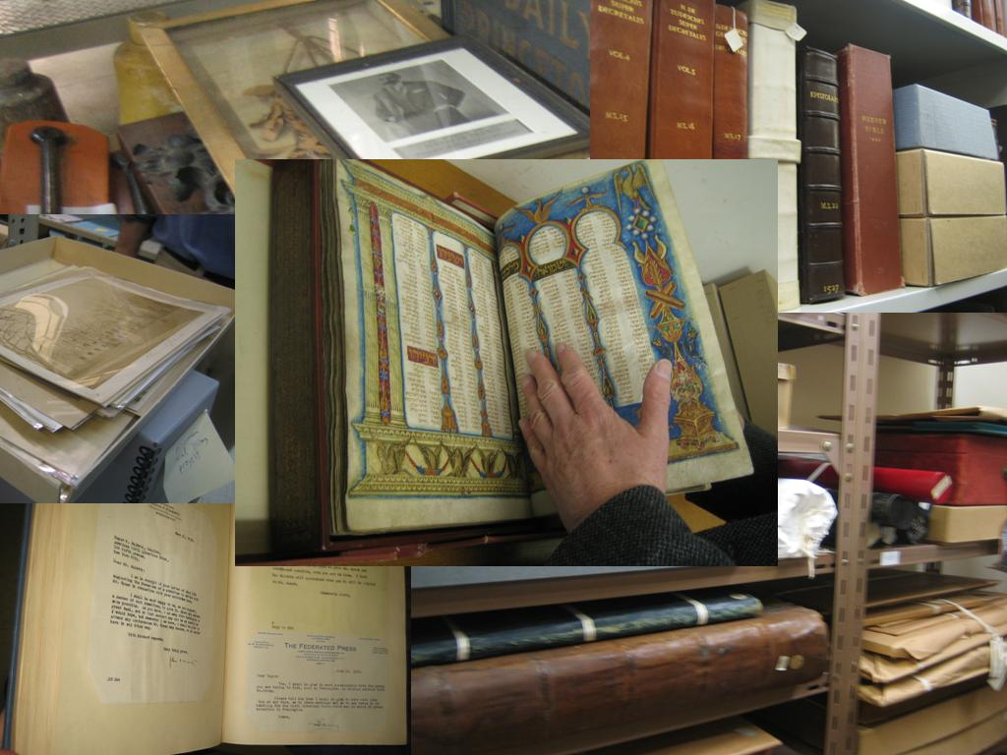
Notes:
Due to their very specialness, we are committed to preserving the originals in our special collections. Why then must we approach digitisation from a preservation point of view? Of course there are exceptions (brittle where we may in fact only get one chance), but in the main, our digitisation should be in service to increased access.
By increasing access we increase the perceived value of our collections. If we don’t, we may not be here (or have sufficient funds) to continue collecting and preserving originals for our collections.

Slide 12
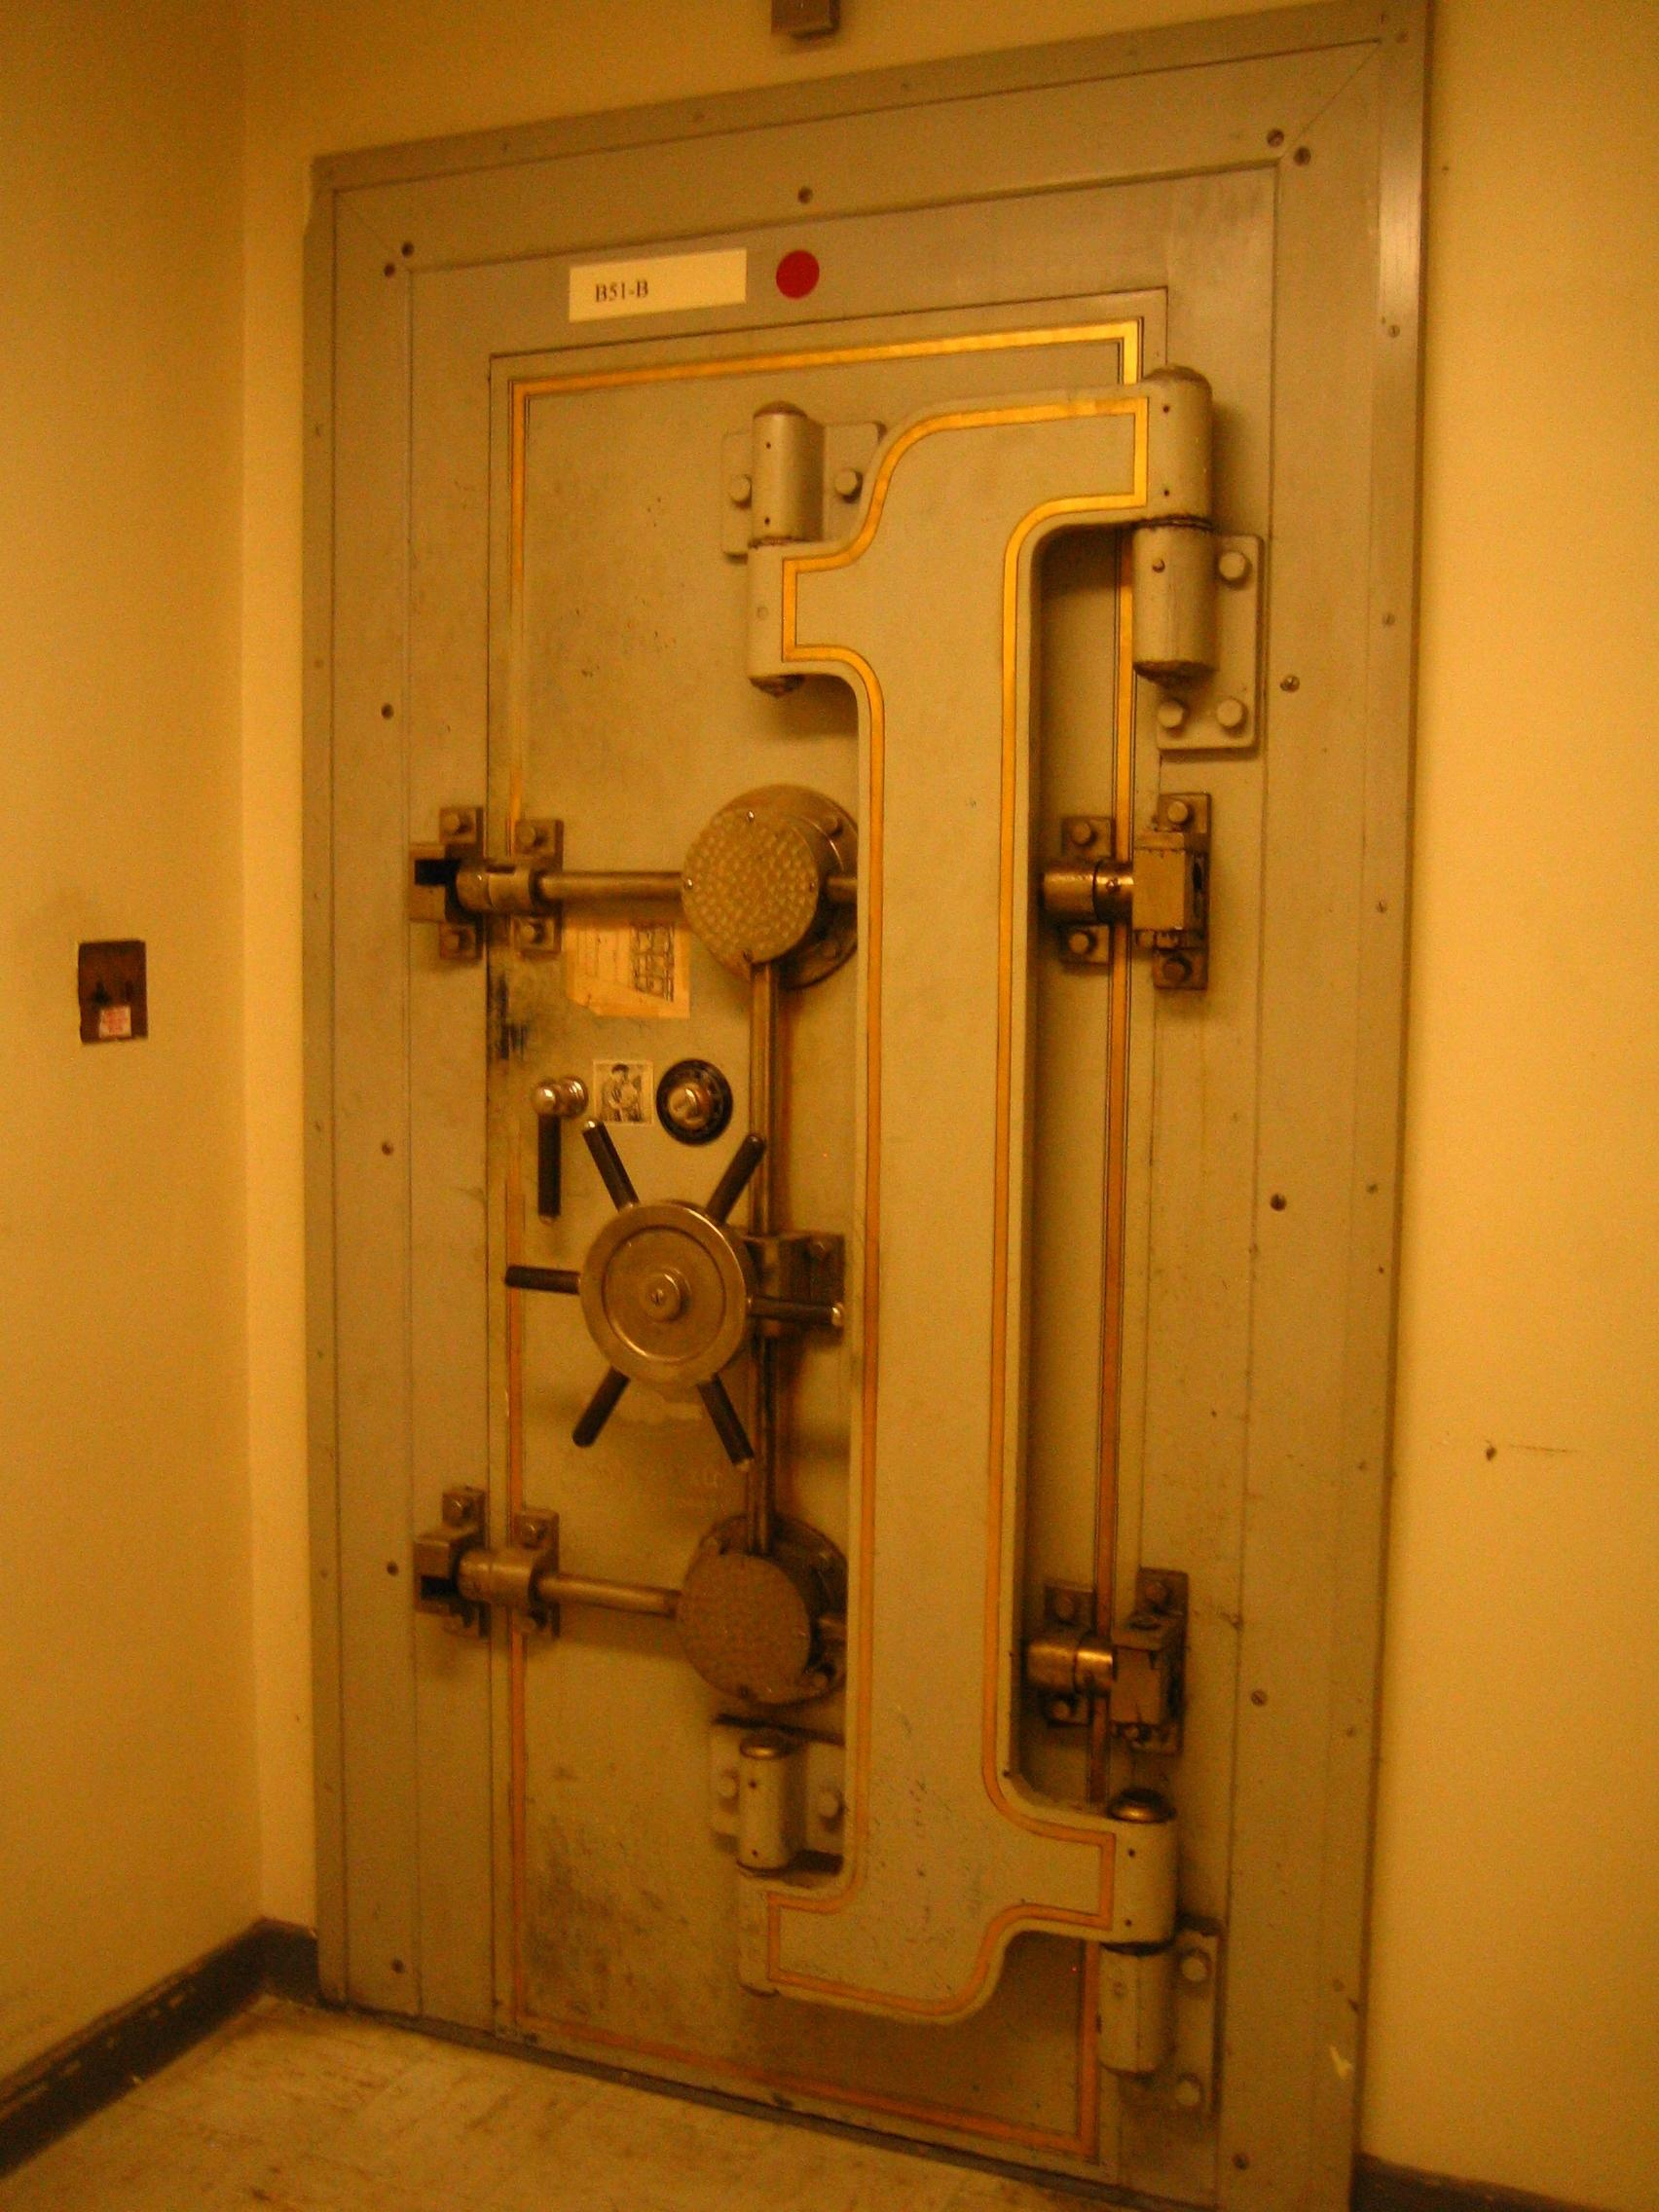
Digitise for access
Yale University Archives vault
Notes:
So the first Provocative Recommendation is that it’s time to think about digitisation in terms of access and begin to unlock our collections. We need to safeguard the originals and set the digital copies free.
The shift in scanning for preservation to scanning for access is an especially important point for OCLC Research to make, since we were at the forefront of the do-it-once, do-it-right parade, waving recommendations for high quality practices and standards. Seeing how much content is available after twenty years – and seeing how little it is used - especially in light of mass digitisation of books - has caused us to change our tune.

Slide 13
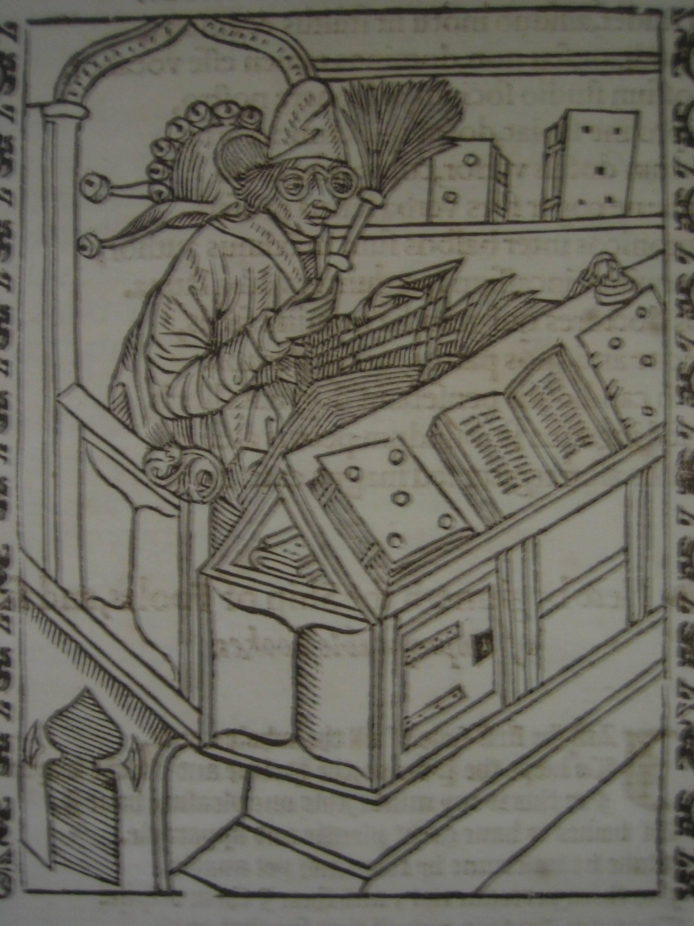
Selection has already been done
Woodcut depicting ‘The reading of useless books’ from Brant, Sebastian Stultifera Navis … The ship of fooles… 1570
Edinburgh University Library Special Collections, Inc. 13
Notes:
The next Provocative Suggestion is that the selection has already been done. So much of our digitising time and effort is spent on deciding what to digitise.
We’ve already carefully chosen the materials; they are in our collections for good reasons.
So we should stop being so selective, trying to guess what our users need. Rather we should scale up digitisation, to make more of these great collections usable.

Slide 14
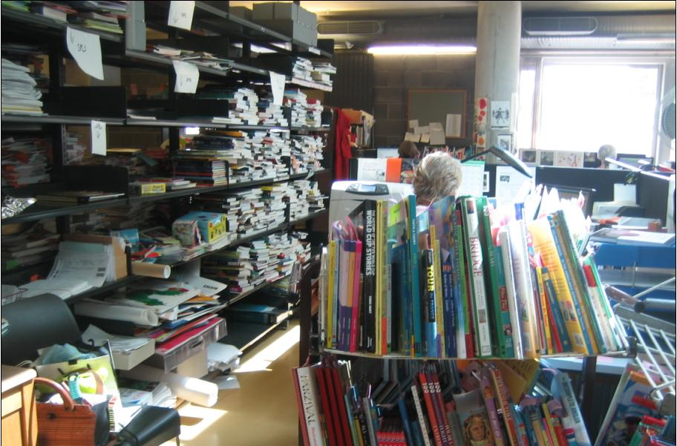
Don’t get further behind
Trinity College Dublin
Notes:
Another recommendation: Don’t let yourself get further behind.
We should consider scanning an entire collection as it is accessioned.
If that’s not feasible, think about scanning small portions (samplings, or a series), then see if the demand supports more effort.

Slide 15
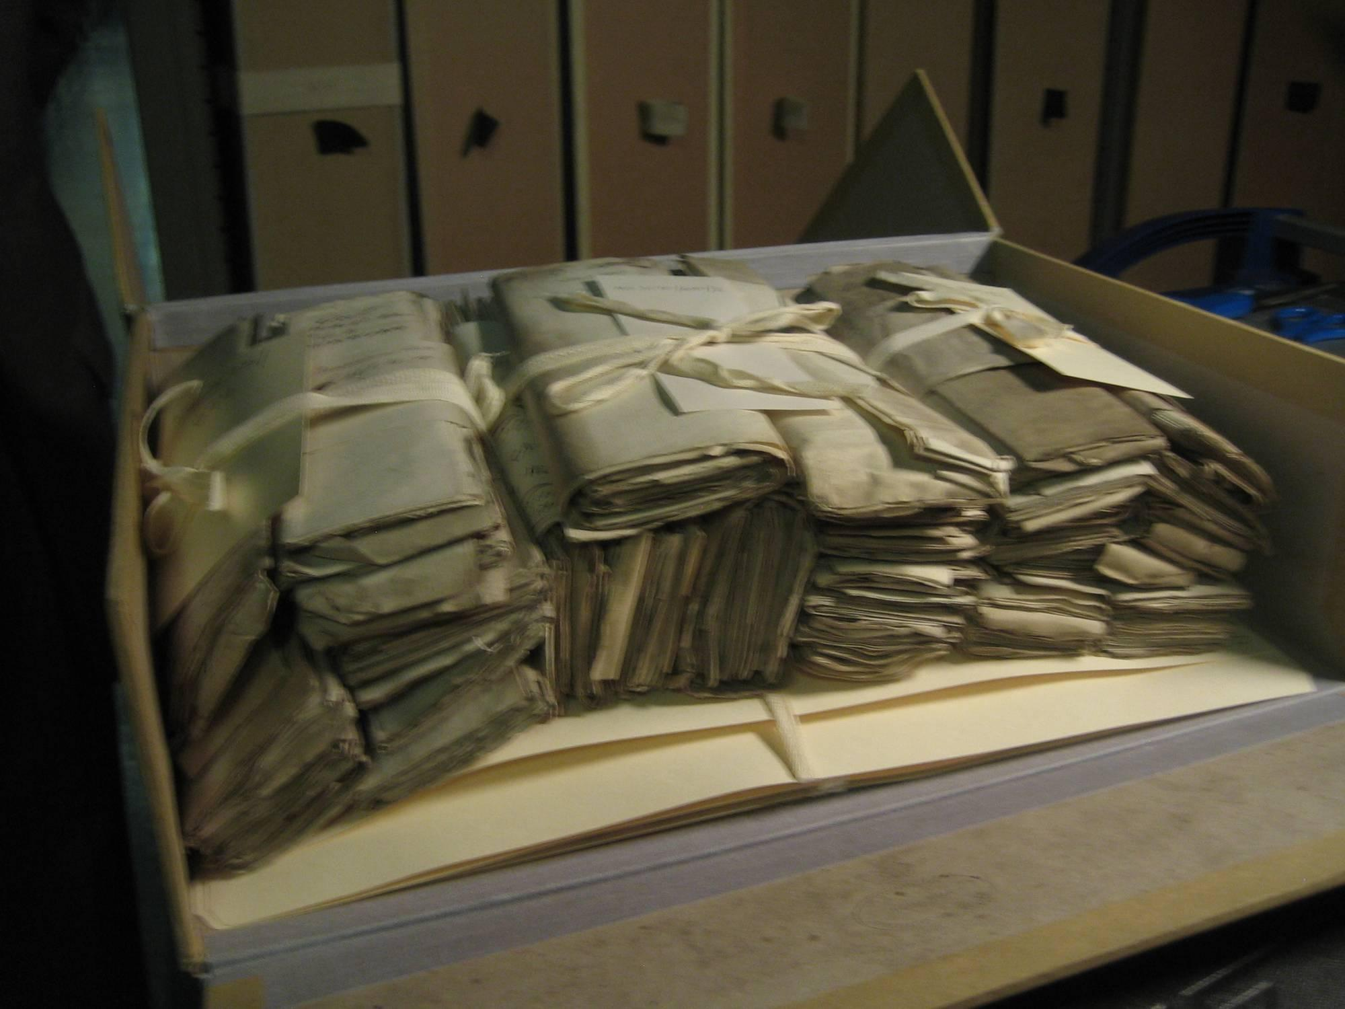
Stop thinking about item-level description
University of Aberdeen
Notes:
Another Provocative Recommendation is to stop thinking about item-level description
Learn from archivists and let go of the obsession to describe items.
Think in collections and arrange and describe unique materials in sub-units.
Make something available, even if you think of it as unfinished.
We’ve got to give up our “slavish devotion to perfection”

Slide 16
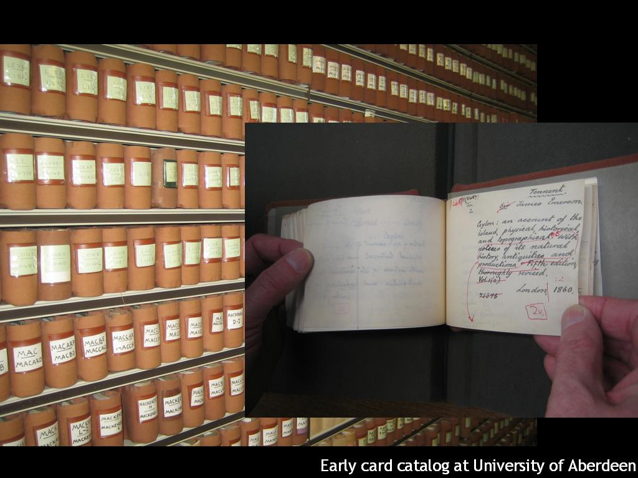
Notes:
And get it on the web!
Putting the most minimal description on the web will not restrict use anywhere near as much as limiting discovery to those who show up in person and know whom to ask for what.

Slide 17
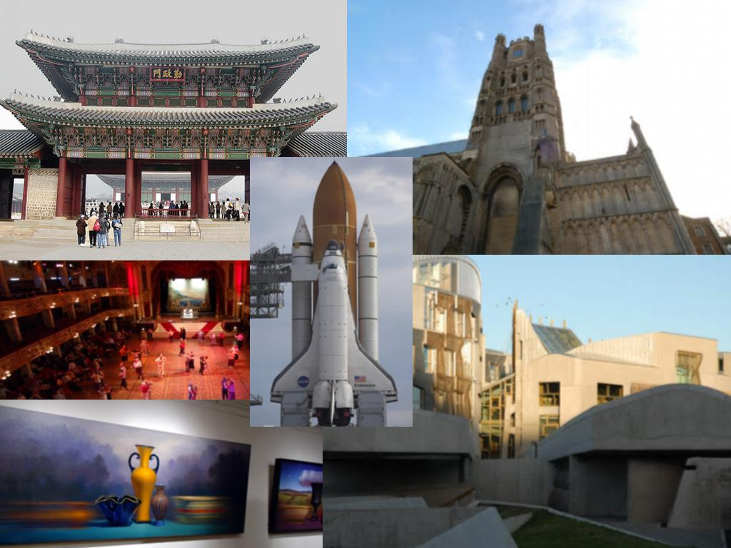
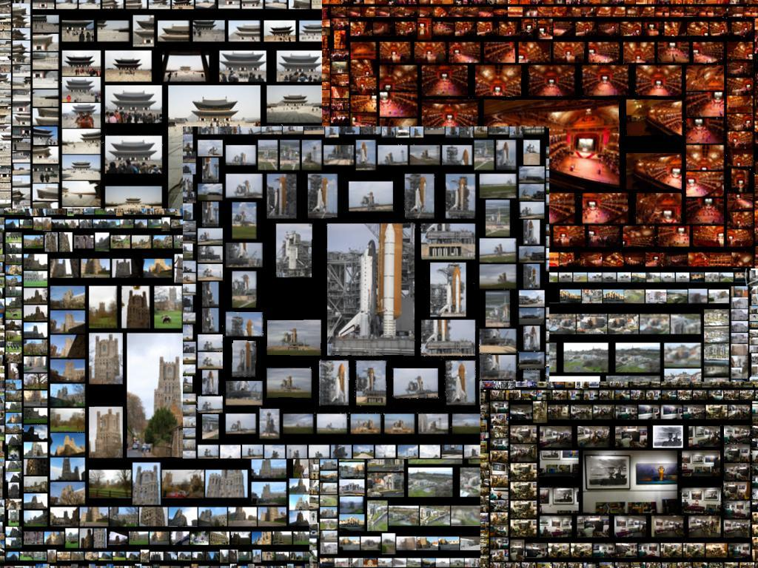
Quantity over quality
Images: labs.live.com/photosynth/
Notes:
It’s great to have access to some nice pictures….
CLICK But the real discoveries are likely to happen when researchers have access to lots of photos. We often take longer to select a few from a lot than it would have taken to scan all of them.
So the next provocative recommendation: When scanning for access, quantity is the goal
Lorcan Dempsey (quoting Stalin) says: Quantity has a quality all its own. A focus on quality is one reason that libraries, archives and museums have not moved their collections in large quantities to the web. This reduces their visibility and impact as the web becomes central to research, learning and civic engagement. Scale matters, and fragmented small-scale activities do not map well onto behaviours in a web environment.

Slide 18
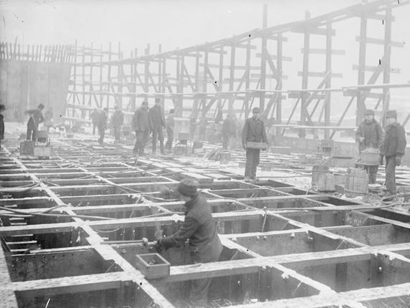
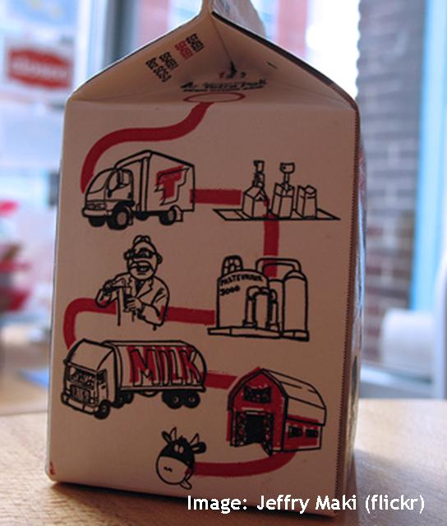
Build permanent infrastructure
Image: Library of Congress
Notes:
Another Recommendation: Build infrastructure – these should be on-going programs, not special projects. We need the organisation CLICK and workflows to make these ongoing, sustainable activities. This is work essential to the organisation, so it should be built into budgets, into the overall technology platform, and into our processes.

Slide 19
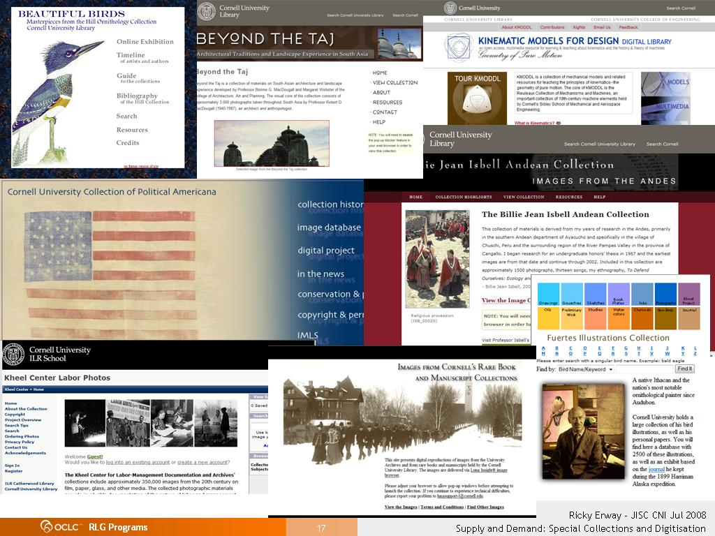
Notes:
Here are just a few of the digital collections at one US institution, Cornell University. Each one is a customised portal to a carefully curated collection.
One reviewer of a proposal to create an integrated discovery framework questioned if it would add sufficient value, considering that most of the collections Cornell has digitised are fragments of larger corpora or otherwise very narrow in scope. (K Calhoun)

Slide 20
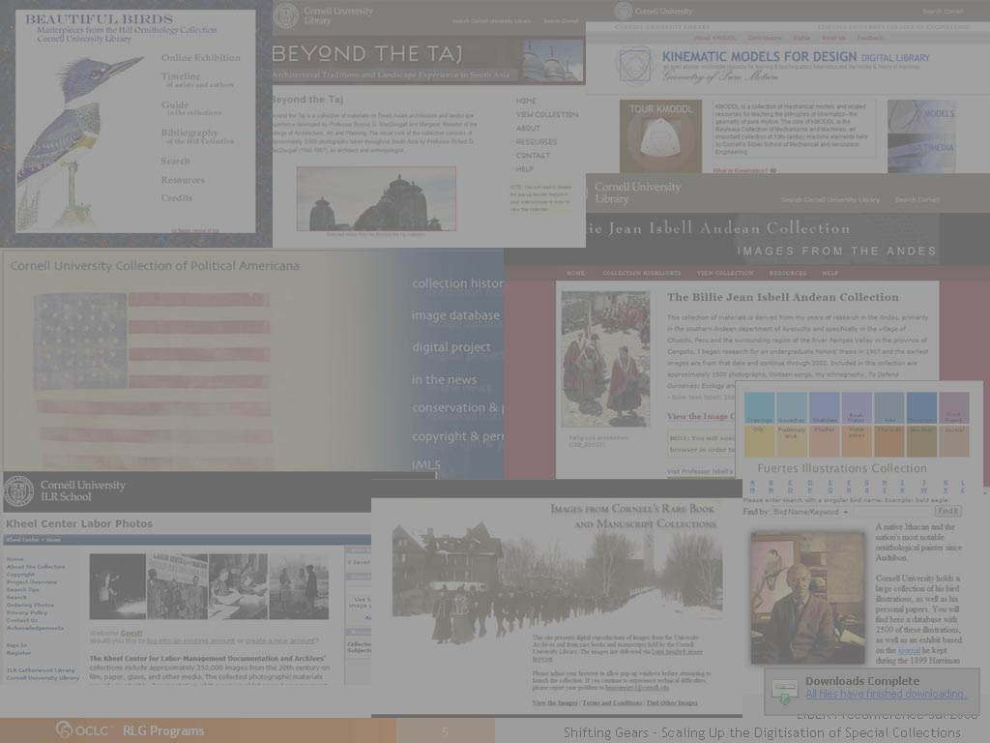
Ongoing programs, not projects
“At this stage, no new effort should be undertaken without a sense of how it will be merged with other existing collections and where the resources for long-term maintenance will come from.”
Cornell University Digital Projects Librarian
Notes:
And here’s the conclusion drawn by the Cornell Digital Projects Librarian.
There should be no new efforts without a sense of how they will be merged with other existing collections and how they will be maintained.
It’s time to stop thinking in terms of projects and start thinking about ongoing processes.

Slide 21
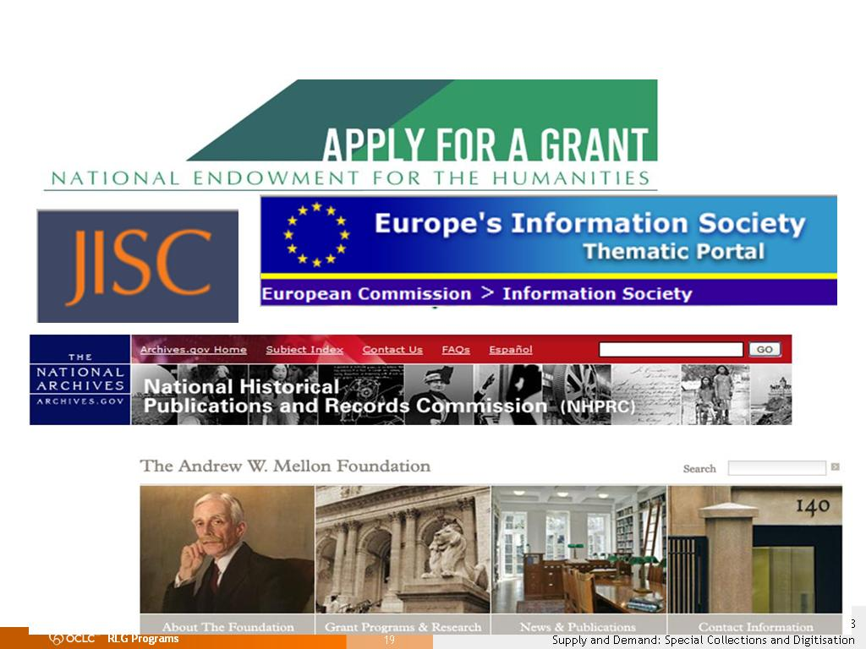
Funding for sustainable workflow at scale
Notes:
Another Provocative Recommendation: Encourage our funders to support those programs that operationalise digitisation, rather than build project-based portals.
Some ‘aware’ funding is now happening. See slide in 2nd half.

Slide 22
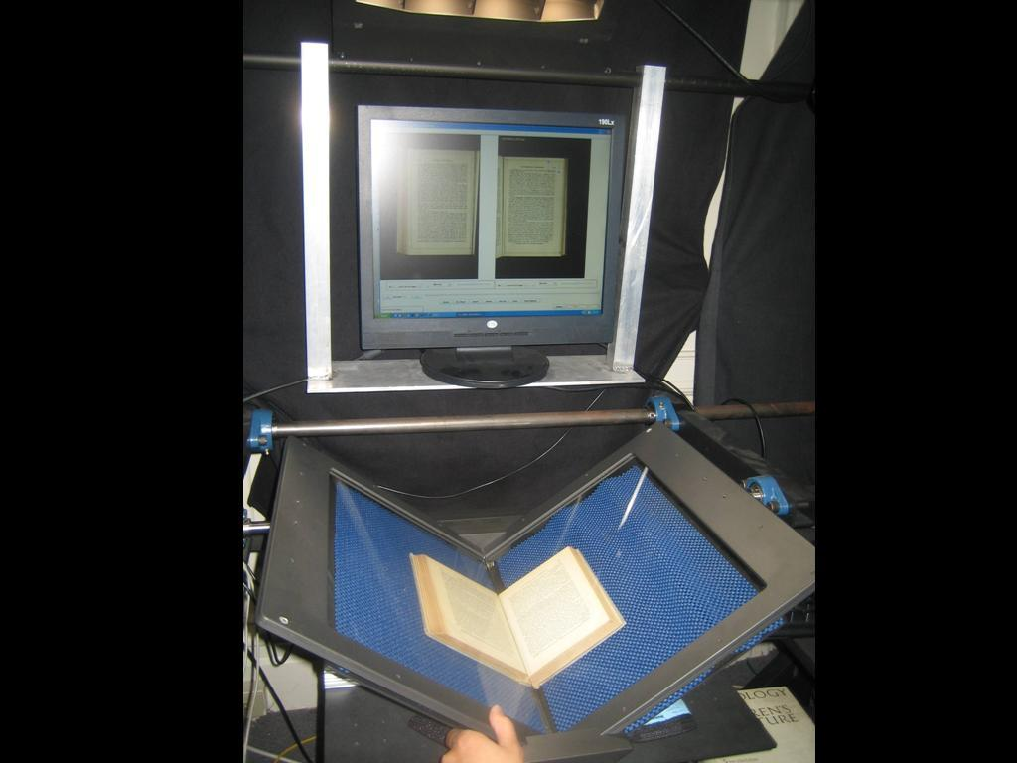
Encourage development of format-specific gear
Scribe book scanner
Notes:
Now that the private sector has shown how easy book scanning can be, we’ve taken to wringing our hands about the challenges of special collections.
Our private sector partners made it easy by creating equipment and processes that made book scanning more routine. The Internet Archive has developed technology using pro-sumer digital cameras and open source software that brings scanning costs down to around 6p a page.
Now we need similar gear for special collections to automate the process and make scale possible.
Let’s encourage our funding agencies to help us digitise our special collections by funding development of format-specific equipment.

Slide 23
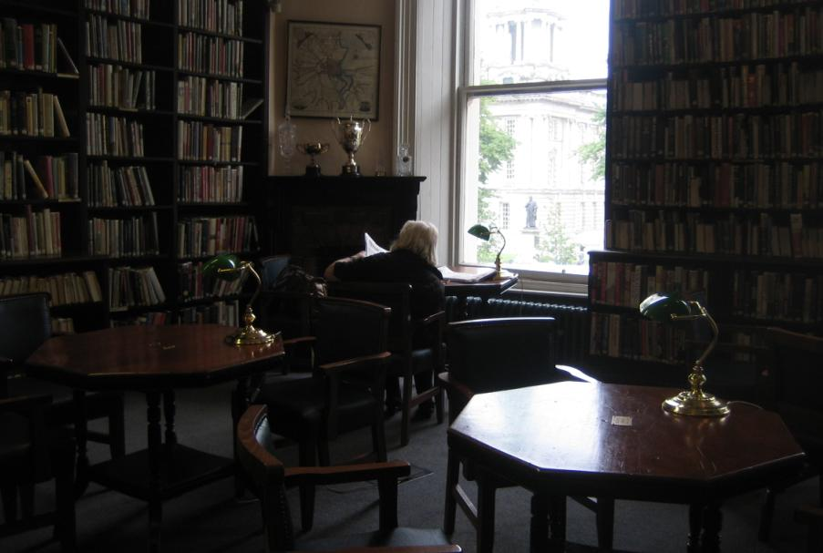
Learn from your users
Linen Hall Library, Belfast
Linen Hall Library, Belfast
University of Glasgow
Notes:
And one of the most important recommendations: Let the users guide you:
– You could scan the collections that are heavily used in the library.
– You can scan on demand – let your researchers identify what’s of interest, and as long as the material has been paged and is in your hands, you might as well capture it and send it to the repository
– Or you might scan signposts and let the level of interest guide future efforts.

Slide 24
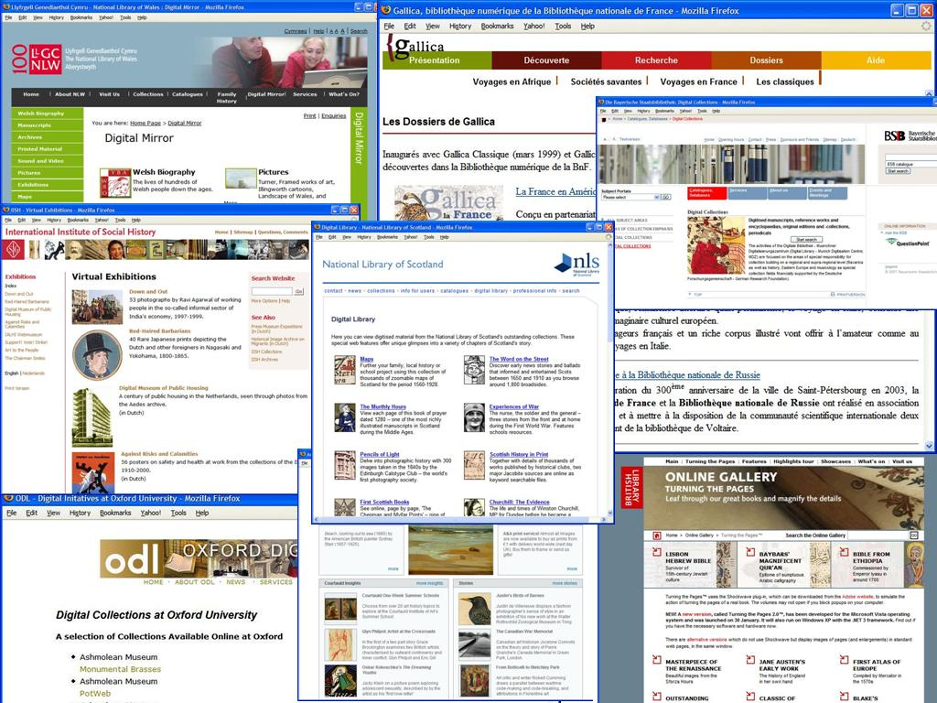
We’re in portal danger …
Notes:
But once we have some special collections digitised, we’ve got to make access easy.
Each one of these portals represents many separate digital collections; portals in themselves. Each of them has to be discovered and searched individually. How many of them do users ever find?
Discovery happens elsewhere. Where are our users?

Slide 25
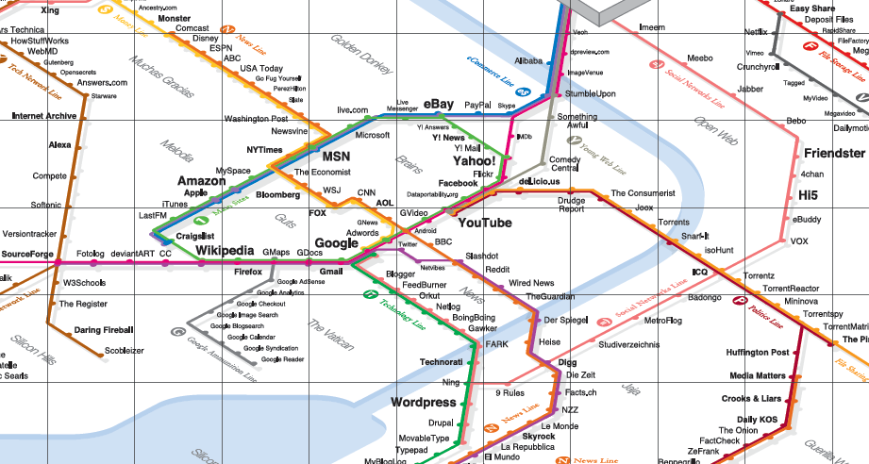
Be where the users are
Image: informationarchitects.jp/web-trend-map-2008-beta/
Notes:
This is the map our users use to navigate today’s information landscape. It’s the 300 most visited sites on the web, mapped onto the Tokyo train map. It shows where our users are going.
Amazon, Yahoo, Google, Wikipedia, and YouTube are dominant, but they’re not overwhelmingly dominant.
Is your library in this picture? There are no libraries in this picture. No OCLC, no JISC, no TEL…
What does their absence tell us?
Libraries deliver services in an environment increasingly dominated by large-scale information hubs. Users bypass the authoritative offerings of libraries in favor of just-in-time information from sources more conveniently embedded in their daily networked lives.
DISCOVERY HAPPENS ELSEWHERE – We need to position supply where the demand is

Slide 26
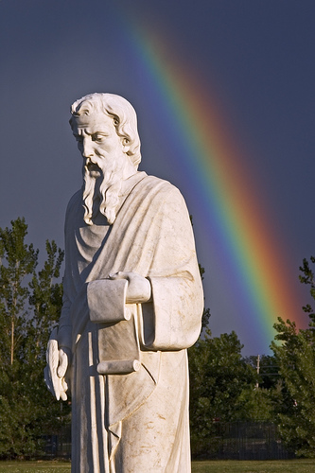
Signs of hope
Show me a sign. flickr image by danr_co
Notes:
So those are some of the Provocative Proposals. Now I’ll show some promising signs we’re seeing in the community.
These weren’t necessarily influenced by Shifting Gears (in fact some predate it), but they exemplify the recommendations in an encouraging way.

Slide 27
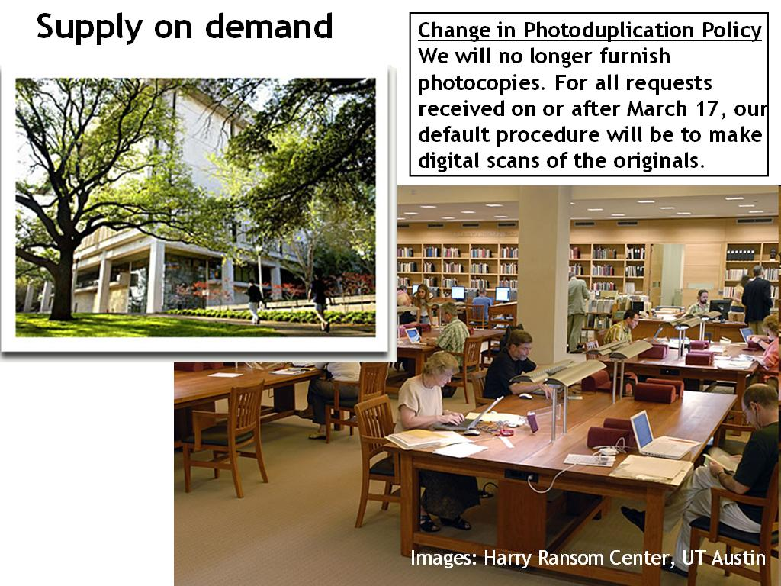
Images: Harry Ransom Center, UT Austin
Notes:
The special collections library at the University of Texas at Austin has stopped providing photocopies on request. Instead they scan on demand… and send the images to the digital repository. Eventually they’ll be able to serve the most requested items digitally to local, and remote, users.
It also helps to preserve the originals, saving them from repeated photocopying.

Slide 28
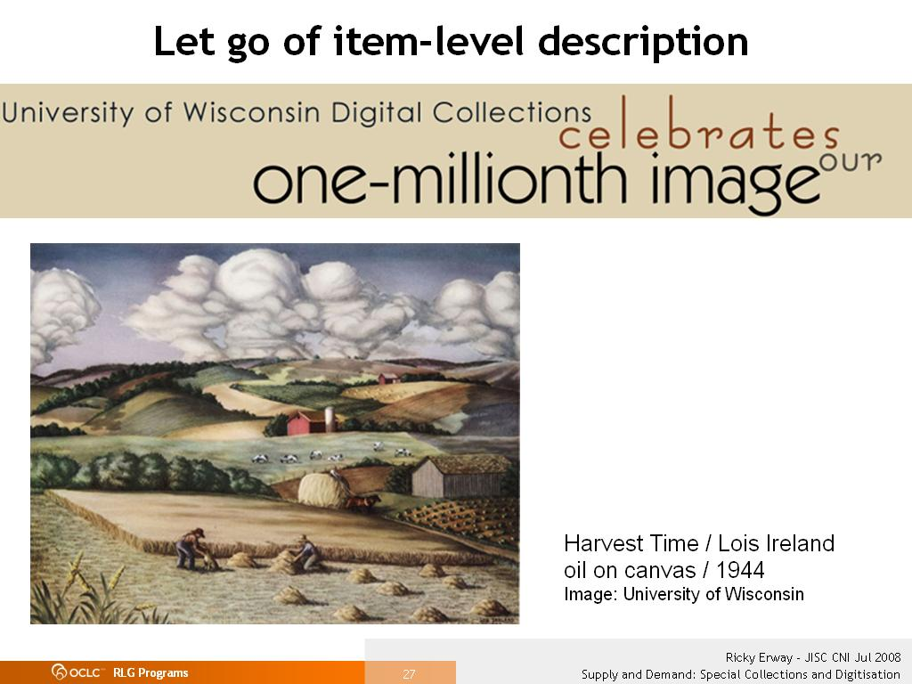
Notes:
The University of Wisconsin has a project to streamline digitisation. Their control model, using their old approaches to scanning and metadata yielded a cost per page of 90 pence.
Their streamlined model, scanning in bulk with no individualised documents or item-level metadata, was 18 pence.
While users preferred the output of the control model, they preferred more stuff over more description.
The University is now looking at ways to automate the isolation of individual documents and improved methods for browsing.
Josh Ranger, spokesman for the project, says: “every dollar spent to make [online] collections perfect is a dollar we’re not spending to get another collection on-line and to a larger potential audience.”

Slide 29
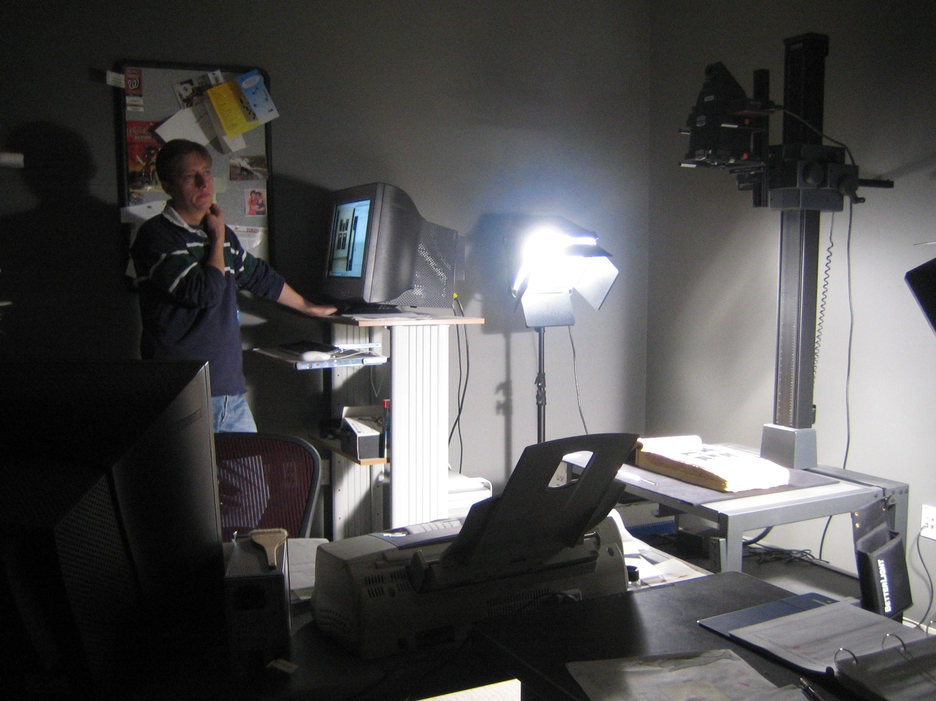
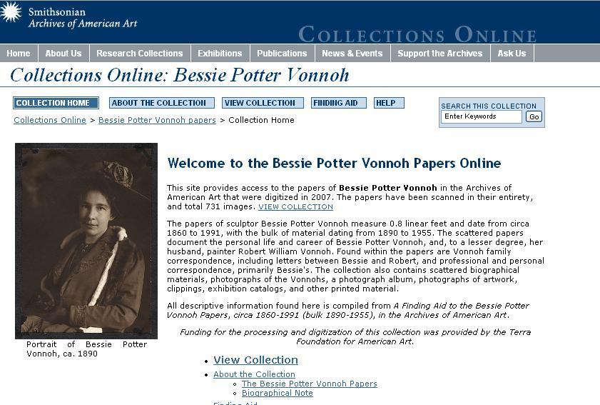
Combine approaches; collapse decisions
Notes:
The Archives of American Art at the Smithsonian is using two tactics at one time
They’re scanning on demand for reading room requests – if they touch it, they scan it. Even if the request is only for a page, they scan the whole thing (an entire book or an entire folder of correspondence). They are building quite a resource of materials that, having been requested, are likely to be of interest again.
And they’re methodically scanning entire collections according to their archival arrangement – no cherry-picking, no decisions. The result is unprecedented access to the content and context of thousands of documents, photographs, diaries, sketches, writings, and rare published materials.

Slide 30
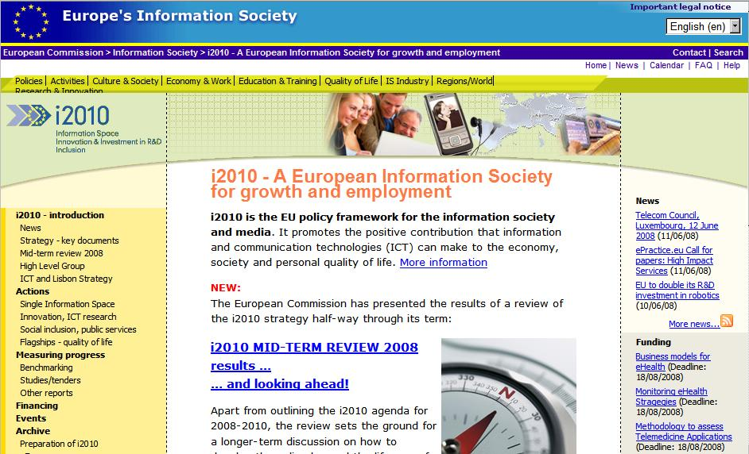
Process not projects
Notes:
The EU Commission i2010 strategy for the Information Society announced a flagship initiative on Digital Libraries and identified the need to reduce costs for mass digitisation of specific materials, saying digital libraries are not just a short term goal but a process.

Slide 31
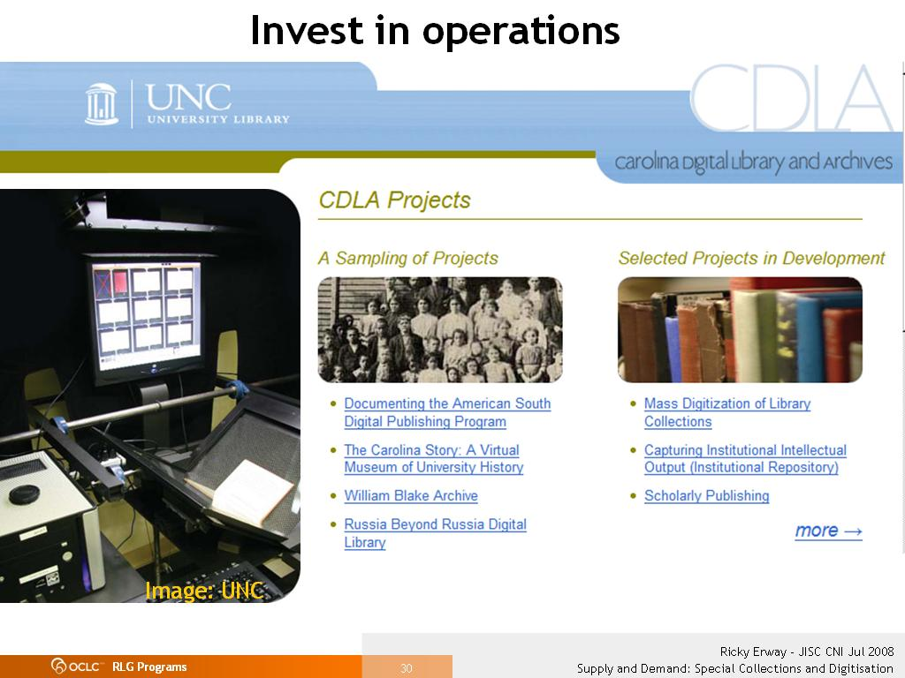
Notes:
The University of North Carolina got a lot of money to digitise a whole collection, instead of cherry-picking “interesting” samples.
They say, "Since we have so much time and money for a relatively small project (22K pages), we’re able to spend a lot of time on research and experimentation on mass digitisation of archival materials. The findings will inform other projects, and the workflow will then be used on a much larger scale.”

Slide 32
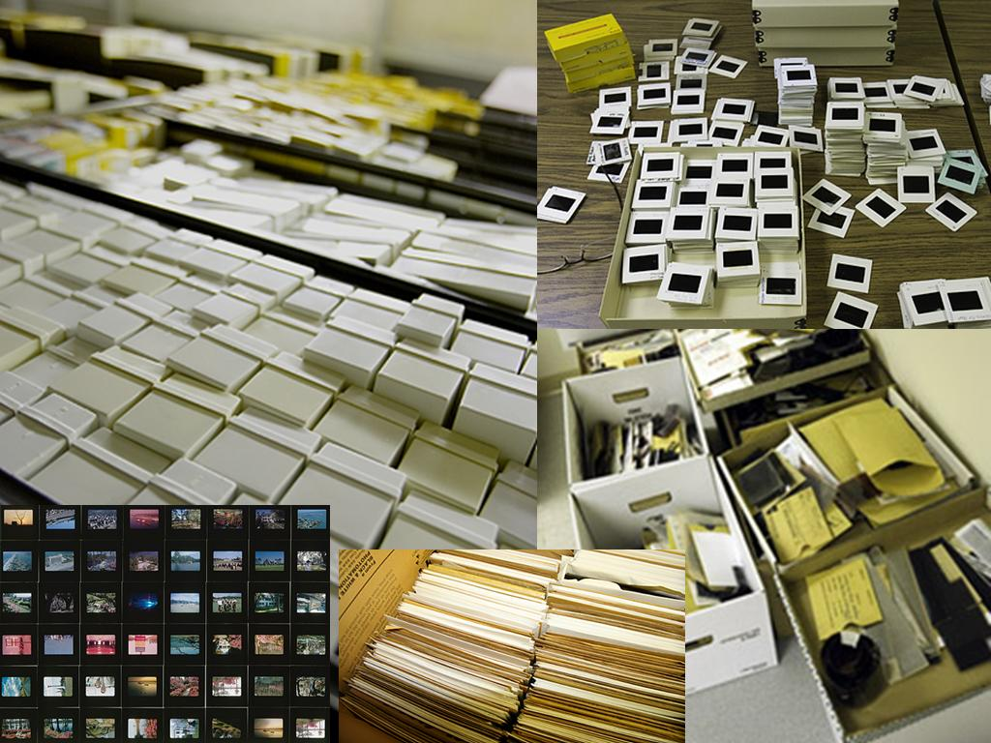
Do it all
Images: A View to Hugh (blog)
Notes:
The Hugh Morton Photographs at the University of North Carolina includes 200,000 slides
The high demand for use of the collection argued for a non-traditional approach to processing.
The collection is unorganized, so they are sorting it chronologically and then by format, right down to the type of film shot – to allow for automated digitisation and processing. Looking at each slide on a light box for 5 seconds (which alone would take almost a year) to make selection decisions as to what to digitise would definitely cost more than scanning all the slides.
One of the processors said “all I am doing is taking one huge pile of stuff, sorting it into smaller piles, sorting those piles into smaller piles, and, finally, describing the piles.”
They are planning to make parts of the collection available incrementally as they complete them. And then let the users do the cherry picking, according to their needs.

Slide 33
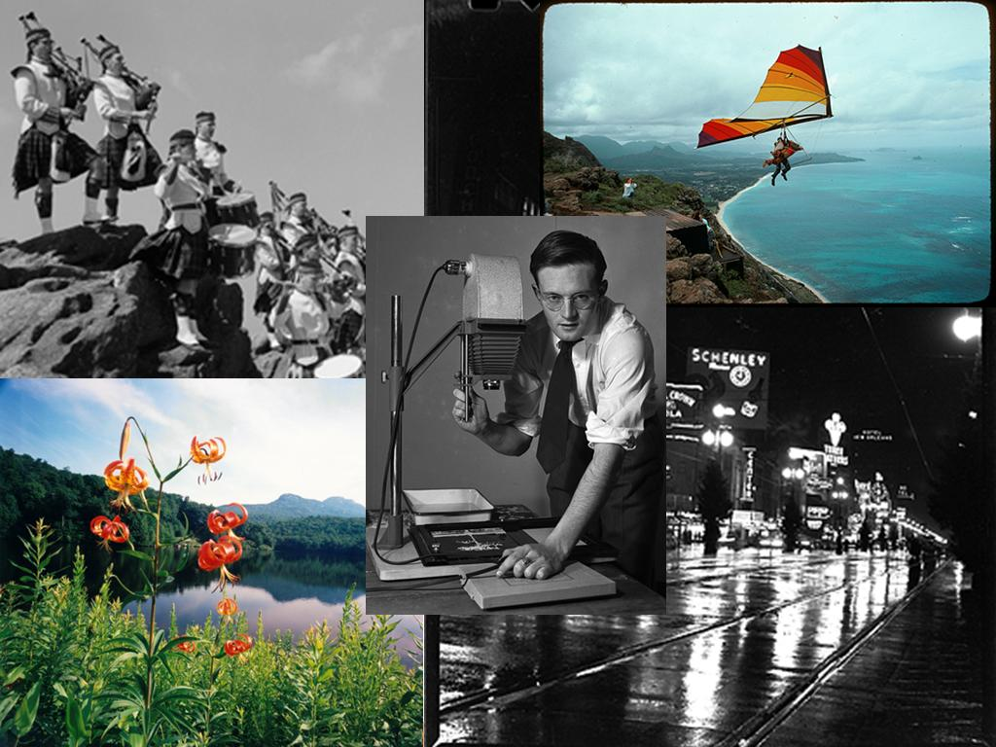

Share your findings
Images: A View to Hugh (blog)
Notes:
The staff on the Morton project wanted to keep people informed about their progress (and offer glimpses into the collection’s wealth). So they developed a blog to meet those needs (it is the source of these images).
They are moving towards methods that emphasize access over preservation, aim for quantity over quality, and that let the users decide which “cherries” they want to pick - and they are sharing what they learn with others.

Slide 34
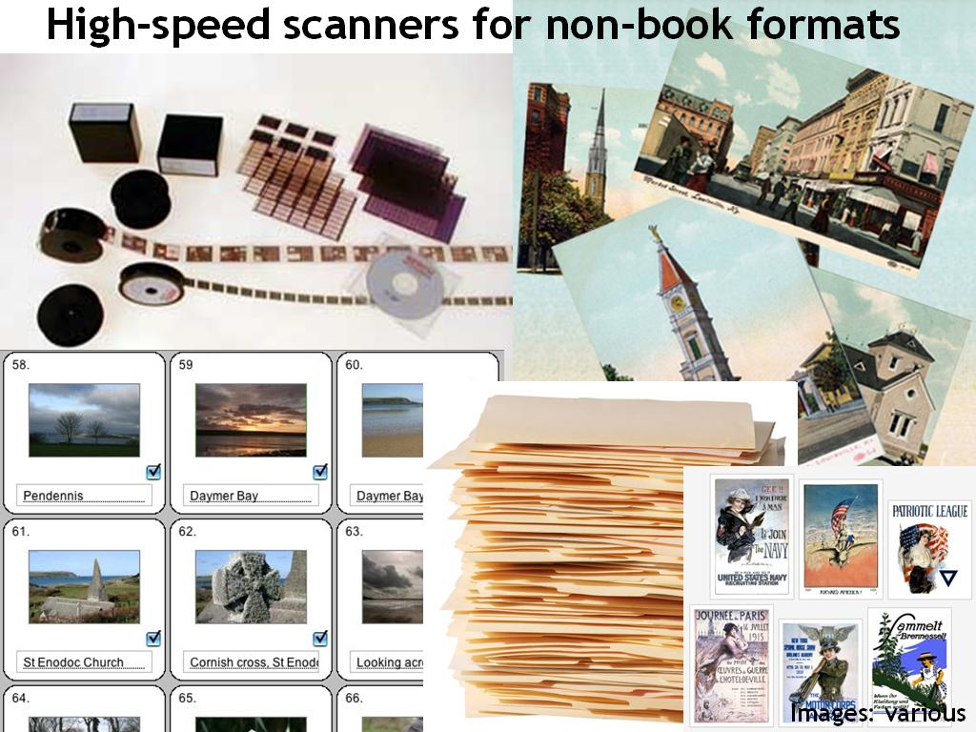
Images: various
Notes:
We’re making progress with purpose-built scanners. Things have been pretty much worked out for microfilm scanning – now we can capture 100 frames a minute.
At OCLC Research, we’re in conversations with a vendor who is working on efficient document handling for photos, postcards, and other flat materials. They estimate a throughput rate, for example, of 250,000 postcards in 3 months
Image Sources:
Microfilm - Challenge Business Services
Postcards – University of Louisville
Slides – Web Photos Pro
Posters – Vintagraph
Files – Proud PR

Slide 35
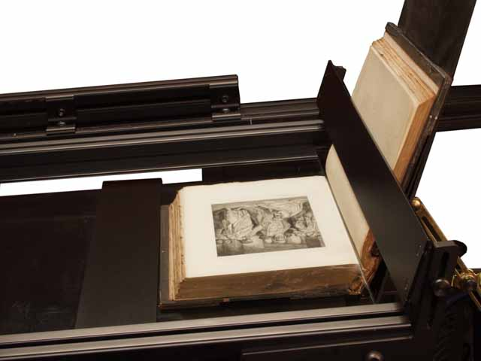
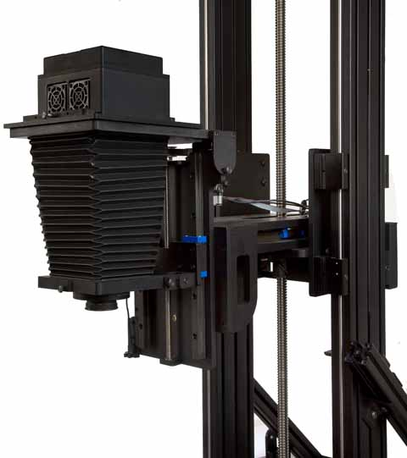
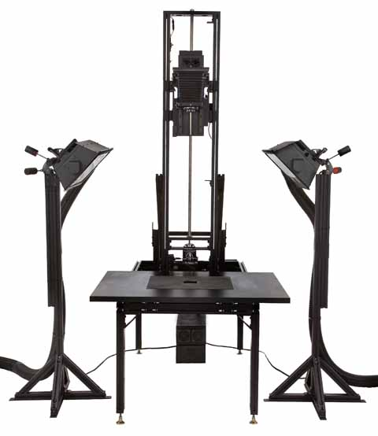
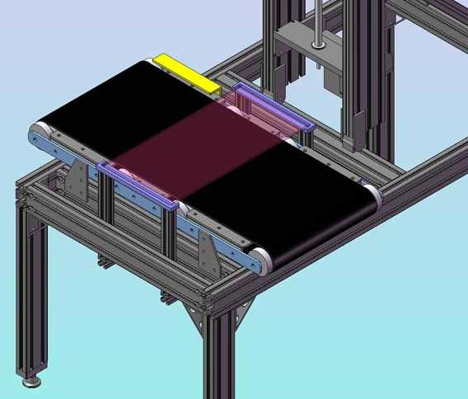
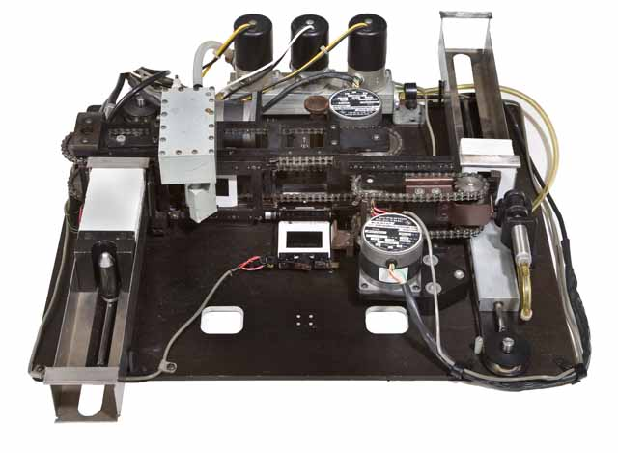
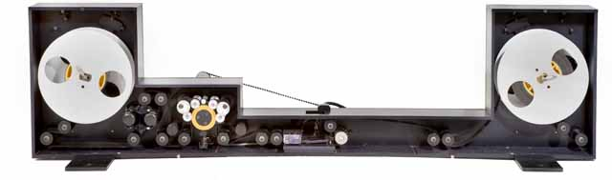
Multi-analogue digitisation
Images: Stokes Imaging
Notes:
1. The Stokes Imaging System consists of a Capture Station, various Material Handling Devices, and Imaging Workflow Software.
2. The distance and angle of the camera can be computer-positioned to take advantage of the various handling devices. High-quality images are captured and access quality images are automatically generated.
3. Material handling is the limiting factor in increasing throughput. Stokes has developed several devices to expedite this process while ensuring that the originals will not be damaged. The most elaborate is the Manuscript Cradle developed for digitising medieval and ancient manuscripts.
4. The Book Cradle allows the digitisation of images from precious books holding the page being captured perfectly flat, ensuring consistent, sharp focus.
5. The cradle supports both backs; the book only has to be opened 105 degrees. One can capture in excess of 100 pages per hour. De-skewing and cropping is automated.
6. The Auto-Slide Loader moves the slide through an electrostatic cleaner with fine brushes and positions it in place for capture, then moves it to the output tray. A tray of 175 slides takes less than 45 minutes, only requiring operator intervention to change trays.
7. The Roll Film Transport accepts up to 400 feet of film. The film passes through an electrostatic cleaner with fine brushes and is registered during capture. Unattended image capture is at a rate of 6 frames per minute.
8. The Cut Film Platen is designed to facilitate the handling of negatives and transparencies up to 11 x 14 inches. A pneumatic device raises and lowers the plate.
9. The Conveyor accepts reflective materials up to 11.5 x 15 inches. The operator loads the next object onto the conveyor while the current one is being captured. It will allow the capture of 6 colour images per minute.
Stokes is currently working on a Robotic Postcard Handler and is interested in hearing about other needs.

Slide 36
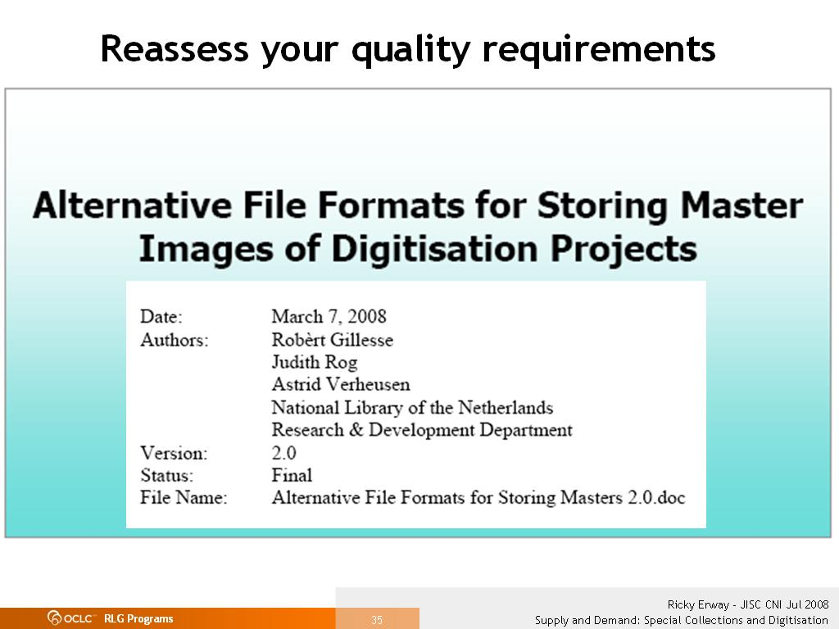
Notes:
National Library of the Netherlands (Koninklijke Bibliotheek) recently released a report that looks at reframing digitisation practices.
Because of the scale of projects and the economics of storage, they are purposefully reconsidering file formats and quality requirements, aiming for “good-enough” results.
The KB has also overhauled their whole approach to digitisation to emphasise quantity over quality.

Slide 37
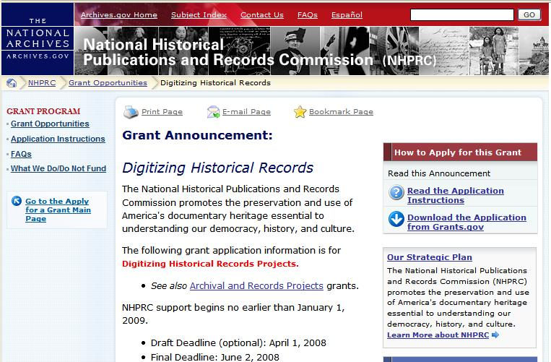

‘Aware’ funding for streamlined
processes
Notes:
And we’re see some encouraging signs from funders.
At OCLC Research, we’ve talked with US government funding agencies and philanthropic foundations. They’re looking for more effective ways to fund digitisation and ways to help change our practice, to make more rare and unique material available.
In this case, the US National Archives funding body is seeking digitising projects that can repurpose existing metadata.
The Mellon Foundation is also launching an aggressive program to fund the description of hidden collections – the first and most important step in increasing access.

Slide 38
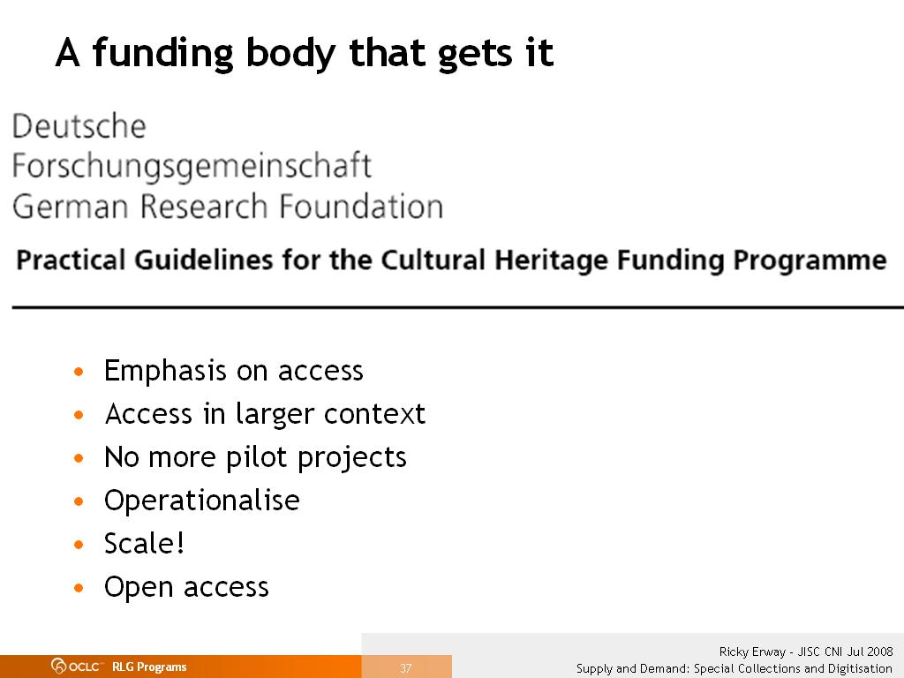
Notes:
The German Research Foundation, or DFG, is the central, funding organisation that promotes research at publicly financed research institutions in Germany. They revised their practical guidelines for funded digitisation projects.
They want the materials that were once difficult to get hold of or vulnerable to damage to be easily viewed at home or on library computers.
They want digital documents linked to other online resources — such as catalogues, bibliographies, secondary literature etc. — so the potential of the Internet is fully leveraged. Thus the objective is not only to make these materials available, but to integrate them into a network.
They discourage experimenting with novel techniques, since a wealth of experience is already available.
They say digitisation is a standard service to provide, rather than a distinctive feature. Digital access to cultural heritage should be the rule rather than the exception.
They support libraries, archives and museums in their endeavour to provide digital versions of as many research-relevant public-domain holdings as possible within a short period of time.
They say that all projects should be designed such that their results will be available to researchers quickly and for the long term. This entails the provision of free access to digital copies on the Internet.

Slide 39
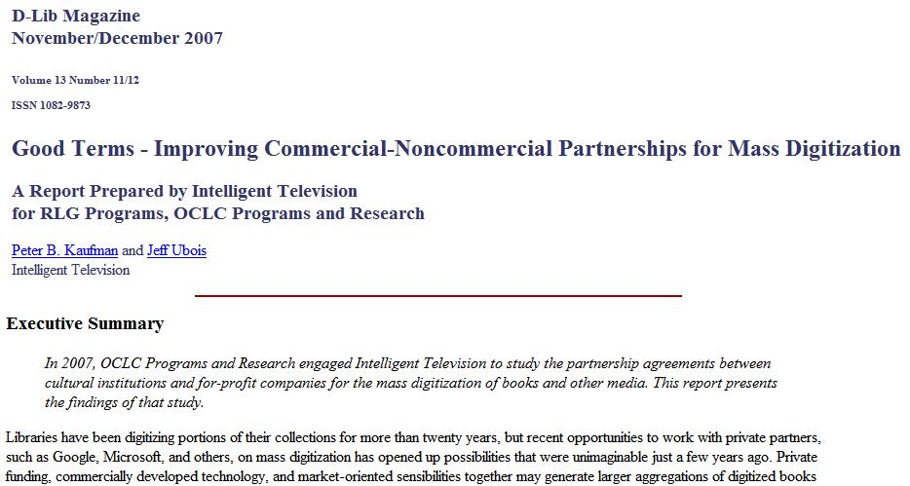
Preserve right to reuse/remix
Notes:
An OCLC Research-sponsored study to assess the public/private partnerships for mass digitisation determined that one of the important capabilities that has been given up is the right to freely create aggregations of the digitised content. While it’s difficult to predict our users’ future demands (or our future users’ demands), we should avoid precluding likely desires. The guidance in this report should help institutions negotiate better deals in the future.

Slide 40
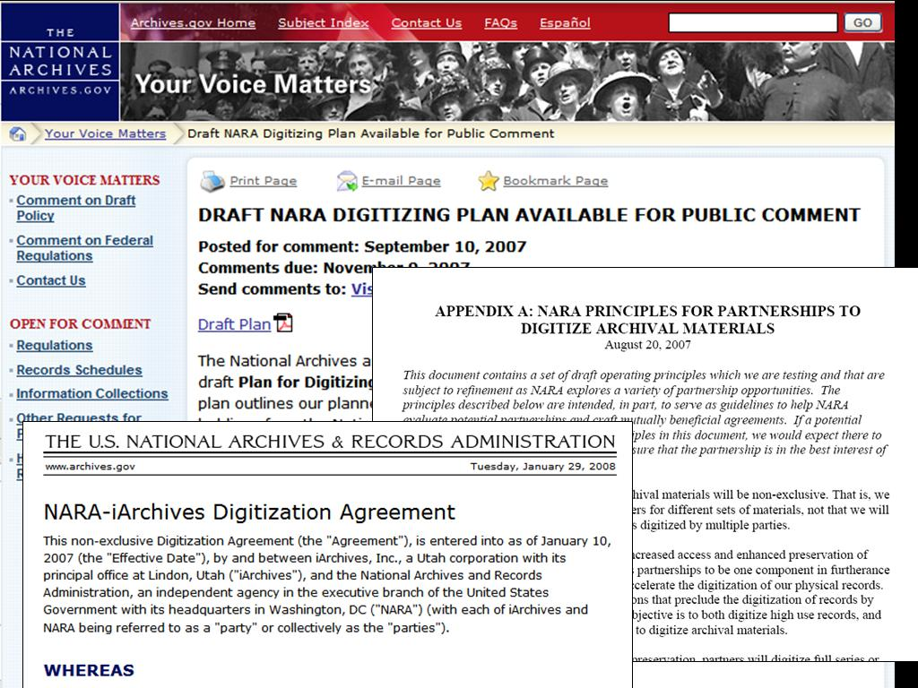
Work with partners to get
what you want
Notes:
The US National Archives has managed to arrange partnerships with private partners to do digitisation on their own terms. They developed their own criteria internally and now go into negotiations knowing what their walk-away points are. And they shared the criteria with the community for comment – as well as the agreements.

Slide 41
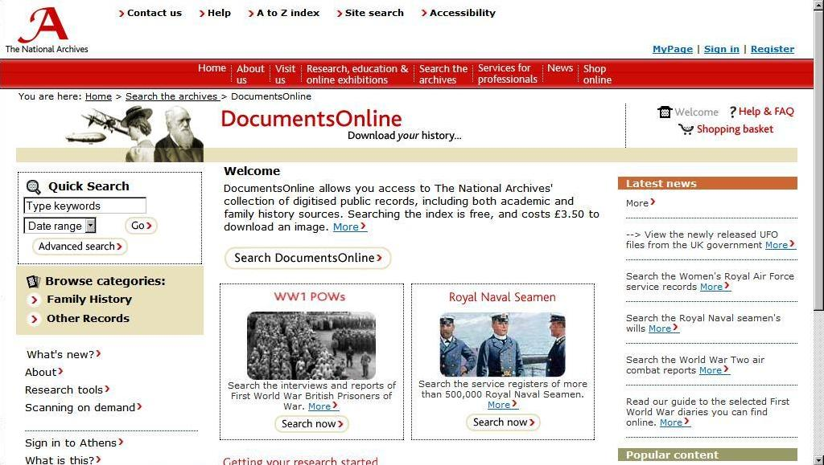

Get going!
Notes:
The National Archives in the UK says it is now primarily a digital archive. 100 times more documents are delivered over the web than on paper. They’ve made a strong argument for industrial-scale digitisation, believing that only wholesale digitisation of complete collections delivers full benefits.
They have in excess of 60m digital documents. The entire archive however would cost 5 billion pounds to digitise.
Dan Jones, the head of business development, doesn’t despair at the size of the task. He quotes the French Marshal Lyautey who asked his gardener to plant a tree. The gardener objected that the tree was slow growing and would not reach maturity for 100 years. The Marshal replied, 'In that case, there is no time to lose; plant it this afternoon!'

Slide 42

Say it out loud
“During the next five
years, the Library will
strengthen further its
distinctive work in two
areas: digital
information technology
and special collections.
At the same time, [we] will work collaboratively with both internal and external partners to increase access to these exceptional tools, systems, and resources; support new modes of teaching, learning, research, and scholarly communication; and preserve, store, and manage traditional and digital materials for future generations.”
Notes:
Emory University announced its Strategic aims for the next 5 years: they have two main areas of focus – digital innovation and special collections. They acknowledge that they are not going to have one of the great general collections in the world, so they see the value in putting their special collections at the forefront of their strategy.

Slide 43







Discovery happens elsewhere: be there
Notes:
Here’s an example of putting images where the users are. The Library of Congress worked with flickr to create a Commons to offer a taste of the hidden treasures in the world's public photography archives, and to see how user input and knowledge can help make these collections even richer. CLICK
With this tactic, CLICK minimal description is good enough…
CLICK A user adds a pointer to a biography and a healthy controversy develops over whether this is a horse or a mule.
CLICK And someone gets to have the last word.
CLICK The Powerhouse Museum in Australia, the Brooklyn Museum, and the Smithsonian have joined the Library of Congress in the flickr commons. Other institutions like Boston Public Library are creating regular flickr photostreams for many of their collections.

Slide 44

Think big thoughts
Notes:
The National and State Libraries Australasia say:
“We are now in a position to explode and reshape our core services, resourcing and infrastructure; to explore radical new approaches across all parts of our work; and to fundamentally shift our libraries to the digital world.”
> Access is our primary driver.
> Digital is mainstream.
> No job will be unchanged.
> Some things we have always done, we will no longer do.

Slide 45

Use supply to increase demand
Notes:
None of this suggests that we discourage access to the originals in our collections. Tony Grafton, in a November 2007 New Yorker article, talks about the two paths that scholars will want to travel, the digital and the paper-based. This is why we are urging special collections and archives to consider digitising with an eye to access, so that our materials, so important and necessary for scholarship, will be visible. If more scholars know about them, more people will come to use the original collections in your institutions.
Using supply to increase demand.

Slide 46

Images: RLG Cultural Materials
Notes:
I think the demand is exciting and I’d like to see that we do our best to satisfy it.

Slide 47
Resources
Shifting Gears http://www.oclc.org/programs/ourwork/collectivecoll/harmonization/specialcollections.htm
Blog http://hangingtogether.org/
Web www.oclc.org/programs
Ricky Erway erwayr@oclc.org
Thanks to Ricky Erway, Jennifer Schaffner, Merrilee Proffitt, Karen Calhoun, and other OCLC contributors.

Slide 48

John MacColl
maccollj@oclc.org
OCLC Research
Leeds University from atop the 97A bus. flickr image by briggate.com

