Slide 1
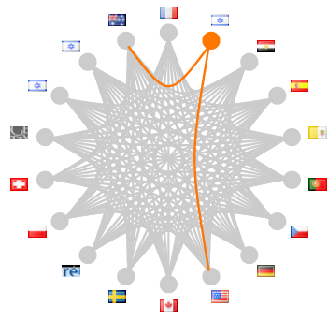
Authorities in a connected world
Indiana Library Federation
2011 November 16
Thomas Hickey
OCLC Chief Scientist

Slide 2
Why do we like authorities?
1. To enable a person to find a book of which either
(A) the author
(B) the title
(C) the subject
2. To show what the library has
(D) by a given author
(E) on a given subject
(F) in a given kind of literature
3. To assist in the choice of a book
(G) as to its edition (bibliographically)
(H) as to its character (literary or topical)
is known.
Charles A. Cutter: Rules for a printed dictionary catalog, 1876
Notes:
To make our catalogs work

Slide 3
What do authority files control?
Names!
  Persons
  Corporations
  Places
  Uniform Titles
  Families
  Trademarks
  Concepts

Slide 4
But we also control
Collective authors
Pseudonyms
Imaginary characters
Deities, saints, angels
Whales, horses, dinosaurs
Buildings
Ships, telescopes, space ships, missiles
Kings, Popes, Presidents
Cities, lakes, mountains

Slide 5
A changing world
Libraries
  Local library
  Library consortia
  National cooperation
  Within languages
  Global
Technology
  Handwritten
  Typed
  Printed
  Online
  Pervasive
EVERYBODY WANTS
TO CHANGE THE WORLD
BUT NOBODY WANTS
TO CHANGE

Slide 6
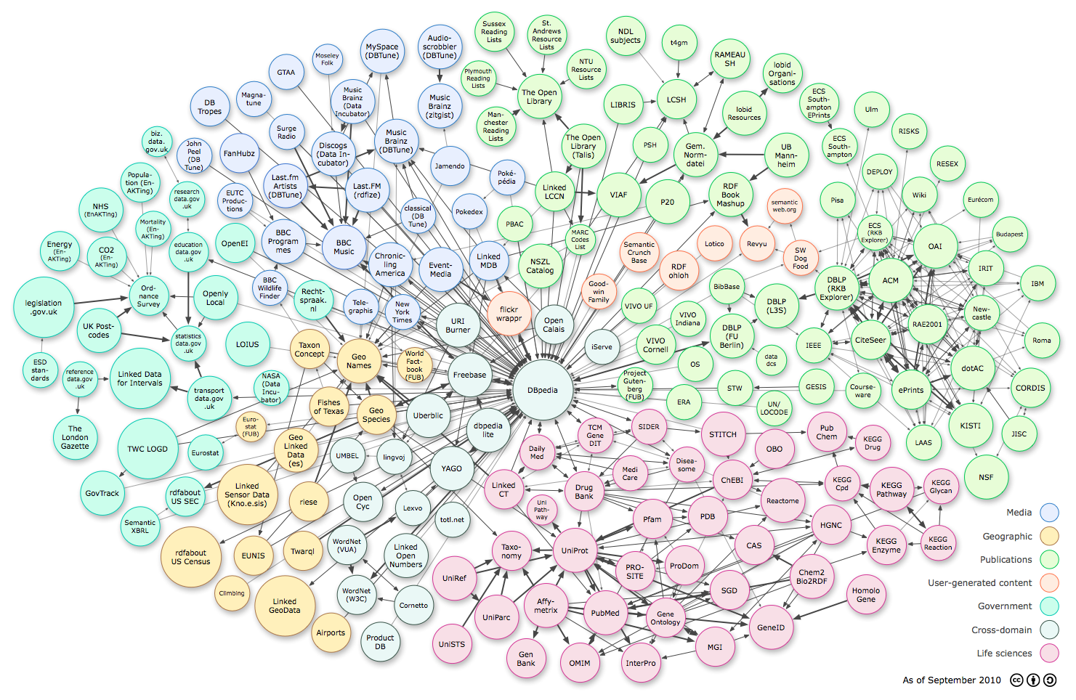
A world of linked data
http://www.w3.org/DesignIssues/diagrams/lod/2010-color.png

Slide 8
Challenges to libraries
Reflect these links in our catalogs
  RDA
Link to external resources
Have non-library resources link to us
  Promote our links
Be integrated in our users workflow

Slide 9
Library data is
Trusted
Understood
Reasonably interoperable
Complex
Within the community, linked data of limited help
Notes:
Within the community, ‘linked data’ of limited help. We already have mechanisms, although they could be used to a greater extent.

Slide 10
Shareable metadata
Public
Simple
Supply data rather than APIs
  Avoid idiosyncratic protocols
    Z39.50
    MARC-21
    ISO2709
Notes:
Needs to be shareable between communities.

Slide 11
Activities OCLC Research involved in
WorldCat Identities
VIAF, xA
ORCID
ISNI
Schema.org

Slide 12
WorldCat Identities
A page for every name in WorldCat
Notes:
~38 million just for personal names + 10M corporate and ~50K subject-names

Slide 13
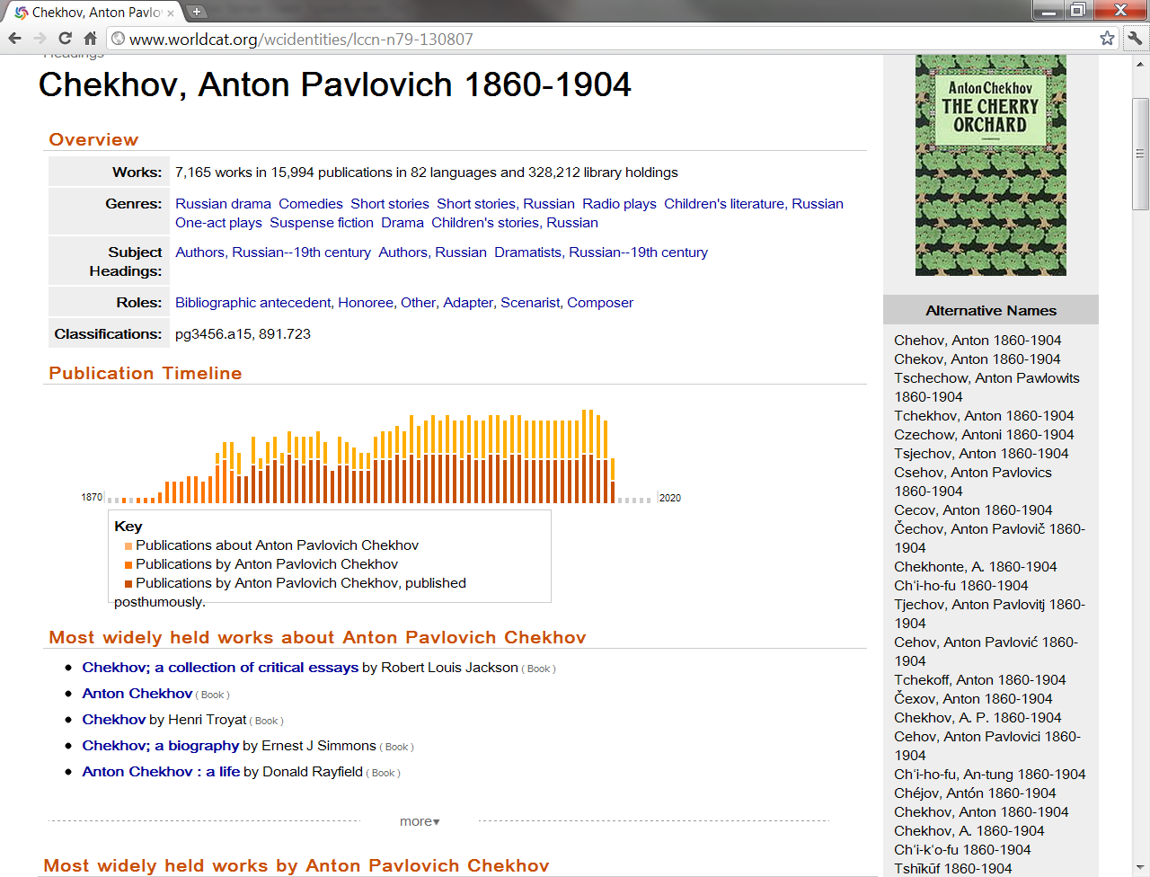

Slide 14
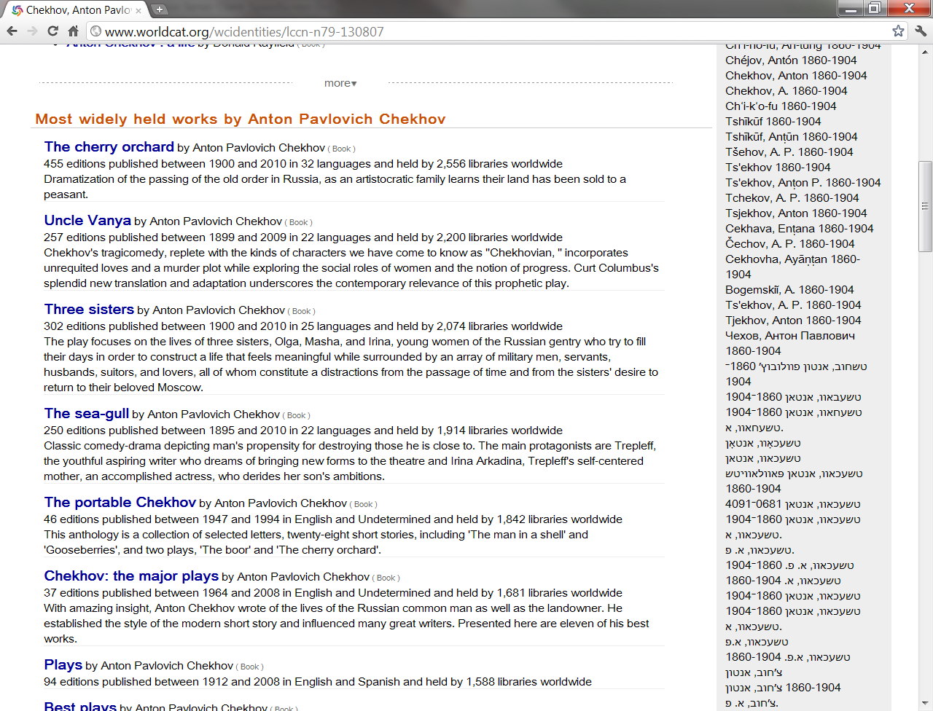

Slide 15
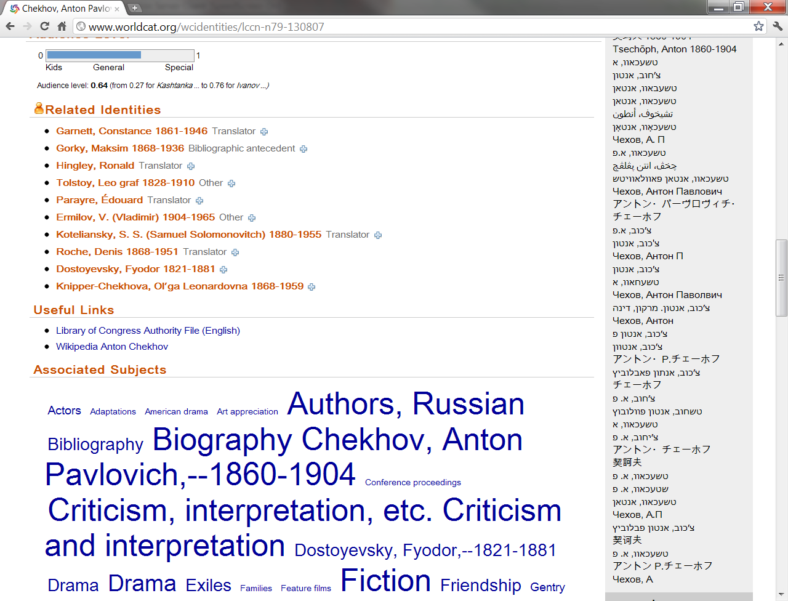

Slide 16
The Virtual International Authority File

Slide 17
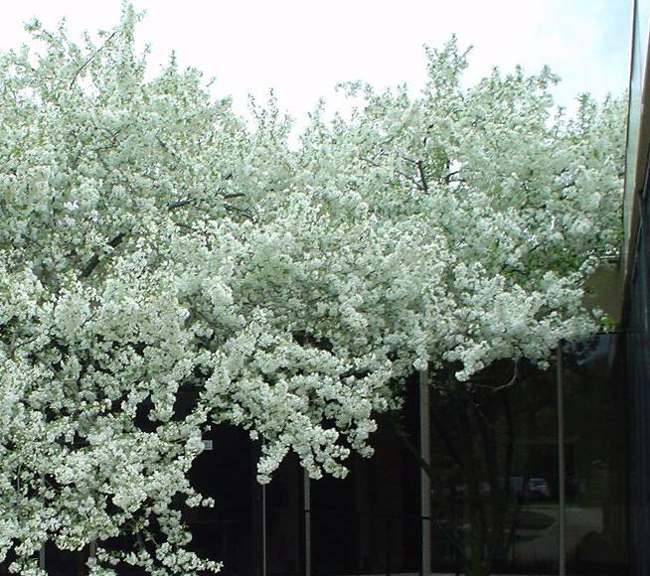
VIAF
Чехов, Антон Павлович
Chekhov, Anton Pavlovich, 1860-1904
Tjechov, Anton, 1860-1904
צ'כוב, אנטון פבלוביץ', 1860-1904
تشيكوف، انطون، 1860-1904 م
6
Notes:
For example, if a user gets information about Chekhov in Russian while searching on the Web, but they have set up their profile to see English in our Latin script – a system application could use VIAF to help display the desired script – for searching further in in the US, or Tjechov in Sweden and could move through the Internet to linked available works by or about this author. Currently VIAF also has Arabic and Hebrew forms of the name.

Slide 18
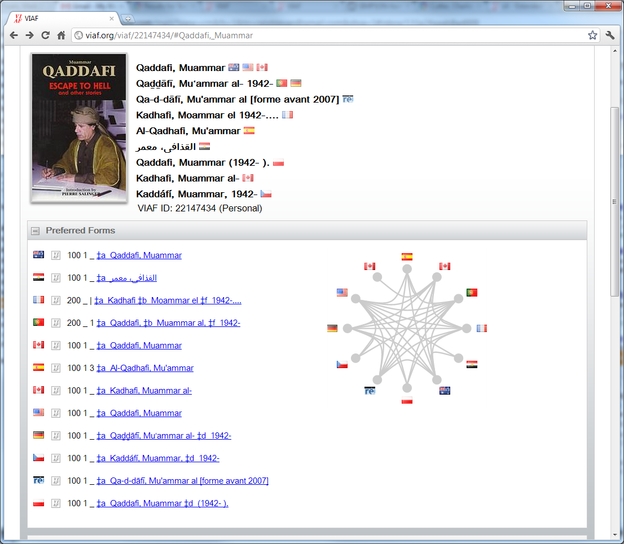

Slide 19
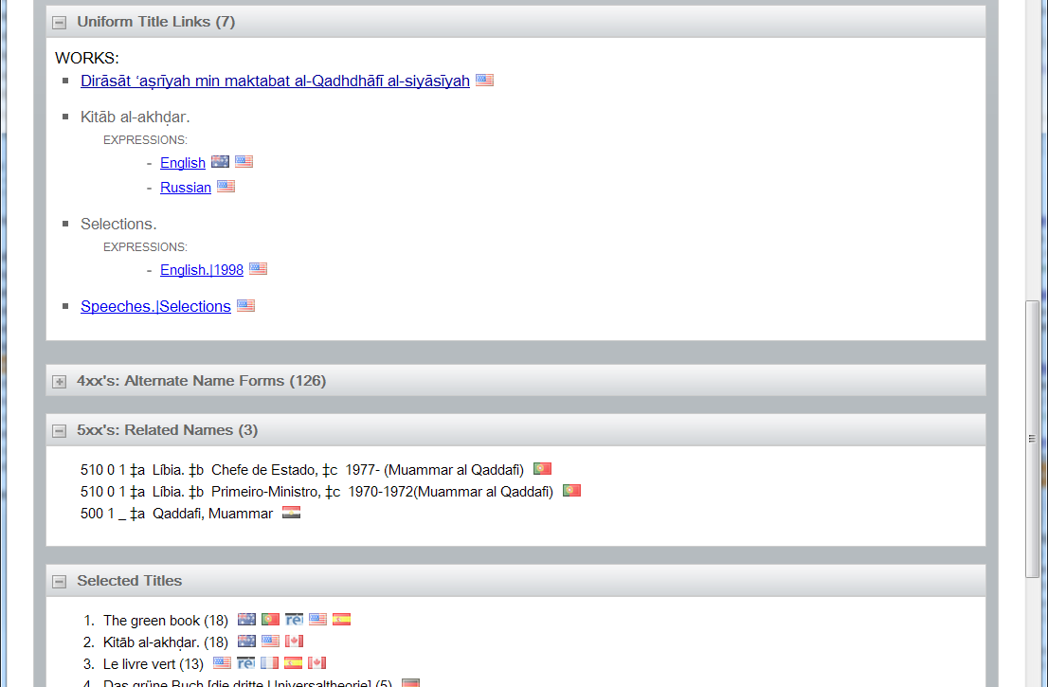

Slide 20
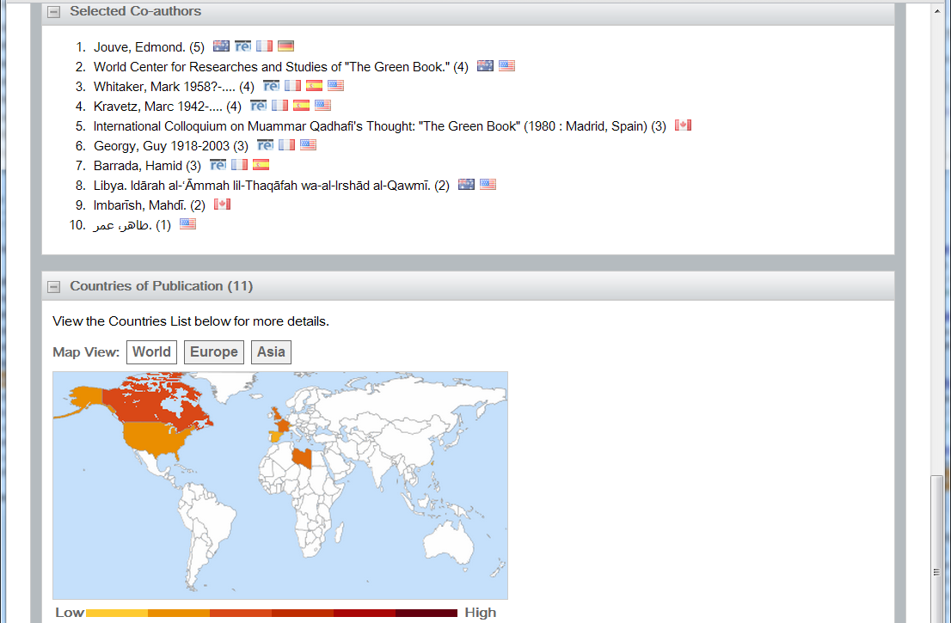

Slide 21
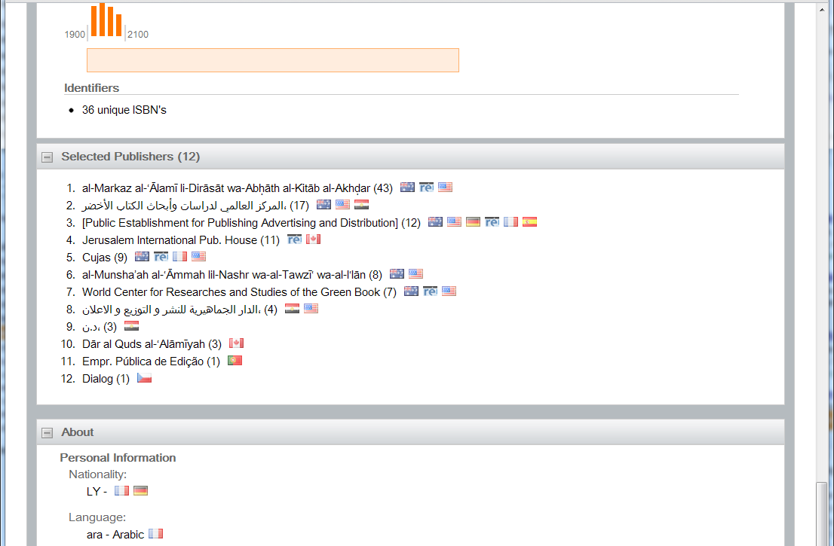

Slide 22
What is VIAF?
Merge of 20+ national level authority files
Cooperative run by BnF, DNB, LC and OCLC
20 million authority records
100 million bibliographic records
16 million merged clusters
Run out of OCLC Research
Planning to make it an OCLC service

Slide 23
Enhancing authorities
Bibliographic
Record
Derived
Authority
Processed
Authority
Authority
Record
Notes:
For every personal name used in either a 100 or a 700 field, a derived authority record is created. In addition to the name, the derived authority record includes a coded summary of the material published. A bibliographic record with multiple personal names will generate multiple derived authority records.
All of the derived authority records for a particular person will be clustered with the authority record for the individual.
The contents of the all the derived authority records for the individual are added to form the processed authority record.

Slide 24
LDR 00826ccm 2200289 a 4500
1 ocm10025532
5 20031229650847.0
8 840627s1982 nyuuua n eng
10 $a 84758340
40 $a DLC $c DLC
19 $a 17706440
20 $c $2.95
28 22 $a 48418 $b G. Schirmer
45 2 $b d198006 $b d198007
48 $b va01 $b ve01 $a ka01
50 00 $a M1529.3 $b .T
100 1 $a Thomson, Virgil, $d 1896-
245 14 $a The cat : $b duet for soprano and baritone / $c
Virgil Thomson ; [words by Jack Larson].
260 $a New York : $b G. Schirmer, $c c1982.
300 $a 1 score (11 p.) ; $c 31 cm.
500 $a For soprano, baritone, and piano.
650 0 $a Vocal duets with piano.
600 10 $a Larson, Jack $x Musical settings.
700 1 $a Larson, Jack.
Language
LC Control Number
LC Classification
Usage
Title
Publisher
Place of Publication
Date of
Publication
Material Type
Authors
Notes:
Two types of information are collected from the bibliographic record associated with the personal names. First, information specific to a work is collected such as the title and LC Control number. Second, information that may apply to multiple works by an author is obtained. The latter information may help to match authors when specific title matches are not available. For this example, J. Larson who writes with V. Thomson in the music subject area is quite likely the same person.

Slide 25
Extracted information
He is a lyricist
His primary subject area is music
He was published in the 80s and 90s by G. Schirmer and Belwin Mills in New York
Worked with Virgil Thomson and Gerhard Samuel
Jack Larson is the only name he has used on his publications
Etc.

Slide 26
Record Flow
SWNL Bib & Authority
BnF Bib & Authority
LC Bib & Authority
VIAF
20 million authority records
10 million links between authorities
Notes:
Processing done in batch on our cluster. Takes 1-2 days processing each month, would take 1-2 months single-threaded
Actually redo all the matching each month. Gives us flexibility at the cost of more computation.
Have a public test site for pre-releases of the database/indexing/interface, etc.

Slide 27
Applications
FRBR matching
  Better matching of non-English metadata
  Uniform identifier across all languages
Authority control for cataloging
Better regionalization of catalogs
Minimize differences across languages of cataloging

Slide 28
xA
A way to ‘control’ VIAF
A way to enhance VIAF
Notes:
Stand-alone authority file that becomes a ‘source’ to VIAF.

Slide 29
xA as a control
Create a xA record and link it to other ‘source’ records
Create two xA records and link them to different ‘source’ records

Slide 30
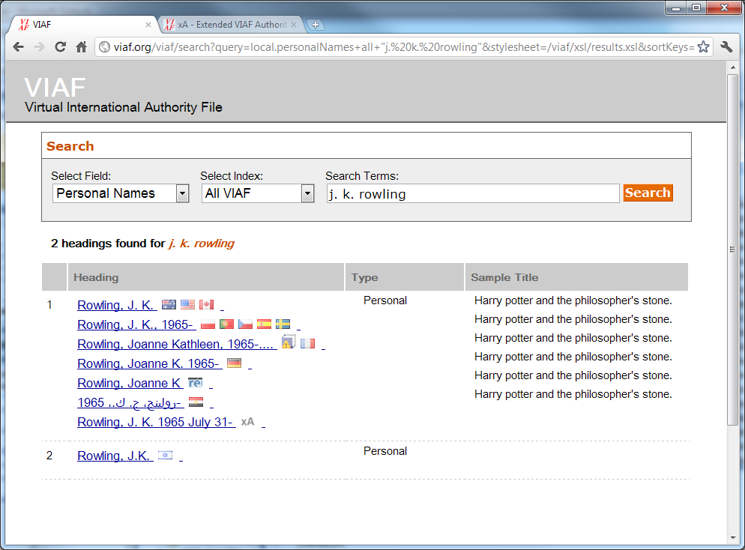

Slide 31
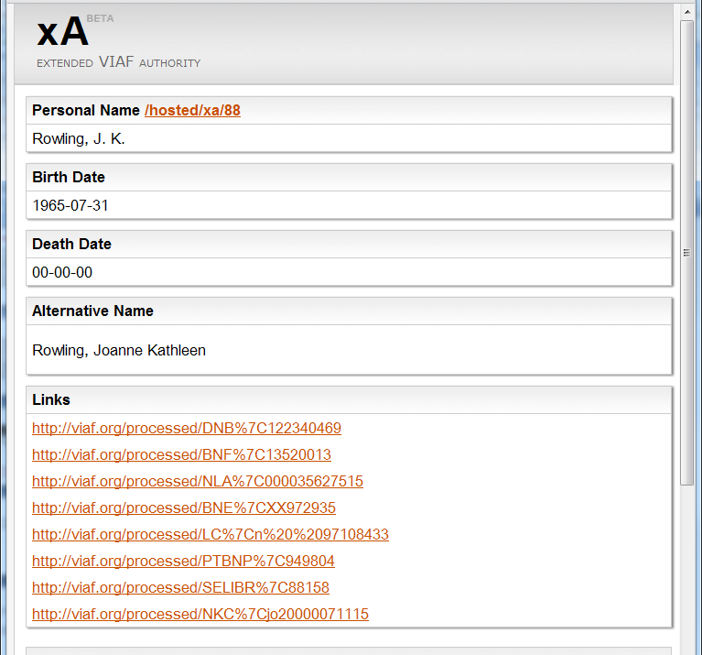

Slide 32
Scholars funnel?
Currently Syriac* names
Interest from Arabic scholars
Why not a larger project?
*David Michelson, University of Alabama

Slide 33
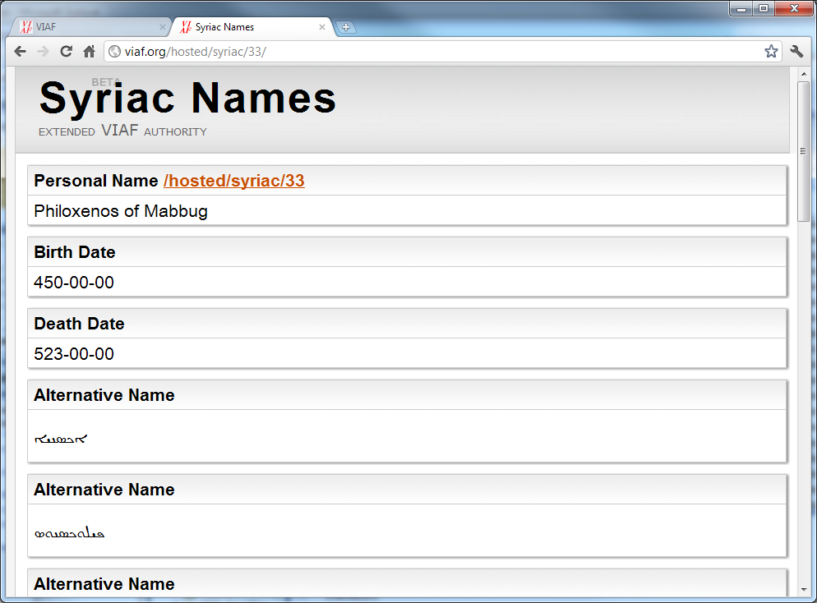
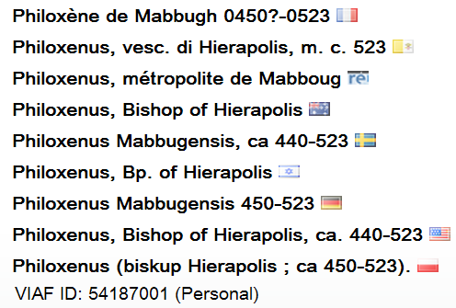
Notes:
WP: Notable Syriac prose writer and a vehement champion of Miaphysitism

Slide 34
ISNI
International Standard Name Identifier
Draft ISO standard:
… aspires to provide a means to uniquely identify creators, including authors, composers, artists, cartographers and performers, among others. Such an authoritative identifier will serve to provide a link for occurrences of the identity across databases on the web
Driven by rights-holders
  Publishers
  Rights agencies representing authors, artists
Notes:
Want to provide an identifier for all sorts of creators to form a link across databases on the web

Slide 35

Open version of Thomson-Reuter’s Researcher ID
Most ‘social’
  Claiming IDs
  Interactive verification of associated works
  Pulling together several current initiatives
Driven by STM, university communities
Primarily interested in researchers
Large number of participants
Mostly concerned with present and future names
Notes:
Current initiatives: Scopus, Scholar Universe, Researcher ID, REPEC, etc.
ORCID may offer the best chance for institutional repositories to quickly get an ID for use in their systems

Slide 36
Cooperation Challenges
What data can be shared?
How to fund the efforts?
Established by different types of institutions:
  Libraries, Standards Organization, STM Publishers
Different
  Technologies
  Time scales
What does the name represent?
  People, personas, organizations
Who is in charge?
Notes:
Historical reasons, including differing policies and procedures in different communities
Who creates the names? Who can update and maintain them?
Who is in charge? Who sets priorities, resolves issues, sets standards?
Systems
Organization, revenue
Not just between the projects themselves, but also challenges in cooperation within the projects. We have worked through some of these issues in VIAF.
Person: Eleanor Marie Robertson
Personas: Nora Roberts, J.D. Robb, Jill March, Sarah Hardesty

Slide 37
Commonalities
All centered in not-for-profits
All interested in data exchange
All interested in global systems
All have an understanding of the problem
  Personal author disambiguation and identification
  Central to their operations
Notes:
But the projects have a striking number of important things in common

Slide 38
Future directions
Transfer VIAF from a research project to a supported OCLC service
Better integration of VIAF and WorldCat
Linking between identifiers
Increased use of explicit links in cataloging and other metadata
Notes:
Explicit links should make it easier to relate library metadata with others as well as improve interoperability within the library community
We especially need links between article authors and library-controlled authors!
Toward that we hope to work with a group at CERN with the inSpire physics literature collection.

