Slide 1

Reconfiguring library boundaries
RLUK pre-conference, London. November 24 2011
Lorcan Dempsey, OCLC @lorcanD

Slide 2
Preamble

Slide 3
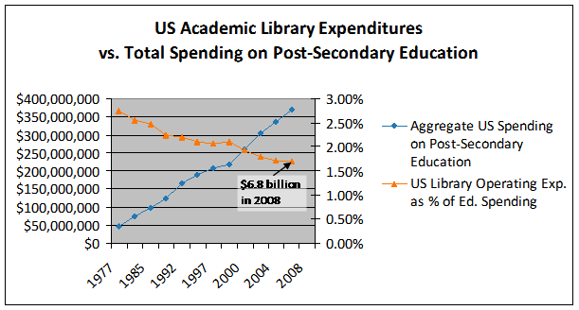

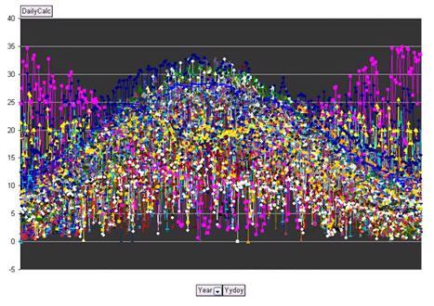
Money
Network
Microsoft research
Impact

Slide 4

Scaling
Webscale
Group
Institutional
Personal

Slide 5



Consolidation at scale
Network encourages efficiencies of scale
Context and community: rich analytics drive richer experiences
The scalability of access: stronger gravitational attraction at network level

Slide 6


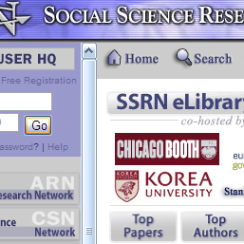
Consolidation at scale
Network encourages efficiencies of scale
Context and community: rich analytics drive richer experiences
The scalability of access: stronger Gravitational attraction at network level

Slide 7

Institution scale
Goodness: A large
collection
in central locations
Organization: Structured around collection
Makes it possible to see library as …

Slide 8

Pic: Günter Waibel

Slide 9
Some directions

Slide 10






Direction?
Widespread sharing of infrastructure within
groups?
Added value: intelligence from circ, acq, …

Slide 11
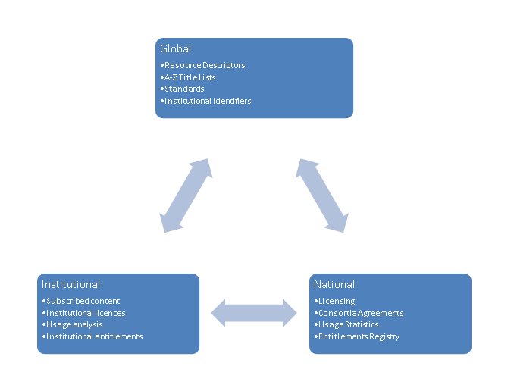

Direction?
Widespread sharing of infrastructure within
groups?
Added value: intelligence from resolution, …

Slide 12


Direction?
Digital discovery at network level?
Shared preservation frameworks?

Slide 13




Direction?
Commodity: How many data wells?
The collection?
Registration model? Library does A&A?
Other players (Elsevier, Thomson Reuters?)

Slide 14





More than 75% of requests to SFX originate externally (Google Scholar, PubMed, etc.). U Minnesota, Discoverability
Direction?
Discovery moves to the network level …..

Slide 15
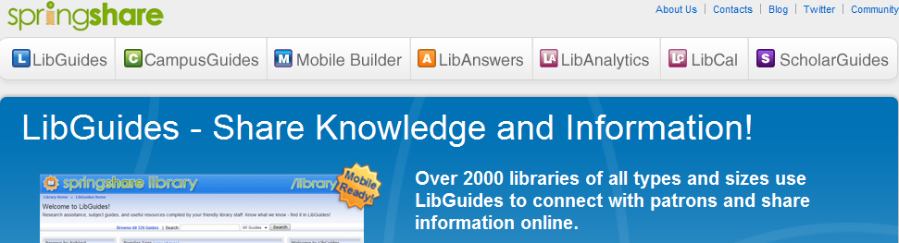
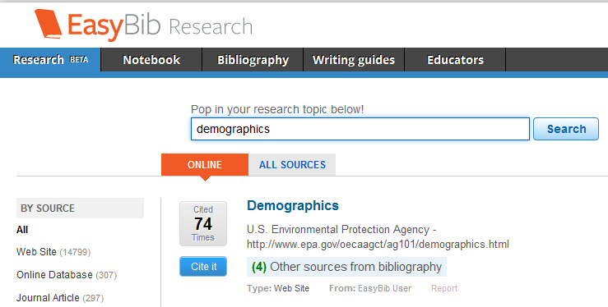

Direction?
….. And to local/institutional curation environments.

Slide 16

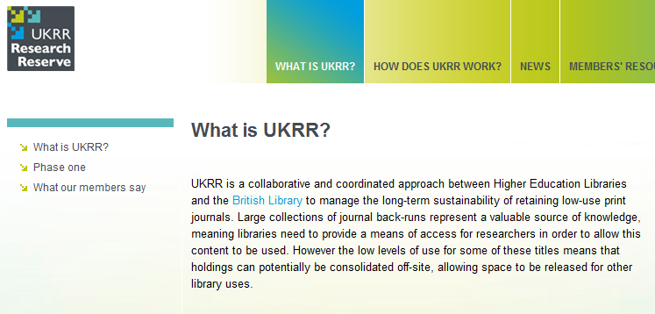
Direction?
Print collections consolidated in
national/regional initiatives?

Slide 17




COLLECTIONS GRID
(Lorcan Dempsey and Eric Childress, OCLC Research)
Stewardship/scarcity
high
low
In many collections
Low-High
Books & Journals
Newspapers
Gov Documents
CD & DVD
Maps
Scores
Low-Low
Freely-accessible web resources
Open source software
Newsgroup archives
low
Uniqueness
High Stewardship
Low Stewardship
High-Low
Research & Learning Materials
Institutional records
ePrints/tech reports
Learning objects
Courseware
E-portfolios
Research data
Prospectus
Insitutional website
High-High
Special Collections
Rare books
Local/Historical Newspapers
Local History Materials
Archives & Manuscripts
Theses & dissertations
high
In few collections

Slide 18
Outside in Bought, licensed
Increased consolidation
Move from print to licensed
Manage down print
Move to user-driven models
Aim: to discover
In Many Collections
Licensed
Purchased
High Stewardship
Low Stewardship
Inside out
Institutional assets: special collections,
research and learning materials, institutional records, …
Reputation management
Increasingly important?
Aim: to *have* discovered … to disclose
In Few Collections
Notes:
Licensed content will dominate in years to come.
Special collections will grow but only modestly (and only at some institutions); mostly growth in managing archival resources including institutional.
Much greater investment in managing research outputs.
No change in web archiving.

Slide 19
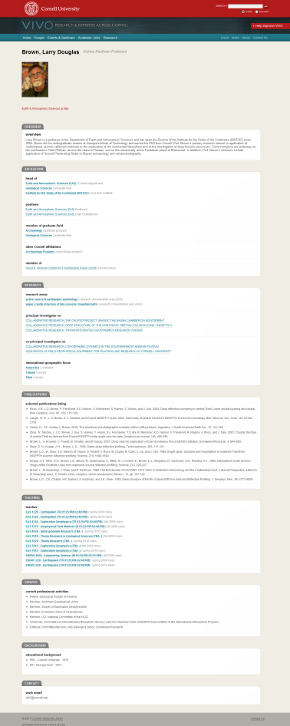

Affiliations
Research
Publications
Teaching
Service

Slide 20
Boundaries

Slide 21
The network reconfigures the library
Boundaries of the library are changing …
…. as the network reduces transaction costs …..
…. and as economics and functionality encourage new approaches.

Slide 22
Role
A university investment in shared information management.

Slide 23
Information management?
IT
New forms of scholarly communication
Computer centre
Press? Departments …
E-learning
Research information management
E-learning
Research office
Repository, …
Data curation and eresearch
e.g. ODAI, Yale
Departments

Slide 24
Strategy:
Making choices
New opportunities
e-research
student experience
reputation/expertise
Strategic choices
Innovate
Partner
Disinvest
Shared services
E-research, digital humanities, student experience, ….
Advantage

Slide 25
Specialization: what business are you really in?
Specialise where can make an impact
Externalise what is routine and can be done well collaboratively or by others
Library: what is distinctive

Slide 26
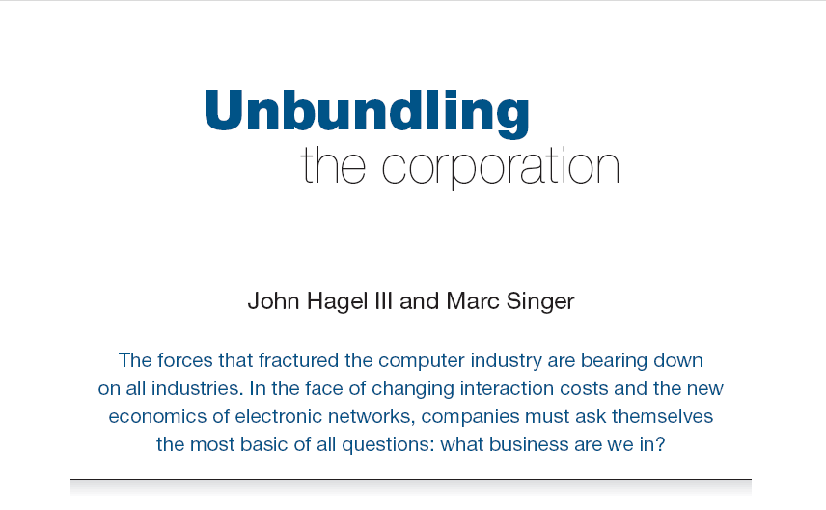
Harvard Business Review (1999)

Slide 27
Core components of a firm
Attracting and building relationships with customers
“Service-oriented”, customization
Economies of scope important
Develop new products and
services and bring them to
market
Speed/flexibility important
Customer
Relationship
Management
Product Innovation
Infrastructure
Back office capacities that
support day-to-day operations
“Routinized” workflows
Economies of scale important

Slide 28
Attracting and building relationships with researchers and learners
“Service-oriented”, customization
Economies of scope important
Develop new
services and have them accepted
Speed/flexibility important
Engagement
Innovation
Infrastructure
Back office capacities that
support day-to-day operations
“Routinized” workflows
Economies of scale important

Slide 29
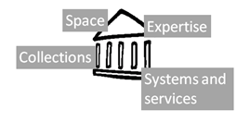

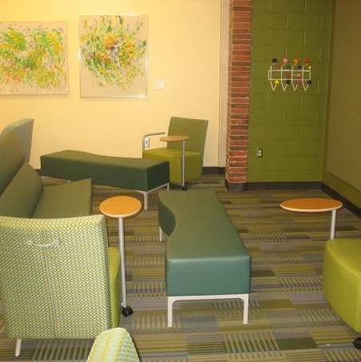

Shifting boundaries
Libraries externalising infrastructure – economies of scale and network effects
Collections
Systems
Discovery?
Relationship management is central – engagement creates distinctive local value
Buildings
The service turn
People
Aggregate social/analyti cs data
Patterns of externalization vary
Collaborative: sharing innovation and resources
Commercial: contracting for services
The emergence of the cloud

Slide 30

Space
Reconfigure around the user experience
rather than around collections.
Infrastructure >> engagement
Social
Ad hoc rendezvous
Meeting place
Showcase and sharing
Exhibitions
Specialist equipment
Specialist staff
GIS, Writing centre, digital humanities, …

Slide 31
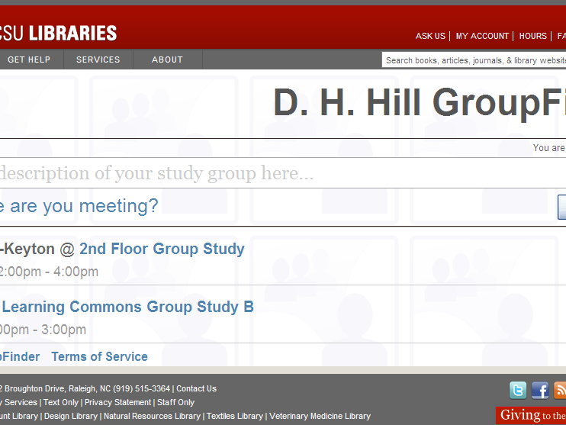
Find members of a group in the library ….

Slide 32
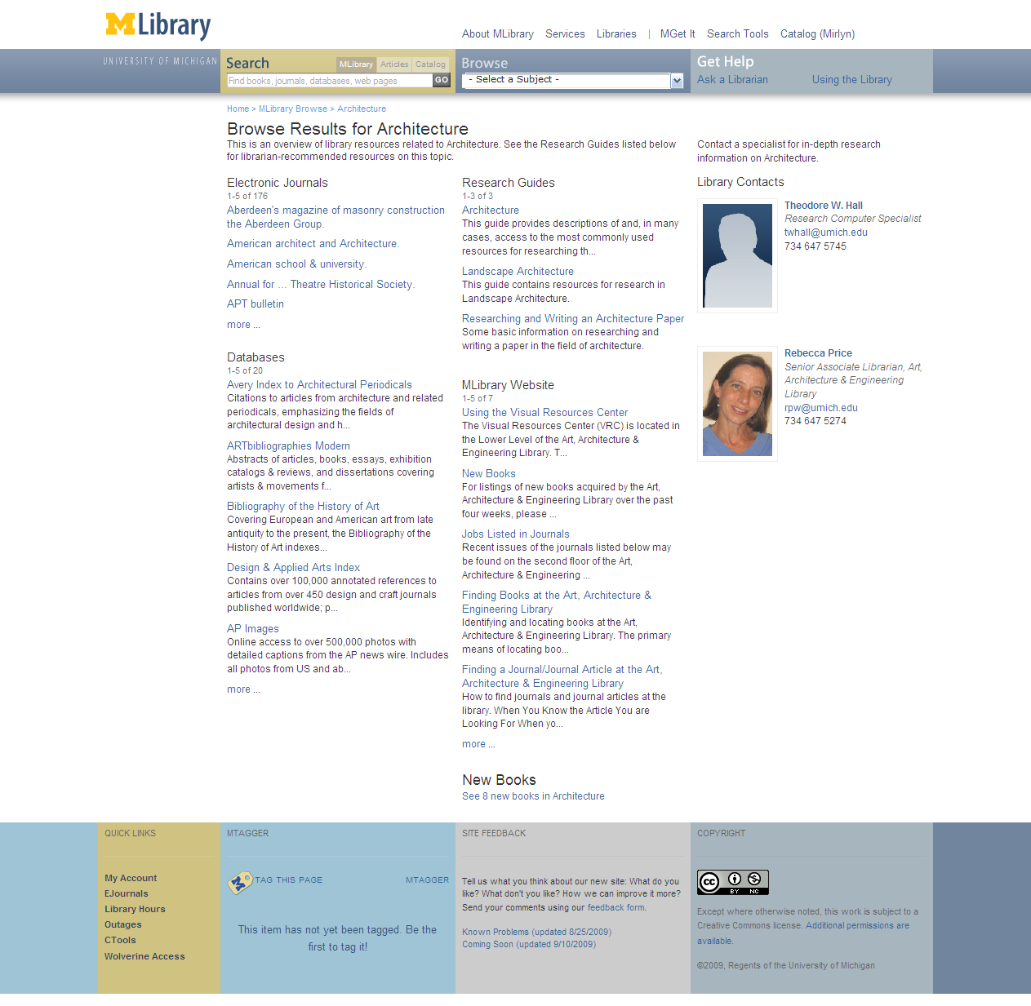
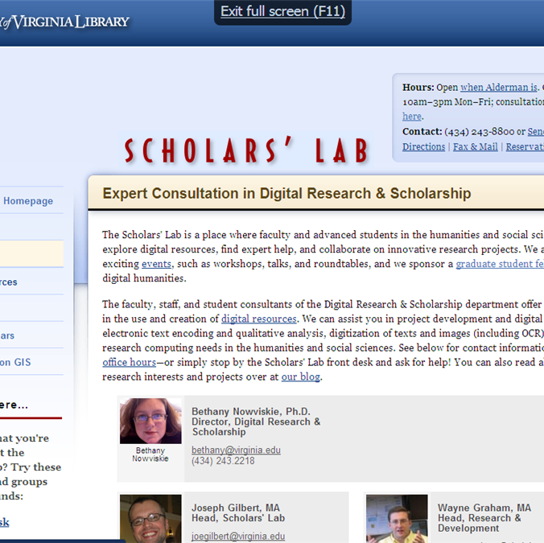

Expertise
People are entry points
Librarans returned in search .. UMich
Engagement with research and learning
Marketing/assessment/
partnership

Slide 33
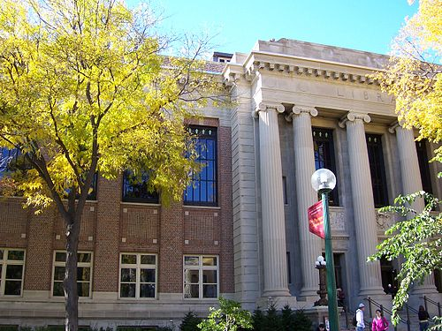
Services
The service turn
U Minnesota, ARL Institutional profile
In alignment with the University's strategic positioning, the University Libraries have re-conceived goals, shifting from a collection-centric focus to one that is engagement-based.

Slide 34
Service
The service turn
Defining distinctive services with the clarity with which we have defined distinctive collections allows us to acknowledge that the 21st century will be marked by different, but equally valid, definitions of excellence in academic libraries, and that the manner in which individual libraries demonstrate excellence will be distinctive to the service needs, and to the opportunities to address those needs, found on each campus.
Scott Walter. “Distinctive Signifiers of
Excellence”: Library Services
and the Future of the Academic
Library. Coll. & res. libr. January 2011 72:6-8

Slide 35


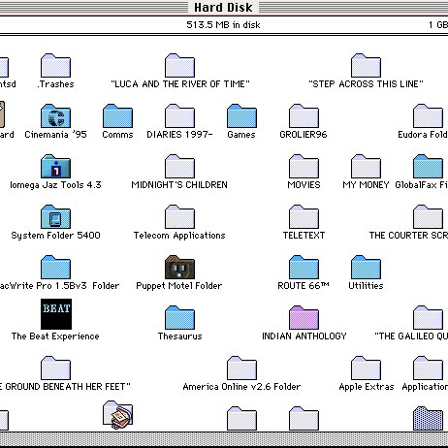

First year initiatives: Bowling Green State Univ Libs
The Library First-Year Initiatives (F.Y.I.) Program strives to make meaningful connections with incoming students early in their academic career.
M Publishing, U Michigan
The University of Michigan Press, the Scholarly Publishing Office, Deep Blue (the University’s institutional repository service), the Copyright Office, and the Text Creation Partnership,
Salman Rushdie Archive, Emory U
Personal digital papers of Salman Rushdie. Have become his reference collection.
Scholarly Commons, U Illinois Urbana Champaign
... to serve the emerging needs of faculty, researchers and graduate students pursuing in-depth research and scholarly inquiry. Access to expertise, hardware and software.

Slide 36

Systems
Engagement, cloud and collaboration
Focus on engagement
Resource guides, integration with learning management, widgets, etc
Recommendation (aggregation)
Move to cloud for infrastructure
ILS, ERM, Discovery: move to cloud-based solutions
Deep collaboration
Shared systems infrastructure:
Orbis Cascade Alliance, 2CUL

Slide 37
Externalization

Slide 38
 | Collab | Public | Third party
Webscale | Repec | PubMed | Worldcat.org
Group | Tripod | OhioLink COPAC
Institutional | Dspace VuFind |  | Hosted LMS
Scaling
Sourcing

Slide 39
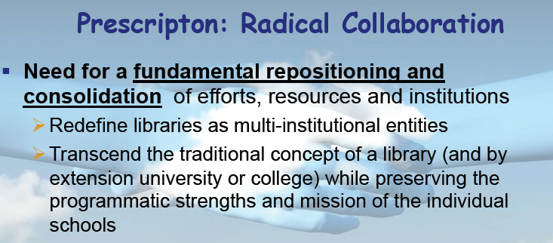
Rick Luce, LIBER 2011, Barcelona

Slide 40
Google Books/Scholar
Mendeley
Web-scale
Externalization
Web
4
Cooperative cataloging
Resource sharing
Collaborative
Externalization
Scaling
Group
2
Licensed e-content
Hosted systems
Self-
Sufficiency
Straight
Externalization
Institution
1
3
Internalized
Collaborative
Public
Third-Party
Sourcing

Slide 41
Google Books
Web-scale
Externalization
Web
4
Hathi Trust
Europeana
Collaborative
Externalization
Scaling
Group
2
JSTOR
Proquest
Self-
Sufficiency
Straight
Externalization
Institution
1
3
Internalized
Collaborative
Public
Third-Party
Life cycles?
Sourcing

Slide 42
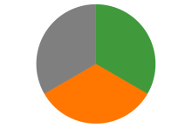
Some directions
Strengthening engagement
Systems for engagement
Relationship with campus partners
Marketing and assessment
The service turn
Externalising infrastructure
Give things up?
Deep collaboration
Cloud
Just in case to just in time
External relationships are
even more critical:
Strategic choices
Sharing Innovation and expertise
New skills
Organizational innovation

Slide 43
Reconfiguring library boundaries
Thank you!
RLUK pre-conference, London. November 24 2011
Lorcan Dempsey, OCLC @lorcanD

