Slide 1

Cooperation in the digital age:
The network reconfigures the library?
@LorcanD
Lorcan Dempsey
OCLC
Biblioteksledermøde 2010, Nyborg Denmark
9 November 2010

Slide 2
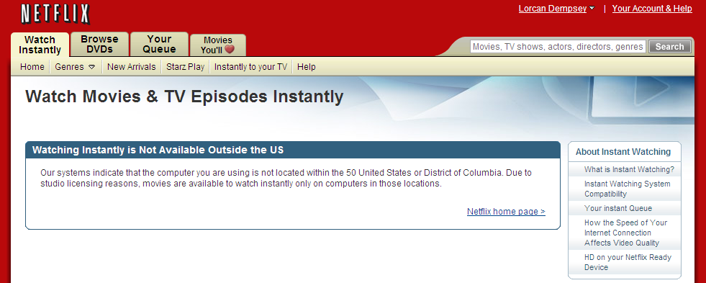
Caveat ….
We cannot step outside our own environment …..
…. but see the world from the rock we stand on.

Slide 3
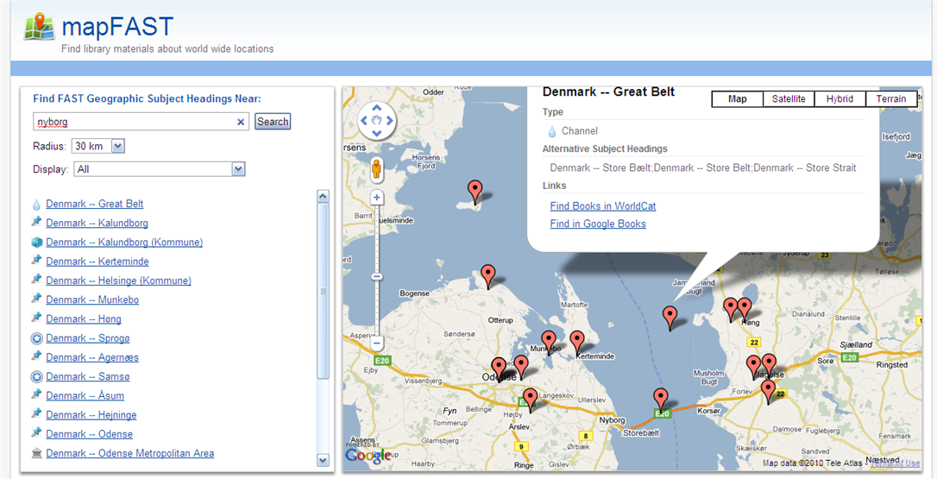

Slide 4
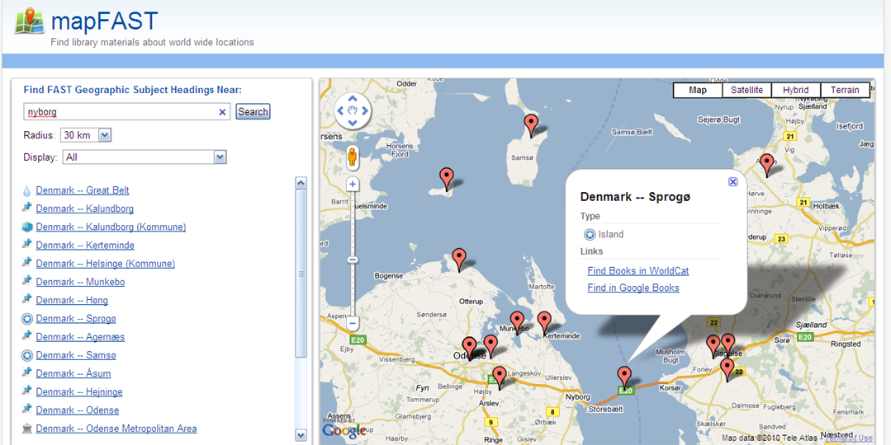

Slide 5
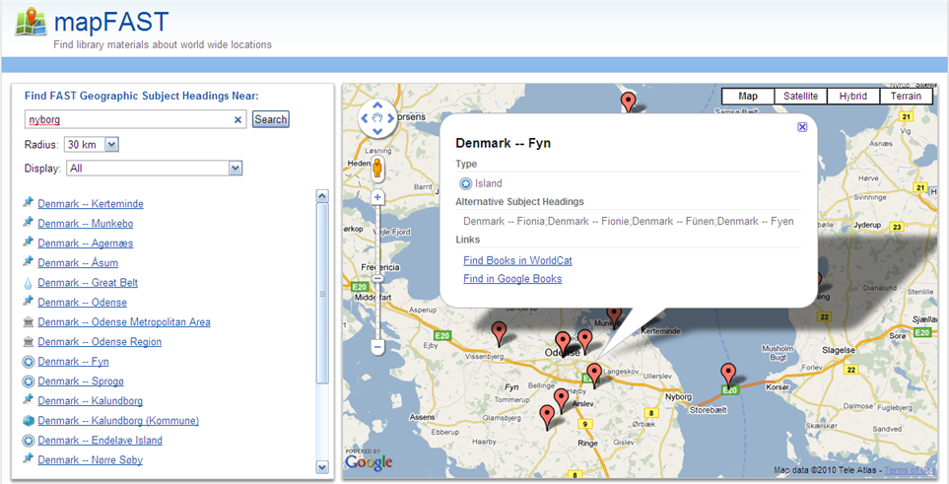

Slide 6
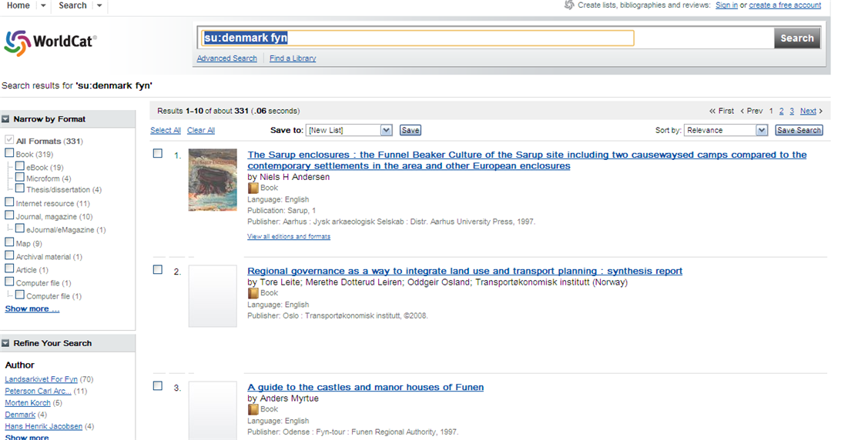

Slide 7
The network reconfigures industries

Slide 8
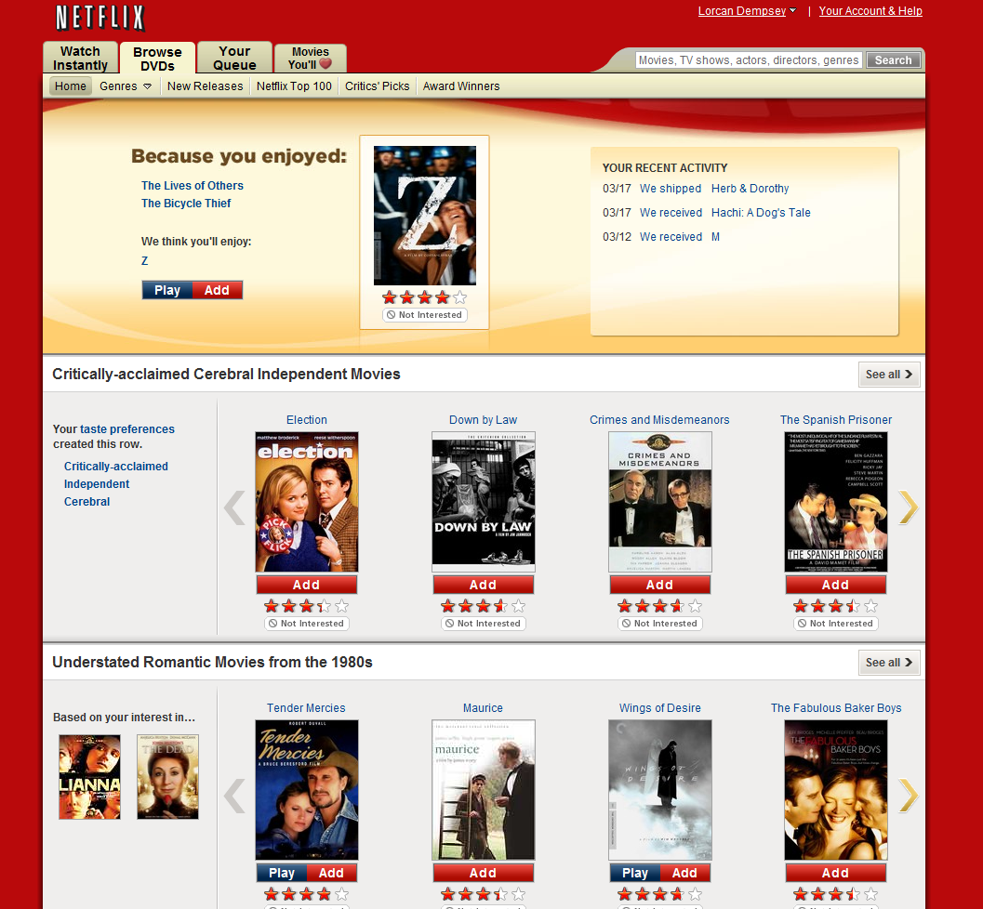

Slide 9
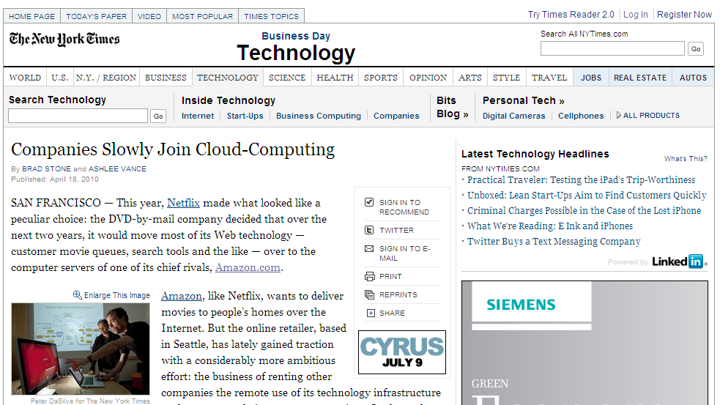

Slide 10
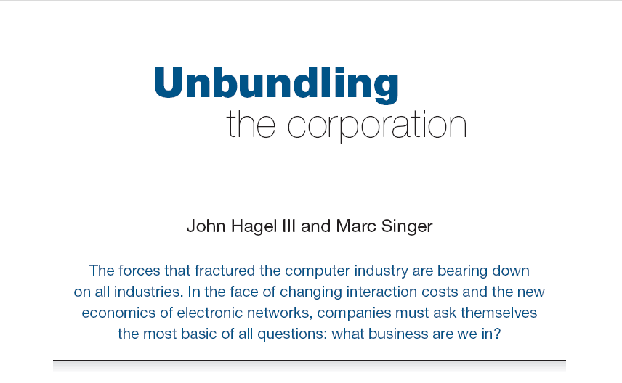
Harvard Business Review (1999)

Slide 11
Core components of a firm
Attracting and building relationships with customers
“Service-oriented”, customization
Economies of scope important
Develop new products and
services and bring them to
market
Speed/flexibility important
Customer
Relationship
Management
Product Innovation
Infrastructure
Back office capacities that
support day-to-day operations
“Routinized” workflows
Economies of scale important

Slide 12
Relationship
management
Infrastructure
Boundary
Flow

Slide 13

The library: a prosaic view:
A bundle of functions an organisation internalises to make information management more efficient.
Contribute to management of scholarly record.

Slide 14
Libraries externalise infrastructure

Slide 15
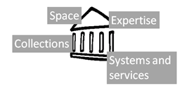
Library

Slide 16
A historic shift
Cataloging
Resource sharing
A&I
e-Journals
Virtual reference
Preservation
Research materials

Slide 17
Inflection point
Derived from : National Clearinghouse on Educational Statistics, 1998-2008

Slide 18
Legacy print repositories
Cataloging
Resource sharing
Digital repository
A&I
e-Journals
Collaborative data/patron driven acquisition
Analytics: usage data
Virtual reference
‘Syndication’ to search engines etc
Preservation
Identifier infrastructure
Research materials
Knowledge base

Slide 19
Specialization: what business are you really in?
Specialise where can make an impact
  Relationship management?
Externalise what is shared and can be done well elsewhere
  Infrastructure?
Library: how much is distinctive?

Slide 20
Scale
 | Institution | Group | Webscale
Peer (collaborative) | HathiTrust; DuraSpace | Orbis Cascade | Repec.org HathiTrust (?)
Public (state/national) |  | JISC; SURFNET; DEFF; DBC; LIBRIS; …
Third party | Locally procured systems and services |  | Flickr Commons, Google Scholar, Worldcat.org
Source
*
*
*

Slide 21
Customer relationship management: a look at space and expertise

Slide 22
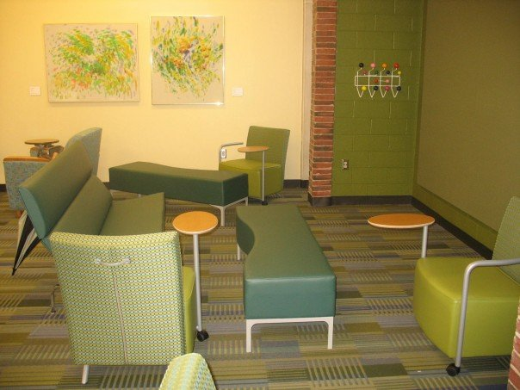
The reconfiguration of space
Shift from Infrastructure to Customer relationship management
  Social: ad hoc rendezvous
  Showcase: exhibition, expertise, specialist equipment/services.
Photo: University of Rochester. S Gibbons

Slide 23
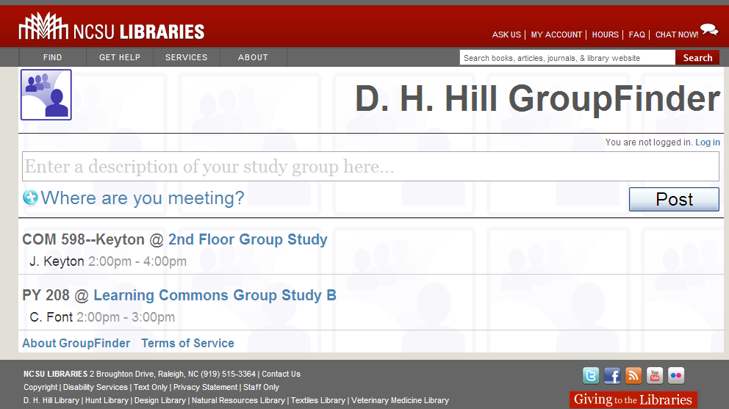
Shift: systems support for use of space
(customer relationship management)

Slide 24
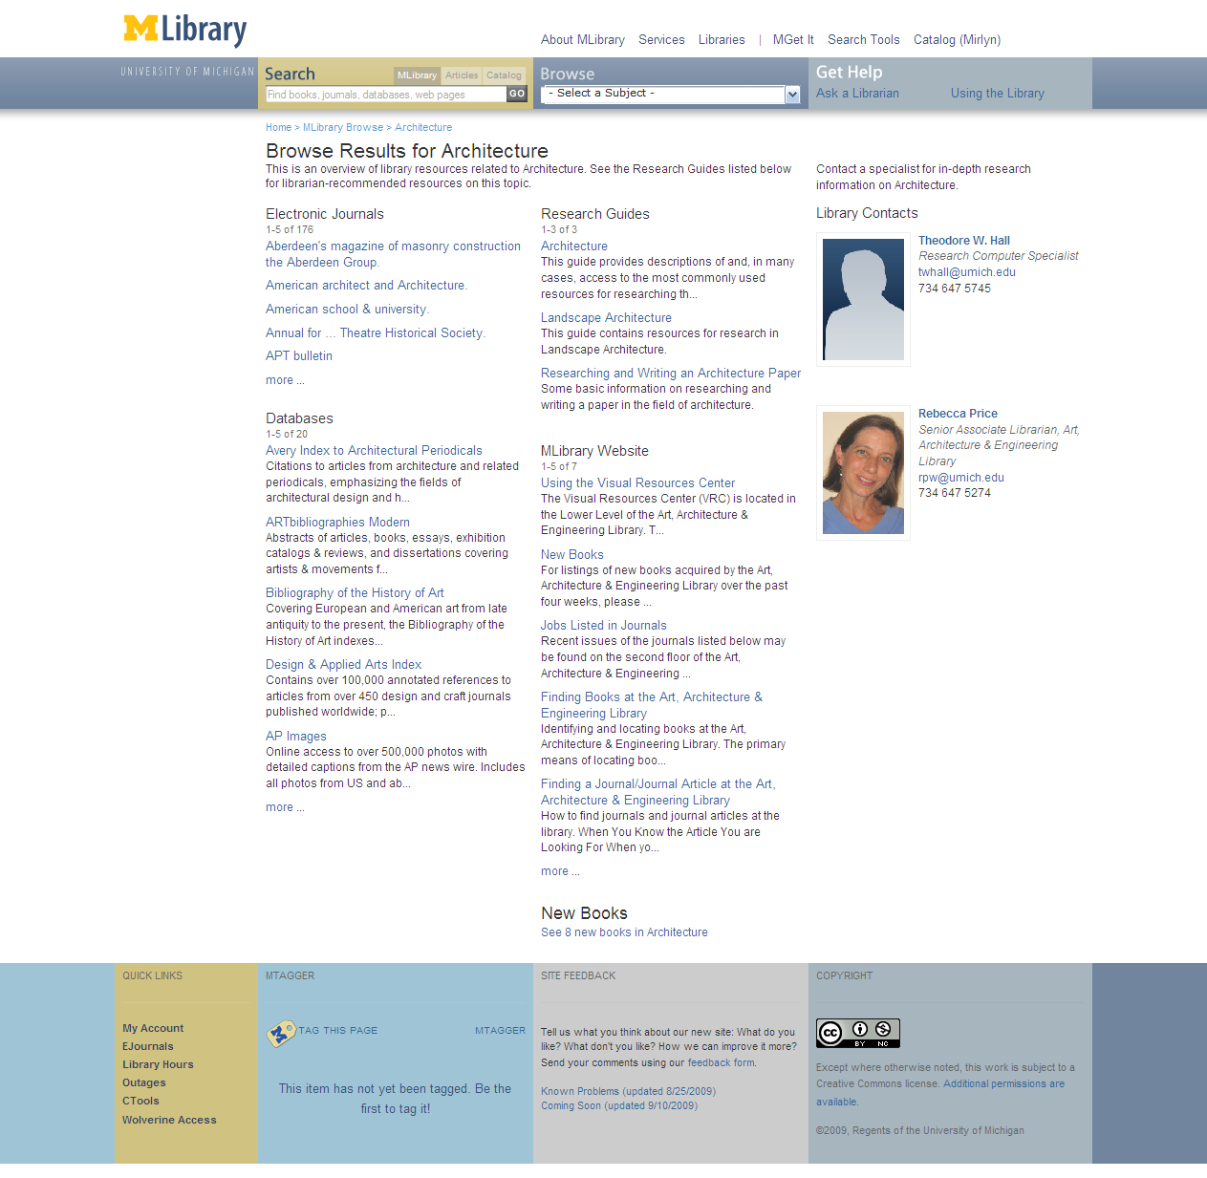
Shift: visibility of library staff: Relationship management?
People are entry points (Dan Chudnov)
Engagement with research/learning/
personal development
If the library wishes to be seen as expert then its expertise must be seen.

Slide 25
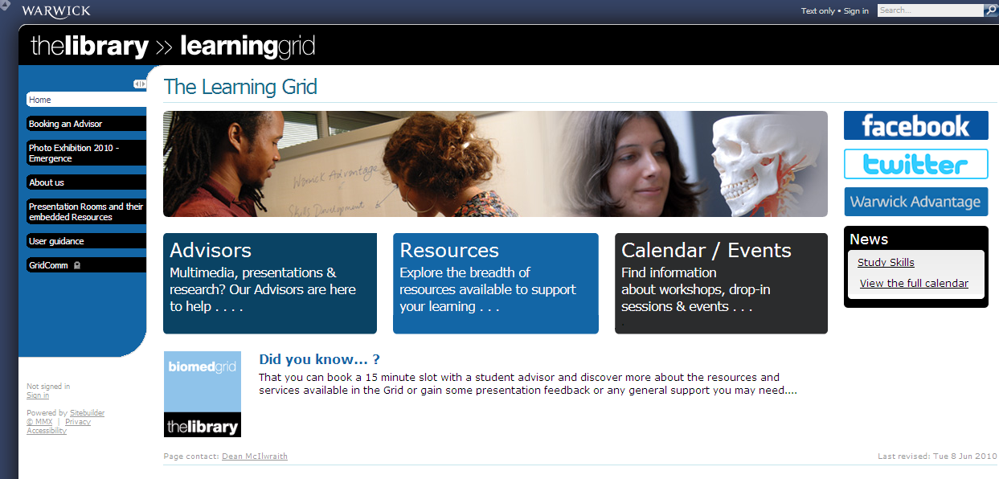

Slide 26
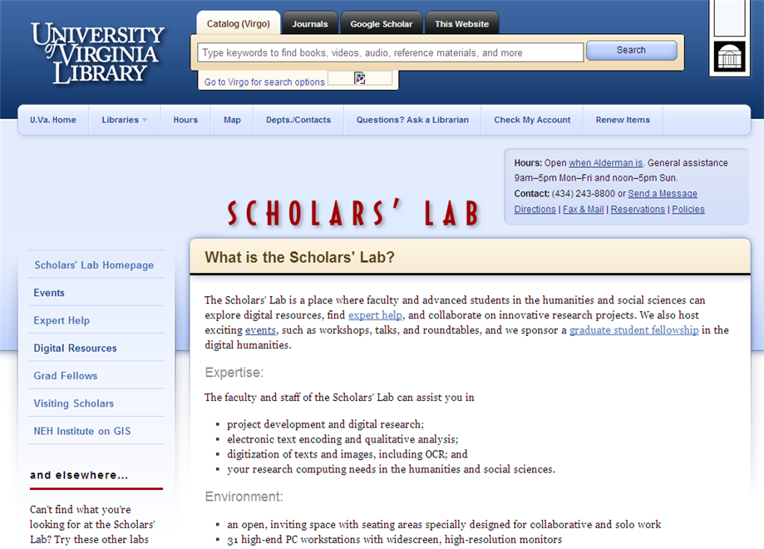

Slide 27
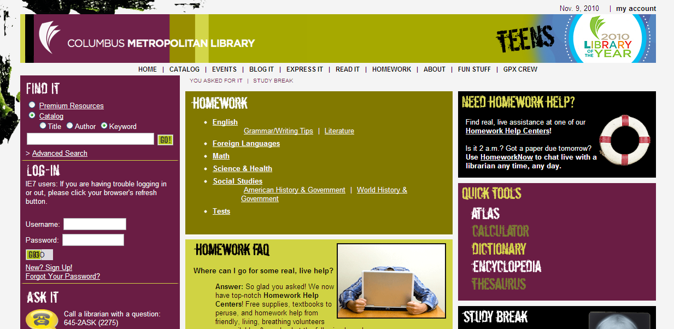

Slide 28
Customer relationship management: a look at systems

Slide 29
Managing demand vs managing supply
Collections: outside in and inside out
Discovery happens elsewhere
(Personal collections)

Slide 30
Sorting out demand

Slide 31
Gavin Potter: Netflix prize competitor
"The 20th century was about sorting out supply," Potter says. "The 21st is going to be about sorting out demand." The Internet makes everything available, but mere availability is meaningless if the products remain unknown to potential buyers.
Read More http://www.wired.com/techbiz/media/magazine/16-03/mf_netflix?currentPage=1#ixzz0mBoE2Mf4

Slide 32
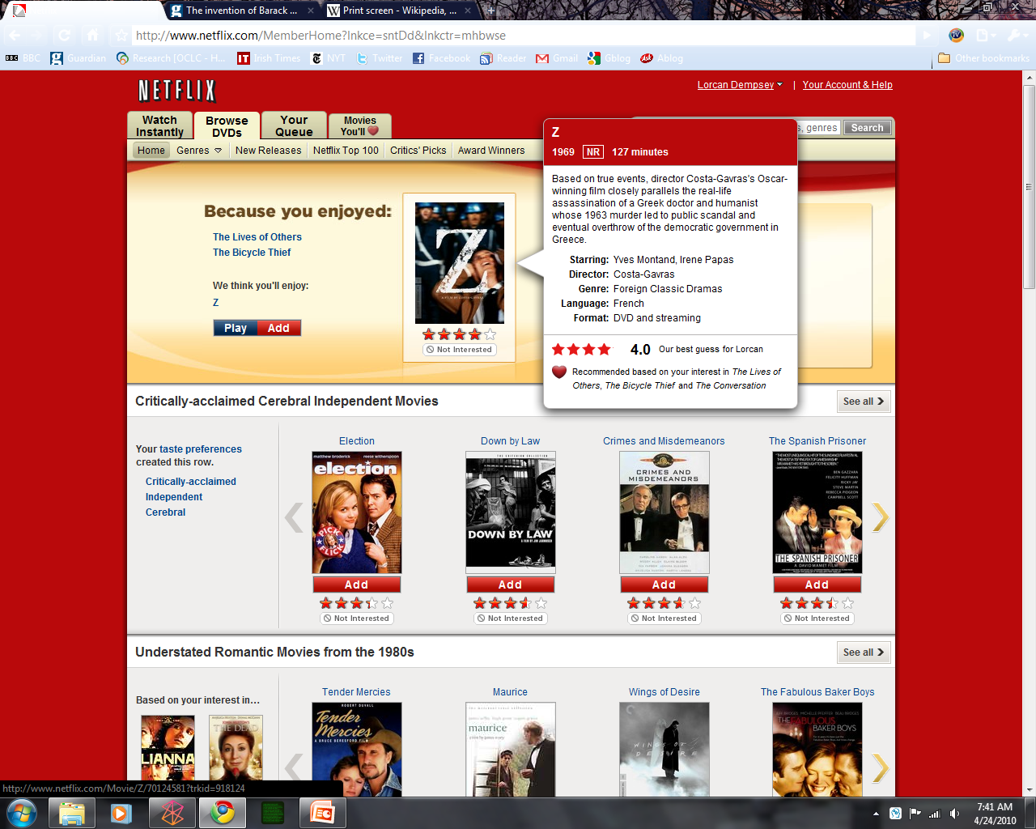

Slide 33
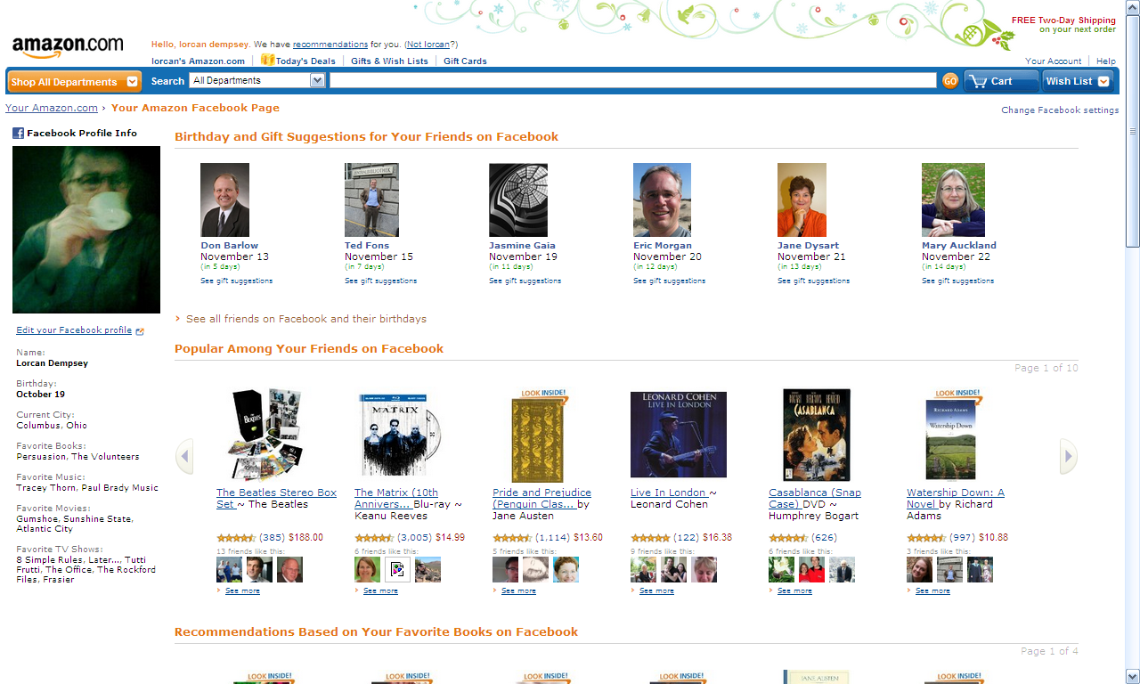

Slide 34
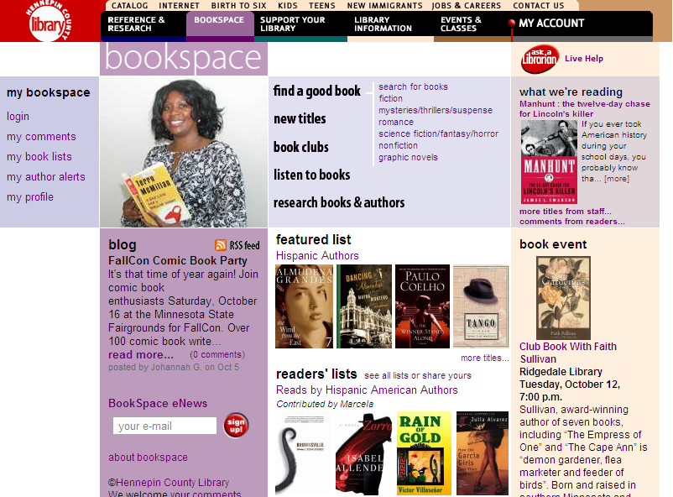

Slide 35
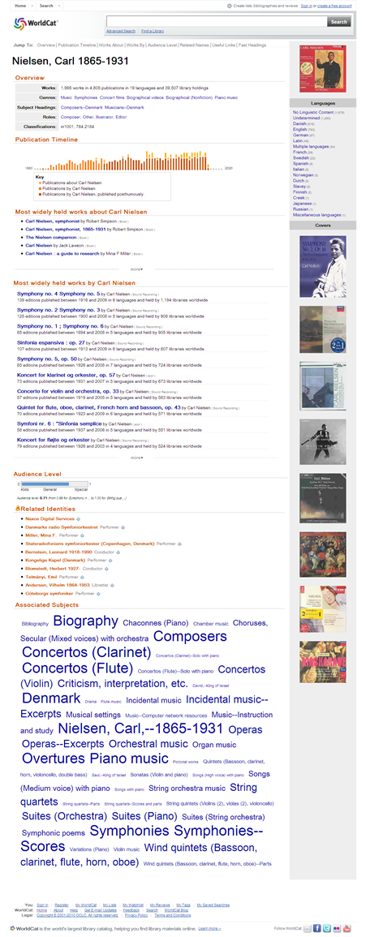
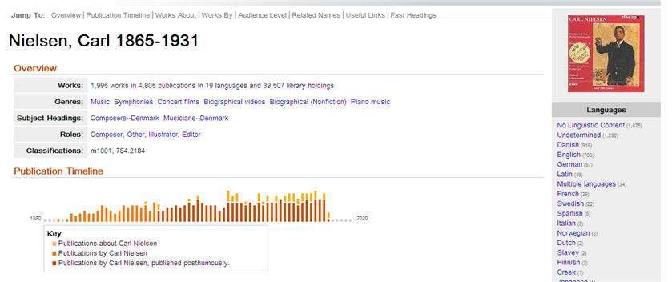
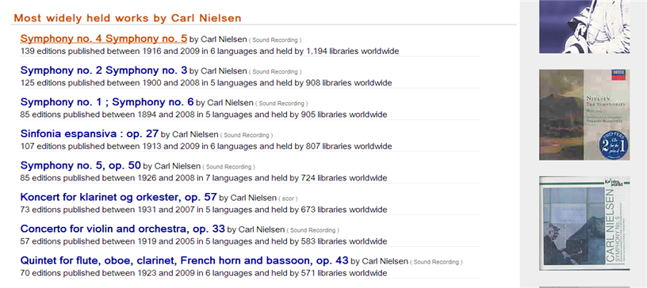
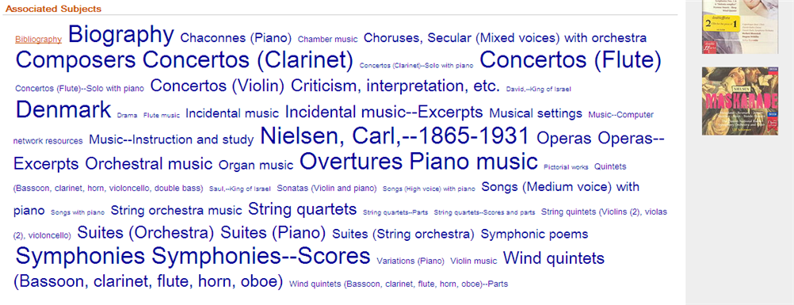

Slide 36
Context, community, conversation
Rank, relate, recommend
Depends on infrastructure:
Shared platform, analytics, integration, syndication, ….

Slide 37
Collections

Slide 38
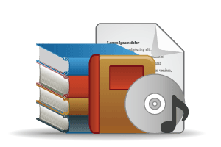


Outside in:
Books, journals, DVDs, … (Bought and licensed)
Aim: to discover …
Inside out:
institutional assets: special collections, research and learning materials, institutional records, …
Aim: to have discovered …

Slide 39
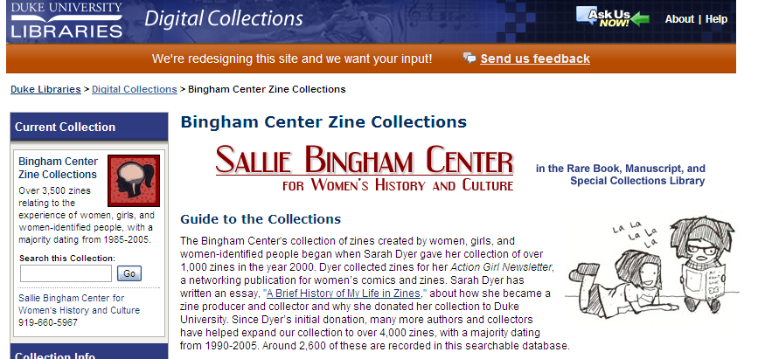
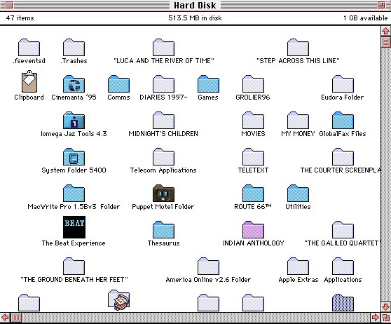
Richard E Luce, Emory University
Change in emphasis: space, budgets, research support
2010 Annual RLG Partnership Symposium
When the Books Leave the Building: The Future of Research Libraries, Collections and Services
Keeping heritage up to date!

Slide 40
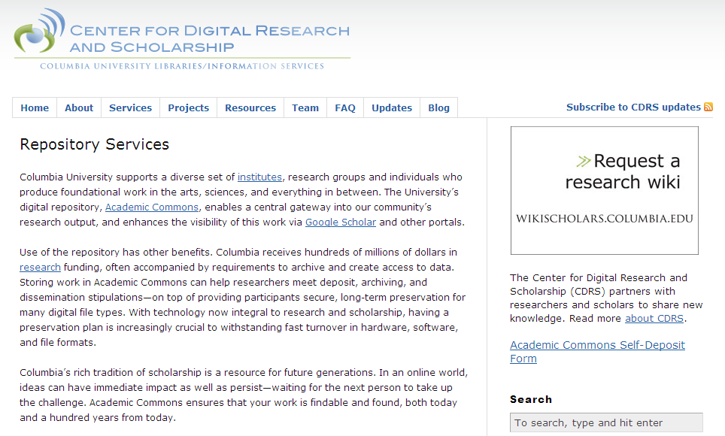
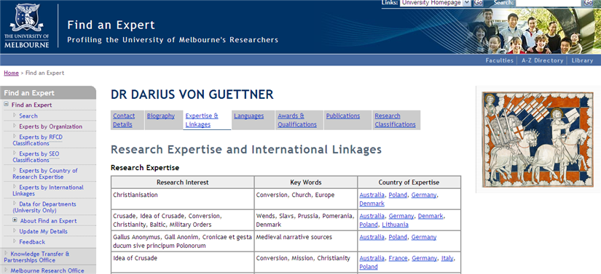
From repository to
research identity and reputation

Slide 41
Discovery happens elsewhere:
3 modes of discovery

Slide 42
Info
Provider
Consumer
Library
1
Direct – outside in
  Discovery layer

Slide 43
In the flow ..
Network level
Mendeley
Google
Amazon
Flickr
iTunes
Wikipedia
Twitter
Facebook
…
Variety of workflow tools
Student portal
Course management system
Reading list
Refworks
VIVO, OSU Pro, …
…
Build around workflow

Slide 44
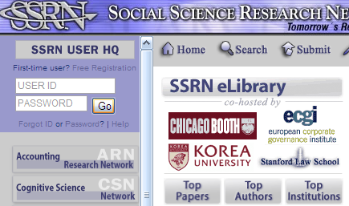





Network level
Matching supply and demand
  Aggregating supply: large inventory
  Aggregating demand: large audience
Referencability
  Wikipedia (an addressable knowledge base)
  Amazon (leading shared book URLs?)

Slide 45
Network Flow
Info
Provider
Consumer
Library
Indirect – from the network flow to the library
  Apps, libx, etc, ….

Slide 46


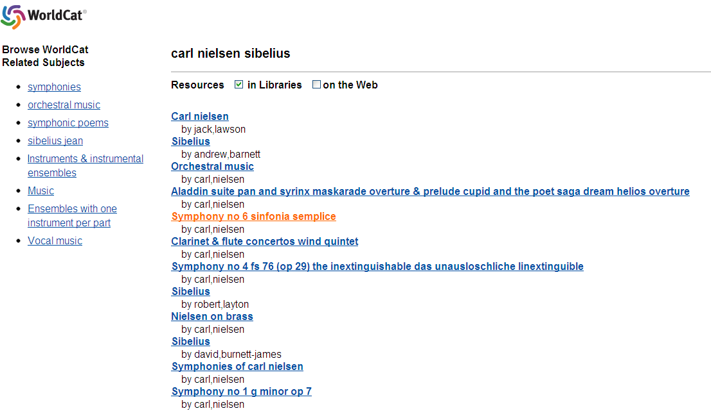

Slide 47
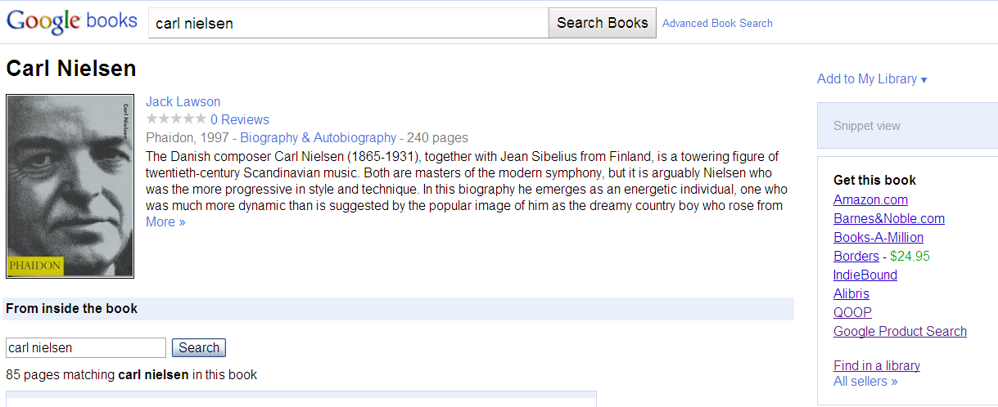

Slide 48
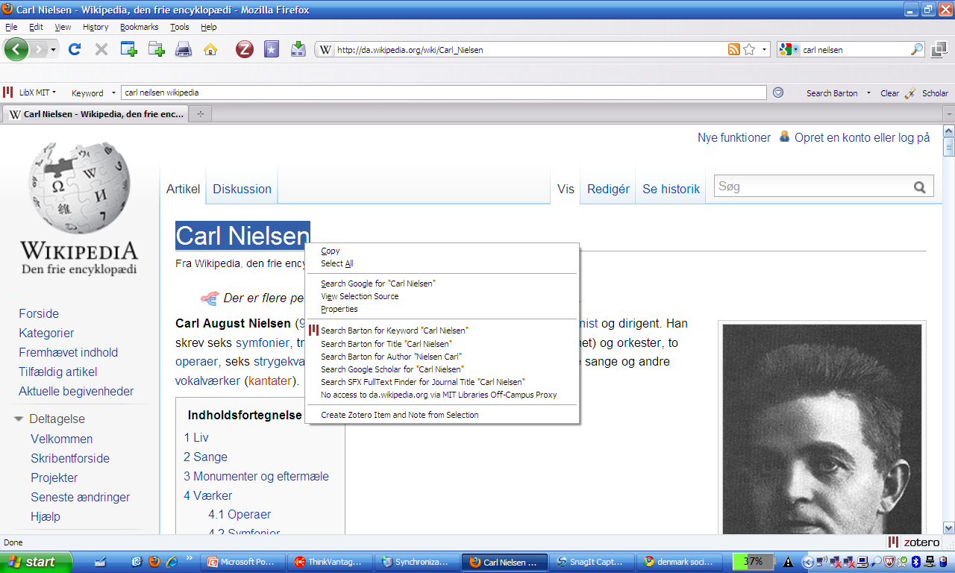
Libx

Slide 49
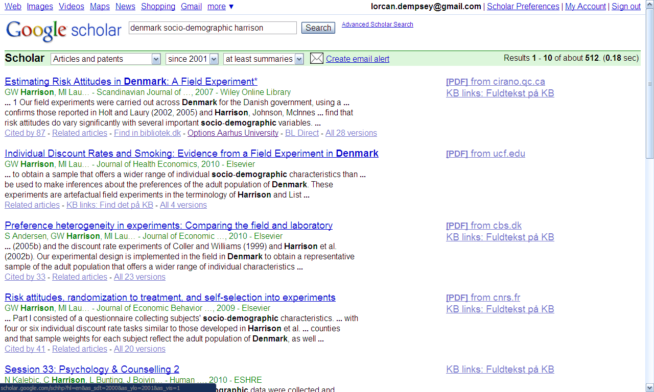
Indirect discovery

Slide 50
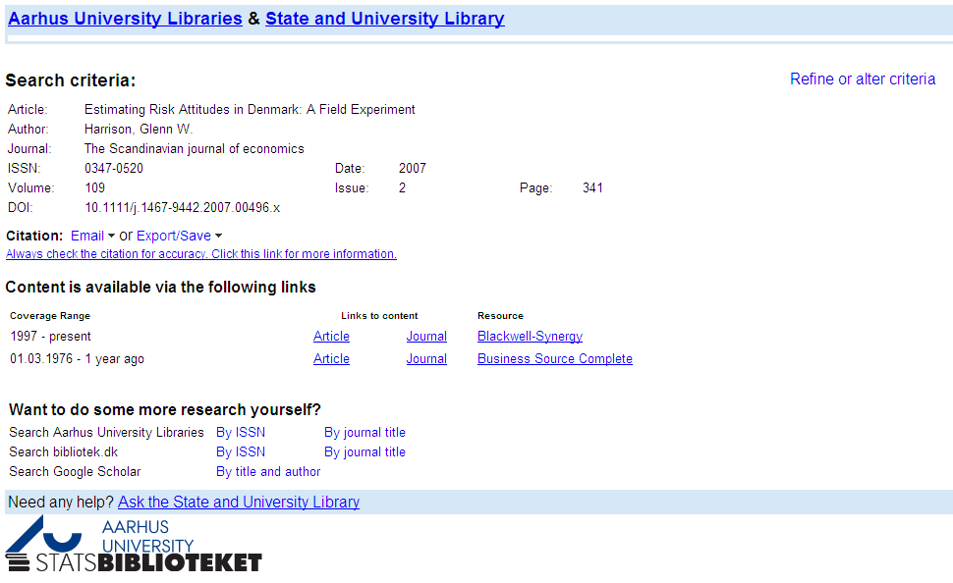

Slide 51
Network Flow
Info
Provider
Consumer
Library
3. Disclosure and syndication – inside out: make discoverable
  Institutional assets: repository, etc
  Holdings: knowledge base, catalog (e.g.google scholar)

Slide 52
Indirect discovery
Disclosure

Slide 53
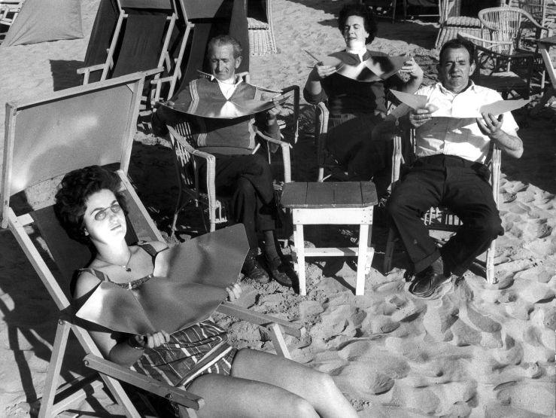

http://www.flickr.com/photos/nationaalarchief/4795486675/sizes/l/in/set-72157624492663716/

Slide 54



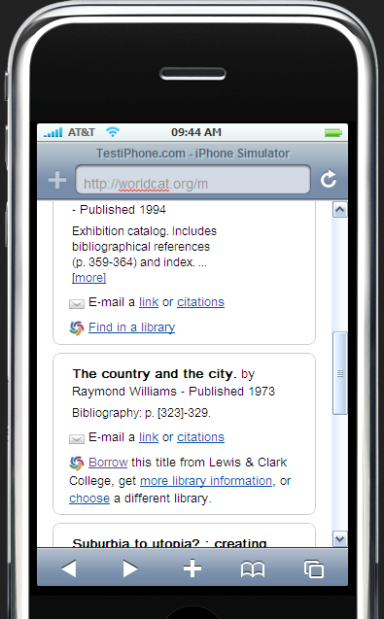

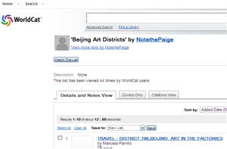

in
mobile
Loading
Network Flow
Info
Provider
Consumer
Library
Lists
Local

Slide 55
Some directions

Slide 56
The boundary between the library and the network is changing
Infrastructure
  Libraries of all type – public and academic - can share some infrastructure services
Relationship management
  This will vary by library type and host organization
    (although will benefit from infrastructure support … e.g. analytics)

Slide 57
Thank you
Lorcan Dempsey
http://www.twitter.com/LorcanD
Http://www.oclc.org/research

