Slide 1

The library, the network
Congrès des milieux documentaire – Redéfinir l’espace documentaire,
Montréal, November 30 2011
Lorcan Dempsey, OCLC @lorcanD

Slide 2


Quebec in Worldcat
Materials published in Quebec:
1,294,911
Published in Quebec in French:
906,090
Quebec “Collective Collection” in WorldCat
6.9 million
1.9 million
Statistics current as of October 2010
Note: Results based on holdings of Quebec institutions
as they are represented and cataloged in WorldCat.

Slide 3
Preamble

Slide 4
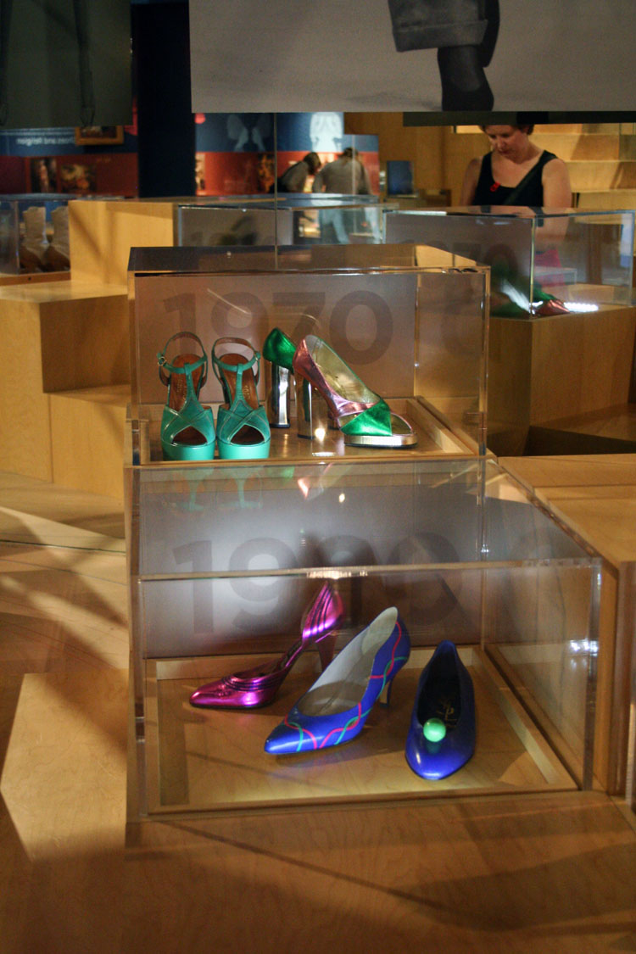
Tamara Dunn
http://www.flickr.com/photos/palmdiscipline/3989975371/
Notes:
Bata Shoe Museum Toronto … like a retail experience.

Slide 5
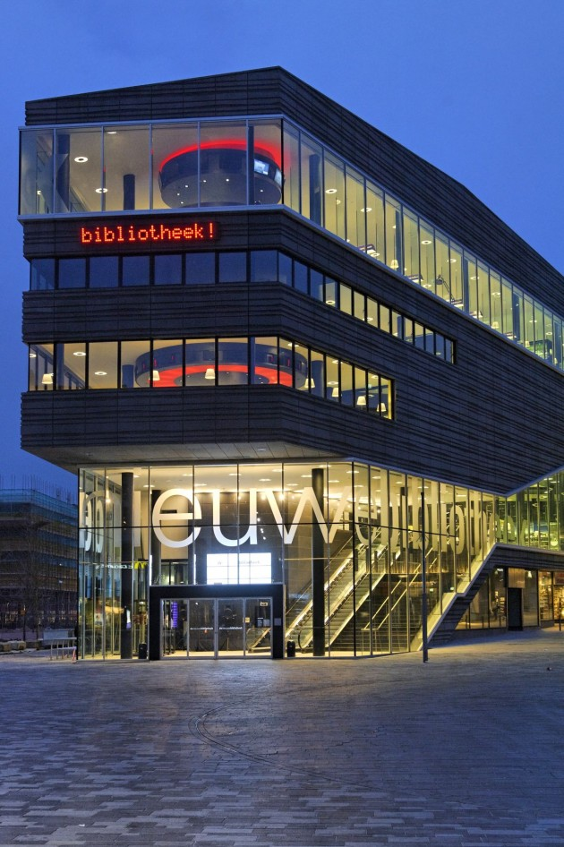
Preamble
Contemporist
http://www.contemporist.com/2010/11/18/almere-library-by-concrete-architectural-associates/
Photography by Wim Ruigrok

Slide 6
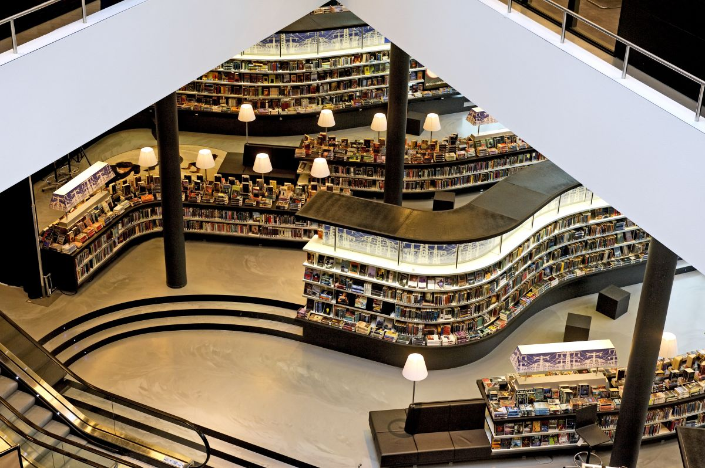

Slide 7
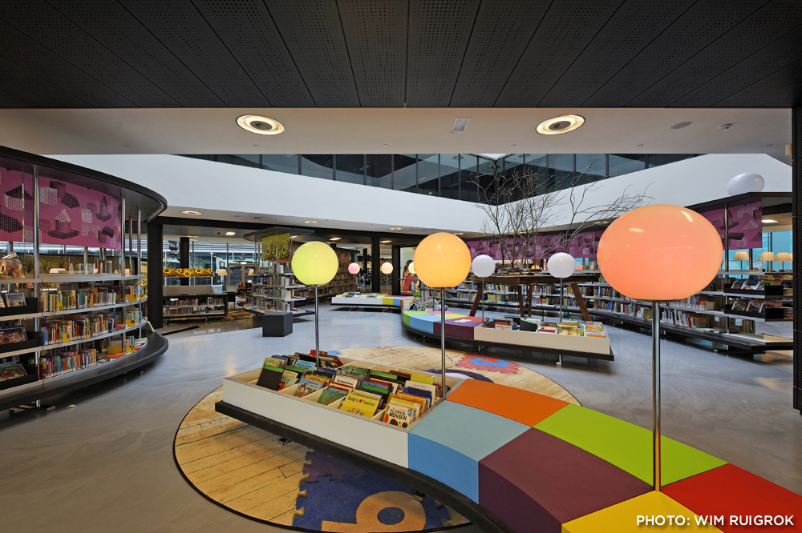

Slide 8
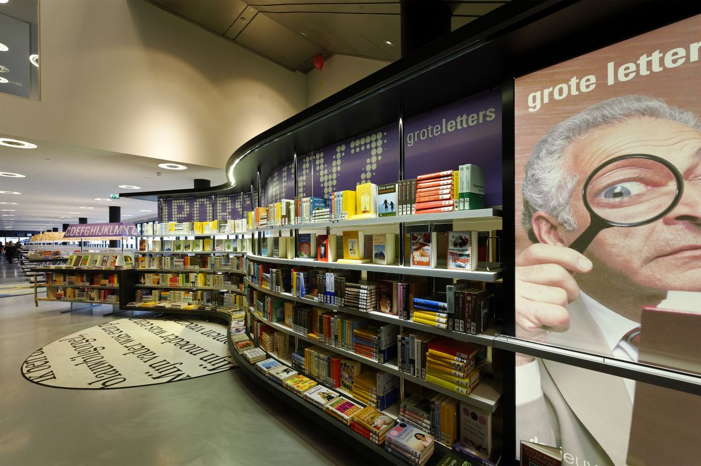

Slide 9
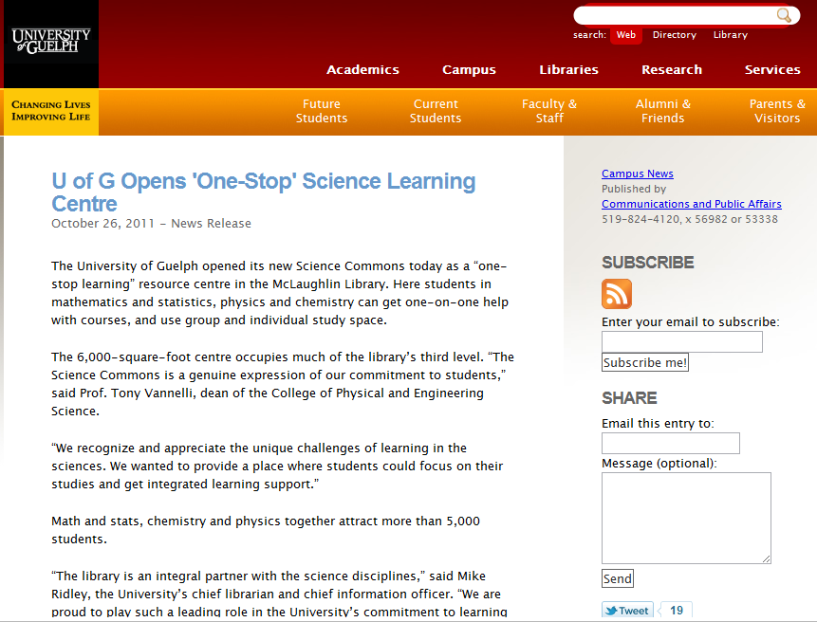

Slide 10
Engagement
Outreach: place (and network)

Slide 11
The network

Slide 12
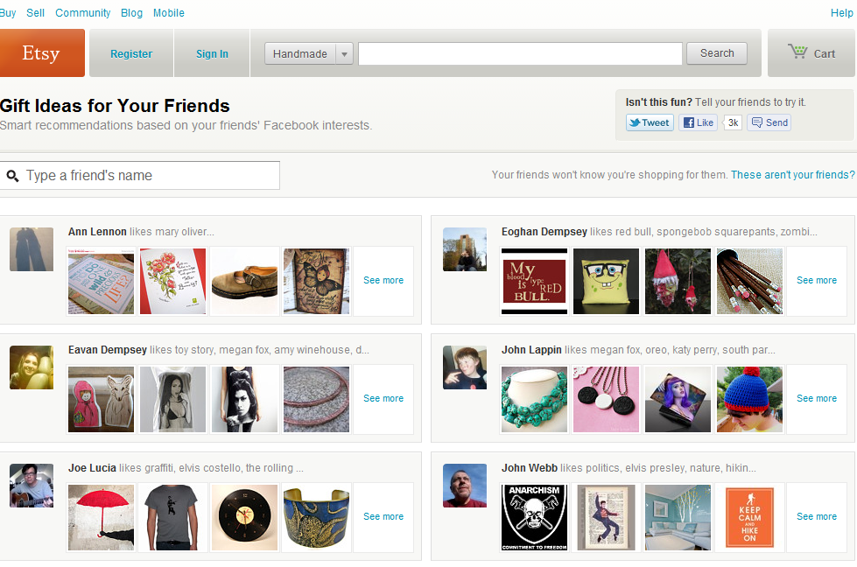

Slide 13
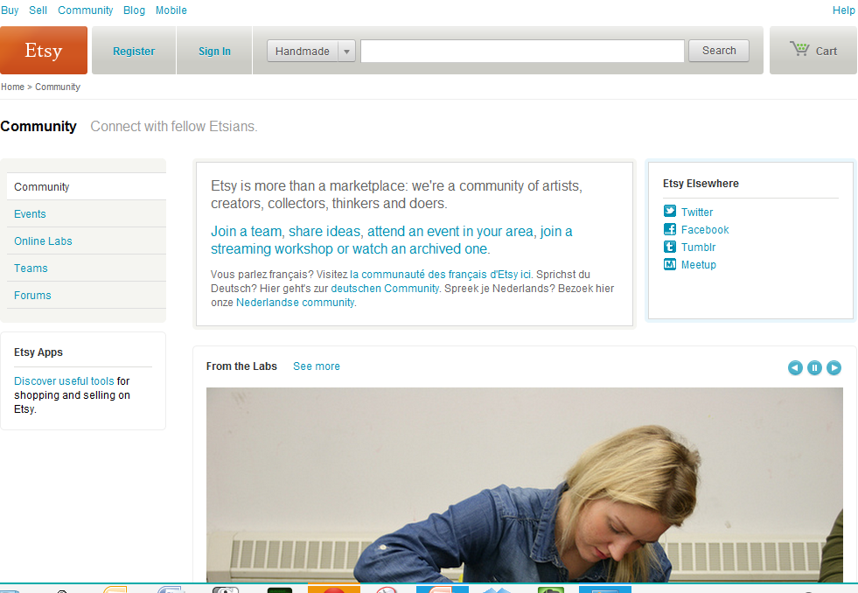

Slide 14
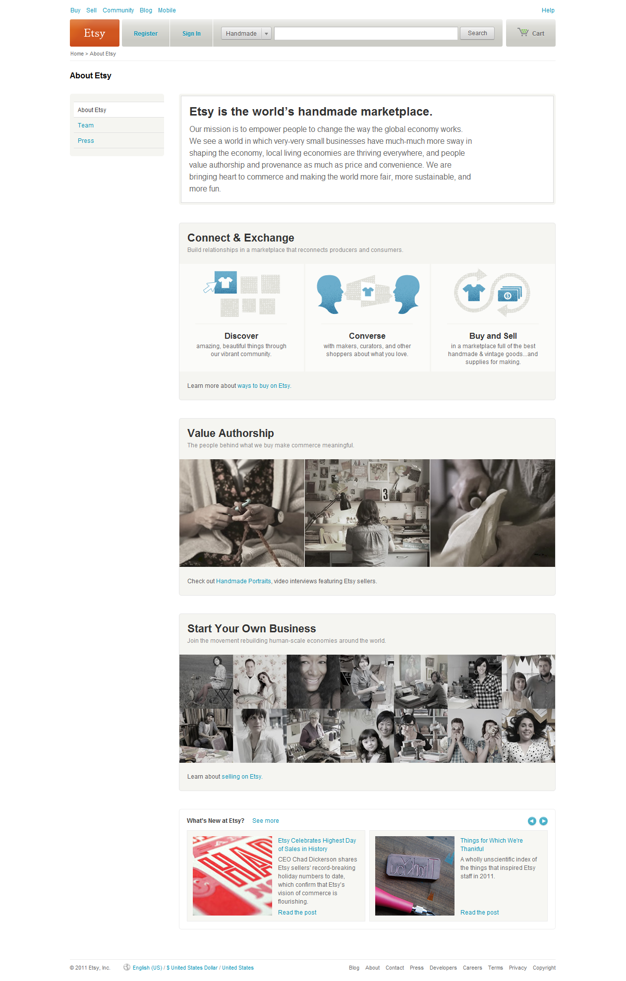
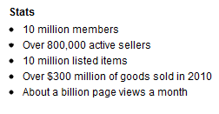

Slide 15
Characteristics
Platform – concentrates data, infrastructure, …
Community/network forms around platform
Network effects are central
Social and analytics are central
Gravitational hubs: the rich get richer
Strong seo and referencability
End user
Social
Analytics
Management

Slide 16
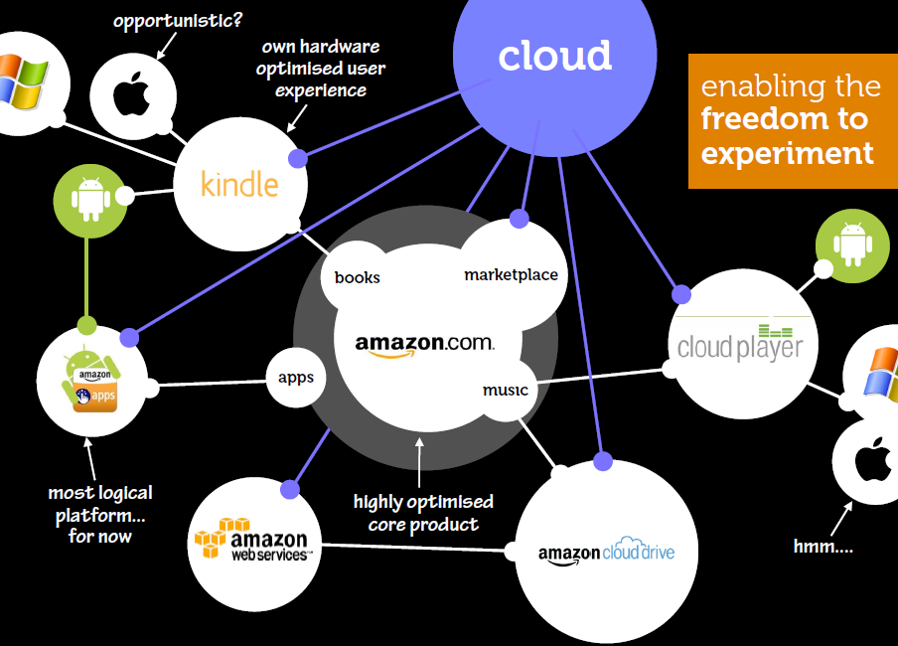
Not just a site but an ecosystem
Beyond the mobile web. Stephanie Rieger. http://www.slideshare.net/yiibu/beyond-themobilewebbyyiibu

Slide 17
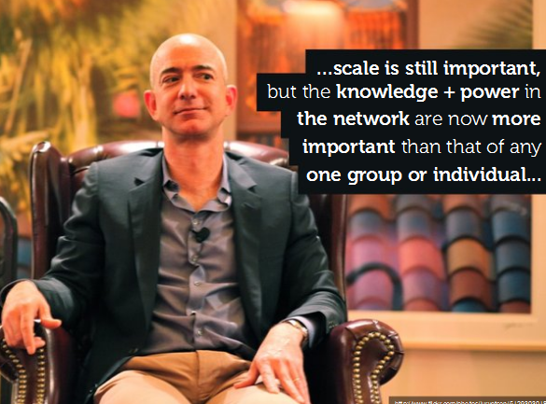
Beyond the mobile web. Stephanie Rieger. http://www.slideshare.net/yiibu/beyond-themobilewebbyyiibu

Slide 18
Scale

Slide 19

Scaling
Webscale
Group
Institutional
Personal

Slide 20

Institution scale
Goodness: A large
collection
in central locations
Organization: Structured around collection

Slide 21
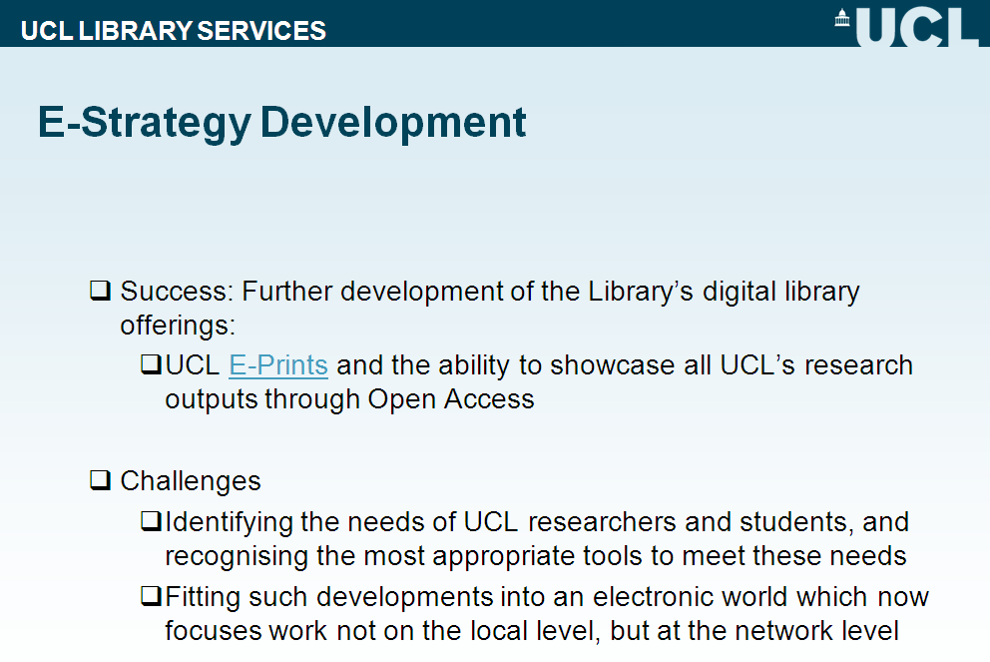

Slide 22


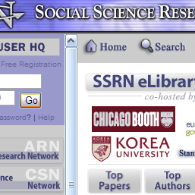
Consolidation at scale
Network encourages efficiencies of scale
Context and community: rich analytics drive richer experiences
The scalability of access: stronger gravitational attraction at network level

Slide 23
Boundaries

Slide 24
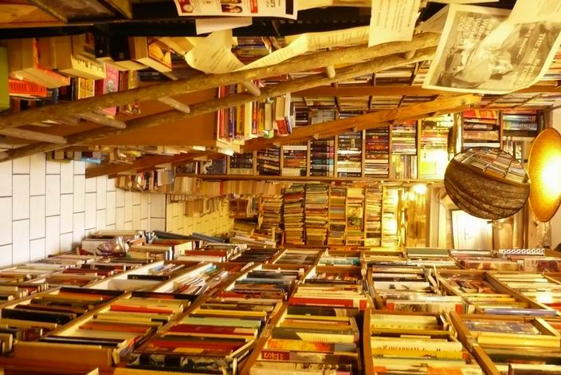








The network reconfigures industries
Google editions

Slide 25
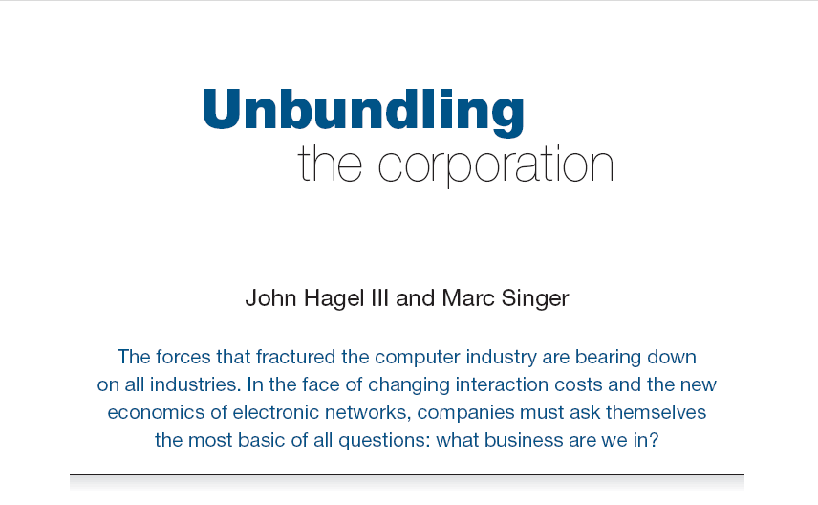
Harvard Business Review (1999)

Slide 26
Core components of a firm
Attracting and building relationships with customers
“Service-oriented”, customization
Economies of scope important
Develop new products and
services and bring them to
market
Speed/flexibility important
Customer
Relationship
Management
Product Innovation
Infrastructure
Back office capacities that
support day-to-day operations
“Routinized” workflows
Economies of scale important

Slide 27
Attracting and building relationships with researchers and learners
“Service-oriented”, customization
Economies of scope important
Develop new
services and have them accepted
Speed/flexibility important
Engagement
Innovation
Infrastructure
Back office capacities that
support day-to-day operations
“Routinized” workflows
Economies of scale important

Slide 28
What business are we in?
Strategy is about choices …
Where is distinctive local impact?
What should be done collaboratively?
What should be done by others?

Slide 29
Library directions?

Slide 30
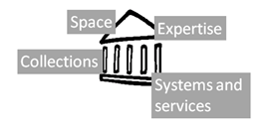
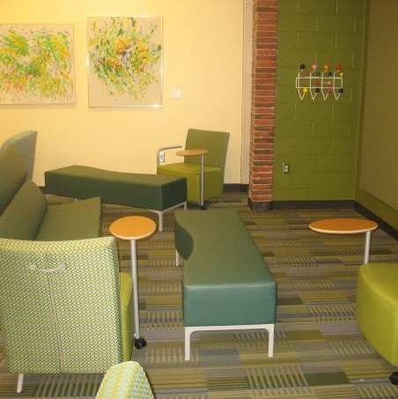

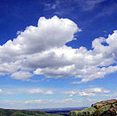
Shifting boundaries
Engagement creates distinctive local value
Buildings
The service turn
People
Aggregate social/analyti cs data
Libraries externalising infrastructure – economies of scale and network effects
Collections
Systems
Discovery?
Collaborative: sharing innovation
and resources
Commercial: contracting for services

Slide 31

Space
Reconfigure around the user experience
rather than around collections.
Infrastructure >> engagement
Social
Ad hoc rendezvous
Meeting place
Showcase and sharing
Exhibitions
Specialist equipment
Specialist staff
GIS, Writing centre, digital humanities, …
Homework help

Slide 32
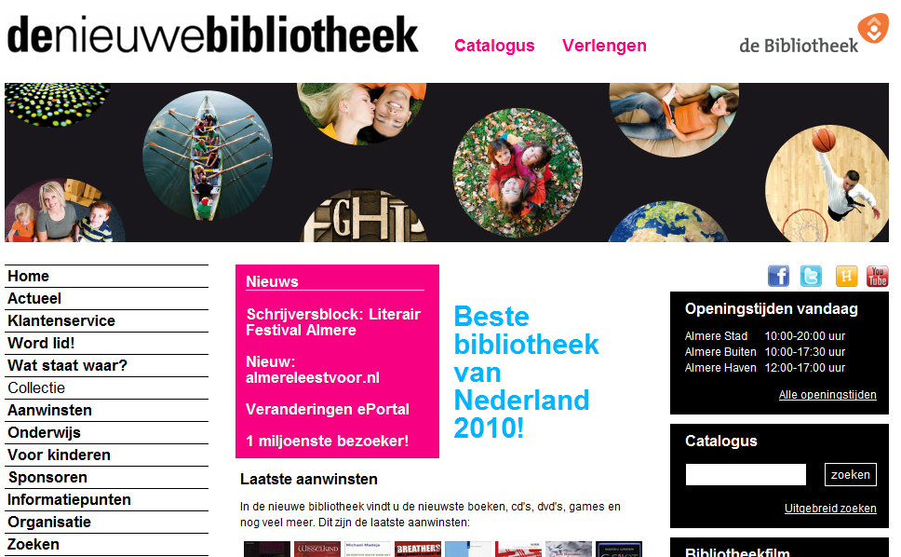

Slide 33
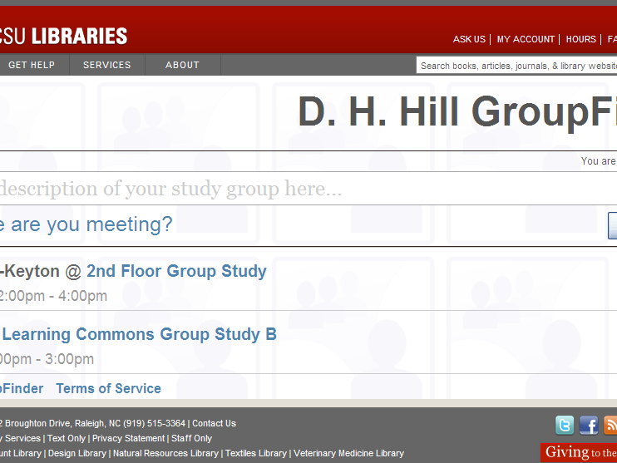
NCSU … Find members of a group in the library ….

Slide 34
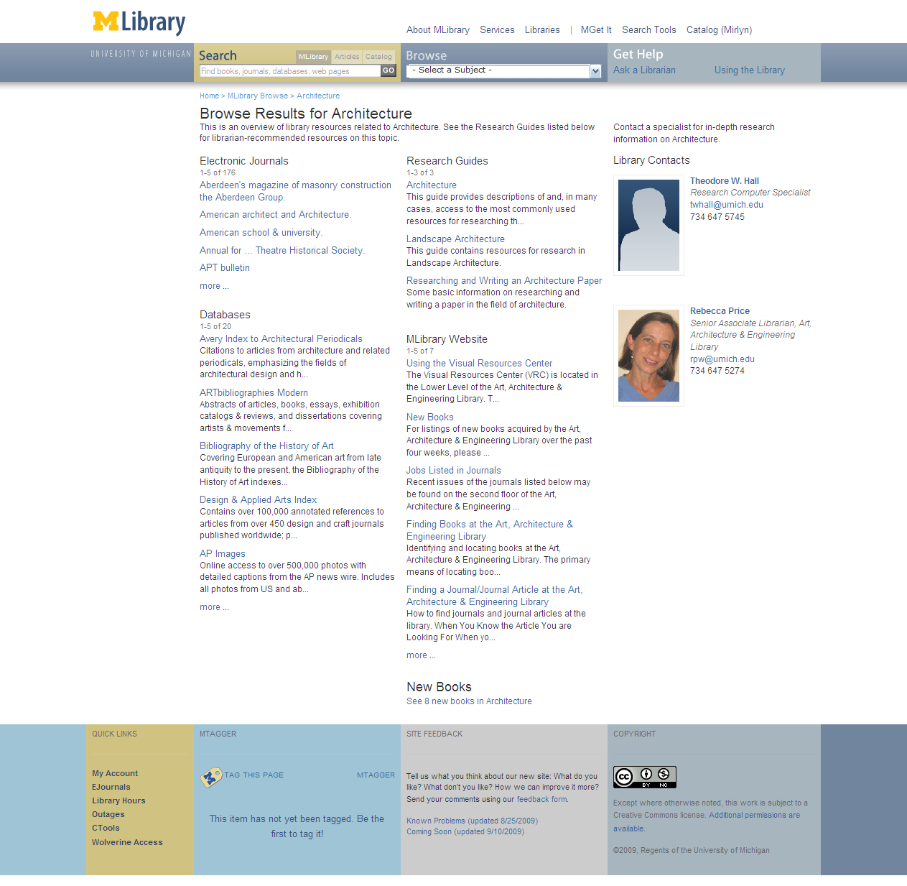
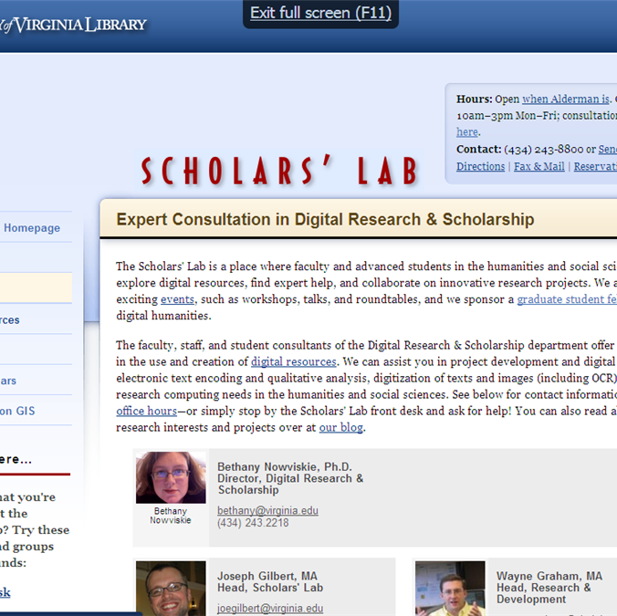

Expertise
People are entry points
(DanChudnov)
Librarians returned in search .. UMich
Engagement with research and learning
Marketing/assessment/
partnership

Slide 35
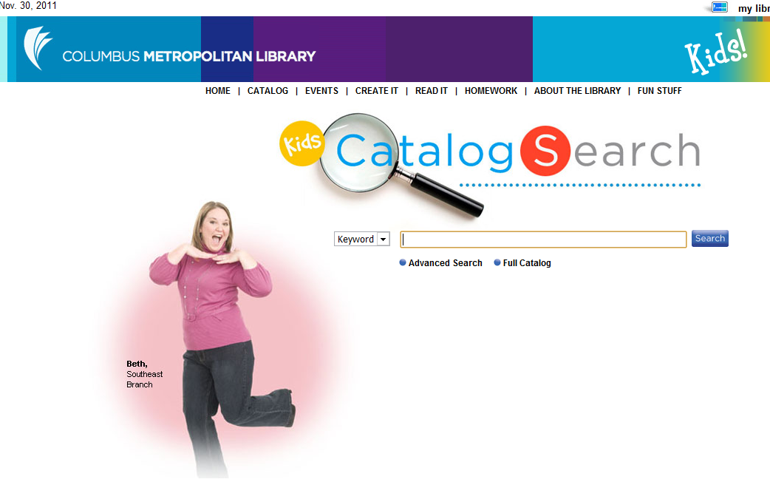
If libraries want to be seen as expert,
their expertise must be visible.

Slide 36
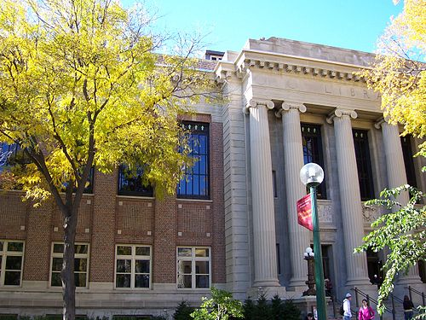
Services
The service turn
U Minnesota, ARL Institutional profile
In alignment with the University's strategic positioning, the University Libraries have re-conceived goals, shifting from a collection-centric focus to one that is engagement-based.

Slide 37
Service
The service turn
Defining distinctive services with the clarity with which we have defined distinctive collections allows us to acknowledge that the 21st century will be marked by different, but equally valid, definitions of excellence in academic libraries, and that the manner in which individual libraries demonstrate excellence will be distinctive to the service needs, and to the opportunities to address those needs, found on each campus.
Scott Walter. “Distinctive Signifiers of
Excellence”: Library Services
and the Future of the Academic
Library. Coll. & res. libr. January 2011 72:6-8

Slide 38


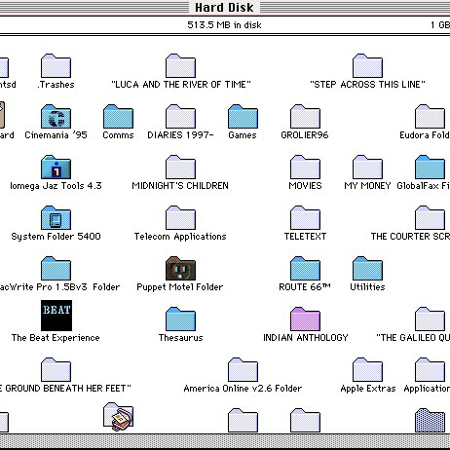
Bookspace: Hennepin County Library
A community space for reading. Social engagement.
M Publishing, U Michigan
The University of Michigan Press, the Scholarly Publishing Office, Deep Blue (the University’s institutional repository service), the Copyright Office, and the Text Creation Partnership,
Salman Rushdie Archive, Emory U
Personal digital papers of Salman Rushdie. Have become his reference collection.

Slide 39
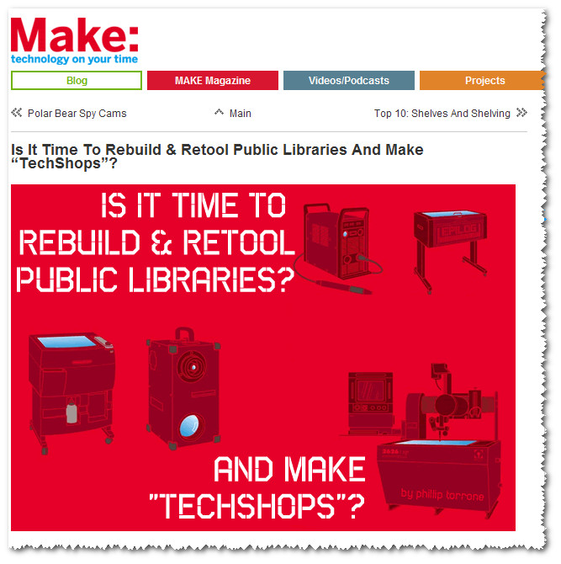

Slide 40


Systems
Engagement, cloud and collaboration
Focus on engagement
Resource guides, integration with learning management, widgets, etc
Recommendation (aggregation)
Move to cloud for infrastructure
ILS, ERM, Discovery: move to cloud-based solutions
Deep collaboration
Shared systems infrastructure:
Orbis Cascade Alliance, 2CUL
OCUL, TriUniversity Group

Slide 41
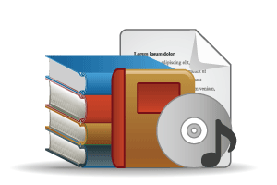



COLLECTIONS GRID
(Lorcan Dempsey and Eric Childress, OCLC Research)
Stewardship/scarcity
high
low
In many collections
Low-High
Books & Journals
Newspapers
Gov Documents
CD & DVD
Maps
Scores
Low-Low
Freely-accessible web resources
Open source software
Newsgroup archives
low
Uniqueness
High Stewardship
Low Stewardship
High-Low
Research & Learning Materials
Institutional records
ePrints/tech reports
Learning objects
Courseware
E-portfolios
Research data
Prospectus
Insitutional website
High-High
Special Collections
Rare books
Local/Historical Newspapers
Local History Materials
Archives & Manuscripts
Theses & dissertations
high
In few collections

Slide 42
Outside in Bought, licensed
Increased consolidation
Move from print to licensed
Manage down print and develop
collective ownership models
Move to user-driven models
Aim: to discover
In Many Collections
Licensed
Purchased
High Stewardship
Low Stewardship
Inside out
Institutional assets: special collections,
research and learning materials, institutional records, …
Reputation management
Increasingly important?
Aim: to *have* discovered … to disclose
In Few Collections
Notes:
Licensed content will dominate in years to come.
Special collections will grow but only modestly (and only at some institutions); mostly growth in managing archival resources including institutional.
Much greater investment in managing research outputs.
No change in web archiving.

Slide 43
Discovery: an example

Slide 44




Direction?
Commodity: How many data wells?
The collection?
Registration model? Library does A&A?
Other players (Elsevier, Thomson Reuters?)

Slide 45




More than 75% of requests to SFX originate externally (Google Scholar, PubMed, etc.). U Minnesota, Discoverability
Direction?
Discovery moves to the network level …..

Slide 46
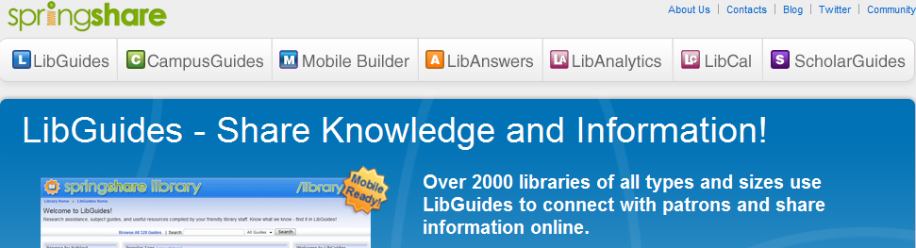
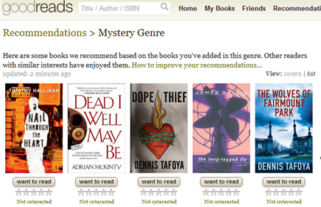
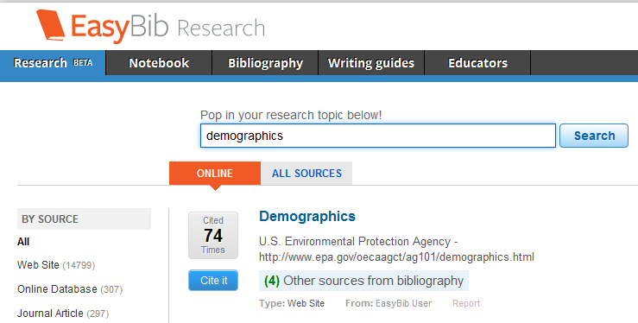

Direction?
….. and to personal/institutional curation environments.
Framed by personal, learing,
professional interests ..

Slide 47










Social reading/
Cataloging
Reading list/
resource guide
Book club/
reading group
Citation/
reference management

Slide 48
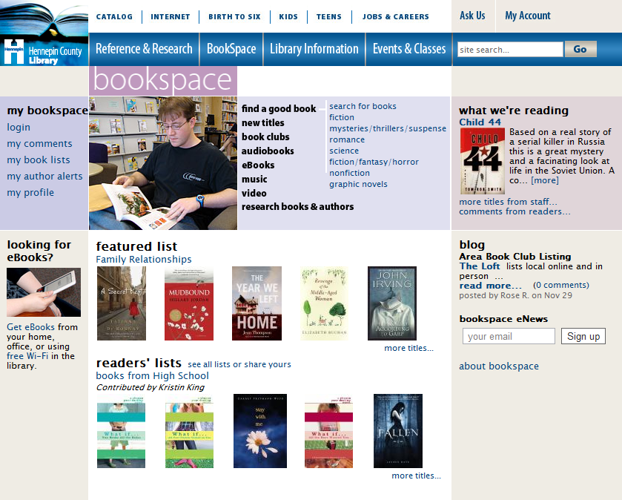
Book club/
reading group

Slide 49
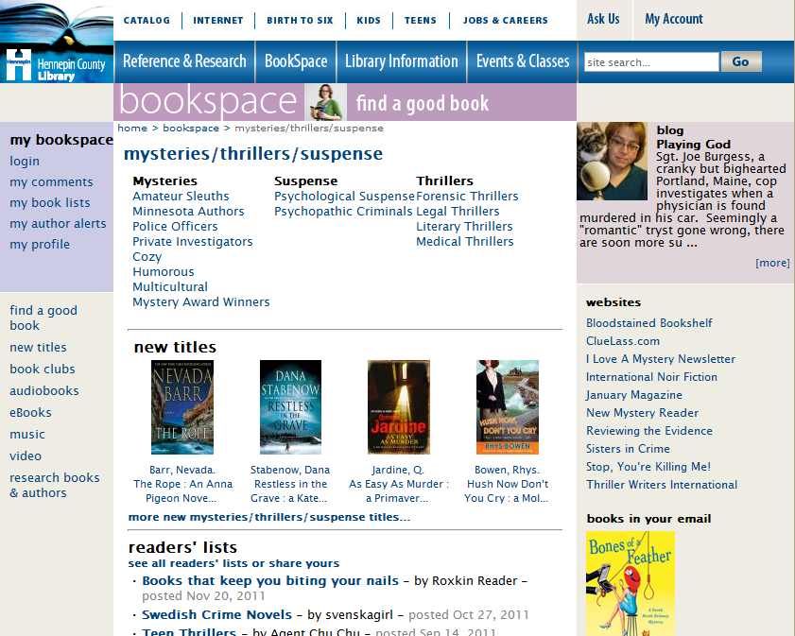

Slide 50
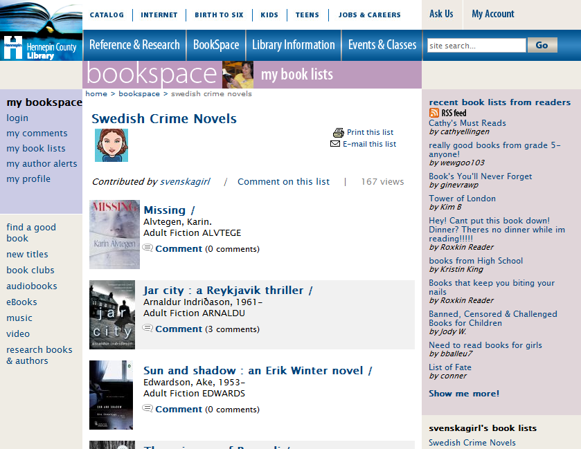

Slide 51
PLAYLIST
Books/articles are social objects
Select, resolve
Social - engagement
Analytics

Slide 52
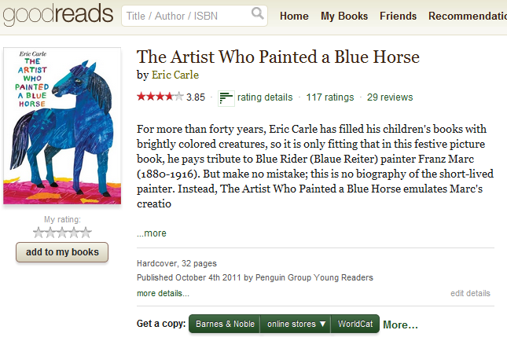

Slide 53
So …
Institutional ..
Discovery layer in the cloud.
Increasingly ‘group’ as collections are shared.
Syndication
Want your stuff in the webscale services:
Google Books, Google Scholar, Wikipedia, Social reading sites, ….
Framing and engaging
Increased investment in curated environments that ‘frame’ data with learnng, personal or professional interests.

Slide 54
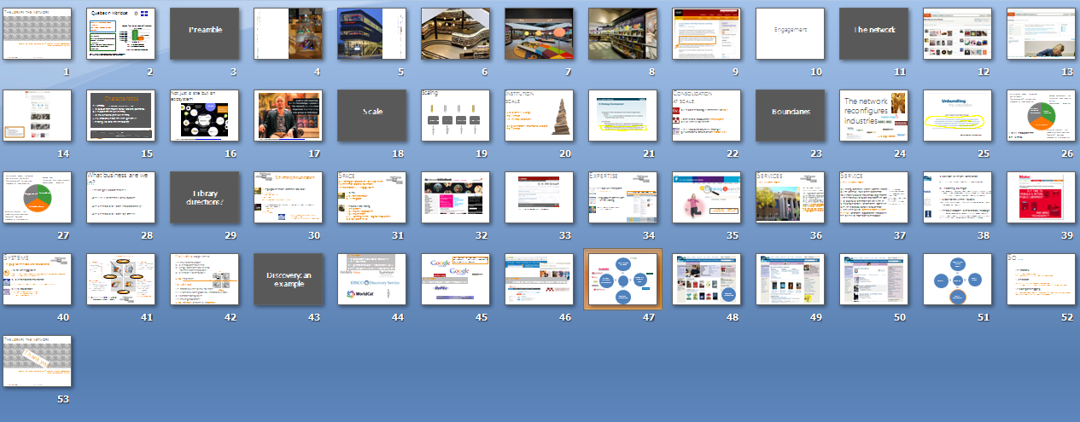
Review …
… in conclusion

Slide 55
The library, the network
Thank you!
Congrès des milieux documentaire – Redéfinir l’espace documentaire,
Montréal, November 30 2011
Lorcan Dempsey, OCLC @lorcanD

