Slide 1

Discovery and disclosure
University of Maryland Libraries September 19 2011
Lorcan Dempsey, OCLC @lorcanD

Slide 2

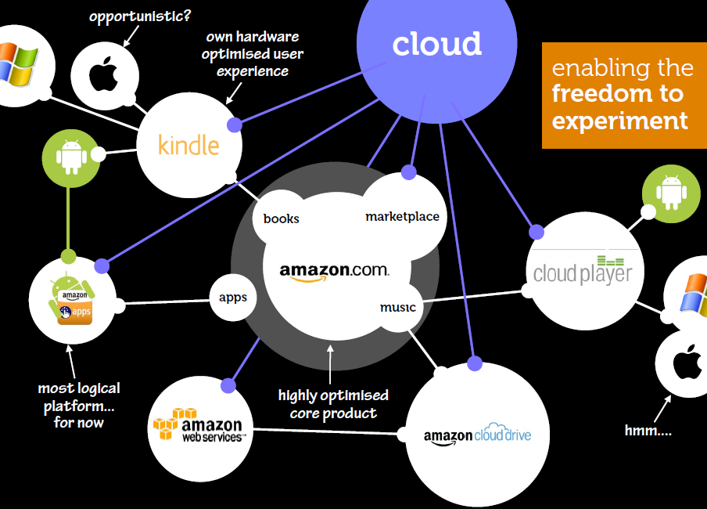
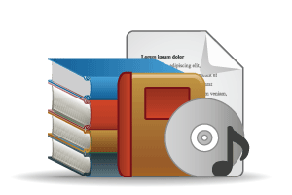



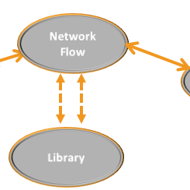
overview
Preamble: discoverability at U Minnesota
Context: the network environment
Purchased Materials
Licensed E-Resources
In many collections
Open Web Resources
Collections: changing characteristics
Licensed
High Stewardship
Purchased
Low Stewardship
Special Collections
Local Digitization
In few collections
Research & Learning Materials
Discovery and disclosure

Slide 3
Discoverability at U Minnesota

Slide 4
Trends
U Minnesota Discoverability
Users expect discovery and delivery to coincide
Usage of portable Internet-capable devices is expanding
Users increasingly rely on nontraditional information objects
Discovery increasingly happens through recommending
Users are discovering relevant resources outside traditional library systems
Discoverability Phase 1 final report. http://z.umn.edu/disco1

Slide 5
Findings
U Minnesota discoverability
Catalogs and web sites still seeing significant use
Some evidence of slowing growth in web traffic, usage is shallow
Google is the single greatest source of traffic to our sites and applications
SFX link resolver is as frequently used as our catalogs or websites
More than 75% of requests to SFX originate externally (Google
Scholar, PubMed, etc.)
Discoverability Phase 1 final report. http://z.umn.edu/disco1

Slide 6
Principles
U Minnesota discoverability
Discovery should be organized around users rather than collections or systems. This organization should be based on realistic, evidence-based models of our users and their research tasks.
Making collections discoverable requires optimizing for access by
local and non-local user populations; being good stewards of
our collections means participating in cooperative ventures
that provide broad access to our collections.
Users are successfully discovering relevant resources through non-library systems (e.g., general web searches, e-commerce sites, and social networking applications). We need to ensure that items in our collections and licensed resources are discoverable in non-library environments.
Discoverability Phase 1 final report. http://z.umn.edu/disco1

Slide 7
The network environment

Slide 8
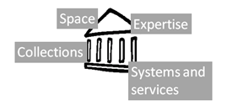
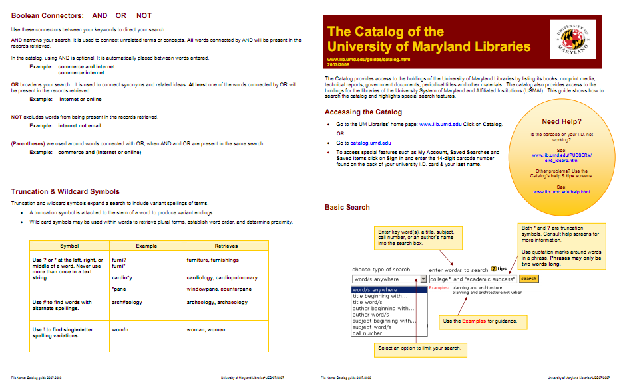
Institutional scale
No longer the sole focus of attention

Slide 9
1. Attention switch
Then: Resources scarce; attention abundant.
Now: Attention scarce; resources abundant.
2. Workflow switch
Then: Expect workflows to be built around my service.
Now: Build services around workflows

Slide 10
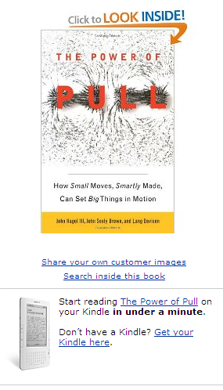
That’s what we mean by the scalability of access. We’re no longer limited simply to the 150 people we can maintain physical-world relationships with, to the books on the shelf across the room, or even those at the local library.

Slide 11








Slide 12

Ithaka s+r
from the summary
Network-level discovery tools include disciplinary resources and powerful search tools which dramatically improve research efficiency while also increasing effectiveness. As a result, faculty discovery practices across all disciplines have continued their marked shift to the network level. This key finding has important implications for resource providers and libraries alike.
Faculty members are reducing their usage of local library services for discovery purposes and, as a result, put less value on the library’s traditional intellectual value-added role as a gateway to information.

Slide 13
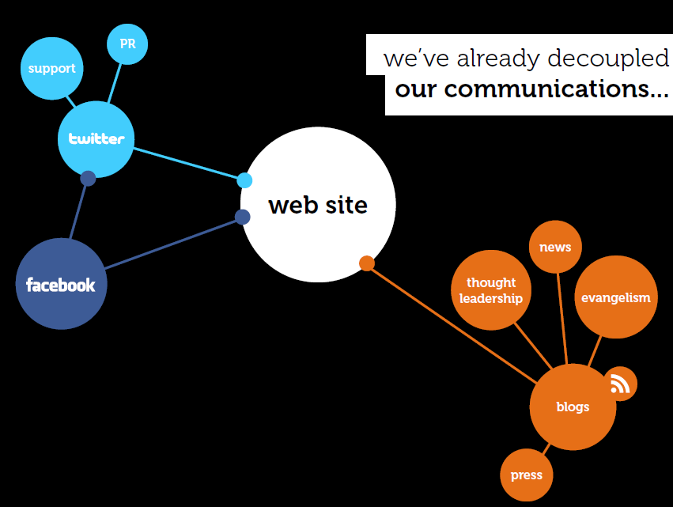
Beyond the mobile web. Stephanie Rieger. http://www.slideshare.net/yiibu/beyond-themobilewebbyyiibu

Slide 14
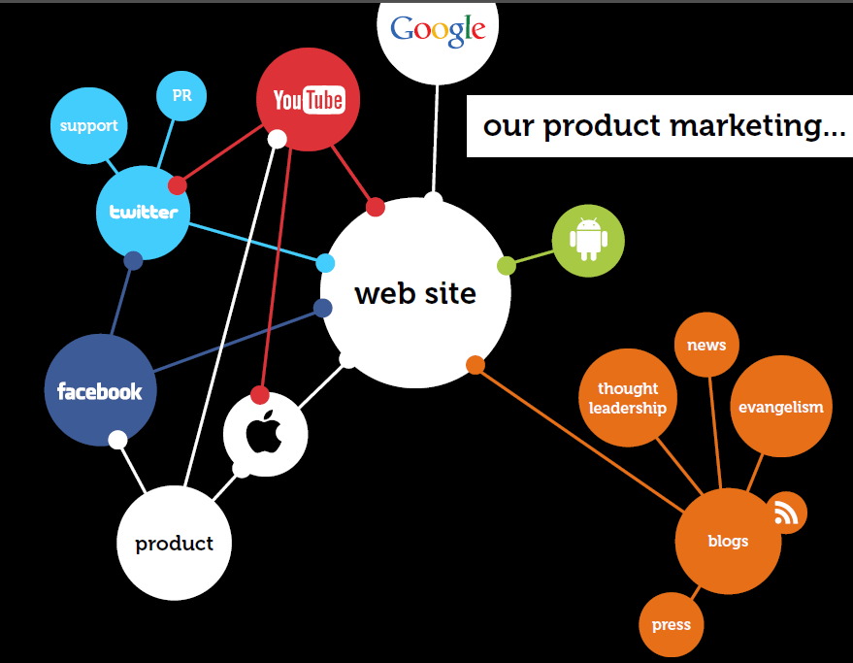
Beyond the mobile web. Stephanie Rieger. http://www.slideshare.net/yiibu/beyond-themobilewebbyyiibu

Slide 15
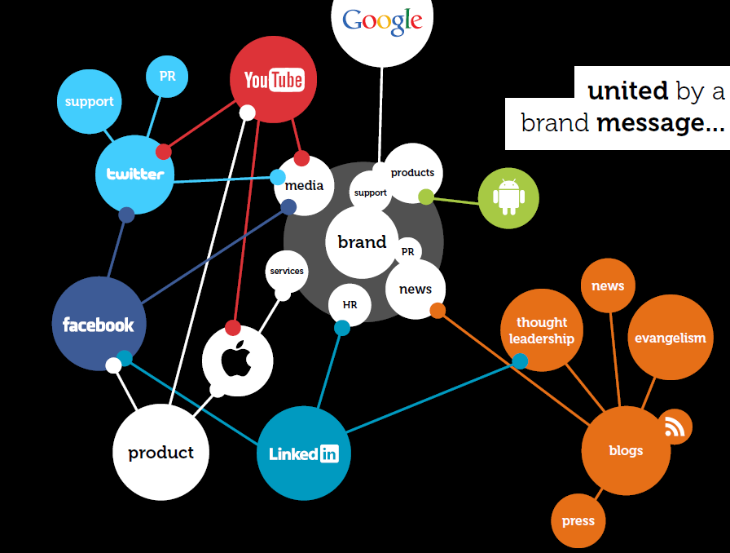
Beyond the mobile web. Stephanie Rieger. http://www.slideshare.net/yiibu/beyond-themobilewebbyyiibu

Slide 16
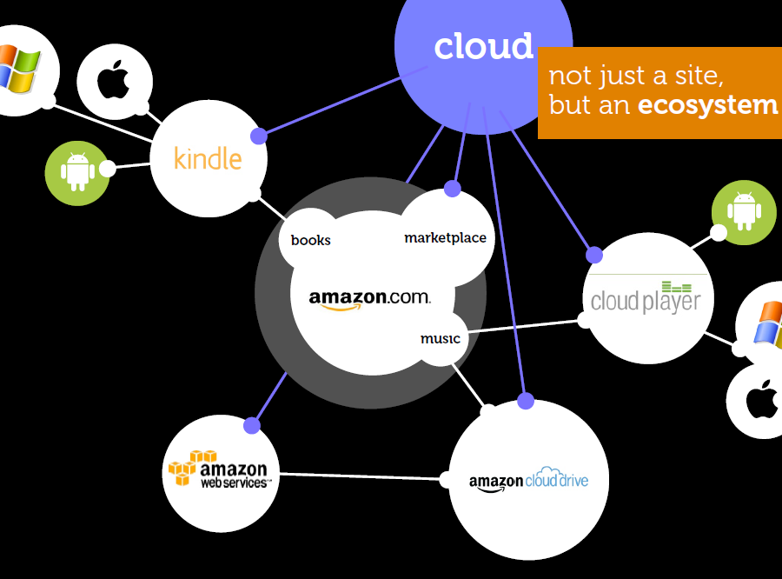
Beyond the mobile web. Stephanie Rieger. http://www.slideshare.net/yiibu/beyond-themobilewebbyyiibu

Slide 17
Beyond the mobile web. Stephanie Rieger. http://www.slideshare.net/yiibu/beyond-themobilewebbyyiibu

Slide 18
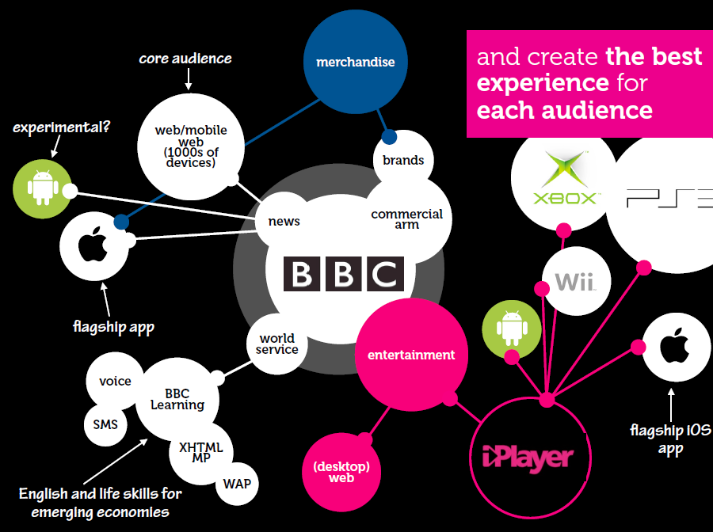
Beyond the mobile web. Stephanie Rieger. http://www.slideshare.net/yiibu/beyond-themobilewebbyyiibu

Slide 19
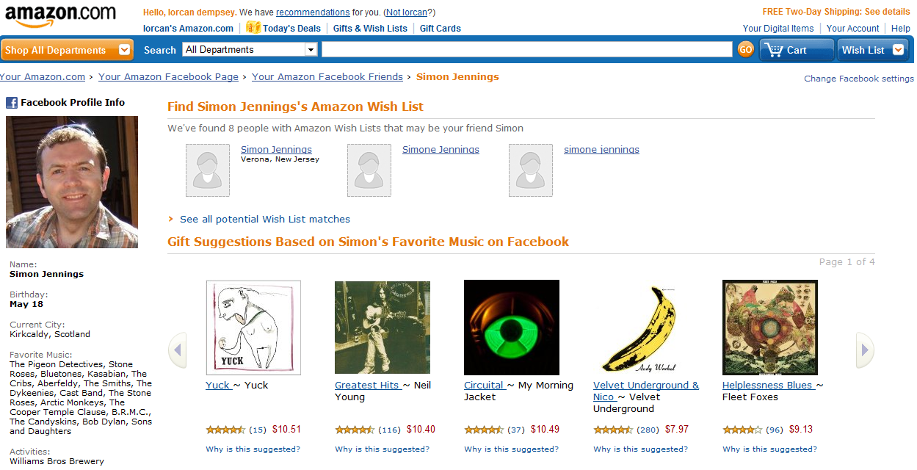

Slide 20
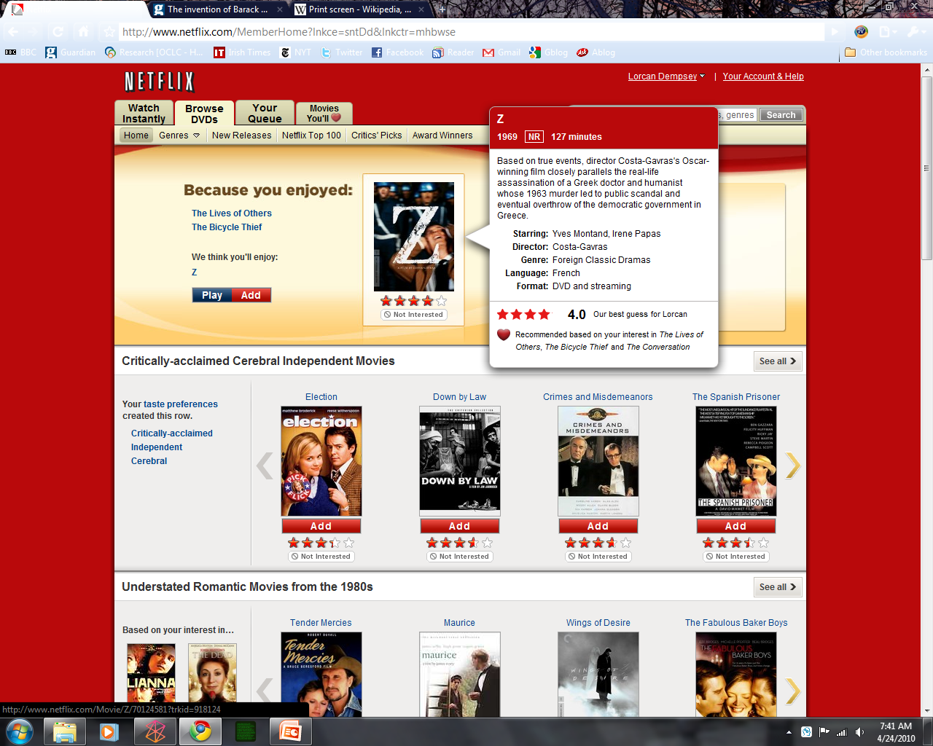
OLD:
My children’s viewing habits have messed it up on me ☺

Slide 21
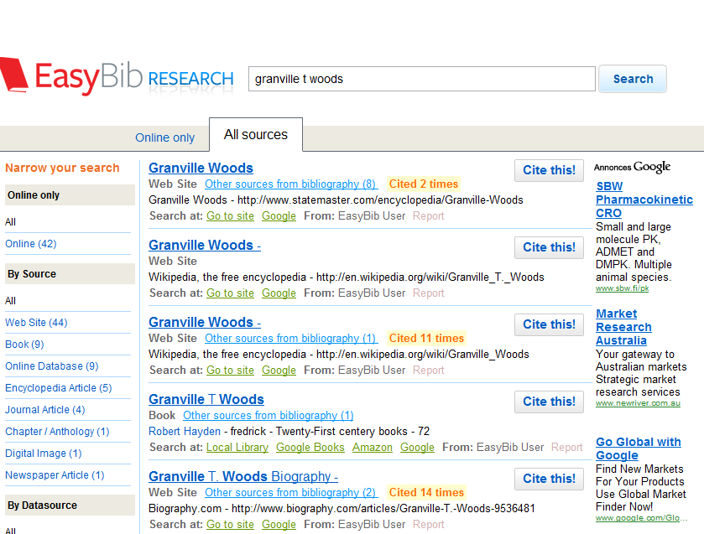
Social and anaytics
Emergent strategies for coping with abundance and scaling community
Ranking, relating, recommending.

Slide 22
Network Level
1. Aggregating supply
Concentrating data.
A full experience.
2. Aggregating demand
Scale: gravitational attraction.
Community e.g. Etsy.
In the flow (Apps, ….)
Social and analytics (rank, relate, recommend)

Slide 23
Changing characteristics of collections

Slide 24
COLLECTIONS GRID
(Lorcan Dempsey and Eric Childress, OCLC Research)
Stewardship/scarcity
high
low
In many collections
Low-High
Books & Journals
Newspapers
Gov Documents
CD & DVD
Maps
Scores
Low-Low
Freely-accessible web resources
Open source software
Newsgroup archives
low
Uniqueness
High Stewardship
Low Stewardship
High-Low
Research & Learning Materials
Institutional records
ePrints/tech reports
Learning objects
Courseware
E-portfolios
Research data
Prospectus
Insitutional website
High-High
Special Collections
Rare books
Local/Historical Newspapers
Local History Materials
Archives & Manuscripts
Theses & dissertations
high
In few collections

Slide 25
Collections Grid
Purchased Materials
Licensed E-Resources
In many collections
Open Web Resources
Licensed
Purchased
High Stewardship
Low Stewardship
Special Collections
Local Digitization
Research & Learning Materials
In few collections

Slide 26
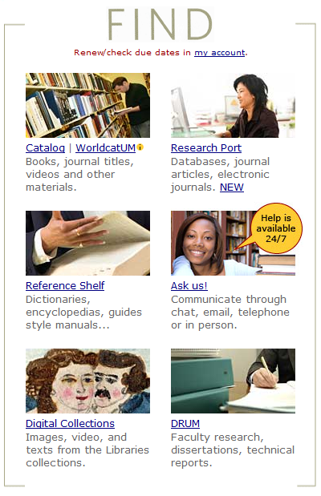

Slide 27
Collections Grid
Purchased Materials
Licensed E-Resources
In many collections
Licensed
Purchased
High Stewardship
Low Stewardship
In few collections

Slide 28
Inflection point
Derived from : National Clearinghouse on Educational Statistics, 1998-2008
Analysis of NCES data by Constance Malpas OCLC Research

Slide 29
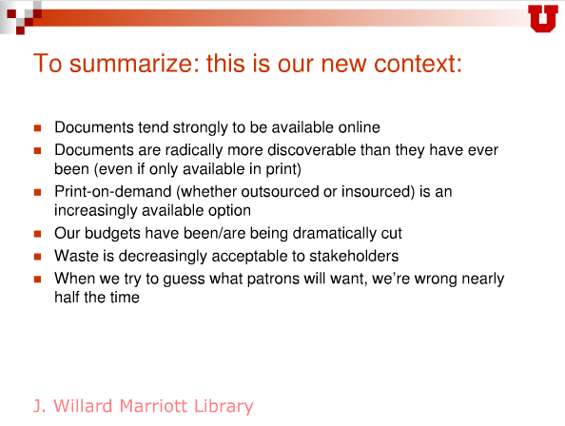
Towards just in case
Rick Anderson
Let them eat … everything: embracing a patron-driven future.
OLA Superconference, Feb 3, 2011
http://www.slideshare.net/amarintha/next-generation-workflows-for-next-generation-libraries

Slide 30
Analysis of ARL data by Constance Malpas OCLC Research
Majority of research libraries shifting toward
e-centric acquisitions, service model
Shrinking pool of libraries with mission and resources
to sustain print preservation as ‘core’ operation – 25?

Slide 31
Collections Grid
In many collections
Licensed
Purchased
High Stewardship
Low Stewardship
Special Collections
Local Digitization
In few collections

Slide 32
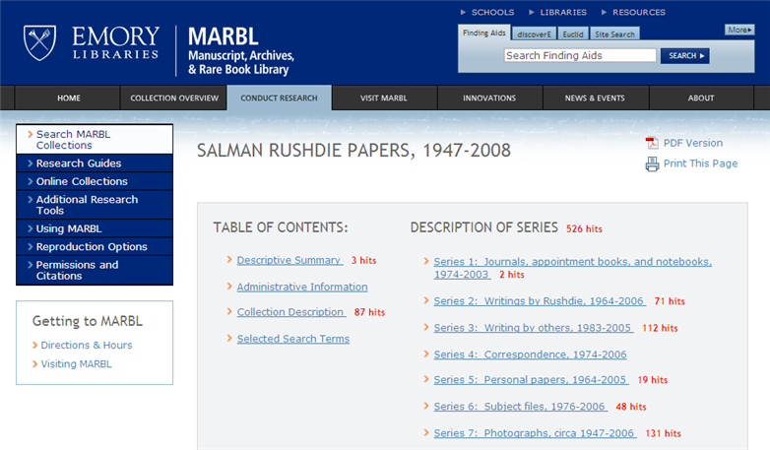
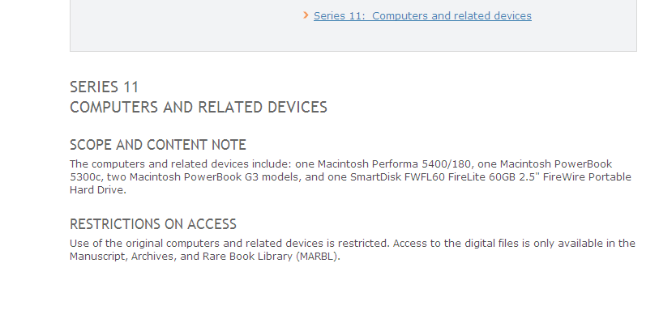

Slide 33
Collections Grid
In many collections
Licensed
Purchased
High Stewardship
Low Stewardship
Research & Learning Materials
In few collections

Slide 34
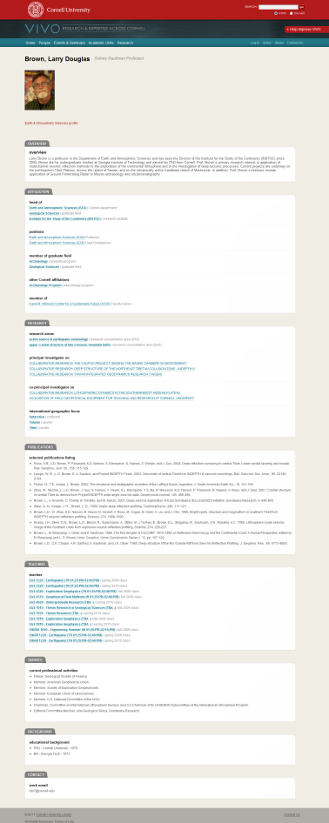

Affiliations
Research
Publications
Teaching
Service

Slide 35
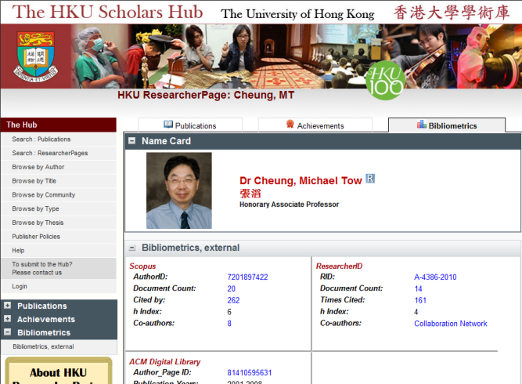
HKU Scholars Hub
”The Hub strives to make HKU authors and their research very visible, with the goal of increasing all forms of collaboration.”

Slide 36
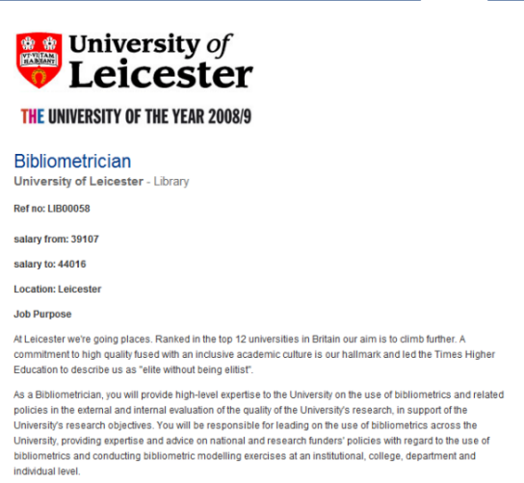
University of Leicester
A new university service – working with faculty to improve faculty visibility.

Slide 37
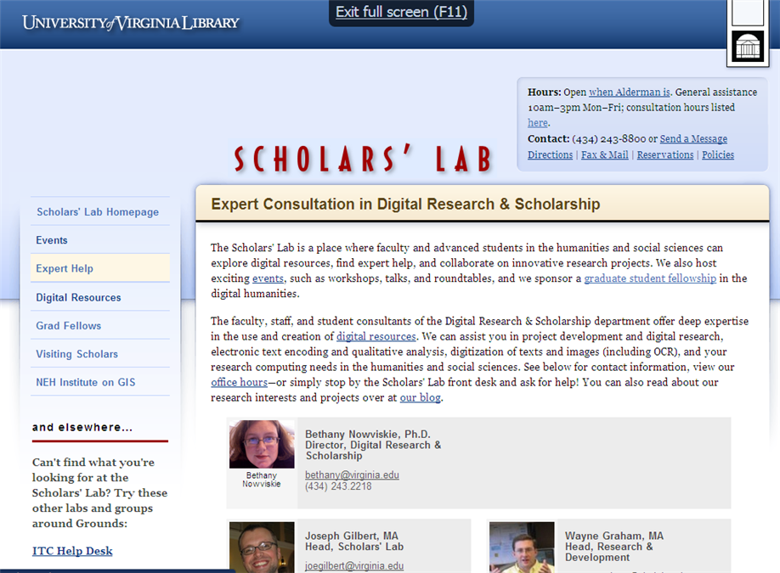
New scholarly outputs
Growth of digital humanities.
Interesting intersection between library and emerging scholarly support services.

Slide 38

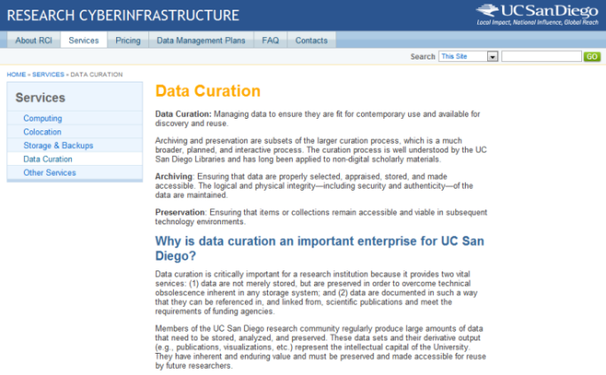

Slide 39
Library attention and investment are shifting
In many collections
Less attention
Licensed
High attention
Purchased
Occasional
High Stewardship
Low Stewardship
Limited
Aspirational
Intentional
In few collections
Notes:
Increasingly, [click] we have seen this attention shift to licensed electronic materials, which are now more ubiquitous and also require less local management effort.
At the same time,

Slide 40
Academic institutions are driving this change
In Many Collections
Licensed
Purchased
High Stewardship
today
+5 yrs??
Low Stewardship
In Few Collections
Notes:
The overall shift in library investment and attention away from traditional purchased collections is driven by university libraries. This chart is one we have used internally at OCLC to describe the kind of change we expect to see in library collections in the next five years. The shape-shifting varies by library type, but it’s most pronounced for academic libraries, where we anticipate fairly dramatic shifts toward licensed collections and toward increased support for managing research outputs and learning objects.

Slide 41
Outside in Bought, licensed
Increased consolidation
Growth in licensed
Move from print to licensed
Aim: to discover
In Many Collections
Licensed
Purchased
High Stewardship
Low Stewardship
Inside out
Institutional assets: special collections,
research and learning materials, institutional records, …
Increasingly important?
Aim: to *have* discovered … to disclose
In Few Collections
Notes:
Licensed content will dominate in years to come.
Special collections will grow but only modestly (and only at some institutions); mostly growth in managing archival resources including institutional.
Much greater investment in managing research outputs.
No change in web archiving.

Slide 42
Discovery and disclosure

Slide 43
Discovery
Not just collections: the full range of what the library has to offer ….
Collections
Website, repositories, … SEO
People, expertise, …
Services
…

Slide 44
Discovery and disclosure
3 things to look at: 2 modes of discovery and disclosure
Direct discovery
Library provides discovery services to the resources it acquires
Indirect discovery
Discovery happens elsewhere, so library leverages third party environments to support discovery.
Disclosure
A new focus on syndication, SEO, APIs, etc, to support new forms of discovery, including an interest in institution’s own materials

Slide 45
Direct discovery
Library access to collections
Info
Provider
Consumer
Library
Direct
Outside in
Integrated access to library collections

Slide 46
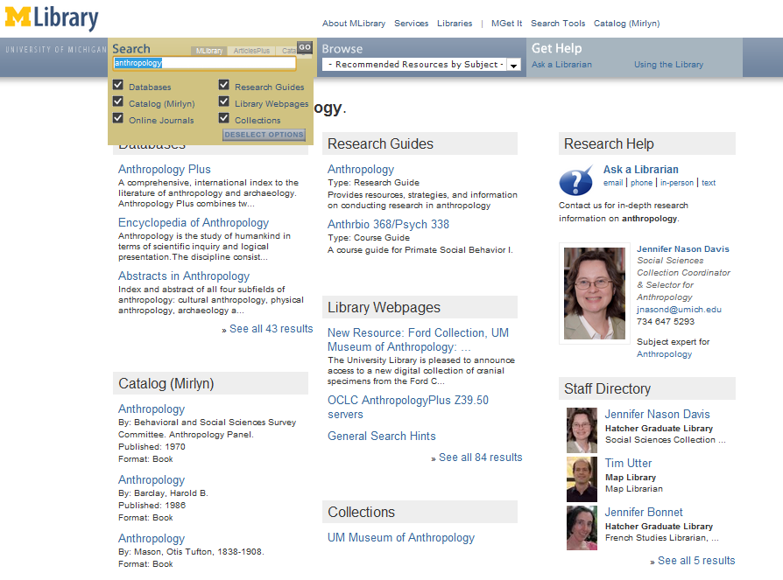
Expertise
People are entry points (Dan Chudnov)
Visibility
If the library wishes to be seen as expert then its expertise must be visible
Example: ‘indexing’ librarians at U Michigan

Slide 47
Direct discovery
Trend towards integration and the cloud
Fragmented: databases, catalog, …..
Metasearch: a layer of integration over distributed resources
Discovery layer: centralised index, cloud based
UE
UE
UE

Slide 48





Slide 49
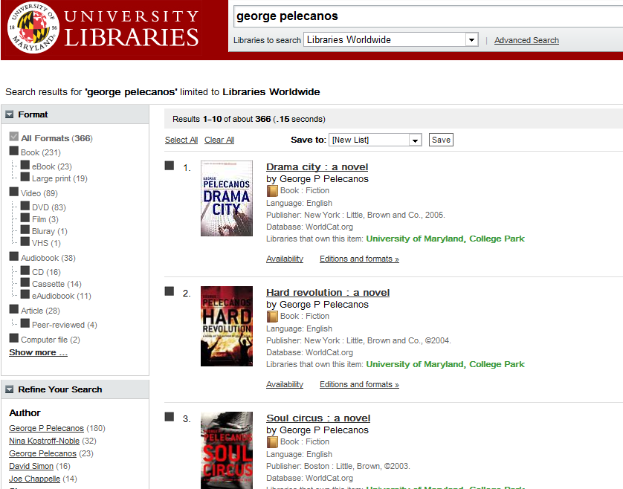

Slide 50
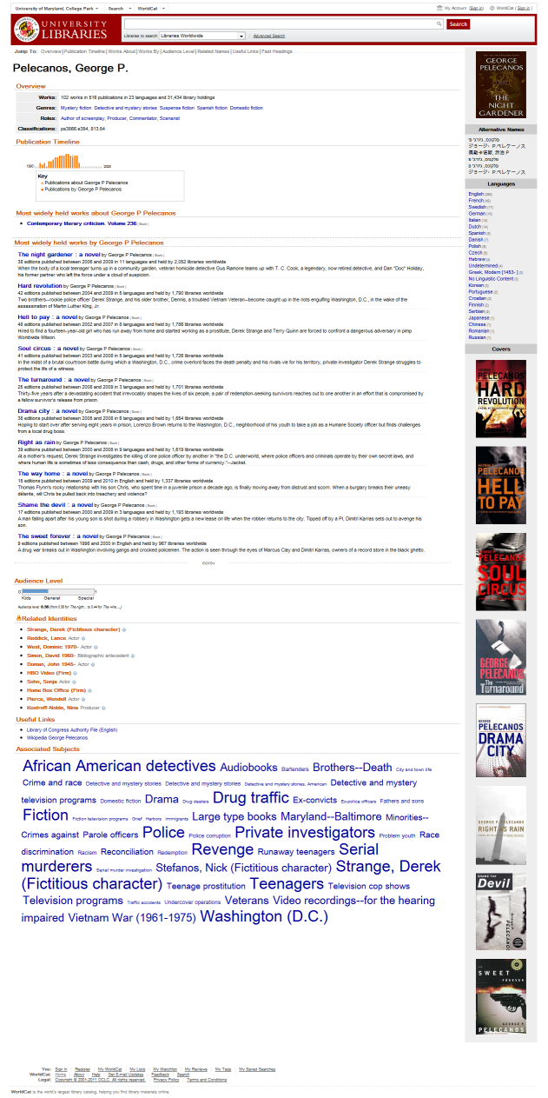
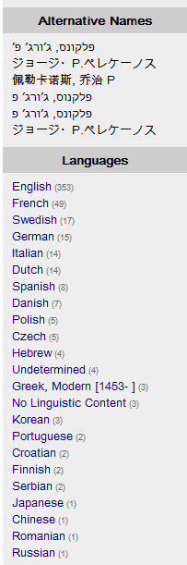
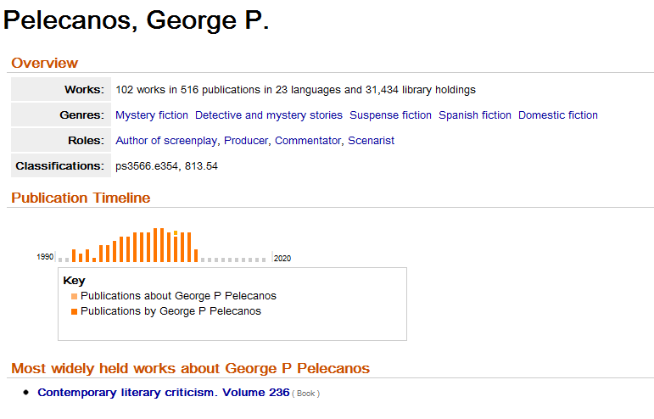
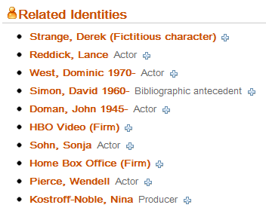
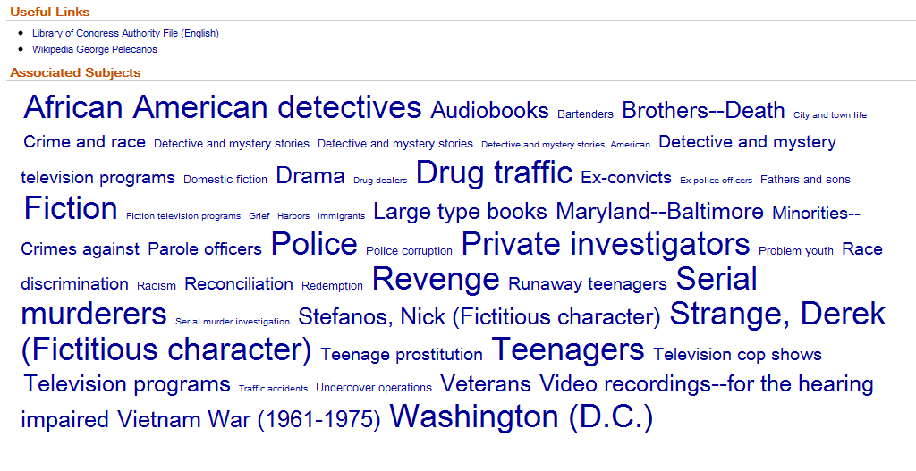

Slide 51
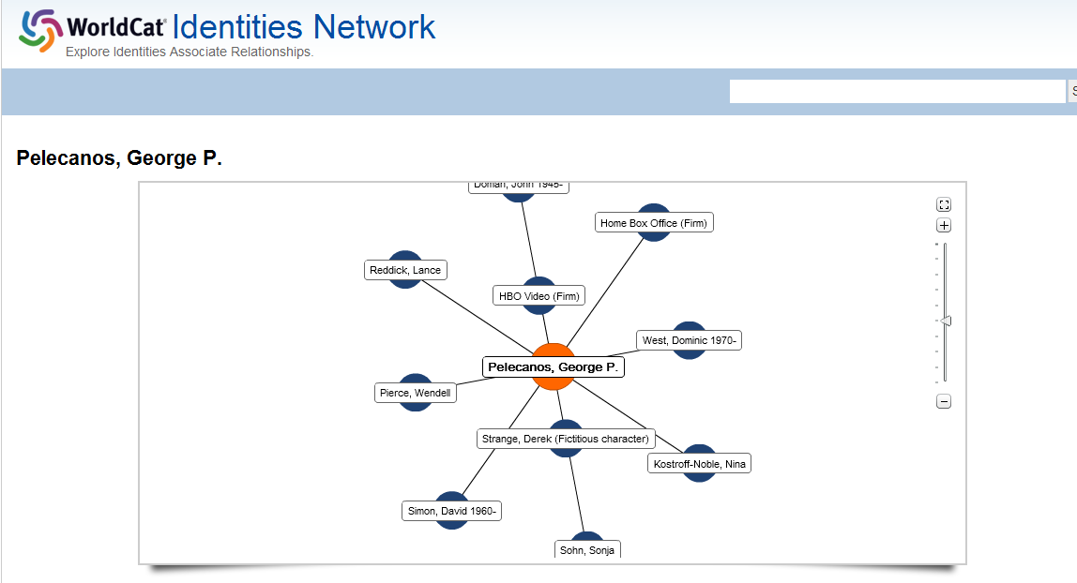

Slide 52
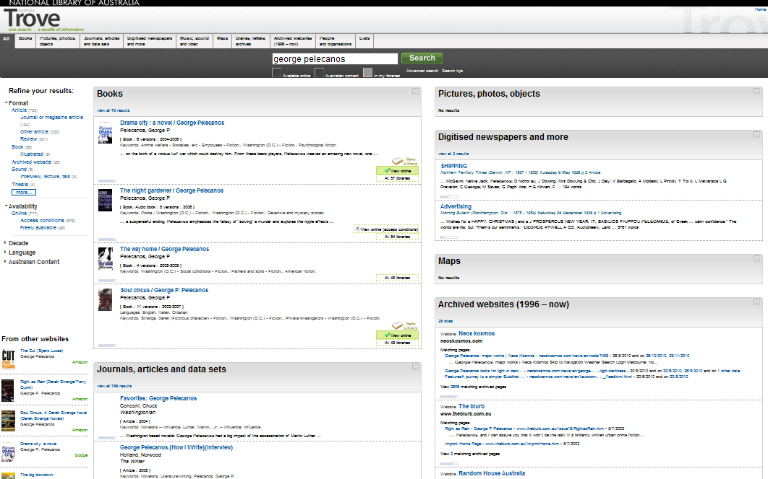

Slide 53
Indirect discovery
Discovery happens elsewhere …
Network Flow
Info
Provider
Consumer
Library
Indirect
Attract users to library by being positioned ‘in the flow’
Widgets, apps
Resolution, …

Slide 54
In the flow ..
Network level
Variety of workflow tools
Mendeley
Google
Amazon
Flickr
iTunes
Wikipedia
Twitter
Facebook
…
Student portal
Course management system
Reading list
Refworks, …
VIVO, OSU Pro, …
…
Build around workflow

Slide 55
Remember …
Beyond the mobile web. Stephanie Rieger. http://www.slideshare.net/yiibu/beyond-themobilewebbyyiibu

Slide 56
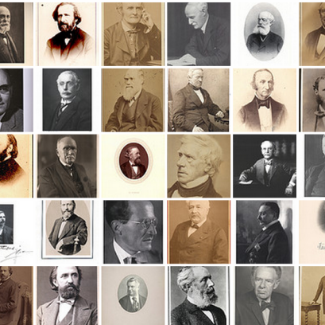
Flickr commons
A good example, however, of increased awareness of the Smithsonian's collections comes from the Smithsonian Libraries' "Portraits of Scientists“ set on Flickr. These photographs of 19th and early 20th century scientists and inventors have been available on the Smithsonian Libraries' website since 2003. Though a popular and cited Web resource, in the three months that the photographs had been on Flickr, they received nearly as many visits as during the previous five years on the Smithsonian site. As an indicator of level of interaction, 55% of photos have comments and 89% have been "favorited".
Read more: Rethinking Evaluation Metrics in Light of Flickr Commons | conference.archimuse.com

Slide 57
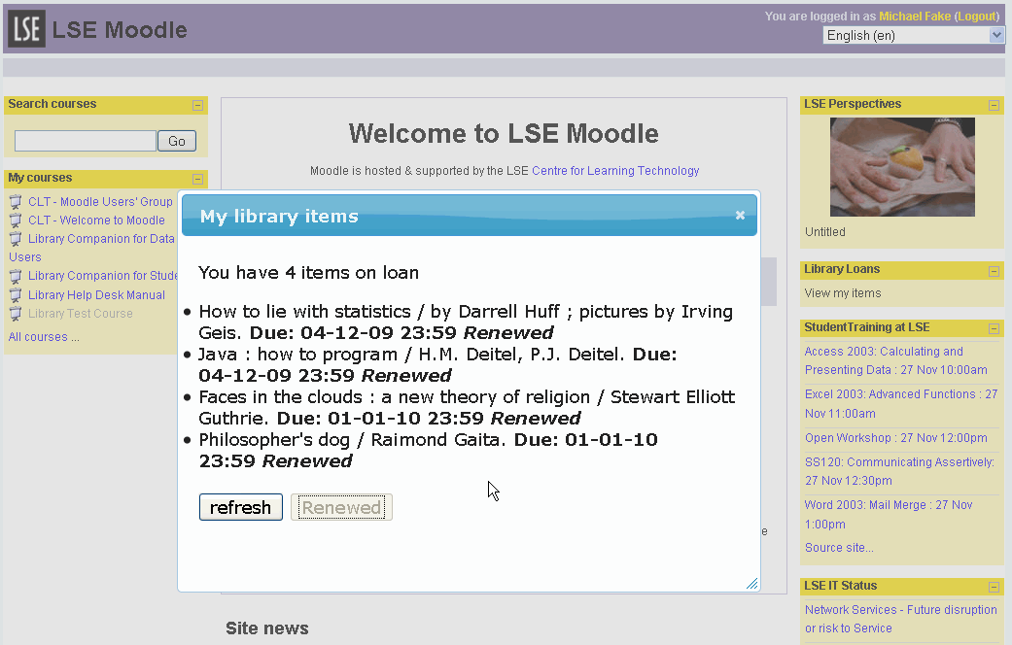
LSE
Library widgets in Moodle.

Slide 58
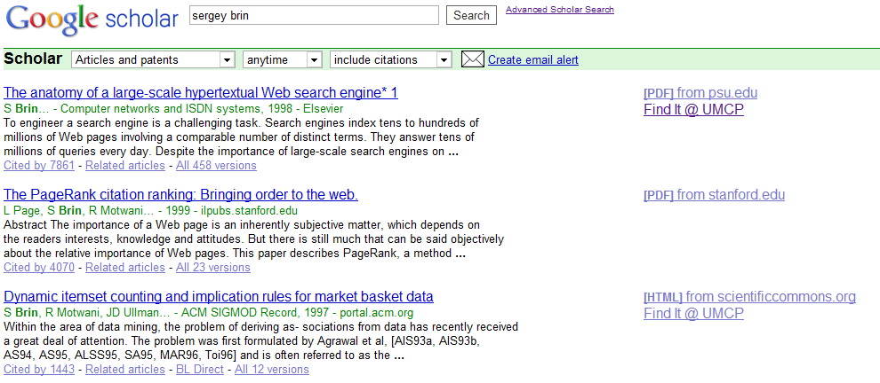

Slide 59
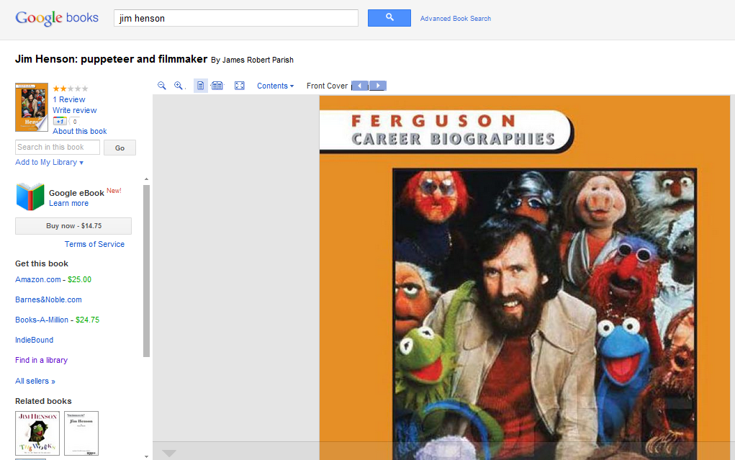

Slide 60
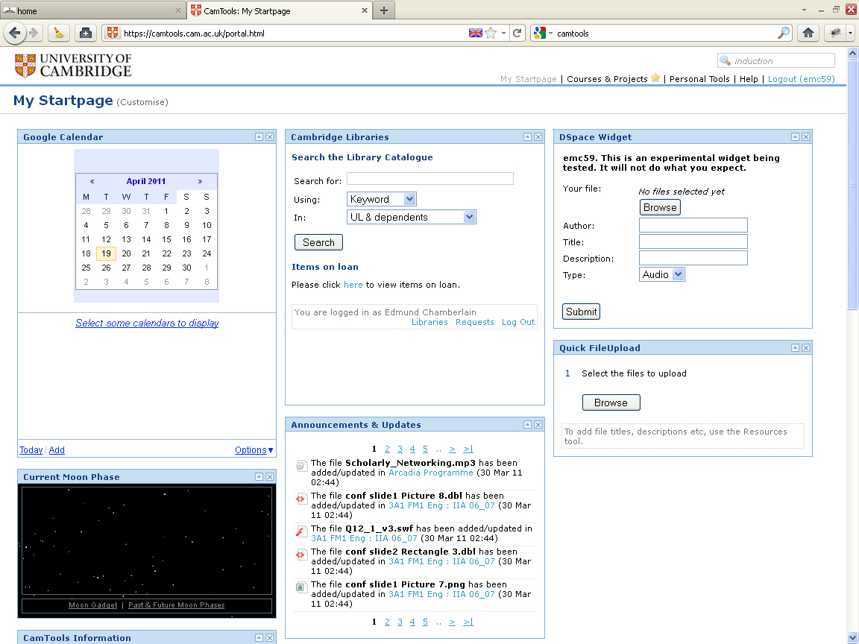
U Cambridge
Sakai based learning management environment.
Library widgets.

Slide 61
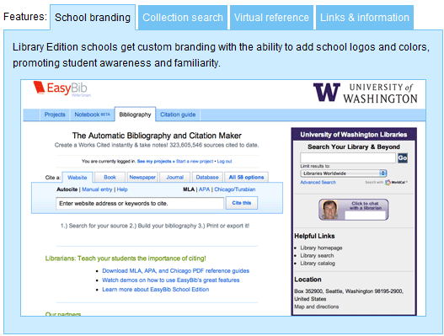

Slide 62
Disclosure
Make sure that resources are visible in the flow
Network Flow
Info
Provider
Consumer
Library
Disclosure and syndication – inside out
Institutional assets – website, repositories, …
Holdings – knowledge base, catalog (e.g. Google Scholar)

Slide 63
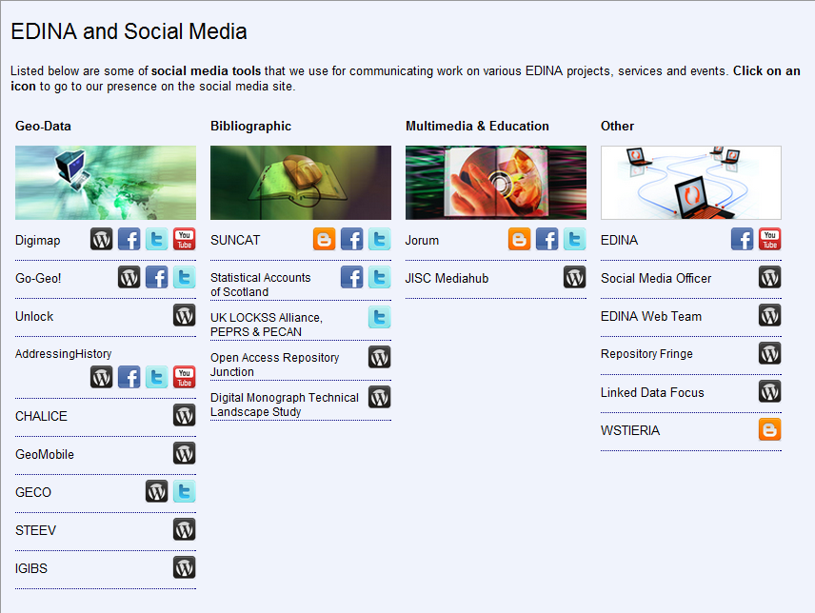
Getting into the flow
Not just providing a way to interact with resources …
… but a way of making yourself visible and attracting resources to you.

Slide 64
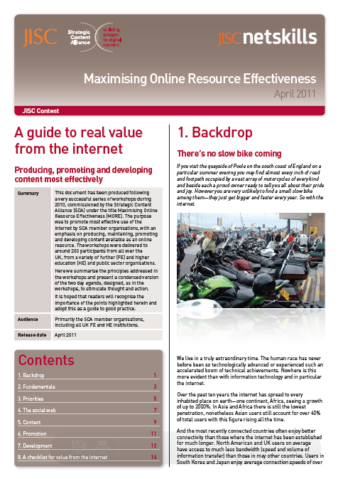
Disclosure
Effective web presence
Strategic content alliance
A set of materials to advise on how to create an effective web presence.
SEO
Metadata
Structure
etc ….

Slide 65
Disclosure
External data aggregators fit in to several categories:
• General metadata aggregations (examples: WorldCat; Google Scholar; OAIster; Primo Central; Google)
• General data object aggregations (examples: HathiTrust; Wikipedia; Internet Archive; Flickr Commons)
• Disciplinary aggregations (examples: AgEcon Search; ArXiv (for physics); EarthPrints)
• Form aggregations (examples: Digital Dissertations; MERLOT (learning objects); ArtSTOR; ArchiveGrid)
• Topical aggregations (examples: Minnesota Reflections; EthicShare)
Discoverability Phase 2 Final Report. http://purl.umn.edu/99734

Slide 66
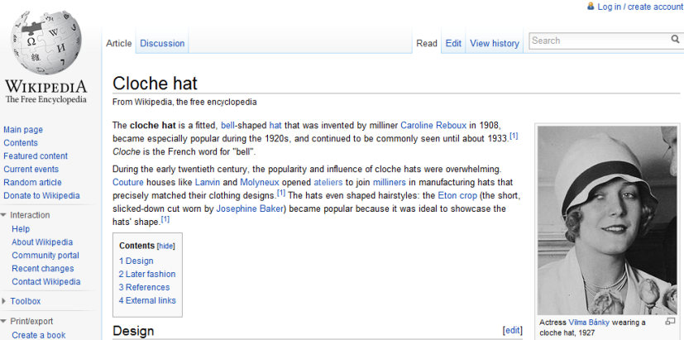
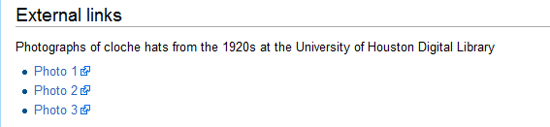

Slide 67
1. Direct Discovery
An overview of services and collections
2. Indirect Discovery
How do you put your resources ‘in the flow’?
3. Disclosure
How do you let other services know
about your unique resources?

Slide 68
Discovery and disclosure
Thank you!
University of Maryland Libraries September 19 2011
Lorcan Dempsey, OCLC

