Slide 1
discovery
delivery
disclosure
Lorcan Dempsey
OCLC
University of Lund 4/5 March 2010
(earlier version presented at U Minnesota Nov 23 2009)

Slide 2
overview: 3 pictures and some context
Interlude: network reconfiguration
Picture: Institutional resource discovery infrastructure: an emerging picture ..
Picture: Institutional collection directions ..
Interlude: network reconfiguration
Picture: Extending the resource discovery picture: disclosure and indirect discovery ..
Conclusion: some tentative directions

Slide 3
interlude
Network reconfiguration
cf bookstores, travel agents, newspapers

Slide 4
Consumer switch
Then: More investment in business/education environments.
Now: More investment in consumer environments.
Workflow switch
Then: Expect workflows to be built around my
service.
Now: Build services around workflows
Attention switch
Then: Resources scarce; attention abundant.
Now: Attention scarce; resources abundant.

Slide 5
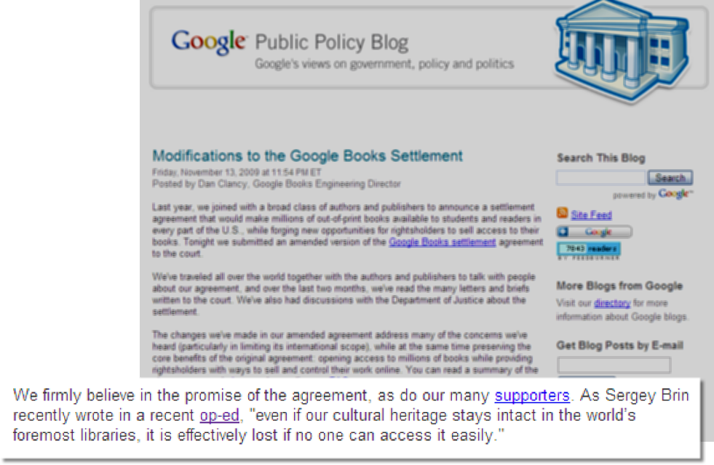

Slide 6
In an environment of scarce attention high
transaction costs equals
low/no availability?

Slide 7
1. emerging pattern
An institutional view: moving beyond materials workflow silos?

Slide 8
User
environment
End User Access
Bought/
Physical
Elctronic/
Licensed
Digitised/
Digital
Special
colls/
Archives
Materials
workflow
Management
environment
Management
Management

Slide 9
User
environment
Find It
End User Access
Get It
Bought/
Physical
Elctronic/
Licensed
Digitised/
Digital
Special
colls/
Archives
Library &
Network
Resource
Metadata
Content
Management
environment
Manage It
Management

Slide 10
User
environment
Find It
OPAC
MetaSearch
A-Z
NxtGen
Website
End User Access
Get It
Bought/
Physical
ILL/CIRC
Elctronic/
Licensed
LINK RESOLVER
Digitised/
Digital
SPECIAL
Special
colls/
Archives
Library &
Network
Resource
Metadata
MARC
A&I
XXX
DC
EAD
Content
Management
environment
Manage It
ILS
ERM
REPOSITORY
SPECIAL
Management

Slide 11
End-user environment
integrated discovery
User
environment
Find It
OPAC
MetaSearch
A-Z
NxtGen
Website
End User Access
Get It
Bought/
Physical
ILL/CIRC
Elctronic/
Licensed
LINK RESOLVER
Digitised/
Digital
SPECIAL
Special
colls/
Archives
Metadata
MARC
A&I
XXX
DC
EAD
Content
Management environment
Integrated resource management
Management
environment
Manage It
ILS
ERM
REPOSITORY
SPECIAL
Management

Slide 12
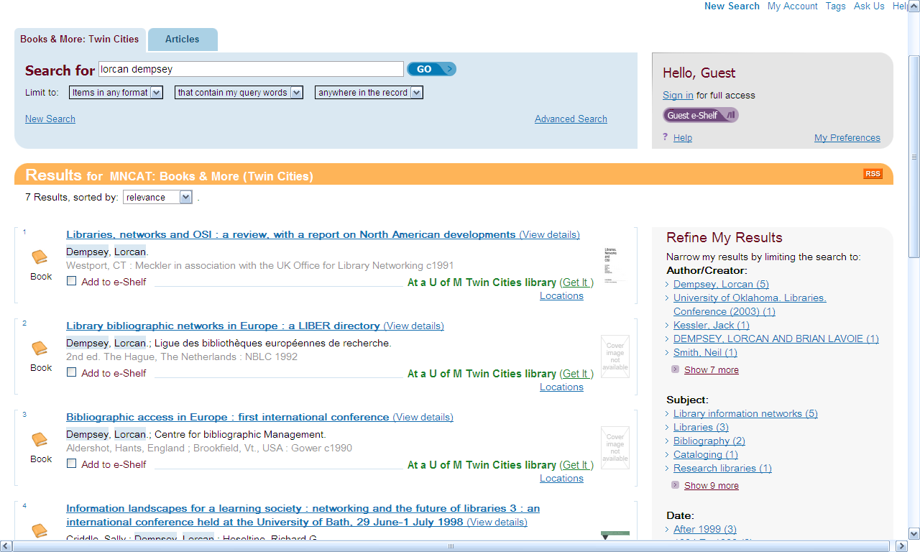

Slide 13
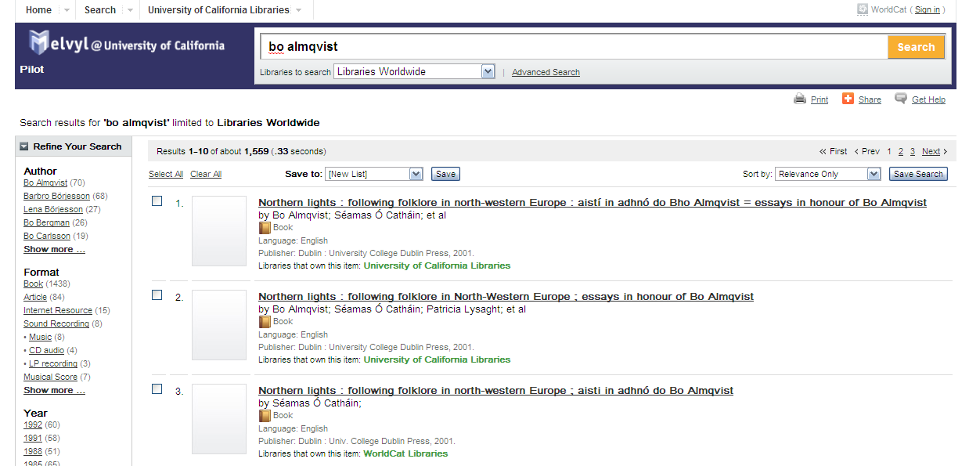

Slide 14
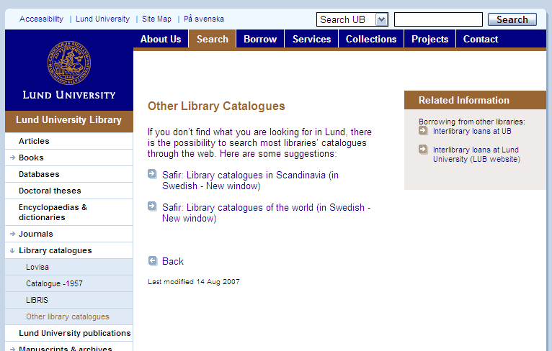
Manage this variety of systems in one framework?

Slide 15
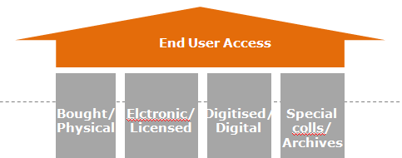
One big index?
Summon
Worldcat Local
Primo Central
Ebsco discovery layer
…

Slide 16
2. collection directions
Outside in and inside out

Slide 17
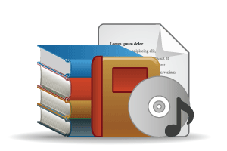



Collections grid
Stewardship
high
low
Low-High
Books & Journals
Newspapers
Gov Documents
CD & DVD
Maps
Scores
Low-Low
Freely-accessible web resources
Open source software
Newsgroup archives
low
Uniqueness
High-Low
Research & Learning Materials
Institutional records
ePrints/tech reports
Learning objects
Courseware
E-portfolios
Research data
Prospectus
Insitutional website
High-High
Special Collections
Rare books
Local/Historical Newspapers
Local History Materials
Archives & Manuscripts
Theses & dissertations
high

Slide 18
Collections grid
Stewardship
high
low
Licensed: concentration?
Small no. of suppliers?
‘Professional’ services
Selective archives.
low
Bought: move to licensed?
Space, GBS, usage, …
Uniqueness
Institutionally important
Future ‘special’
high
Special to whom?
Distinctive?

Slide 19
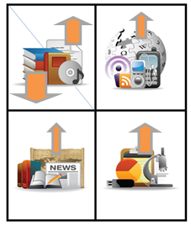
Outside in: consolidation of bought, licensed?
Integration less difficult?
Discover, deliver
Disclose holdings
Manage claims
Inside out:
reputation, institutional assets, institutional record,
distinctive, …
Disclose. Array alongside other insitutions? Make sense as individual destinations? …

Slide 20
interlude
Challenge of institution scale

Slide 21
3 pressures
User-centric
Network level
Multiscalar

Slide 22
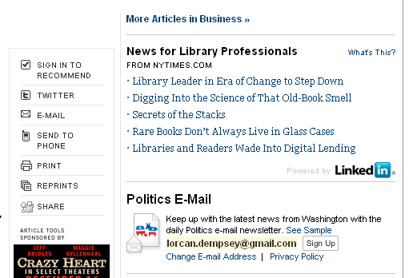
User-centric
Site-centric
Network-centric
User-centric
NYT headlines ->

Slide 23
User-centric
Socialized, realtime, and mobile …
  registration
Identity services (Facebook?)
Be the trusted Identity Service for as many
people as possible
  give them identifiers
  authenticate them
  provide claims about them
    who they are
    what they do
    what they want
  Act as their Agent
(Andy Dale, OCLC)

Slide 24
Network level
Network is the unit of attention ..
Data aggregation
Gravitational pull
Network effects
Long tail (match supply and demand)
Consumer – research and learning – professional

Slide 25
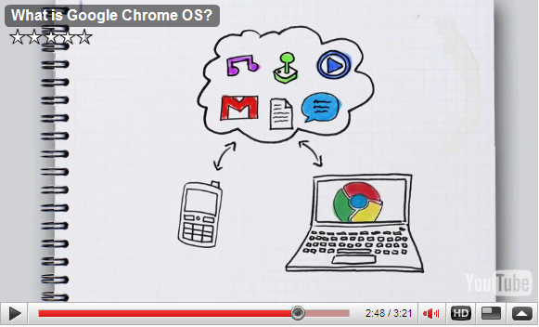
Website: stuck in the middle?
Social, realtime, mobile
Cloud and mobile: natural partners

Slide 26

Multiscalar: user
Personal
Departmental
Disciplinary
Institution
Network level
Examples:
Discovery
Researcher pages
Citation management
Deposit papers/research data

Slide 27
Multiscalar supply ….
Scale
Source
 | Institution | Group | Webscale
Peer (collaborative) | HathiTrust; DuraSpace
Public (state/national) |  | LIBRIS
Private (third party) | Summon | Worldcat Cataloging | Worldcat.org,Flickr Commons, KB in Google Scholar

Slide 28
3. extending the picture
But … readers do not integrate at institutional level …

Slide 29
In the flow ..
Variety of campus venues
Network level
Student portal
Course management system
Reading list
Refworks
VIVO, OSU Pro, …
…
Mendeley
Google
Amazon
Flickr
iTunes
Wikipedia
Twitter
Facebook
…

Slide 30
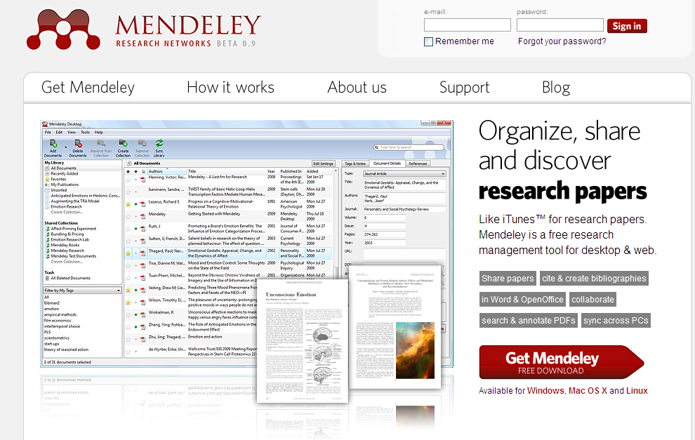
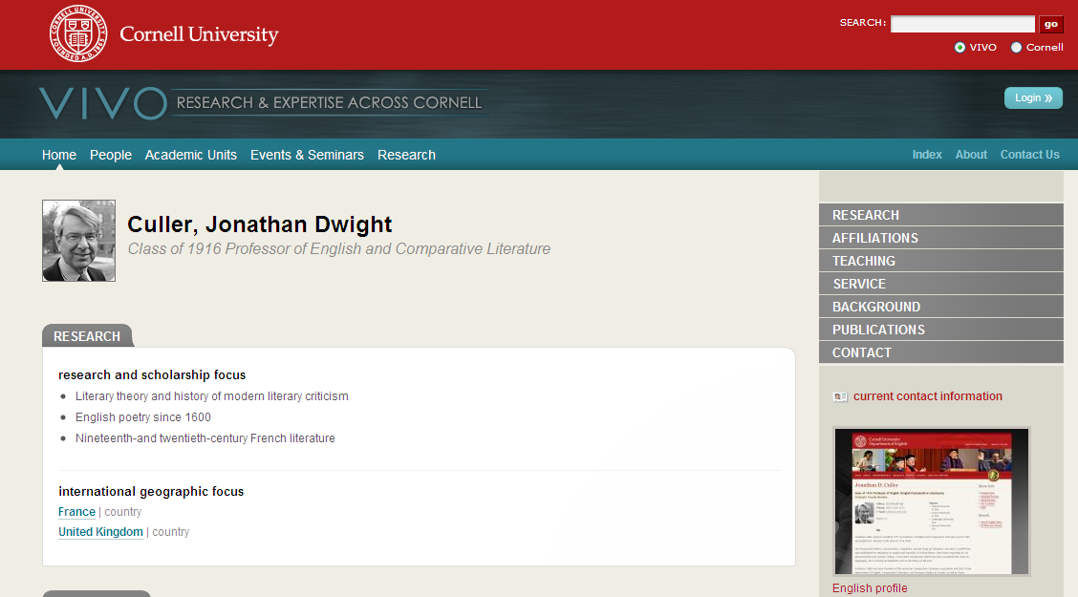
100,000 users and
8 million research papers
VIVOweb Project is a
two-year $12 million
project funded by the
NIH.
VIVO at Cornell

Slide 31
Flow
3
Info
Provider
Consumer
2
Library
1
Direct – added value
2 and 3: discovery happens elsewhere
Disclosure: holdings (non-unique) and existence.
SEO: part of the web, not just on it ..
2. Disclosure and syndication
3. Indirect – may involve identity, locate, resolution or other services at library

Slide 32
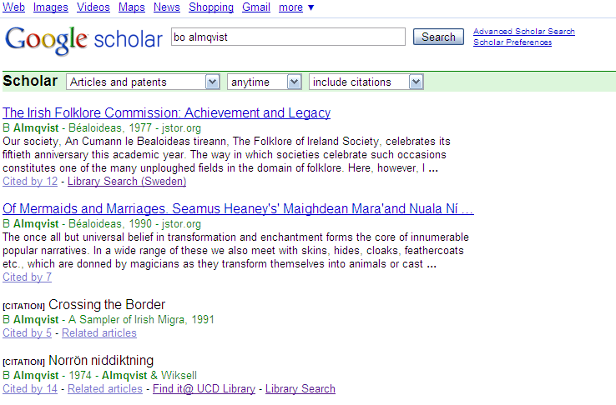
Indirect discovery

Slide 33
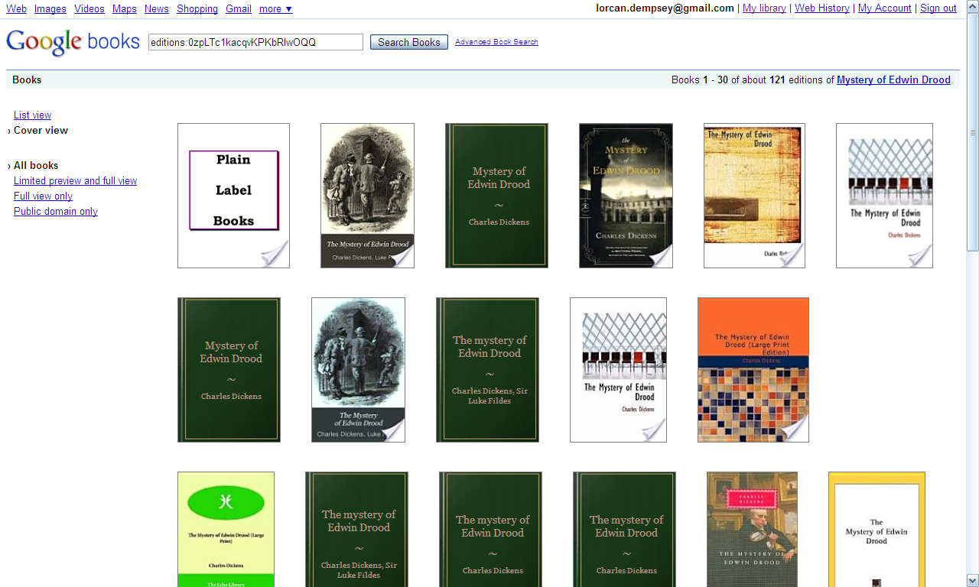
Indirect discovery

Slide 34
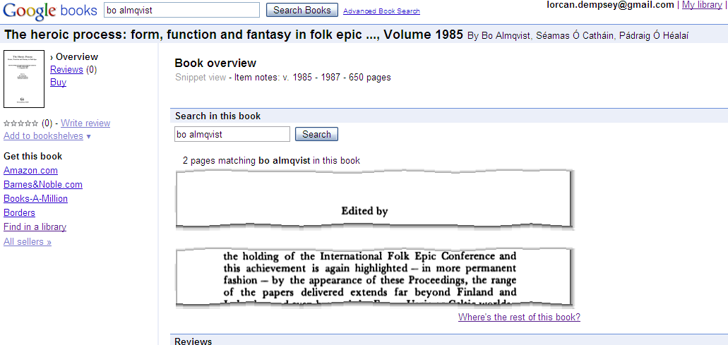

Slide 35
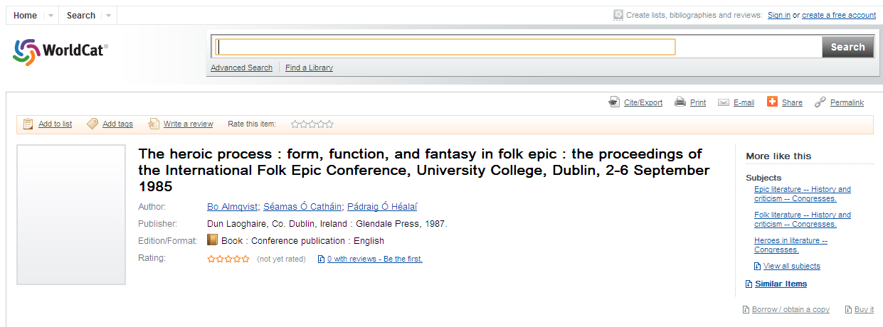

Slide 36
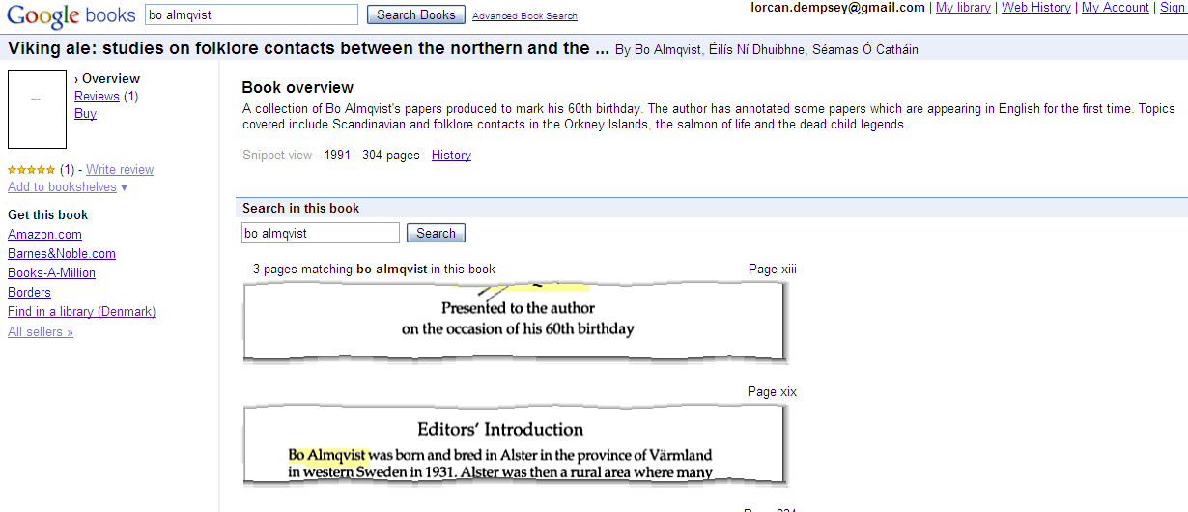

Slide 37
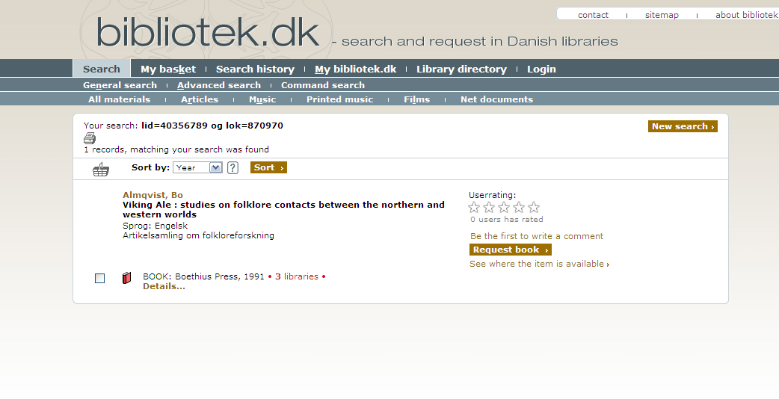

Slide 38
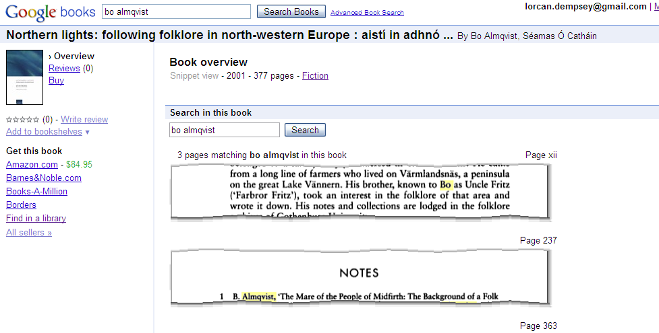

Slide 39
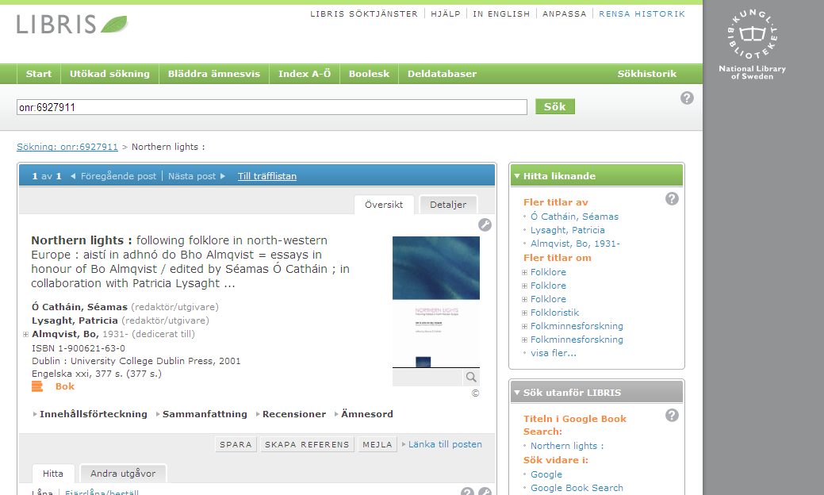

Slide 40
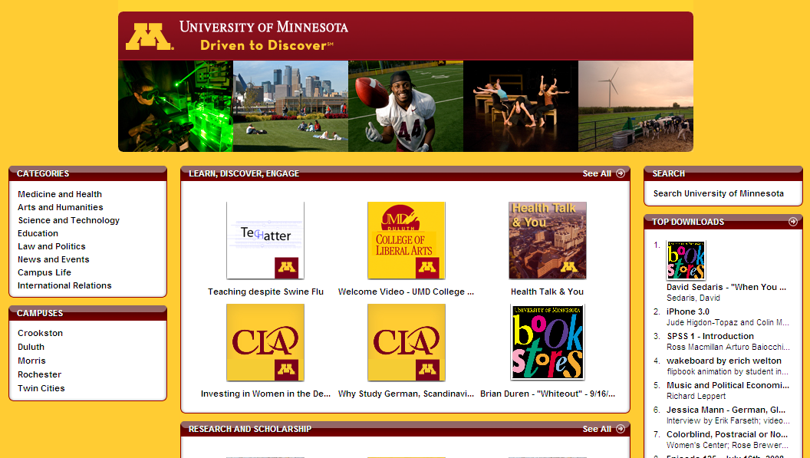
Syndication via iTunes

Slide 41
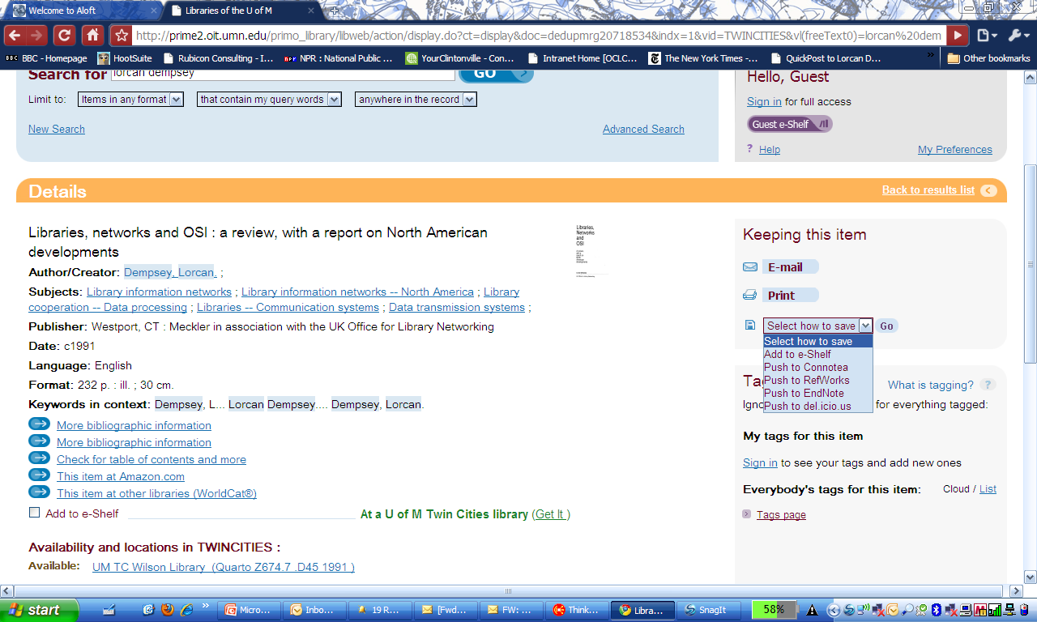
Syndication: bookmarking&RSS

Slide 42
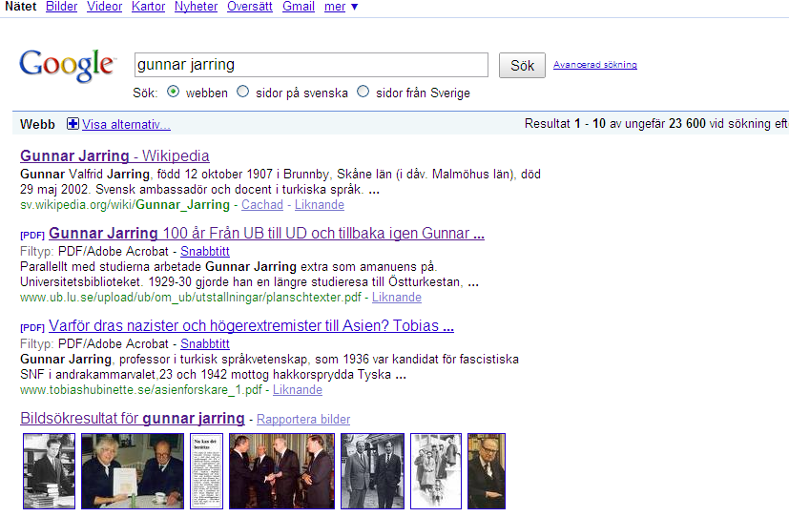
Syndication via wikipedia

Slide 43
Social objects
Conversation
Connections
Context
Discussion, ratings, rankings, reviews, etc
Link to others through mutual interests
Those who bought this also bought, etc

Slide 44
Flow
Info
Provider
Consumer
Library
Social: incentives and scale
Federation, syndication, ..

Slide 45
Flow
Info
Provider
Consumer
Library
Library
Library
Social: incentives and scale
Federation, syndication, ..
Collaborative sourcing, …

Slide 46
Research findings
First recourse
Value convenience
Variable use of social tools
Flow
Info
Provider
Consumer
Library
Library
Library
Thinking about variety
of disclosure paths
Sometimes confusing: high transaction costs
Referral traffic growing
Still important destination

Slide 47
tentative con-clusions

Slide 48
Move to emerging discovery layer pattern
Books: a new balance?
Journals: move to consolidation?
Discovery layer: need one?
Institutional materials: disclose through discovery layer, but also syndicate …
Analytics: let traffic influence design of website

Slide 49
Disclose and syndicate
Institutional collections: SEO (sitemaps, etc), move to ‘flow’ services as appropriate, …
Holdings: syndicate (knowledge base, holdings, …)
SEO. Consistent URL patterns across services, hackable URLs, bookmarking buttons, etc
Appification …
…

Slide 50
User and institutional leverage
Expertise, reputation (provide bibliographic tools, ..)
Watch Identity Management: prepare for when manage context (usage) and claims.
Integration with other campus systems (course management, ..)
‘Follow’ and intervene? (Salesforce.com)

Slide 51
Organizational
Seek collaborative sourcing models
Externalize infrastructure
Focus on distinctive impact
Place local in bigger contexts
Recognize that things have changed …

Slide 52
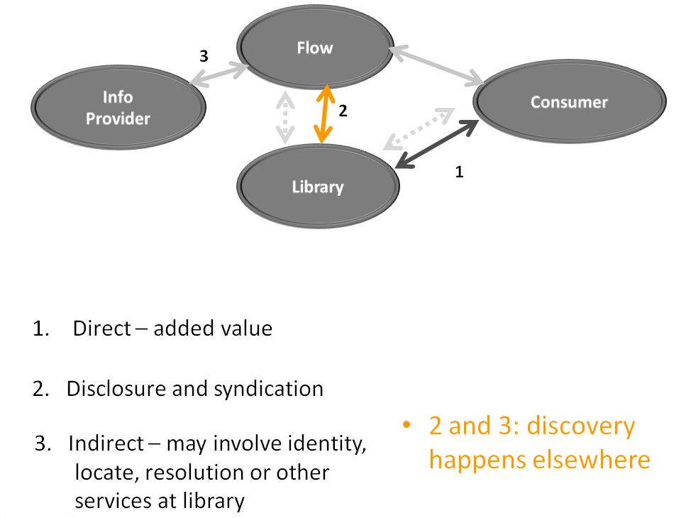
Thank you
dempseyl@oclc.org
http://www.oclc.org/research
http://orweblog.oclc.org
http://www.twitter.com/lorcanD

