Slide 2

the university library: reconfiguring organizational boundaries in a network environment
Getting ready for 2020: the library's role in research, education and society
LIBER 40th Annual Conference
Barcelona
2 July 2011
Twitter: @LorcanD
Lorcan Dempsey, OCLC

Slide 3
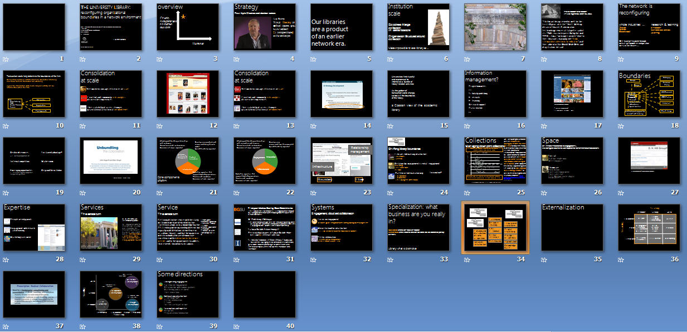
Overview

Slide 4
overview
*
Some simple
models which
I hope are not
too simplistic,
crude and
reductive …
Humour

Slide 5
Our libraries are a product of an earlier network era

Slide 6

Institution scale
Goodness: A large
collection
in central locations
Organization: Structured around collection
Makes it possible to see library as …

Slide 7


Slide 8
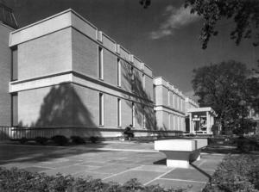
From modernist to modern
Inside Higher Ed, March 21, 2011
"Skillman Library served us well for the first 30 years of its life," Neil J. McElroy, dean of libraries & information technology services at Lafayette, said of its 1960s-era centerpiece. But by the mid-1990s, it was "no longer suitable," due to the librarian's changing role "from steward of collections to educator" and the advent of the World Wide Web and digitization, he said.

Slide 9
The network is reconfiguring whole industries … research & learning
Travel
News
Book retail
E-research
Network level services
Learning
We have yet to work through
what systemwide reconfiguration
means for libraries …

Slide 10
Transaction costs help determine the boundaries of the firm:
Delineation between activities that are conducted internally and those that are transacted for externally
Higher the transaction costs, more likely an activity will be internalized within the firm
Firm:
Manufacturing
R&D
Human Resources
Finance
Call center
Supply chain
Plants/grounds

Slide 11



Consolidation at scale
Network encourages efficiencies of scale
Context and community: rich analytics drive richer experiences
The scalability of access: stronger gravitational attraction at network level

Slide 12
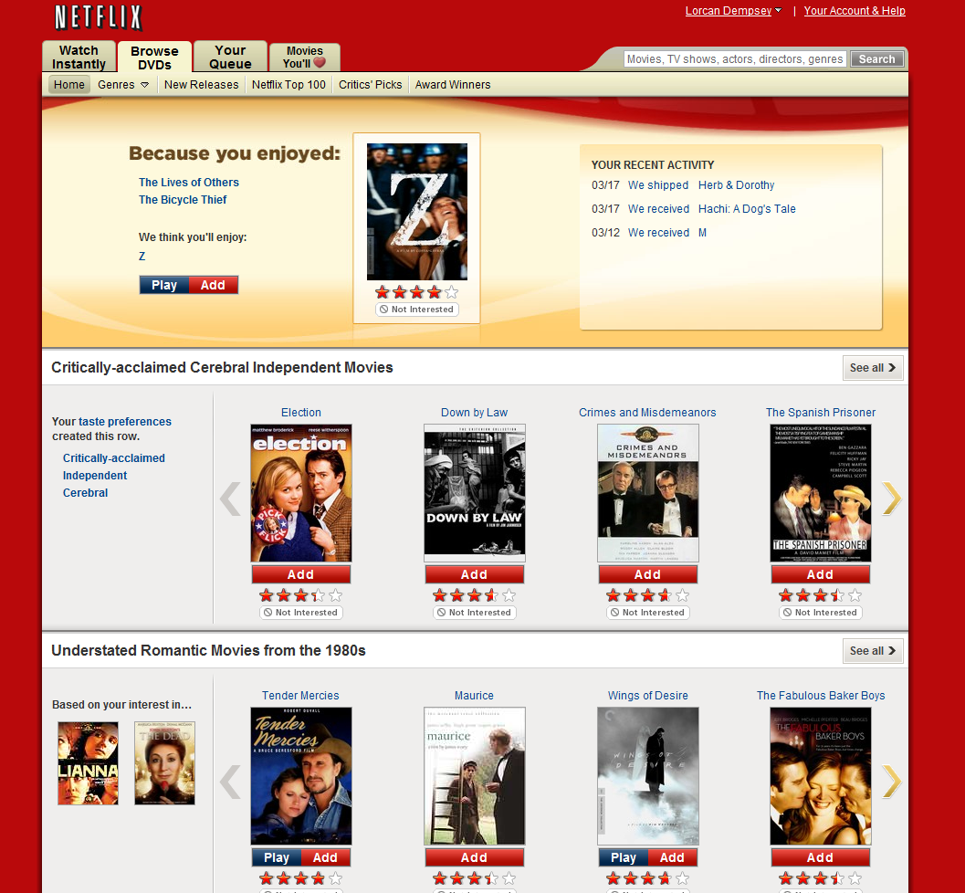

Slide 13


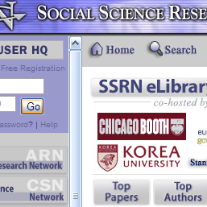
Consolidation at scale
Network encourages efficiencies of scale
Context and community: rich analytics drive richer experiences
The scalability of access: stronger gravitational attraction at network level

Slide 14
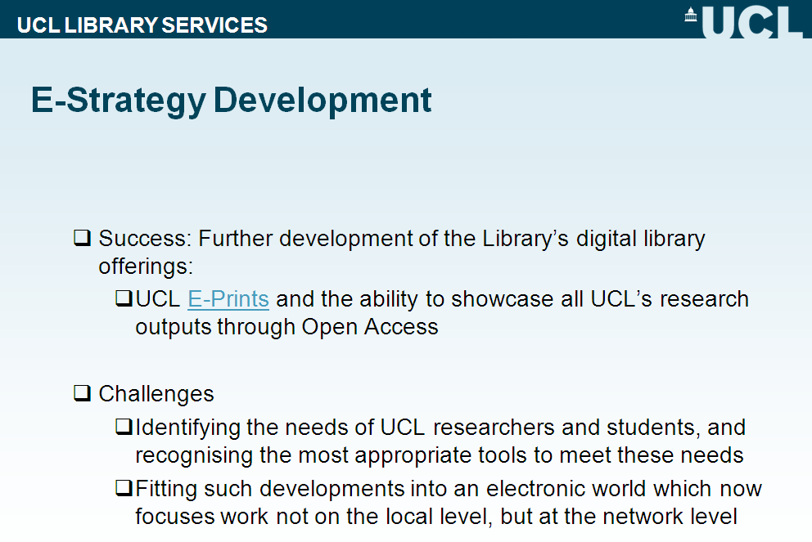

Slide 15
a Coasian view of the academic library
Universities find it useful and economical to internalize a bundle of information-related activities
As the pattern of transaction costs change, so too will the boundaries of the library.

Slide 16

Bangor University, Wales
“searching has been deskilled”
Externalised and consolidated in Google ….

Slide 17
Boundaries
Cataloging
Google
Resource sharing
Bangor
A&I/E-journals
University:
Library
Teaching
Research
Administration
Laboratories
Sports facilities
JSTOR/Portico
Virtual ref
Instititutional support for research and learning
Shared storage

Slide 18
Information management?
IT
New forms of scholarly communication
Computer centre
Press? Departments …
E-learning
Research information management
E-learning
Research office
Repository, …
Data curation and eresearch
e.g. ODAI, Yale
Departments

Slide 19
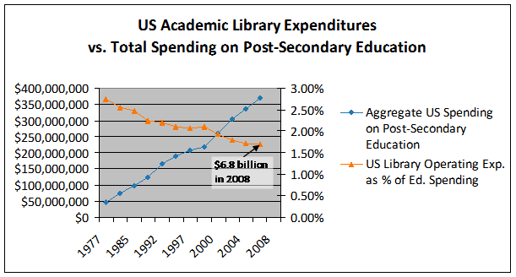
Strategy:
Making choices
New opportunities
e research
student experience
Strategic choices
Innovate
Partner
Disinvest
Shared services
E-research, digital humanities, student experience, ….
Sustained advantage

Slide 21
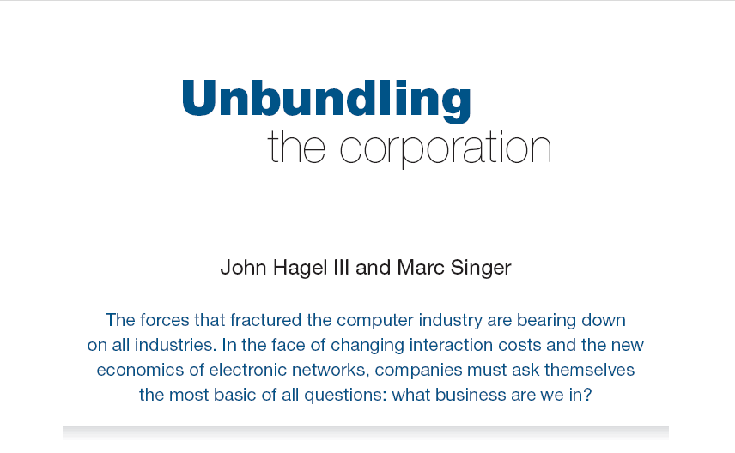
Harvard Business Review (1999)

Slide 22
Core components of a firm
Attracting and building relationships with customers
“Service-oriented”, customization
Economies of scope important
Develop new products and
services and bring them to
market
Speed/flexibility important
Customer
Relationship
Management
Product Innovation
Infrastructure
Back office capacities that
support day-to-day operations
“Routinized” workflows
Economies of scale important

Slide 23
Attracting and building relationships with researchers and learners
“Service-oriented”, customization
Economies of scope important
Develop new
services and have them accepted
Speed/flexibility important
Engagement
Innovation
Infrastructure
Back office capacities that
support day-to-day operations
“Routinized” workflows
Economies of scale important

Slide 24
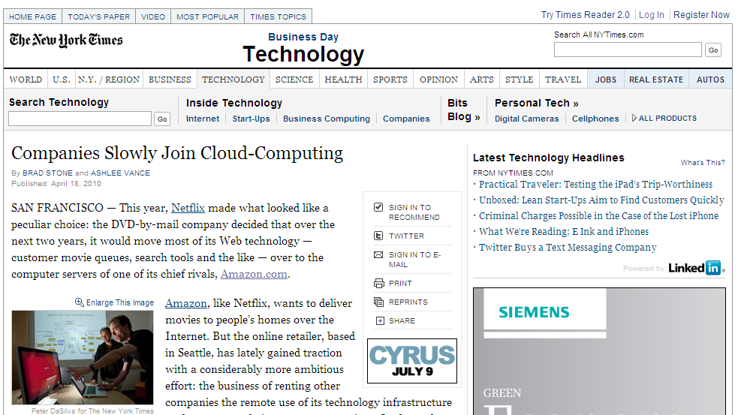
Relationship
management
Infrastructure
Boundary
Flow

Slide 25
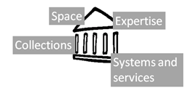

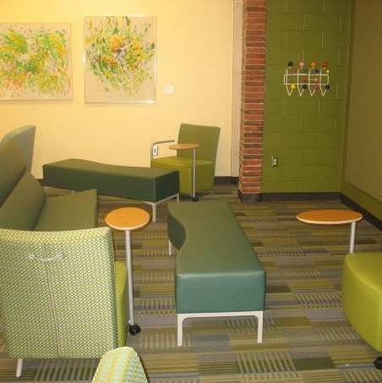

Shifting library boundaries
Libraries externalising infrastructure
Collections
Systems
Relationship management is central - engagement
Buildings
The service turn
People
Innovation?
Patterns of externalization vary
Collaborative
Commercial
The emergence of the cloud

Slide 26
Collections
We are moving to a situation where network-level management of the collective collection becomes the norm, but it will take some years for service, policy and infrastructure frameworks to be worked out and evolution will be uneven. The network may be at the level of a consortium, a state or region, or a country. At the moment, this trend is manifesting itself in a variety of local or group mass storage initiatives, as well as in several regional and national initiatives. [Emerging network level management of the collective print collection]
Lorcan Dempsey
Managing down print collections

Slide 27

Space
Shift from infrastructure to engagement ..
Reconfigure around the user experience rather than around collections
Social
Ad hoc rendezvous
Meeting place
Showcase
Exhibitions
Specialist equipment
Specialist staff
GIS, Writing centre, digital humanities, …

Slide 28
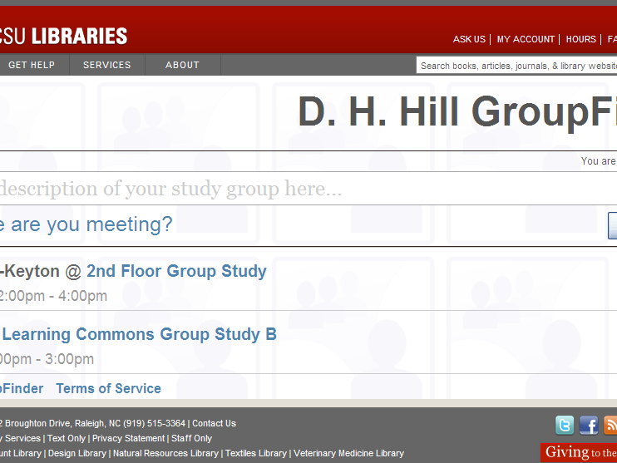
Find members of a group in the library ….

Slide 29
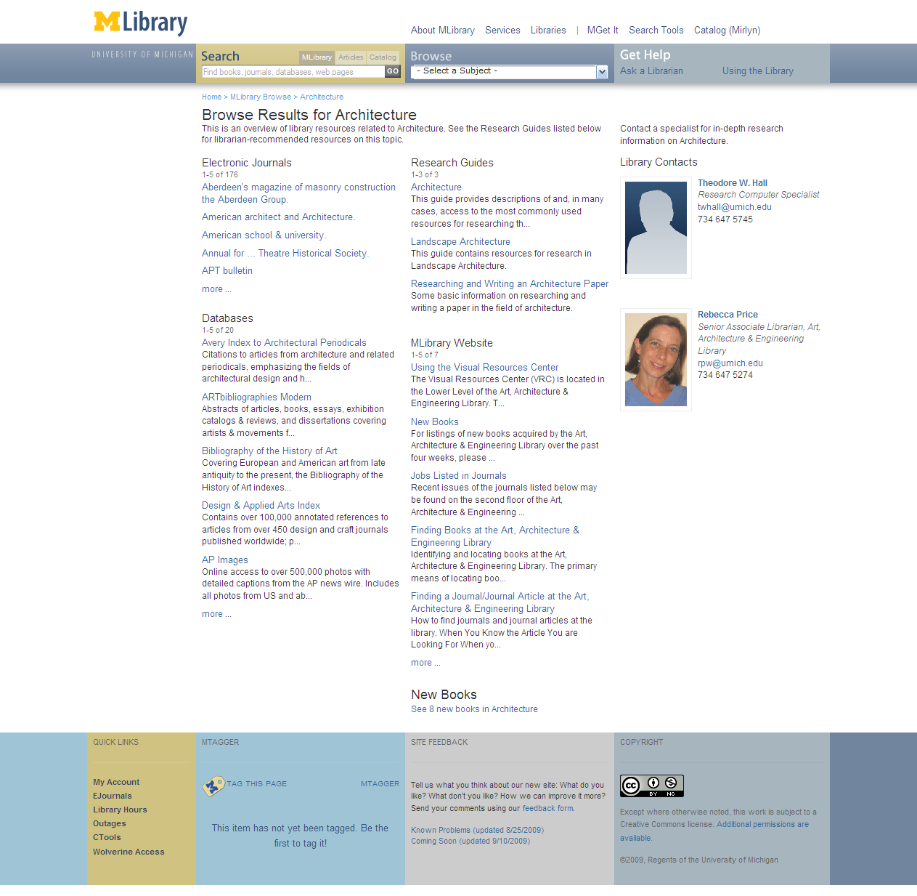


Expertise
People are entry points
Engagement with research and learning
Marketing/assessment/
partnership
e.g. Leicester, Bangor

Slide 30
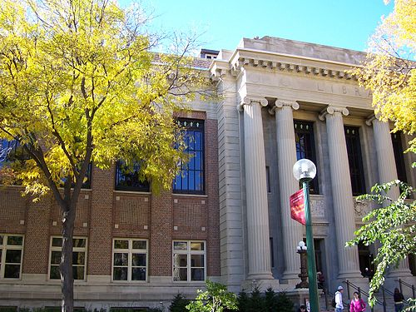
Services
The service turn
U Minnesota, ARL Institutional profile
In alignment with the University's strategic positioning, the University Libraries have re-conceived goals, shifting from a collection-centric focus to one that is engagement-based.

Slide 31
Service
The service turn
Defining distinctive services with the clarity with which we have defined distinctive collections allows us to acknowledge that the 21st century will be marked by different, but equally valid, definitions of excellence in academic libraries, and that the manner in which individual libraries demonstrate excellence will be distinctive to the service needs, and to the opportunities to address those needs, found on each campus.
Scott Walter. “Distinctive Signifiers of
Excellence”: Library Services
and the Future of the Academic
Library. Coll. & res. libr. January 2011 72:6-8

Slide 32


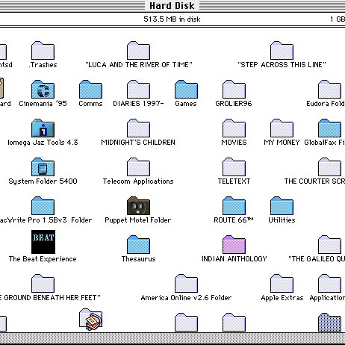

First year initiatives: Bowling Green State Univ Libs
The Library First-Year Initiatives (F.Y.I.) Program strives to make meaningful connections with incoming students early in their academic career.
M Publishing, U Michigan
The University of Michigan Press, the Scholarly Publishing Office, Deep Blue (the University’s institutional repository service), the Copyright Office, and the Text Creation Partnership,
Salman Rushdie Archive, Emory U
Personal digital papers of Salman Rushdie. Have become his reference collection.
Scholarly Commons, U Illinois Urbana Champaign
... to serve the emerging needs of faculty, researchers and graduate students pursuing in-depth research and scholarly inquiry. Access to expertise, hardware and software.

Slide 33


Systems
Engagement, cloud and collaboration
Focus on engagement
Resource guides, integration with learning management, widgets, etc
Move to cloud for infrastructure
ILS, ERM, Discovery: move to cloud-based solutions
Deep collaboration
Shared systems infrastructure:
Orbis Cascade Alliance, 2CUL

Slide 34
Specialization: what business are you really in?
Specialise where can make an impact
Externalise what is routine and can be done well collaboratively or by others
Library: what is distinctive

Slide 35
Cataloging
Resource sharing
Legacy print repositories
A&I
e-Journals
Digital repository
Collaborative data/patron driven acquisition
Virtual reference
Analytics: usage data
Preservation
‘Syndication’
Identifier infrastructure
Knowledge base

Slide 36
Externalization

Slide 37
Scaling
Institution
Group
Web
Tripod:
(Tri-college
library catalog)
Collaborative
DSpace
RePEc
Bibliographic
Standards
(LC Classification,
MESH, LCSH)
Rero,
REBUIN,
Bibsys,
Libris
Sourcing
Public
PubMed
VTLS Virtua
(hosted ILS)
JISC Collections
worldcat.org
Third-Party

Slide 38
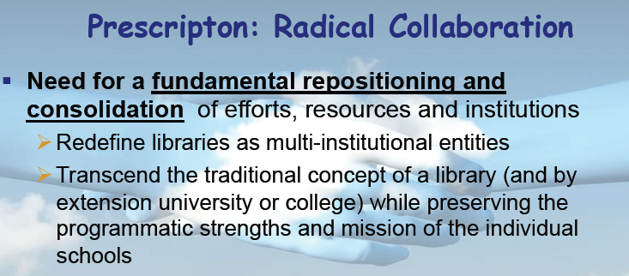
Rick Luce

Slide 39
Google Books/Scholar
Mendeley
Web-scale
Externalization
Web
4
Cooperative cataloging
Resource sharing
Collaborative
Externalization
Scaling
Group
2
Licensed e-content
Hosted systems
Self-
Sufficiency
Straight
Externalization
Institution
1
3
Internalized
Collaborative
Public
Third-Party
Sourcing

Slide 40
Google Books
Web-scale
Externalization
Web
4
Hathi Trust
Europeana
Collaborative
Externalization
Scaling
Group
2
JSTOR
Proquest
Self-
Sufficiency
Straight
Externalization
Institution
1
3
Internalized
Collaborative
Public
Third-Party
Life cycles?
Sourcing

Slide 41
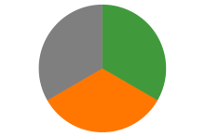
Some directions
Strengthening engagement
Systems for engagement
Relationship with campus partners
Marketing and assessment
The service turn
Externalising infrastructure
Give things up?
Deep collaboration
Cloud
Just in case to just in time
External relationships are
even more critical:
public support, vendor
choices
Sharing Innovation and expertise
New skills
Organizational innovation

