Slide 1
“I always stick with the first thing that comes up on Google.” Motivating student engagement with the digital information service environment
Libraries in the Digital Age (LIDA) 2012
Zadar, Croatia, June 18, 2012
Lynn Silipigni Connaway, Ph.D.
Senior Research Scientist

Slide 2

“I find Google a lot easier…so many journals come up and when you look at the first ten and they just don’t make any sense. I, kind of, give up.”
(USU7, Female, Age 19)
Notes:
“I find Google a lot easier than going to the library website because I don’t know, it’s just like sometimes so many journals come up and when you look at the first ten and they just don’t make any sense I, kind of, give up. Google, I don’t know. It’s just Google it’s – I find it easier just to look through anything.” (USU7, 0:34:11, Female, Age 19, Digital Visitors and Residents)
White, D. S., & Connaway, L. S. (2011-2012). Visitors and residents: What motivates engagement with the digital information environment. Funded by JISC, OCLC, and Oxford University. Retrieved from http://www.oclc.org/research/activities/vandr/

Slide 3
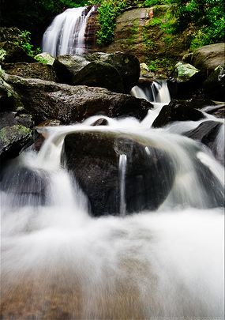
Then and Now
Then: The user built workflow around the library
Now: The library must build its services around user workflow
Then: Resources scarce, attention abundant
Now: Attention scarce, resources abundant
(Dempsey, 2008)
Notes:
Dempsey, L. (2008). Always on: Libraries in a world of permanent connectivity. First Monday, 14(1). Retrieved from http://www.firstmonday.org/htbin/cgiwrap/bin/ojs/index.php/fm/article/view/2291/207
Today, more than 1.7 billion people, or almost one out of every four humans on the planet, are online (Wasserman, 2012).
Wasserman, S. (2012, June 18). The Amazon effect. The Nation. Retrieved from http://www.thenation.com/article/168125/amazon-effect
http://www.flickr.com/photos/aramisfirefly/3580397954/

Slide 4
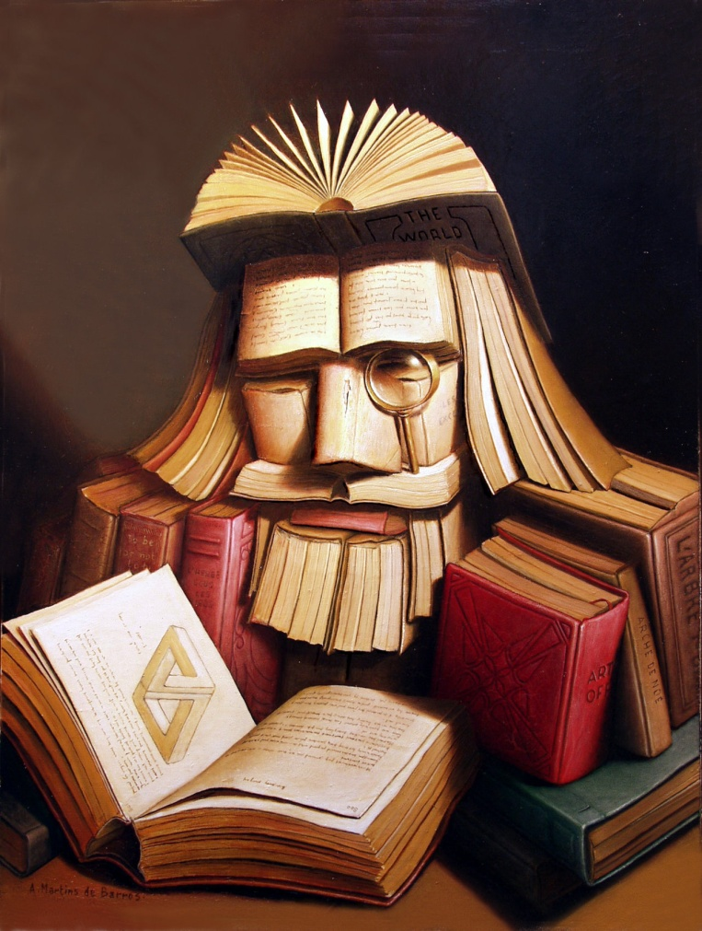

Understanding Motivations & Engagement

Slide 5

Visitors and Residents: What motivates engagement with the digital information environment?
Funded by
JISC
OCLC
Lynn Silipigni Connaway, Ph.D.
Oxford University
David White
Alison Le Cornu, Ph.D.
In partnership with
University of North Carolina, Charlotte
Donna Lanclos, Ph.D.
Notes:
Microsoft Clip Art

Slide 6
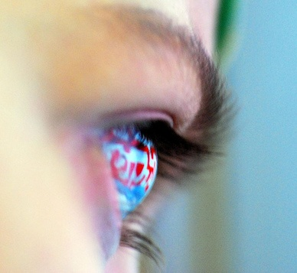
Residents
Significant online presence & usage
Collaborative activity online
Contribute online
Mobile device dependence
>10 hours online/week
(White & Connaway, 2011-2012)
Notes:
Residents: significant online presence and usage; high level of collaborative activity online; contributions to the online environment in the form of uploading materials, photos, videos; high dependence on a mobile device (smart phone, laptop, etc.); more than 10 hours a week spent online.
White, D. S., & Connaway, L. S. (2011-2012). Visitors and residents: What motivates engagement with the digital information environment. Funded by JISC, OCLC, and Oxford University. Retrieved from http://www.oclc.org/research/activities/vandr/
http://www.flickr.com/photos/nicocavallotto/363251198/

Slide 7
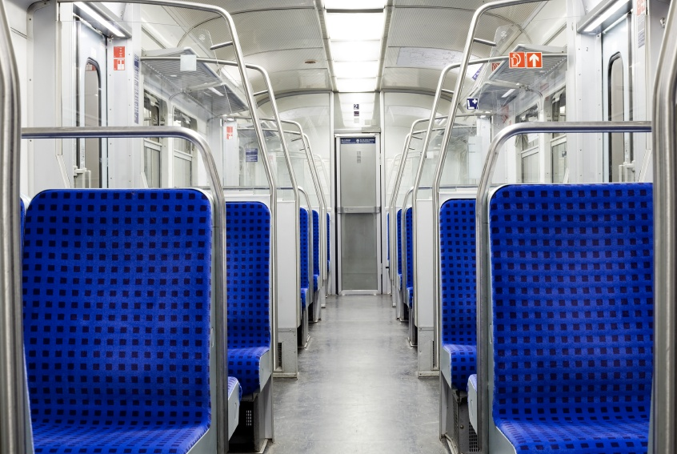
Visitors
Functional use of technology
Formal need
Passive online presence
Favor FtF interactions
<6 hours online/week
(White & Connaway, 2011-2012)
Notes:
Visitors: functional use of technology, often linked to formal need (such as use of software for specific coursework, or organizing meetings through email contact); less visible/more passive online presence, more likely to favor face- to- face interactions (even as they use the internet to organize/schedule those interactions); fewer than 6 hours spent online a week.
White, D. S., & Connaway, L. S. (2011-2012). Visitors and residents: What motivates engagement with the digital information environment. Funded by JISC, OCLC, and Oxford University. Retrieved from http://www.oclc.org/research/activities/vandr/
Microsoft Clip Art

Slide 8
Video: goo.gl/wW1oB
First Monday Paper: goo.gl/RFSLz
(White & Connaway, 2011)
Notes:
Discuss Prensky and how this is an attempt to move away from Native/Immigrant metaphor:
“‘The digital natives/digital immigrants distinction is dead or at least dying’. So proclaims Doug Holton in his blogpost. He continues: ‘Unfortunately, the idea is still uncritically accepted even in some journal articles, and perhaps used as an excuse or crutch too often for poor or ineffective teaching practices’. Holton is not alone in his criticism. McKenzie (2007) writes strongly against Prensky’s (2001a, b) typology identifying a number of ‘thinly supported claims’, while Kennedy, et al. (2010) demonstrate through an empirical research project that Prensky’s age–related hypothesis is very much less clear–cut than the Natives and Immigrants dichotomy implies. Our intention is to propose an alternative, which we have termed ‘Visitors and Residents’.”
White, D. S., & Le Cornu, A. (2011). Visitors and Residents: A new typology for online engagement. First Monday, 16(9). Retrieved from http://firstmonday.org/htbin/cgiwrap/bin/ojs/index.php/fm/article/viewArticle/3171/3049

Slide 9
Why Visitors and Residents Project?
If we build it, they will NOT come.
Shifting changes in engagement with information environment
Effect of larger cultural changes influenced by Web?
New attitudes towards education?
Gap in user behavior studies
Need for longitudinal studies
Investigate context and situation
Inform project & service design to improve engagement & uptake
(White & Connaway, 2011-2012)
(Connaway & Dickey, 2010)
(Cool & Spink, 2002)
Notes:
White, D. S., & Connaway, L. S. (2011-2012). Visitors and residents: What motivates engagement with the digital information environment. Funded by JISC, OCLC, and Oxford University. Retrieved from http://www.oclc.org/research/activities/vandr/
Connaway, L. S., & Dickey, T. J. (2010). The digital information seeker: Report of the findings from selected OCLC, RIN, and JISC user behaviour projects. Retrieved from http://www.jisc.ac.uk/media/documents/publications/reports/2010/digitalinformationseekerreport.pdf
Cool, C., & Spink, A. (2002). Issues of context in information retrieval (IR): An introduction to the special issue. Information Processing and Management: An International Journal, 38(5), 605-611.

Slide 10

Why Visitors and Residents Project?
Understand motivations & expectations for using technologies
Enable educators & service providers to make informed decisions
Position role of library within the workflows & information-seeking patterns of students & faculty
Influence design & delivery of digital platforms & services
Investigate & describe user-owned digital literacies
(White & Connaway, 2011-2012)
Notes:
Microsoft Clip Art

Slide 11
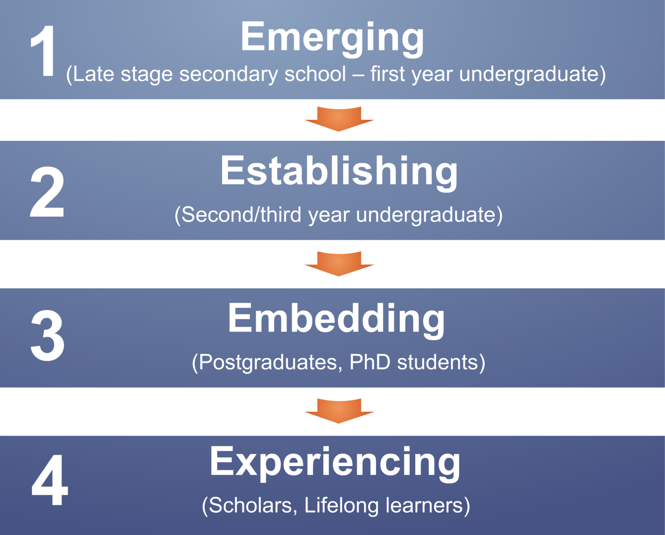
Visitors and Residents
(White & Connaway, 2011-2012)
Notes:
White, D. S., & Connaway, L. S. (2011-2012). Visitors and residents: What motivates engagement with the digital information environment. Funded by JISC, OCLC, and Oxford University. Retrieved from http://www.oclc.org/research/activities/vandr/

Slide 12
Objectives
Examine links between age & technological engagement
Describe social network in which digital & analog information-seeking strategies are embedded
Inform JISC Developing Digital Literacies strand
Create matrix of implementation options
(White & Connaway, 2011-2012)
Notes:
The findings will be used to create a matrix of implementation options allowing those designing and delivering digital platforms and services to make informed decisions relative to engagement and motivation for individuals at each of the educational stages.
Work as an interdisciplinary team, bringing to bear our relative expertises in Educational Technology, Library Information and Science/Research Methodology (User behavior), and Anthropology (Ethnography)
White, D. S., & Connaway, L. S. (2011-2012). Visitors and residents: What motivates engagement with the digital information environment. Funded by JISC, OCLC, and Oxford University. Retrieved from http://www.oclc.org/research/activities/vandr/

Slide 13

Triangulation of Data
Several methods:
Semi-structured interviews (qualitative)
Diaries (qualitative)
Online survey (quantitative)
Enables triangulation of data
(Connaway et al., 2012)
Notes:
“Several methods of data collection are being utilized in this study: semi-structured interviews, diaries, and an online survey. The multi-method design enables triangulation, which provides a cross examination of the data analysis and results. The quantitative and qualitative methods, including ethnographic methods that devote individual attention to the subjects, yield a very rich data set enabling multiple methods of analysis.”
Connaway, L. S., Lanclos, D., White, D. S., Le Cornu, A., & Hood, E. M. (2012). User-centered decision making: A new model for developing academic library services and systems. IFLA 2012 Conference Proceedings, August 11-17, Helsinki, Finland.

Slide 14

Ethnography
Rapport
Observations
Conversations
Diaries
Ethnography enables us to establish rapport with target communities & become immersed in other people’s existence
(Connaway & Powell, 2010)
Notes:
Ethnography
(From Basic Research Methods 5th Edition, p. 175-176)
Ethnography involves establishing rapport, selecting research participants, transcribing observations and conversations, and keeping diaries, although Geertz believes that none of these techniques or procedures adequately defines the venture. He believes ethnography is defined by the kind of intellectual effort it is, “an elaborate venture in ‘thick description.’ ”
Reality, as perceived by the observer, is described in such detail that the reader can experience the total event as if he or she had actually been involved in it.
The goal of ethnography is to establish rapport with target communities, via a flexible toolkit of methods including participant observation, structured and unstructured interviews, reliance on selected research participants as “key informants,” and keeping diaries. The analytical intellectual work of ethnography involves being able to engage in a particular way of seeing (Wolcott 2008) that is informed by the ethnographer’s immersion in the reality of other people’s existence. Such qualitative data must be approached and interpreted in a way that recognizes and retains this richness (Connaway and Powell 2010).
Geertz, Clifford. 1973. The interpretation of cultures: selected essays. New York: Basic Books, 6.
Connaway, L. S., & Powell, R. R. (2010). Basic research methods for librarians. Santa Barbara, CA: Libraries Unlimited.

Slide 15

Diaries
Ethnographic data collection technique
Get people to describe what has happened
Center on defined events or moments
(Connaway & Powell, 2010)
Notes:
The diaries are an ethnographic data collection technique and a form of event sampling, which can focus participant attention on those areas which most interest researchers. Connaway and Powell (2010) point out that instruments (like diaries) that are intended to get people to describe what has just happened to them may be affected by distortions of memory and retrospection. They recommend that the question under review “center on discrete, defined events or moments so that such recording effort becomes reasonable and recall efforts are relatively straightforward” (Connaway and Powell 2010, 222).
Connaway, L. S., & Powell, R. R. (2010). Basic research methods for librarians. Santa Barbara, CA: Libraries Unlimited.

Slide 16

Interviews
Allows for probing, clarification, new questions, focused questions, exploring
Enables data collection for extended period of time
(Connaway & Powell, 2010)
Notes:
Interviews
(From Basic Research Methods 5th Edition, p. 218-220)
Interviewing’s primary strength is its ability to range over a time period, thereby capturing more than the single instant of an isolated action . This flexible technique allows the investigator to probe, to clarify, and to create new questions based on what has already been heard. Well conducted, in-depth interviews develop narratives along the lines of most immediacy for the participant while also providing the researcher with the opportunity to include focused questions that fill in gaps, clear up ambiguities, explore new lines of inquiry, and make connections among statements. The thoughtful sequencing of different mechanisms for eliciting information includes the use of direct questions when following up on topics that a participant has identified as critical, silence that allows people the time needed to reflect on a topic, and structured questions to pull an interview back on track.
Connaway, L. S., & Powell, R. R. (2010). Basic research methods for librarians. Santa Barbara, CA: Libraries Unlimited.
Glaser, Barney G., and Anselm L. Strauss. 1967. The discovery of grounded theory; strategies for qualitative research. Chicago: Aldine Pub. Co., 273.
Kvale, Steinar. 1996. IntervVews: an introduction to qualitative research interviewing. Thousand Oaks, Calif: Sage Publications, 133-135.
Whyte, William F. “On Making the Most of Participant Observation,” The American Sociologist 14 (1979): 56-66.

Slide 17

Surveys/Questionnaires
Encourages frank answers
Eliminates variation in the question process
Can collect large amount of data in short period of time
Delivery
In-person
Telephone
Mail
Email
Online
Point of contact
(Connaway & Powell, 2010)
Notes:
Basic Research Methods 5th Edition, p. 146-147
“The questionnaire, especially the mail, email, and Web-based questionnaire, tends to encourage frank answers. This is in large part because it is easier for the researcher to guarantee anonymity for the respondent when using a mail questionnaire.”
“Another way of stating the second advantage is that the fixed format of the questionnaire tends to eliminate variation in the questioning process. Once the questions have been written in their final version and included in the questionnaire, their contents and organization will not change.”
“Questionnaires can facilitate the collection of large amounts of data in a relatively short period of time. Questionnaire-based surveys of several thousand people are not unusual, and responses typically are expected within one to two weeks.”
Basic Research Methods 5th Edition, p. 221
“Questionnaires vary by means of delivery (in-person, telephone, mail, email, WWW, and point-of-contact) and format (open-ended questions, attitudinal
scales, multiple choice questions, ratings, and rankings). This is perhaps the most thoroughly studied form of data gathering.”
Connaway, L. S., & Powell, R. R. (2010). Basic research methods for librarians. Santa Barbara, CA: Libraries Unlimited.

Slide 18

Project Phases
Phase 1:
Interviewed Emerging educational stage individuals
Last year of secondary/high school & first year of university
Majority of students aged 18 & 19 with a few outliers
Phase 2:
Interviewed individuals in
Establishing (second/third year undergraduate),
Embedding (postgraduates, PhD students), &
Experienced (Scholars) stages
Some Phase 1 and Phase 2 participants agreed to submit monthly diaries
(White & Connaway, 2011-2012)
Notes:
White, D. S., & Connaway, L. S. (2011-2012). Visitors and residents: What motivates engagement with the digital information environment. Funded by JISC, OCLC, and Oxford University. Retrieved from http://www.oclc.org/research/activities/vandr/
Microsoft Clip Art

Slide 19

Project Phases
Phase 3:
Continued interviews
Continue collecting diaries
Test interview & diary results with in-depth survey
50 participants from each educational stage from US & UK
Use findings to
Explore possible trends
Identify transitions between stages
Phase 4:
Interview second group of 6 students in Emerging stage
Help determine if methods of engagement change over time
4
(White & Connaway, 2011-2012)
Notes:
Phase 3:
Continued interviews
Continue collecting diaries
Test interview & diary results with in-depth survey
50 participants from each educational stage from US & UK
Use findings to
Explore possible trends
Identify transitions between stages
Phase 4:
Interview second group of 6 students in Emerging stage
Help determine if methods of engagement change over time
White, D. S., & Connaway, L. S. (2011-2012). Visitors and residents: What motivates engagement with the digital information environment. Funded by JISC, OCLC, and Oxford University. Retrieved from http://www.oclc.org/research/activities/vandr/
Microsoft Clip Art

Slide 20
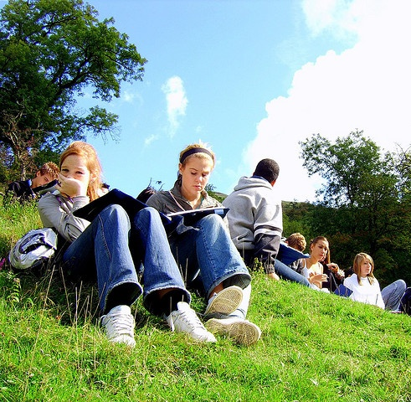
Phase 1
Emerging educational stage
31 participants
16 US
15 UK
Quantitative data:
Demographics, number of occurrences of technologies, sources, & behaviors
Qualitative data:
Themes & direct quotes
(White & Connaway, 2011-2012)
Notes:
The initial 6-month pilot stage focused on the Emerging educational stage to refine the research methodology and to establish the value of the work to the stakeholders. In the US the project worked in close partnership with the University of North Carolina, Charlotte (UNCC) to recruit participants, from different socio-economic groups from both private and public secondary schools as well as first-year university students. In the UK participants were drawn from Oxford Brooks University, Warwick University and secondary schools in Oxford and Leicester.
31 individuals in the Emerging Educational Stage (late stage secondary/high school and 1st year university) were recruited- 16 in the US and 15 in the UK.
The quantitative data include demographics; number of occurrences for different types of technologies, sources, and behaviors.
White, D. S., & Connaway, L. S. (2011-2012). Visitors and residents: What motivates engagement with the digital information environment. Funded by JISC, OCLC, and Oxford University. Retrieved from http://www.oclc.org/research/activities/vandr/
http://www.flickr.com/photos/orangeacid/252090910

Slide 21


Phase 2
Continued interviews
Establishing (2nd-3rd year undergraduates)
10 (5 US, 5 UK)
Embedding (postgraduates, PhD students)
10 (5 US, 5 UK)
Experienced (scholars)
10 (5 US, 5 UK)
Began data analysis
(White & Connaway, 2011-2012)
Notes:
White, D. S., & Connaway, L. S. (2011-2012). Visitors and residents: What motivates engagement with the digital information environment. Funded by JISC, OCLC, and Oxford University. Retrieved from http://www.oclc.org/research/activities/vandr/
Microsoft Clip Art

Slide 22

Phase I and 2: Participant Demographics
61 participants
15 secondary students
46 university students and faculty
34 females
27 males
38 Caucasian
5 African-American
2 Two or more
1 Asian
2 Hispanic
13 Unidentified
(White & Connaway, 2011-2012)
Notes:
Phase I and 2: Participant Demographics (All Stages)
15 Secondary students, 46 University students and faculty
Ethnicities (All)
5 African-American, 38 Caucasian, 2 Two or more, 1 Asian, 2 Hispanic, 13 Unidentified
Genders (All)
34 females, 27 males
Economic class:
We recorded the residential post-code/zipcodes for the participants as a way to identify broad socio-economic categories (given what we knew about socio-economic homogeneity in the cities in which we were working).
Attempts were made to recruit secondary students from schools with a wide range of socio-economic backgrounds. This is basically a convenience sample of students—those who were willing to be interviewed by us, in institutions that allowed us entry.
We also asked questions about parents’ educational backgrounds, and current/past vocations, to enrich our picture of interviewee backgrounds.
White, D. S., & Connaway, L. S. (2011-2012). Visitors and residents: What motivates engagement with the digital information environment. Funded by JISC, OCLC, and Oxford University. Retrieved from http://www.oclc.org/research/activities/vandr/
http://www.flickr.com/photos/doug88888/4570566630/

Slide 23
Participant Gender (US vs. UK)
(White & Connaway, 2011-2012)
Notes:
Need to have samples from UK and US to try to get a better fix on why the behaviors look the way they do.
Are they because of the technology?
Culture?
Living in town? Living in suburbs?
Living in US/UK?
Going to College?
Genders (US) (31 total)
15 Female
16 Male
Genders (UK) (30 total)
19 Female, 11 Male
White, D. S., & Connaway, L. S. (2011-2012). Visitors and residents: What motivates engagement with the digital information environment. Funded by JISC, OCLC, and Oxford University. Retrieved from http://www.oclc.org/research/activities/vandr/

Slide 24
Participant Gender (By Stages)
(White & Connaway, 2011-2012)
Notes:
Emerging
19 Females (11 UK, 8 US)
12 Males (4 UK, 8 US)
Establishing
3 Females (1 UK, 2 US)
7 Males (4 UK, 3 US)
Embedding
8 females (4 UK, 4 US)
2 males (1 UK, 1 US)
Experiencing
4 Females (3 UK, 1 US)
6 Males (2 UK, 4 US)
White, D. S., & Connaway, L. S. (2011-2012). Visitors and residents: What motivates engagement with the digital information environment. Funded by JISC, OCLC, and Oxford University. Retrieved from http://www.oclc.org/research/activities/vandr/

Slide 25
Participant Ages (US vs. UK)
(White & Connaway, 2011-2012)
Notes:
Age (US only) (31 total)
17 16-19 years old
7 20-29 years old
1 30-39 years old
3 40-49 years old
3 50-59 years old
Age (UK only) (30 total)
12 16-19 years old
3 20-29 years old
3 30-39 years old
3 40-49 years old
2 50-59 years old
7 Unidentified
White, D. S., & Connaway, L. S. (2011-2012). Visitors and residents: What motivates engagement with the digital information environment. Funded by JISC, OCLC, and Oxford University. Retrieved from http://www.oclc.org/research/activities/vandr/

Slide 26
Participant Ages (By Stages)
(White & Connaway, 2011-2012)
Notes:
Emerging
27 16-19 years old (12 UK, 15 US)
1 20-29 years old (0 UK, 1 US)
2 30-39 years old (2 UK, 0 US)
1 50-59 years old (1 UK, 0 US)
Establishing
2 16-19 years old (0 UK, 2 US)
4 20-29 years old (1 UK, 3 US)
1 30-39 years old (1 UK, 0 US)
1 40-49 years old (1 UK, 0 US)
2 Unidentified (2 UK, 0 US)
Embedding
5 20-29 years old (2 UK, 3 US)
1 30-39 years old (0 UK, 1 US)
2 40-49 years old (1 UK, 1 US)
2 Unidentified (2 UK, 0 US)
Experiencing
3 40-49 years old (1 UK, 2 US)
4 50-59 years old (1 UK, 3 US)
3 Unidentified (3 UK, 0 US)
White, D. S., & Connaway, L. S. (2011-2012). Visitors and residents: What motivates engagement with the digital information environment. Funded by JISC, OCLC, and Oxford University. Retrieved from http://www.oclc.org/research/activities/vandr/

Slide 27
Participant Ethnicity (US vs. UK)
(White & Connaway, 2011-2012)
Notes:
Ethnicities (US) (31 total)
17 Caucasian
7 Unidentified
5 African-American
2 Hispanic
Ethnicities (UK) (30 total)
21 Caucasian
6 Unidentified
2 Multi-ethnic
1 Asian
White, D. S., & Connaway, L. S. (2011-2012). Visitors and residents: What motivates engagement with the digital information environment. Funded by JISC, OCLC, and Oxford University. Retrieved from http://www.oclc.org/research/activities/vandr/

Slide 28
Participant Ethnicity (By Stages)
(White & Connaway, 2011-2012)
Notes:
Emerging
22 Caucasian (10 UK, 12 US)
4 Unidentified (4 UK, 0 US)
3 African-American (0 UK, 3 US)
1 Hispanic (0, UK, 1 US)
1 Two or more (1 UK, 0 US)
Establishing
6 Caucasian (4 UK, 2 US)
2 African-American (0 UK, 2 US)
1 Two or more (1 UK, 0 US)
1 Unidentified (0 UK, 1 US)
Embedding
4 Caucasian (3 UK, 1 US), 4 Unidentified (1 UK, 3 US), 1 Hispanic (0 UK, 1 US), 1 Asian (1 UK, 0 US)
Experiencing
6 Caucasian (4 UK, 2 US), 4 Unidentified (1 UK, 3 US)
White, D. S., & Connaway, L. S. (2011-2012). Visitors and residents: What motivates engagement with the digital information environment. Funded by JISC, OCLC, and Oxford University. Retrieved from http://www.oclc.org/research/activities/vandr/

Slide 29
Academic Disciplines (By Stages)
(White & Connaway, 2011-2012)
Notes:
These are the Academic Disciplines for the 46 participants not labeled as still being in Secondary school (Undergraduates, Graduates, and Faculty), pulled from all 4 educational stages.
Because there were so many majors and disciplines, they have been filtered down to the six basic groups. You can find them here http://en.wikipedia.org/wiki/List_of_academic_disciplines. Professions & Applied Sciences are: Agriculture, Architecture and Design, Business, Divinity, Education, Engineering, Environmental Studies and Forestry, Family and Consumer Science, Health Science, Human Physical Performance and Recreation, Journalism, Media Studies and Communication, Law, Library and Museum Studies, Military Sciences, Public Administration, Social Work, Transportation.
Emerging
8 Professions & Applied Sciences (3 UK, 5 US) , 2 Undeclared (0 UK, 2 US), 2 Humanities (2 UK, 0 US), 2 Natural Sciences (2 UK, 0 US) , 1 double major (0 UK, 1 US) , 1 Social Sciences (0 UK, 1 US)
Establishing
4 Professions & Applied Sciences (3 UK, 1 US) , 4 double major (1 UK, 3 US) , 1 Humanities (1 UK, 0 US), 1 Formal Sciences (0 UK, 1 US)
Embedding
2 Professions & Applied Sciences (2 UK, 0 US), 4 Humanities (3 UK, 1 US), 2 Natural Sciences (0 UK, 2 US) , 2 Social Sciences (0 UK, 2 US)
Experiencing
3 Humanities (2 UK, 1 US), 3 Professions & Applied Sciences (2 UK, 1 US), 1 Social Sciences (1 UK, 0 US), 3 Natural Sciences (0 UK, 3 US)
White, D. S., & Connaway, L. S. (2011-2012). Visitors and residents: What motivates engagement with the digital information environment. Funded by JISC, OCLC, and Oxford University. Retrieved from http://www.oclc.org/research/activities/vandr/

Slide 30

Participant Interview Questions
1. Describe the things you enjoy doing with technology and the web each week.
2. Think of the ways you have used technology and the web for your studies. Describe a typical week.
3. Think about the next stage of your education. Tell me what you think this will be like.
Notes:
For faculty, these are being slightly edited to ask about their preconceptions of academic life before the stage they currently occupy, as well as what they think the future might hold.
Microsoft Clip Art

Slide 31
Participant Interview Questions
4. Think of a time when you had a situation where you needed answers or solutions and you did a quick search and made do with it. You knew there were other sources but you decided not to use them. Please include sources such as friends, family, teachers, coaches, etc.
5. Have there been times when you were told to use a library or virtual learning environment (or learning platform), and used other source(s) instead?
6. If you had a magic wand, what would your ideal way of getting information be? How would you go about using the systems and services? When? Where? How?
(Connaway & Radford, 2005-2007)
(Dervin, Connaway, & Prabha, 2003-2005)
Notes:
These questions come from previous research
1. Dervin, B., Connaway, L. S., & Prabha, C. (2003-2005). Sense-making the information confluence: The hows and the whys of college and university user satisficing of information needs. Funded by the Institute for Museums and Library Services (IMLS). Retrieved from http://www.oclc.org/research/activities/past/orprojects/imls/default.htm
2. Radford, M. L., & Connaway, L. S. (2005-2007). Seeking synchronicity: Evaluating virtual reference services from user, non-user, and librarian perspectives. Funded by the Institute for Museums and Library Services (IMLS). Retrieved from http://www.oclc.org/research/activities/synchronicity/default.htm

Slide 32

Codebook
Place
Sources
Tools
Agency
Situation/context
Quotes
Contact
Technology Ownership
Network used
(White & Connaway, 2011-2012)
Notes:
The codebook was created with a grounded analysis of the interviews of the Emerging group, and is to date one of our most significant research findings.
There was significant discussion among researchers about the content of the codebook, via emails and Skype conversations. We started writing the codebook in May, and the final version came about in mid-September.
The content of the codebook reveals the priorities and practices of the Emerging group, but can also be used to analyze the remaining groups we have yet to interview. (for instance, we can use the codebook to analyze faculty interviews even if we don’t have a code for LinkedIn)
Discuss the content of the codebook.
White, D. S., & Connaway, L. S. (2011-2012). Visitors and residents: What motivates engagement with the digital information environment. Funded by JISC, OCLC, and Oxford University. Retrieved from http://www.oclc.org/research/activities/vandr/
Microsoft Clip Art

Slide 33

Codebook
I. Place
A. Internet
1. Search engine
a. Google
b. Yahoo
2. Social Media
a. FaceBook
b. Twitter
c. You Tube
d. Flickr/image sharing
e. Blogging
B. Library
1. Academic
2. Public
3. School (K-12)
C. Home
D. School, classroom, computer lab
E. Other
(White & Connaway, 2011-2012)
Notes:
How we used the codebook:
First: the 3 researchers and research assistant coded the same two transcripts, one US and one UK (both secondary school).
We met and re-met and coded and re-coded until there was agreement.
THEN we went our separate ways to code. BUT we still communicate with each other in our coding processes, because of the remote nature of our collaboration.
Coding is done on paper, for the most part, and then the codes are entered into word, or scanned and sent to research assistants, who enter the coding into NVivo9. When the research assistants are entering the coding, they notice discrepancies, document them, and generate a discussion about what was intended, and what should the final coding be.
This continuous communication provides more consistency in coding across the researchers.
When Inter-coder Reliability was calculated between all five coders it was found to be an average of 0.6380 for Kappa and an Agreement Percentage of 98%.
White, D. S., & Connaway, L. S. (2011-2012). Visitors and residents: What motivates engagement with the digital information environment. Funded by JISC, OCLC, and Oxford University. Retrieved from http://www.oclc.org/research/activities/vandr/
http://www.flickr.com/photos/themadguru/3546619930/

Slide 34
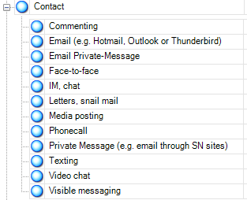
Nvivo 9
Qualitative research software
Upload documents, PDFs, & videos
Create nodes & code transcripts
Merge files
Queries
Reports
Models
(QSR International, 2011)
Notes:
QSR International. (2011). NVivo 9: Getting started. Retrieved from http://download.qsrinternational.com/Document/NVivo9/NVivo9-Getting-Started-Guide.pdf
Screenshot of our codebook in Nvivo 9

Slide 35
Facebook
(White & Connaway, 2011-2012)
Notes:
Facebook (by stages) (calculated by sources)
Facebook
Emerging 94% (29)
Establishing 100% (10)
Embedding 100% (10)
Experiencing 90% (9)
White, D. S., & Connaway, L. S. (2011-2012). Visitors and residents: What motivates engagement with the digital information environment. Funded by JISC, OCLC, and Oxford University. Retrieved from http://www.oclc.org/research/activities/vandr/

Slide 36
Social Media & Safety, Security
(White & Connaway, 2011-2012)
Notes:
Facebook and Caution by Stages (Calculated by sources)
Facebook AND Caution
Emerging 23% (7), Establishing 20% (2) , Embedding 20% (2), Experiencing 20% (2)
“You’re absolutely right I’m cautious in the sense that I know that putting too much up about yourself could leave you vulnerable perhaps to people contacting you for the wrong reasons.” (UKF2, 0:08:49, Female, age unidentified, Digital Visitors and Residents) (Experiencing)
“I do have the concerns of like… Because you have those people, especially like Twitter and Facebook, especially Facebook where you have people that try to add you and it’s just like “Who are you?” And it’s like “Who are these people?” And it’s like sometimes you may think it’s one person. Because people have the tendency to make a profile and use somebody else’s picture and so you think “Oh okay I know this person.” But then it’s really somebody else.” (USU11, 0:12:06, Female, Age 20, Digital Visitors and Residents) (Establishing)
White, D. S., & Connaway, L. S. (2011-2012). Visitors and residents: What motivates engagement with the digital information environment. Funded by JISC, OCLC, and Oxford University. Retrieved from http://www.oclc.org/research/activities/vandr/

Slide 37
Credibility
(White & Connaway, 2011-2012)
Notes:
Wikipedia AND Authority, Legitimacy by Stages (Calculated by number of sources)
Wikipedia AND Authority, Legitimacy
Emerging 42% (14), Establishing 20% (2), Embedding 20% (2), Experiencing 10% (1)
“They don’t fail you but you get ridiculed in front of everyone for sourcing Wikipedia…No, I just don’t even use it. Because I can find the information I need to on other sites. But looking at the author, I try to use a lot of college websites. Or the university databases. They really like those websites because they’re legitimate.” (USS3, 00:32:43, Female, Age 17, Digital Visitors and Residents) (Emerging)
“Erm, well I guess a lot of the times teachers say don’t use .com or don’t use Wikipedia, they like hate when we use Wikipedia. But Wikipedia is always right, so I always use that.” (USS6, 0:30:12, Female, Age 17, Digital Visitors and Residents) (Emerging)
White, D. S., & Connaway, L. S. (2011-2012). Visitors and residents: What motivates engagement with the digital information environment. Funded by JISC, OCLC, and Oxford University. Retrieved from http://www.oclc.org/research/activities/vandr/

Slide 38
Opportunism
(White & Connaway, 2011-2012)
Notes:
Opportunism by Stages (Calculated by sources)
Convenience
Emerging 94% (29), Establishing 100% (10), Embedding 100% (10), Experiencing 90% (9)
“And since a lot of my academic work is done at night, later hours, it’s much more convenient to do so within the home rather than to go to a library and seek out a computer there.” (UKG2, 0:06:35, Female, age unidentified, Digital Visitors and Residents) (Embedding)
“So it’s the same thing like with Google if I need to look anything up really fast I just typically use that really quickly.” (USG3, 0:07:02, Female, Age 23, Digital Visitors and Residents) (Embedding)
White, D. S., & Connaway, L. S. (2011-2012). Visitors and residents: What motivates engagement with the digital information environment. Funded by JISC, OCLC, and Oxford University. Retrieved from http://www.oclc.org/research/activities/vandr/

Slide 39
Sources
(White & Connaway, 2011-2012)
Notes:
Databases, Wikipedia, and Books by Stage (Calculated by number of sources)
Databases
Emerging 19% (6), Establishing 30% (3), Embedding 80% (8), Experiencing 80% (8)
Wikipedia
Emerging 77% (24), Establishing 90% (9), Embedding 70% (7), Experiencing 50% (5)
“I realised that there were some undergraduates that had some papers due yesterday because they were like “Oh, Wikipedia was down! Now where am I going to get my information?”” (USG5, 0:57:26, Female, Age 30, Digital Visitors and Residents) (Embedding)
“I think they say don’t trust every word it says, because obviously it can’t definitely be factually correct. But if you are just looking for more information it’s good, I think, just to find out about things.” (UKS1, 0:09:40, Male, Age 18, Digital Visitors and Residents) (Emerging)
Books
Emerging 90% (28), Establishing 100% (10), Embedding 90% (9), Experiencing 70% (7)
“My teacher, she had told me to go on the internet and look up some statistics for my SAP and I really couldn’t find them. But when I went to the library, I found books and stuff that had more information than what Google or Wikipedia or anybody else had.” (USS1, 0:25:36, Female, Age 17, Digital Visitors and Residents) (Emerging)
“Basically sort of what you do in the natural world like go into a library and picking books off a shelf.” (UKU11, 0:36:23, Male, Age 33) (Establishing)
White, D. S., & Connaway, L. S. (2011-2012). Visitors and residents: What motivates engagement with the digital information environment. Funded by JISC, OCLC, and Oxford University. Retrieved from http://www.oclc.org/research/activities/vandr/

Slide 40
Libraries = Books
(White & Connaway, 2011-2012)
Notes:
The content seems to reflect an indication that the library associated with books and that participants often wish to meet their information needs online for the convenience and then only go the library when necessary (requirements for class or accessing something in particular they cannot get online). Other mentions are of the restraints on their time already and that taking the time to go the physical library is an inconvenience to their time and other instances where a teacher has directed them to find a particular book from the school library.
“There’s been some times where it’s not available online but I can walk up to the library and get a photocopy or take the book itself or something.” (USG2, 0:14:24, Male, Age 25, Digital Visitors and Residents) (Embedding)
“I think I probably have to come to the library more as a college student as opposed to when I was in high school I probably just looked something up offline. There are more restrictions now, at least for me, with the sort of resources that you can use as far as internet sources and things like that. In high school it was generally if you had a project they kind of just, I guess, expected that you’d go online. So I didn’t have any book requirements or things like that.” (USG3, 0:12:08, Female, Age 23, Digital Visitors and Residents) (Embedding)
“Firstly I would go to find an answer immediately I would go straight to Google. If I couldn’t find anything about it on there then I would then probably ask friends and then if not I would then go to my local library and look for anything, any books on the topic or something that I want to find out. If not there, depending on what it was, if it was within school then I would go to teachers, if it wasn’t then probably go to someone who knew of the area that I wanted to know.” (UKS5, 0:21:47, Female, Age 17, Digital Visitors and Residents) (Emerging)
“Yeah. So it's, the books at Abbingdon are very, very limited. We’re to go to Brookes... but again, I'd have to time it to get my husband to take me or drop me off, just because parking at either campus is a nightmare. I always order them in advance, so I've just got to pick them up. Unless I'm struggling and I actually need to go and look for resources or information, because it's great that you can see which books they've got but it doesn't always tell you what's in them. You're kind of guessing on the title. Some I've been really successful with, and some it's just been a complete failure, that it didn't have anything of what I needed.” (UKU7, 0:10:28, Female, Age 34, Digital Visitors and Residents) (Emerging)
“Oh my goodness when I was starting my academic life everything was in the library and you could go in to these libraries at your university which were such fascinating places. Because as you were looking for a specific title you would come across other disciplines and you would stop and have a look and say “Oh this is interesting.” And you’d read a little bit on psychology or philosophy or whatever you happened to walk by. And I absolutely miss that because it seems now that you don’t quite have the opportunity so often to fall upon things that I wouldn’t have thought to search for. You can do that with a library but when you use online materials you’re much more specific in what you’re looking for so you don’t tend to find those things. So I miss that – the old fashioned library.” (UKF2, 0:16:10, Female, age unidentified, Digital Visitors and Residents) (Experiencing)

Slide 41
Sources
(White & Connaway, 2011-2012)
Notes:
Librarians; Teachers, Professors; and Peers by Stages (Calculated by number of sources)
In the codebook, Peers were considered “school, university colleagues but not “friends.”” Whereas Colleagues were Friends/Colleagues (“mates”), a separate node.
Librarians
Emerging 13% (4), Establishing 0% (0), Embedding 10% (1), Experiencing 20% (2)
Concerning Librarians:
“I haven’t called them, I don’t think I’ve ever talked to the librarians here since I’m not in the building much.” (USU4, 0:45:50, Male, Age 19, Digital Visitors and Residents) (Emerging)
Teachers, professors
Emerging 81% (25), Establishing 90% (9), Embedding 50% (5), Experiencing 20% (2)
Peers
Emerging 48% (15), Establishing 50% (5), Embedding 40% (4), Experiencing 50% (5)
Concerning Human Sources:
“Because that’s the other thing, it’s more verbal communication that I find easier, so not always the website, although I do usually use the internet it’s not my preferred choice. So I would usually speak to someone about it.” (UKS4, 0:31:44, Female, Age 17, Digital Visitors and Residents) (Emerging)
White, D. S., & Connaway, L. S. (2011-2012). Visitors and residents: What motivates engagement with the digital information environment. Funded by JISC, OCLC, and Oxford University. Retrieved from http://www.oclc.org/research/activities/vandr/

Slide 42
Decompartmentalization
(White & Connaway, 2011-2012)
Notes:
Multi-tasking by Stages (Calculated by number of sources.)
Multi-tasking
Emerging 26% (8), Establishing 30% (3), Embedding 20% (2), Experiencing 10% (1)
“…and I’m a big multi-tasker so I will have – the beauty of a laptop is that you can take it wherever you go. So I will if I wanted to watch something on TV I’ll have it and I’ll be working on something even if it’s, you know, something a little for graphic design or just responding to emails while I’m watching my TV programme at night.” (USG4, 0:14:07, Female, Age 23, Digital Visitors and Residents) (Embedding)
“Again it’s going back to using the internet. I would rather use my own websites because I know then that I’m going to be on the internet, in which case I’ll be able to do Facebook at the same time, my emails at the same time and things like that.” (UKS4, 0:20:26, Female, Age 17, Digital Visitors and Residents) (Emerging)
White, D. S., & Connaway, L. S. (2011-2012). Visitors and residents: What motivates engagement with the digital information environment. Funded by JISC, OCLC, and Oxford University. Retrieved from http://www.oclc.org/research/activities/vandr/

Slide 43
Control, Choice
(White & Connaway, 2011-2012)
Notes:
Available Time and Time Wasting by Stages (Calculated by sources)
Available Time - when they make a choice to use a source dependent on the time available, either using a quick more convenient source because of limited time or taking longer in their preferred searching method because they had more time to spend on it. The responses reflect a lack of time available to do their searching.
Emerging 39% (12), Establishing 40% (4), Embedding 50% (5), Experiencing 50% (5)
“What I’ll do is I’ll just google it. And it’s like “Oh, I need this. Hold on.” And I was like “Specifically it involves these three words – bam, bam, bam.” And then whatever comes up. And if I’m not satisfied with that I’ll try another set of words until I get it. And then it depends on the time. So let’s say like I only had five minutes, I would probably do it three times and if I haven’t found it by the third time I’m going to settle with whatever is there.” (USG5, 0:35:54, Female, Age 30, Digital Visitors and Residents) (Embedding)
“But, yes, convenience, I needed the answer, my maths, I was doing an exercise, I got stuck on a question, I still had the rest of the exercise to go and I had like an hour to do it and I just wanted the formula and the quickest way to do it was to type it into Google and it came up. So, yes, it’s definitely a convenience thing I think.” (UKS2, 0:29:30, Female, Age 17, Digital Visitors and Residents) (Emerging)
Time Wasting
Emerging 35% (11), Establishing 40% (4), Embedding 30% (3), Experiencing 40% (4)
“Yes. I know tons of websites that I can waste my time away like, you know, just anything and, like, entertaining sites that I’ll sometimes go on and they’ll make me laugh or something. But, yes, I definitely know that if I let myself I could waste pretty much my entire day on the internet if I allowed myself.” (USG2, 0:12:54, Male, Age 25, Digital Visitors and Residents) (Embedding)
“Rough estimate, probably about three or four hours a day I would say. It is quite a lot, it is very easy to just waste your time online.” (UKS3, 0:10:30, Male, Age 17, Digital Visitors and Residents) (Emerging)
White, D. S., & Connaway, L. S. (2011-2012). Visitors and residents: What motivates engagement with the digital information environment. Funded by JISC, OCLC, and Oxford University. Retrieved from http://www.oclc.org/research/activities/vandr/

Slide 44
Time
(White & Connaway, 2011-2012)
Notes:
Addiction and Distraction by Stages (Calculated by number of sources.)
Addiction
Emerging 29% (9), Establishing 10% (1), Embedding 20% (2), Experiencing 10% (1)
Distraction
Emerging 48% (15), Establishing 20% (2), Embedding 60% (6), Experiencing 50% (5)
“Not particularly. I mean I definitely think I use the internet more for practical uses than fun uses. I’m not one for sitting on the internet for hours but I do find the internet especially I can end up wasting a lot of time. If I let myself do that I can sit for hours just sat doing nothing and not get anything done because it’s so big and addictive.” (UKS2, 0:39:31, Female, Age 17, Digital Visitors and Residents) (Emerging)
“Probably the biggest thing is email. I live on my email and Facebook also, which I’m not as proud of. Just because it’s a time vortex.” (USS3, 0:06:59, Female, Age 17, Digital Visitors and Residents) (Emerging)
White, D. S., & Connaway, L. S. (2011-2012). Visitors and residents: What motivates engagement with the digital information environment. Funded by JISC, OCLC, and Oxford University. Retrieved from http://www.oclc.org/research/activities/vandr/

Slide 45
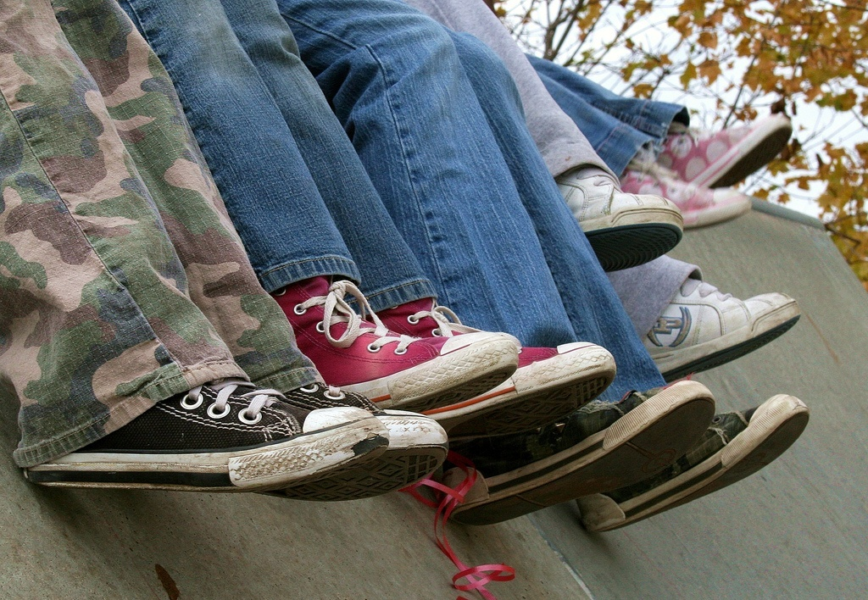
“I always stick with the first thing that comes up on Google because I think that’s the most popular site which means that’s the most correct.”
(USS1, Female, Age 17)
Notes:
Title Quote:
“I always stick with the first thing that comes up on Google because I think that’s the most popular site which means that’s the most correct.” (USS1, 0:21:57, Female, Age 17, Digital Visitors and Residents)
http://www.flickr.com/photos/pinksherbet/2001899627/

Slide 46

“I knew that the internet wouldn’t give me a wrong answer.”
(UKS4, Female, Age 17)
Notes:
“I knew that the internet wouldn’t give me a wrong answer.” (UKS4, 00:24:10, Female, Age 17, Digital Visitors and Residents)
http://www.flickr.com/photos/ravages/236981527/

Slide 47

“I simply just type it into Google and just see what comes up.”
(UKS4, Female, Age 17)
Notes:
“I simply just type it into Google and just see what comes up” (UKS4, 00:13:36, Female, Age 17, Digital Visitors and Residents)
http://www.flickr.com/photos/ana_cotta/2532911186/
Information Studies students: (Bertot, et al., 2012, p. 213)
28% use OPAC daily or weekly
86% use Google daily or weekly
Bertot, J. C., Berube, K., Devereaux, P., Dhakal, K., Powers, S., & Ray, J. (2012). Assessing the usability of WorldCat Local: Findings and considerations. The Library Quarterly, 82(2), 207-221.

Slide 48
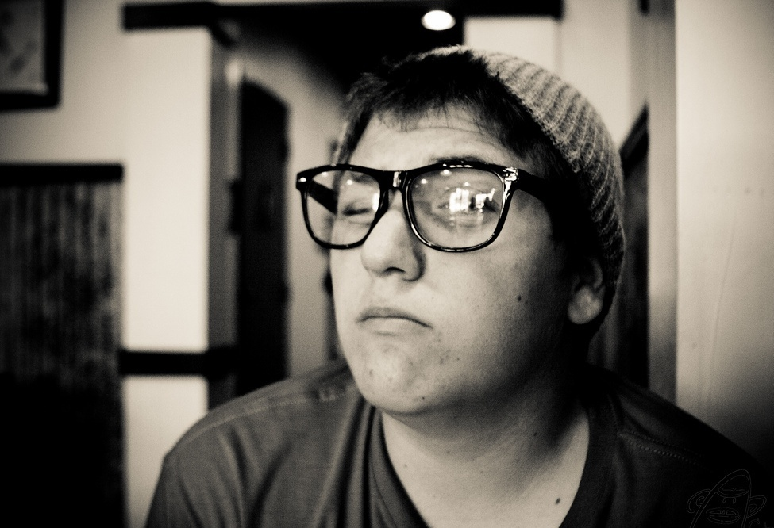
“...Google doesn’t judge you.”
(UKF3, Male, Age Unidentified)
Notes:
“It’s convenience. It’s the immediacy of it. And also the fact that Google doesn’t judge you.” (UKF3, 0:16:35, Male, age unidentified, Digital Visitors and Residents)
http://www.flickr.com/photos/cubmundo/6184306158/

Slide 49
Diaries
20 Phase 1 and Phase 2 participants agreed to be diarists
13 US & 7 UK
9 Phase 1 and Phase 2 participants submitted complete diaries
7 US & 2 UK
Share information-seeking situations each month
Communicate in any format
diary
video chat
videos
em@il
instant messenger
phone
Notes:
20 of the Phase 1 and Phase 2 participants agreed to be diarists (13 US, 7 UK) (some did not submit any)
7 Phase 1 participants submitted complete diaries for 3 months during the summer of 2011 (complete meaning at least 3 entries) (5 US, 2 UK)
2 Phase 2 participants submitted complete diaries for at least 3 months over the winter of 2011-2012 (2 US)
The US participants were more faithful than the UK participants in submitting the diaries.
At the end of Phase 2, we have 9 complete sets (at least 3 entries) of diaries
7 US participant
2 UK participants
Several participants have submitted intermittent monthly diaries. Although we have not yet done a thorough analysis of the diaries, the team has begun to discuss whether they have been as effective a way as we’d hoped to gather data due to the difficulties, especially in the UK, of keeping contributors on task. We are discussing several options in lieu of the diaries, which now will include individual monthly conversations with participants via phone or Skype, participant video submissions, or IM sessions with the participants.

Slide 50

Diaries
All except one selected EMAIL
Why?
“It’s for formal communication”
Notes:
We currently are analyzing the diaries.

Slide 51

Students: Information Seeking in Action
Notes:
Users often won’t ask the librarian because the librarian looks too busy and they don’t want to bother the librarians or they are intimidated by the librarians.
Radford, M. L., & Connaway, L. S. (2005-2007). Seeking synchronicity: Evaluating virtual reference services from user, non-user, and librarian perspectives. Funded by the Institute for Museums and Library Services (IMLS). Retrieved from http://www.oclc.org/research/activities/synchronicity/default.htm

Slide 52
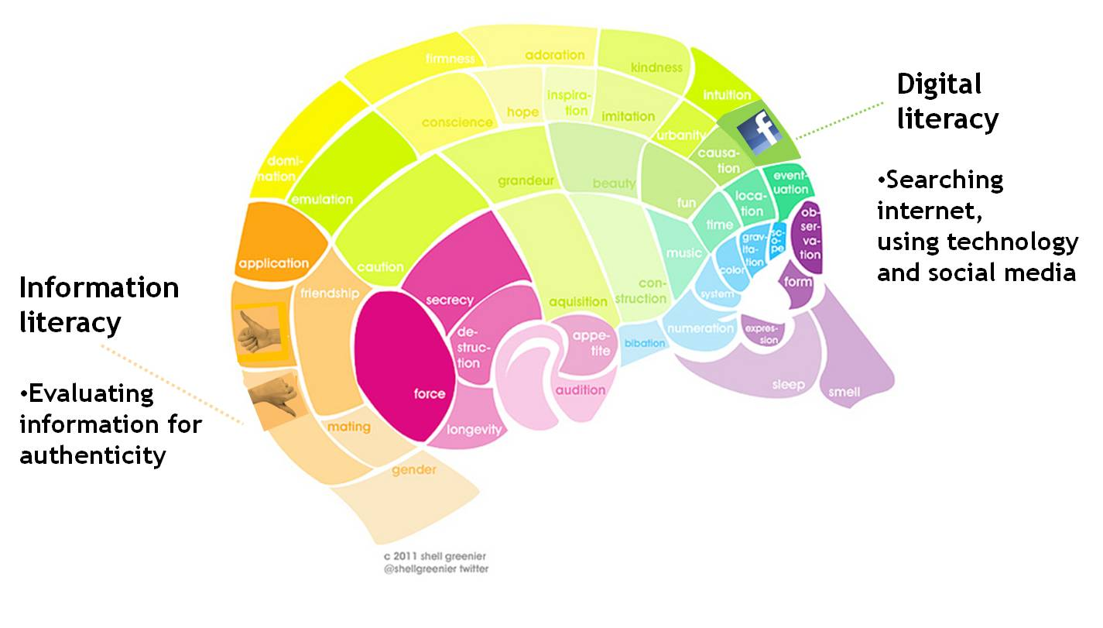
Information Literacy vs. Digital Literacy
Notes:
“Studying for my Earth science class, just Google the question, the first answer that pops up, if it’s right or wrong, that’s what I’m going to study.” (USU8, 0:25:58, Female, Age 19, Digital Visitors and Residents)
“I used a lot of journals, like scientific journals and stuff and then I even didn’t use a computer for some of it. Like I went to the library and found stuff there. And like we learned how to use google a little better, like fish out the .com and stuff, like you can do that. And just get the .orgs and .edu’s because they are more reliable sources.”, (USS6 0:23:00, Female, Age 17,Digital Visitors and Residents).
Ethnographic Research in Illinois Academic Libraries (ERIAL) project
Students search Google more than 2x as much as other databases
Students do not know how to search Google
Don’t know how to limit news articles
Don’t know how to query Google Book Search or Google Scholar
Don’t understand the organization & display of Google results
Ethnographic Research in Illinois Academic Libraries (ERIAL) project:
Kolowich, S. (2011, August 22). Study: College students rarely use librarians’ expertise. USA Today. Retrieved from http://www.usatoday.com/news/education/story/2011-08-22/Study-College-students-rarely-use-librarians-expertise/50094086/1

Slide 53
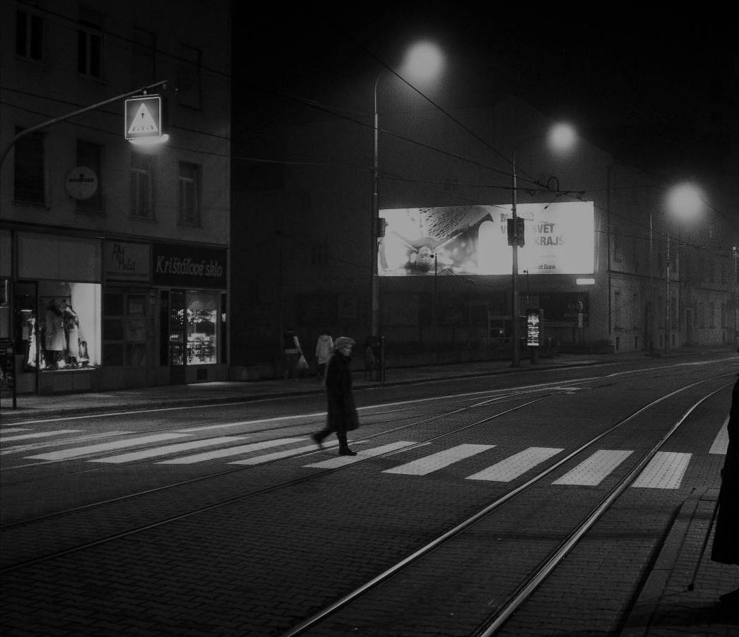
Learning
Black
Market
http://wp.me/pLtlj-fH
Notes:
There is a Learning Black Market”: learners use non-traditional sources but feel they cannot talk about them in an institutional context. Wikipedia usage is an example of this. (White & Connaway, 2011)
White, D. S., & Le Cornu, A. (2011). Visitors and Residents: A new typology for online engagement. First Monday, 16(9). Retrieved from http://firstmonday.org/htbin/cgiwrap/bin/ojs/index.php/fm/article/viewArticle/3171/3049

Slide 54
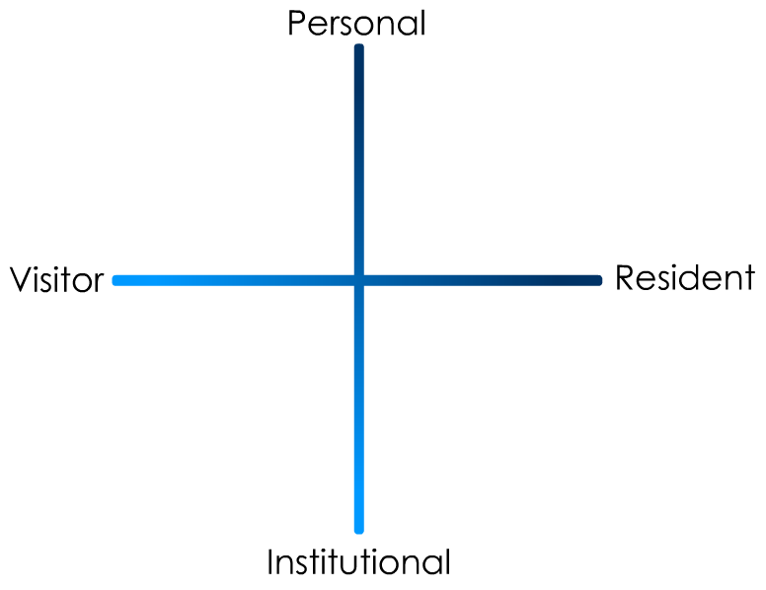
(White & Connaway, 2011-2012)
Notes:
White, D. S., & Connaway, L. S. (2011-2012). Visitors and residents: What motivates engagement with the digital information environment. Funded by JISC, OCLC, and Oxford University. Retrieved from http://www.oclc.org/research/activities/vandr/

Slide 55

Sources
II. Sources
A. Human
B. Digital
1. E-books
2. Online textbooks
3. Databases
4. Websites
a. Discovery Channel
b. Textbook Sites
c. University databases
d. Major media sites
e. Non-English Language
f. Dictionary
g. Wikipedia
h. University Websites
i. Music Websites
j. Fan Websites
k. iPlayer/television programs
l. Retail websites
m. Exam board sites (UK)
n. Syllabus- and discipline-based sites
o. iTunesU
p. Photo websites
q. Other
(White & Connaway, 2011-2012)
Notes:
II. Sources
A. Human
B. Digital
1. E-books
2. Online textbooks
3. Databases
4. Websites
a. Discovery Channel
b. Textbook Sites
c. University databases
d. Major media sites (includes newspaper and news sites)
e. Non-English Language
f. Dictionary
g. Wikipedia
h. University Websites (not databases)
i. Music Websites
j. Fan Websites
k. iplayer/television programmes
l. Retail websites
m. Exam board sites (UK)
n. Syllabus- and discipline-based sites (includes non-academic help sites)
o. iTunesU
p. Photo websites
q. Other (includes digital music, digital photos – not online)
5. VLEs, CMSs
C. Physical
White, D. S., & Connaway, L. S. (2011-2012). Visitors and residents: What motivates engagement with the digital information environment. Funded by JISC, OCLC, and Oxford University. Retrieved from http://www.oclc.org/research/activities/vandr/
Microsoft Clip Art

Slide 56
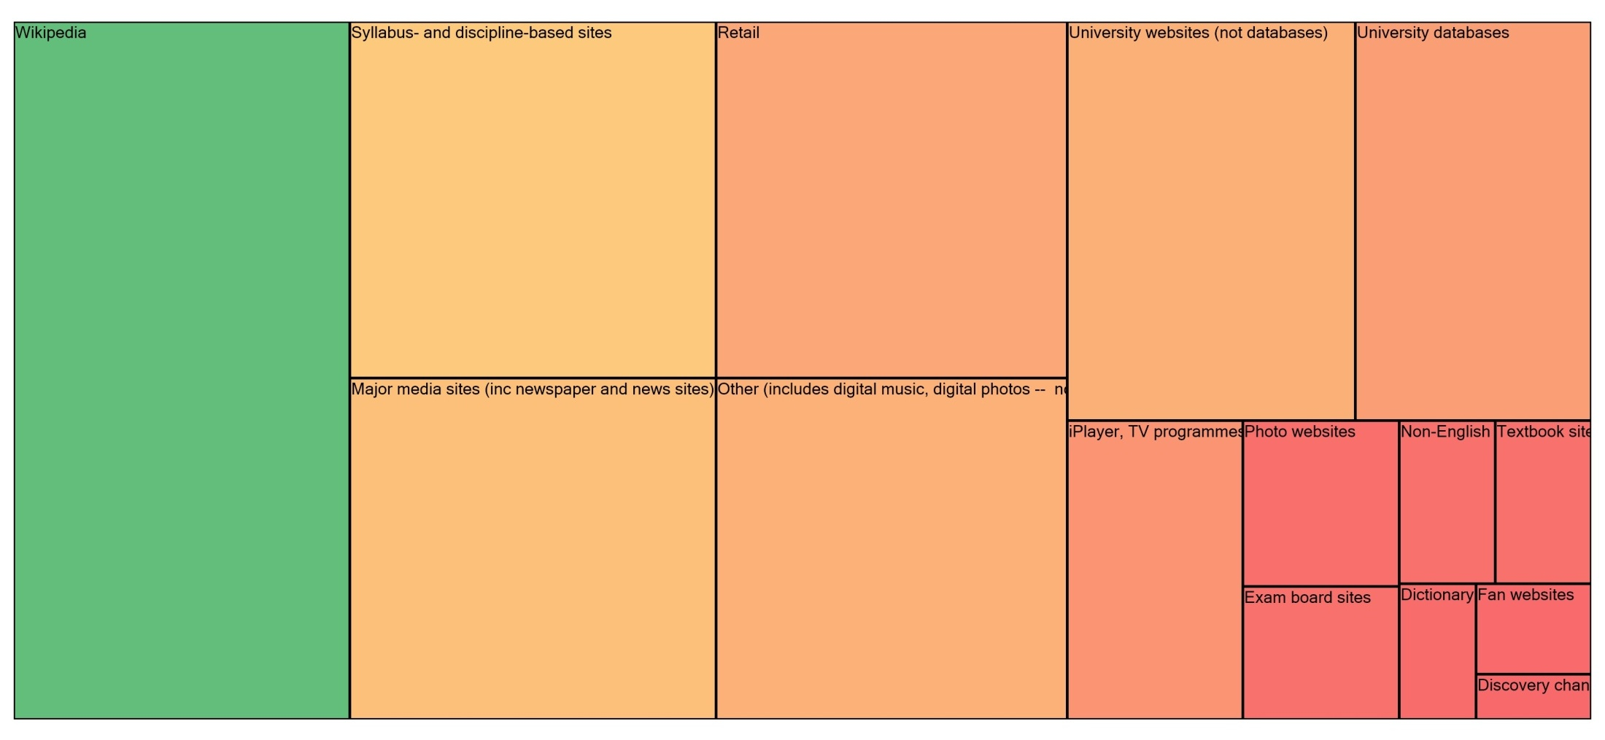












Sources
Syllabus & discipline based sites
Retail
University websites
University databases
Major media site
Other
iPlayer/TV
Photo sites
Non English Language
Textbook websites
Exam board
Dictionary
Fan sites
Disc Ch
(White & Connaway, 2011-2012)
Notes:
This is the updated Sources Tree map. (All stages, Phase 1 and 2)
Students’ Perceptions of Teachers’ opinions of Wikipedia:
“Avoid it.” (UKS8, 0:28:28, Female, Age 16, Digital Visitors and Residents) (Emerging)
“They used to tell us in high school not to use Wikipedia.” (USU1, 0:34:59, Female, Age 19, Digital Visitors and Residents)
“It’s like a taboo I guess with all teachers, they just all say – you know, when they explain the paper they always say, “Don’t use Wikipedia.”” (USU7, 0:33:05, Female, Age 19, Digital Visitors and Residents) (Emerging)
Students’ on Wikipedia:
“I use it, kind of like, I won't cite it on my papers but I, kind of, use it as a like, as a start off line. I go there and look up the general information, kind of, read through it so I get a general idea what it is. Then I start going through my research.” (USU7, 0:33:49, Female, Age 19, Digital Visitors and Residents) (Emerging)
“…I would actually use my phone to Wiki or to use Wikipedia to look up something and then I would just be like “Okay” and keep to that. Just because it’s there and it’s easy and it’s just kind of getting this first point of call and maybe a better understanding.” (UKU9, 0:27:59, Male, age unidentified, Digital Visitors and Residents) (Establishing)
“I think academia does not like Wikipedia just for the fact it can be edited, but I really think that Wikipedia is in some ways better than other sources and some ways not as good because one thing is like the kind of go to place just like if you want to read about something and you know it’s on Wikipedia you can just go there and quickly read about it. And also there’s so many people that can edit and modify Wikipedia pages so you can have a less biased and more standardized information.” (USU14, 0:02:03, Male, Age 18, Digital Visitors and Residents) (Establishing)
White, D. S., & Connaway, L. S. (2011-2012). Visitors and residents: What motivates engagement with the digital information environment. Funded by JISC, OCLC, and Oxford University. Retrieved from http://www.oclc.org/research/activities/vandr/

Slide 57
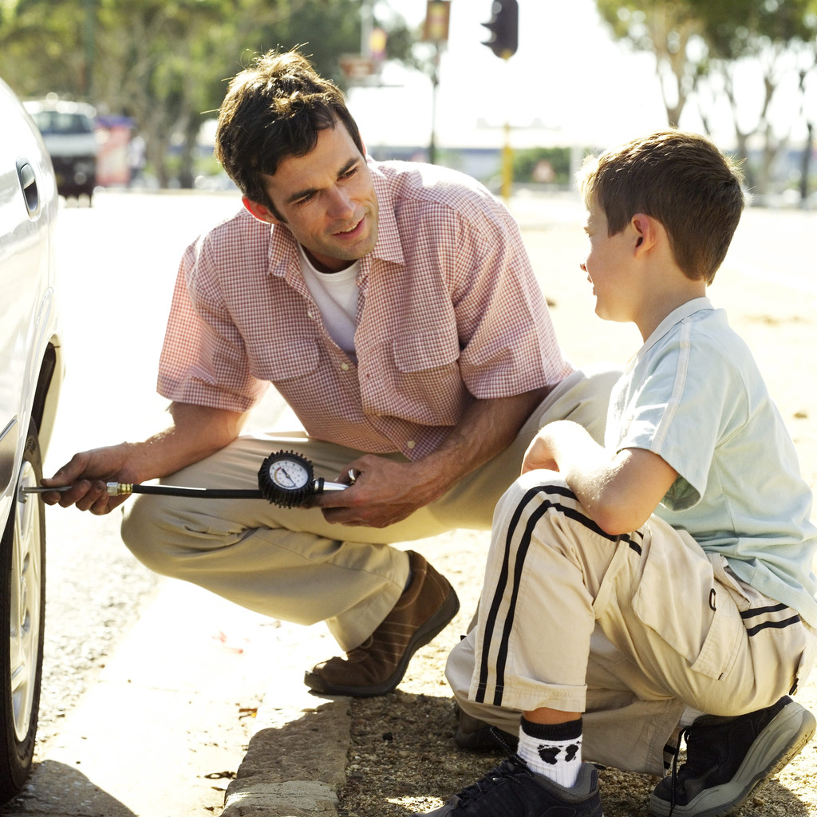
Contact
VII. Contact
Face-to-Face
Phone Call
Video chat
IM/Chat
Texting
Private messaging
Commenting
Media posting
Visible messaging
Letters (Post/Mail)
Email
(White & Connaway, 2011-2012)
Notes:
VII. Contact
Face-to-Face
Phone Call
Video chat
IM/Chat
Texting
Private messaging (e.g. email through SN sites)
Commenting
Media posting
Visible messaging
Letters (Post/Mail)
Email (e.g. Outlook, Hotmail or Thunderbird)
White, D. S., & Connaway, L. S. (2011-2012). Visitors and residents: What motivates engagement with the digital information environment. Funded by JISC, OCLC, and Oxford University. Retrieved from http://www.oclc.org/research/activities/vandr/
Microsoft Clip Art

Slide 58
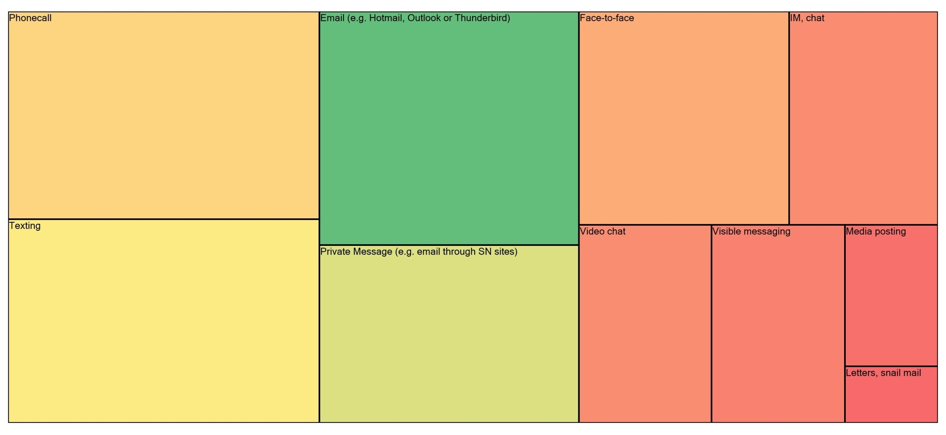










Contact
Phone call
Email
Face to Face
IM chat
Texting
Video chat
Visible messaging
Media posting
Private messaging (via social networking sites)
Postal mail
(White & Connaway, 2011-2012)
Notes:
This is the updated Contact Tree map. (All stages, Phase 1 and 2)
Private Messaging
“Just because all my friends have it, it’s just an easy way to catch up and then, especially if I need some work to hand in for tomorrow, go and find out on Facebook, ask all my friends.” (UKS1, 0:05:59, Male, Age 18, Digital Visitors and Residents) (Emerging)
Phone Call
“…just send an email, because calling, they’re not there, you leave a message, they call you back, they’re not there, new message, come back and forth.” (USF4, 0:42:38, Male, Age 54, Digital Visitors and Residents) (Experiencing)
Texting
“I do use texting a lot more than calling on the phone.” (USU1, 0:05:59, Female, Age 19, Digital Visitors and Residents) (Emerging)
Video Chat
“I use Skype for communicating with my father and my brother. …I tend to see Skype as a use for people I – they’re not peripheral friends, they’re closer friends and I would like to have longer conversations with them and so I use Skype as a video function to call someone and talk face-to-face.” (UKG2, 0:04:37, Female, age unidentified, Digital Visitors and Residents) (Embedding)
White, D. S., & Connaway, L. S. (2011-2012). Visitors and residents: What motivates engagement with the digital information environment. Funded by JISC, OCLC, and Oxford University. Retrieved from http://www.oclc.org/research/activities/vandr/

Slide 59

Agency
IV. Agency
Evaluation
Decision/Choice
Convenience/ease of use/accessible
Familiarity
Repetition
Relevance
Authority/Legitimacy
Available Time
Speed
Privacy
Safety, security
a. Caution
b. Confidence
10. Multitasking
11. Browsing
12. Searching
13. Currency
14. Fun, enjoyment
15. Addiction
16. Distraction
17. Time wasting
18. Quantity
19. Reliability
20. Avoidance
C. Motivation
1. Create
2. Collaborate (helping others)
3. Connection; sharing with others
(White and Connaway 2011-2012)
Notes:
IV. Agency
Evaluation
Decision/Choice
Convenience/ease of use/accessible
Familiarity
Repetition
Relevance
Authority/Legitimacy
Available Time
Speed
Privacy
Safety, security
a. Caution
b. Confidence
Multitasking
Browsing
Searching (Clearly stated by informants that they are actively looking for information)
Currency
Fun, enjoyment
Addiction
Distraction
Time wasting
Quantity
Reliability
Avoidance (choosing online as a way to avoid real-life activites)
C. Motivation
1. Create
2. Collaborate (helping others)
3. Connection; sharing with others
4. Put in public domain
a. Self promotion
b. Share practice
c. Self disclosure
5. Extrinsic (externally motivated)
6. Intrinsic (internally, self motivated)
7. Lazy (No motivation; choosing not to do things or to use sources)
8. Organization
White, D. S., & Connaway, L. S. (2011-2012). Visitors and residents: What motivates engagement with the digital information environment. Funded by JISC, OCLC, and Oxford University. Retrieved from http://www.oclc.org/research/activities/vandr/
Microsoft Clip Art

Slide 60
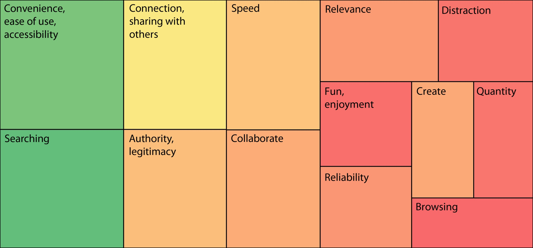
Agency
(White & Connaway, 2011-2012)
Notes:
This is the updated Agency Tree map created by David. (All stages, Phase 1 and 2)
Distraction
“Being online is a little unproductive sometimes. Sometimes I will actually turn off my internet if I want to be more productive, and that’s because in an environment where I almost subconsciously check Facebook or check my email, it tends to be very distracting while I’m trying to read an in-depth text.” (UKG2, 0:19:18, Female, age unidentified, Digital Visitors and Residents) (Embedding)
Ease/Convenience
“Well I probably actually use these things on emails because it’s an incredibly easy and quick way of getting information.” (UKS8, 0:04:36, Female, Age 16, Digital Visitors and Residents) (Emerging)
Ease/Convenience: Wikipedia
“I just thought, because it was the easiest thing to do there and then, and I didn’t have a lot of time and I just though Wikipedia would be the best option.” (UKS1, 0:16:49, Male, Age 18, Digital Visitors and Residents) (Emerging)
“Probably not the best, but I think it’s the simplest and easiest way to get going. So if I needed to produce a much more detailed and developed essay I would probably explore further on the internet.” (UKS1, 0:17:52, Male, Age 18, Digital Visitors and Residents) (Emerging)
Reliable
“But I try to find one source that looks like its reliable, not biased and applicable and then look at the references it cites.” (USU10, 0:46:55, Male, Age 28, Digital Visitors and Residents) (Establishing)
White, D. S., & Connaway, L. S. (2011-2012). Visitors and residents: What motivates engagement with the digital information environment. Funded by JISC, OCLC, and Oxford University. Retrieved from http://www.oclc.org/research/activities/vandr/

Slide 61
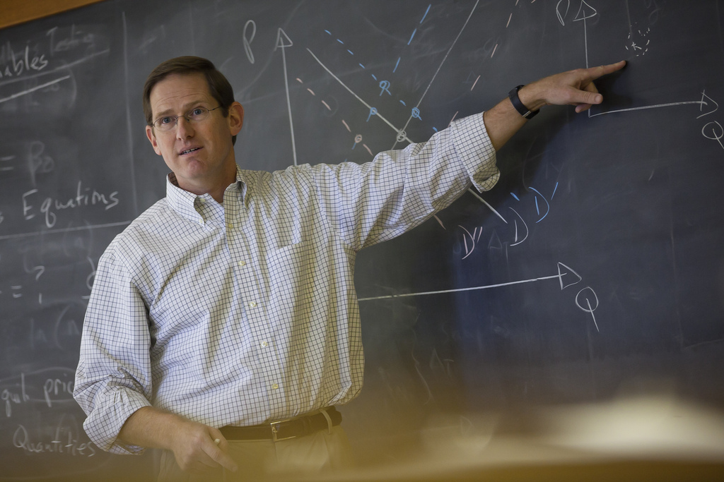
People
II. Sources
A. Human
1. Mother
2. Father
3. Extended family
4. Experts/Professionals
5. Friends/Colleagues
6. Teachers/Professors
7. Peers
8. Librarians
9. Other
B. Digital
C. Physical
(White & Connaway, 2011-2012)
Notes:
II. Sources
Human
Mother
Father
3. Extended family (siblings, cousins, relatives, children, spouses)
4. Experts/Professionals
5. Friends/Colleagues (‘mates’)
6. Teachers/Professors
7. Peers (school, university colleagues but not ‘friends’)
8. Librarians
9. Other
B. Digital
1. E-books
2. Online textbooks
3. Databases
4. Websites
5. VLEs, CMSs
C. Physical
Books
Notes
White, D. S., & Connaway, L. S. (2011-2012). Visitors and residents: What motivates engagement with the digital information environment. Funded by JISC, OCLC, and Oxford University. Retrieved from http://www.oclc.org/research/activities/vandr/
http://www.flickr.com/photos/lafayette-college/5515447182/

Slide 62
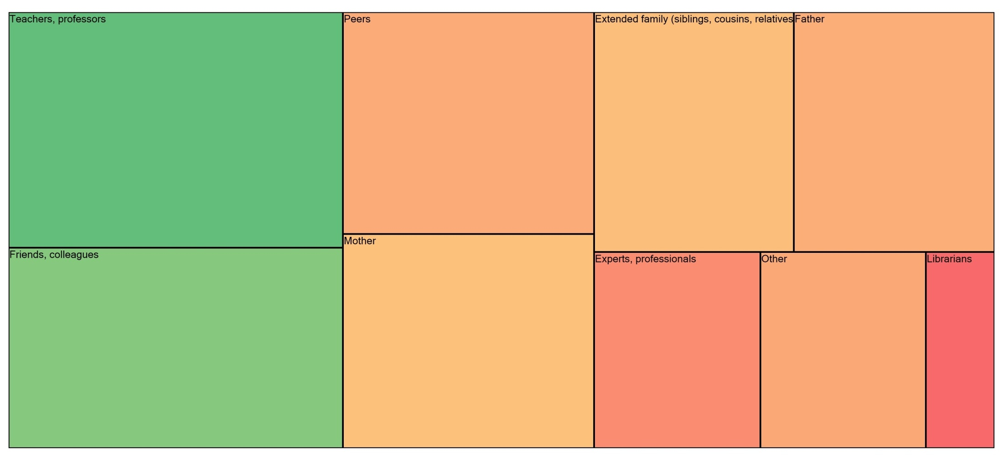









Human Sources
Teachers, professors
Peers
Extended family
Father
Mother
Friends, colleagues
Experts, professionals
Other
Librarians
(White & Connaway, 2011-2012)
Notes:
This is the updated People Tree map. (All stages, Phase 1 and 2)
In the codebook, Peers were considered “school, university colleagues but not “friends.”” Whereas Colleagues were Friends/Colleagues (“mates”), a separate node.
“One of my favorite ways of getting information is by asking people. Instead of Googling the whole time I mostly have faith in the fact that people are actually learning, if I can go to a tutor and ask them something.” (UKU3, 0:19:34, Female, Age 19, Digital Visitors and Residents) (Emerging)
“I do, like I’ll call home and ask my dad a question about something or another, or like my grandparents. My grandpa took like a bunch of high level math stuff, so I’ve asked him periodically but if I could I’d just as soon know everything automatically, that’d just be easy.” (USU4, 0:41:48, Male, Age 19, Digital Visitors and Residents) (Emerging)
White, D. S., & Connaway, L. S. (2011-2012). Visitors and residents: What motivates engagement with the digital information environment. Funded by JISC, OCLC, and Oxford University. Retrieved from http://www.oclc.org/research/activities/vandr/

Slide 63
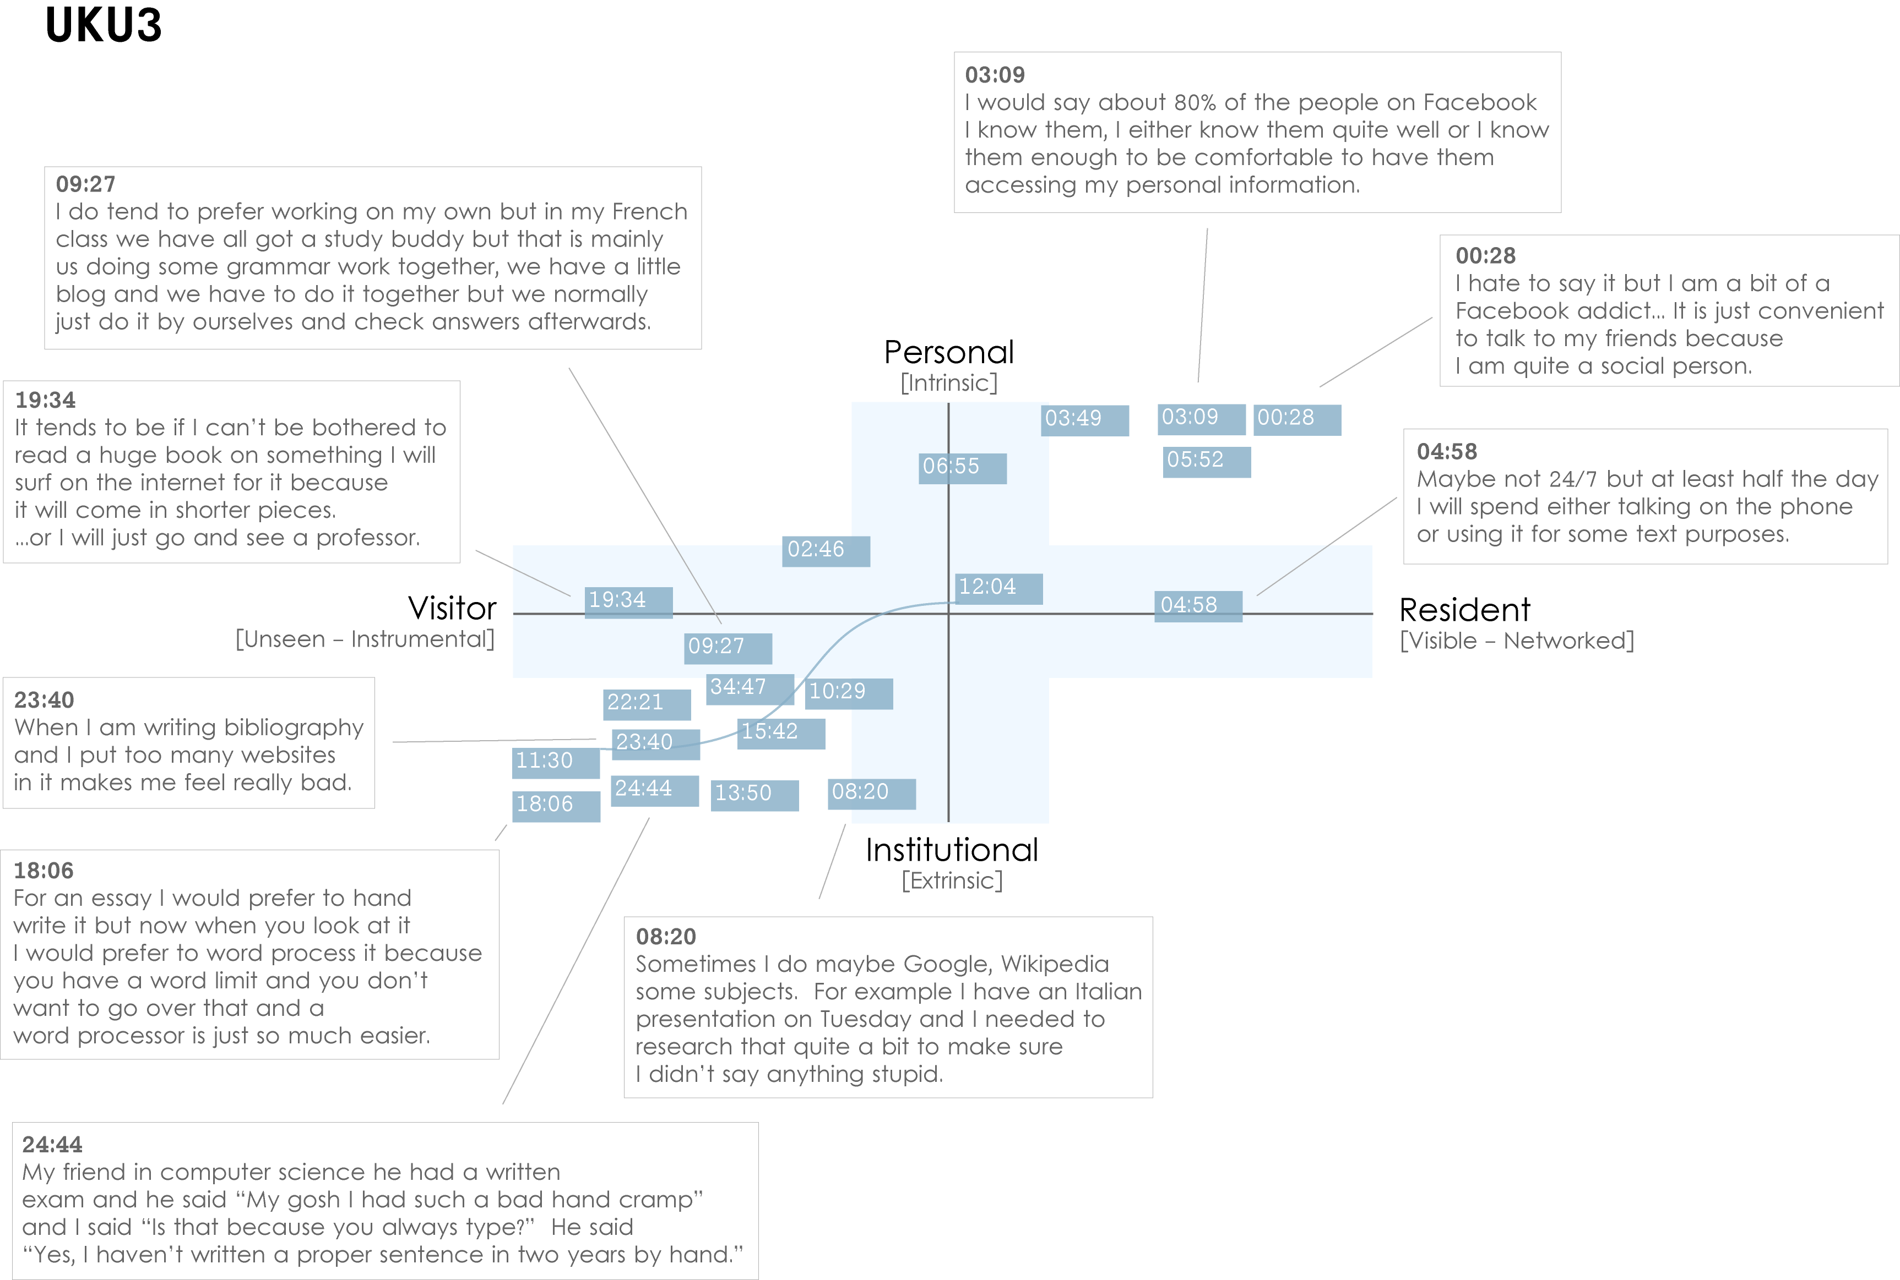
Notes:
UKU3 (UK 1st year undergraduate)
This participant has a clear demarcation between Resident modes of engagement in her personal life and Visitor modes of engagement for study.
The map is a mode of engagement landscape onto which individuals can be plotted. The limits of the map have been defined by the four major framing concepts of the project: V&R – Personal and Institutional. The Personal end of the axis encompasses an individual’s private life, and the Institutional is their professional and/or academic life.
The data from the Emerging educational stage seem to suggest that individuals were engaging with systems and materials not provided by their institutions to do institutional work (e.g., consulting Wikipedia to write an essay). Such user-owned literacies, when mapped like this, take a prominent role in the academic work of many of our research subjects. Given the effect that the internet is having on collapsing the relationship between certain modes of activity and specific physical spaces, it is important not to tie notions of the intuitional and the personal to ideas of “school/university/library” and “home” as buildings.
White, D. S., & Connaway, L. S. (2011-2012). Visitors and residents: What motivates engagement with the digital information environment. Funded by JISC, OCLC, and Oxford University. Retrieved from http://www.oclc.org/research/activities/vandr/

Slide 64
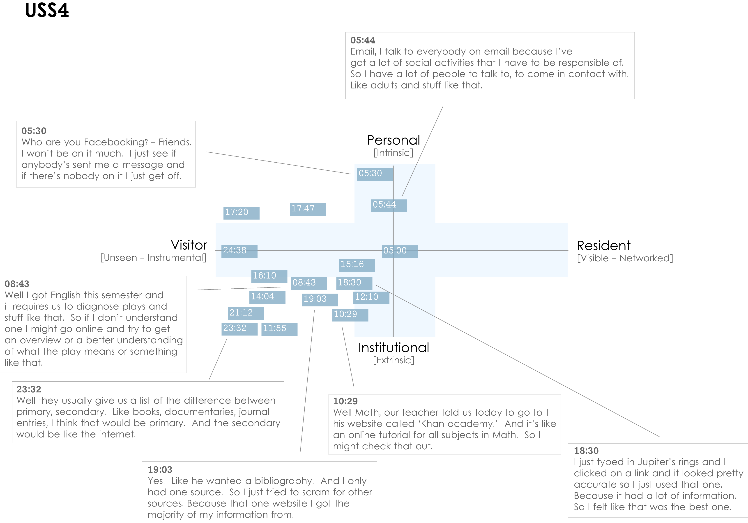
Notes:
USS4 (US high-school student)
This is an example of a participant who is predominantly engaging in a Visitor mode. The quotes illustrate that he does use the web regularly for his studies, but is not interested in being “visible” online.
The distinction between internal and external motivation can quickly become complicated. However, attempting to define why individuals engage with particular kinds of information can help identify substantive and relevant issues. For instance, the difference between the personal and the institutional diminishes as individuals become increasingly embedded in academic contexts. This convergence would be representative of the process of “becoming” an expert in a given discipline, and in the shift from predominantly consuming to constructing knowledge. The numbers on the dark blue blocks represent the time-code point in the interview at which the participant discussed an activity or approach.
White, D. S., & Connaway, L. S. (2011-2012). Visitors and residents: What motivates engagement with the digital information environment. Funded by JISC, OCLC, and Oxford University. Retrieved from http://www.oclc.org/research/activities/vandr/

Slide 65
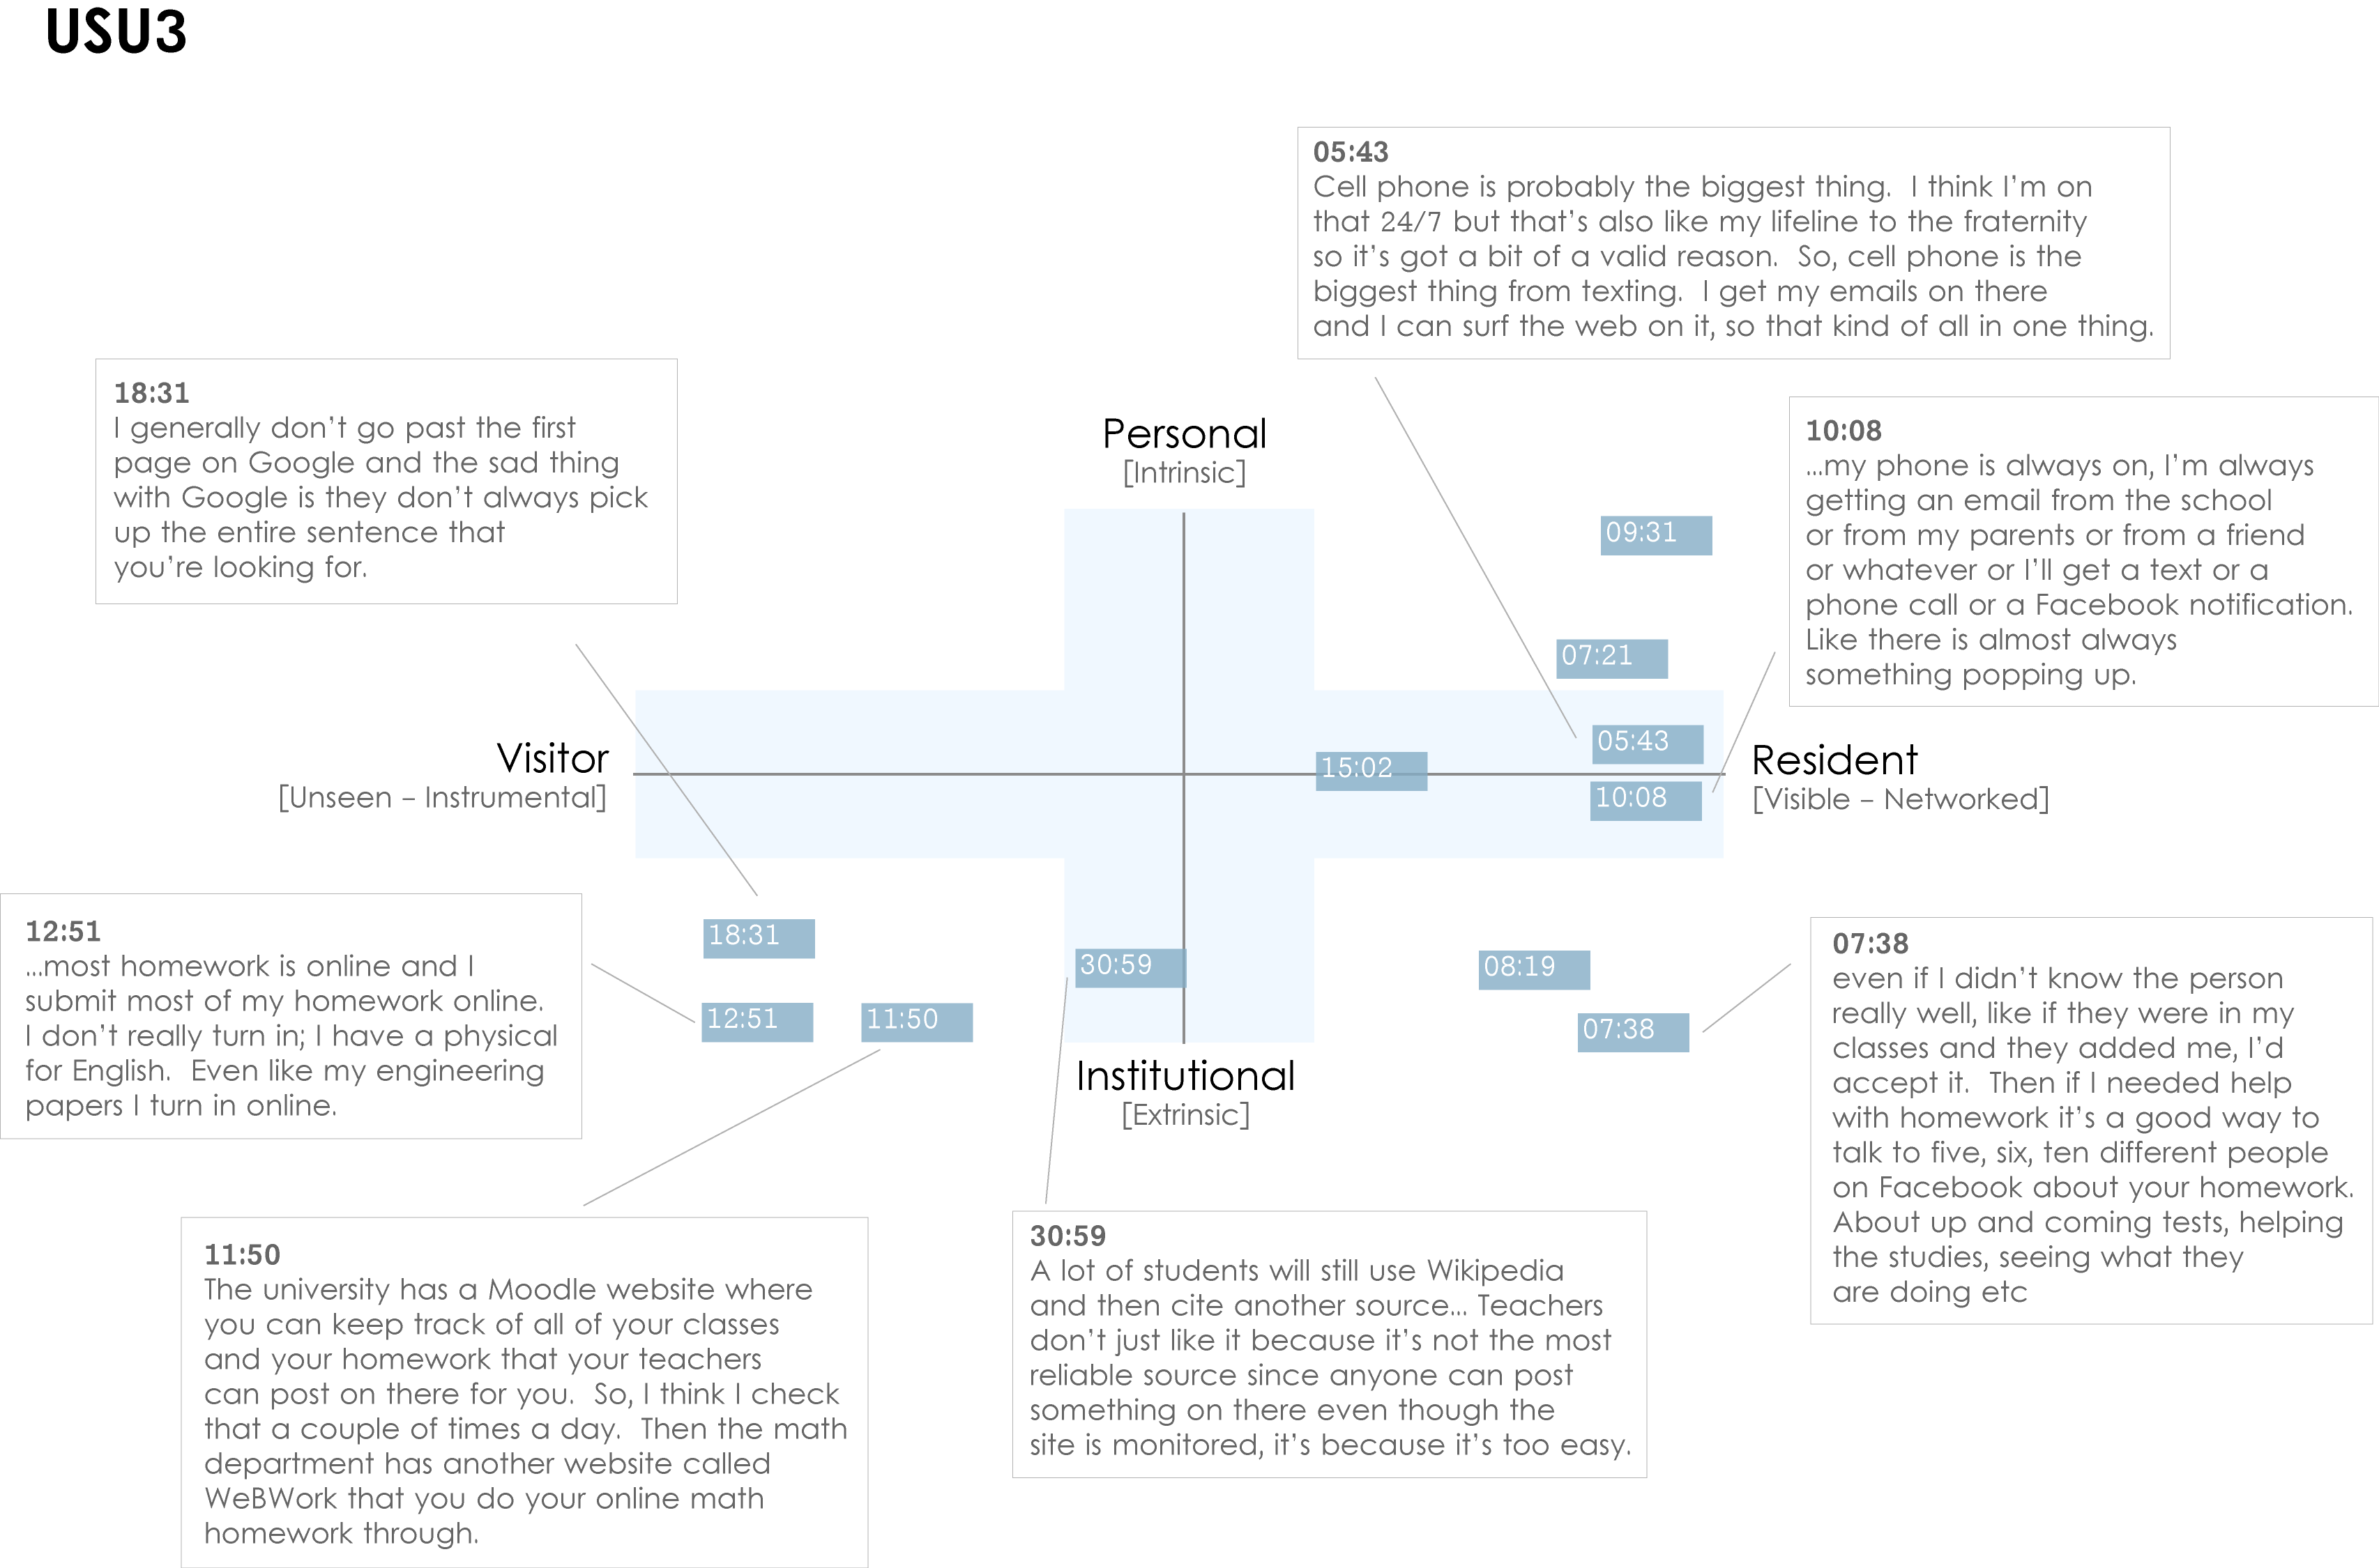
Notes:
USU3 (US 1st year undergraduate) This participant is highly Resident, connected to friends, family and study related matters “24/7” via a smartphone. His willingness to “friend” fellow students with a view to discussing assignments in Facebook is the main form of activity that takes place in the Resident/Institutional quadrant. This tends to be the only activity that takes place in this quadrant amongst participants from the Emerging educational-stage.
It should be possible to plot our code book onto the map, which would provide the ability to automatically plot coded data from individuals or groups. For example, Extrinsic and Intrinsic motives have been coded in NVivo, which map directly to the vertical axis (Personal/Institutional). Other codes can be identified as more Resident in nature: “Visible messaging,” “Media posting,” “Connection: sharing with others;” or as more Visitor in nature: “Searching,” “Email,” “Word processing.”
White, D. S., & Connaway, L. S. (2011-2012). Visitors and residents: What motivates engagement with the digital information environment. Funded by JISC, OCLC, and Oxford University. Retrieved from http://www.oclc.org/research/activities/vandr/

Slide 66

“A strategic instructional venture isn’t about just training students how to search database interfaces, but about building their fluency with data, visual, spatial, media, information, and technology literacies…This is how we transform scholarship.”
(Mathews, 2012)
Notes:
Mathews, B. (2012). Think like a startup: A white paper to inspire library entrepreneurialism. Retrieved from http://chronicle.com/blognetwork/theubiquitouslibrarian/2012/04/04/think-like-a-startup-a-white-paper/
“A strategic instructional venture isn’t about just training students how to search database interfaces, but about building their fluency with data, visual, spatial, media, information, and technology literacies. This is how we can advance the role of the library. This is how we transform scholarship.” (pg. 9)
Example of the teachable moment:
“Yeah, I don't step in the library anymore… better to read a 25-page article from JSTOR than 250-page book.” Undergraduate student IMLSFG_07
“Yeah, like go to, you could go to JSTOR you can look at like a journal index and it’s library, the catalog for that volume and all sorts of things. And, it’s not really, I wouldn’t think it’s the most efficient way, but sometimes it takes a lot less time than a search.” Undergraduate student IMLSFG_07
“It’s beautiful, and in the research facilities are amazing there in terms of how many databases they have, but my entire undergraduate, and the majority of my graduate, I had no idea. I probably knew about 1/100 of the information that was available in the library. Then I spent a couple hours with the main librarian there, just doing a couple of searches that I needed to do, and now I can do that as fast online, through the library’s homepage. I can do that as fast as I can going through Google and get better, more reliable information. So I use it a lot actually.” Graduate student IMLSFG_06
Institute for Museums and Library Services Research Grant. (2003-2005). Sense-making the information confluence: The hows and the whys of college and university user satisficing of information needs. B. Dervin, Ohio State University, Principal Investigator; L. S. Connaway, & C. Prabha, OCLC Research, Co-Investigators. Project Website URL: http://www.oclc.org/research/activities/past/orprojects/imls/default.htm
Microsoft Clip Art

Slide 67

“By focusing on relationship building instead of service excellence, organizations can uncover new needs and be in position to make a stronger impact.”
(Mathews, 2012)
Notes:
Mathews, B. (2012). Think like a startup: A white paper to inspire library entrepreneurialism. Retrieved from http://chronicle.com/blognetwork/theubiquitouslibrarian/2012/04/04/think-like-a-startup-a-white-paper/
Users do not know they can ask librarians (ERIAL, Seeking synchronicity: Revelations and recommendations for virtual reference)
Kolowich, S. (2011, August 22). Study: College students rarely use librarians’ expertise. USA Today. Retrieved from http://www.usatoday.com/news/education/story/2011-08-22/Study-College-students-rarely-use-librarians-expertise/50094086/1
Example: Seeking Synchronicity
Librarians identified successful VR encounters as those where they were able to offer instruction and specialized knowledge, the user had a positive attitude
Users identified successful VR encounters as those providing convenience, an accurate answer, and they were comfortable with the service
Connaway, L. S., & Radford, M. L. (2011). Seeking synchronicity: Revelations and recommendations for virtual reference. Dublin, OH: OCLC Research. Retrieved from http://www.oclc.org/reports/synchronicity/full.pdf
Microsoft Clip Art

Slide 68
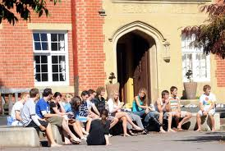
Future Phases
Phase 3: Months 13-24
Continue diaries with 24 participants
Online survey of 400 students and scholars
Phase 4: Months 25-36
Interview 6 new Emerging students
Analyze data
Report findings

Slide 69
References
Bertot, J. C., Berube, K., Devereaux, P., Dhakal, K., Powers, S., & Ray, J. (2012). Assessing the usability of WorldCat Local: Findings and considerations. The Library Quarterly, 82(2), 207-221.
Connaway, L. S., & Dickey, T. J. (2010). The digital information seeker: Report of the findings from selected OCLC, RIN, and JISC user behaviour projects. Retrieved from http://www.jisc.ac.uk/media/documents/publications/reports/2010/digitalinformationseekerreport.pdf
Connaway, L. S., Dickey, T. J., & Radford, M. L. (2011). "If it is too inconvenient I'm not going after it": Convenience as a critical factor in information-seeking behaviors. Library & Information Science Research, 33(3).
Connaway, L. S., Lanclos, D., White, D. S., Le Cornu, A., & Hood, E. M. (2012). User-centered decision making: A new model for developing academic library services and systems. IFLA 2012 Conference Proceedings, August 11-17, Helsinki, Finland.
Connaway, L. S., & Powell, R. R. (2010). Basic research methods for librarians. Santa Barbara, CA: Libraries Unlimited.
Connaway, L. S., & Radford, M. L. (2011). Seeking synchronicity: Revelations and recommendations for virtual reference. Dublin, OH: OCLC Research. Retrieved from http://www.oclc.org/reports/synchronicity/full.pdf

Slide 70
References
Cool, C., & Spink, A. (2002). Issues of context in information retrieval (IR): An introduction to the special issue. Information Processing and Management: An International Journal, 38(5), 605-611.
Dempsey, L. (2008). Always on: Libraries in a world of permanent connectivity. First Monday, 14(1). Retrieved from http://www.firstmonday.org/htbin/cgiwrap/bin/ojs/index.php/fm/article/view/2291/207
Dervin, B., Connaway, L. S., & Prabha, C. (2003-2005). Sense-making the information confluence: The hows and the whys of college and university user satisficing of information needs. Funded by the Institute for Museums and Library Services (IMLS). Retrieved from http://www.oclc.org/research/activities/past/orprojects/imls/default.htm
Kolowich, S. (2011, August 22). Study: College students rarely use librarians’ expertise. USA Today. Retrieved from http://www.usatoday.com/news/education/story/2011-08-22/Study-College-students-rarely-use-librarians-expertise/50094086/1
Mathews, B. (2012). Think like a startup: A white paper to inspire library entrepreneurialism. Retrieved from http://chronicle.com/blognetwork/theubiquitouslibrarian/2012/04/04/think-like-a-startup-a-white-paper/
QSR International. (2011). NVivo 9: Getting started. Retrieved from http://download.qsrinternational.com/Document/NVivo9/NVivo9-Getting-Started-Guide.pdf

Slide 71
Selected Readings
Radford, M. L., & Connaway, L. S. (2005-2007). Seeking synchronicity: Evaluating virtual reference services from user, non-user, and librarian perspectives. Funded by the Institute for Museums and Library Services (IMLS). Retrieved from http://www.oclc.org/research/activities/synchronicity/default.htm
Wasserman, S. (2012, June 18). The Amazon effect. The Nation. Retrieved from http://www.thenation.com/article/168125/amazon-effect
White, D. S., & Connaway, L. S. (2011-2012). Visitors and residents: What motivates engagement with the digital information environment. Funded by JISC, OCLC, and Oxford University. Retrieved from http://www.oclc.org/research/activities/vandr/
White, D. S., & Le Cornu, A. (2011). Visitors and Residents: A new typology for online engagement. First Monday, 16(9). Retrieved from http://firstmonday.org/htbin/cgiwrap/bin/ojs/index.php/fm/article/viewArticle/3171/3049

Slide 72
The researchers would like to thank Erin Hood for her assistance in keeping the team organized, analyzing the data, and disseminating the results.

Slide 73
Picture Credits
Residents
http://www.flickr.com/photos/nicocavallotto/363251198/
Phase 1
http://www.flickr.com/photos/orangeacid/252090910
Phase I and 2 Participant Demographics
http://www.flickr.com/photos/doug88888/4570566630/
US vs. UK Participant University Majors
http://www.flickr.com/photos/kkoshy/2927378663/
Codebook
http://www.flickr.com/photos/themadguru/3546619930/
Preliminary Findings (Guilty dog)
http://www.flickr.com/photos/59262640@N00/61264743/
“I always stick with the first...” (USS1)
http://www.flickr.com/photos/pinksherbet/2001899627/
Slide 41: “I knew that the internet wouldn’t give me a wrong answer.” (UKS4)
http://www.flickr.com/photos/ravages/236981527/
Slide 42: “I simply just type it into Google and just see what comes up.” (UKS4)
http://www.flickr.com/photos/ana_cotta/2532911186/
Slide 43: “Google doesn’t judge me” (UKF3)
http://www.flickr.com/photos/cubmundo/6184306158/
Slide 53: People: Professor
http://www.flickr.com/photos/lafayette-college/5515447182/

Slide 74
Questions & Discussion
Lynn Silipigni Connaway, Ph.D.
connawal@oclc.org

