Slide 1

Exploration, Innovation and Community for Libraries, Archives and Museums:
A View from OCLC Research
Lynn Silipigni Connaway, Ph.D.
Senior Research Scientist

Slide 2
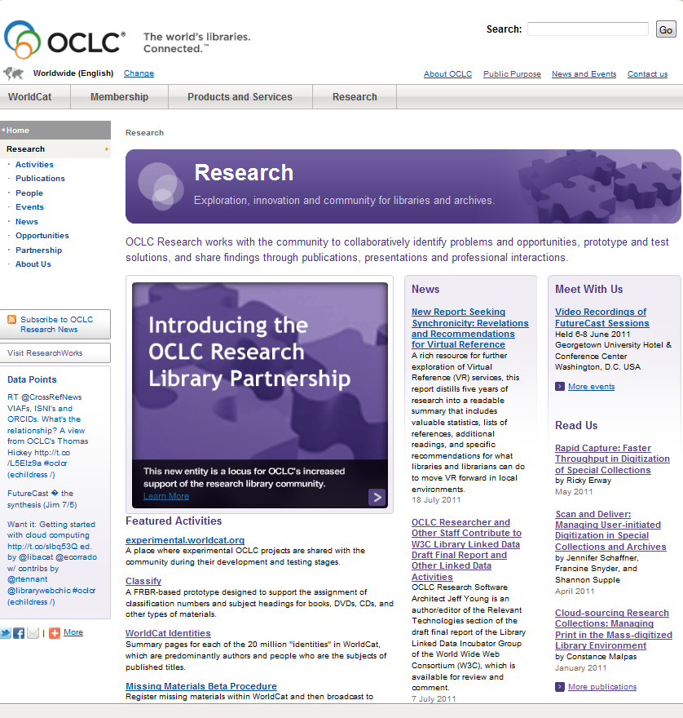
Topics
About OCLC Research
How activities originate
How projects are chosen
Sample projects

Slide 3
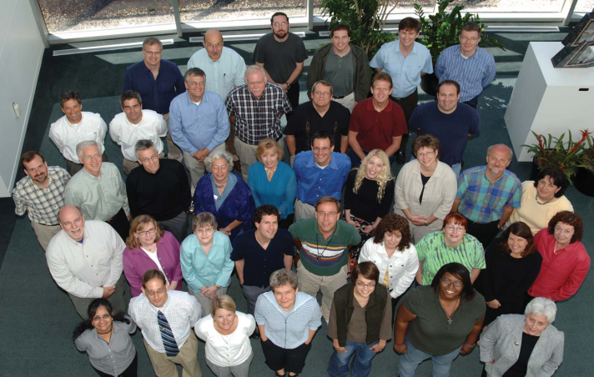
OCLC Research
Focus:
  Applied research in support of OCLC’s public mission
  Exploration, innovation and community norms for libraries, archives and museums
Resources:
  ~45 OCLC Research staff
    Expertise in libraries, archives, museums, metadata, controlled vocabularies, ILL, preservation, economics, computational linguistics, user behavior, more…
  OCLC, OCLC Research Library Partnership, Innovation Lab, OCLC institutions, collaboration with other agencies
OCLC Research does:
  OCLC Research reports
  Prototypes
  Open source software
  Work with large data sets
  Grants/support for external research
  Peer-reviewed articles
  Standards-related work
Notes:
OCLC Research can trace it origins to a small research unit at OCLC, originally established by Fred Kilgour. It exists to conduct or advance applied research consistent with OCLC’s mission to reduce library costs and further access to information.
Slightly less than 50 staff are part of the unit – this varies over the year with interns, etc. – and includes a range of expertise and abilities. In many respects OCLC Research is a company within the company and has talent onboard from programming to web design to economics and beyond.
As OCLC provides a number of different research-based outputs, let me briefly say which OR does not do – we sometimes contribute to work by our Marketing staff who do membership reports like the famous Pattern Recognition, but we don’t do the reports, nor do we do WebJunction’s various reports. OCLC Research is not a product research and development unit though we will sometimes contribute to product/service work including transitioning work initially done in OR to our production systems.
OCLC Research does have a report series, build prototypes, create software, work with large data sets (esp. WorldCat), assist outside academic research work, publish in the peer-reviewed literature, and we are often involved in important standards work.

Slide 4
How activities originate
OCLC Research activities originate in many ways:
  Ideas or suggestions from any source
    OCLC Research, OCLC business units
    Member libraries, OCLC Research Library Partnership (ORLP)
  Opportunities for collaboration with researchers, libraries, other agencies
    May or may not be related to grants sought or awarded
    ORLP working groups formed for some activities
  Requests for assistance
    OCLC business units
    National library agencies, other national/international agencies, standards bodies, NGO’s
    Member libraries, ORLP, researchers, others

Slide 5
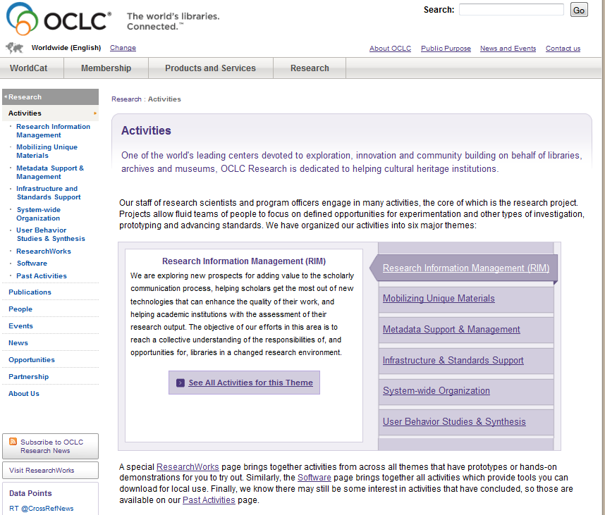
How projects are chosen
Many factors considered:
  Is the activity important to OCLC, its members, library world?
  Is the activity in keeping with OCLC Research’s strengths and interests?
  Is OCLC Research uniquely / well-suited to the task?
  Are appropriate resources available?
OCLC Research Themes
Notes:
OCLC Research Activities
Research Information Management (RIM)
Mobilizing Unique Materials
Metadata Support & Management
Infrastructure & Standards Support
System-wide Organization
User Behavior Studies & Synthesis

Slide 6
Sample projects
National libraries & OCLC
VIAF
ORLP request for assistance
Missing Materials
Researcher collaboration
Seeking Synchronicity
Digital Visitors & Residents
Collaborative solution seeking
Cloud-Sourcing Research Collections
OCLC Research original
Classify

Slide 7
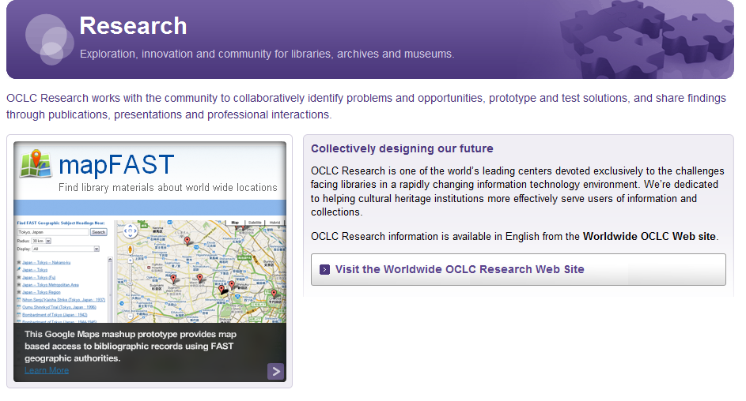
More information
OCLC Research Web site: http://www.oclc.org/research/

Slide 8
User Behavior Studies & Synthesis
Seeking Synchronicity
Addressed current issues, such as evaluation, sustainability, and relevance
Identified ways to increase visibility, use, and recognition of VRS
Improve service
Help secure funding and growth
Funded by IMLS, Rutgers, and OCLC
Addressed:
  Factors influencing selection and use of VRS
  User and staff perceptions of VRS
  Why non-users do not choose VRS
Developed recommendations
Notes:
This project innovatively addressed current issues concerning the evaluation, sustainability, and, ultimately, the relevance of VRS for libraries.
The study also identified ways to increase the visibility and use of VRS, and to improve service.
Improving virtual reference services and making them more attractive to the public should result in increased use and increased recognition that VRS fills an important niche not served by other, more traditional library services.
This, in turn, could help secure funding allocations, and the growth and improvement of services.
The project was funded by a grant from the Institute of Museum and Library Services (IMLS) and in-kind contributions from Rutgers, The State University of New Jersey, and OCLC.
This international study, conducted jointly by OCLC and the Rutgers School of Communication, Information and Library Studies, addressed:
factors influencing the selection and use of chat-based VRS
user and staff perceptions of satisfaction
why non-users of these services do not choose VRS
It also developed research-based recommendations for VRS staff to increase satisfaction.
Add Report published and numerous papers and book chapters published and presented

Slide 9
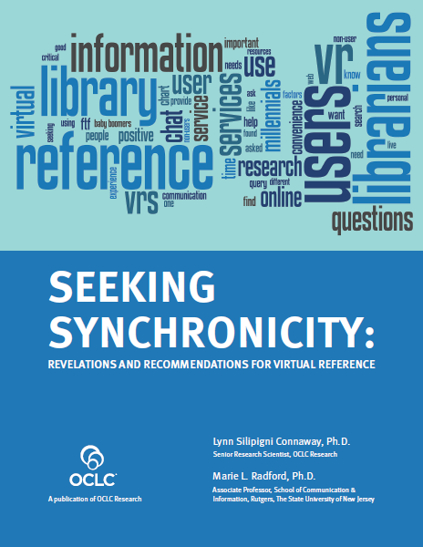
User Behavior Studies & Synthesis
Seeking Synchronicity
Major findings:
All about relationships
Death of ready reference exaggerated
Query clarification key to accuracy and effectiveness
Convenience is the hook
Pay attention to the questions asked and interpersonal behavior
Generational differences come into play
Marketing matters
Notes:
report. Major findings:
It’s all about the relationships
The death of ready reference has been exaggerated
Query clarification is key to accuracy and effectiveness
Convenience is the hook
Pay attention to the questions asked and your interpersonal behavior when communicating
Generational differences do come into play
Marketing matters

Slide 10
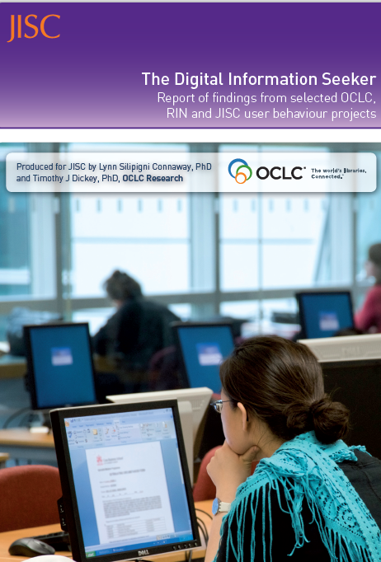
User Behavior Studies & Synthesis
Digital Information Seeker
Common Findings:
  Convenience
  E-journals increasingly important
  Google & other search engines 1st choice
  Enhanced content for evaluation
  Users confident in own ability
  Information literacy not kept pace with digital literacy
  More digital content
  Libraries = collections of books
  Value human resources
Notes:
http://www.jisc.ac.uk/media/documents/publications/reports/2010/digitalinformationseekerreport.pdf
Among the central findings are the following:
• Disciplinary differences do exist in researcher behaviours, both professional researchers and students.
• E-journals are increasingly very important to the process of research at all levels.
• The evidence provided by the results of the studies supports the centrality of Google and other search engines.
o Google is often used to locate and access e-journal content.
• At the same time, the entire Discovery-to-Delivery process needs to be supported by information systems, including increased access to resources.
o Journal backfiles are particularly problematic in terms of access
The realities of the online environment observed above led several studies to some common conclusions about changing user behaviours:
• Regardless of age or experience, academic discipline, or context of the information need, speed and convenience are important to users.
o Researchers particularly appreciate desktop access to scholarly content.
o Users also appreciate the convenience of electronic access over the physical library.
• Users are beginning to desire enhanced functionality in library systems.
• They also desire enhanced content to assist them in evaluating resources.
• They seem generally confident in their own ability to use information discovery tools.
However, it seems that information literacy has not necessarily improved.
o High-quality metadata is thus becoming even more important for the discovery process.
In addition, some common findings regarding content and resources arise:
• More digital content of all kinds and formats is almost uniformly seen as better.
• People still tend to think of libraries as collections of books.
• Despite this, researchers also value human resources in their information-seeking.
In some cases, the studies reviewed included findings which seem to contradict one another, and for which evidence may be mixed:
• There is evidence for both broad and narrow range of tools used for scholarly research.
• There is evidence both in favour and against formal training in electronic searching.
• There are mixed conclusions on the question of whether recommendations, provided by recommender systems, and social media are having an impact on information seeking.

Slide 11
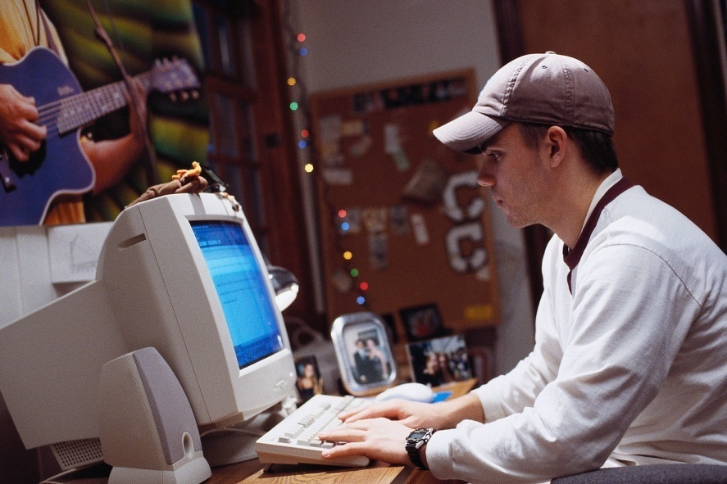
User Behavior Studies & Synthesis
Digital Information Seeker
Contradictory Findings:
“Google generation”
Search engine speed
Support for library OPAC advanced search options & social features
Notes:
Digital Information Seeker, pg. 4-5.
In a few cases, the above findings from the studies under review offered evidence that runs counter to popular perceptions of the current information scene.
Many popular media claims about the “Google generation” may not be supported by all the evidence.
In choosing among search engines, some evidence indicates that speed may not be the most important evaluative factor.
The studies that addressed library OPACs provide little support for the advanced search options which are still popular in these systems.

Slide 12
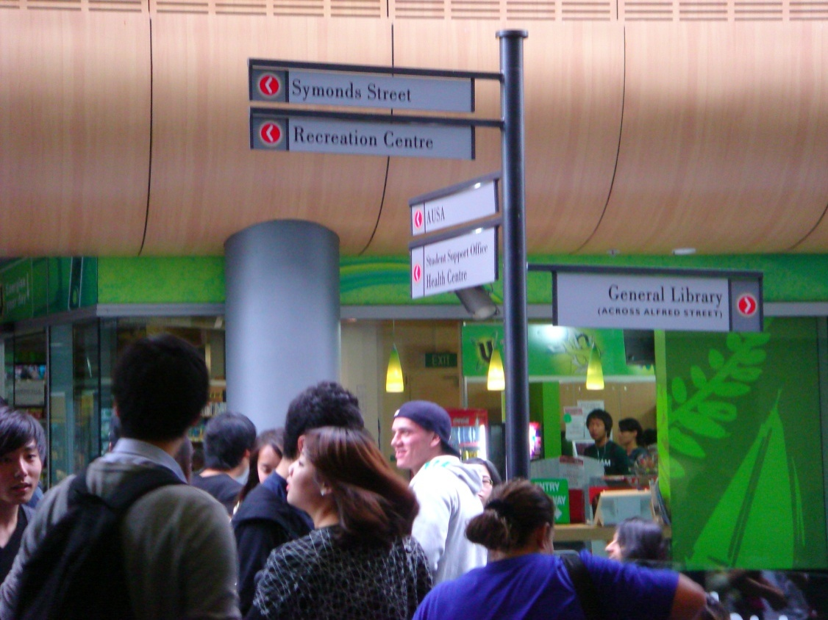
Digital Natives and Digital Immigrants

Slide 13

Old people just don’t get this stuff

Slide 14
Research Addressing Digital Learners
Need for a longitudinal study “to identify how individuals engage in both the virtual and physical worlds to get information for different situations” (Connaway & Dickey 2010, p.56).
The information literacy of young people, has not improved with the widening access to technology: in fact, their apparent facility with computers disguises some worrying problems (Centre for Information Behaviour and the Evaluation of Research 2008).
Academic staff perceive students as being more digitally capable than is really the case (Beetham, McGill, and Littlejohn 2009).
Notes:
“to identify how individuals engage in both the virtual and physical worlds to get information for different situations could be conducted”

Slide 15
Communication Mode with Instructors:
Significant association between age & use?
a. Institutional e-mail account No association
b. Personal e-mail account No association
c. Instant messaging No association
d. Text message (via phone) No association
e. Facebook/MySpace No association
f. Talking via phone No association
g. Talking in person No association
h. WebCT Association
Mark Bullen, Tannis Morgan, and Adnan Qayyum: http://www.cjlt.ca/index.php/cjlt/article/view/550/298
Notes:
Net generation learners are more likely to use certain Information and Communication Technologies (ICT)-based applications with peers, but not with instructors. Only the use of WebCT to communicate with instructors was significantly associated with age, with net generation students indicating a higher frequency of use (1.77) than non-net generation students (1.40), p. 16.
Digital Learners in Higher Education Web site: http://digitallearners.wordpress.com/

Slide 16
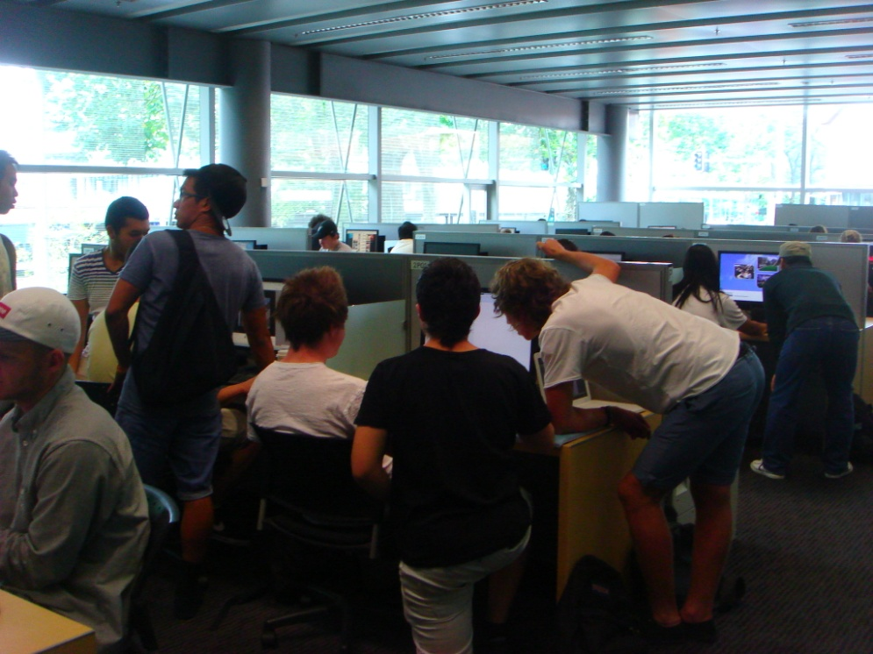
Visitors and Residents:
What motivates engagement with the digital information environment?
Funded by
JISC
OCLC
  Lynn Silipigni Connaway, Ph.D.
Oxford University
  David White
University of North Carolina, Charlotte
  Donna Lanclos, Ph.D.

Slide 17
http://is.gd/VqXHkT

Slide 18
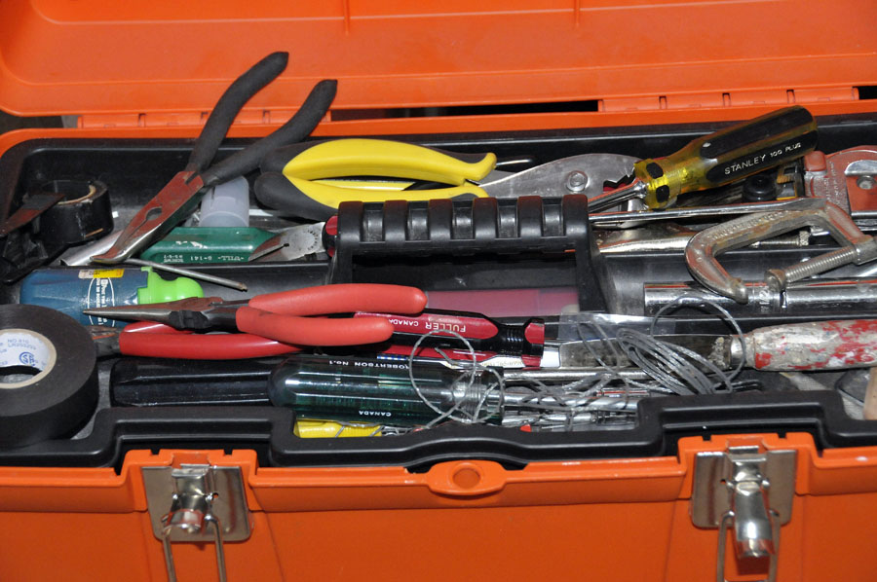
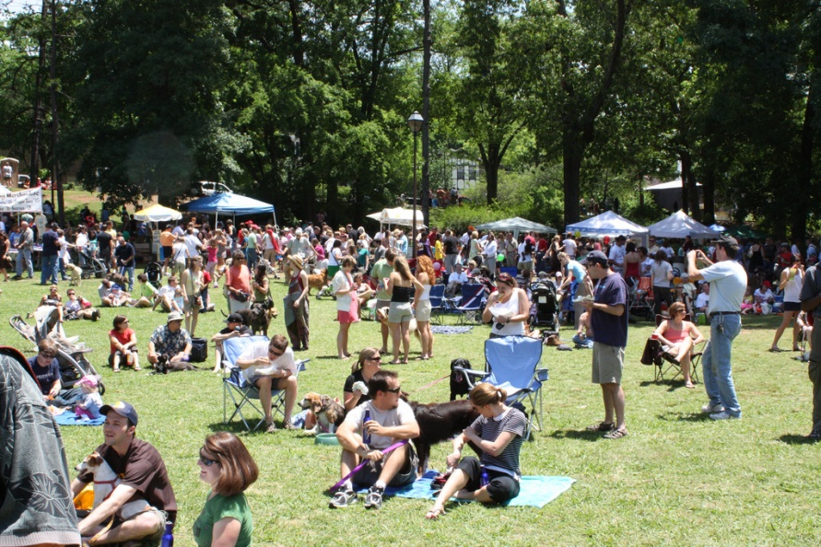

Slide 19
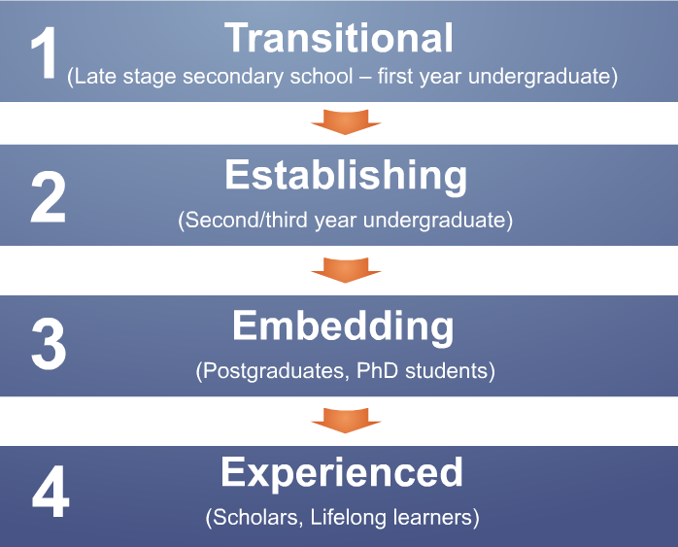
Visitors and Residents Study

Slide 20
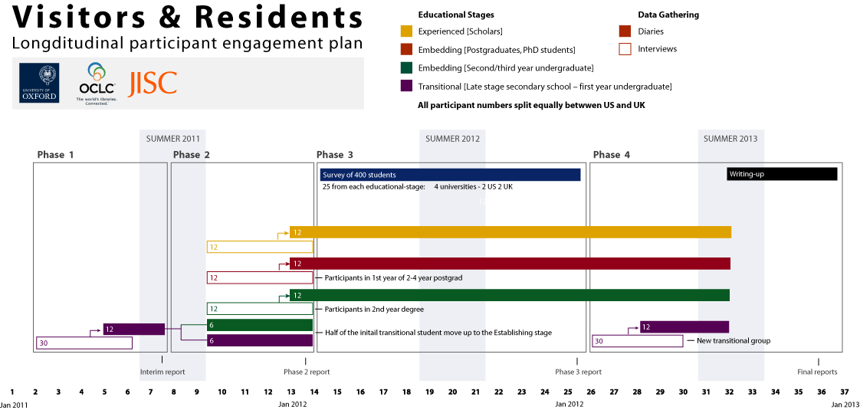

Slide 21
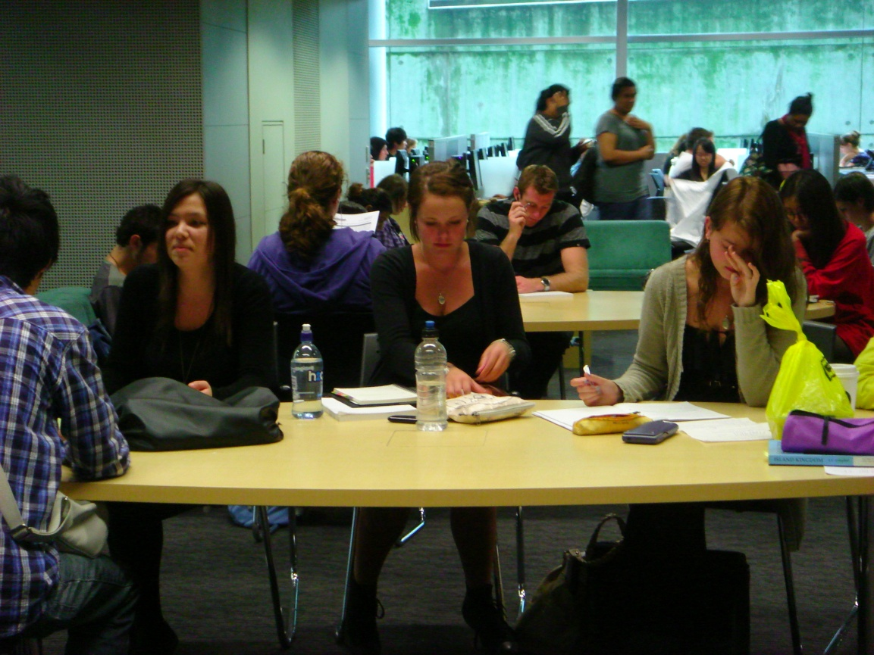
“…our generation isn’t technology orientated. I think it’s always a stereotype.”
(Participant UKS4)

Slide 22
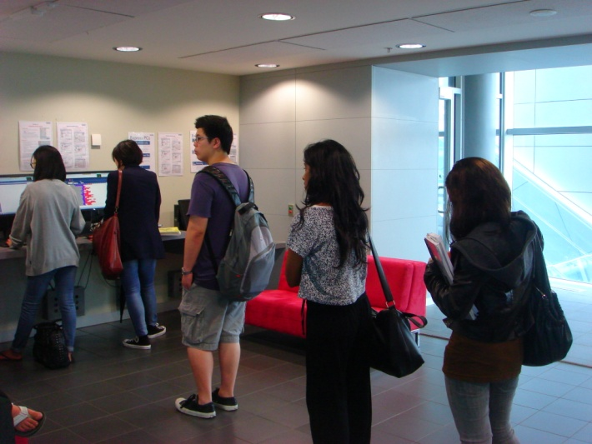
“I think that lots of like companies and people away from my generation think that we rely and we’re obsessed with gadgets and gizmos and everybody has to buy the newest iPhone and iPad and newest everything. At the end of the day, as a student, are you really know is that is what the internet is for. How you get to it – it doesn’t matter if you don’t own a computer and you have to come to the library to use it. Um…like it’s available to you and you don’t care like how you get it.”
(WorldCat.org Focus Group Interview UKU4th year university student)

Slide 23


=
Notes:
Screenagers in focus group interviews in 2008 said that “email is for old people.”
In interviews with last year secondary school/first year university students we are told that email is for “formal communication.”

Slide 24
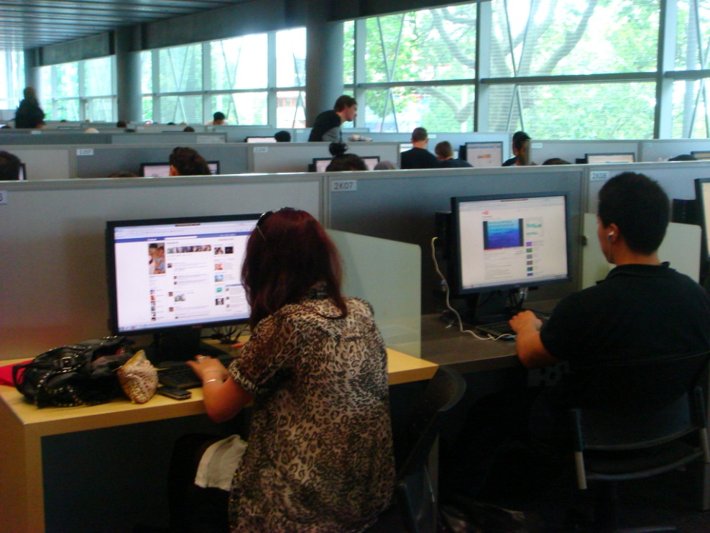
Facebook is for administration & social communication
Notes:
“…he was the only one who received it and the teacher told him to pass it on. And he sent a message to everyone in the calls on Facebook, so that helped.” (UKS1 00:12:22)

Slide 25

Don’t mention Wikipedia!
English
The Free Encyclopedia
3 642 000+ articles
日本語
フリー百科事典
750 000+ 記事
Deutsch
Die freie Enzyklopädie
1 233 000+ Artikel
Español
La enciclopedia libre
761 000+ artículos
Français
L’encyclopédie libre
1 106 000+ articles
Русский
Свободная энциклопедия
714 000+ статей
Italiano
L’enciclopedia libera
803 000+ voci
Português
A enciclopédia livre
685 000+ artigos
Polski
Wolna encyklopedia
802 000+ haseł
Nederlands
De vrije encyclopedie
688 000+ artikelen
Notes:
Interviewer: ‘Do they actually fail you?’
‘They don’t fail you but you get ridiculed in front of everyone for sourcing Wikipedia.’ (USS3)

Slide 26


Information Literacy
Skills lacking
Not kept pace with digital literacy
Researchers self-taught & confident
Notes:
“Digital literacies and information literacies do not go hand in hand.”
Centre for Information Behaviour and the Evaluation of Research. 2008. Information behaviour of the researcher of the future: A CIBER briefing paper. London: CIBER, p. 20
““I just type it into Google and see what comes-up…” (UKS2 00:16:21)
“I simply just type it into Google and just see what comes up” (UK4 00:13:36)
“I always stick with the first thing that comes up on Google because I think that’s the most popular site which means that’s the most correct.” (USS1 0:21:57)
“I knew that the internet wouldn’t give me a wrong answer.” (UKS4 00:24:10)
“That’s the only problem, just knowing what information to use and why.” (UKS1 00:24:05)
“Perfect thing, I think it would be that all the useful, accurate, reliable information would like glow a different colour or something so I could tell without wasting my time going through all of them.” (UKS2 00:37:09)

Slide 27
Why Visitors and Residents Project?
If we build it, they will NOT come.
Shifting changes in engagement with information environment
  Effect of larger cultural changes influenced by Web?
  New attitudes towards education?
Gap in user behaviour studies – need for longitudinal studies
Understand motivations for using and expectations of technologies and spaces in information environment
Inform project & service design to improve engagement & uptake
http://www.oclc.org/research/activities/vandr/

Slide 28
Selected Readings
Beetham, Helen, Lou McGill, and Allison Littlejohn. Thriving in the 21st Century: Learning Literacies for the Digital Age (LLiDA Project). Glasgow: The Caledonian Academy, Glasgow Caledonian University, 2009. http://www.academy.gcal.ac.uk/llida/LLiDAReportJune2009.pdf.
Bullen, Mark, Tannis Morgan, and Adnan Qayyum. Digital Learners in Higher Education: Generation is Not the Issue. Canadian Journal of Learning and Technology, 37(1), Spring 2011. http://www.cjlt.ca/index.php/cjlt/article/view/550/298
Connaway, Lynn Silipigni, and Timothy J. Dickey. The Digital Information Seeker: Report of the Findings from Selected OCLC, RIN, and JISC User Behaviour Projects. 2010. http://www.jisc.ac.uk/media/documents/publications/reports/2010/digitalinformationseekerreport.pdf.
Nicholas, David. Rowlands, Ian. Huntingdon, Paul. Information Behaviour of the Researcher of the Future: A CIBER Briefing Paper. London: CIBER, 2008. http://www.jisc.ac.uk/media/documents/programmes/reppres/gg_final_keynote_11012008.pdf.
Warwick, Claire. Galina, Isabel. Terras, Melissa. Huntington, Paul. Pappa, Nikoleta. LAIRAH research on good practice in the construction of digital humanities projects. University College London. 2008.
http://discovery.ucl.ac.uk/13810/

Slide 29
The researchers would like to thank Dr. Alison LeCornu for her assistance in keeping the team organized, scheduling and conducting interviews, analyzing the data, and disseminating the results.

Slide 30

Thanks
Questions & Comments
Lynn Silipigni Connaway
connawal@oclc.org

