Slide 1


OCLC Research:
Common Issues, Shared Explorations
Eric Childress
Consulting Project Manager
OCLC Research
WiLS Peer Council – Spring 2011 (24 May)
Notes:
Madison, WI 24 May 2011
It’s my pleasure to be able to talk to all of you about OCLC Research today.
About me: My role is to provide logistical and project management support for OCLC Research including things like working with other parts of OCLC to help the leverage work done originally in OCLC Research.

Slide 2
Outline
About OCLC
OCLC membership reports
  Perceptions 2010
OCLC Research activities
  About OCLC Research
  WorldCat Genres

Slide 3
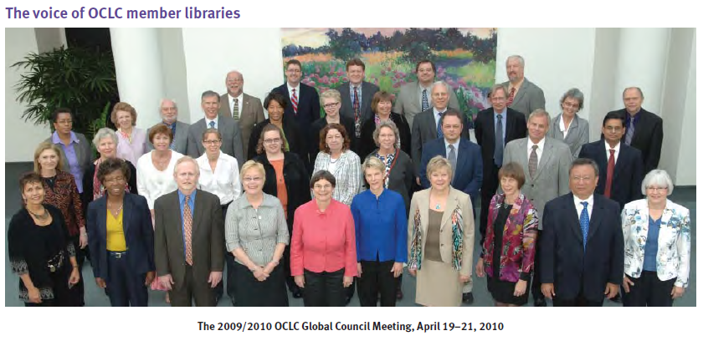
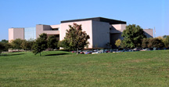
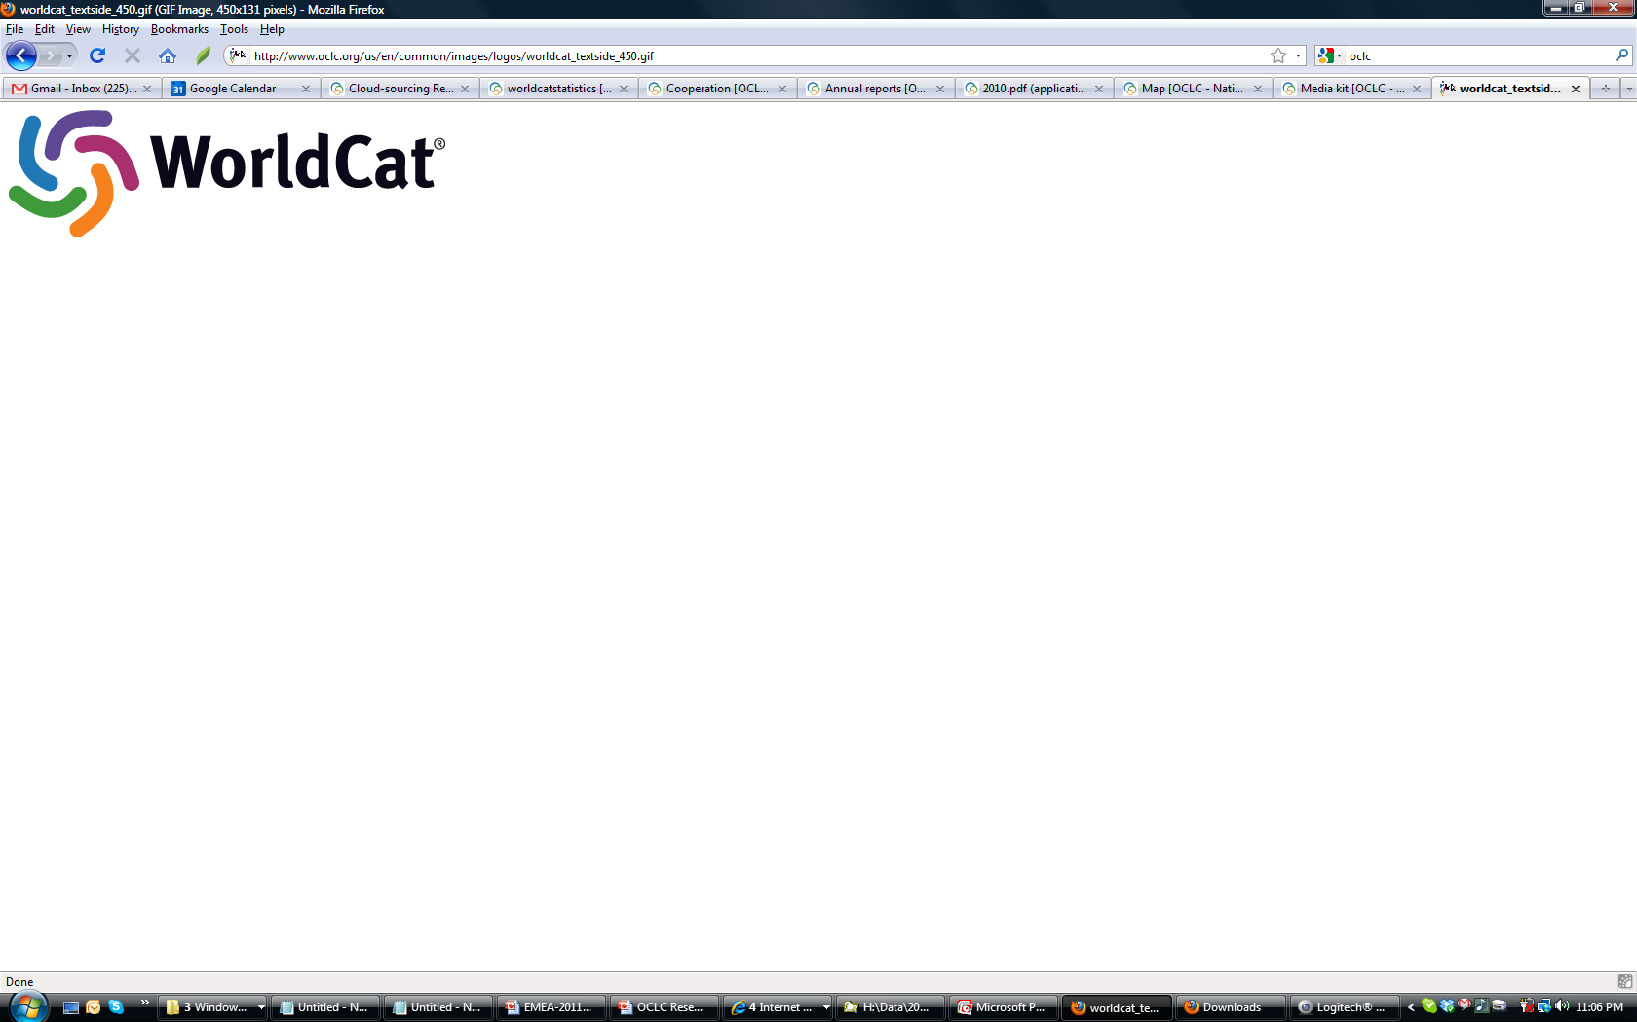
About OCLC
The world’s largest library cooperative
Notes:
Images from OCLC’s headquarters campus in Dublin, Ohio, USA

Slide 4
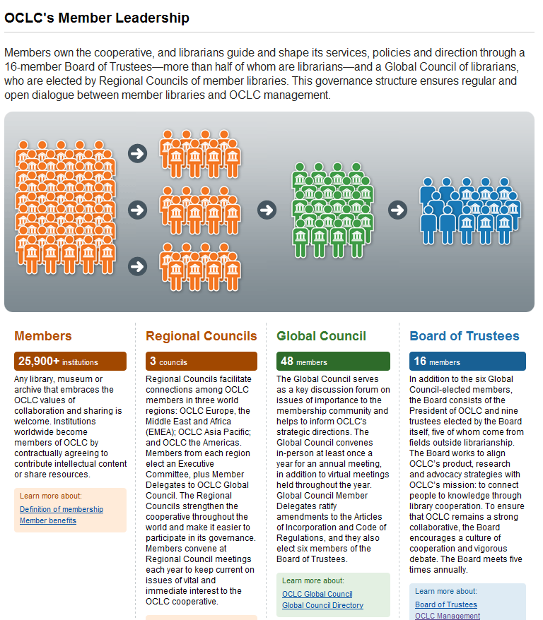
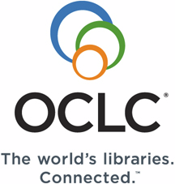
OCLC Online Computer Library Center, Inc
Non-profit, founded 1967
Mission:
Connecting people to knowledge through library cooperation.
Vision:
The world's libraries. Connected.
Members:
Americas = 21K+
Europe, Middle East, Africa = 2K+
Asia Pacific = 2.3K+
Non-profit corporation:
President + 16-member leadership team
~1100 staff located in 20 offices in 10 countries

Slide 5
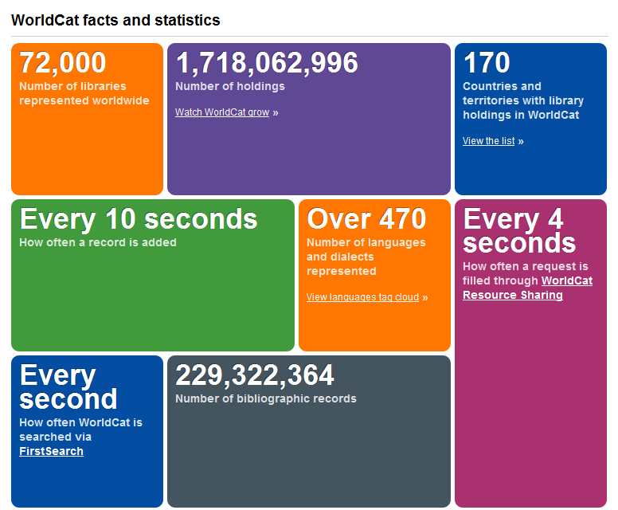

Slide 6
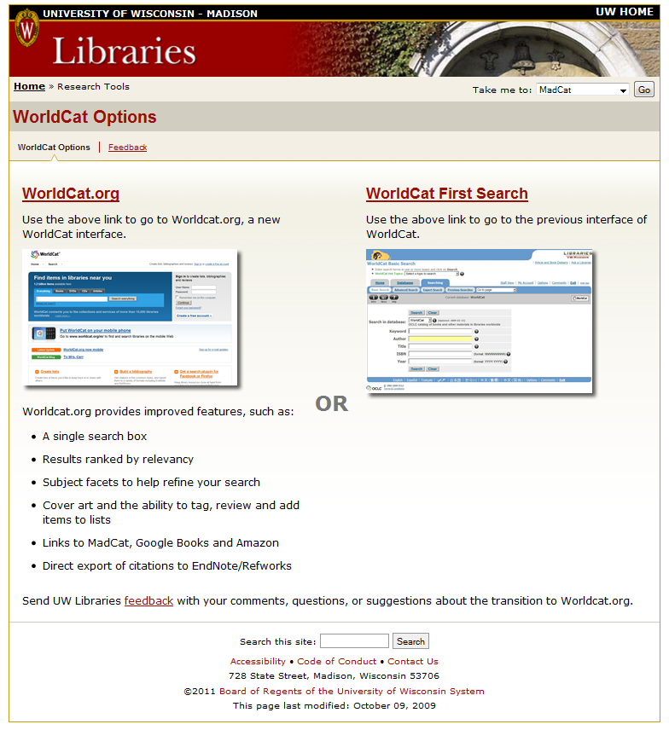
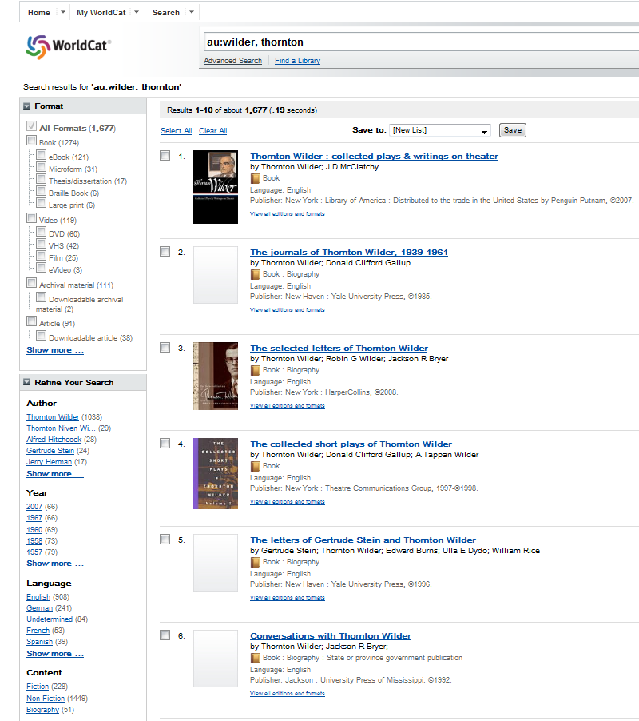

Slide 7
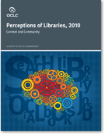
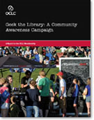
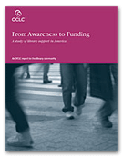
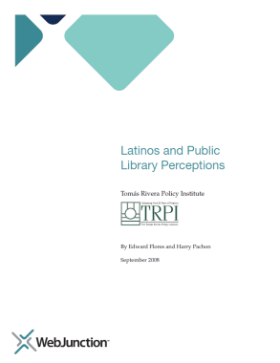
OCLC Membership Reports
Timely reports on important topics

Slide 8
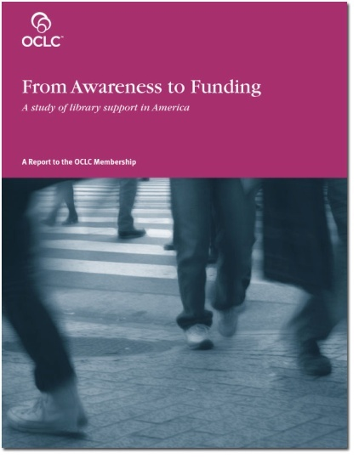
From Awareness to Funding: A study of library support in America
Issued 2008
Research and develop strategies for marketing and communication for U.S. Public Libraries to sustain and increase funding
Focus on:
  Residents in communities >200K
  Elected officials
OCLC with Leo Burnette (Firm)
Support from Gates Foundation

Slide 9
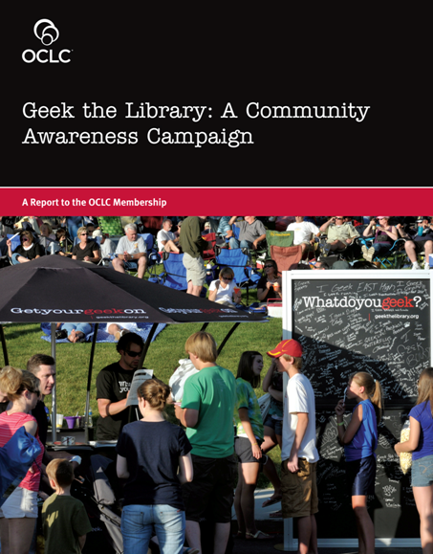
Geek the Library: A Community Awareness Campaign
Issued 2011
Tested a professionally-developed marketing and communication campaign approach for U.S. Public Libraries to sustain and increase funding
Pilot – 2009-2010
  Includ. in secondary mkt: Milwaukee Public Library System, WI (13 branches)
OCLC with Leo Burnette (Firm)
Support from Gates Foundation

Slide 10
Latinos and Public Library Perceptions
Issued 2008
Latino attitudes and habits with respect to public libraries
Arose from work related to WebJunction’s Spanish Language Outreach Program (Gates Foundation funded)
Six-state survey of adult Latinos conducted March to May 2008
WebJunction in collaboration with the Tomás Rivera Policy Institute
Notes:
“This report holds what is likely the most accurate data to date on Latino library usage. Prior research on Latinos and libraries has not been able to provide a reliable baseline and was not conducted at a scale to provide actionable data.” – executive summary

Slide 11
Perceptions of Libraries, 2010: Context and Community
Issued 2011
Revisits landscape-of-the-digital-consumer of the 2003 Perceptions report from OCLC
Surveyed residents of U.S., Canada, U.K. in January 2010
  Provides information on economically-challenged consumer attitudes
Harris Interactive blind study (survey) commissioned by OCLC

Slide 12
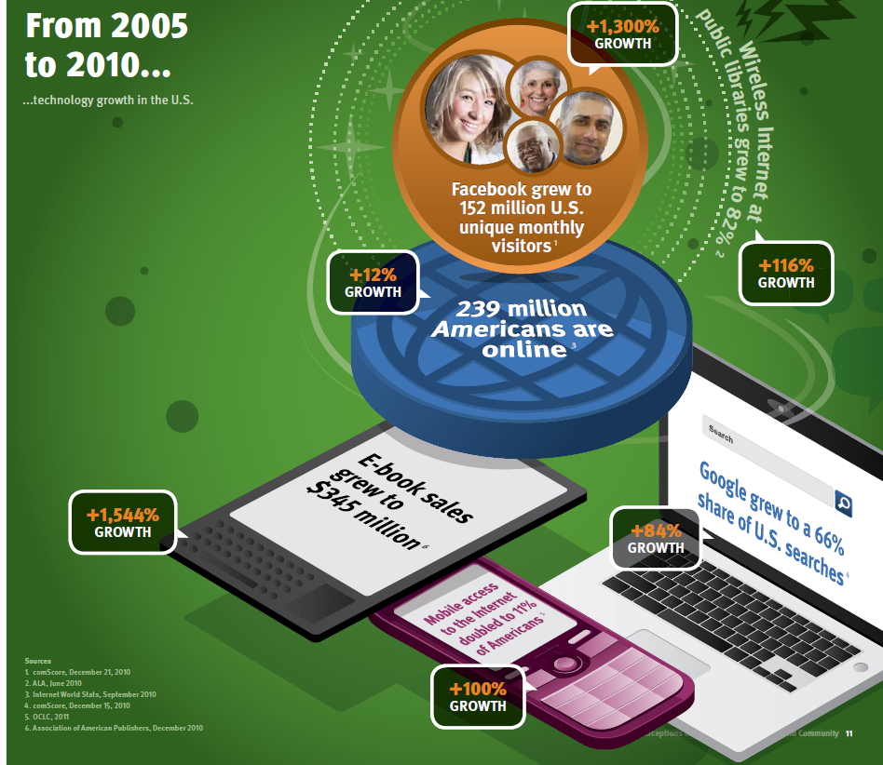
From 2005 to 2010
Trending up:
Social networking
Mobile devices
E-books
Google use
Public libraries providing wireless networking

Slide 13
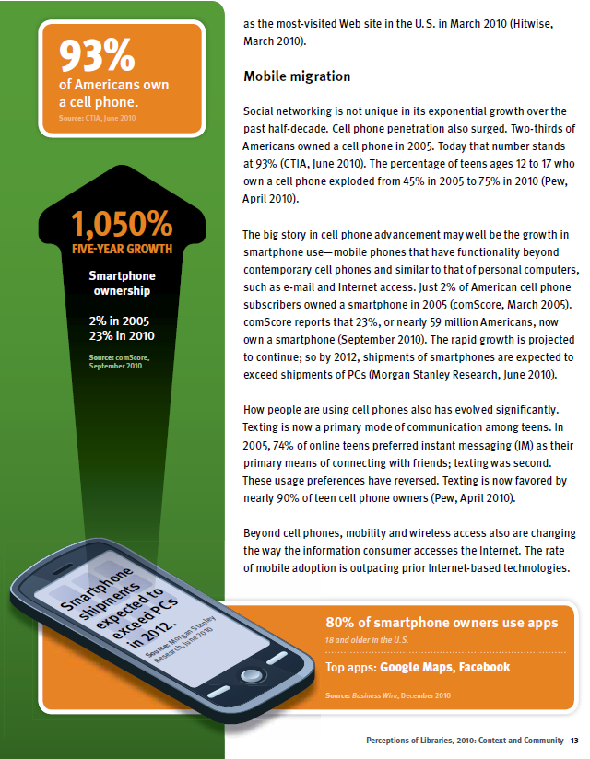
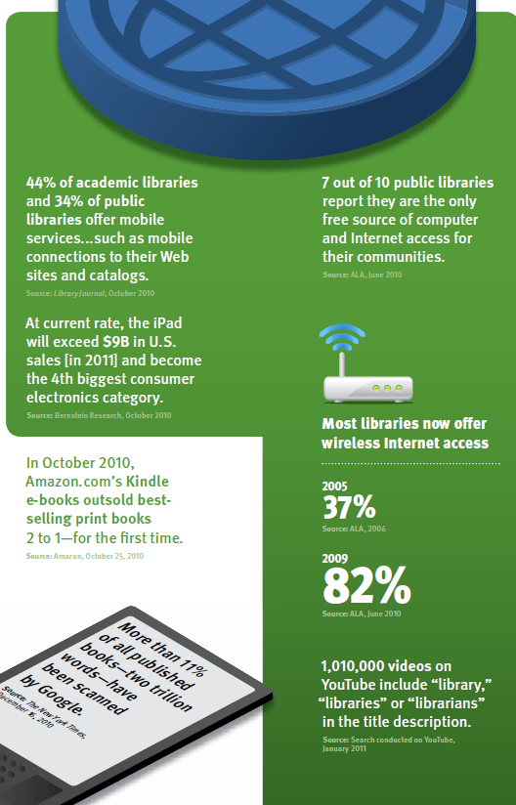
Socializing
Mobile devices are “in”
Smartphones
Ebook readers
Other media devices (Ipods, etc.
Libraries are supporting wireless networking
Notes:
While the battle of e-resources and services has intensified across
an increasing number of providers and services over the last five
years, the landscape of print book suppliers for consumers has
remained largely the same—Amazon, a few other large book
suppliers and libraries. Earlier we reviewed the number-one activity
at U.S. libraries is “borrowing print books,” followed by “leisure
reading.” When respondents were asked to identify the most
important role of the library, “books, videos and music” topped the
list. This view was consistent across all age groups surveyed with
the exception of teens ages 14–17, who indicated that “a place to
read” was the most important library role to them. Libraries as a
source of books remain both top-of-mind and top-of-personal-value
for Americans.

Slide 14
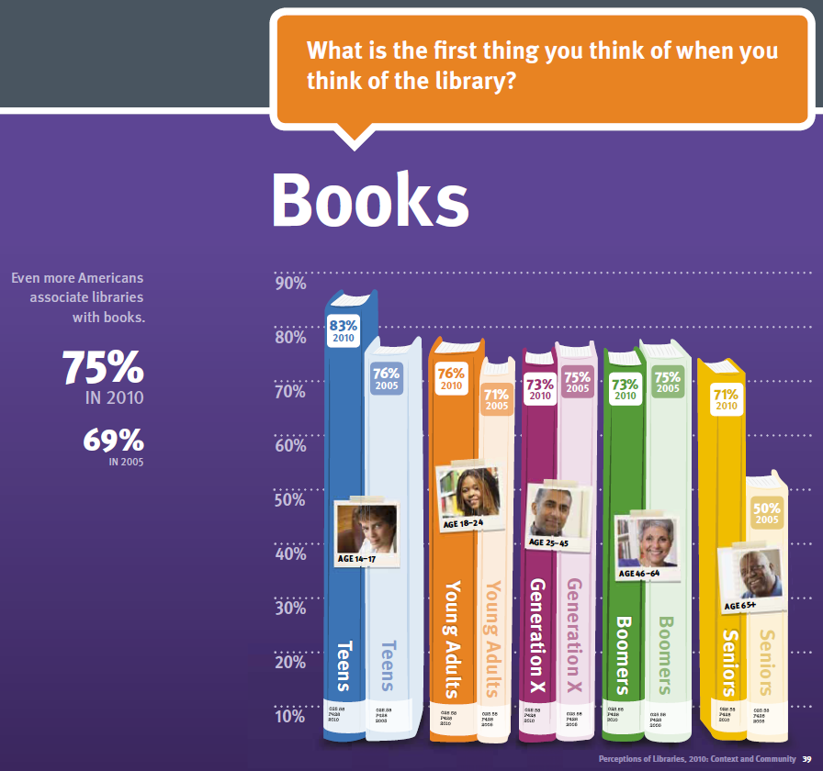
The Library Brand
“Books” are
libraries’ most
recognizable brand

Slide 15
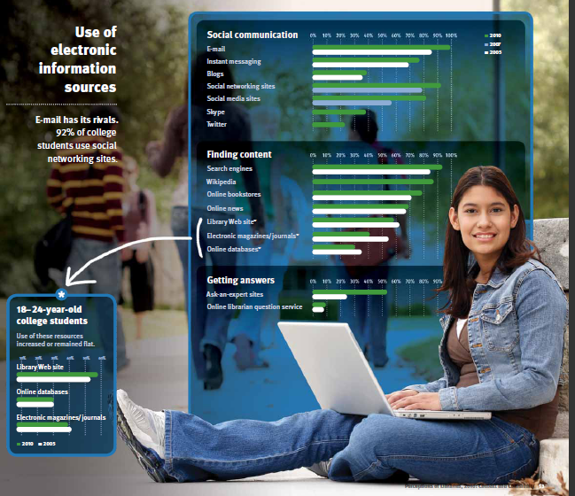
College students & e-info sources
New:
Skype
Twitter

Slide 16
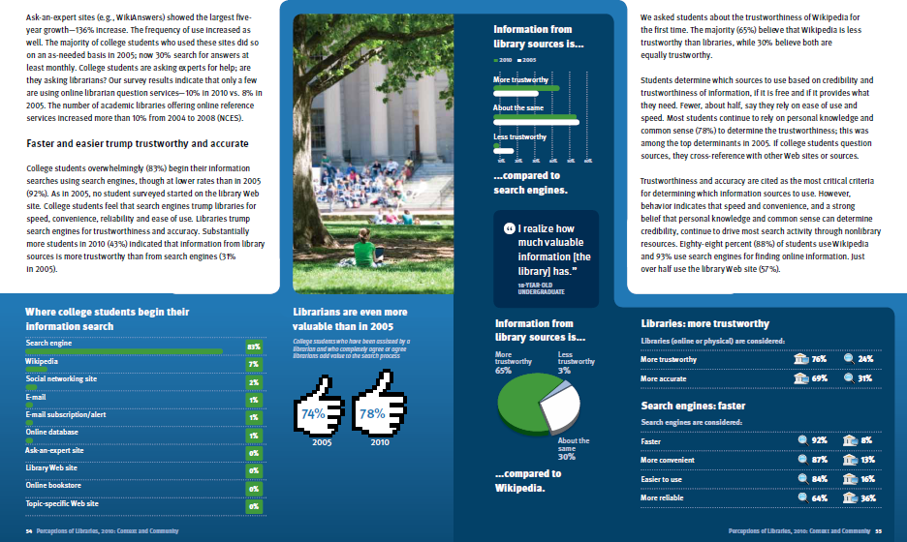
College students & perceptions of “good”
“However...speed and convenience, and a strong belief that personal knowledge and common sense can determine credibility, continue to drive most search activity through nonlibrary resources.”
“Trustworthiness and accuracy are cited as the most critical criteria for determining which information sources to use. “

Slide 17
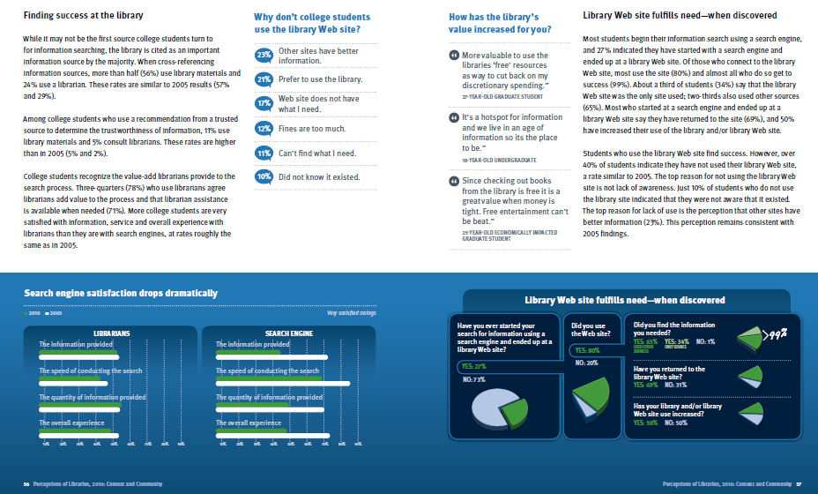
College students & search engines
While libraries may not be the first source college students turn to...When cross-referencing information sources, more than half (56%) use library materials and 24% use a librarian.
27% have started on the Web and ended on the library Web site
Of those who connect to the library Web site, most use the site (80%) and almost all who do so get to success (99%).

Slide 18
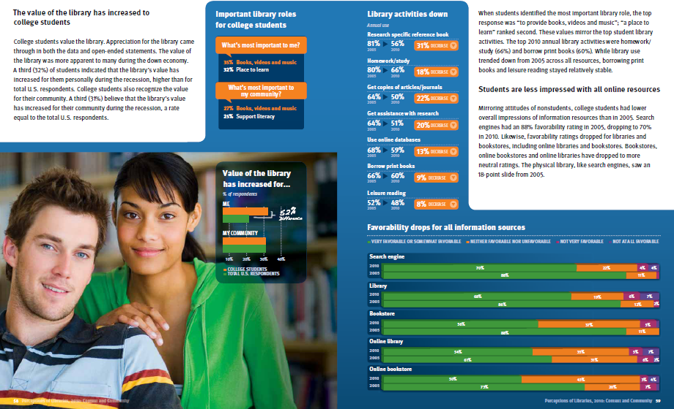
College students and library services
A third (32%) of students indicated that the library’s value has increased for them personally during the recession, higher than for total U.S. respondents
Libraries' most important role to students:
1) to provide books, videos & music
2) a place to learn
Top student use of libraries (2010):
1) homework/study (66%)
2) borrow print books (60%)

Slide 19
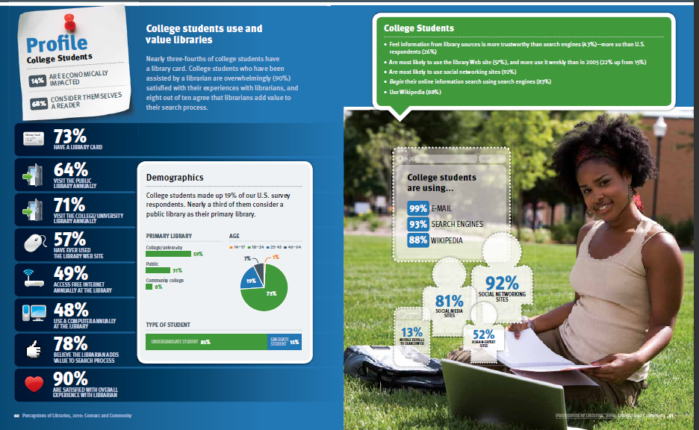
College students and libraries

Slide 20
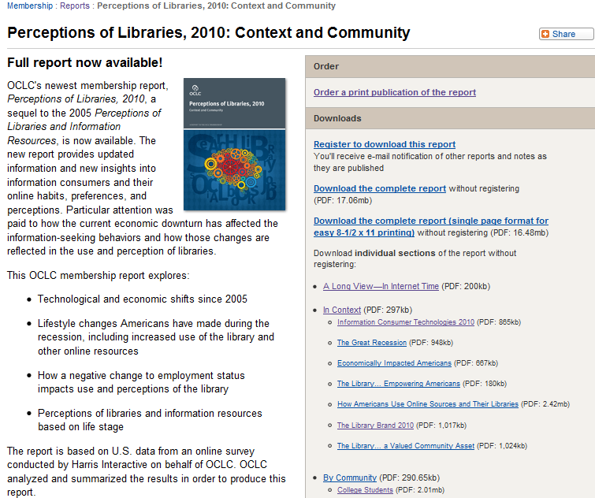
Read the full report...
Notes:
http://www.oclc.org/reports/2010perceptions.htm

Slide 21
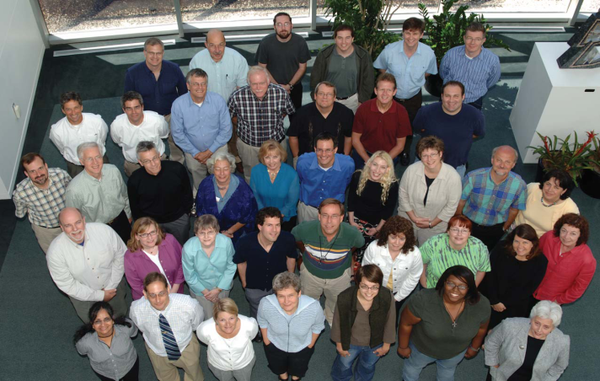
OCLC Research
Collaboratively identify problems and opportunities, prototype and test solutions, and share findings

Slide 22
OCLC Research
Focus:
  Applied research in support of OCLC’s public mission
  Exploration, innovation and community norms for libraries, archives and museums
Resources:
  ~50 OCLC Research staff in U.S. & Europe
    Expertise in libraries, archives, museums, metadata, controlled vocabularies, ILL, preservation, economics, computational linguistics, Web design, more…
  OCLC, ORLP, Innovation Lab, OCLC institutions, collaboration with other agencies
OCLC Research does:
  OCLC Research reports
  Prototypes
  Open source software
  Work with large data sets
  Grants/support for external research
  Peer-reviewed articles
  Standards-related work
Notes:
OCLC Research can trace it origins to a small research unit at OCLC, originally established by Fred Kilgour. It exists to conduct or advance applied research consistent with OCLC’s mission to reduce library costs and further access to information.
Slightly less than 50 staff are part of the unit – this varies over the year with interns, etc. – and includes a range of expertise and abilities. In many respects OCLC Research is a company within the company and has talent onboard from programmiing to web design to economics and beyond.
As OCLC provides a number of different research-based outputs, let me briefly say which OR does not do – we sometimes contribute to work by our Marketing staff who do membership reports like the famous Pattern Recognition, but we don’t do the reports, nor do we do WebJunction’s various reports. OCLC Research is not a product research and development unit though we will sometimes contribute to product/service work including transitioning work initially done in OR to our production systems.
OCLC Research does do a our own report series, build prototypes, create software, work with large data sets (esp. WorldCat), assist outside academic research work, publish in the peer-reviewed literature, and we are often involved in important standards work.

Slide 23
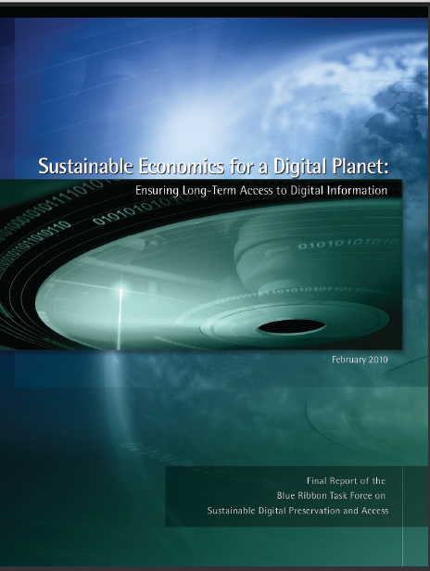
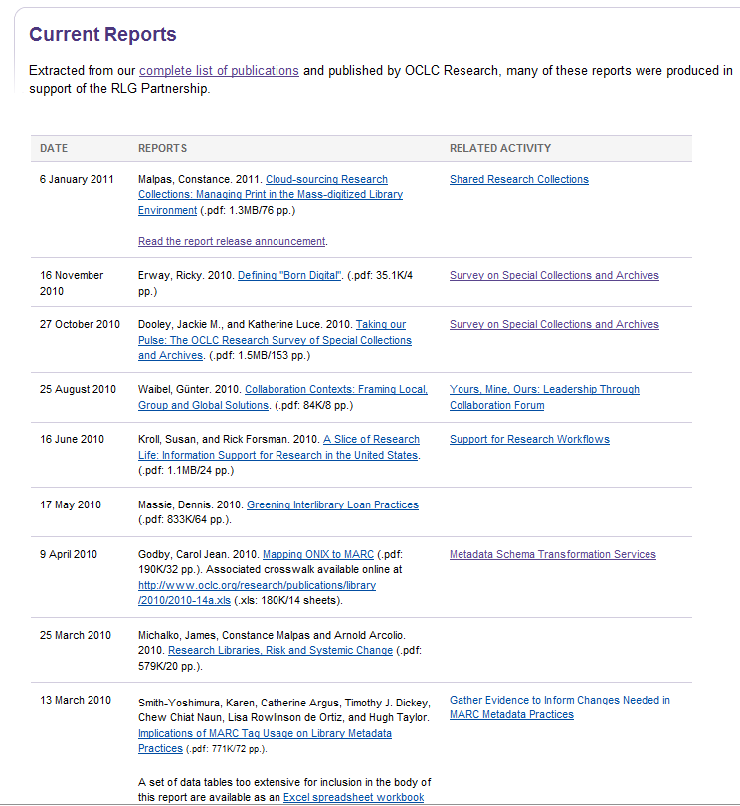
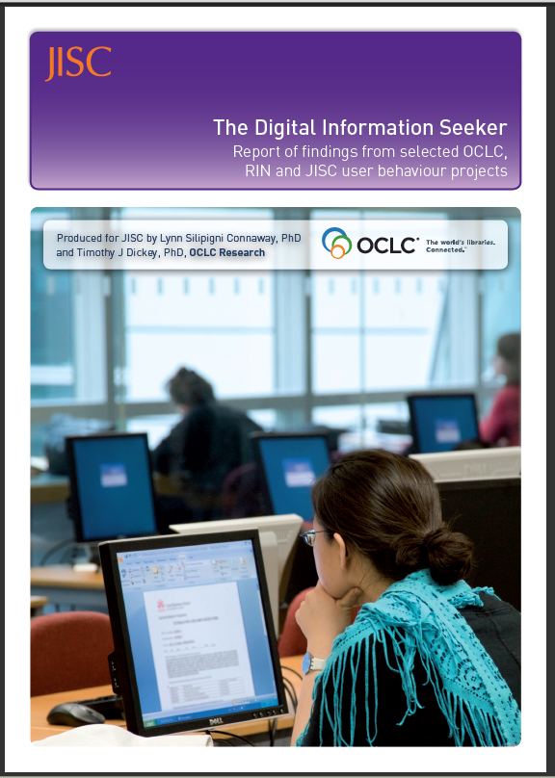
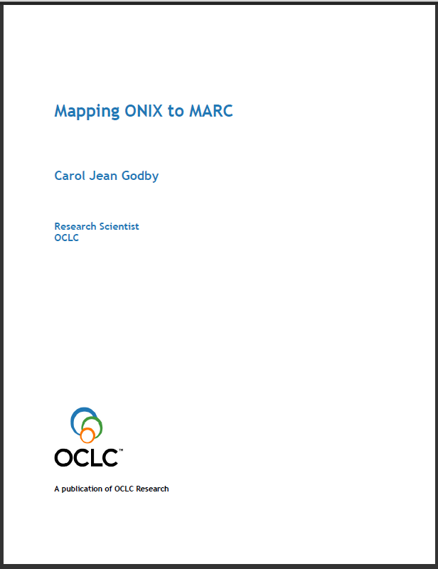
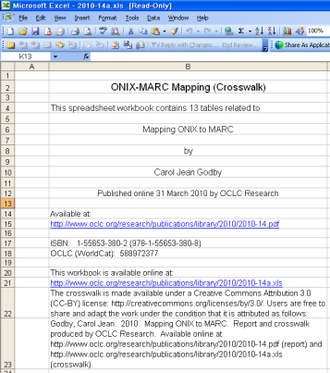
OCLC Research reports+

Slide 24
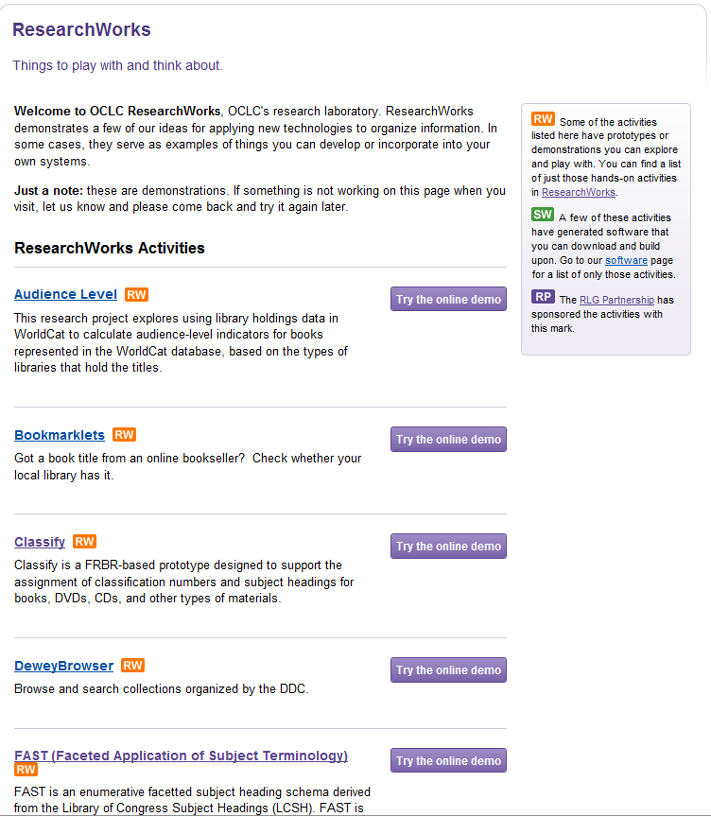
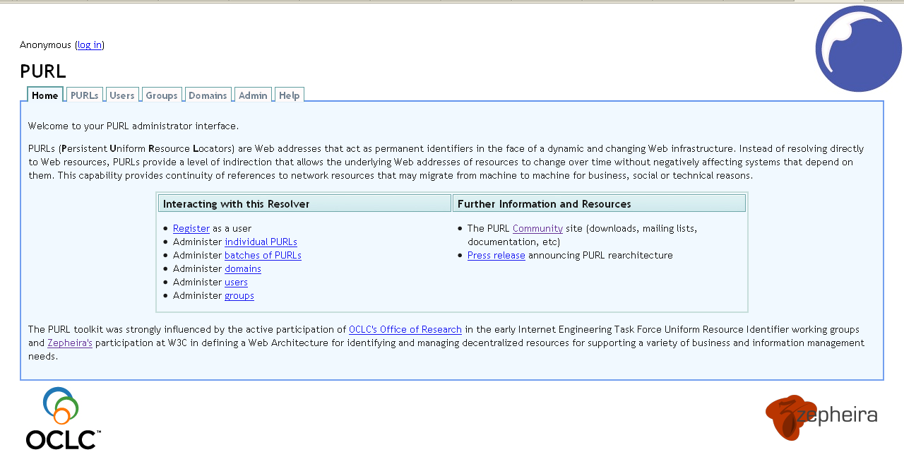
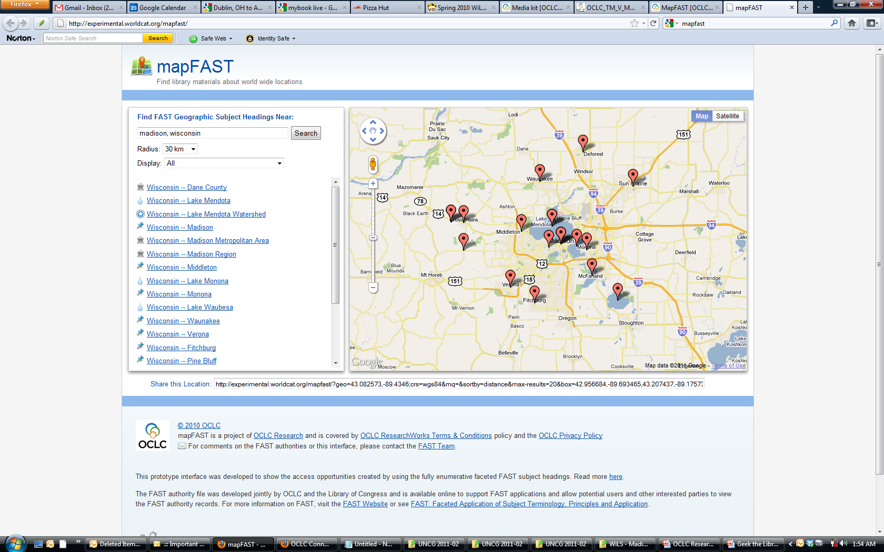
OCLC Research prototypes
Notes:
OCLC ResearchWorks is a labs area on the OCLC Research site that provides access to various experimental services and prototypes.
I’ve noted two examples – the PURL service which OCLC has been supporting as a free resolver service for many years; the other item is a new tool that maps FAST geographic headings to a map interface as a quick proof concept of the FAST subject headings work we’ve done (FAST is a faceted version of LCSH) – the latitude and longitude values for these geographic headings were captured by OCLC Research, added to the FAST headings, and also passed back to LC for LC to enrich its own LCSCH geographic headings.

Slide 25


Genres
Experimental service
Enables users to discover authors, topics, characters, places and more by genre
Provides access via WorldCat to library materials available locally and globally

Slide 26
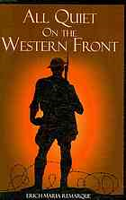
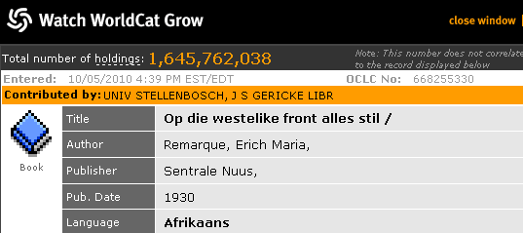

140 million
creative works
229 million
resource descriptions
1.7 billion library location symbols
Notes:
WorldCat includes nearly 200 million resource descriptions (bibliographic records) that represent more than 1 billion individual items held by libraries and other participating institutions. The descriptions are associated with more than 140 million creative works published as books, music, movies, etc.

Slide 27
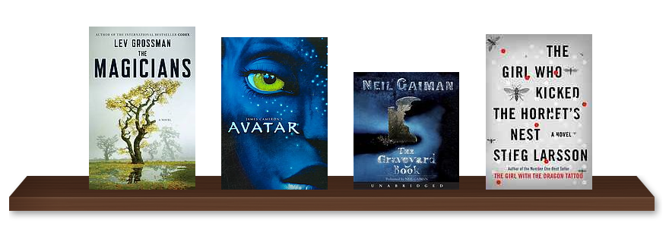
WorldCat is a vast resource containing rich content about millions of works, identities, classes, categories, subjects, people, places…

Slide 28
Some ways OCLC employs this data
WorldCat Identities
  Provides a summary page for every name in WorldCat (currently some 30 million names)
Classify
  An experimental service for assigning class numbers and subject headings
WorldCat Genres
  Enables users to view WorldCat by genre

Slide 29




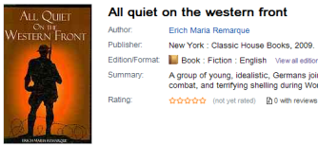
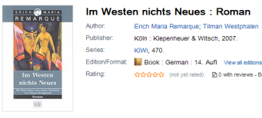
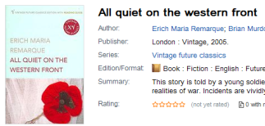

Sample work set
Work
Im Westen nichts Neues
German
Edition
English
Translations
Spanish
Audio book
Publications
Descriptions

Slide 30
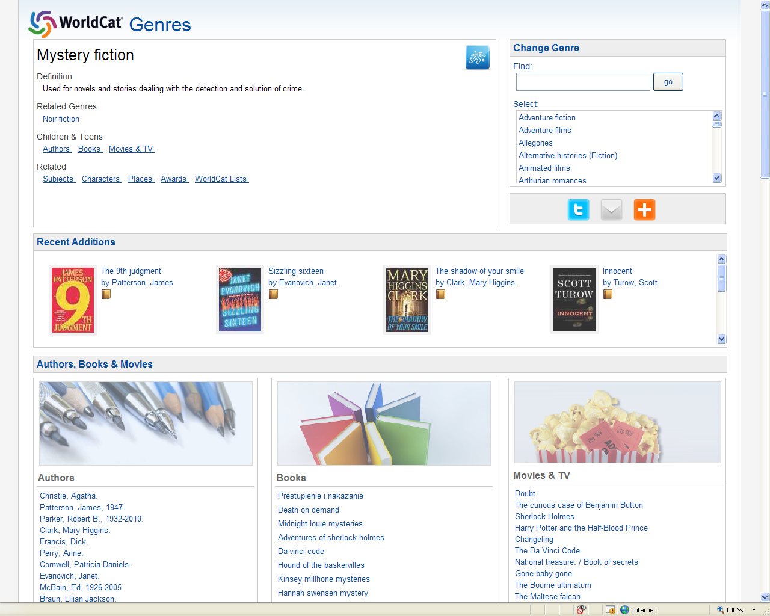
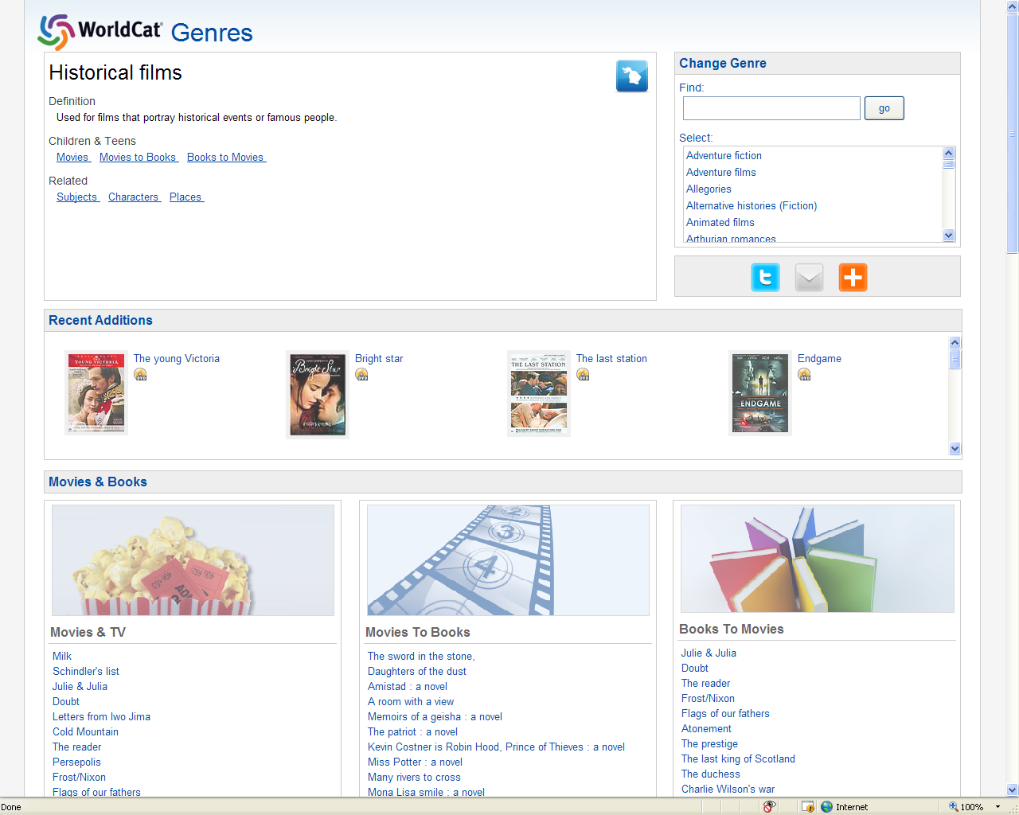
The challenge is to take advantage of key elements in convenient, useful and interesting services

Slide 31
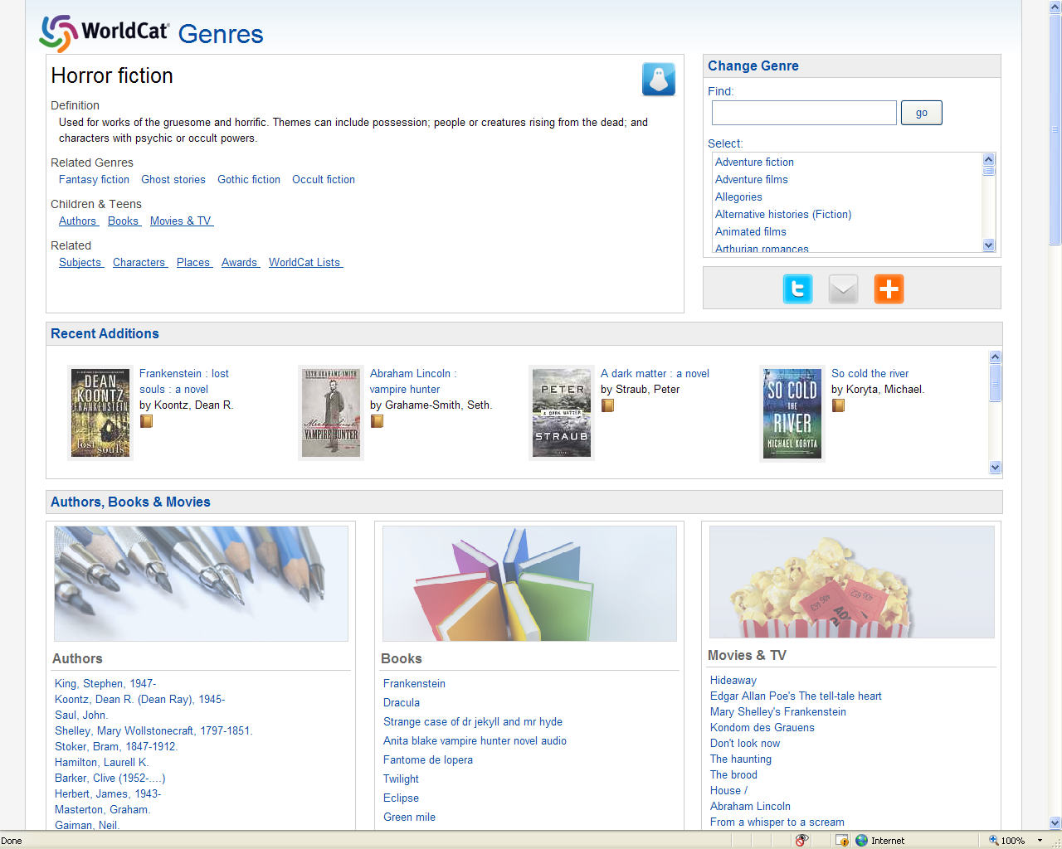
Notes:
The genre terms, definitions, and related headings are derived from controlled vocabularies.
Recent items are retrieved using the WorldCat API which makes a wide range of indexes available to software applications. There are indexes for subject, genre, geographic coverage and many other data elements. Results can be ranked by library holdings count and filtered by audience level.
The list of top authors is based on publications and holdings counts for an author in a given genre.

Slide 32
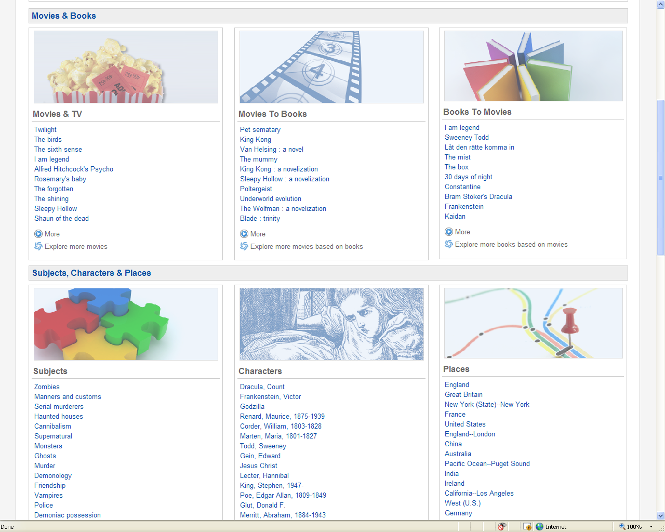
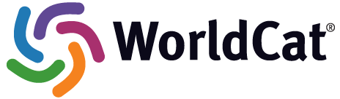
Notes:
For the following two sections, we use the World API to retrieve relevant items
Movies to Books > Movie novels
Books to Movies > Film adaptations
We also display subjects, characters, and places. These terms have been preprocessed to produce term pairs related to one another. In this case, ‘Zombies’ and ‘Serial murderers’ are topics strongly associated with Horror fiction, whereas ‘Friendship’ has a weaker association. By clicking on a term a user can explore a topic, e.g., friendship, or a place, e.g., Ireland in the context of the genre. The next slide provides brief summaries from the descriptions of the top horror films in WorldCat with Ireland as a setting.

Slide 33

Horror films + Ireland
Dementia 13. A noble Irish family find themselves at the mercy of an axe-wielding killer and are made prisoners in their secluded ancestral castle.
Plague town. In a remote village, a shocking secret lives on with each and every baby born. Now for a group of lost tourists, every conception of 'family' will soon be sliced to pieces
Shrooms. Keen for adventure, a group of American teenagers come to Ireland having been promised the "trip" of a lifetime by their Irish friend, Jake, a mushroom expert.

Slide 34
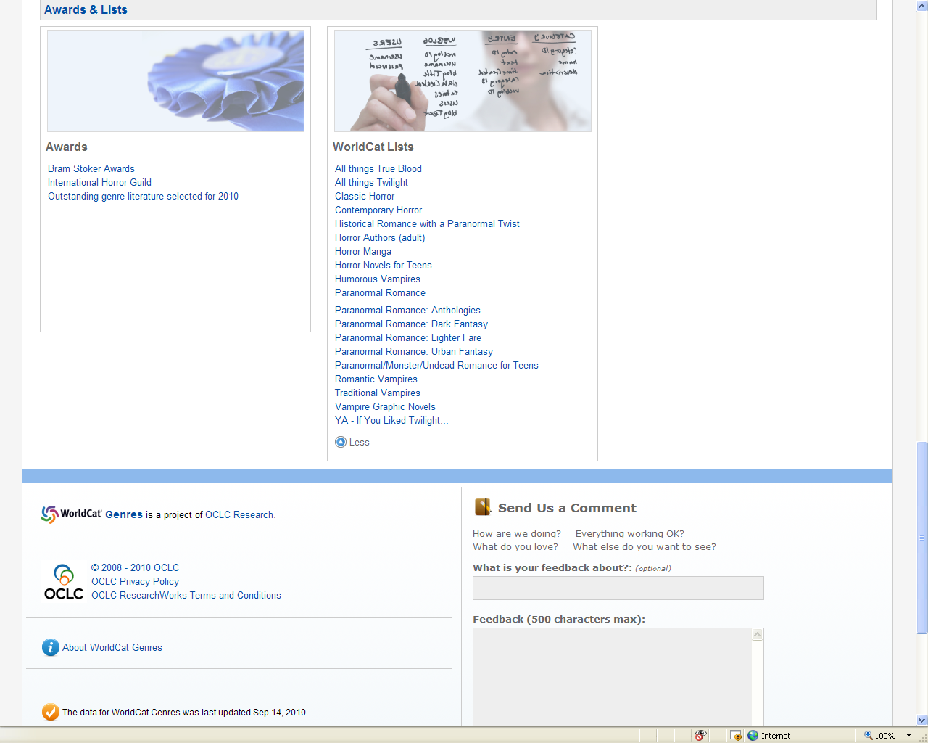
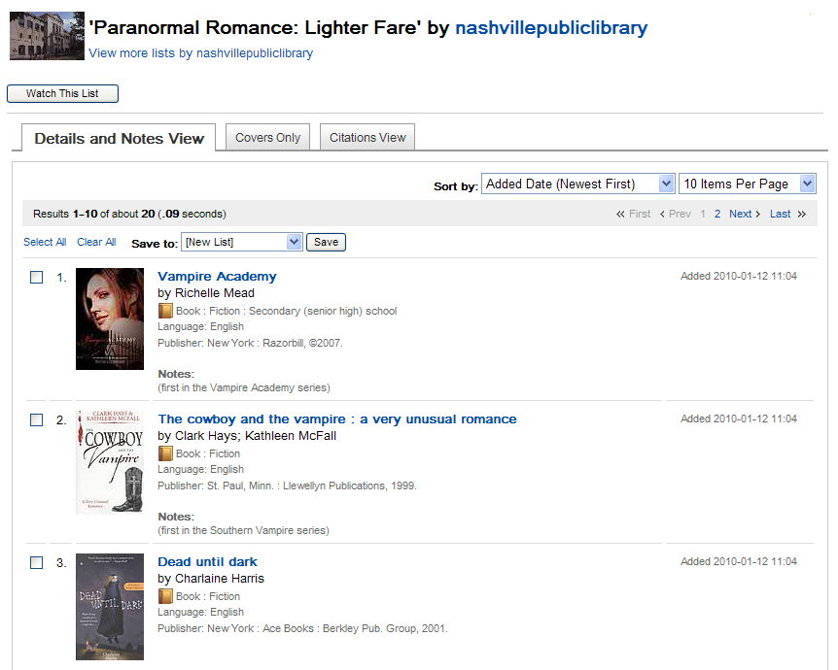
Notes:
At the bottom of the page we feature awards and lists. We provide links to lists created by WorldCat.org users and to external sites for film and literary awards. These are the only data elements that require human intervention to associate them with the genre term.

Slide 35
Top genres
Viewed
  Historical fiction
  Adventure fiction
  Fantasy fiction
  Mystery fiction
  Science fiction
  Horror fiction
  Love stories
  Spy stories
Requested
  Domestic fiction
  Psychological fiction
  Urban fiction

Slide 36
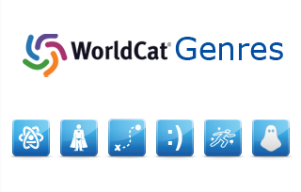
http://www.worldcat.org/genres/
Notes:
WorldCat Genres Team
OCLC Research
Carol Hickey
JD Shipengrover
Roger Thompson
Diane Vizine-Goetz
Harry Wagner
WorldCat.org
James Buettner
Bob Schulz

Slide 37
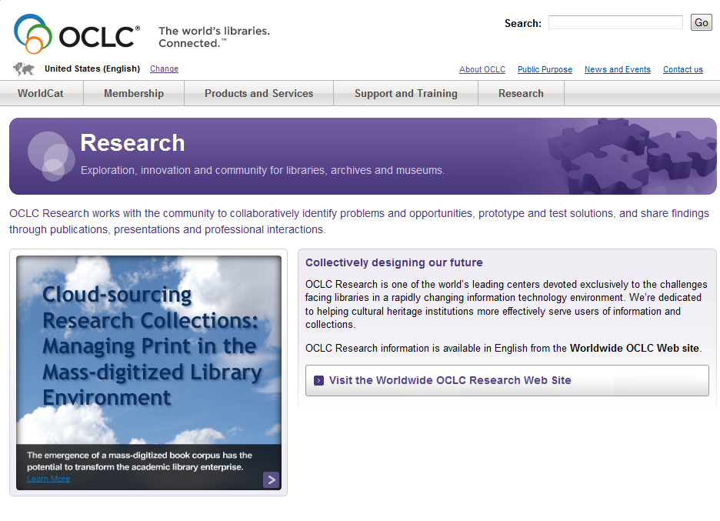
More information
OCLC Research Web site: http://www.oclc.org/research/

