Slide 1


OCLC Research:
Shared Issues, Collaborative Work for Libraries and Beyond
Eric Childress
Consulting Project Manager
OCLC Research
UNCG - Spring, 2011 UL/LIS Lecture
Notes:
Greensboro, North Carolina. 2011-02-22
It’s my pleasure to be able to talk to all of you about OCLC Research today.
A little about me – I’m a cataloger by training and initially worked in what is now the Metadata Services products area at OCLC. I was loaned to OCLC Research for some specific projects and eventually asked to join OR permanently. My role is to provide logistical and project management support including things like working with other parts of OCLC to help the leverage work done originally in OCLC Research.

Slide 2
Outline
About OCLC
About OCLC Research
Selected OCLC Research activities
  VIAF (Virtual International Authority File)
  WorldCat Identities
  Greening Interlibrary Loan Practices
  Cloud-sourcing Research Collections: Managing Print in the Mass-digitized Library Environment

Slide 3
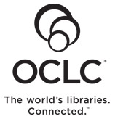
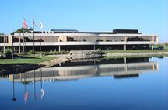
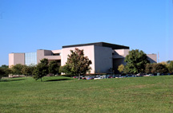
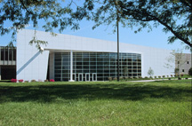
OCLC Online Computer Library Center, Inc.
Non-profit, founded 1967 for Ohio academic libraries
Conducts/supports applied research, advocacy, fostering industry standards & best practices
Cooperative cataloging, interlibrary loan, virtual reference + DAM (digital asset mgt.), DDC, more
Governance: member-elected Regional/Global Council ; Board of Trustees (some elected by GC)
Institutions: 72K in 170 countries
1100 staff, 22 offices in 10 countries
Annual revenue = ~$220 M

Slide 4
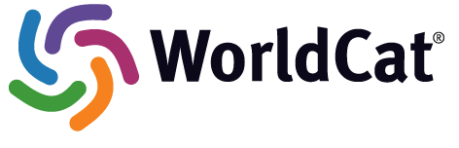
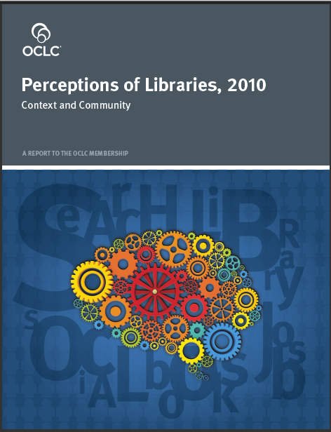
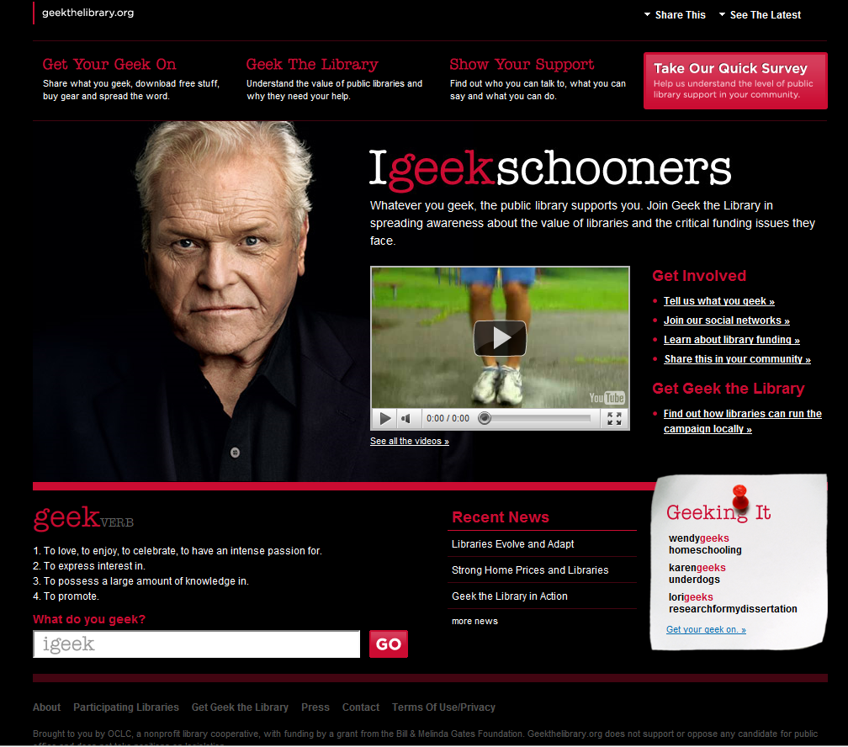
214 M bibliographic records
1.6 B holdings
Notes:
Just so by way of quick illustration, here 3 items of potential interest:
Product/service: WorldCat, OCLC’s second-best-known endeavor and the one that started it all – the world’s largest cooperative library catalog
A research study – this one done by OCLC’s marketing group; this is the latest in a group of reports that have arisen after OCLC produced it’s initial draft installment “Scan” report for OCLC Member’s Council and was instructed by Council to complete and issue the report with due speed. The focus of the reports vary, but generally focus on exploring trends and/or perceptions critical to libraries. We often work with outside parties such as Harris Interactive to conduct mulit-country surveys of users.
An advocacy campaign – done in part with outside grants and working with highly-regarded outside private firm, Geek the Library is designed to assist U.S. public libraries in particular with assembling library impact data for decision-makers and colorful campaign materials to help library advocacy work in local communities.

Slide 5
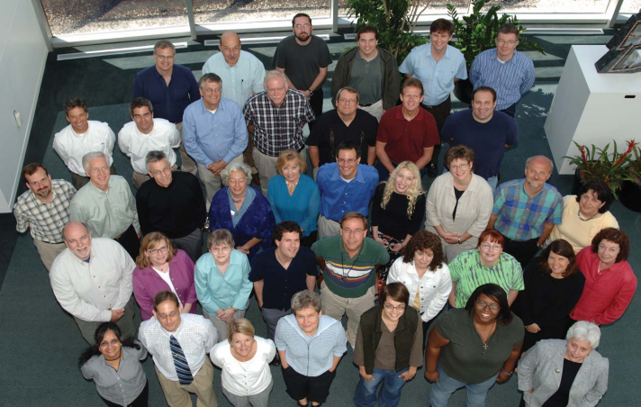
OCLC Research
Focus:
  Applied research in support of OCLC’s public mission
  Exploration, innovation and community norms for libraries, archives and museums
Resources:
  ~50 OCLC Research staff in U.S. & Europe
    Expertise in libraries, archives, museums, metadata, controlled vocabularies, ILL, preservation, economics, computational linguistics, Web design, more…
  OCLC, RLG Partnership, Innovation Lab, OCLC institutions, collaboration with other agencies
OCLC Research does NOT do:
  OCLC Membership reports
  WebJunction reports
  Product R&D
OCLC Research does do:
  OCLC Research reports
  Prototypes
  Open source software
  Work with large data sets
  Grants/support for external research
  Peer-reviewed articles
  Standards-related work
Notes:
OCLC Research can trace it origins to a small research unit at OCLC, originally established by Fred Kilgour. It exists to conduct or advance applied research consistent with OCLC’s mission to reduce library costs and further access to information.
Slightly less than 50 staff are part of the unit – this varies over the year with interns, etc. – and includes a range of expertise and abilities. In many respects OCLC Research is a company within the company and has talent onboard from programming to web design to economics and beyond.
As OCLC provides a number of different research-based outputs, let me briefly say which OR does not do – we sometimes contribute to work by our Marketing staff who do membership reports like the famous Pattern Recognition, but we don’t do the reports, nor do we do WebJunction’s various reports. OCLC Research is not a product research and development unit though we will sometimes contribute to product/service work including transitioning work initially done in OR to our production systems.
OCLC Research does do a our own report series, build prototypes, create software, work with large data sets (esp. WorldCat), assist outside academic research work, publish in the peer-reviewed literature, and we are often involved in important standards work.

Slide 6
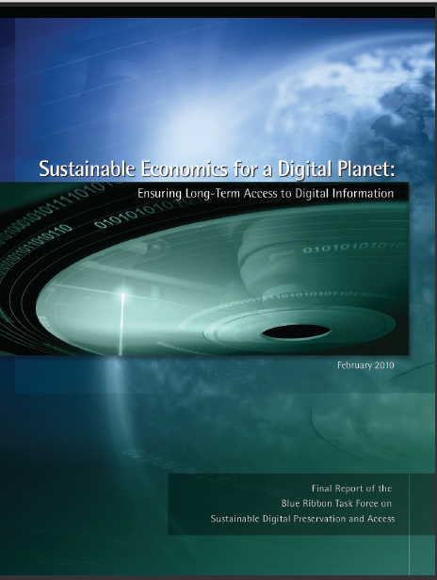
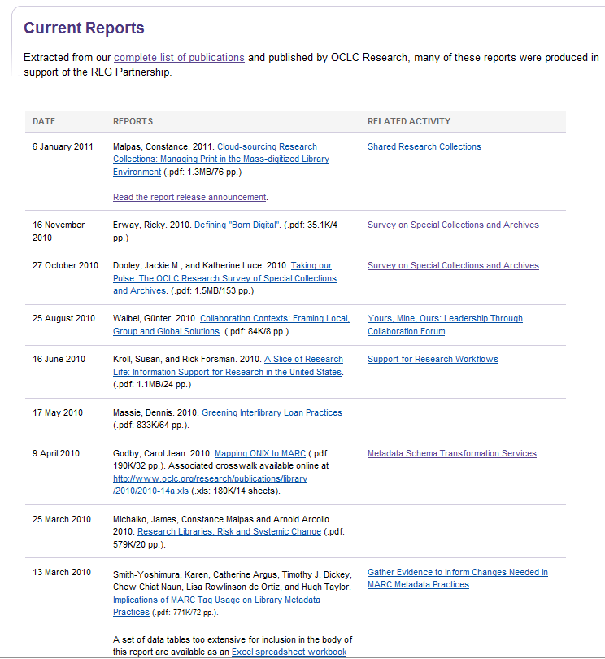
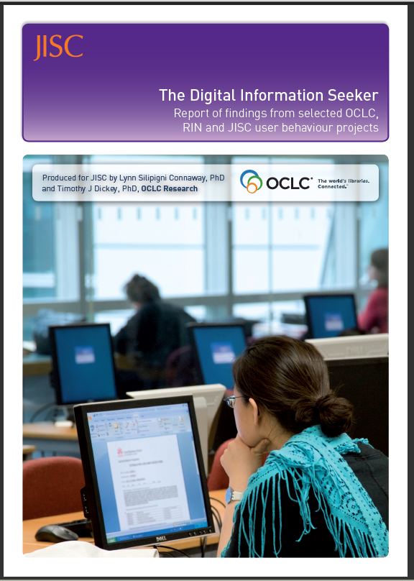
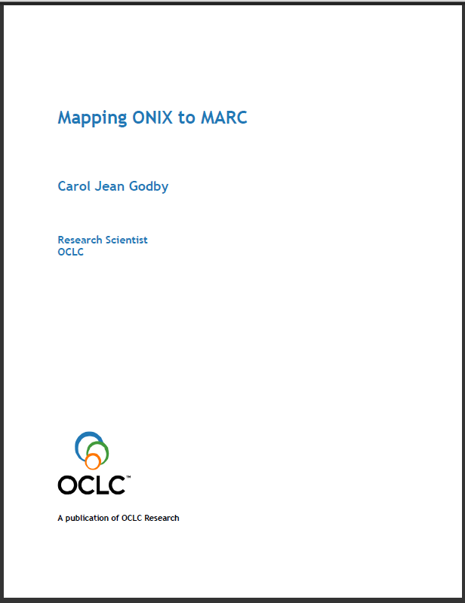
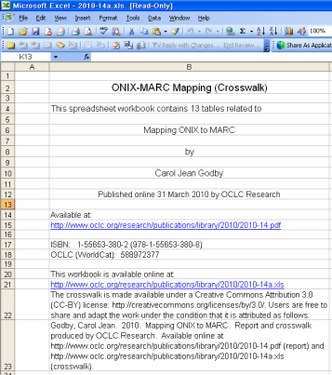
OCLC Research reports+
Notes:
Let me highlight a few outputs.
We issue on average about a report per month. Many of these are related to activities that the RLG Partnership has had a key role in, but not all. The center document, Mapping ONIX to MARC is an example of a non-RLG Partnership oriented report that was recently released with an accompanying spreadsheet that offers 13 tables of crosswalk logic.
OR staff are also often important contributors to reports issued by other bodies. The two reports pictured are examples. One is a report of a NSF Blue Ribbon Panel on Preservation that examined sustainability in the context of preservation management -- one of our scientists co-chaired the panel. The other is a synthesis of a number of recent user studies from OCLC and various UK agencies.

Slide 7
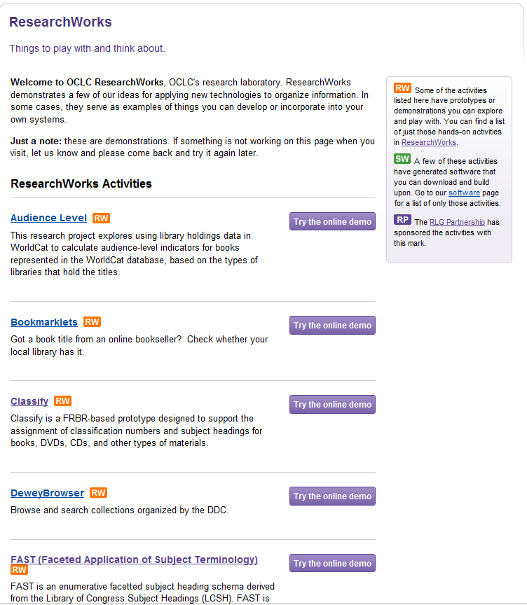
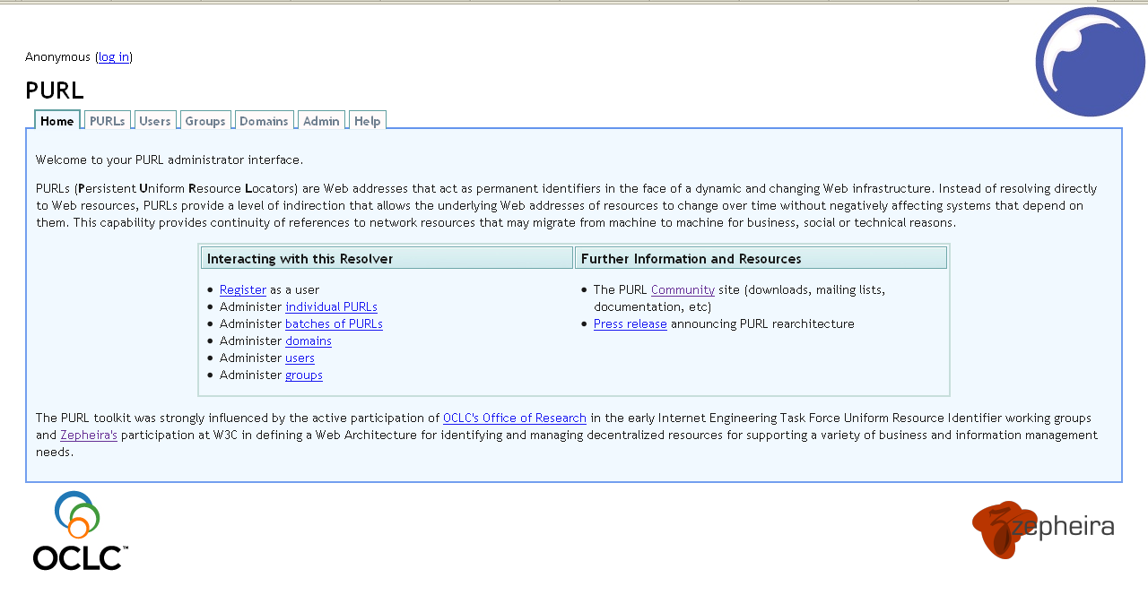
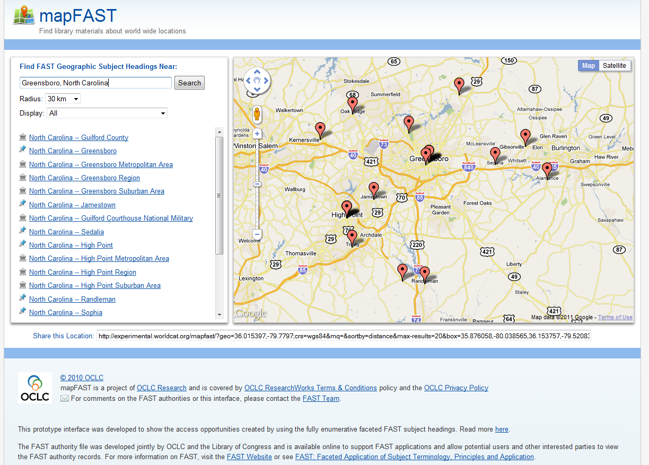
OCLC Research prototypes
Notes:
OCLC ResearchWorks is a labs area on the OCLC Research site that provides access to various experimental services and prototypes.
I’ve noted two examples – the PURL service which OCLC has been supporting as a free resolver service for many years; the other item is a new tool that maps FAST geographic headings to a map interface as a quick proof concept of the FAST subject headings work we’ve done (FAST is a faceted version of LCSH) – the latitude and longitude values for these geographic headings were captured by OCLC Research, added to the FAST headings, and also passed back to LC for LC to enrich its own LCSCH geographic headings.

Slide 8
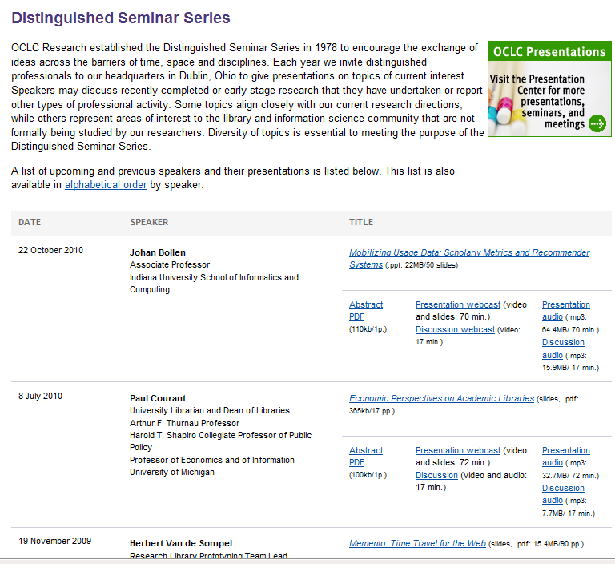
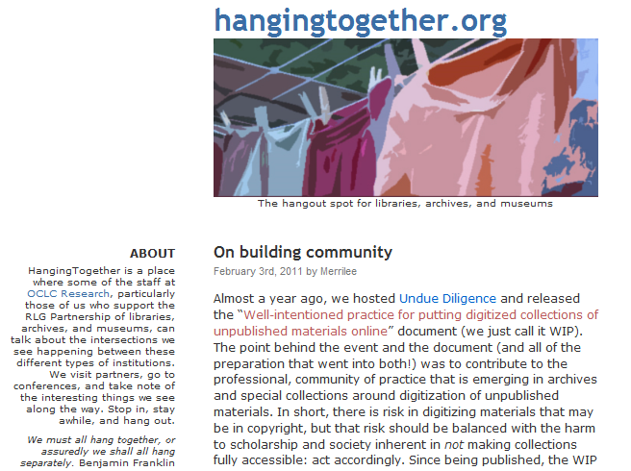
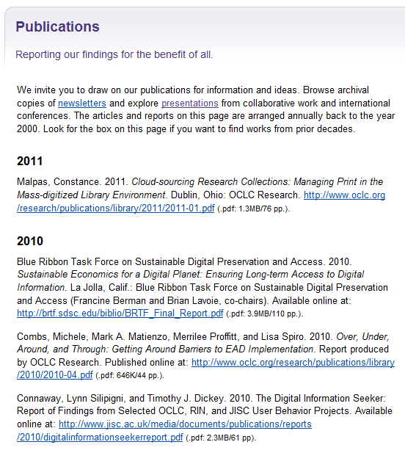
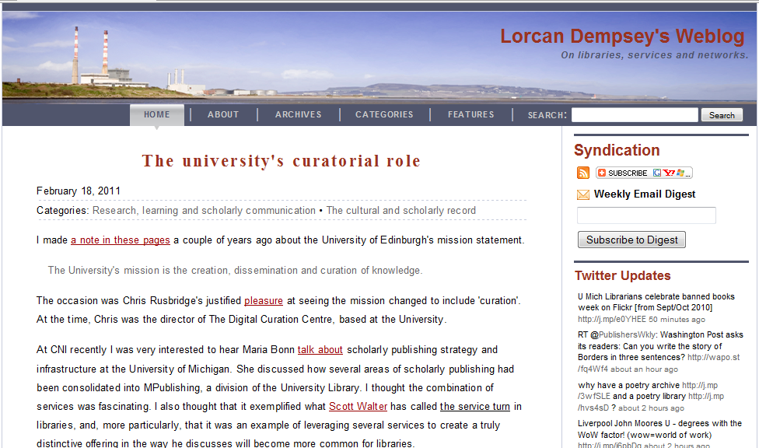
OCLC Research events, blogs...
Notes:
OCLC Research also hosts invited lectures several times a year, each by a scholar or thought leader.
Our staff also make a variety of presentations during the year, and we do our best to gather and post these in a single place on the OCLC web site.
And lastly, not least, OCLC Research staff pen several widely-read blogs.
Our reports, presentations, annual RLG Partnership meeting presentations, etc. are made available to anyone, OCLC member or not, as part of OCLC’s public mission. We think the work we do adds value, and we’re delighted to share it.

Slide 9
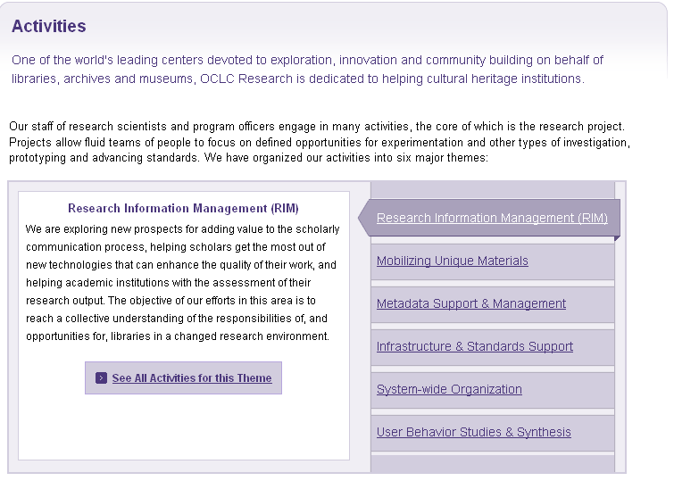
OCLC Research Activities
Notes:
OCLC Research typically has dozens of projects and prototypes active at any given moment. To help present these activities in a cogent manner, we’ve divided our activities into six broad “themes.”
- Researching Information Management (RIM) includes activities that explore the information and communication needs and patterns of modern scholars
- Mobilizing Unique Materials is focused on exploring economies and efficiencies for special collections and unique materials in libraries, archives, and museums
- Metadata Support & Management is centered on activities that advance the state of the art and more efficiently and effectively match resource description done by libraries, archives, and museums with the needs of today’s and tomorrow’s users
- Infrastructure & Standards Support includes work on standards, models, and shared infrastructure for libraries, archives, and museums
- System-wide Organization activities are extending and enriching our understanding of how to more effectively manage the collective collection (i.e. resources distributed across all libraries, archives, and museums) in a digital age
- User Behavior Studies & Synthesis includes studying the behavior of library users to identify and share recommendations on how to better serve library users' needs now and in the future

Slide 10
Sample projects
Metadata Support & Management
  VIAF (Virtual International Authority File)
  WorldCat Identities
System-wide Organization
  Greening Interlibrary Loan Practices
  Cloud-sourcing Research Collections: Managing Print in the Mass-digitized Library Environment

Slide 11
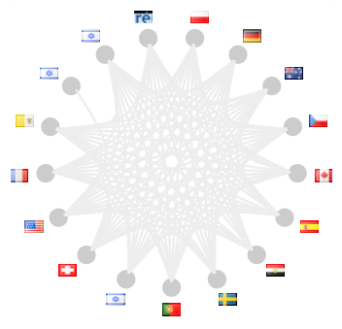
VIAF (Virtual International Authority File)
Cooperative project
  Led by BnF, DNB, LC and OCLC
Matching & merging of national-level authority files
Browser interface
Machine services
http://viaf.org/

Slide 12
VIAF (cont’)
As of Jan 2011:
  21 files
  17 million names
  6.5 million links
  14 million clusters
  Personal, corporate, conference names
Leverages both authority files and bibliographic data (including data mining of WorldCat)
OCLC Research-developed software routines benefit from review/reporting of experts in VIAF organizations
Future: transition to OCLC production service

Slide 13
Why do VIAF?
Potentially faster, better, cheaper authority work
  VIAF is concrete expression of long-time IFLA idea of system for sharing/leveraging authority work across communities –
Disambiguation is valuable
  ISNI (International Standard Name Identifier) will leverage VIAF to help populate and maintain its files
  Localization made easier
Linked data
  VIAF provides a predictable identifier to link authority files, various names and identifier – a “hub” grade identifier
  VIAF data is freely accessible in machine-readable form
  Freebase, other projects leveraging VIAF

Slide 14
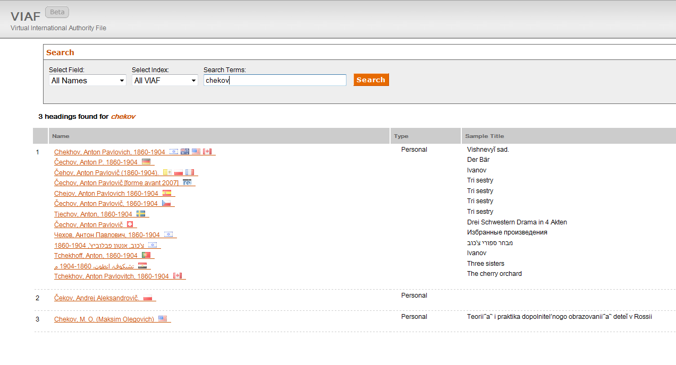

Slide 15
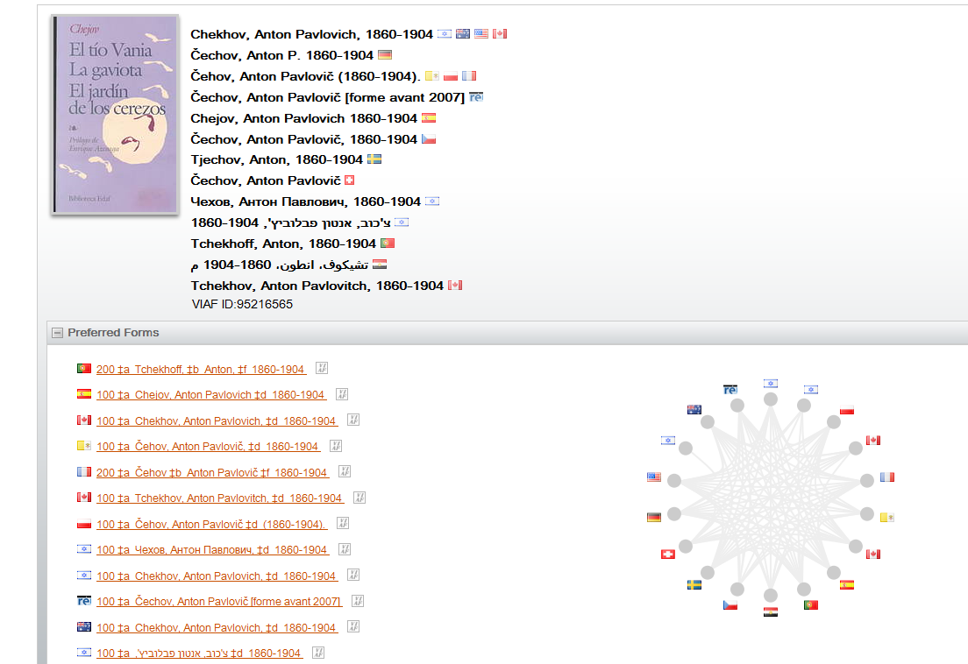

Slide 16
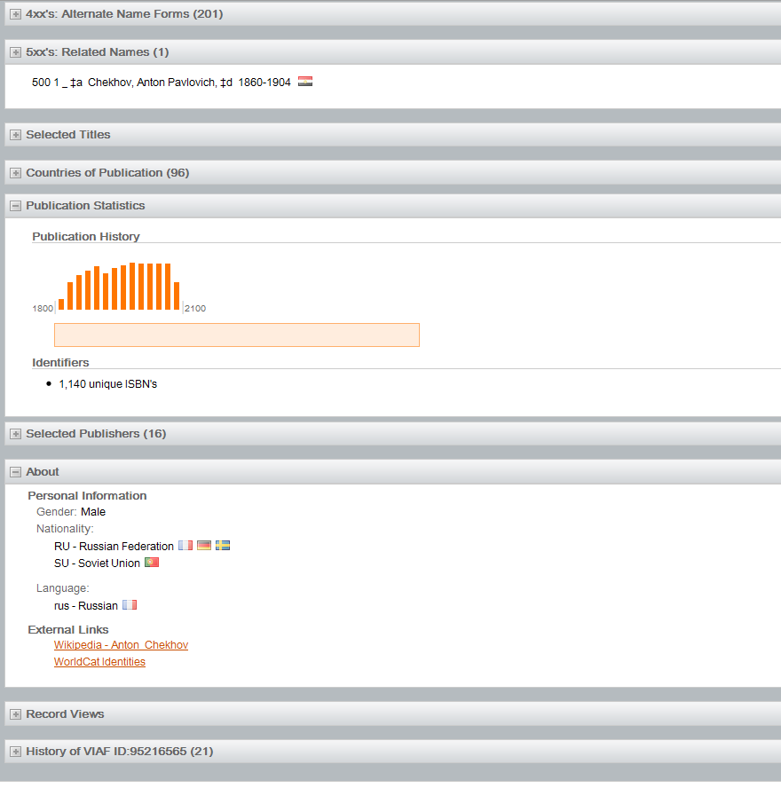

Slide 17
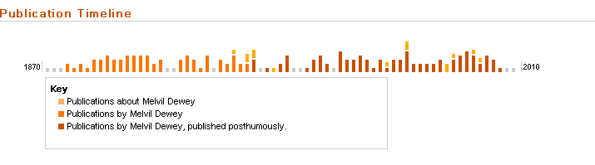
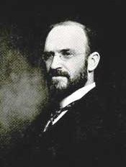
WorldCat Identities
Using data mining techniques OCLC builds a summary page for persons and corporate bodies referenced in WorldCat bibliographic records (25 million⁺)
Data is derived from bibliographic data and authority records and holdings in WorldCat
Special features include a publication timeline:

Slide 18
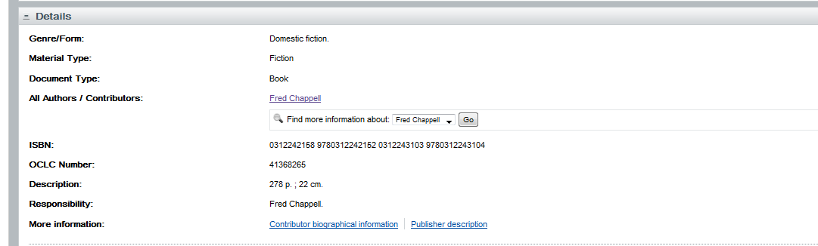
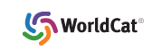
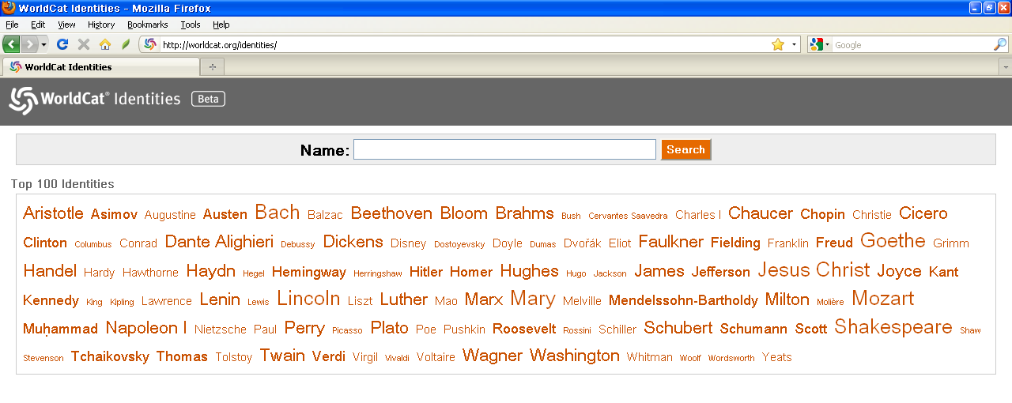

Slide 19
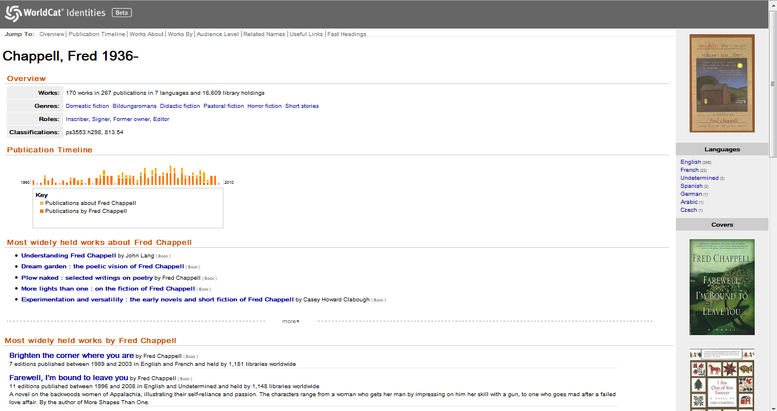
Notes:
Main panel:
-Overview
Number of works, languages, library holdings
Genres
Most commonly-assigned subject headings
LCC and DDC numbers

Slide 20
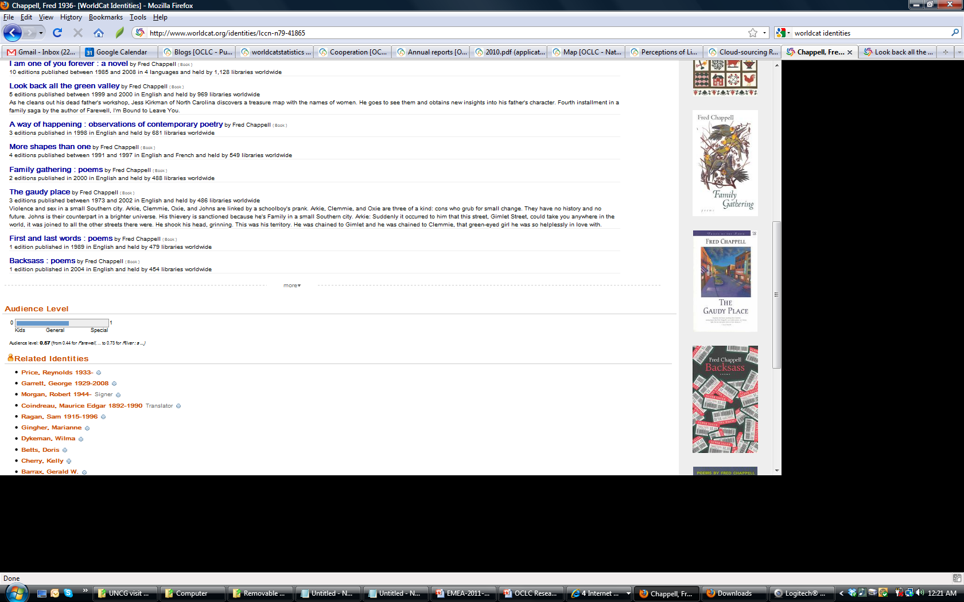
Notes:
Most widely held works by Linda Ronstadt (con’t)
Audience Level – this is from an OCLC Research project that uses information in bibliographic records and holdings to calculate an approximate, relative audience level across all of the author’s works
Related identities – these persons, agencies, characters co-occur in bibliographic records with the identity

Slide 21
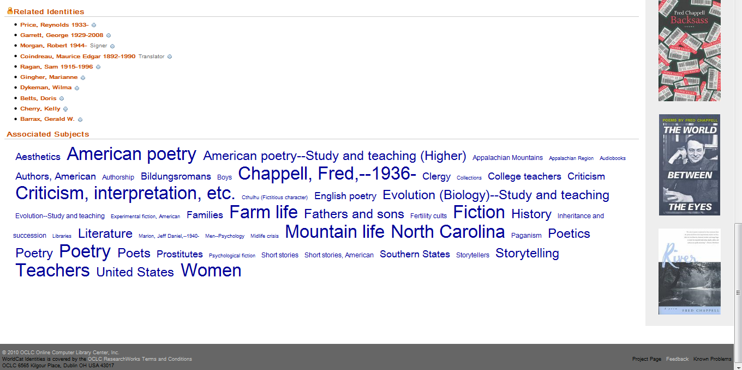
Notes:
Useful links – links to authority files and Wikipedia as we know them
Associated subjects – subject headings from things by and about the identity in a tag cloud
Note: These are FAST headings (from an OCLC Research project that facets LC subject headings into less complex strings)

Slide 22
Greening Interlibrary Loan Practices
Goal: reduce carbon footprint of entire resource sharing system
3-month study led to OCLC Research report
  Funded by OCLC Research and OCLC Delivery Services
  Contracted with California Environmental Associates (www.ceaconsulting.com) for analysis
  Interviews and data from selected libraries
    10 libraries on consortia arrangements, shipping methods and guidelines, and packaging material composition and sourcing
  Determined per book-mile greenhouse gas emissions and associated impacts from packaging, shipping, and paper use for 4 lending institutions
  Offered recommendations for best practices

Slide 23
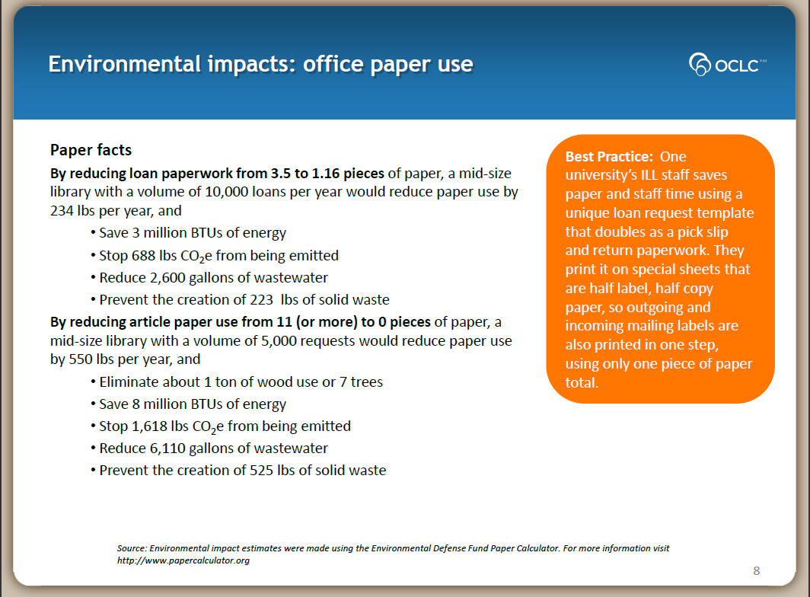
Sample findings…

Slide 24
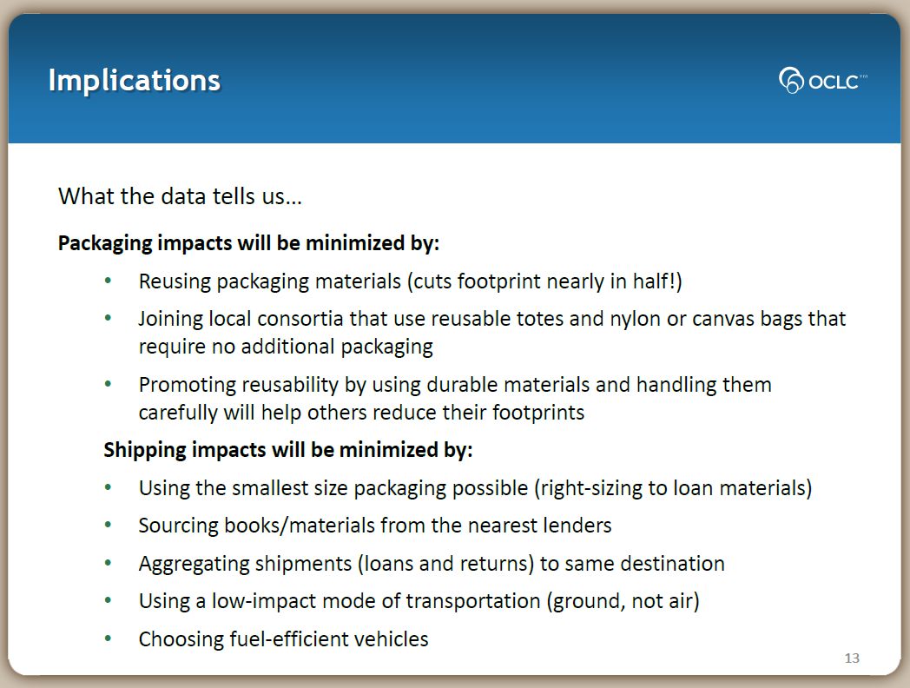
Implications for best practice…

Slide 25
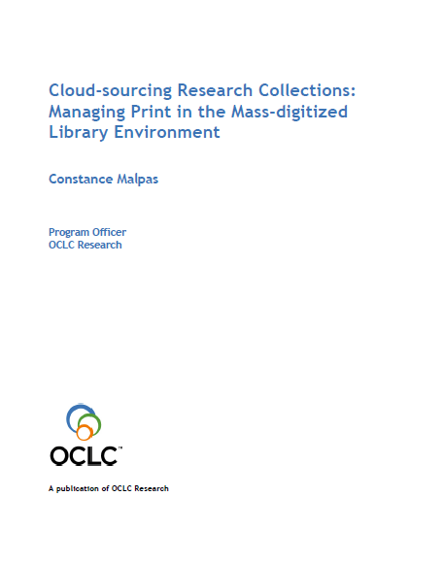
Cloud-sourcing Research Collections
OCLC Research report (January 2011)
Jointly designed and executed by OCLC Research, the HathiTrust, New York University’s Elmer Holmes Bobst Library, and the Research Collections Access & Preservation (ReCAP) consortium

Slide 26
Cloud-sourcing Research Collections (cont’)
Premise:
  Mass-digitization presents opportunity to transform the academic library experience reduce/optimize print stock
  Optimizing print stock in a library (or collectively across multiple libraries) lowers costs and permits libraries to re-deploy resources
“Based on a year-long study of data from the HathiTrust, ReCAP, and WorldCat, we concluded that our central hypothesis was successfully confirmed” (p.8)
  Mass-digitized library collection managed by the HathiTrust duplicates a sizeable (and growing) portion of virtually any academic library in U.S.
  And also of most large-scale print storage facilities
  Even small networks of libraries and repositories can exhibit this significant overlap in print/digitized corpus

Slide 27
Cloud-sourcing Research Collections (cont’)
Additional findings:
  The total digital corpus (HaithiTrust) is largely representative of the collective academic library collection
  Substantial library space savings and cost avoidance could be achieved if academic institutions outsourced management of redundant low-use inventory to shared service providers
    Possibly $500,000 to $2 million per ARL library annually
  Public-domain portion of the digital corpus (HaithiTrust) – not representative of an academic collection (i.e., skewed)

Slide 28
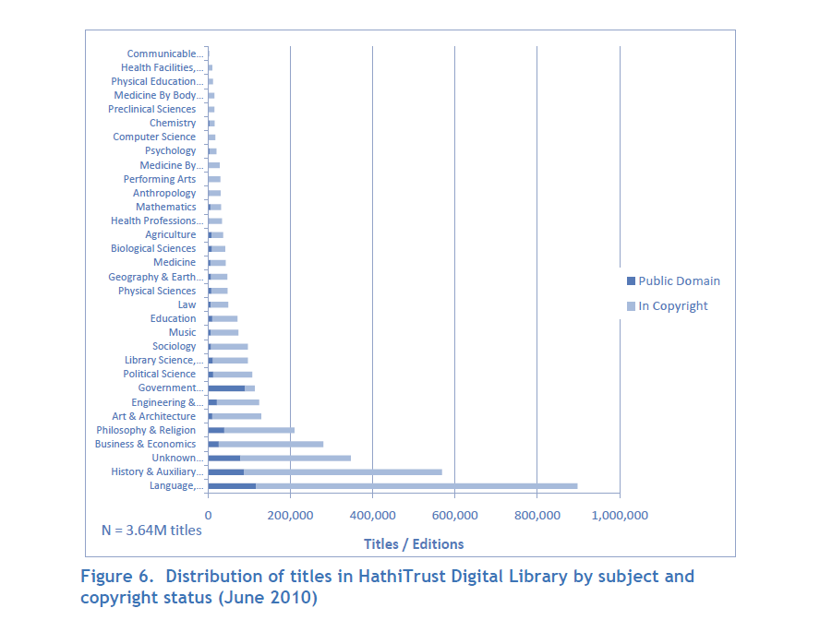

Slide 29
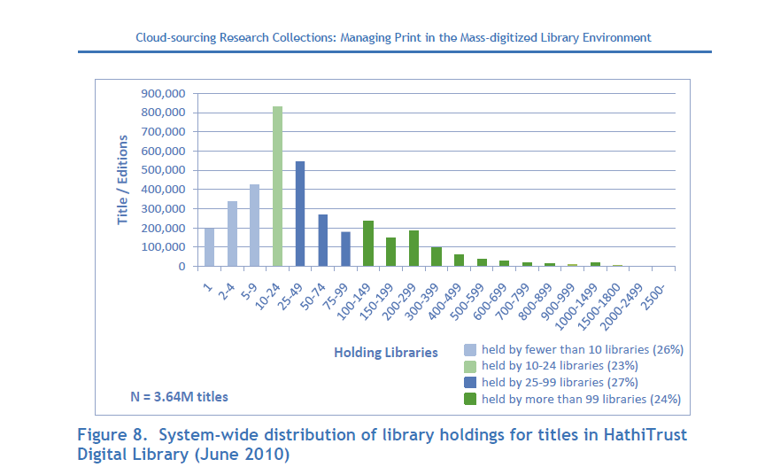

Slide 30
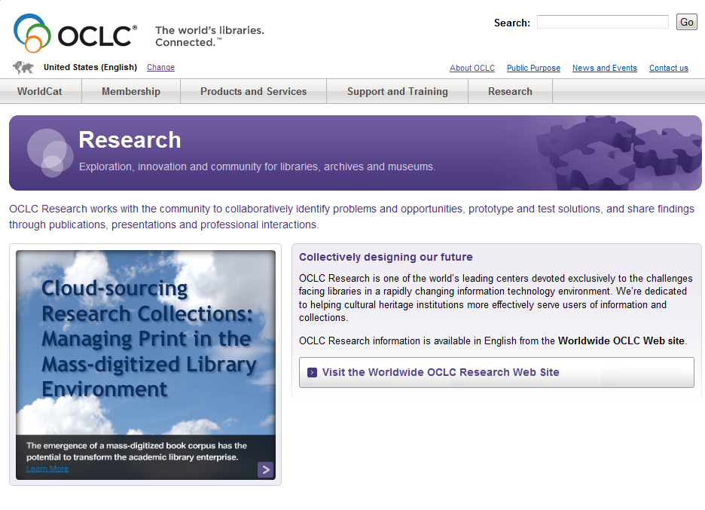
More information
OCLC Research Web site: http://www.oclc.org/research/

