Slide 1
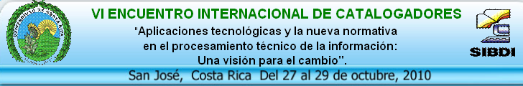
OCLC Research at work: FRBR, VIAF & Classify
Eric Childress
OCLC Research
Notes:
“Desde la clasificación de metadatos hasta el Dublín Core, FRBR, VIAF y Dewey: El impacto y la influencia de la Investigación en OCLC en las tendencias actuales de las Bibliotecas y Centros de Información” = “From the classification of metadata to the Dublin Core, FRBR, VIAF and Dewey: The impact and the influence of the Investigation in OCLC in the present tendencies of the Libraries and Information centers.”
Presented at Vi Encuentro Internacional de Catalogadores (San José, Costa Rica)
Credits:
[The section on FRBR based in part on Diane Vizine-Goetz What Users Want & How FRBR Can Help (.ppt 2MB/21 slides)
A Symposium for Publishers and Librarians, 18-19 March 2009, OCLC, Dublin, Ohio (USA)
An earlier version of this presentation was given at the ALCTS Cataloging & Classification Section Forum, 23 January 2009, ALA Midwinter Meeting, Denver, CO (USA) http://www.oclc.org/research/presentations/vizine-goetz/publisher-symposium.ppt]
[The sections on VIAF and Classify are based in part on an internal OCLC “Inside Scoop” presentation done by Thom Hickey (VIAF) and Diane Vizine-Goetz (Classify) in 2010]

Slide 2
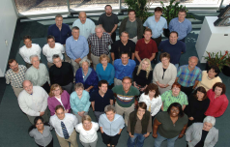
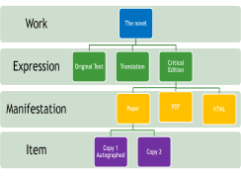
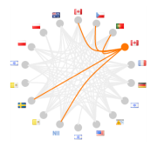
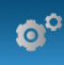
Outline
Overview of OCLC Research
FRBR (Functional Requirements of Bibliographic Records) - related work
VIAF (Virtual International Authority File)
OCLC Classify
Notes:
I will speak about four topics:
OCLC Research, a unit of OCLC
OCLC’s work with FRBR, a model for expressing important relationships in the intellectual works held in library collections
VIAF, a cooperative project to integrate authority data from many sources
and Classify, a tool from OCLC Research that is designed to assist librarians in making classification assignments

Slide 3

OCLC Research
1
Notes:
First topic: OCLC Research

Slide 4
OCLC Research, a division of OCLC
Three activities in one unit:
  OCLC Research
    Applied research
  RLG Partnership
    Collaboration with research libraries, archives, museums
  Innovation Lab
    Quick prototyping of products
~50 staff
  Scientists & Program Officers
  Programmers/Engineers
  Staff in supporting roles
Applied research, standards work, prototypes, reports, events in support of OCLC’s mission
  Infrastructure & Standards Support
  Metadata Support & Management
  Mobilizing Unique Materials
  Research Information Management (RIM)
  System-wide Organization
  User Behavior Studies & Synthesis
Outputs are freely available
Notes:
OCLC Research can trace its origins to a unit established by OCLC founder and first president, Frederick Kilgour. Today, OCLC Research is actually three activities in one unit:
OCLC Research’s applied research work
The RLG Partnership, a collaboration between OCLC Research and leading research libraries, archives and museums
A new activity for OCLC, the Innovation Lab, focuses on moving product ideas from idea to quick prototype
We have approximately 50 staff based primarily at OCLC offices in Ohio and California. OCLC Research includes scientists, program officers, programmers, engineers, a user interface specialist, communications staff, and others.
OCLC Research exists to conduct activities in support of OCLC’s public purposes. OCLC Research is engaged in a wide range of activities including participating in standards work, data mining, building prototypes and sofware, original research reports, and more. These six areas of activity are our current themes for organizing our work.
OCLC Research routinely makes software, reports, presentations, and other outputs freely available for non-commercial use by anyone.

Slide 5
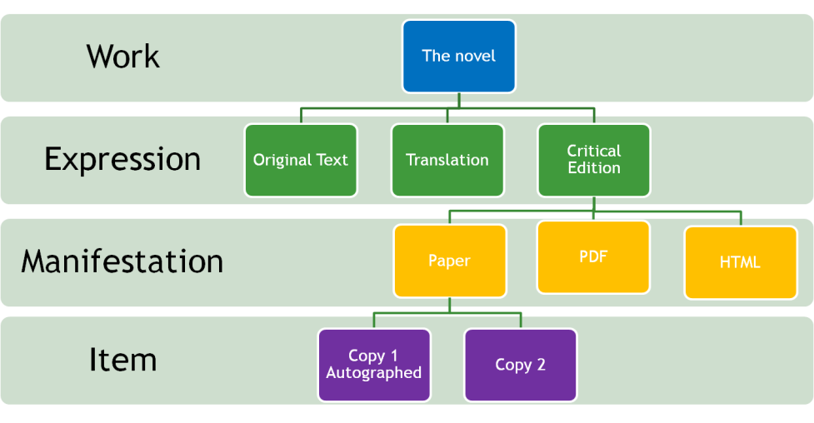
FRBR (Functional Requirements of Bibliographic Records) – related work
2
Notes:
Second topic: FRBR

Slide 6
FRBR in Five
FRBR = Functional Requirements for Bibliographic Records
Developed by cataloging experts working under the auspices of IFLA (International Federation of Library Associations and Institutions)
FRBR is from a document issued by IFLA:
  Functional requirements for bibliographic records : final report (1998) [link]
FRBR is a conceptual model not a standard
  FRBR systematically models the bibliographic universe
Notes:
FRBR is an acronym for Functional Requirements for Bibliographic Records, a conceptual model for describing the bibliographic universe.

Slide 7
Group 1 - Bibliographic Entities
Group 1: products of intellectual or artistic endeavor that are named of described in bibliographic records
  work, expression, manifestation, item
Work
  A distinct intellectual or artistic creation
Expression
  The intellectual or artistic realization of a work
Manifestation
  The physical embodiment of an expression of a work
Item
  A single example of a manifestation
Notes:
7
FRBR’s Group 1 entities are its best known aspect.
A work: A distinct intellectual or artistic creation. “Work” is a concept.
An expression: The work realized in a particular version or translation.
A manifestation: this is an expression that has been issued or published
An item: an instance or copy of a manifestation (e.g., on the shelves in a library)

Slide 8
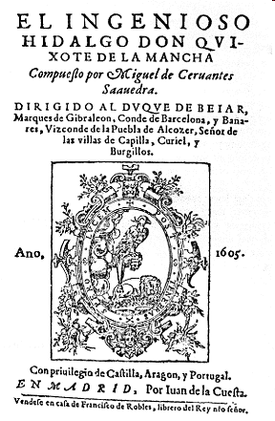
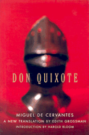
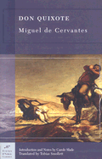



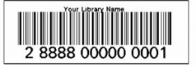
FRBR example – Don Quixote
Work
El ingenioso hidalgo don Quixote de la Mancha
Original
edition
English
Translation
Illustrated
edition
Expressions
Manifestations
Items
Notes:
To provide an example, let’s consider The Ingenious Hidalgo Don Quixote of La Mancha by Miguel de Cervantes. Published in two volumes a decade apart (in 1605 and 1615), Don Quixote is considered by many to be the most influential work of literature in the Spanish literary canon.
The work level is conceptual. Cervantes had his own conception of what the story and characters of Don Quixote would be.
As he put his ideas to paper, a two volume expression of the work became real and would be published in its original Spanish language edition, but also in many subsequent editions and translations. These are expressions of the work.
For each expression there may have been a single manifestation or many manifestations. So, for a modern example, we may have a printed book, but also possibly many electronic formats. These are manifestations.
And for each manifestation, there may be many copies such as the ones you have in your libraries. These are items. Generally, items mostly inventory and require only inventory control kinds of metadata, but in some cases – such as rare books – each item may merit significant additional cataloging.

Slide 9
OCLC FRBR Work-set Algorithm
Provides a FRBR-based view of the data
Records clustered into works using author and title fields from bibliographic and authority records
Author names and titles normalized to construct a work key
All records with the same key are grouped together in a work set or cluster
Notes:
Shortly after the publication of the IFLA document, OCLC Research began to work on developing software that could attempt to FRBRize MARC records so we could build FRBR-inspired views of WorldCat.
We developed and released two versions of specifications. And at OCLC we have a very sophisticated set of processes that leverage our algorithm and additional work to build these views.
We use a several-step process, described here, to normalize important data, compare data and group records with same/similar author and title values together into worksets and then assign work keys.
9

Slide 10
FRBR: WorldCat Statistics (July 2010)
 | Work sets | Manifestations | Holdings | % Holdings
Single record sets | 117,784,970 | 117,784,970 | 405,719,876 | 24.94%
Multi-record sets | 22,420,612 | *79,844,748 | 1,221,370,696 | 75.06%
Total | 140,205,582 | 197,629,718 | 1,627,090,572
*Manifestation breakdown:
3.56 = average number of manifestations for
multi-record worksets
40% of the manifestations belong to 16% of the works
Notes:
This is a recent set of statistics.
The single-record worksets form the majority of WorldCat. That is to say, most books, CDs, movies, etc. are only issued once, as a single edition. No one finds the need to issue additional editions or translations.
But for a small but noteworthy part of WorldCat, we have titles that have been issued in editions and translations. Indeed it is this part of WorldCat that generates the most holdings.
10

Slide 11
How does OCLC leverage FRBR?
FRBR is very useful for improving many products, services, & prototypes
OCLC leverages FRBR for:
  Record error detection and correction
  Enhancing existing records
  Statistical counts and studies
Used by:
  OCLC Research
  OCLC products & services
OCLC FRBR algorithm specification is openly available
Sample OCLC applications:
  WorldCat.org
    See other editions..
  WorldCat Identities
    Helps identify most widely-held works by and about a person, etc.
  WorldCat Genres
    A new interface to WorldCat data – view WorldCat by Genre
  OCLC Metadata Services for Publishers -- publisher metadata-to-MARC-record processing
    OCLC blends from-ONIX-records data with MARC data for alternate editions to create new MARC records
Notes:
OCLC has found this process of clustering records into worksets challenging, but also very rewarding. OCLC leverages FRBR to help us with improving WorldCat including correcting records with errors, but also enhancing existing records and doing lots of useful and interesting analysis.
These clustering techniques have proven so useful that we’ve incorporated and leveraged FRBR in many, many projects, prototypes, and products. In fact, I’ll be speaking about VIAF and Classify today which both rely significantly on the work-clustering we’ve done as part of FRBR

Slide 12

VIAF (Virtual International Authority File)
3

Slide 13
VIAF (Virtual International Authority File)
A partnership of the Library of Congress, Deutsche Nationalbibliothek, Bibliothèque nationale de France, & OCLC
  Plus participation by many additional libraries (including the Biblioteca Nacional de España & the Biblioteca Nacional de Portugal)
Special processing by OCLC Research of source authority files and, bibliographic files is used to produce a single “virtual” file of VIAF authority records
  20+ national level authority files
  14+ million contributed authority records
  60+ million VIAF partner-contributed bibliographic records
  + information derived from WorldCat and other OCLC work
  is leveraged to produce 11+ million merged VIAF authority records
viaf.org = Freely-available search interface and data services
Work is underway to transition the VIAF prototype into an OCLC production service
Notes:
VIAF has its conceptual origins in work done by IFLA, and indeed owes much to pioneering investigation and thinking by Dr. Tillett and others over several decades before VIAF itself would take form.
VIAF took its initial shape through a partnership of 3 national libraries (LC, the DNB, the BnF) and OCLC, and these four agencies continue to be influential in its form and governance, but VIAF has expanded rapidly in the last two years and continues to grow, encompassing participation by over a dozen national libraries and others. Of special note to any Central or South American audience will be the participation and contributions of the national libraries of Spain and Portugal.
VIAF effectively combines various national authority files into a super authority file, using advanced algorithms developed by OCLC, improved with feedback from the VIAF partner agencies.
VIAF is available through a freely-available service and work is now beginning to move this from a stable prototype into a truly production-grade OCLC service.

Slide 14
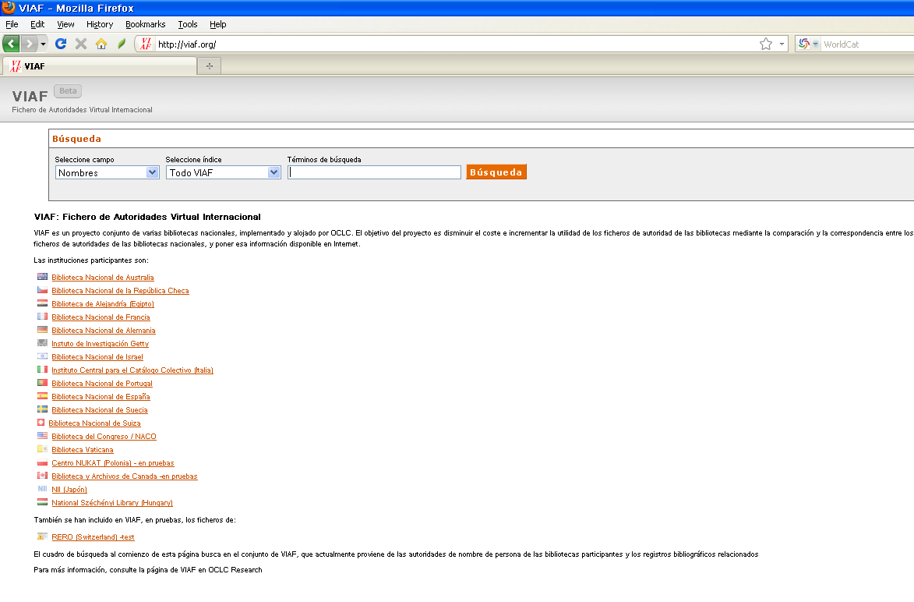
viaf.org
Notes:
To give you a sense of what VIAF looks like, I will walk you through one example. This is the opening screen to VIAF.
As you’ll note you’re seeing a Spanish interface. VIAF partners – in this case the national library of Spain – have assisted us in making available translations of the interface. VIAF will automatically detect what language setting you have on your browser and supply the appropriate language interface if the language you’ve set matches one of the available languages of the interface.

Slide 15
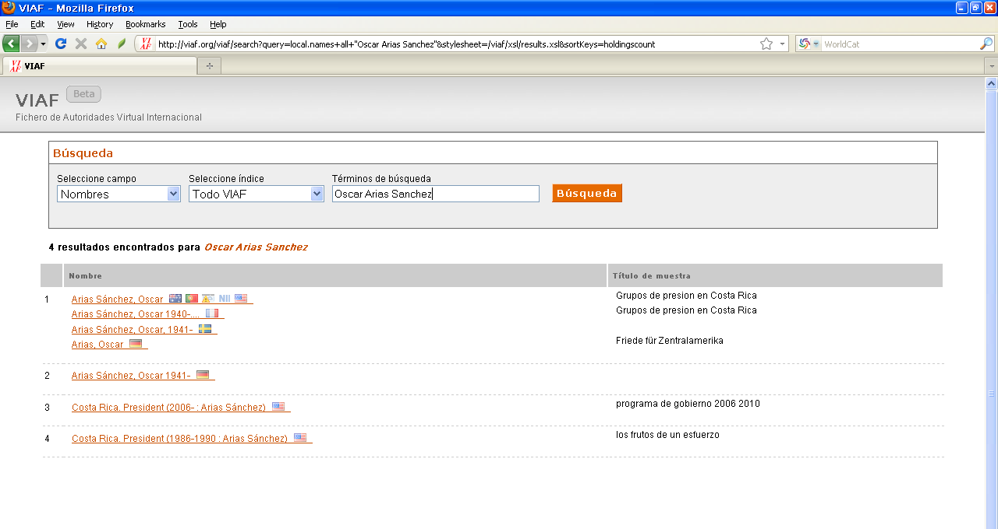
A search for Oscar Arias Sanchez
Notes:
Here is a search result for Oscar Arias Sanchez.
As you ca see the search results provide a sense of the multiple forms of name that may be encountered, and even variations (or errors) in birth years or other aspects that might cause matching errors. VIAF has done a very good if not perfect job of matching authority records. And as you’ll note, it looks like two different agencies have determined a close but different birth year. When I get back to the United States we’ll report this issue and ask the respective library to make a correction to their authority record.
Now lets look more closely at the first VIAF record.

Slide 16
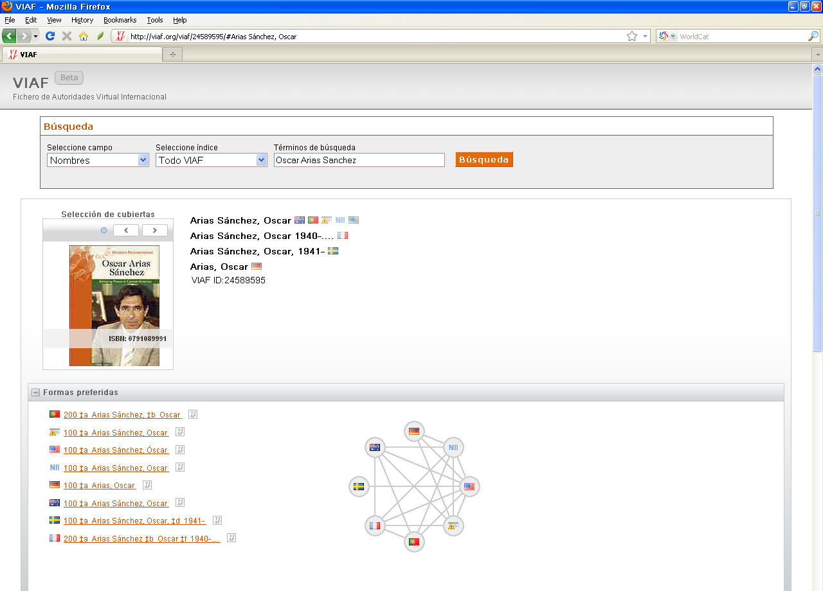
Oscar Arias Sanchez
Notes:
As you can see Mr. Arias Sanchez is represented in many authority files. The small diagram displays links that we were able to automatically make between authority records based on preferred names and other elements.

Slide 17
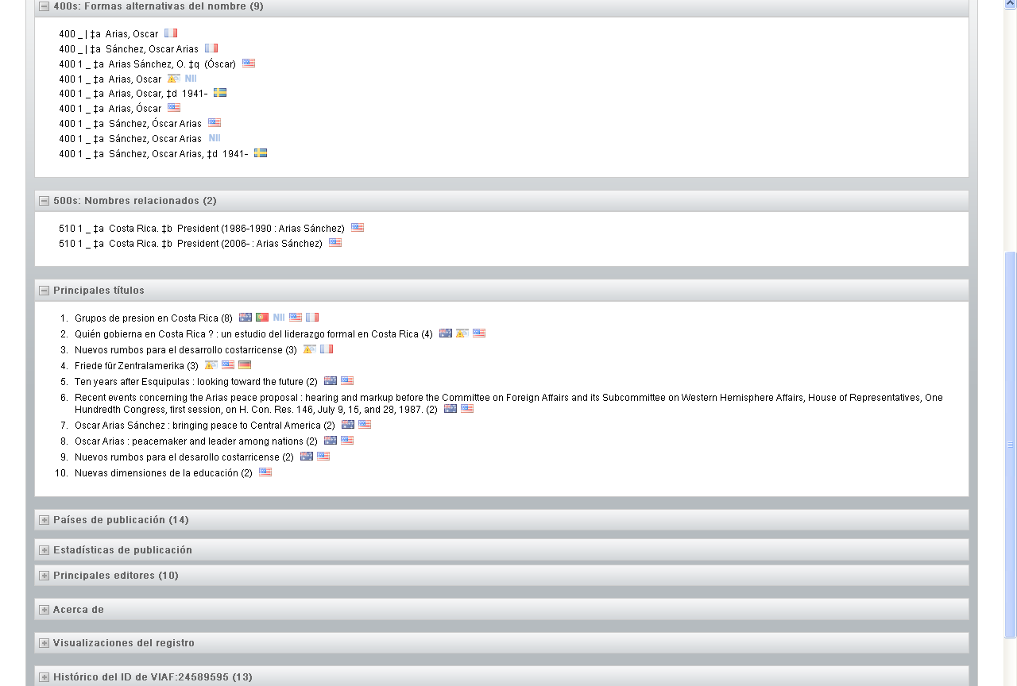
Oscar Arias Sanchez
Notes:
Next we see a display of the universe of variant names recorded in the respective authority files. It may come as no surprise to learn that a variant name in one file is often a preferred name in another. This helps us with matching, but it also points out how difficult it can be to have systems effectively search personal names across many systems without access to this sort of database.
Next we related names. In this case, Arias Sanchez as the holder of the Office of President
Third down the screen we see a list of selected publications he has authored. This bibliography information has been key to the matching algorithms used by VIAF. When multiple files declare “X” to be the author of a work, we’re able to use statistical measures and other techniques to confidently predict that “X” no matter his/her name in respective authority files, is the same person and then cluster their records together.

Slide 18
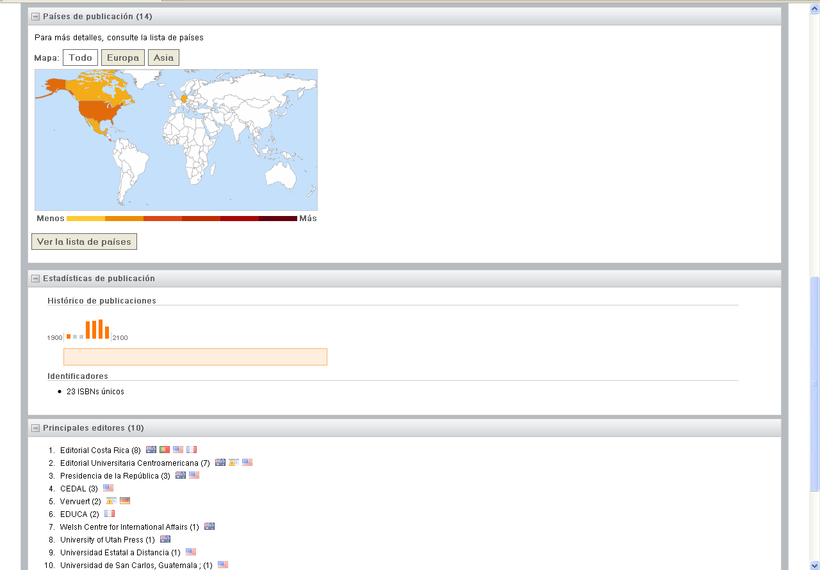
Oscar Arias Sanchez
Notes:
Moving on to additional features of VIAF, these are some features inspired by other work by OCLC Research and which rely in part of data in WorldCat. We can offer a map of places of publication for the publications of the author, a graph displaying the appearance of publications over time, and last but not least publishers closely associated with the author’s corpus.

Slide 19
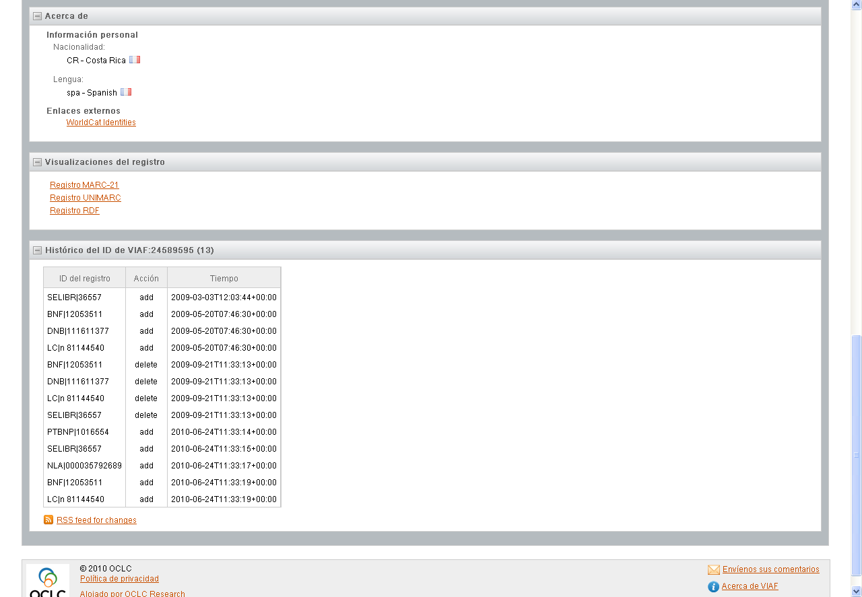
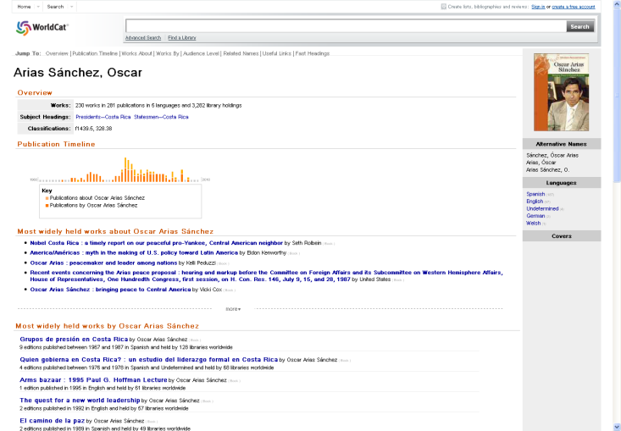
Oscar Arias Sanchez
Notes:
And the last features include
- Mined or inferred information about the author’s nationality and primary language.
We also will link to WorldCat Identities (another project of OCLC Research), Wikipedia, etc. as we are aware of the links.
We also provide several options for downloading the VIAF record in MARC or RDF
And lastly, we record a history of modifications made to the record. These help with trouble-shooting and also demonstrate the ongoing improvements that we’re making to VIAF

Slide 20
OCLC Classify
4

Slide 21
Classify
Experimental service from OCLC Research
  http://classify.oclc.org/
Leverages classification assignments in WorldCat and other OCLC data
Offers class numbers for books, videos, CDs and other materials
  User interface for day-to-day tasks
  Machine service for batch processing
Freely-available
Updated quarterly
Classify page presents:
  Title (work level)
  Author (work level)
  Formats available
  Number of editions
  Number of library holdings
  Suggested class numbers (Dewey, Library of Congress, National Library of Medicine)
    Most Frequent (holdings)
  FAST Headings
  Editions List
    Title, Author, Format, Holdings, Language, OCLC Number, Date, Class numbers
Notes:
[Read screen]

Slide 22
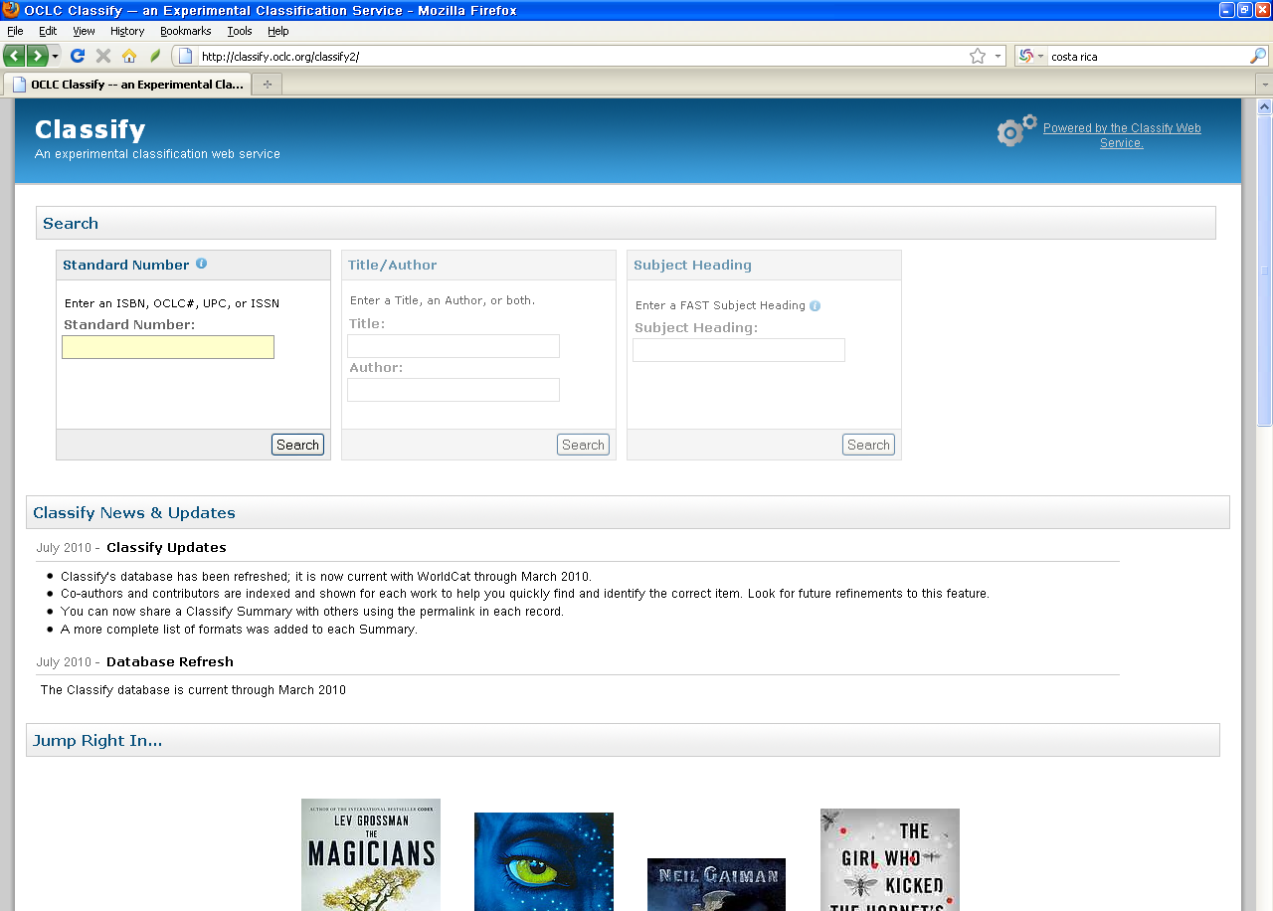
Classify
Notes:
This is the interface to Classify.
If you’ll notice, there are three search options at the top of the screen:
1) A standard number search such as an ISBN
2) A title and author search
3) Search by FAST subject heading. (FAST is a project of OCLC Research and the Library of Congress that provides a facetted version of the Library of Congress Subject Headings).

Slide 23
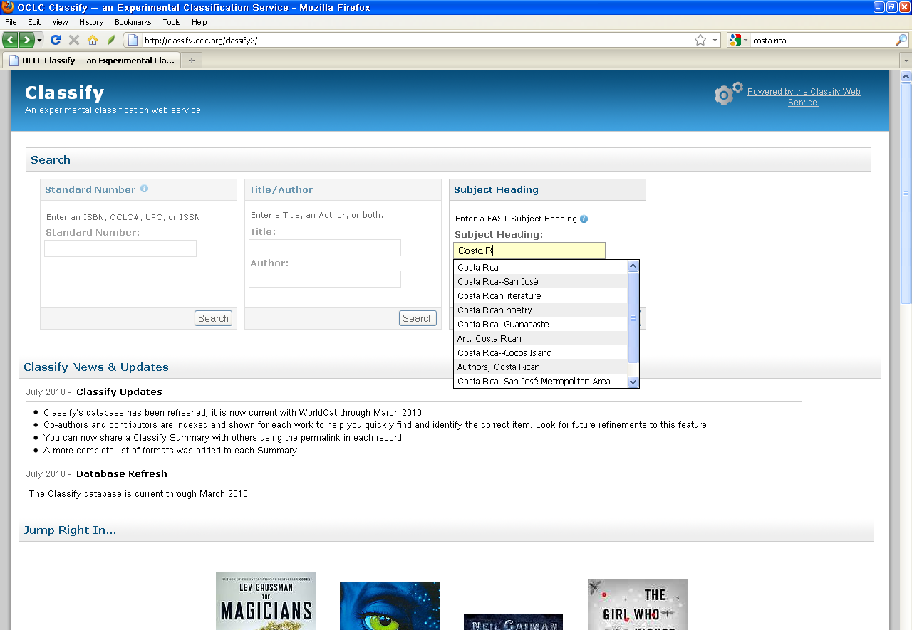
Classify – Costa Rica search
Searching for Costa Rica
Notes:
We’ll search Classify for Costa Rica

Slide 24
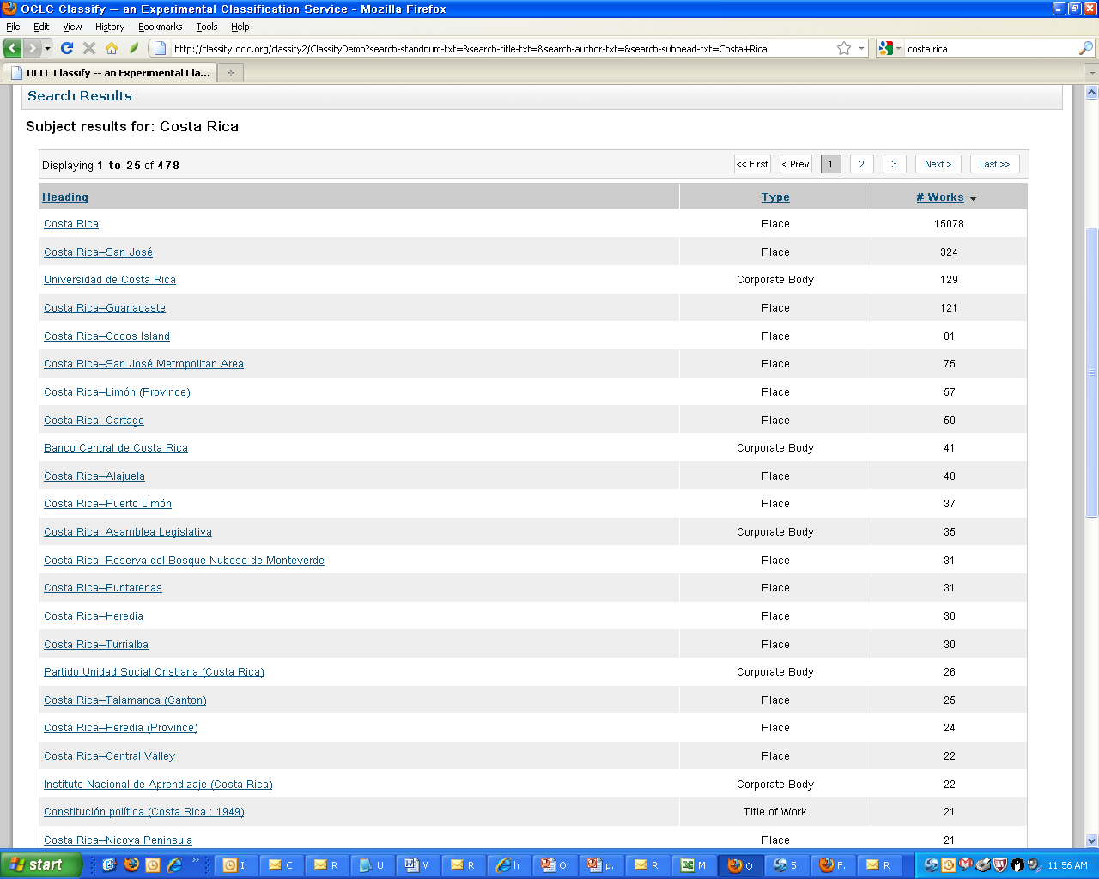
Classify – Costa Rica search results
Notes:
As you can see we've retrieved a along list of possible FAST subject headings.
The first column provides a list of relevant FAST subject headings, the second identifies what kind of heading the heading is, and the third tells us how many works (remember this is FRBR worksets, not just numbers of records).
Let’s select the first heading, Costa Rica

Slide 25
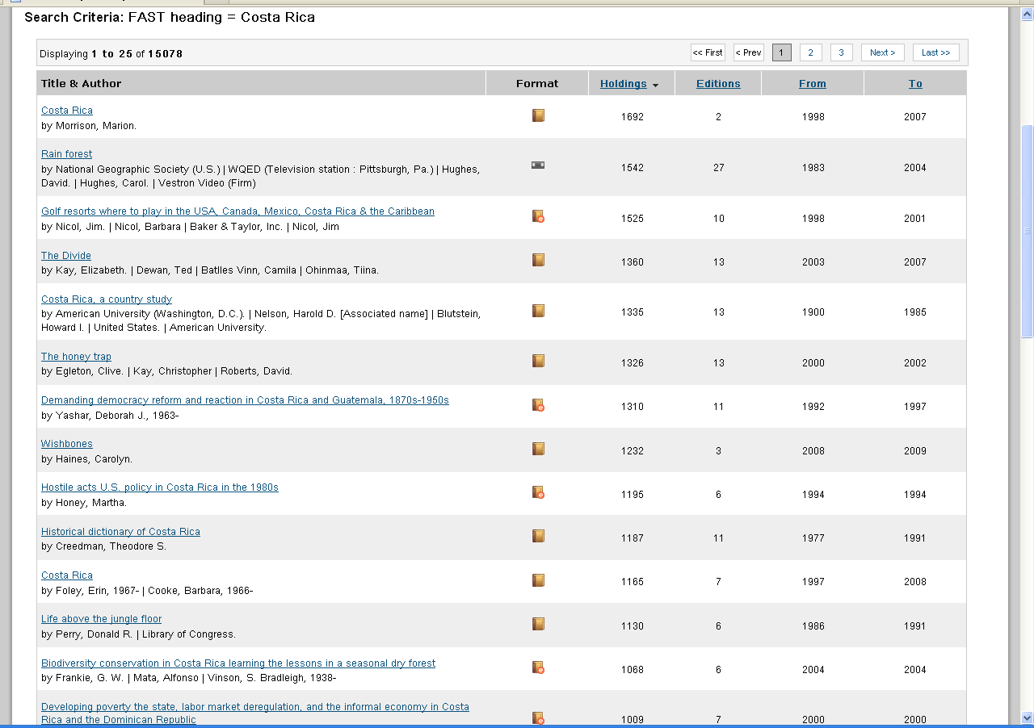
Costa Rica – search result
Notes:
We’ve now retrieved a list of over 15 thousand works that have the FAST heading, “Costa Rica.”
As you can see the first column provides a brief citation, the second records the format, the third the number of holdings in WorldCat, the fourth tells us how man editions, and the last two columns provide the earliest and latest years of publication represented in the workset.
Let’s select the second work, “Rain Forest.”

Slide 26
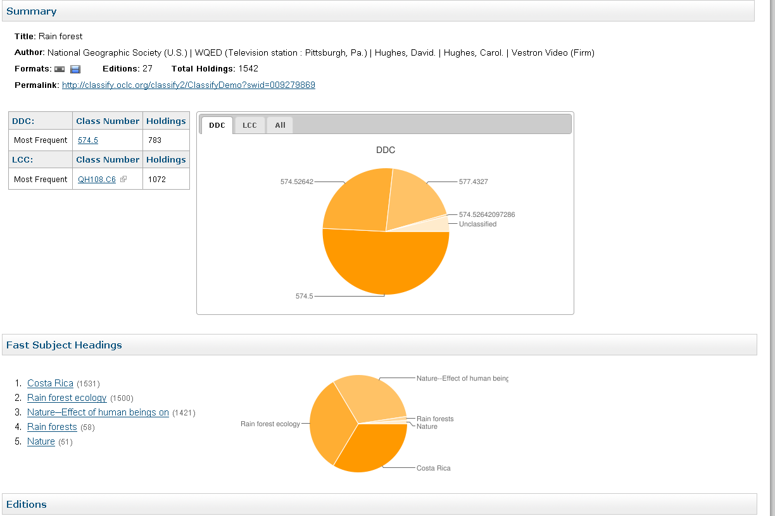
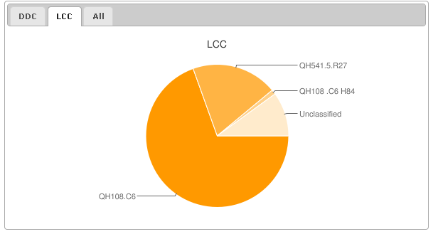

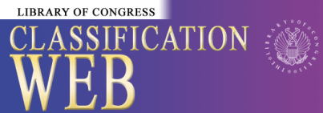
“Rain forest” example
Notes:
This is classify record
As you can see, there is lots of information provided about the title. Classify has mined data from all editions of the work and also carefully recorded attributes from the MARC records that allow Classify to indicate, for example, whether LC assigned the classification number. But more on that later.
As you can see, the pie chart for DDC shows the frequency with which several assigned DDC numbers have been assigned.
We can also go down to see the most frequent FAST subject headings assigned to this work.
Now, let’s also see the Library of Congress Classification numbers assigned [click]
and get a sense of where the various hot-links will take us.
At the top of the screen, the DDC number will take us to another, experimental service from OCLC Research, called DeweyBrowser. DeweyBrowser lets you browse a subset of WorldCat by DDC number, sort of similar to browsing the shelf in the library – it can help you decide if the particular number is really the most appropriate one.
The LCC number deep-links into Classicification Web from LC. You’ll need a ClassWeb subscription to use the service, but for those libraries that have a subscription this is a much-liked feature of Classify.
Last, at the bottom the FAST subject headings hot-link will re-search Classify…

Slide 27
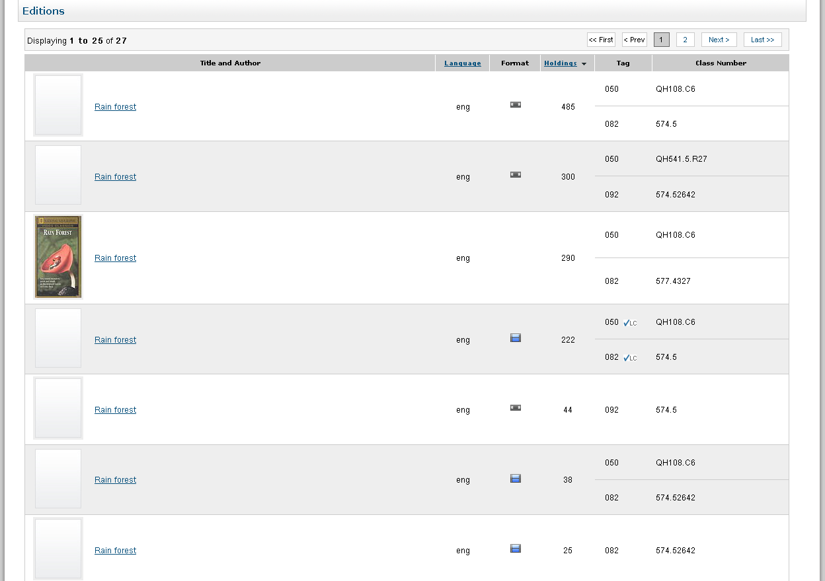
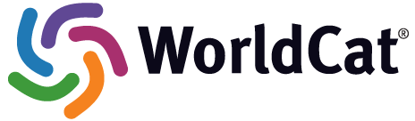
“Rain forest” example
Notes:
If we go to the balance of the Classify screen for “The Rain Forest” we can see the many editions along with their respective DDC and LCC assignments.
If we look down the list {click} you’ll notice that assignments by LC have been flagged.
Lastly, if you want to see the worldcat.org display for an edition, one need only click on the title of the edition.

Slide 28
Thank you

