Slide 1
An Investigation of
Digital Reference Interviews:
A Dialogue Act Approach
Bei Yu, Assistant Professor
Keisuke Inoue, PhD Candidate

Slide 2


The web is full of conversations…

Slide 3
How can we find information in conversations effectively?

Slide 4
How can information retrieval systems effectively utilize a collection of conversations as an information resource?
How can IR systems incorporate processes or structure of information-seeking conversations?

Slide 5
Research Questions
What are the linguistic properties of computer-mediated information-seeking conversations?
  Dialogue acts analysis of digital reference interviews
How can such properties be detected automatically?
    Machine learning experiments of dialogue acts annotation

Slide 6
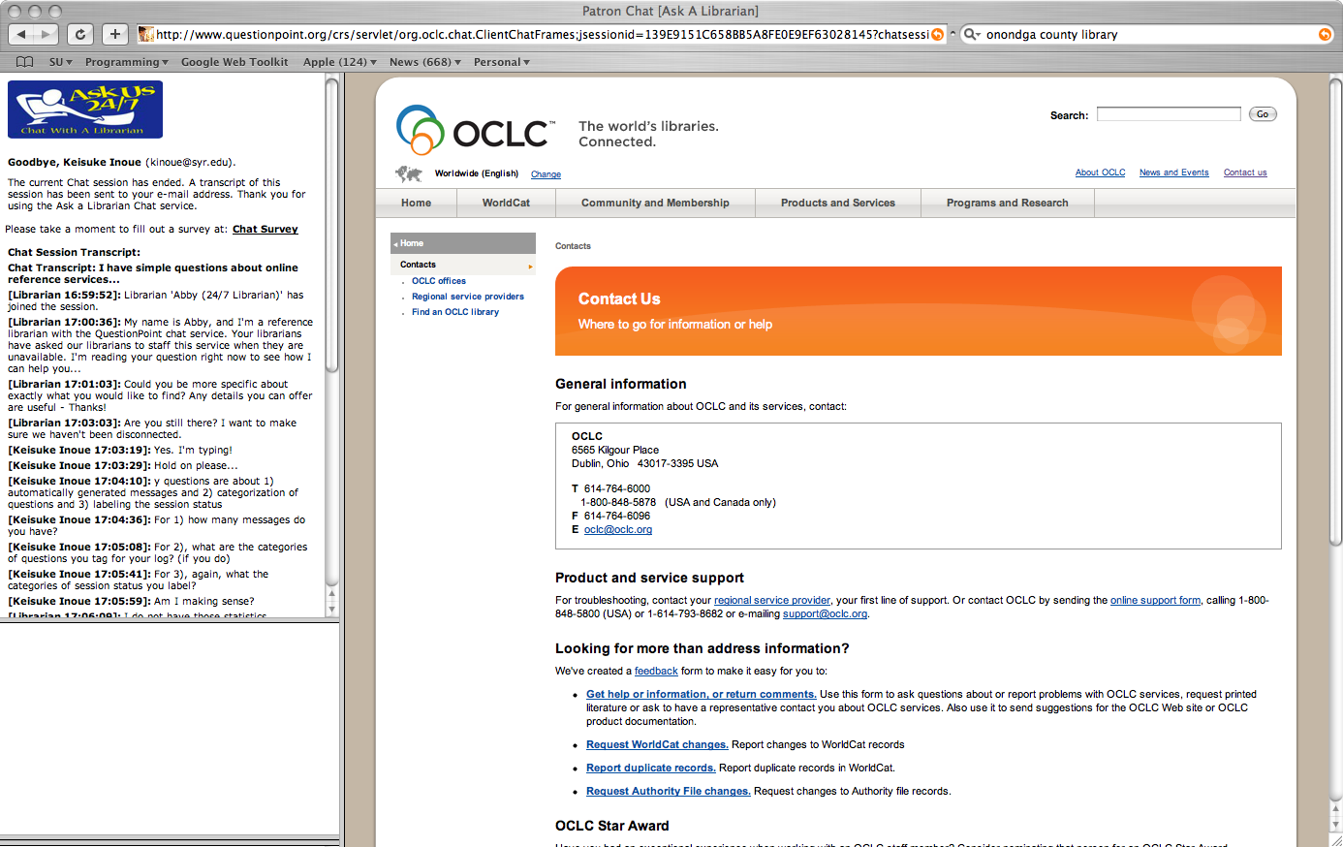
Data
Online chat reference log provided by OCLC, courtesy of Dr. Radford and Dr. Connaway
800 interview sessions collected from April. 2004 to Sept. 2006
200 interviews were selected for discourse analysis based on the questions asked.

Slide 7
Dialogue Act Classification
  “The communicative function of utterances in dialogue-based interactions”
  Popescu-Belis, 2008
  Two levels of analysis:
  function and domain
  Two coals of dialogues:
  underlying goals and communicative goals

Slide 8
Unit of Analysis
n = 210, m = 26 (average), l = 1.5 (average)

Slide 9
Classification Scheme

Slide 10
Classification Scheme Structure

Slide 11

Example
Info. Provision
Topic
Info. Request
Topic
Which colleges did top
fashion designers go?
You mean top fashion
designers anywhere?
?
Info. Provision
Topic
Info. Provision
ASK US!
Answer
Calvin Klein Graduated
from NY’s Fashion Institute
of Technology in 1964
Yep, anywhere in U.S.
Info. Provision
?
Feedback
Info. Request
ASK US!
Topic
I need more
recent ones…
Do you have anyone in mind?
Info. Provision
?
Topic / Background
ASK US!
No… I’m deciding
which school to go.
(continue…)

Slide 12
Annotation
Three MLIS students worked on approx. five sessions per week (20 weeks total).
Approx. 8K messages, 12K segments.
Approx. 20% overlap between two annotators.
Approx. 10% overlap between three annotators.
Kappa was confirmed satisfactory (> .8) except for the deepest layer.

Slide 13
Results Example:
Distribution of Dialogue Act Functions

Slide 14
Results Example:
Information Domains over Time
Start Mid End
Start Mid End

Slide 15
Observations
DA analysis enabled:
  Confirming the theories/models of Communication, Linguistic, and information behavior.
  Characterizing the digital reference interviews
  Enabling comparisons with other types of information-seeking conversations.

Slide 16
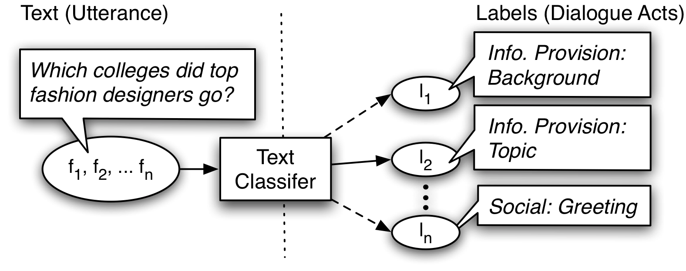
Machine Learning
(Text Classification)
Given a piece of text, find a label for the text.
Different types of variables (features) to represent text.
Various algorithms to find labels.

Slide 17
Algorithm
HM-SVM
  Combining the HMM (Hidden Markov Model) and SVM (Support Vector Machine)
  A few implementations available
  Proven to be effective for structured labels
  No applications for DA labeling yet

Slide 18
Preliminary Results
Classifying the Function (shallowest) Layer (with SVM):
Class | Precision | Recall | F-Measure
Info. Provision | 0.861 | 0.894 | 0.877
Info. Request | 0.697 | 0.687 | 0.692
Task Mgmt | 0.703 | 0.67 | 0.686
Dialogue Mgmt | 0.851 | 0.763 | 0.804
Social Rel. Mgmt | 0.89 | 0.868 | 0.879
Weighted Average | 0.836 | 0.837 | 0.836

Slide 19
Machine Learning
The preliminary results are promising.
The future work include:
  Experimenting with the Domain (deeper) layer
  Testing with HM-SVM
  Analyzing the results and testing with different features.

Slide 20
Summary
DA analysis:
  Confirmed the previous theories/models.
  Characterized the digital reference interviews
Future Work
  Comparisons with other types of conversations
  Improving the Machine Learning and applying it to IR systems experiment (e.g. as a new feature for a ranking algorithm).

Slide 21
Thank you to the ALISE / OCLC for the wonderful opportunity.
Thank you to Dr. Lynn Connaway for all the work and support.

