Slide 1
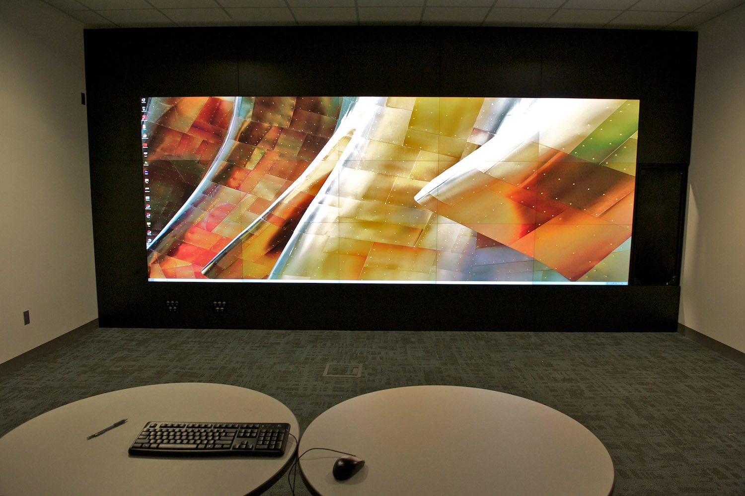
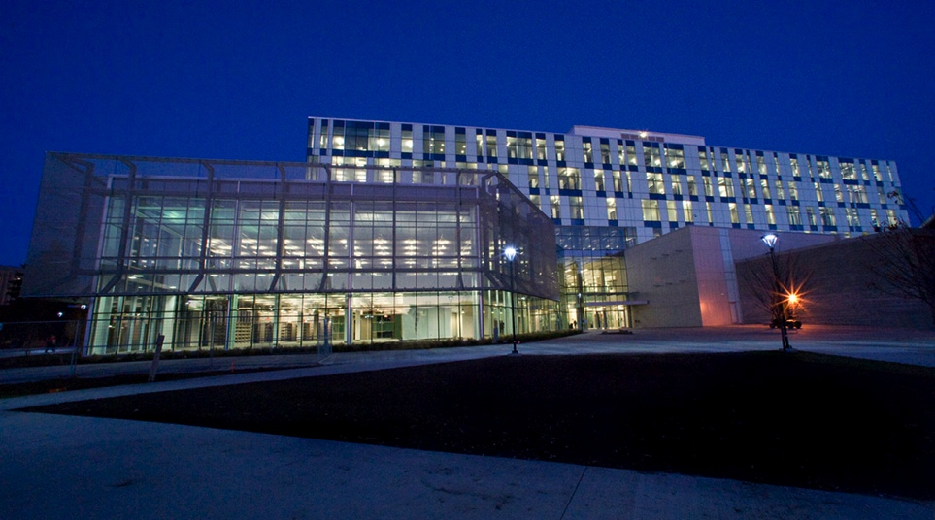
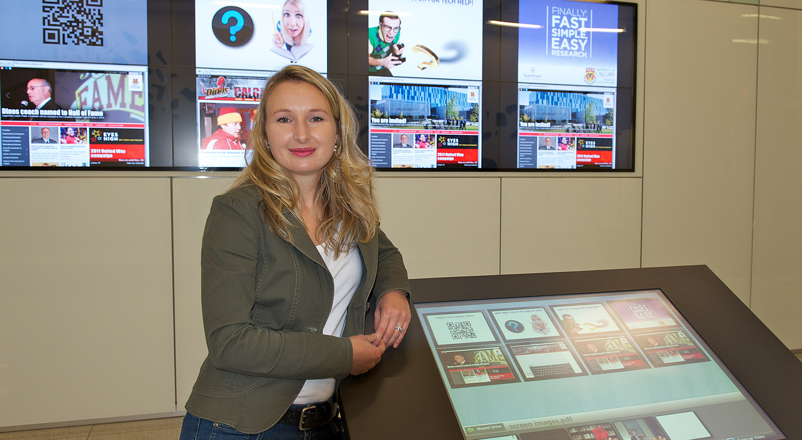
Taylor Family Digital Library
Technology Officer
University of Calgary
Shawna Sadler
OCLC Research Colloquium
June, 2012

Slide 2
Presentation Outline
Overview of new Taylor Family Digital Library
Organizational Overview
Featured Partners
Featured Spaces
Next Steps…

Slide 3
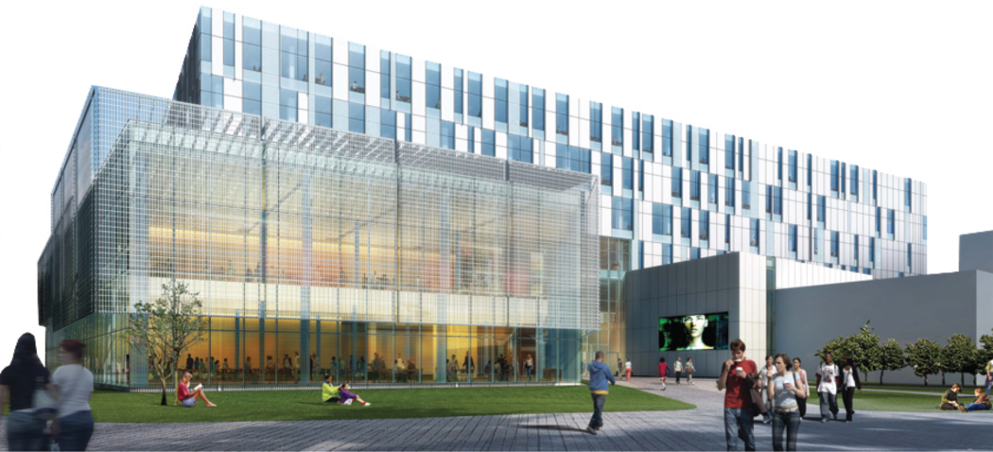
Taylor Family Digital Library
Completion Winter 2010
265,000 sq.ft.
$205 Million Project

Slide 4
The Vision
The Vision
Providing outstanding support for Scholarship, Learning and the Creation of Knowledge, Libraries and Cultural Resources is a key component in the University’s Excellence in Research, Teaching and Community Service.
We will fulfill this vision through a convergence of our Libraries, Museum, Archives, Special Collections and University Press and through campus, community, national and international partnerships.
State-of-the-art Learning and Research Centre
We Should Imagine Greatness

Slide 5
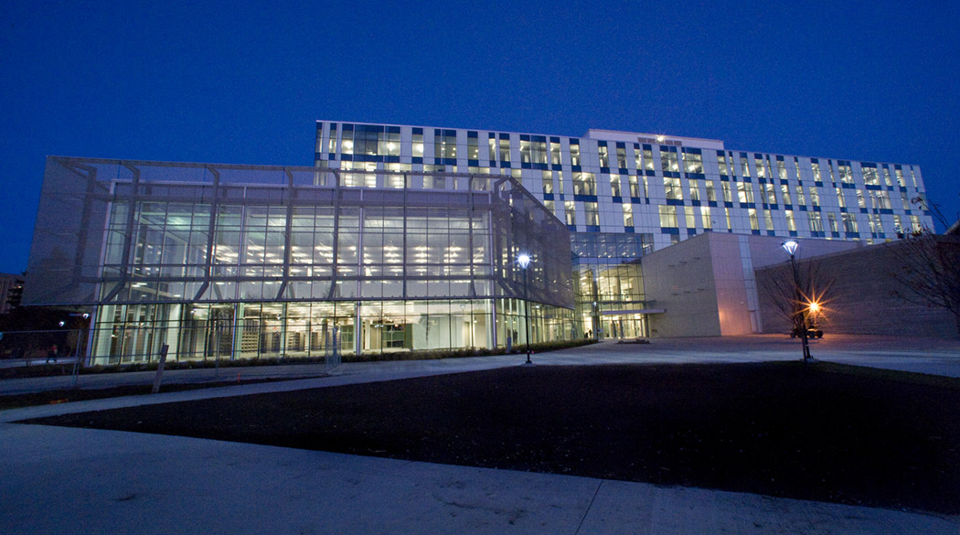
The Taylor as an
Instrument of Research
Students Faculty Community Researchers

Slide 6
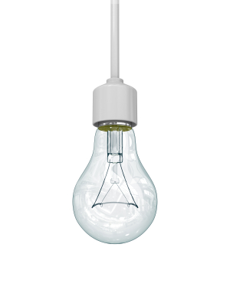

Convergence
Libraries, Archives, Museum & Press

Slide 7
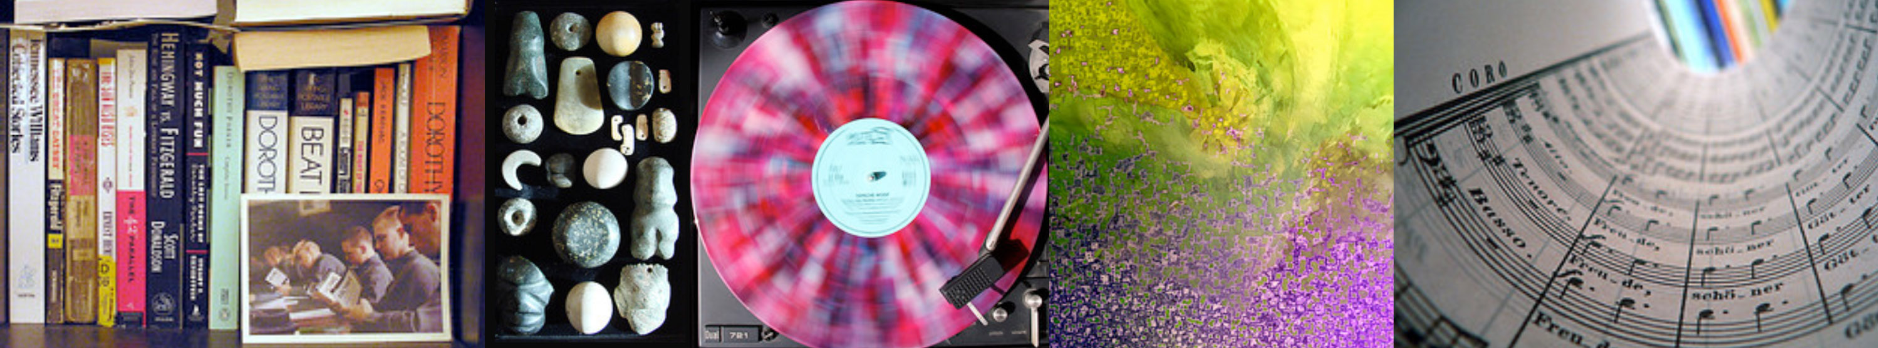
Collections of the Future

Slide 8
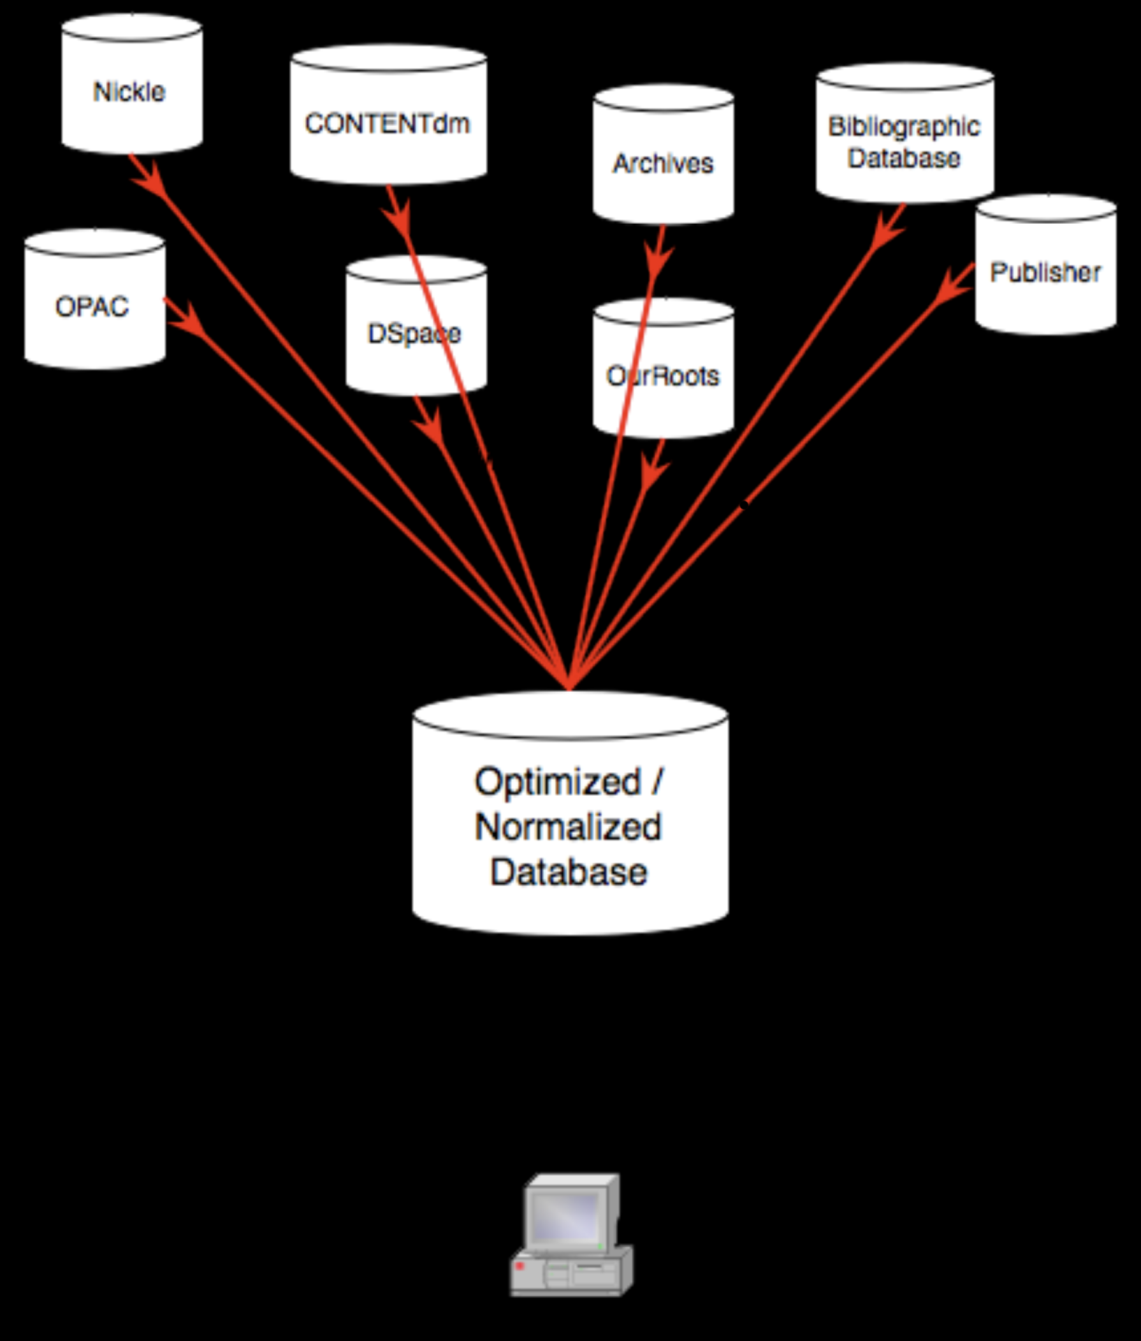
Integrated Discovery
Staffing
Notes:
8

Slide 9
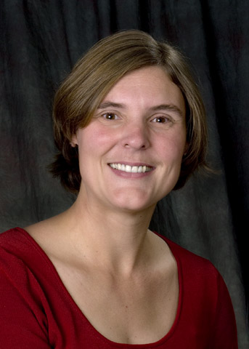
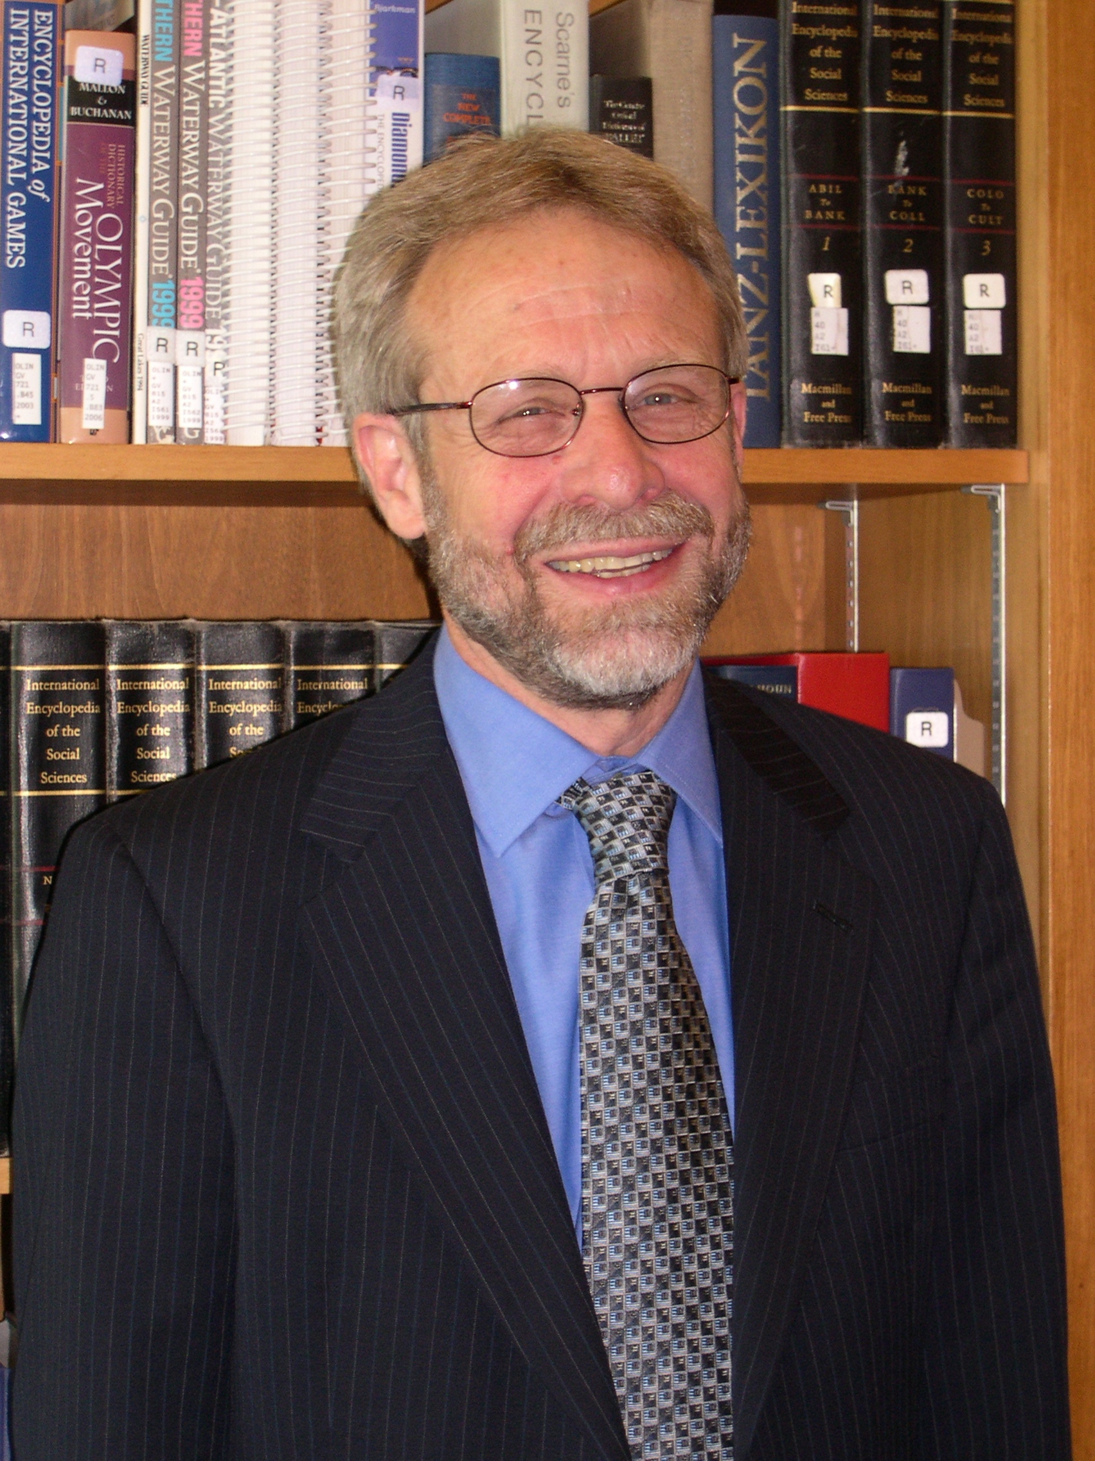
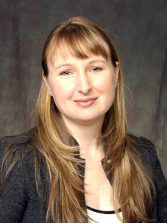
TFDL Project Team
Claudette Cloutier
TFDL Program Director
Tom Hickerson
Vice Provost and University Librarian
Shawna Sadler
TFDL Technology Officer

Slide 10
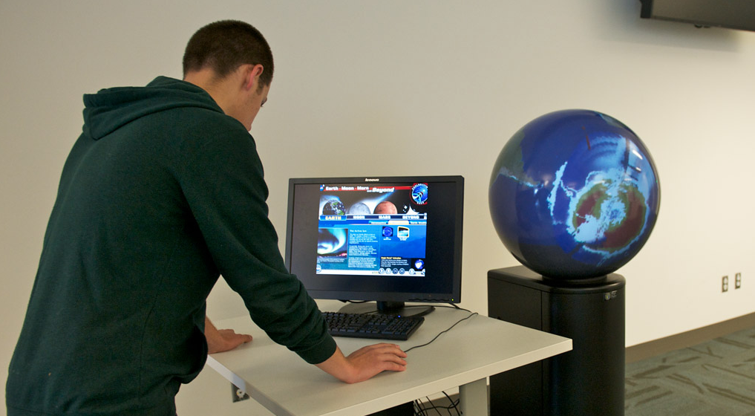
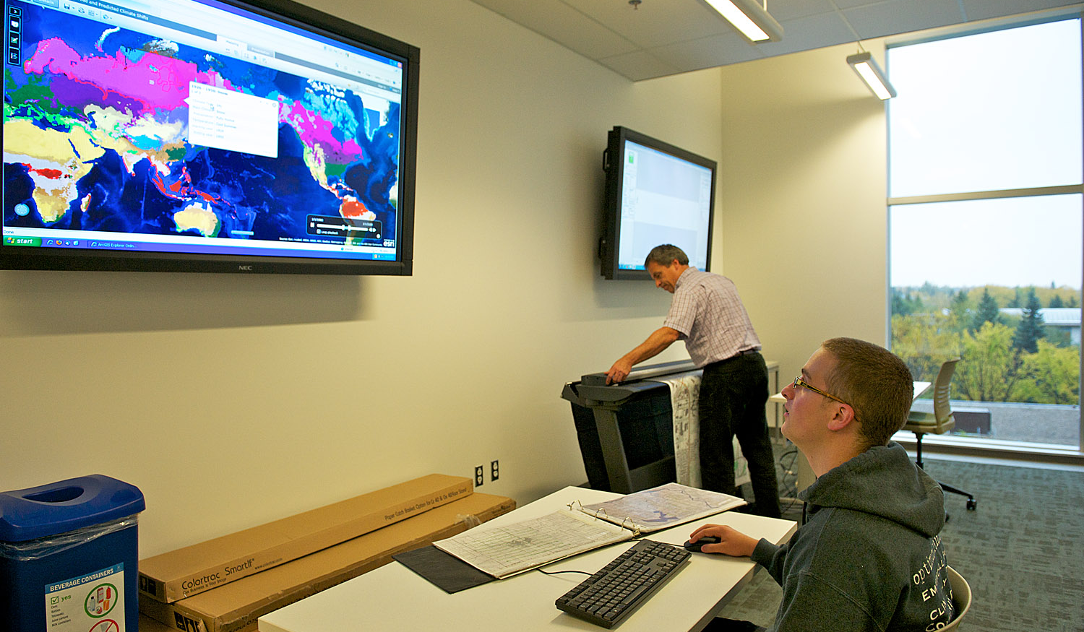
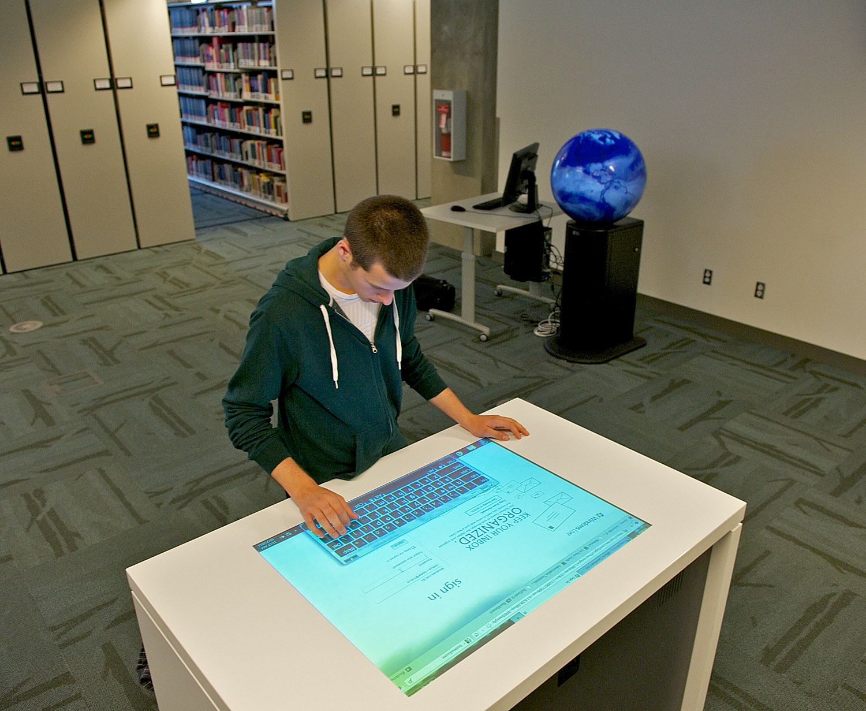
Themes
Agile – All spaces and technology infrastructures must be easily adaptable to changing student and researcher needs
Contemporary – Spaces and technologies must remain cutting edge, so to give our UofC Community unique access to innovation
Inspiring – Technologies must leverage opportunities for our students and researchers in exciting new ways
Innovative – The Library Technology staff must apply a high-level of creativity to selecting and employing technologies in the library

Slide 11
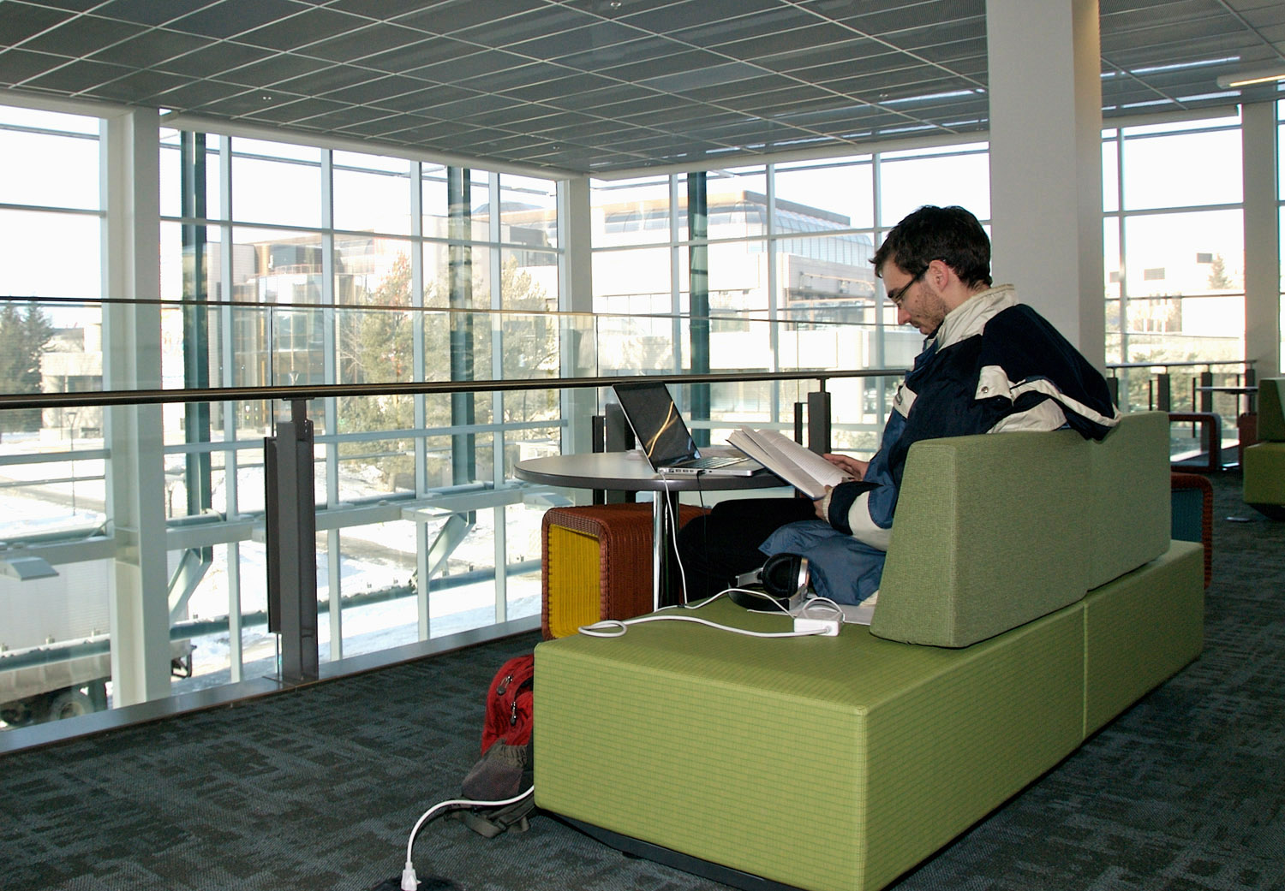
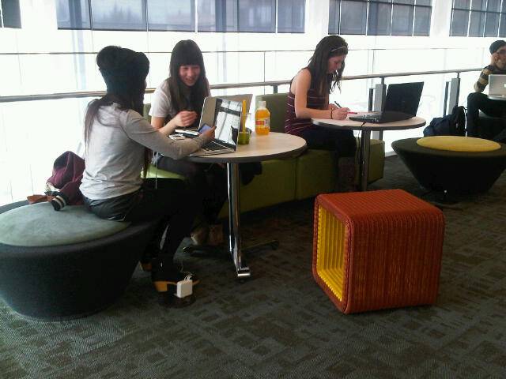
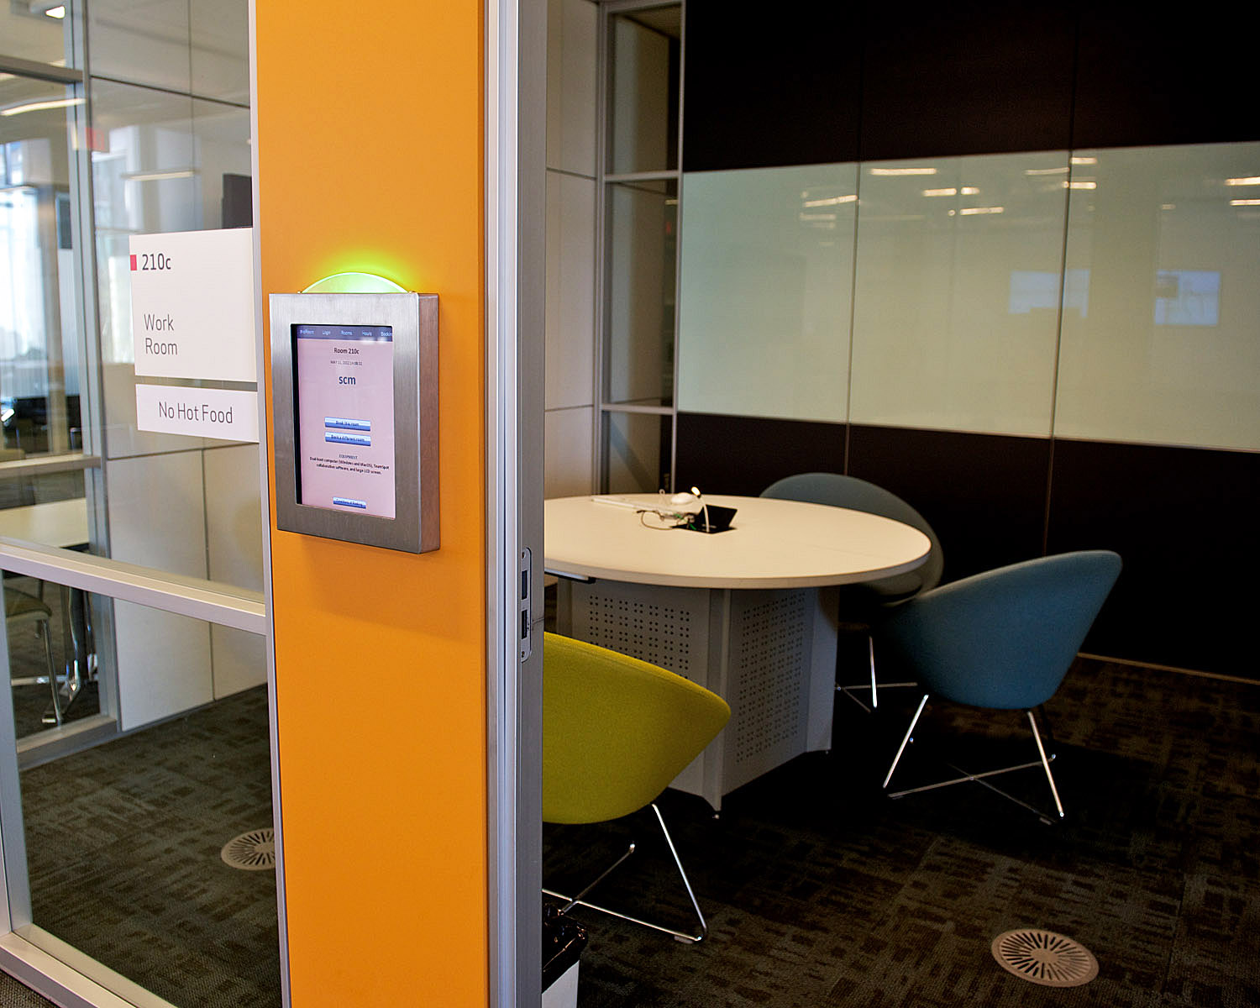
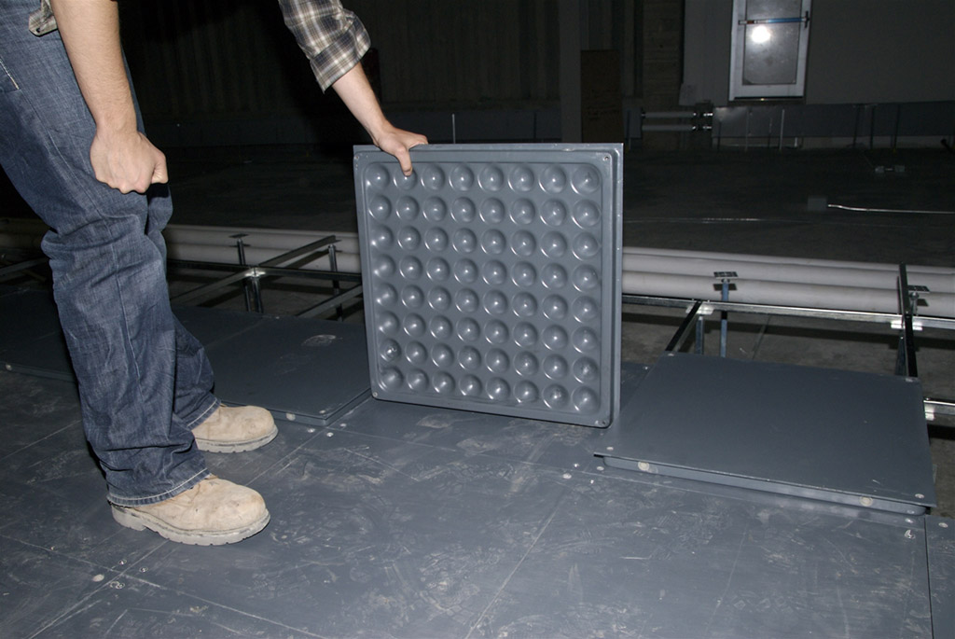
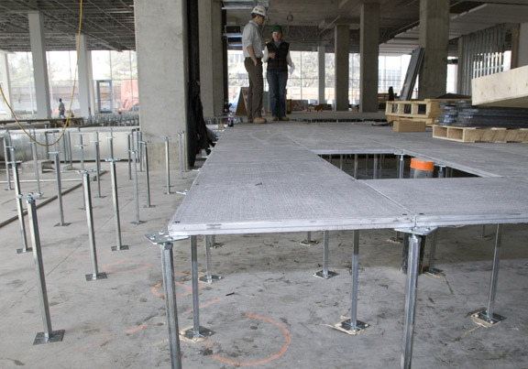
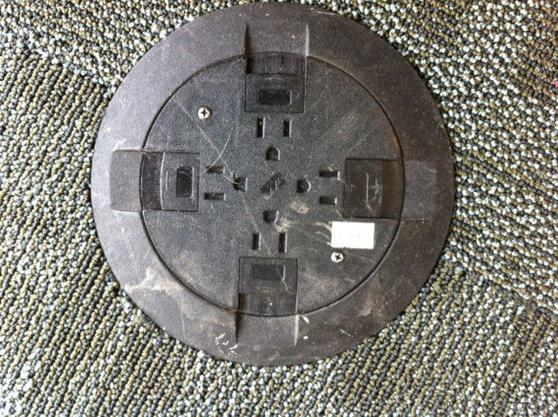
Agile Infrastructure
Raised Flooring, demountable walls, moveable furniture

Slide 12
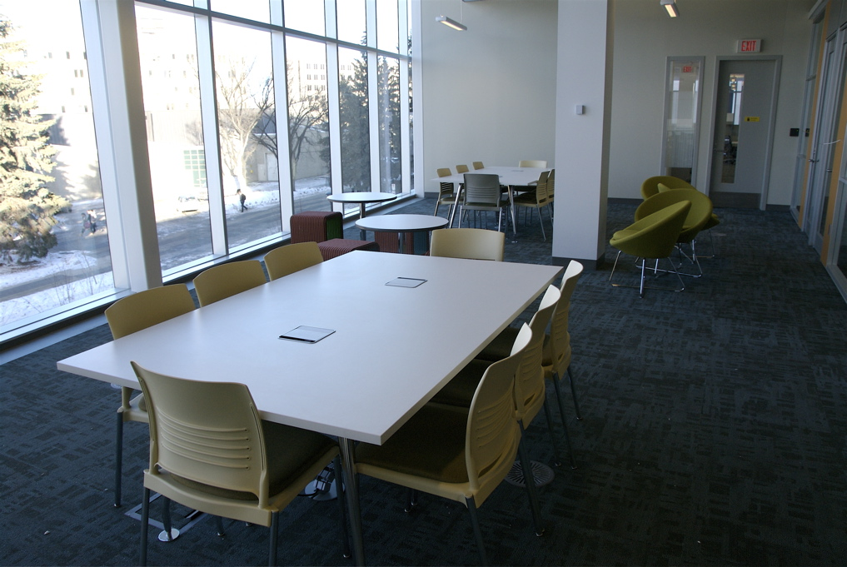
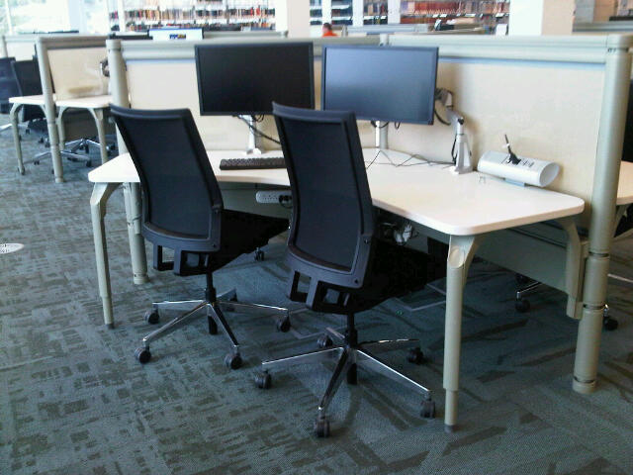
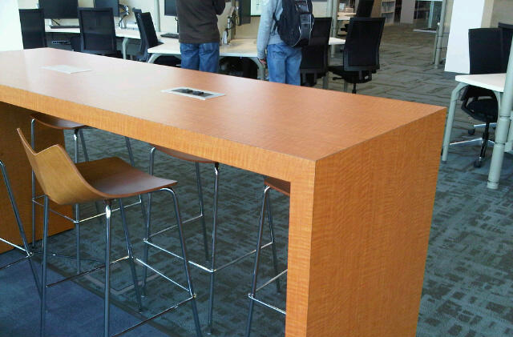
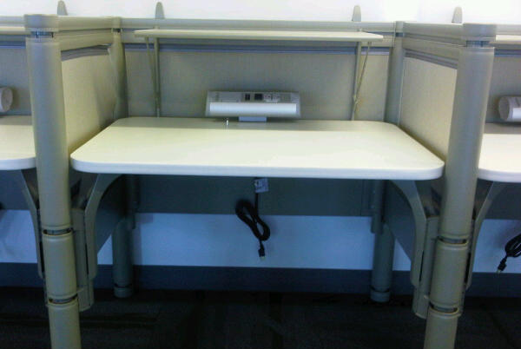
Contemporary Infrastructure
Electrical outlets built into furniture

Slide 13
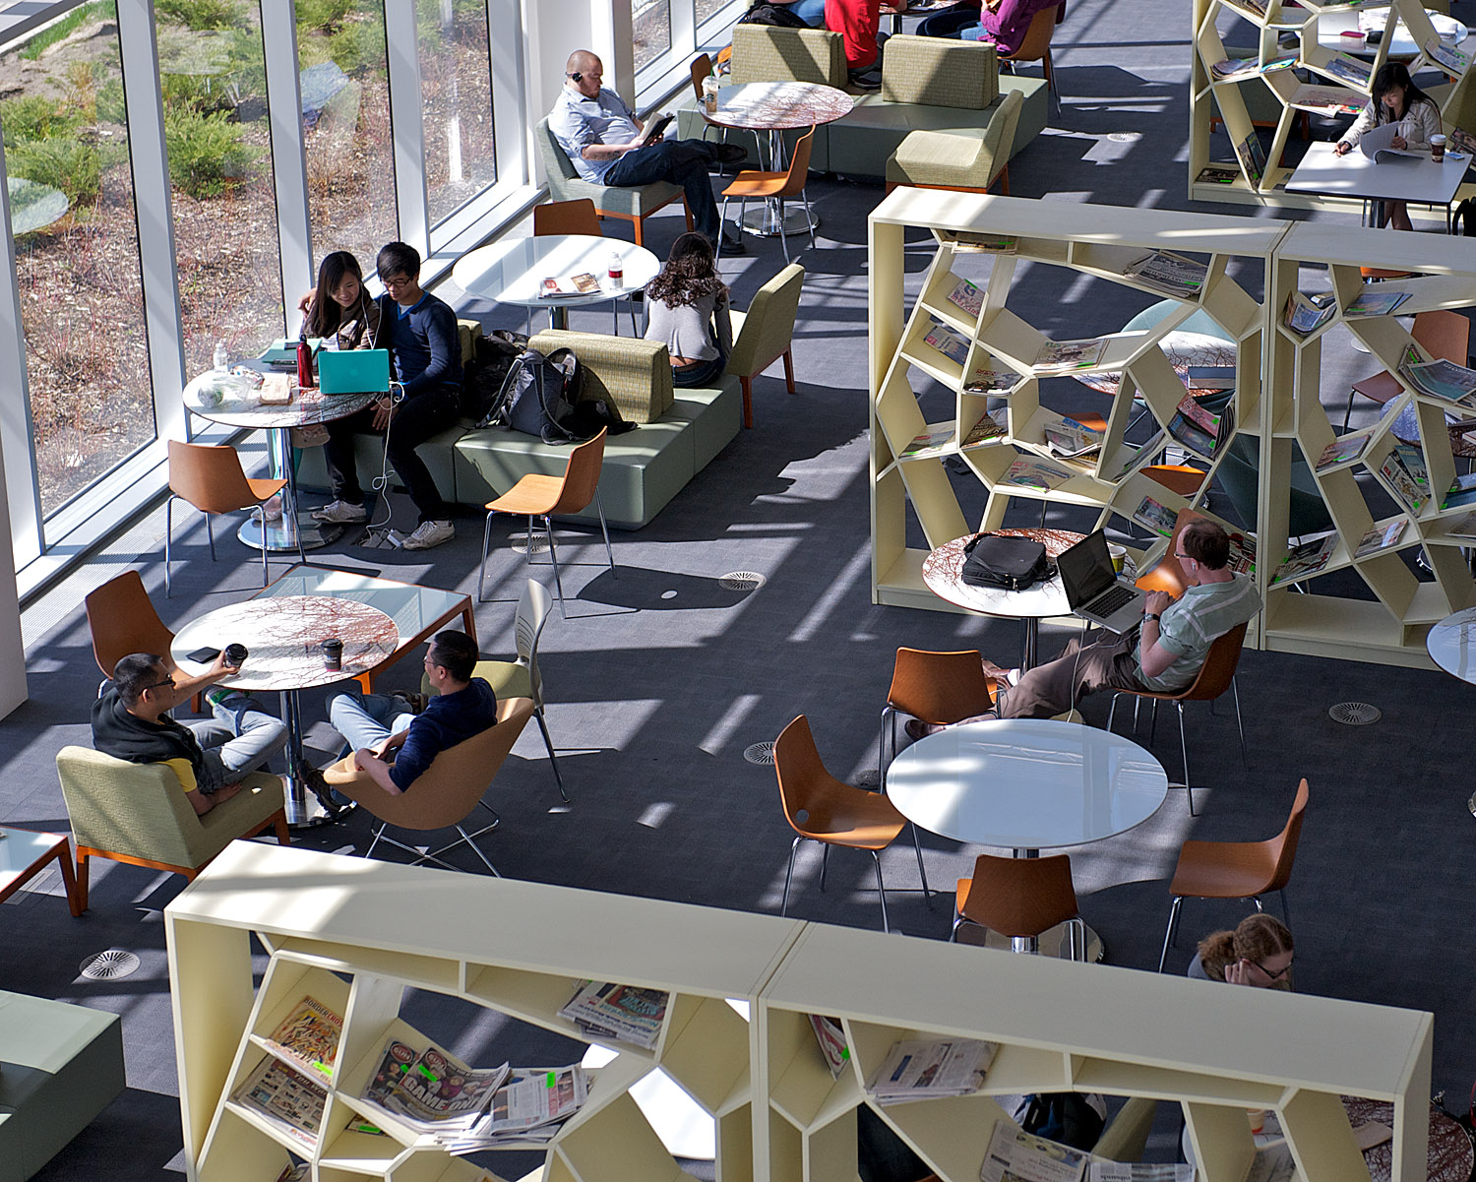
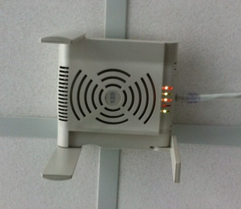
Contemporary Infrastructure
100% Wireless infrastructure

Slide 14
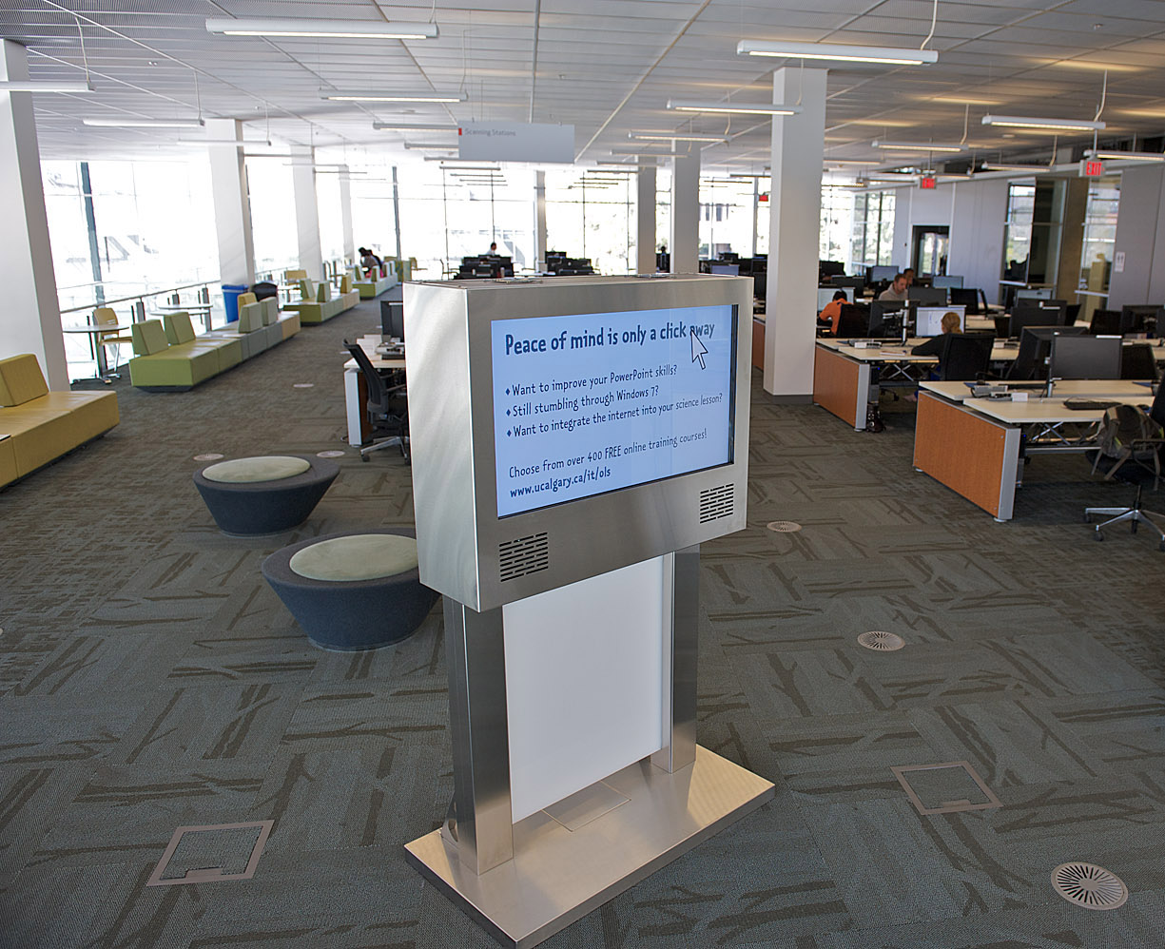
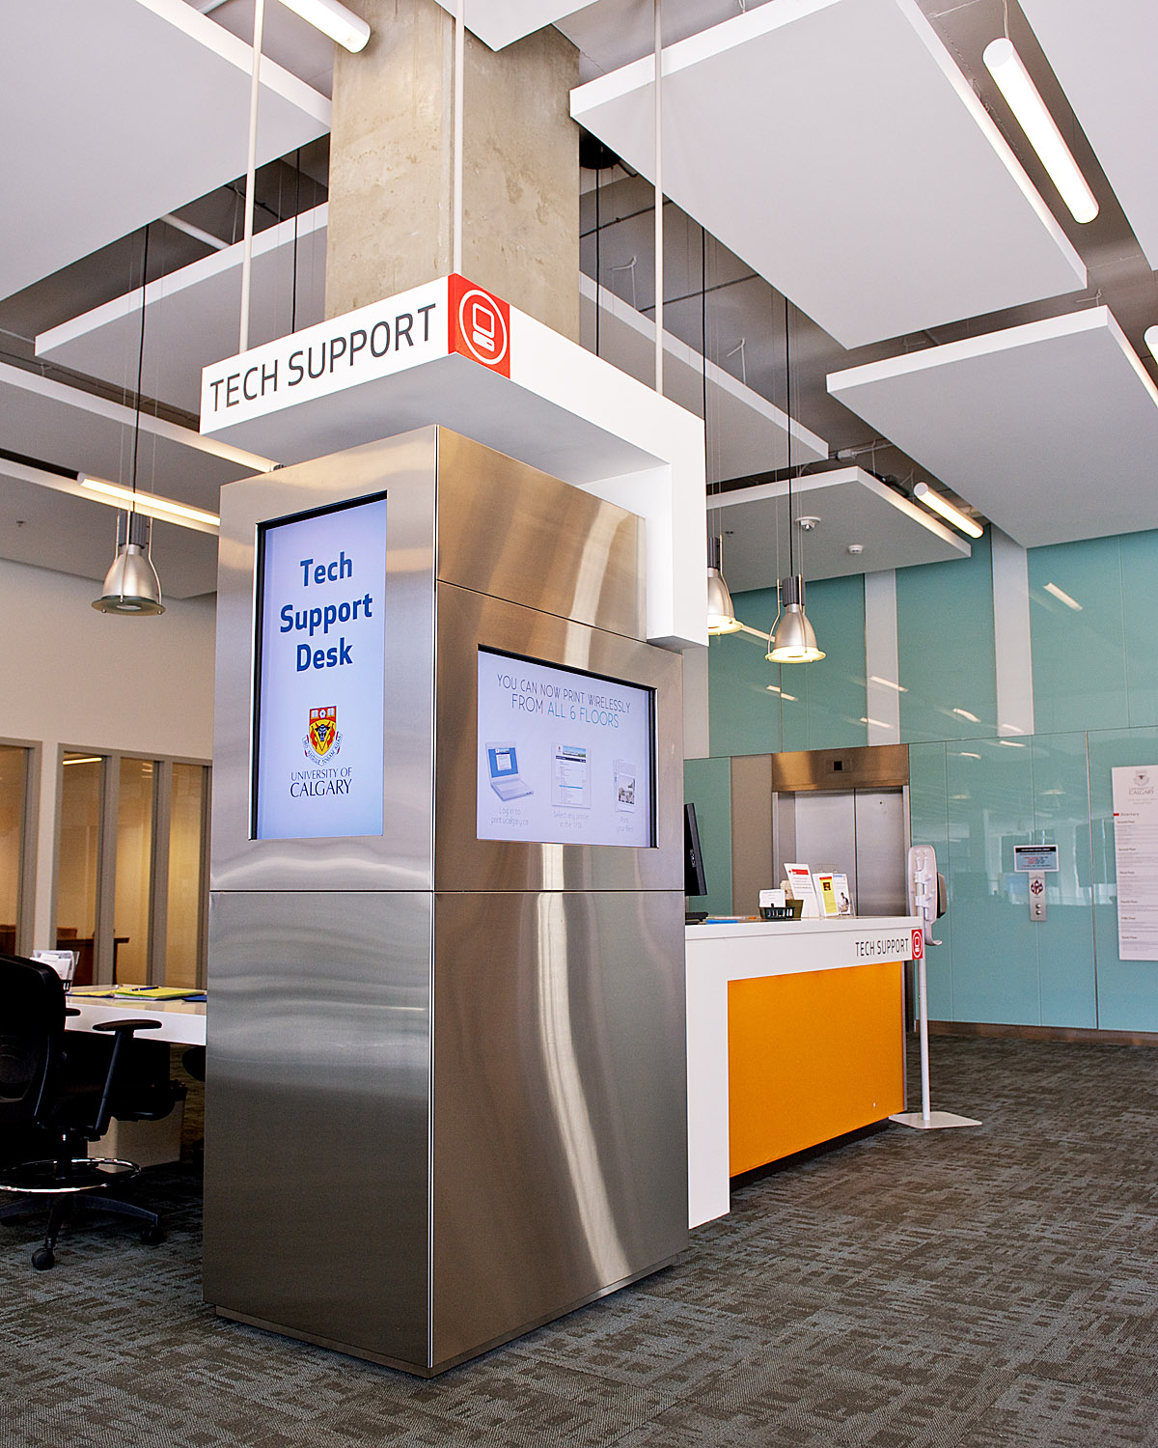
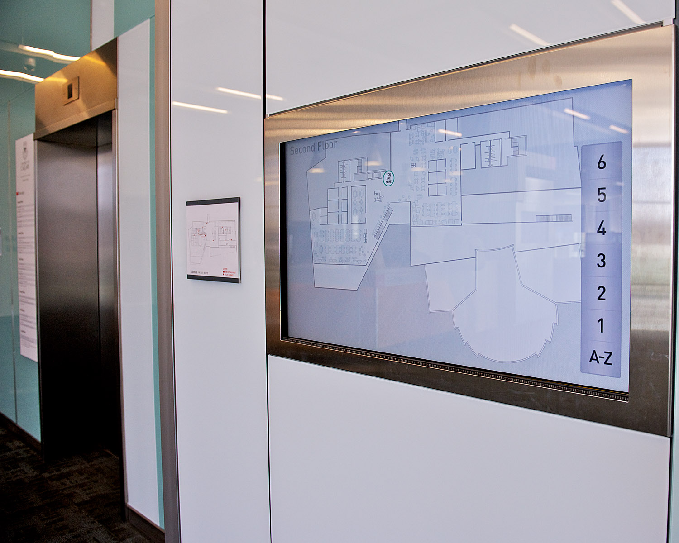
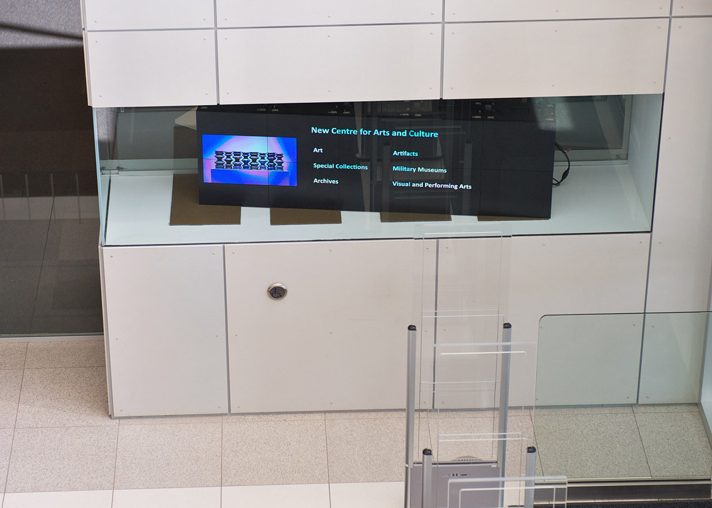
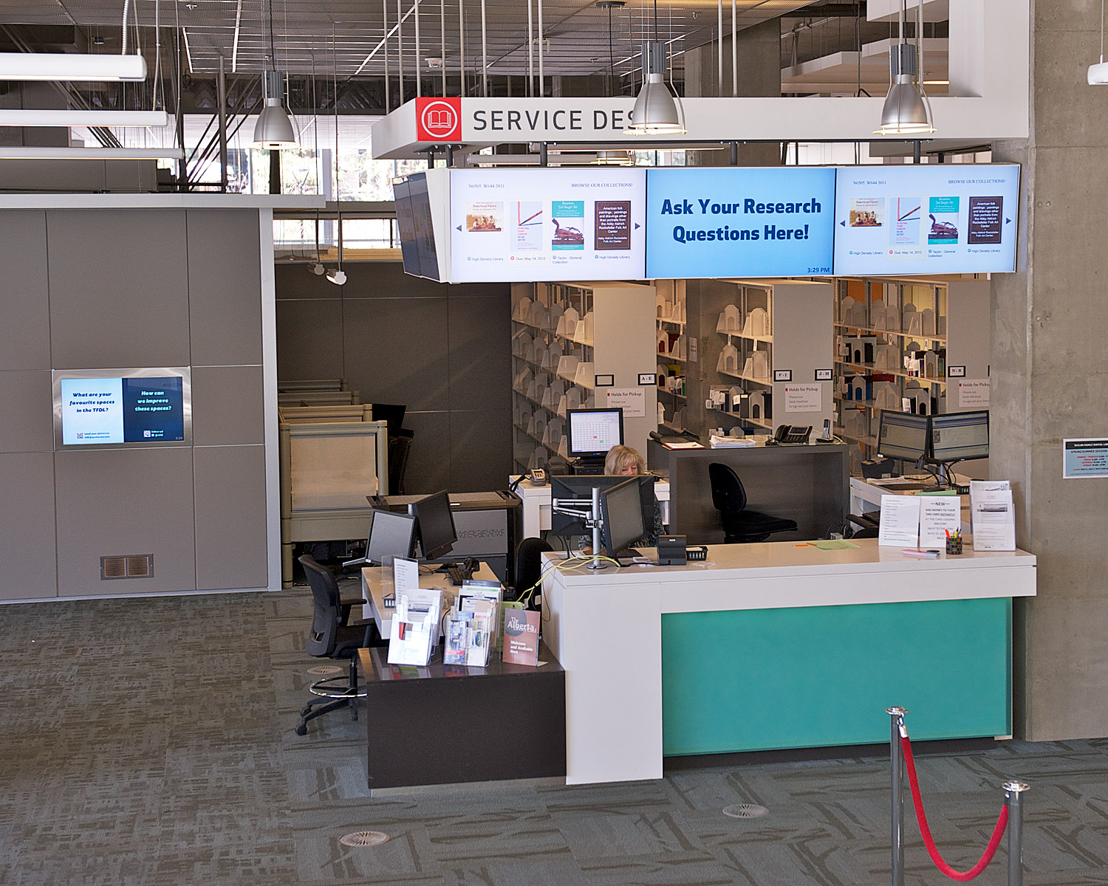
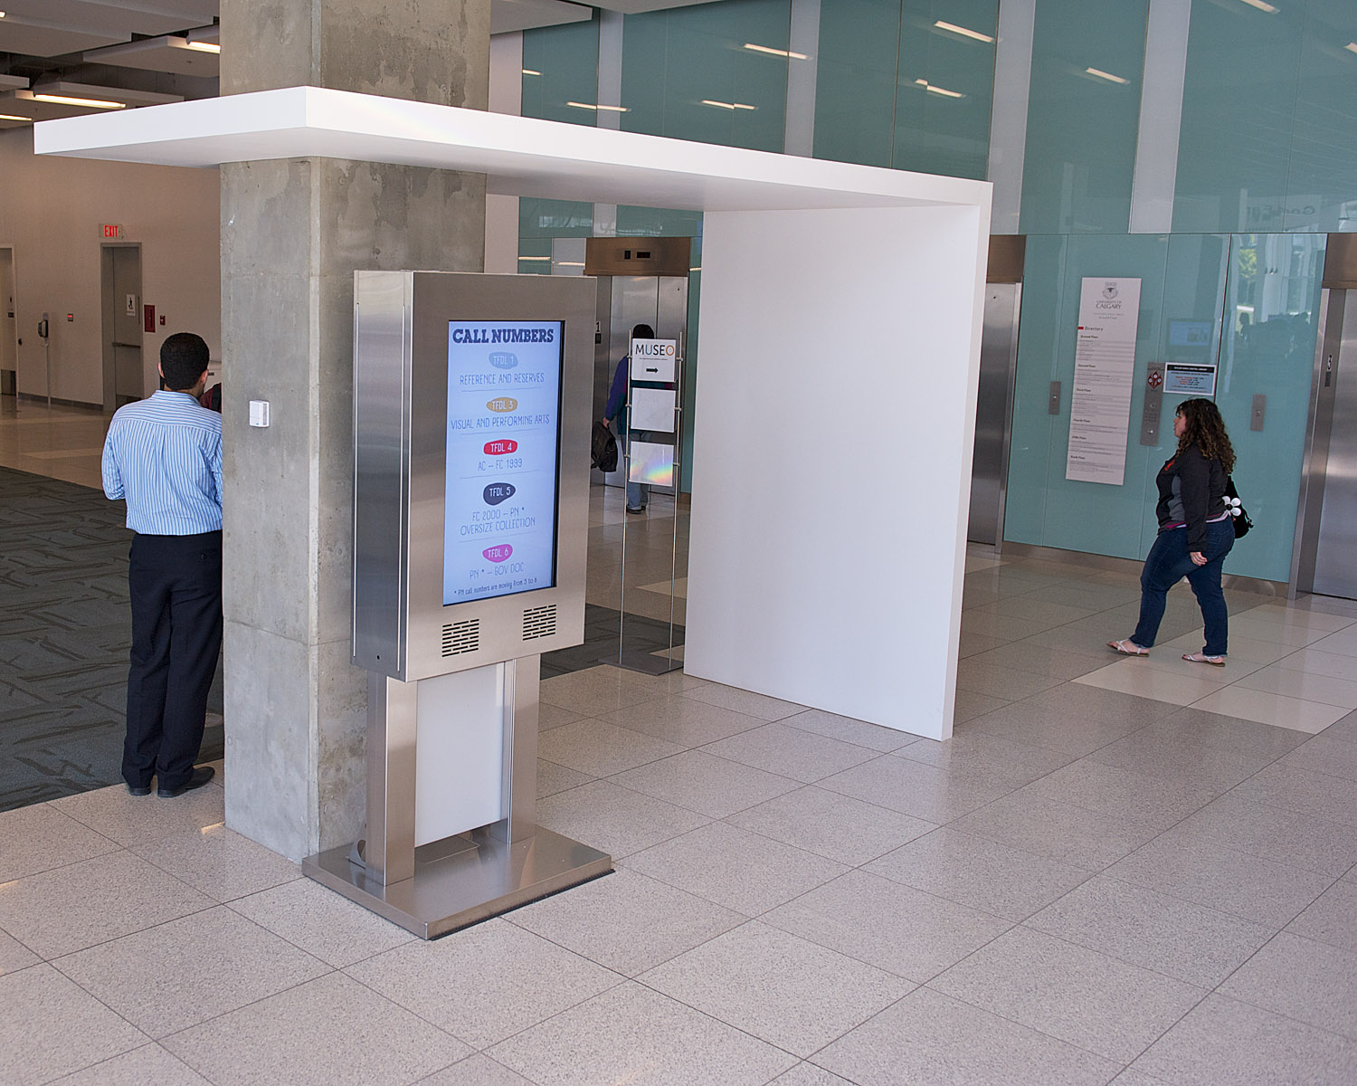
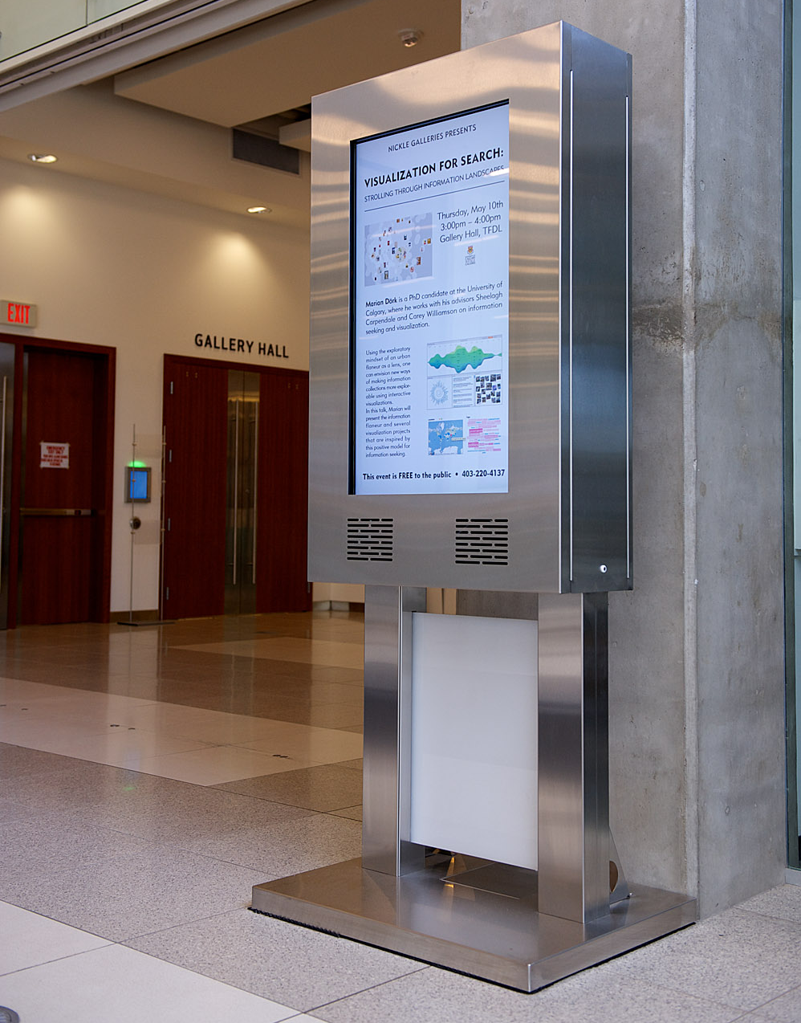
Innovative Infrastructure
Digital Signage

Slide 15
Integrating Reference & Circulation

Slide 16
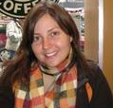
Mobile Reference
December 2010 all public service staff in TFDL were given an iPad to begin mobile service delivery
  Staff received training and $50 giftcard to ensure standard apps on all iPads
Staff, most librarians, more reluctant to deliver services via mobile devices
  Librarians felt they were “selling” something and uncomfortable
Service currently under redesign and staff retraining
  Reference Working Group established in fall to redesign reference service and look at issues relating to mobile reference including encouraging staff to think about user at point of need.
Leeanne Morrow, Head Instruction & Reference

Slide 17
Outreach K-12
University School Week:
  Grades 2-10 in the TFDL to explore our collections, resources and the tools in our Digital Media Commons
Information literacy sessions:
  Grades 10-12 International Baccalaureate Program and Academic Program in our new classrooms
“One off” instruction as per request by teachers:
  Grade 7’s learning about “building the west” through the use of our digitized political papers in Archives
  Viewing documents on the touch tables
Leeanne Morrow, Head Instruction & Reference

Slide 18
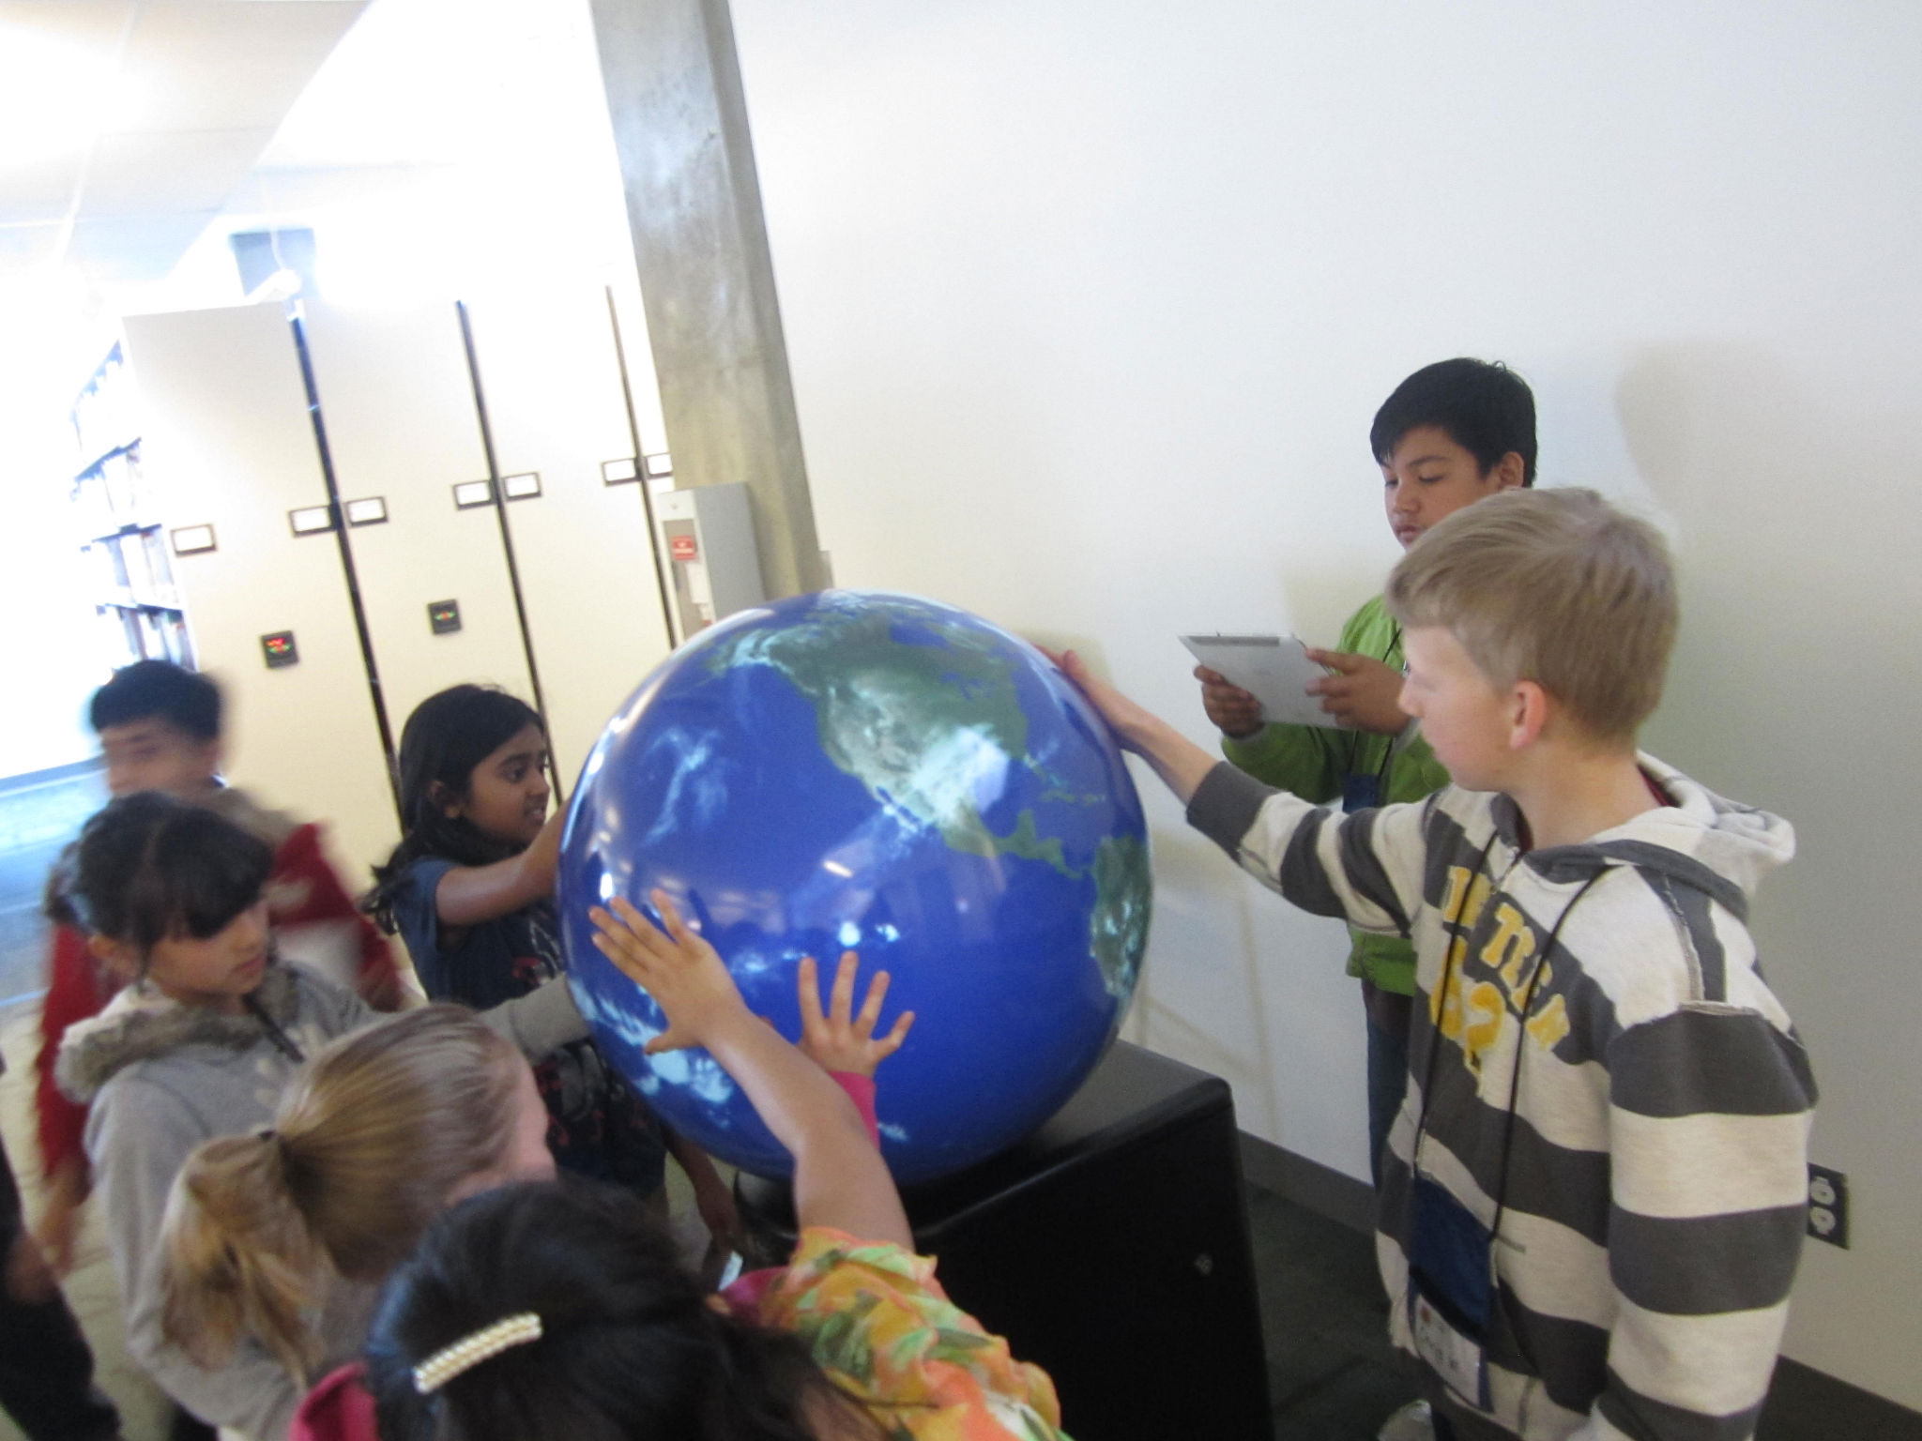
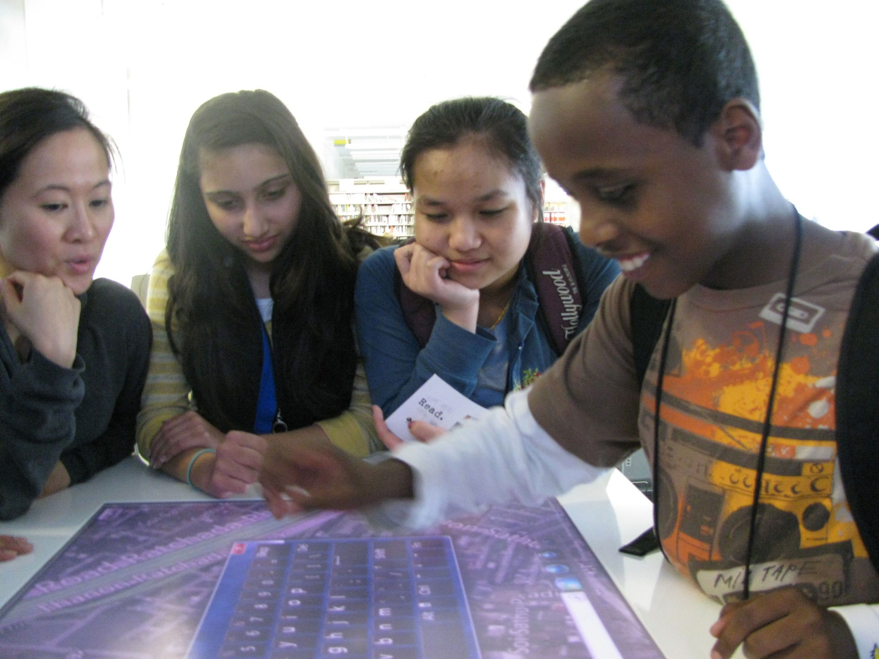
Photos of our K-12 Student Tours

Slide 19
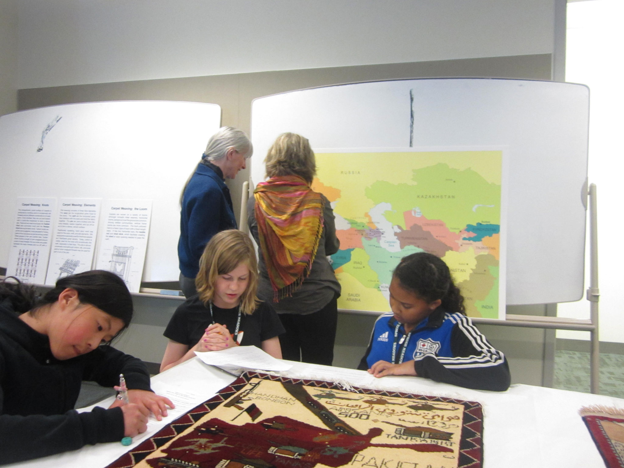
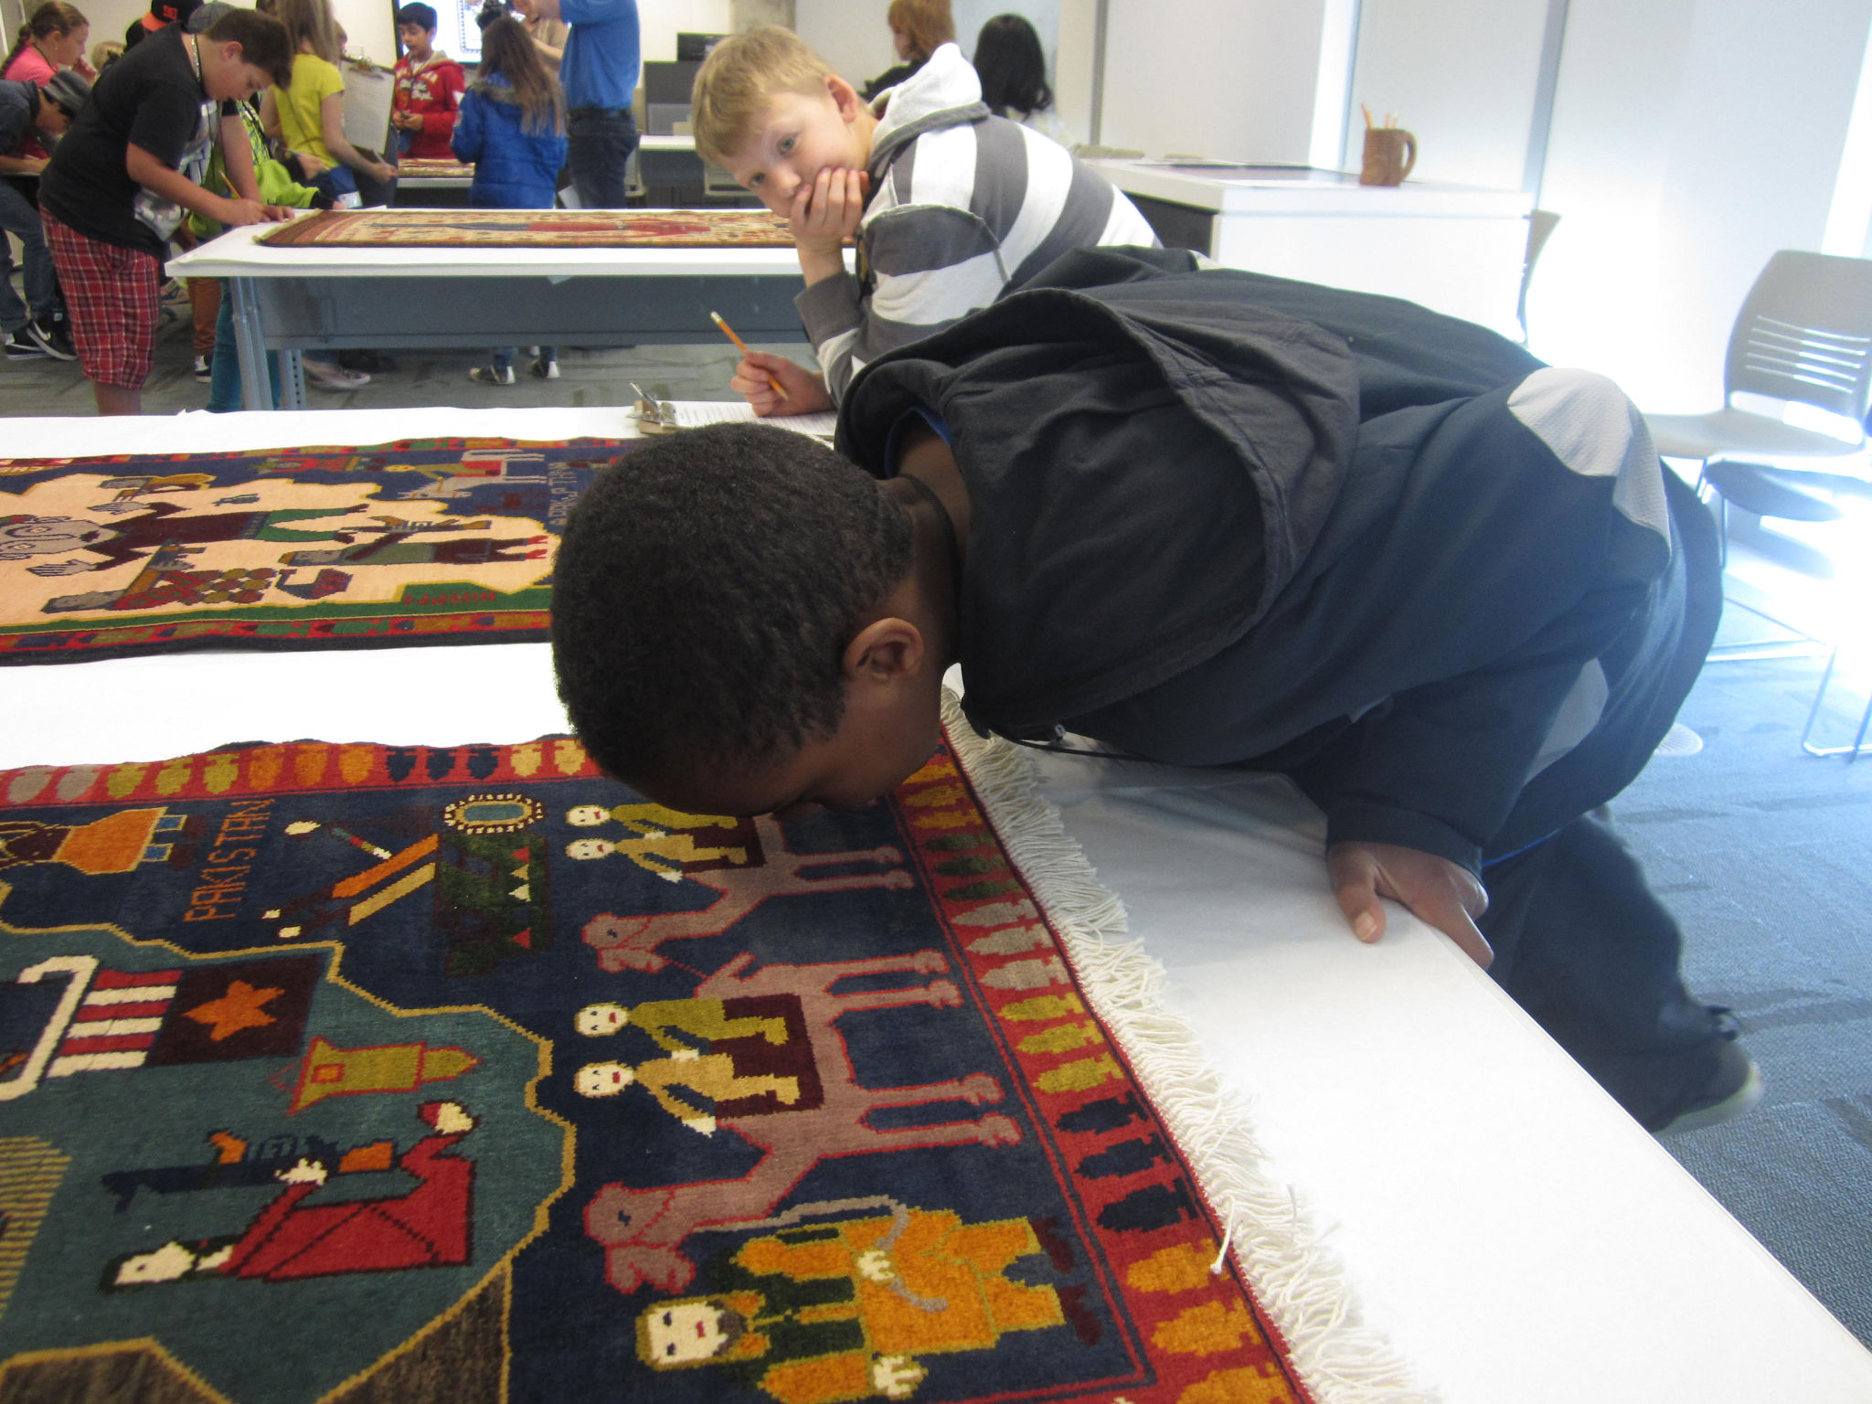
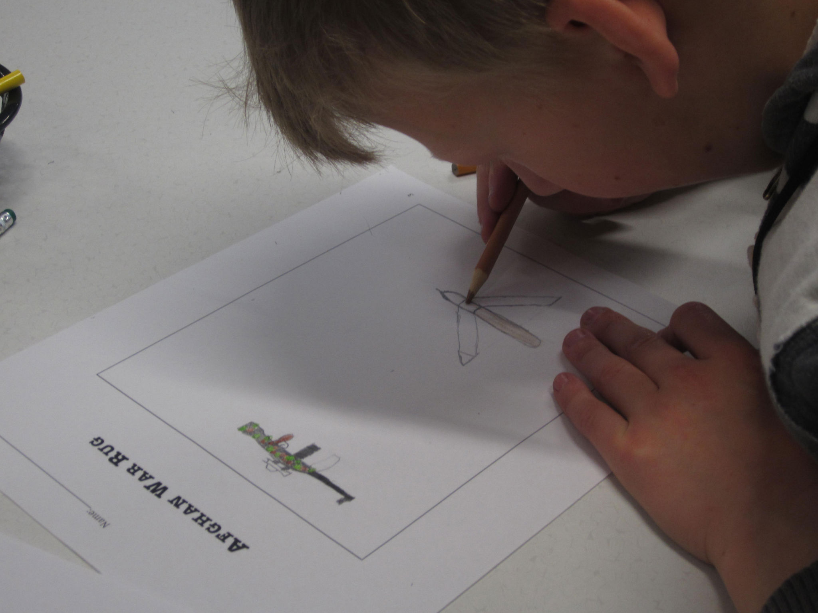
Photos of our K-12 Student Tours

Slide 20
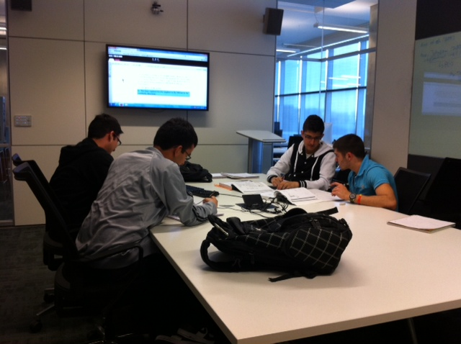
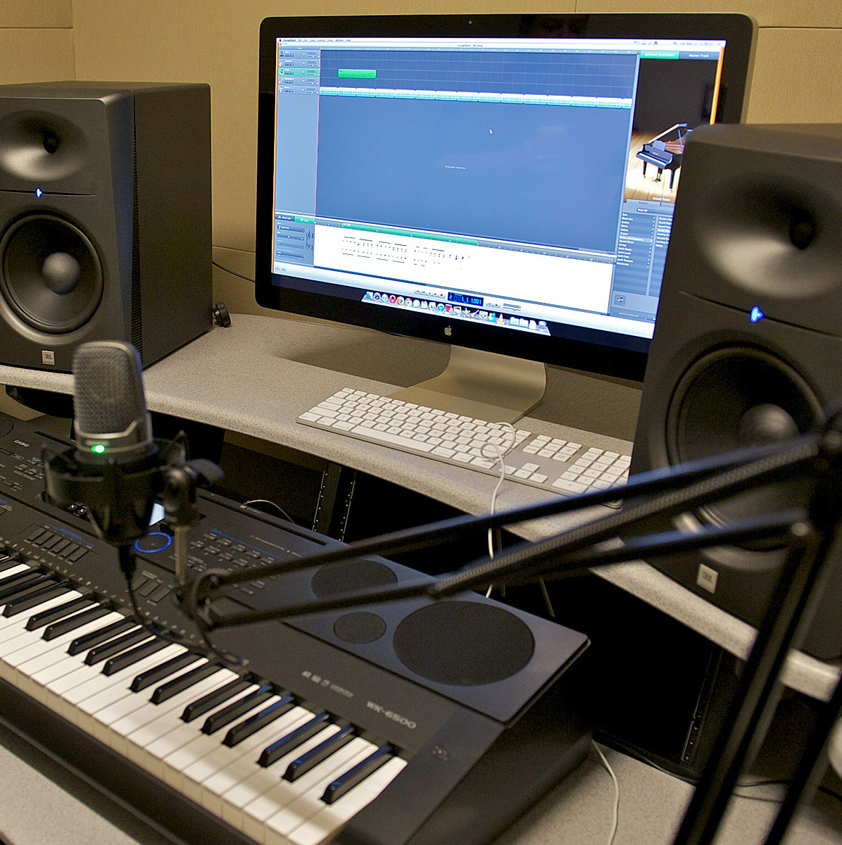
Collaborative Spaces
Workrooms
Presentation Practice Rooms
Edit Suites

Slide 21

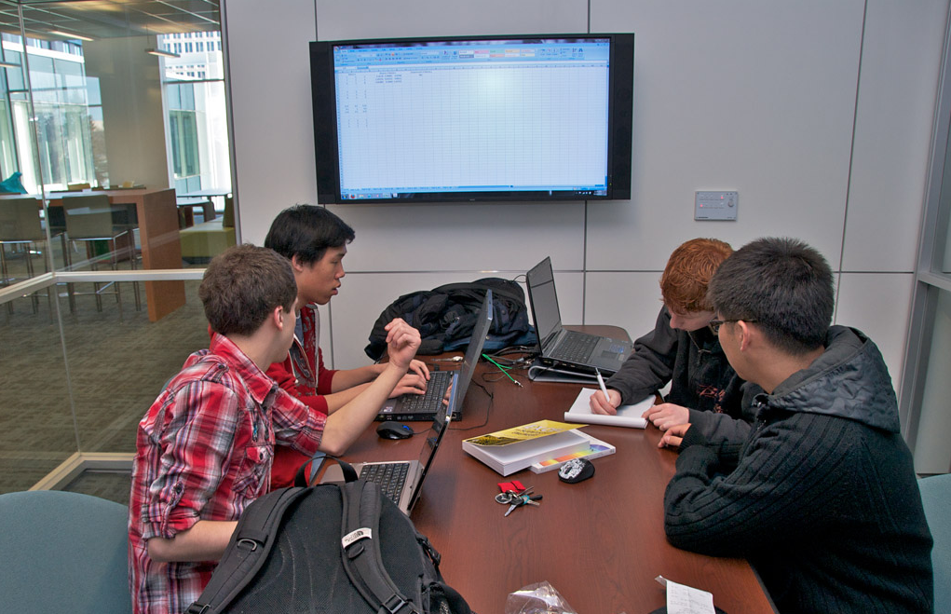
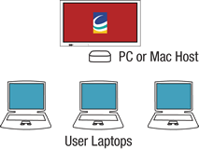
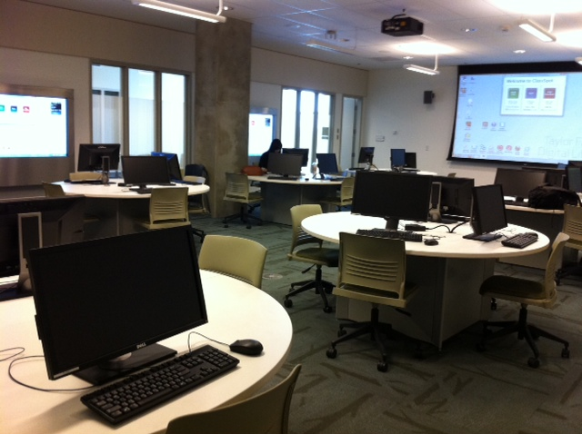
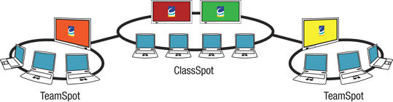
Collaborative Spaces
Software to Enable
Student Collaborative Work
TeamSpot
ClassSpot

Slide 22
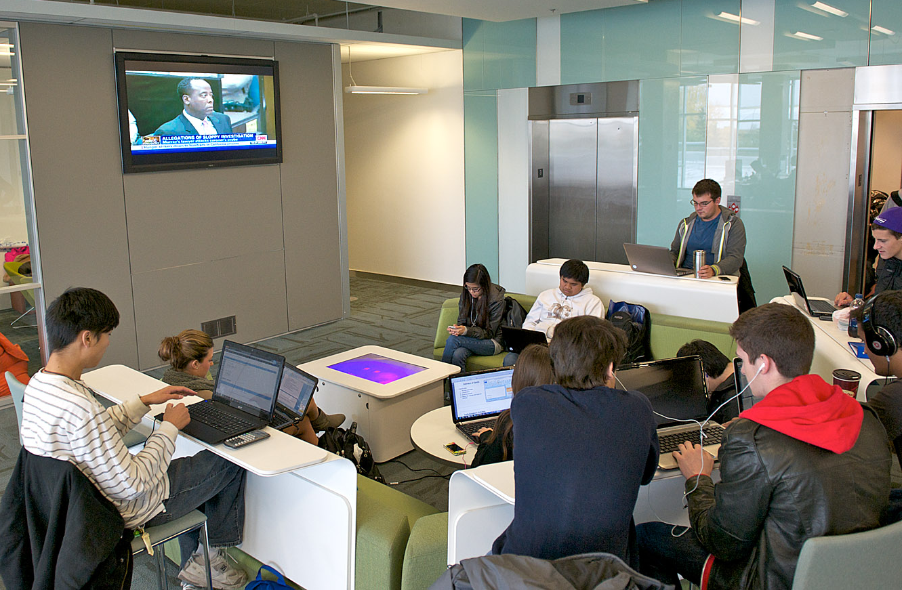
Collaborative Spaces
Furniture to Support Collaboration

Slide 23
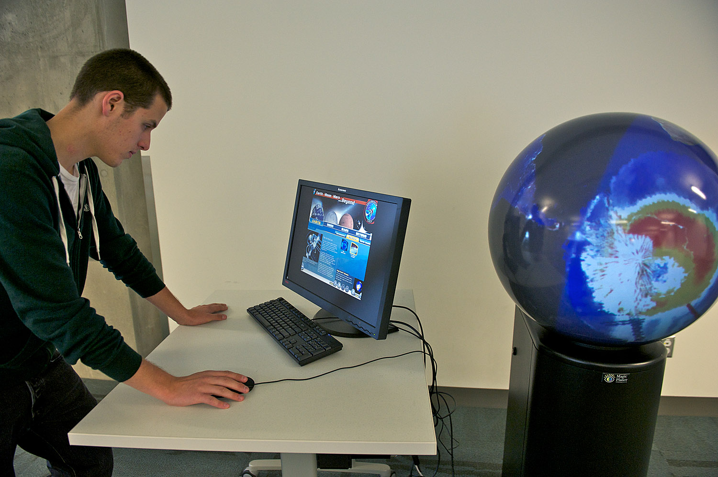
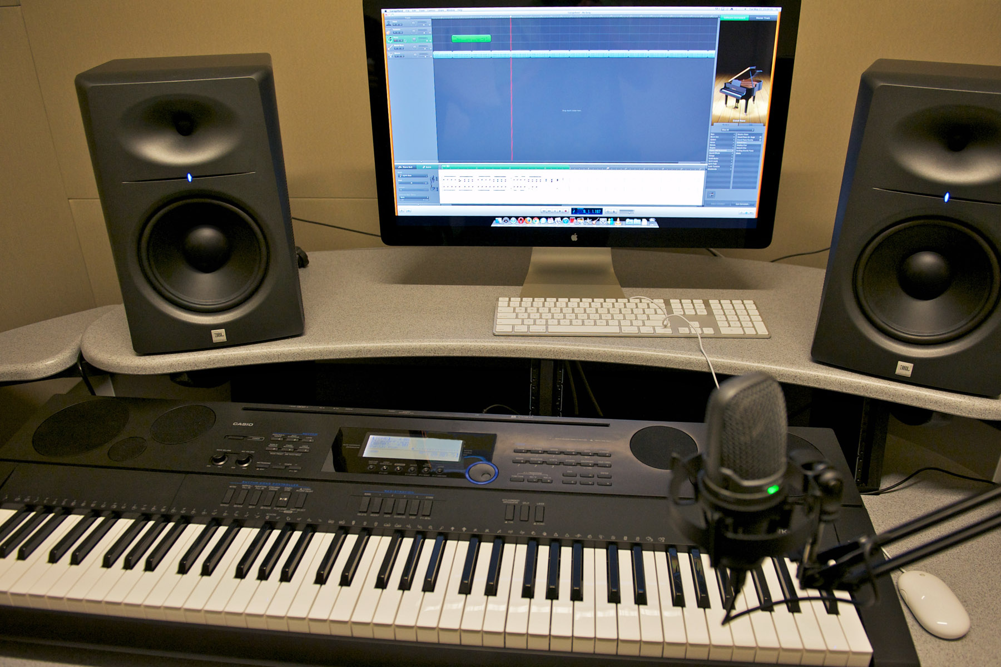
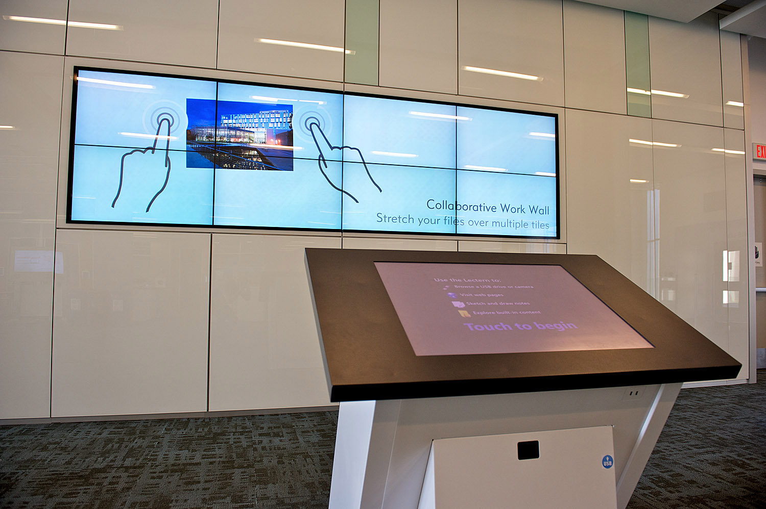
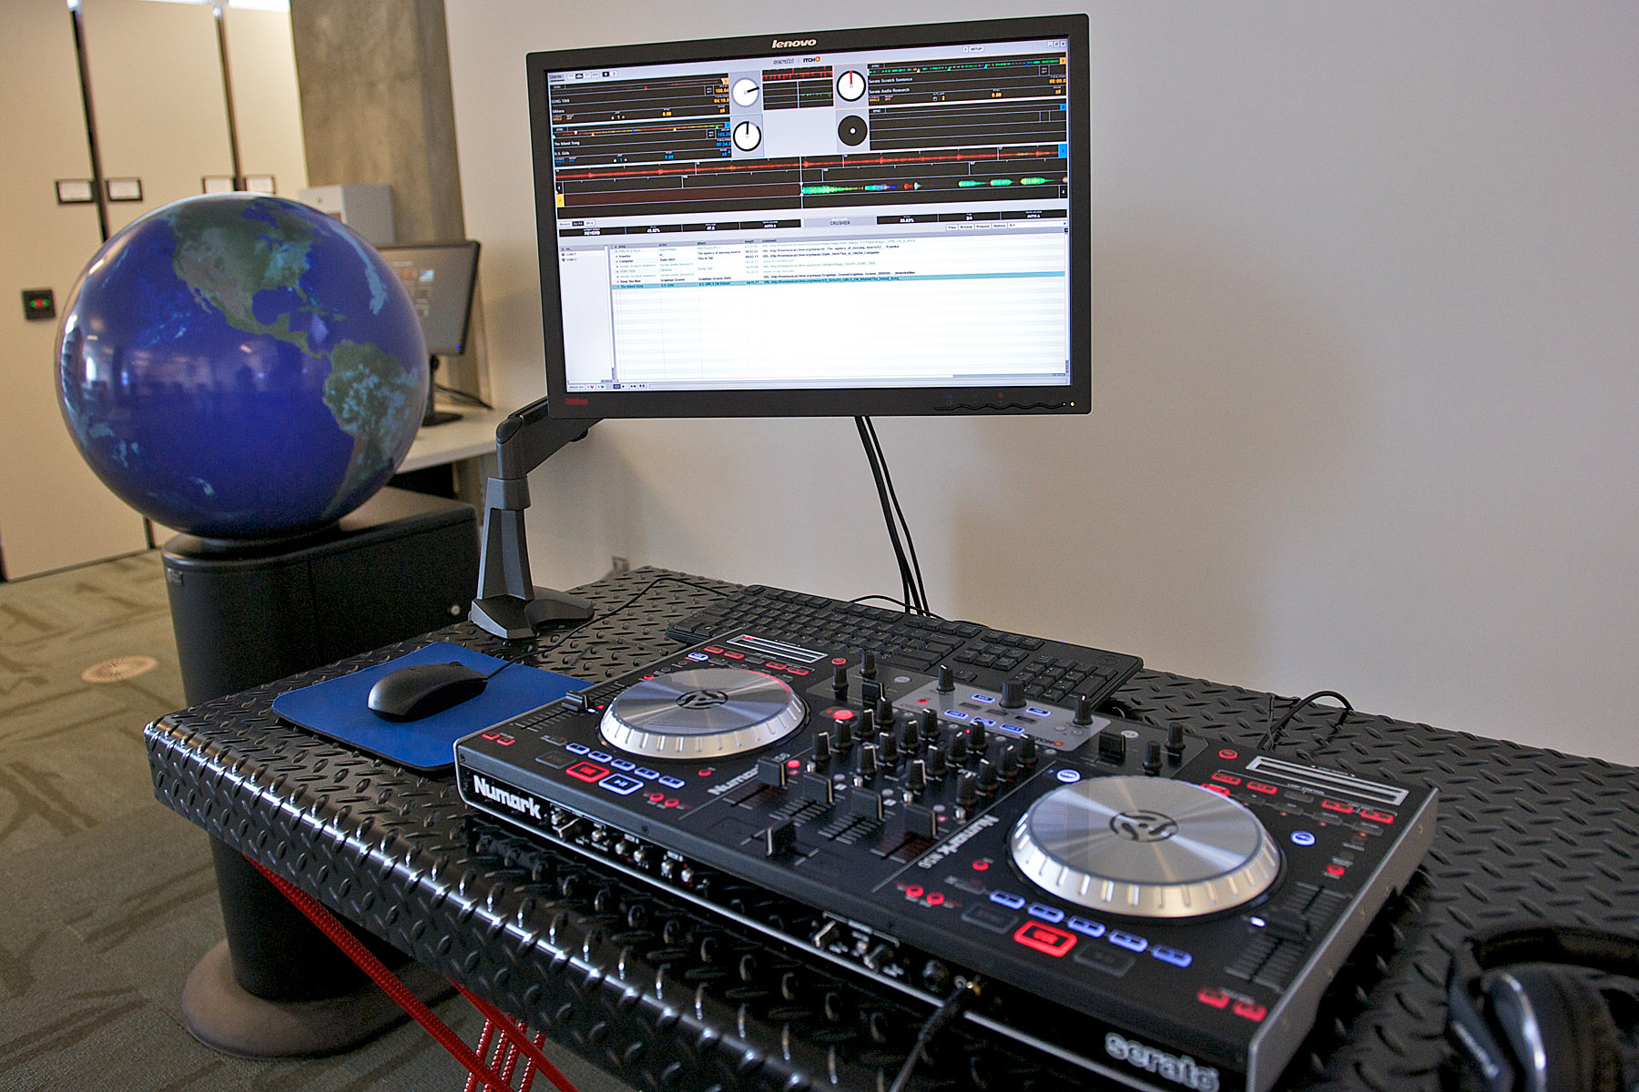
Collaborative Spaces
New Public Computing

Slide 24

Public Computers
PC
Mac, iMacs and Mac Pros
Netbook Checkout

Slide 25



Multi-Surface Computing

Slide 26


New Staffing
Educational Technologist
Background in grade school education
B.Ed.
Data Visualization & 3D Graphics
Background in Computer Science research
Ph.D. Computer Science

Slide 27

Nickle Galleries
Open the Nickle Galleries
Fall of 2012

Slide 28


New Alliances
Student Success Centre & Alumni Services

Slide 29
Building Relationships:
Student Success Centre
  Team teaching programs where services overlap
    Writing and citation help, technology and learning programs
  2. Sharing resources where users can benefit
    Promotion and training of SSC staff to use libguides for topics that can benefit all users i.e. career planning
  3. Staff training opportunities
    Cross training in areas where there is over lap

Slide 30
Building Relationships:
Alumni Services
1. TFDL programs planning in initial stages
  Authors talks, alumni of the month talks
2. Team building through staff volunteers
  Staff from both units cross volunteer to help each other out and learn more i.e. LCR staff volunteer at Convocation
3. Cross referral to users at our service desks
  Library Staff refer Alumni event questions to new Alumni desk and Alumni staff refer resource access questions to TFDL Service Desk

Slide 31

Building Relationships:
Researchers
Visualization Studio
Neutral position on campus
Collaborative Workspace
No windows, protect privacy of data
High Resolution
Lots of digital Real-Estate

Slide 32
Research Commons
Our next initiative within the TFDL, how to create a Research Commons as a distributed model

Slide 33


Research in the Library
Grad student conducting interviews and gathering data
in the library

Slide 34


Research in the Library
Exhibit Grad Project

Slide 35

Research in the Library
Bohemian Bookshelf
Interviewed & Gathered Data in the Library
Increased credibility and high-level of success
Alice Thudt, Uta Hinrichs and Sheelagh Carpendale.

Slide 36
New Alliances with Community
Host events in the Gallery Hall
Invite the community onto campus
Community participation in University programming

Slide 37

Thanks!
Shawna Sadler
TFDL Technology Officer
University of Calgary
403.220.2729
ssadler@ucalgary.ca

