Slide 1
Libraries in the Service of their Universities
Francis X. Blouin Jr.
Bentley Library, University of Michgian
June 5, 2012

Slide 2
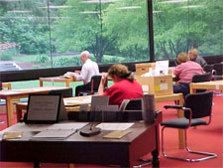
What is the Bentley Library ?
Michigan Historical Collections
University Archives
Reference services
Digital curation
Independent of U Library
Reports to the Provost

Slide 3
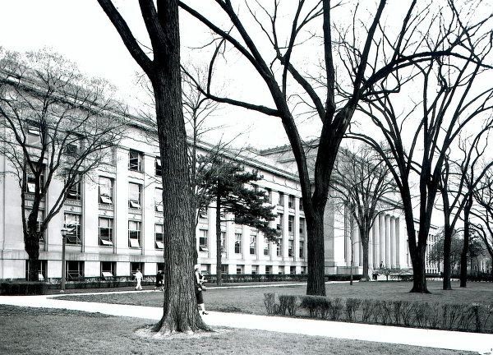
University of Michigan
Founded 1817
19 schools and colleges
Three campuses
58,000 Students
8,500 instructional staff
Budget: $5.5 Billion

Slide 4
How can special collections serve the university?
Three Points:
Focus on University Archives
Rethink what are special collections
A grander vision!

Slide 5
Changing Environment
Google books ---
Bookshops with espresso book machines
Changing NYPL reading room
Changing nature of records production
New philosophy of education—
  From information based to experience based

Slide 6
1.University Archives
University archives used to be collections of historical documents
Moving since the 1970’s toward records management.
Now shifting entirely to born digital documentation.

Slide 7
Problems in this latest shift
No secretaries of file clerks
Outdated or nonexistent policies
FOIA (in public universities and the tendency to push for destruction “read it, shred it”
Mix of official, professional, and personal in information file structures
Emergence of personal storage of official material

Slide 8
Challenges
Managing the creation, use, and retention of born digital information on campus
Setting up policies about ownership, file systems, retention, and system design
Managing storage and retrieval
Insuring security and preservation of content

Slide 9
University archives no longer just collect-rather they need to manage digital content from the point of creation through to the point of inactivity and placement in secure storage. The University archives needs now to be totally integrated into the information flow on campus through the entire records cycle.

Slide 10
Is the university archives a special collection?
Some say yes
Some say yes,but

Slide 11
The traditional role
For many university libraries the University archives is:
  A set of historical documents
  An accumulation of paper records
  Presented as a subset of rare book and manuscript collections
  Rooted in pre 21st century methodologies

Slide 12
The 21st century model
Some university libraries are moving aggressively in the area of university archives:
-- Connecting to university IT
-- Connecting to university legal counsel
-- working to set policies for retention and storage
-- making arrangement for secured storage
-- integrating with initiatives on big data management

Slide 13
Advantages of the 21st century model
Integrating the library function with all the schools and colleges on the campus.
Integrating library function with institutional information flow and information preservation
Establishing the library as the center for institutional memory
Sharing in the university investment in IT.

Slide 14
MESSAGE:
Rethink the importance of the University Archives as central to the new environment for information flow and retention on campus

Slide 15
2. Rethinking special collections
Move from a sense of “what we have” to understanding collections as a source of intellectual authority on the campus.
Special collections are an assemblage of voices that can instruct
Exposure to powerful voices in collections can be as useful and impactful as exposure to powerful voices in the classroom

Slide 16
Shift from the idea of special collections—which is materials based to special connections which is idea based.
This fits newer ideas of education where students are encouraged less to gain information and more to experience the processes by which information is accumulated and known

Slide 17
From this perspective:
The library is a special collection—
A place for uncovering knowledge and moving on from fixed descriptive systems
A place for understanding information

Slide 18
Message
We need to move away from a materials focus on special collections

Slide 19
3. Grand Vision
I would like to think that special collections could emerge as an intellectual center on the campus where the collections themselves are the intellectual authorities in ways that faculty are authorities in other departments.
Libraries might establish a department of academic programs

Slide 20
Department of academic programs
The voices of the collections are the principal intellectual argument for the programs
Faculty within the library or outside the library work with these “voices” in courses designed to experience the creation of and evaluation of knowledge.
This would build on the CLIR initiative
Moves collections from “material” to intellectual resource—voices of intellectual authority

Slide 21
(continued)
Leverages the university investment in libraries and special collections
Expose students to information issues as posed by the university archives.
Establishes the library as a full partner in the academic mission of the university and away from the notion of service.

Slide 22
Conclusion
By rethinking special collections including the university archives perhaps we will move beyond a question of how these serve the university to a recognition that these are essential to what the university of the 21st century is becoming.

