Slide 1
Aligning Special COLLECTIONS with the Institutional Mission
Tim Pyatt, Huck Chair
Eberly Family Special Collections Library
June 5, 2012
OCLC Research Library Partners
Libraries Rebound

Slide 2
“it will become increasingly difficult to distinguish libraries based on their holdings of these materials. Instead, libraries and their institutions will increasingly be distinguished by the special collections of rare and unique materials that they hold…”
Don Waters, Mellon Foundation in an address to the ARL in fall of 2005

Slide 3
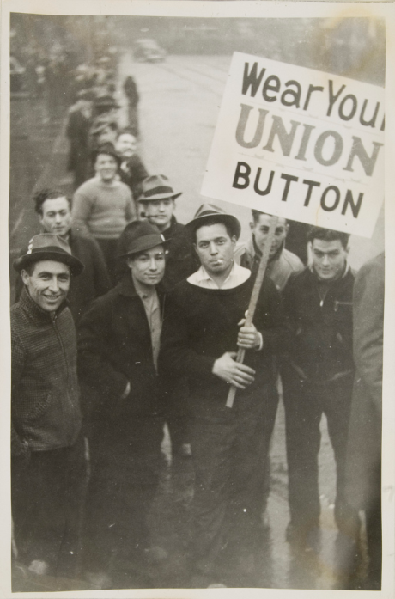
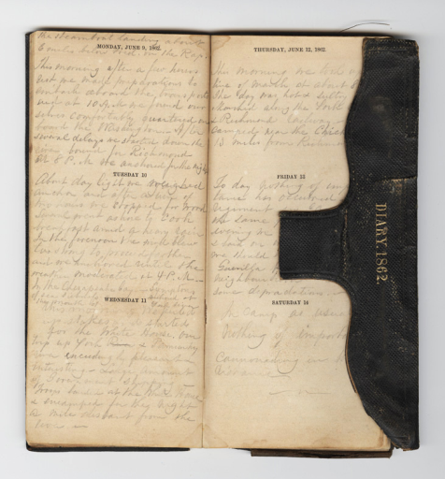
What are Special Collections? Most would agree…
Papers of Ernest Hemingway
Records of the United Steel Workers
News from Nowhere (Kelmscott Press)
Civil War solder’s diary

Slide 4
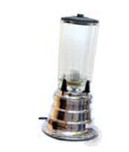


Some materials depend on the institutional context..
Fred Waring’s “blendors”
The Hunger Games
Eighteen Century Collections Online (licensed database)
The People’s Contest (collaborative digital site)

Slide 5



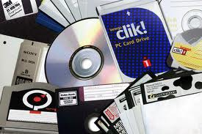
What is Special Collections?
Place of discovery and excitement
Integral part of Library and Campus
Place of innovation
Place of public trust
Place of institutional distinction

Slide 6
Alignment – Mission Improbable?
Historically independently and opportunistically built
Dedicated and sometimes inflexible funding sources
Have avoided “trendy” collecting and supporting short term needs

Slide 7
Collection Assessment
RLG Conspectus
Taking Our Pulse (2010 OCLC Report)
Taking Stock and Making Hay (2011 OCLC Report)
21st Century Collections (2012 ARL issue brief)

Slide 8
Penn State Assessment Process
Task force charged by dean
Composed of 3 subject librarians, 1 non-library faculty member, assessment librarian, and director of library development

Slide 9
Data Points considered
Historical SCL strengths
Collection use and support
Main Library strengths and strategic plans
Campus strategic plan
Areas of opportunity

Slide 10
Some early results
Deaccession policy
More topical approach
Finding the “gaps” and identifying new opportunities
Greater transparency about the SCL’s holdings and direction

Slide 11
Benefits of closer alignment:
Greater understanding and support of Special Collections collecting policy
More potential for integrated services and engagement from librarians outside of Special Collections
More focused collections with greater support from campus add to our “distinctiveness”
Greater development potential – a clearly articulated plan is easier to sell to donors

