Slide 1
Supporting researchers at Leiden University Kurt De Belder University Librarian Director Leiden University Libraries & Leiden University Press
Libraries Rebound: Embracing Mission, Maximizing Impact, June 5-6, 2012

Slide 2
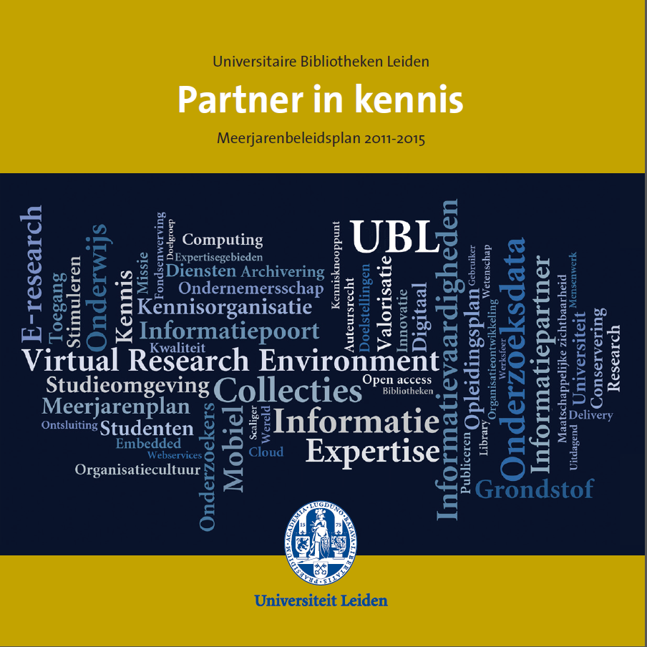
Leiden University Libraries – Strategic plan 2011-2015: Partner in Knowledge
http://media.leidenuniv.nl/legacy/meerjarenbeleidsplan-ubl-2011-2015.pdf

Slide 3
Partner in Knowledge (1)
Library to become expert centre digital information for research and teaching.
New areas of expertise in research support:
Virtual Research Environments (=> production)
Data management & curation (pilots)
Text & data mining (exploring project)
Copyright (production)
GIS (exploring project)
Publication support (exploring project)
[further areas to be identified through in-depth focus group discussions with researchers]

Slide 4
Partner in Knowledge (2)
Important for Leiden University Libraries:
One organisation in 2010
Strategic plan developed with library staff
Changes in function profiles (e.g. subject specialists)
Within appointments time explicitly allocated for development of new expertise
Focus on working in projects
Sufficient funding for staff training and development

Slide 5
Partner in Knowledge (3)
Approach
Expertise approach (not subject approach).
Balance between own expertise and mediation.
Collaboration is central: with researchers, research groups, computing centre and external partners such as SURF, national data archives (DANS & 3TU.Datacentre), Microsoft Research.
Bottom up but accompanied by strategic discussion at leadership level of university.

Slide 6
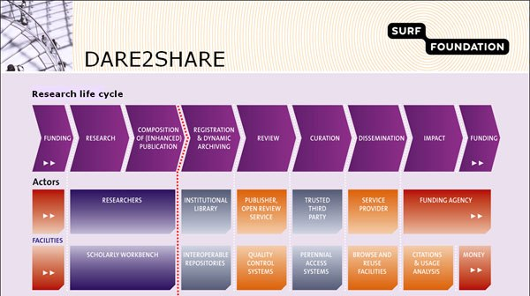
Research life cycle
Leo Waaijers: The DARE Chronicle: Open Access to Research Results and Teaching Material in the Netherlands, Ariadne, 53, October 30, 2007. http://www.ariadne.ac.uk/issue53/waaijers

Slide 7
RESEARCH
Virtual Research Environments (VRE)
DataLabs
Data Information Office

Slide 8
PUBLICATION
Virtual Research Environments (VRE)
Copyright Office
Institutional Repository
Leiden University Press

Slide 9
REGISTRATION
ARCHIVING
Current Research Information System (CRIS)
Library assigns Digital Author Identifier for Leiden authors
Institutional Repository
Virtual Research Environments (VRE) & DataLabs (library focuses on data management during research project)
Digital Faculty Archives

Slide 10
REVIEW
No activities by library

Slide 11
CURATION
Repository materials curated at E-depot from KB (National Library, The Netherlands).
DataLabs to be curated at DANS and 3TU.DataCentre.
2013 close down of first VRE => project with research group to look at long term curation of research materials.

Slide 12
DISSEMINATION
Repository connected with general search engines (Google, WorldCat, …), specialized search engines (NARCIS, DRIVER, DART, …).
Manages publication pages of faculty.
VRE (public website, blog, wiki).
Leiden University Press.
Founding member of OAPEN (Open Access Publishing in European Networks – www.oapen.org).

Slide 13
IMPACT
Publication advice
Monthly repository statistics per publication available to authors
Collaboration with CWTS

Slide 14
FUNDING
Collaboration with LURIS (Leiden University Research and Innovation Services).

Slide 15
Results
Library becomes known within the university for these new services and its image changes.
Library staff is enthusiastic.
Library is invited to participate with (large) research funding requests.
Extra university funding allocated for some of these services.
Quick reaction time in related areas (e.g. copyright).
Unexpected opportunities present themselves (e.g. research/teaching)
Waiting list of research groups for VRE’s.
Show impact of library on primary processes.

Slide 16
Thank you for your attention
k.f.k.de.belder@library.leidenuniv.nl
www.linkedin.com/in/kurtdebelder
@KurtDeBelder

