Slide 1
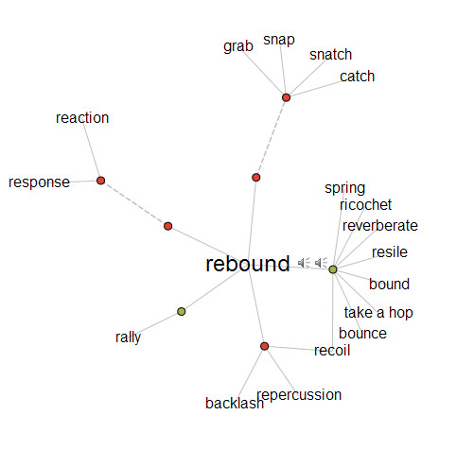

Slide 2
Research Information Management
Opportunities for libraries in support of research process and outputs
Mobilizing Unique Materials
Describe, disclose, discover, deliver effectively
Metadata Support and Management
New models, workflows for network level services
Infrastructure and Standards Support
Support new architectures and their adoption
System-wide Organization
Cooperative models of acquiring and managing collections
User Behavior
DEFINE FUTURE RESEARCH
LIBRARY SERVICES –
REVITALIZE OUR
VALUE PROPOSITION
TRANSFORM CURRENT
OPERATING PRACTICES AND
PROCESSES –
IMPLEMENT SYSTEMIC CHANGE

Slide 3
Future Library Services
Built around
  Local Priorities
  Local Infrastructure
  Unique institutional assets
Research
Support
Buildings
& Space
Special Collections
to create portfolio of distinctive services

