Slide 1
Hello!

Slide 2
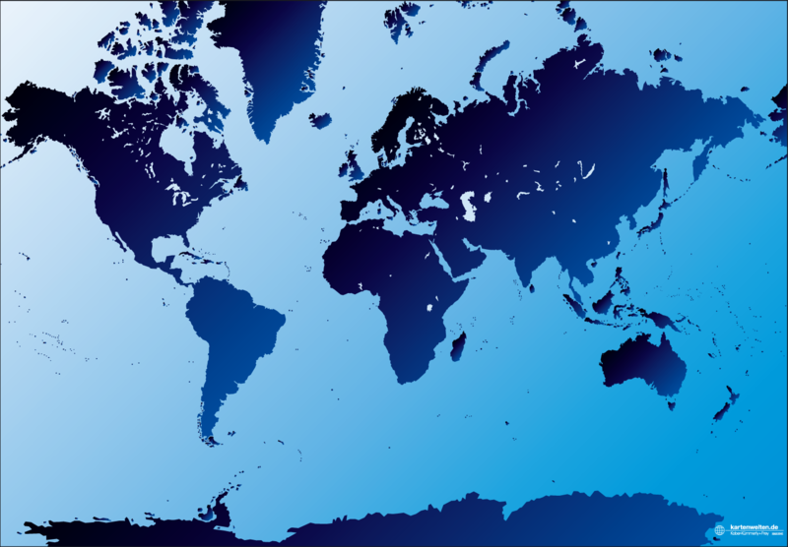
OCLC Research Library Partnership – Presence & Reach
San Mateo, CA Dublin, OH
Leiden, NL
Notes:
Offices in San Mateo, CA and Dublin, Ohio, and in Leiden (Netherlands). New Senior Program Officer, Titia van der Werf who will be based in Leiden and work closely with current and potential Partnership institutions.
About 15 FTE focused on the Partnership and its activities -- plus the efforts of our research scientist colleagues as we need them. There is a good bit of interaction between the two U.S. offices – we use video conferencing for our weekly meetings plus staff travel to the other location as needed to take best advantage of the presence of colleagues from OCLC offices around the world.

Slide 3
OCLC Research Library Partnership
US &
Canada
(Americas)
119/78%
Asia-
Pacific
7/4%
Europe &
Middle East (EMEA)
27/18%
Notes:
(As of September 2011) 153 Partner institutions
112 from the US; 6 from Canada;
34 from outside of North America including 21 from the UK and Ireland, 5 from Continental Europe and 7 from the Pacific Rim.
What sets us apart from other library consortia? The Distinctive Difference is the fact that ours is a truly transnational partnership. Fully 22% of our Partners come from outside of North America.

Slide 4
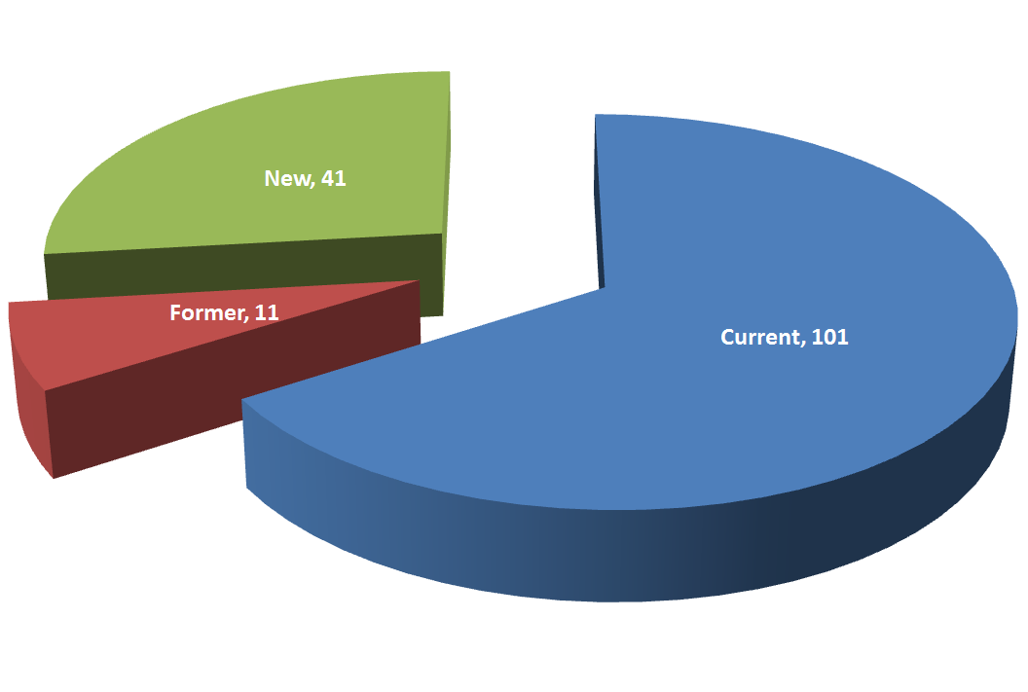
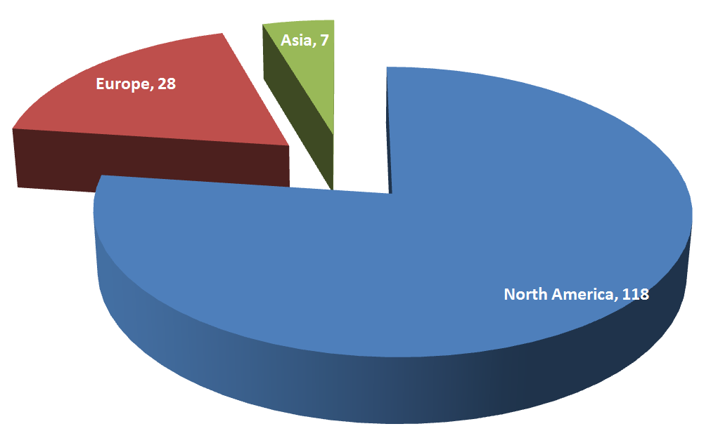
OCLC Research Library Partnership
153 Partners
At September 2011
50% of ARL
62% of RLUK
24 of top 26 in
THE World University

Slide 5
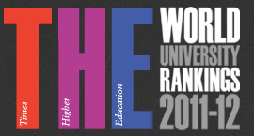
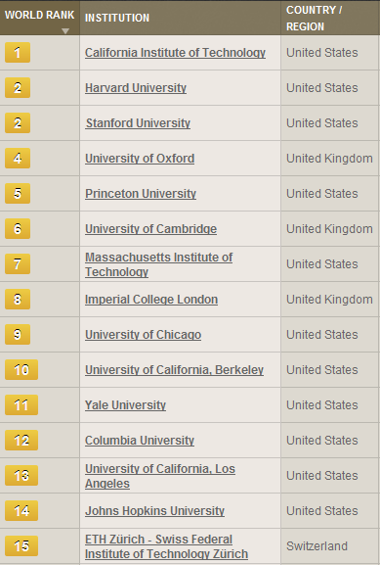
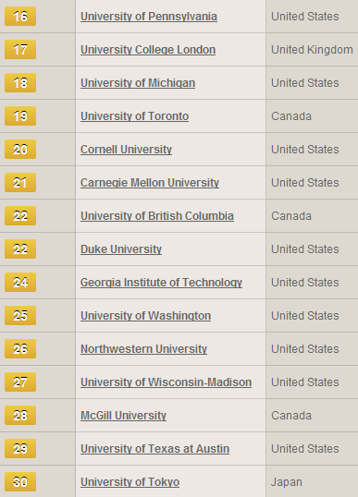
Libraries at 25 of the top 30 world universities
are OCLC Research Library Partners
= not yet affiliated

Slide 6
A few of our newest Partners
The Royal Danish Library (DK)
The Tate Gallery, University of York, LSE (UK)
The Universities of Utrecht and Amsterdam (NL)
The Universities of Auckland (NZ), La Trobe (AU), and Hong Kong
The Universities of British Columbia, Manitoba and Montréal (CA)
Dartmouth College and Notre Dame University (US)
Notes:
Our newest Partners represent a cross-section of the research library world,
From a small but multi-site museum to a large national library;
From public universities to elite private colleges.
The total membership spans the distance from the 53rd parallel in the North (University of Aberdeen, Scotland)
to the 43rd parallel in the South (National Library of New Zealand’s Christchurch Center, South Island, NZ)

Slide 7
OCLC Research work agenda
1
2
3
4
5
6
Research Information Management
Opportunities for libraries in support of research process and outputs
Mobilizing Unique Materials
Describe, disclose, discover, deliver effectively
Metadata Support and Management
New models, workflows for network level services
Infrastructure and Standards Support
Support new architectures and their adoption
System-wide Organization
Cooperative models of acquiring and managing collections
User Behavior
DEFINE FUTURE RESEARCH
LIBRARY SERVICES – REVITALIZE
OUR VALUE PROPOSITION
TRANSFORM OUR CURRENT
OPERATING PRACTICES AND
PROCESSES – IMPLEMENT
SYSTEMIC CHANGE

Slide 8
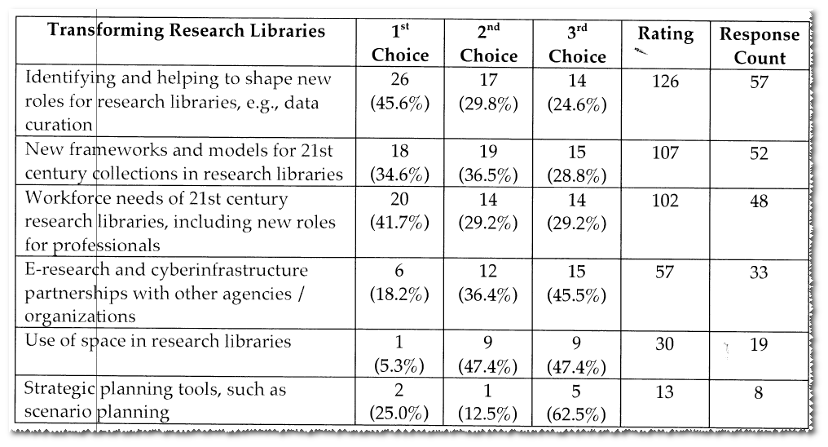
ARL Transforming Research Libraries Committee
Surveyed directors for top three areas that ARL should emphasize
on behalf of members over next 2 years.

Slide 9
OCLC Research Library Partner Collections Assessment

Slide 10
OCLC Research Library Partner Collections Assessment Advisory Group (2011-2012)
Steve Bosch
Materials Budget Procurement & Licensing Librarian, University of Arizona
Caroline Brazier
Director of Scholarship & Collections, British Library
David Seaman
Associate Librarian for Information Management, Dartmouth College
Tom Teper
Associate Dean of Libraries & Associate University Librarian for Collections, University of Illinois, Urbana-Champaign
Ann Thornton
Interim Director of NYPL Libraries & Director of Reference and Research Services, New York Public Library
Bert Zeeman
Deputy University Librarian & Faculty Librarian for Humanities, Universiteit van Amsterdam
Notes:
Project being led by Constance Malpas, who is working with a group of advisors to help scope the offering in this first year. Looks for reports early in 2012.

Slide 11
OCLC Research. Analysis based on WorldCat and HathiTrust snapshot data. Data current as of June 2011.
Notes:
We’ll product something similar to this for the OCLC RLP as a whole.

Slide 12

S A M P L E
OCLC Research. Analysis based on WorldCat and HathiTrust snapshot data. Data current as of June 2011.
Notes:
We’ll be producing individual and collective reports for partners. And we’ll be working with the advisory group to fine tune the report structure, which will include visualizations of duplication by title, format, subject and (US!) copyright status, as well as a to-be-determined title pick-list.

Slide 13
Subject distribution of ‘Sample University’ titles duplicated in HathiTrust Digital Library
S A M P L E
OCLC Research. Analysis based on WorldCat and HathiTrust snapshot data. Data current as of June 2011.

Slide 14
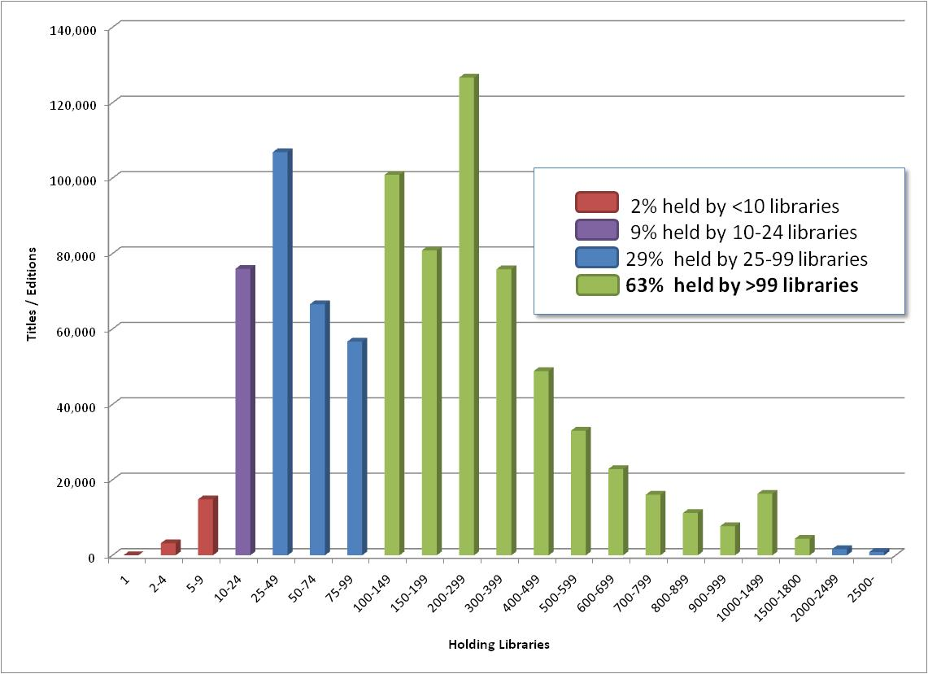
System-wide print distribution of ‘Sample University’ titles duplicated in HathiTrust Digital Library
S A M P L E
OCLC Research. Analysis based on WorldCat and HathiTrust snapshot data. Data current as of June 2011.

Slide 15
Born Digital:
An Archival Approach

Slide 16
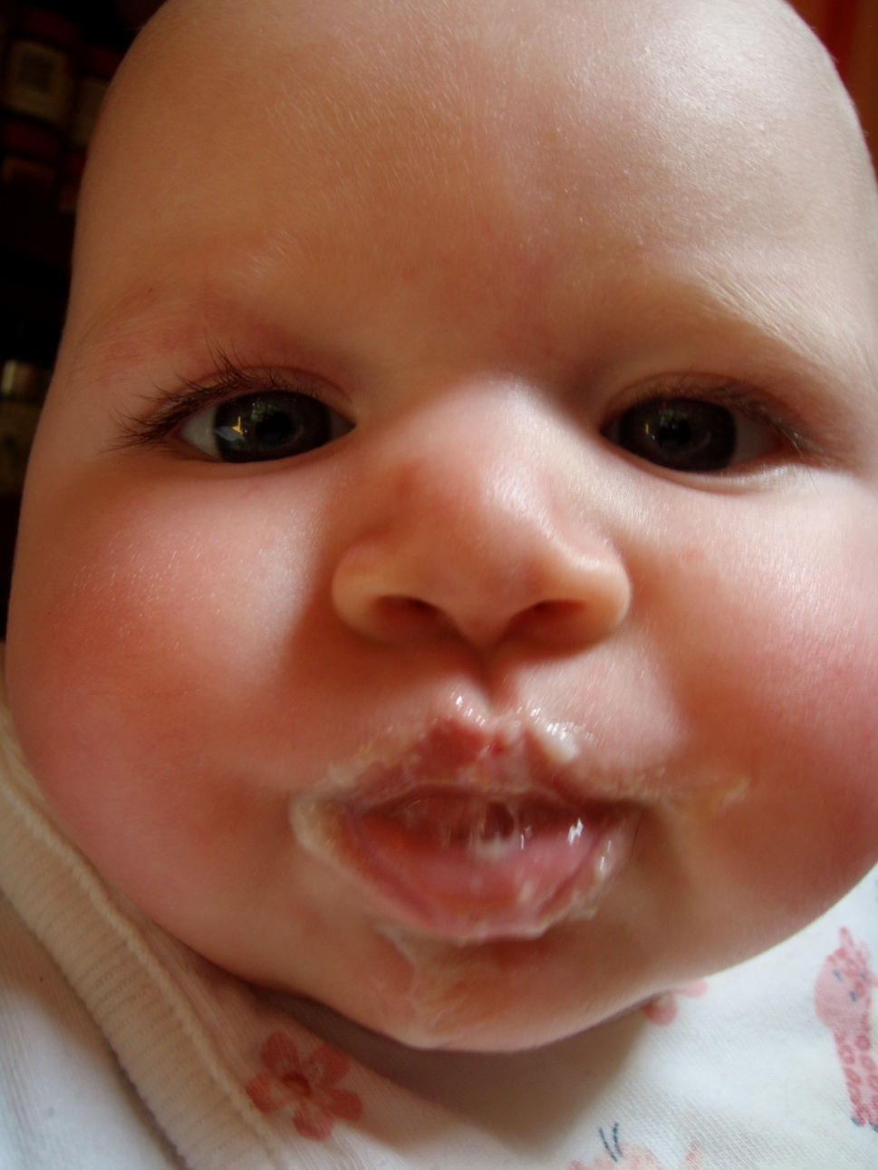
Assumptions
The average research library has made limited progress with born- digital materials beyond IRs.
Archivists can and should be major players in digital library development.
Archival approaches to date have focused on complex solutions.
Resources are very limited.
Most institutions need a “baby steps” approach to get started.
Notes:
Jackie Dooley and Ricky Erway in the lead.
Focus on enhancing effective management of born-digital materials as they intersect with special collections and archives in research libraries.
First off we attempted a definition of born digital:
Items created and managed in digital form.
Working with a number of advisors, we intend to identify the skills and practices in the archival tradition that will be of value in the preservation of, and access to, materials that were born digital. We’ll also assemble the minimal steps that need to be taken, while ensuring that no harm is done.
Photo by Merrilee Proffitt. CC BY-NC

Slide 17
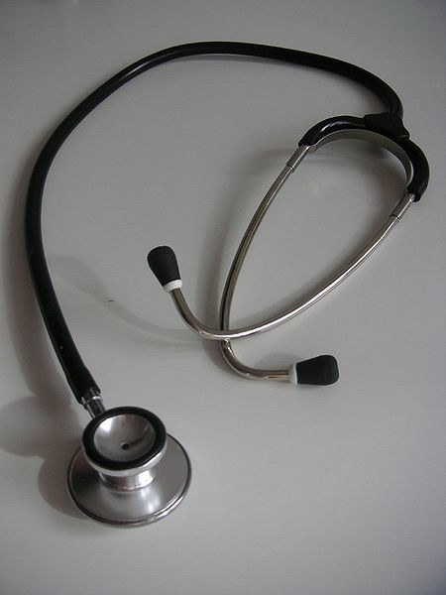
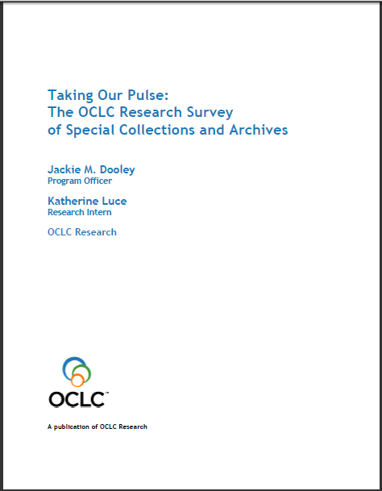
Taking Our Pulse: The OCLC Research Survey of Special Collections and Archives
<http://www.oclc.org/research/publications/library/2010/2010-11.pdf>
Notes:
A 2009 survey of special collections and archives in the US and Canada shows that digitization of special collections and increasing user access to those collections are of critical importance to research libraries.
The survey was a follow up to the 1998 ARL survey led directly to many high-profile initiatives to "expose hidden collections.“
We updated ARL’s survey instrument and extended the subject population to encompass the 275 libraries in the following five overlapping membership organizations:
• Association of Research Libraries (124 universities and others)
• Canadian Academic and Research Libraries (30 universities and others)
• Independent Research Libraries Association (19 private research libraries)
• Oberlin Group (80 liberal arts colleges)
• RLG Partnership, U.S. and Canadian members (85 research institutions)
The rate of response was 61% (169 responses).
http://commons.wikimedia.org/wiki/File:Stethoscope_1.jpg
Stethoscope. Public domain.

Slide 18
Among our key U.S./Canada findings …
“Your three most challenging issues”
  Space
  Born-digital materials
  Digitization
Tough economy renders “business as usual” impossible; 75% of library budgets diminished
-----
Survey population: 275 research libraries in U.S. and Canada
Notes:
The OCLC report reveals, despite the efforts to uncover hidden collections, much rare and unique material remains undiscoverable, and monetary resources are shrinking at the same time that user demand is growing. The balance sheet is both encouraging and sobering:
• The size of ARL collections has grown dramatically, up to 300% for some formats
• Use of all types of material has increased across the board
• Half of archival collections have no online presence
• While many backlogs have decreased, almost as many continue to grow
• User demand for digitized collections remains insatiable
• Management of born-digital archival materials is still in its infancy
• Staffing is generally stable, but has grown for digital services
• 75% of general library budgets have been reduced
• The current tough economy renders “business as usual” impossible
The top three “most challenging issues” in managing special collections were space (105 respondents), born-digital materials, and digitization.

Slide 19
Top education and training needs
  Born-digital materials: 83%
  Information technology: 65%
  Intellectual property: 56%
  Cataloging and metadata: 51%

Slide 20
Born-digital archival materials
Digital materials currently held by: 79%
Holdings reported by: 35%
  Percent held by top two libraries: 51%
  Percent held by top 13 libraries: 93%
Assignment of responsibility for born-digital management made by: 55%
We conclude that collecting is generally reactive, sporadic, limited.

Slide 21
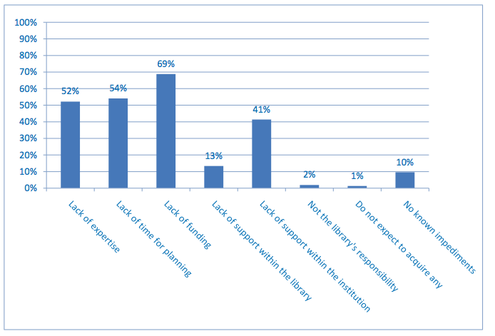
Born-digital: Impediments

Slide 22
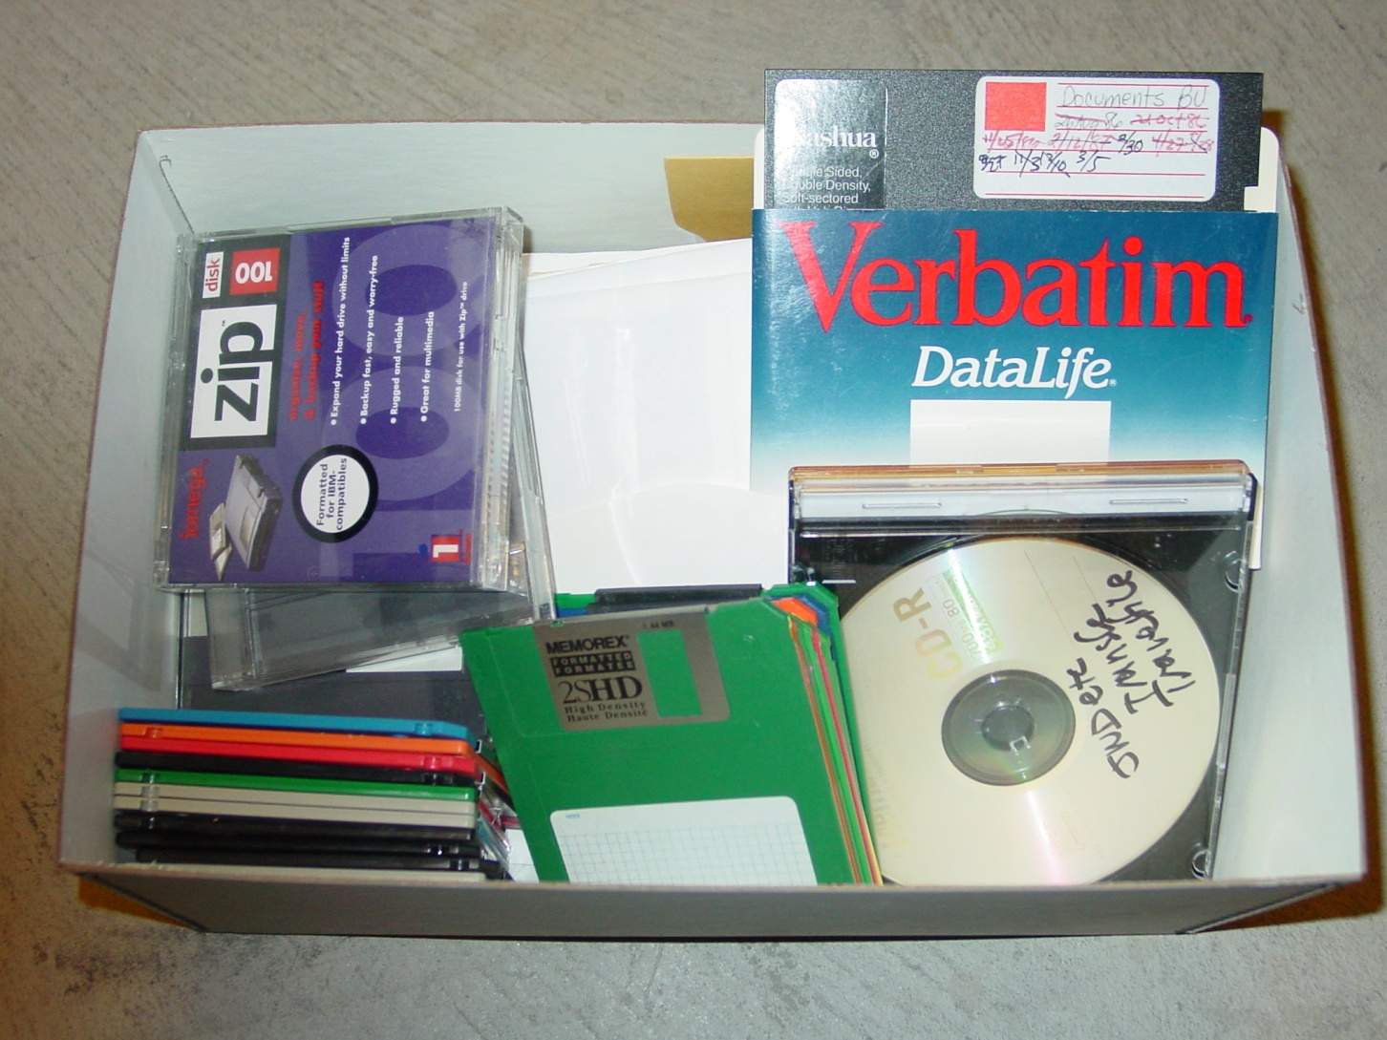
In sum, born-digital materials are …
  Undercollected
  Undercounted
  Undermanaged
  Unpreserved
  Inaccessible
American Heritage Center

Slide 23
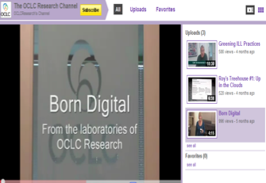
Our born-digital special collections project

Slide 24
Why this project?
Majority of research libraries have yet to take even baby steps in born-digital management.
Majority of archivists have yet to take action because they think they don’t know enough, don’t have specialized resources, are generally intimidated, need guidance on how to conquer fear and take initial steps.
Research library directors often don’t know how/why archivists’ skills and expertise are broadly relevant to library-wide management of digital library content.

Slide 25
Objectives
  Explore where “special collections and archives” intersect with “born digital” and “digital library”
  Articulate the relevant skills and expertise held by archivists
  Describe how these pertain to various types of born-digital material
  Outline “baby steps” to begin preserving physical media

Slide 26
Target audiences
  Research library directors and higher administration
  Archivists and special collections librarians
  Other research library specialists
    Collection development
    Digital library
    Information technology
    Institutional repository
    Metadata
    Scholarly communications
    Web development

Slide 27
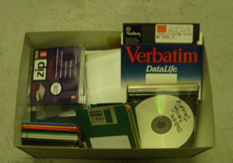
Born-digital archival materials are …
Audio
Databases
Email
Institutional records
Manuscripts
Moving images
Photographs
Publications
Social media
Static data sets
Textual documents
Video games
Websites
Works of art
… and more
American Heritage Center
Notes:
To start out, we recognized that different people may have entirely different things in mind when they use the term born-digital. So we identified nine different types of born-digital material (you could no doubt, add more). There’s a document, but those of you with short attention spans (or who’d like to see OCLC Research staff make fools of ourselves) may want to view the video on our YouTube channel.

Slide 28
There is no one-size-fits-all solution for managing born-digital content.

Slide 29
Archival skills and expertise
    Appraisal
    Authenticity
    Collective metadata
    Collection development
    Context
    Deeds of gift
    Donor relations
    Hierarchical relationships
    Intellectual property
    Legal issues
    Preservation as permanence
    Privacy and confidentiality
    Provenance
    … but we need new
    skills too

Slide 30
Know your digital donors
      Primary/core identities?
      Work products?
      Habits?
      Relationship between physical and digital content?
      Equipment?
      Storage locations?
      Restricted information?
      Naming conventions?
      “Deleted” files?
      Cloud content?
      “Digital will”

Slide 31
Manage sensitive personal information
    Social Security numbers
    Bank account numbers
    Passwords
    Medical records
    Counseling records
    Student records
    Employment records
    Materials covered by attorney-client privilege
    Research data related to human subjects
    Federally classified or federally restricted materials
Kirschenbaum & Nelson, RBS L-95, 2011

Slide 32
Collections management baby steps
    Inventory what you have
      Types of physical media?
      Estimated number of gigabytes?
        Maximum per physical object
    Initial appraisal
      What types of content?
      Level of significance/uniqueness?

Slide 33
Organizational baby steps
    Make friends with IT
    Promote your skills
    Keep pursuing educational opportunities
    … and learn by baby steps.

Slide 34
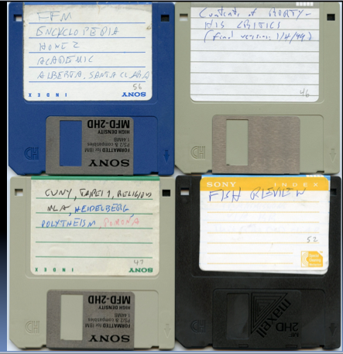
Technical baby steps
    Learn BASIC “do no harm” file management
      Capture metadata
      Identify file formats
      Virus scans
      Bit imaging
      Checksums
Stanley Fish Papers, Univ. of California, Irvine

Slide 35
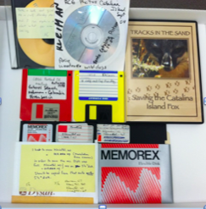
Technical baby steps
    Photograph physical media
    Transfer from physical media to secure storage
    Make copies; keep archival copy
    Document all actions
      Who did what?
      Source of metadata
Smithsonian Archives

Slide 36
Identify your low-hanging fruit
    Contemporary physical media & file formats
    Creator-curated email: convert to PDF
    Photographs: expose on Flickr
    Text documents: convert to PDF
    Web pages: select a harvester and go for it
    … and what else?

Slide 37
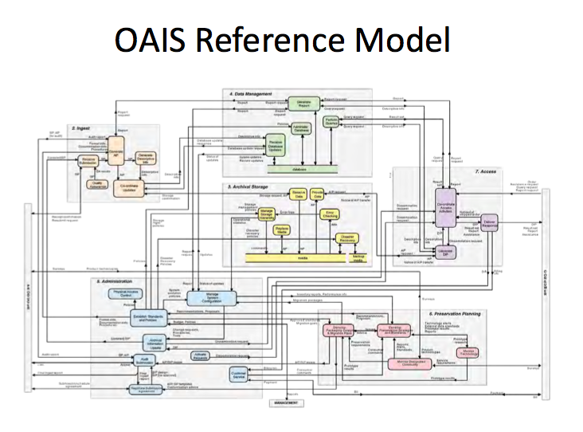
Ignore this (for now)!

Slide 38
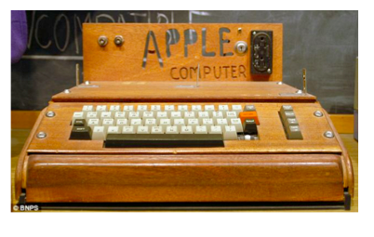
Ignore this (for now)!
Kirschenbaum & Nelson, RBS L-95

Slide 39


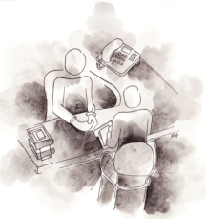
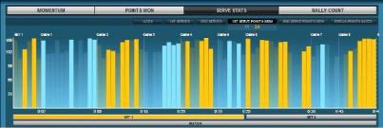
Benefits of
Partnership?
A seat at the table
Direct,
consultative
access to staff
Time-bound, privileged access to outputs
Annual Comparative
Collection Profile
Notes:
What do you get out of partnership?
First and foremost, you or your library’s leadership chose to join the Partnership in order to gain a seat at the table of the largest collaborative research and action-oriented organization devoted to the needs of research libraries. This means that you have a voice in determining our directions, a hand in testing our solutions and a foot in the door in participating in activities that push out the boundaries of what we can accomplish together. But your real ability to make a difference comes down to how well you use all of the communication channels available to you.
Second, you and your colleagues have privileged access to the outputs of our collective work. This is a new benefit this year – we’re experimenting with offering you exclusive, 30-day access to the wealth of materials and experiences being produced and shared under the Partnership roof. Published reports, survey analyses, webinars, videos and events are all available to you at no charge and before the rest of the community. We’ll post these on our website but we’ll limit our notification to just you – using our Partnership Announce e-mailing list. So pay attention! And reap your just rewards!
A third benefit is one that some of you who have been partners for a while already know about and may even have taken advantage of – direct consultative access to program officers and research scientists to advise on some of your thorniest problems. So pick up the phone or send us an email. We’re always eager to hear from you.
A fourth class of benefit is entirely new this year and has been developed in response to expressions of interest from across the Partnership: an annual, individualized profile of your collection as represented in WorldCat and in sync with strategic priorities within the Partnership. As detailed previously, this annual profile work will help partners plan and take collective action in areas of key need. In this first year, the profile work will demonstrate the overlap between Partnership collections and the HathiTrust -- both individually and collectively -- based on WorldCat and Hathi holdings.
Deriving benefit is not a unilateral proposition! Institutions garner the most benefit when staff participate in advisory/focus groups to help shape new solutions and services. Or by sharing expertise as we produce new webinars on topics of current concerns. By participating in surveys, offering thoughts on implementing new technologies, sharing digital collections and metadata, becoming a SHARES member and participating in research. Watch the weekly news updates, subscribe to our RSS feeds, read reports, download webinars. . . Raise your hands and your voice when an interesting opportunity presents itself – your colleagues within the Partnership will thank you and so will we!
Reach out to us, share your thoughts, help us to shape the future!

Slide 40
Thank you!
Merrilee
proffitm@oclc.org
Jackie
dooleyj@oclc.org
Titia
Coming soon!

