Slide 1

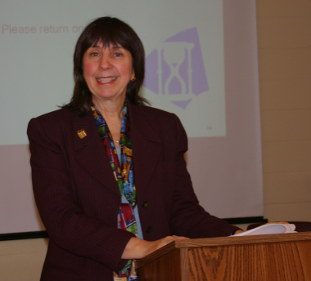
Seeking Synchronicity: Revelations & Recommendations for Virtual Reference
Lynn Silipigni Connaway, Ph.D.
Senior Research Scientist
OCLC Research
Marie L. Radford, Ph.D.
Associate Professor
Rutgers, The State University of NJ

Slide 2
Seeking Synchronicity:
Evaluating Virtual Reference Services from User,
Non-User, & Librarian Perspectives
Funded by IMLS, OCLC, & Rutgers University
Four phases:
  Focus group interviews
  Analysis of 850 QuestionPoint live chat transcripts
  Online surveys
    137 VRS Users
    175 VRS Librarians
    184 VRS Non-users
  Telephone interviews
  76 VRS Users
  100 VRS Librarians
  107 VRS Non-users
Notes:
Synthesizing “Seeking Synchronicity”
Going back to 2005, our research of the use of virtual reference (VR) has had one primary goal: to deliver research-based recommendations that will improve the service that information professionals provide. The purpose of this publication is to distill several years’ and several hundred pages’ worth of work into a few very specific, easily digestible, actionable suggestions for how you can sustain and develop your VR services and systems (Radford and Connaway 2005–2008a).
As stated, this publication boils down many research projects done by many researchers, at OCLC, Rutgers University and elsewhere. For those of you interested in the long version, please take some time with the bibliography at the end of this work and especially check out the Seeking Synchronicity website http://www.oclc.org/research/activities/synchronicity/). For those of you who want the “abridged version of the short version,” here it is—what we learned, presented so you can quickly understand and apply our research findings to immediately improve your VR experiences.
What went into the original research
The project “Seeking Synchronicity: Evaluating Virtual Reference Service from User, Non-User, and Librarian Perspectives” was funded by the Institute of Museum and Library Services (IMLS); Rutgers, The State University of New Jersey; and OCLC Online Computer Library Center, Inc. It consisted of four phases of data collection and analysis, lasting from October 1, 2005 to March 29, 2008 (Radford and Connaway 2005–2008a). It used a logical sequence in the process of data collection, with each phase informing the next. A range of qualitative and quantitative methods of analysis were used.
Phase I:
We conducted a total of eight focus group interviews, two each with VRS librarians and users, and four with non-users. Three of the non-user focus group interviews were with the youngest members of the “Millennial” Generation, born between 1979 and 1994. The responses from the youngest Millennials, used here for those ages 12–18 and known as “screenagers,” (Rushkoff 1996) suggested that this group had different expectations for services and systems than the other demographic groups. The focus group sessions were transcribed, and we extracted major themes from the data. Results were used to inform construction of the online survey and telephone
interview instruments. Millennials also were specifically recruited for the online surveys and telephone interviews.
Phase II:
We gathered VRS transcripts from the 24/7 Reference Cooperative and OCLC QuestionPointdatabases in two subphases. From July 2004 through June 2005, a random sample of 25 transcripts was taken each month from a database of nearly 264,000 VRS sessions. In addition to these 300 transcripts, a second random sample of approximately 50 transcripts was taken from a database of more than 250,000 VRS sessions for each month between December 2005 and November 2006, resulting in an additional 550 transcripts. The VRS transcripts contained a wealth of information,and these data were used to expand existing coding schemes and to construct new ones. The transcripts were analyzed for the following: interpersonal communication behaviors, accuracy, type of question, subject of question, length of interaction, type of library, wait time, and query clarification behaviors and techniques. As a direct result of the transcript analysis, we created and applied two new coding schemes, including the Query Clarification Coding Scheme and the Ready Reference Accuracy Coding Scheme.
Phase II:
We developed online survey instruments from focus group interview data, and from the initial research questions. A separate online survey was developed and pretested for each of the three cohort groups—VRS librarians, users of VRS and non-users of VRS. Participants completed a total of 496 online surveys. The respondents in each demographic category provided answers for questions that resulted in both quantitative and qualitative data.
Phase IV:
Telephone interview questions for all three groups were developed from participant responses in the focus group interviews and to the online surveys, as well as from the initial research questions. We then developed a separate set of interview questions and pretested for each of the three study groups. A total of 283 telephone interviews were completed.

Slide 3

Why Not Virtual Reference?
What we learned from non-users:
Preference for FtF service
Do not know it exists
Unknown or unfamiliar format
Notes:
Chapter 1: Pull, Not Push—Attracting Potential Users
What’s Hot and What’s Not
While the people we interviewed and surveyed for our studies reported many reasons for not using VR, several stand out as worthy of focus if we are to try to encourage more use of these services:
• Preference for FtF Service. Many users have great relationships with reference librarians that have developed in traditional settings. This makes the value proposition of VR one that “can sometimes compete with, rather than augment, FtF reference.”
• They don’t know it exists. Many users are simply unfamiliar with available VRS and the technology and information available through these services.
• VR is an unknown or unfamiliar format. Users may lack comfort with the chat format, which may be attributed to demographic factors, such as age and socio-economic and educational levels, and experience with technology and chat services.
Other notable reasons:
• Equating chat reference with a generic online chat room in which they might encounter
unknown strangers.
• Being negatively evaluated by a librarian; possible embarrassment.
• Having reference transcripts revealed (e.g., to professors).

Slide 4

Lack of Knowledge that VR Exists
VR Non-users Online Survey
“I’ve never used this type of service and never knew it was available—that’s probably why I never tried it.”
(Millennial)
Notes:
Chapter 1: Pull, Not Push—Attracting Potential Users
When asked what would get them to try VRS, older adults wanted some hand holding as these comments indicate:
“I would need much guidance.” –Older Adult (Non-users Online Survey)
“Someone walking me through it.” –Older Adult (Non-users Online Survey)
“Perhaps someone could teach me on a face‑to‑face basis.” –Older Adult (NonUser Online Survey)

Slide 5
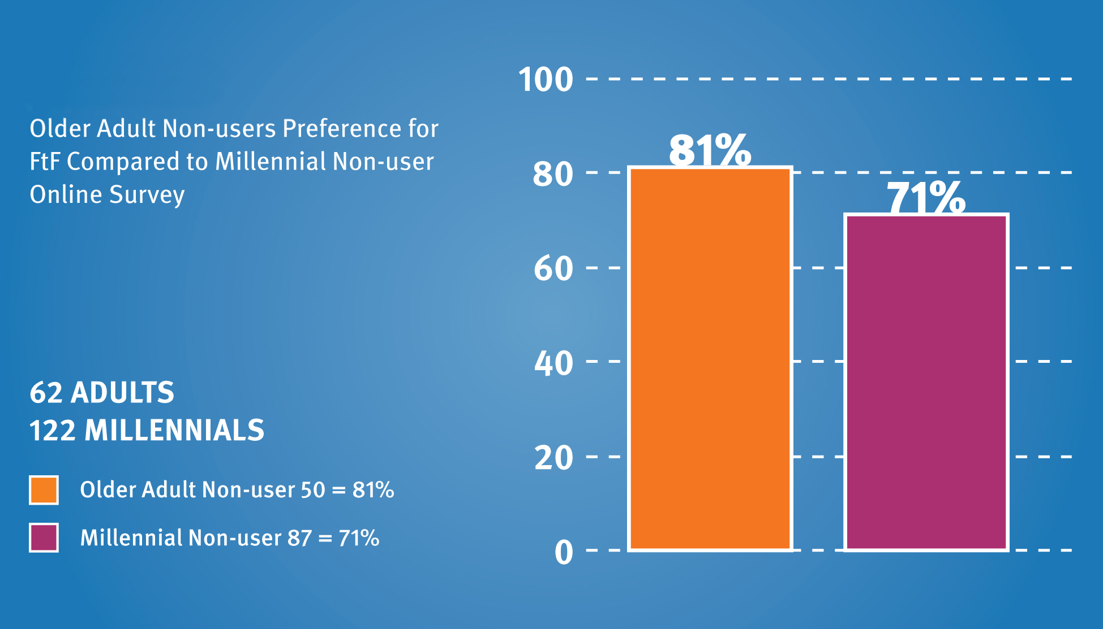
FfF Reference Preferred
VR Older Adult Non-users
Notes:
Chapter 1: Pull, Not Push—Attracting Potential Users

Slide 6
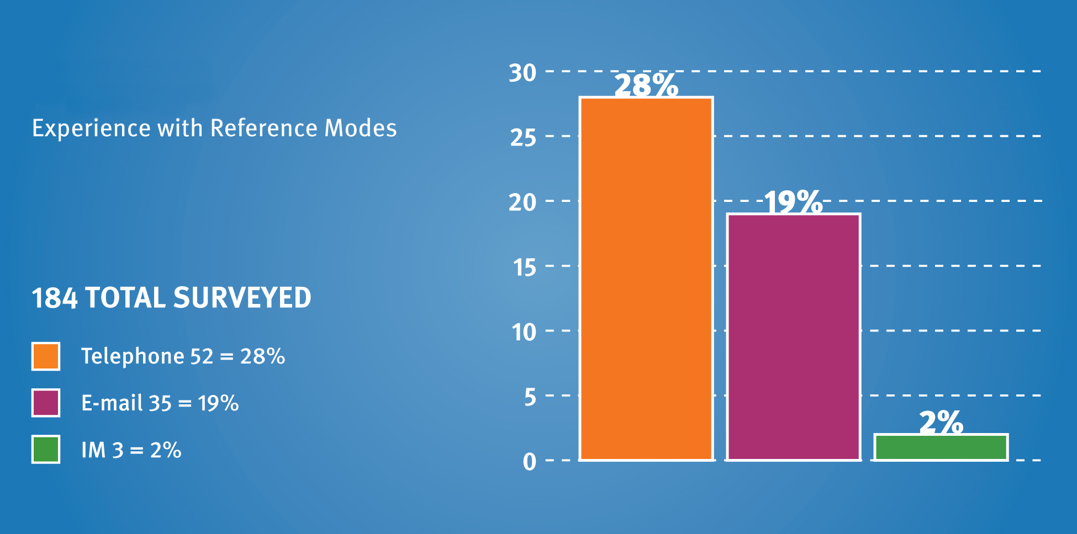
Reference Experience
VR Non-users
Notes:
Chapter 1: Pull, Not Push—Attracting Potential Users
What’s not:
Among the VRS non-users, many were regular users of the library who simply reported that they weren’t aware of the available VRS. Unlike studies that report on the general lack of familiarity with online library resources, our research focused on those who do use the library.
Yet within this group of library users, 28% had used the phone for library reference questions, and 19% had asked a question through e-mail.1 Only 2%, though, had ever used chat or Instant Messaging (IM) reference. This figure is low because we specifically recruited non-users of VR.
This lack of familiarity indicates a lack of promotion on the library’s part and/or a basic misunderstanding of what VR is on the users’ part.

Slide 7

Top Recommendation
Attracting Potential Users
Introduce & demonstrate online alternatives during in-person reference sessions, library use instruction classes & library programs.
Notes:
Chapter 1: Pull, Not Push—Attracting Potential Users
Recommendations
In providing VRS, libraries are clearly attempting to offer an easy, convenient, Web-based alternative
service to live reference. When asked in telephone interviews what might convince them to try VR,
61% of our participants listed some factor related to convenience. Being unaware of VRS is the
biggest factor for not using it. The factors listed above clearly outweigh the convenience factor of
chat reference and limit the widespread use of VRS.
Our strongest recommendation to boost use of VRS is to introduce and demonstrate online alternatives during in-person reference sessions, library use instruction classes and library programs. Taking the initiative to educate users in the physical library about VR options addresses all three of the main issues we identified:
• First, by acknowledging and leveraging the positive relationship that users have with librarians FtF, the promotion of VRS can become an extension of that bond, rather than competing with it. The trust that users place in live librarians—and that we hope would be validated in every reference session, either in person or virtually—can then help users overcome their initial reluctance.
• Since most users were not even aware of VRS, there is probably no better moment to promote them than in the live, library environment. In the live environment, a current, active library user makes a much more impressionable and persuadable user. Any marketing done, even reasonably priced marketing, such as “viral marketing” (referrals), can help promote VRS. Not knowing about the service makes it impossible to use!
• Introduction of the service by a trusted librarian may go a long way toward allaying the fears
of users, especially younger ones. If librarians acknowledge the validity of these concerns,
they can place the use of VR within a broader context, initiating a discussion about media
literacy in general.

Slide 8

Two Views of What’s Effective:
Positive Factors in VR Experiences
Users:
Convenience
Comfort with service
Accuracy
Librarians:
Ability to leverage complex & specialized knowledge
Positive attitudes, responses, & feedback
VR tools & hybrid
communication modes
Notes:
Chapter 2: Double Vision—How Users’ And Librarians’ Views on Virtual Reference Differ

Slide 9

Two Views of What’s Not Effective:
Negative Factors in VR Experiences
Users:
Abrupt, dismissive answers
Grumpy, ill-informed or uninterested librarians
Poor wrap-up
Librarians:
Convoluted & confusing questions
Rude, impatient &/or disappearing users
Unrealistic expectations
Notes:
Chapter 2: Double Vision—How Users’ And Librarians’ Views on Virtual Reference Differ
It may be a truism that people on opposite sides of any service experience will be exasperated by perceived bad behavior on the other’s part; nobody likes dealing with cranky people. It is interesting to note, though, that librarians put so much emphasis on users’ positive attitudes and behaviors as success factors, along with the technology and quality of their materials and training.
Users, on the other hand, emphasize a need for comfort, ease of use, accuracy and speed. While this dichotomy isn’t surprising, it is important to recognize these differences so that service behaviors do not turn off inadvertently and turn away users. In any customer- supplier relationship, hoping that the customer will change his/her attitudes is a losing proposition. If improvements are to be made, they must be undertaken by the provider.

Slide 10

Comfort With VR:
Focus Group Interview
“I was on the site at 2 or 3 in the morning and it felt personalized. I don’t know, I felt like I was the only person the other person had to talk to and they took the time out.” (User)
Notes:
Chapter 2: Double Vision—How Users’ And Librarians’ Views on Virtual Reference Differ
“[Market] it more. Because I didn’t hear about it until I started working at this job a few months ago.” –User (Focus Group)
“We’ve been able to reach people we know we’d never reach otherwise, they’d never come in the building, wouldn’t pick up the phone; we’ve actually had people tell us that, they say reference librarians are scary.” –Librarian (Focus Group)

Slide 11
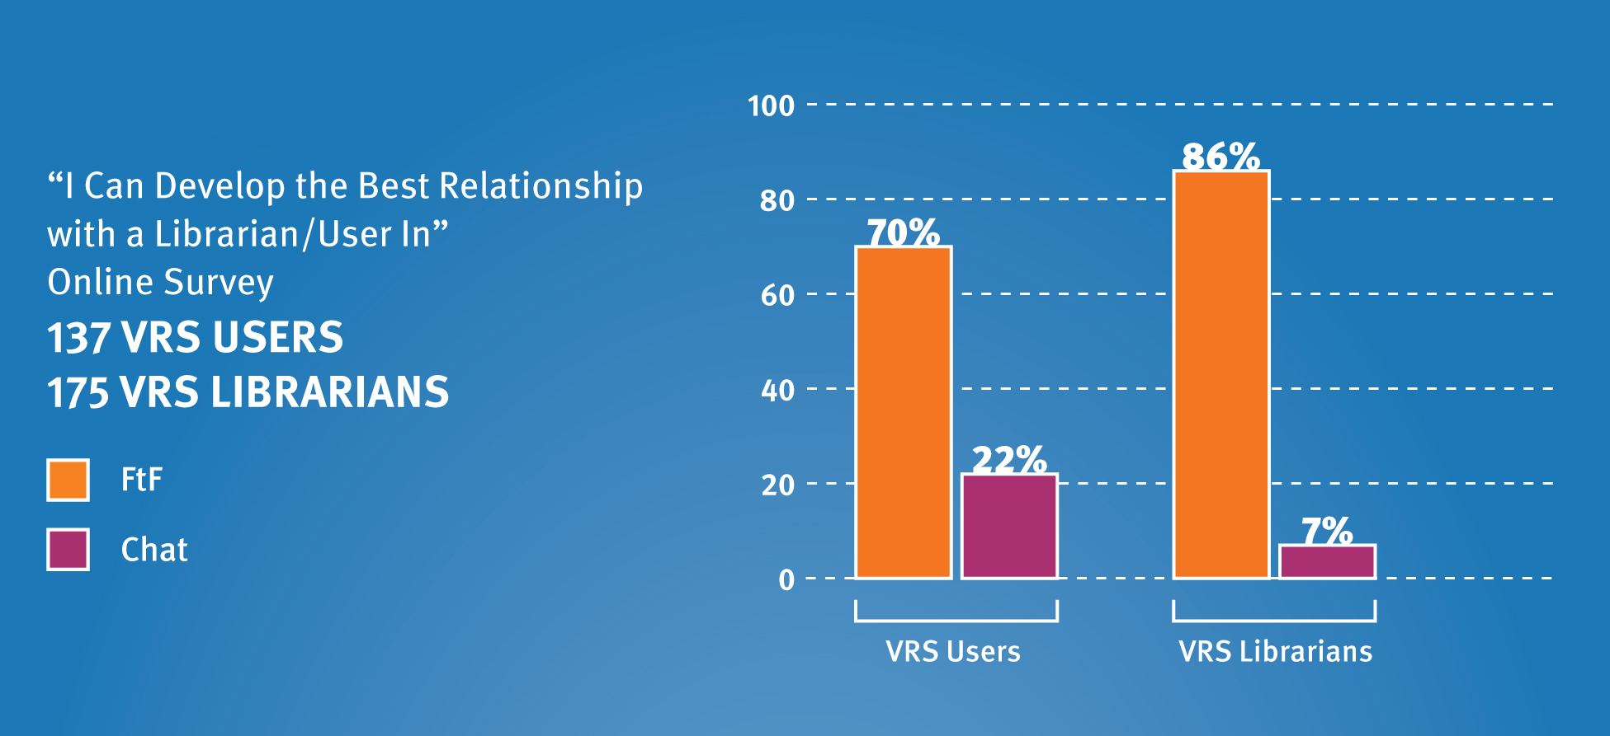
Mode for Developing Best Relationship:
VR Users & Librarians
Notes:
Chapter 2: Double Vision—How Users’ And Librarians’ Views on Virtual Reference Differ

Slide 12
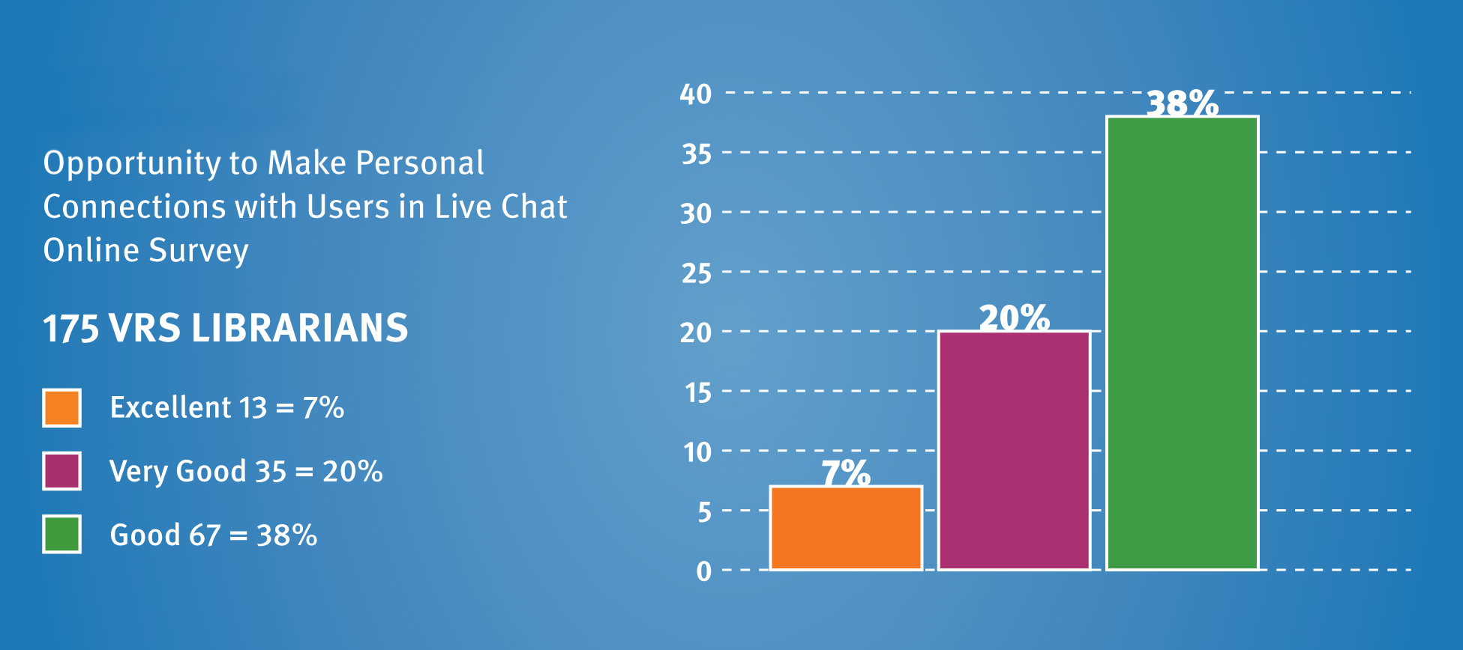
Making Personal Connections:
VR Librarians
Notes:
Chapter 2: Double Vision—How Users’ And Librarians’ Views on Virtual Reference Differ

Slide 13

Talkin’ bout Generational Differences:
Positive Perceptions of VR
Baby Boomers & Millennials:
Appreciate quick, on-target responses
Value those “who know their stuff”
Convenience
Appreciate personable & friendly exchanges
Would recommend to others
Notes:
Chapter 3 “Talkin’ ‘Bout My Generation:” Millennial Vs Boomer Use of Virtual Reference

Slide 14

Positive Perceptions of VR:
Millennials
Immediacy
24/7 late-night & weekend availability
Convenience
Co-browsing
Personalized interfaces
Would recommend VR
Less intimidating than FtF reference
Notes:
Chapter 3 “Talkin’ ‘Bout My Generation:” Millennial Vs Boomer Use of Virtual Reference
Millennial users find that VR suits their liking for immediacy, and they find 24/7 late-night and weekend availability of VR appealing. They appreciate the convenience (i.e., not having to travel to the library and being able to communicate with a librarian from their desktops), and value reliable co-browsing and interfaces that can be personalized. A vast majority of Millennial respondents would recommend VR, which they find to be much less intimidating than FtF reference exchanges.
Millennial users are less concerned with format than they are with immediate delivery. They have higher than average tolerance for nonstandard grammar and punctuation, and will often settle for information that is “good enough.” While they tend to have shorter attention spans, they have broader attention ranges—their minds sometimes “leap about” like hypertext. They spend very little time using content, instead “squirreling” downloads and preferring quick chunks of information (Connaway and Dickey 2010).
Google is Millennials’ overwhelming first choice for information—for screenagers and graduate students alike. For screenagers, parents and friends are their second choice; graduate students also seek human sources for help, and they include academic superiors among those sources, generally because their research tends to be more sophisticated and exhaustive.

Slide 15

Why Millennials May Not Use VR
Fear technology complicated
Fear of annoying, overwhelming, or pestering
Trust their own abilities
Believe they don’t need assistance
Don’t know it’s available!
Notes:
Chapter 3: “Talkin’ ‘Bout My Generation:” Millennial Vs Boomer Use of Virtual Reference

Slide 16
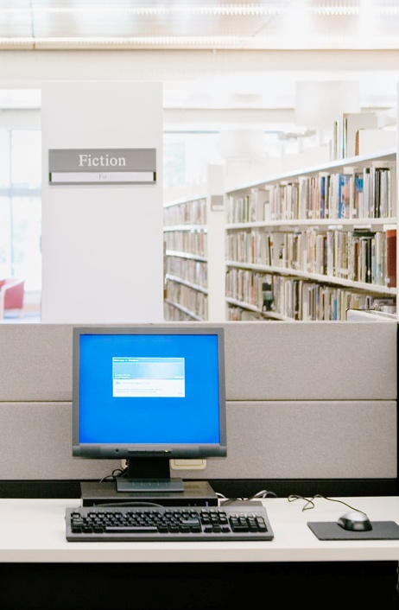
Fear It Is Too Complicated:
Focus Group Interviews
“I stray away from the library and the library’s online catalog.”
  (Undergraduate Student)
Notes:
Chapter 3 “Talkin’ ‘Bout My Generation:” Millennial Vs Boomer Use of Virtual Reference
“Lessen the intimidation factor.” – Faculty (Focus Group)
“The library is a good source if you have several months.” – Undergraduate student (Focus Group)
“[Google] is user friendly…library catalog is not.” – Faculty (Focus Group)

Slide 17

Why Older Adults May Not Use VR
Preference for FtF & personal relationships
Comfort with library & find it convenient
Lack experience with other reference methods
Lack of computer skills & slow typing speed
Don’t know it’s available!
Notes:
Chapter 3: “Talkin’ ‘Bout My Generation:” Millennial Vs Boomer Use of Virtual Reference
Baby Boomers read more and use public libraries more than earlier generations. Most of them have Internet access and report that they would miss it if they could no longer use it.
.

Slide 18

Intergenerational Recommendations
Promote VR by marketing & word-of-mouth
Reassure teens that questions are welcome
Involve users in VR development
Encourage users to enter library phone numbers in cell phones for quick reference help
Notes:
Chapter 3: “Talkin’ ‘Bout My Generation:” Millennial Vs Boomer Use of Virtual Reference
Recommendations
So what do Millennials and Baby Boomers want from their libraries, particularly with regard to VRS?
Our research suggests a few recommendations:
• Libraries that offer VR should promote it explicitly, both through marketing and word-of-mouth. All non-user groups studied indicate they would try VR if it were recommended by a trusted librarian, colleague or friend. Explicit recommendations from librarians to try VR help to reassure young people that librarians really do want them to use this type of service, and that there is a trustworthy “face” behind the technology. Promoting VR during FtF reference situations and in demonstrations during library use instruction also will help transfer the positive impressions that many users have of live library interactions into a library’s virtual spaces.
• Librarians should remember that teens may be hesitant to ask questions. Teens need reassurance that their questions are welcome—this is important for both FtF and VR interactions. They are sensitive to rejection, so tread gently and choose to tell them what you can do for them rather than what you can’t.
• Involve users in the development of VR to ensure that their needs and preferences are considered (Walter and Mediavilla 2005). The service should be flexible, customizable, allow for feedback, provide trusted guidance and include opportunities for social and interactive learning.
• Encourage users to enter library phone numbers into their cell phones to make it easier for them to call the library for quick reference help.

Slide 19

Critical Incident Technique (CIT)
Flanagan (1954)
Qualitative technique
Focuses on most memorable event/experience
Allows categories or themes to emerge rather than be imposed
Notes:
Chapter 4: “Way Sweet” or “Just Wrong:” Critical Factors for Virtual Reference Success

Slide 20

Critical Incident Technique (CIT)
VR Users’ & Librarians’ Questions
Remember 1 specific successful VRS interaction
Remember 1 specific unsuccessful VRS interaction
Describe each interaction
Identify factors that made interactions successful or unsuccessful
Notes:
Chapter 4: “Way Sweet” or “Just Wrong:” Critical Factors for Virtual Reference Success
In order to find out what users most highly value (or dislike) about VR, we asked VRS librarians and users these CI questions:
• Think about one experience in which you felt a chat reference encounter achieved (or did
not achieve) a positive result.
• Describe the circumstances and nature of the reference query.
• Describe why you felt this encounter was (was not) a success.
We also added an additional question for the VRS users:
• Did the chat format help your experience to be successful/unsuccessful? If yes, how?
For non-users of VRS, the questions were very similar, but they solicited comment on the other reference format(s) the non-users experienced, including face-to-face (FtF), phone, e‑mail and SMS text messaging.

Slide 21
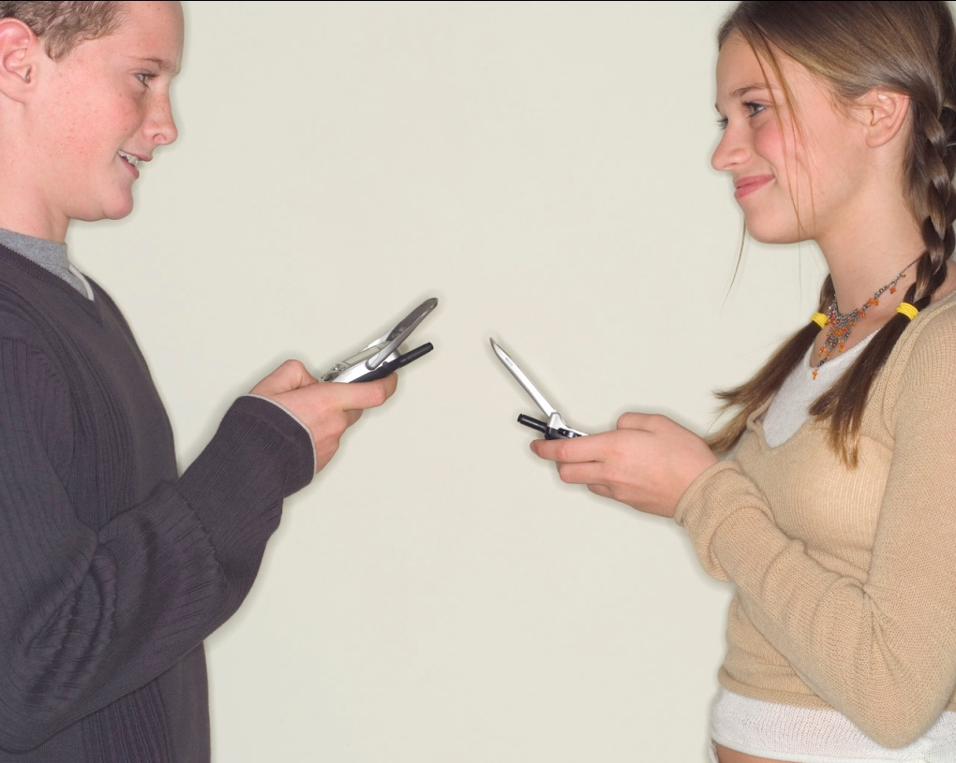
What’s Effective:
VR Users Value
Knowledge and accuracy of answers/information
Positive attitude
Communication skills
Notes:
Chapter 4: “Way Sweet” or “Just Wrong:” Critical Factors for Virtual Reference Success

Slide 22

What’s Effective:
VR Librarians Value
Relationships with VR Users Who:
Approach with willingness to explain needs openly
Are agreeable to receiving help
Demonstrate ordinary politeness & common courtesy (e.g., use please & thank you)
Admit lack of knowledge
Notes:
Chapter 4: “Way Sweet” or “Just Wrong:” Critical Factors for Virtual Reference Success

Slide 23

What’s Effective:
VR Users Value
Relationships with VR Librarians Who:
Offer opinions/advice
Explain search strategy
Are less formal (e.g., use chat speak)
Encourage users during reference encounter
Use personal greetings
Let users know when search will take time
Warn users before signing off/disconnecting
Notes:
Chapter 4: “Way Sweet” or “Just Wrong:” Critical Factors for Virtual Reference Success
It also is vitally important to remember to “show your smile” in VR. As far as relationships go, many factors contribute to a positive VR interaction. These include interpersonal issues such as attitude, relationship quality and rituals of polite behavior; skill-related factors, such as the ability to teach, convey information and demonstrate knowledge; and convenience/ease of use.

Slide 24

What’s Not Effective:
VR Librarians Speak
Users who are:
Impatient
Rude or insulting
Unreceptive to suggestions
Notes:
Chapter 4: “Way Sweet” or “Just Wrong:” Critical Factors for Virtual Reference Success

Slide 25

What’s Not Effective:
VR Users Speak
Unsuccessful VR experiences entailed:
Abrupt session ending
Limiting time of session
Sending users to Google
Reprimanding user
Failing or refusing to provide information
Notes:
Chapter 4: “Way Sweet” or “Just Wrong:” Critical Factors for Virtual Reference Success

Slide 26

Recommendations from CIT Findings
Positive attitude crucial
Provide specific & accurate answers
Take your time
Pay attention to “close”
Always be pleasant & polite
Notes:
Chapter 4: “Way Sweet” or “Just Wrong:” Critical Factors for Virtual Reference Success
This leads us to the following recommendations when it comes to establishing positive VR interactions:
First, provide specific and accurate answers. The fastest way to turn off a user to your VR service is to give poorly researched, sloppy or vague information.
Take your time. Users are open to waiting for quality information, especially if the librarian asks them politely to be patient and sets accurate expectations about how long the process will take. When possible, connect users to a specialist and/or give a referral to a subject specialist as appropriate.
Pay attention to the “close.” Users report a negative reaction to an abrupt ending to the VR interview and to feeling that the librarian was limiting their time. Be personal in your closing rather than just pushing an impersonal script. Adding a “Bye, take care” or other similar, informal closing is recommended.
Always, always, always be pleasant and polite. In almost every society, admitting ignorance and asking for help is considered a passive and “needy” activity. In FtF encounters, much of the negative social stigma associated with asking questions can be mitigated by normal, friendly, inviting behavior on the part of the librarian. In VR situations, though, many of the positive emotional and social cues are missing. A response that a VR librarian intends to be simply concise can be interpreted as brusque or rude. Taking the time to add encouraging remarks, asking for patience, using a pleasant greeting and personal closing, and explaining what’s going on are all ways to “sound” friendly when you can’t do so in person. Use your basic service excellence skills.
These recommendations are appropriate, of course, for any VR interaction. They are especially important, though, for creating positive reference interactions. For example, ask the user if this is the first time using VR. If it is, there’s a very good chance that you’re about to determine their attitude about the service for a long time to come. The absolute definition of a “win” is simple—do they come back to use the service again? Do they recommend VRS to their friends? If they have had positive encounters they will come back and they will tell others to try VRS.

Slide 27

What’s Effective:
Importance of Query Clarification
Found to boost accuracy
Use variety of clarifying questions
Expect clarifying questions from users
Use follow-up questions to verify needs are met
Notes:
Chapter 5: Questions About Questions—The Importance of Query Clarification
What’s Effective
Query clarification is needed: Our analysis revealed that only 4% (24) of interactions did not need some type of additional dialogue to further define the question. And librarians are asking questions for clarification; 74% (438) of librarians asked clarifying questions in VR encounters. This rate is higher than those reported in FtF reference studies, which find that query clarification is done in between 45–60% of interactions (Gers and Seward 1985; Dewdney and Ross 1994; Ross and Nilsen 2000).
Query clarification improves the quality of VR answers: Our research reports that 73% (72 of 98 questions) of correctly answered, ready-reference questions were clarified as opposed to 21% (21 of 98 questions) that were correctly answered without clarification. So asking questions definitely boosts accuracy.
A variety of clarifying questions: Almost half (45%, 196 of 436 respondents) of the VR librarians we studied sought additional subject information, while about a third (31%, 135) asked for more background on the question, such as deadline and project requirements. One-fifth (87) verified their understanding of the question by restating it, and 19% (83) asked which sources and search strategies had already been tried by the user. More than 10% (48) asked about both the type of resources desired—book, article, online information—and the depth of information needed— summary or detailed history. Only 4% (17) of librarians asked whether the user wanted to be referred to a subject expert or another library or librarian.
Clarifying questions from users. Our transcript analysis provided a unique opportunity for us to study the behavior of both librarians and users in the back and forth of the VR encounter. Our research is among the first to study query clarification by users as well as librarians. We found that users engaged in clarification 22% (130) of the time by offering additional information about the question. Users offered information both in response to librarians’ questions and spontaneously, without librarian prompting. More than half (52%, 69) offered additional subject information while 24% (32) provided background information, such as class- or grade-level data. One-fifth of users (20%, 26) elaborated on the amount of information needed and 14% (18) revealed the sources and search strategies they already had used.
Verifying that needs are met: More than half (52%, 219) of the librarians who clarified the user’s question closed the interview with “Does this completely answer your question?” or some variant of that question. This has proven to be a tried and true strategy for increasing user satisfaction in FtF reference research (Ross, Nilsen, and Radford 2009).

Slide 28

What’s Not Effective
Using “closed” questions in online interactions
Not clarifying reference questions
Notes:
Chapter 5 Questions About Questions—The Importance of Query Clarification
What’s Not Effective
Using “closed” questions in online interactions with users: Librarians used closed questions (67%, 569) twice as often as open questions (33%, 285) as a clarifying technique, which suggests that librarians may be worried about time pressure and may be rushing to closed questions too quickly. Meanwhile open questions used to refine heir understanding of the questioner’s information needs in the presearch stage of the VR interaction is seen in our sample to actually save time. Librarians who do not clarify before searching may go on a wild goose chase for the wrong information. School or work assignments (“imposed queries”) (Gross 1995, 1997), which may not be open to the same question negotiation techniques as personal information needs (“self-generated queries”) (Gross 1999), were 26% (151 of 592 interactions) of the analyzed chat reference interactions. Of the 26% (151), 24% (36) were school or academic assignments. A slightly higher number of interactions (29%, 171 of 592 interactions) were self-generated queries. Query type—imposed or self-generated—could not be determined 46% (270 of 592 interactions) of the time, which indicates that librarians did not clarify by asking about query type in almost half of the interactions we analyzed.
Not clarifying reference questions: A review of one reference transaction illustrates why asking a user for more information is not only good practice but also important for service excellence. In this case, the user asked: “if a 15 year old can start diving classes now.” After saying, “One moment please. I will see what I can find,” the librarian begins to search and then, after several minutes, replies: “After looking at a few websites it seems that beginning scuba diving classes start at age 12 to 16. It depends on how good a swimmer the person is. As a scuba diver myself I think the age range sounds right.” The user then responds: “I don’t want scuba diving classes I want driving classes.” Although the user typed the word “diving” instead of “driving,” to trigger the misunderstanding, the librarian wasted valuable time searching when a quick clarification via a closed question (e.g., “Do you mean scuba diving or sky diving?”) would have immediately revealed the typo. Later the user grows impatient with waiting for a reply and logs off abruptly.

Slide 29
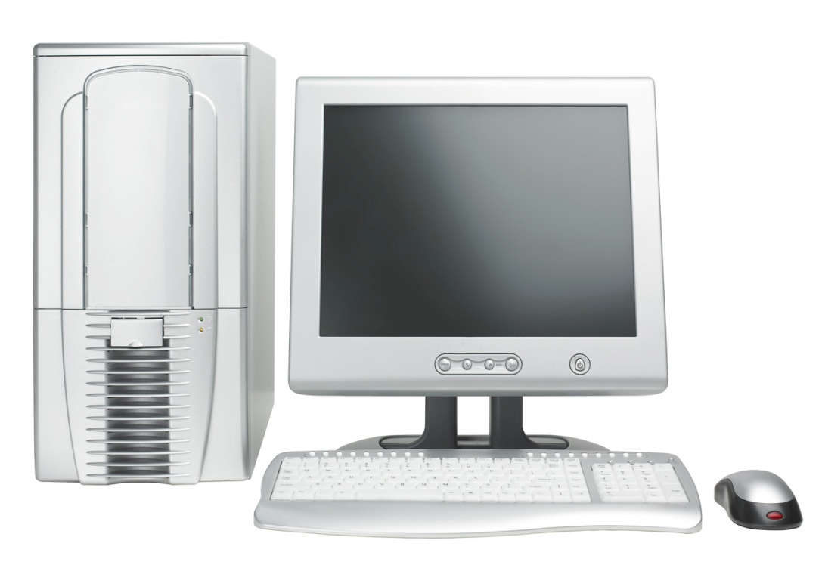
Convenience Factor Important
Ease of the Web
Online full-text journal articles
24x7 availability
Search engines
Notes:
Chapter 6 The Convenience Factor—Easy Is as Easy Does
What’s Effective
• Ease of the Web. Users believe the Web is fast and easy, providing immediate access to information and giving them what they want.
• Online full‑text journal articles. Users are not lazy when they rely on full-text articles. They want easy access to information now.
• 24x7 availability. Users want convenient access to information.
• Search engines. Users value simplicity.

Slide 30

Barriers to Convenience
Difficulty of library systems
Print articles
Limited hours, distance to library
Notes:
Chapter 6: The Convenience Factor—Easy Is as Easy Does
What’s Not Effective
• Difficulty of library systems. Researchers (students and faculty) find libraries frustrating and try to avoid them.
• Print articles. People think it is less convenient to physically access print articles.
• Limited hours, distance to the library. Some individuals believe the library presents barriers to their access to information.

Slide 31

Convenience Factor:
Focus Group Interview
“I’ve always thought that the library was a good source if you have a few months to spend on a paper.”
  (Undergraduate Student)
Notes:
Chapter 6: The Convenience Factor—Easy Is as Easy Does
“The convenience is still better online than in person, you don’t have to make trips to the library.” – Millennial (User Telephone Interview)
“Google, I don’t have to know, I go to one spot.” – Graduate student (Focus Group)
“I don’t go into the [library] system unless I have to because there’s like 15 logins, you have to get into the research databases. Then it takes you out of that to [the local consortium].…” – Undergraduate student (Focus Group)

Slide 32

Recommendations to Boost Convenience
Deliver resources 24/7
Integrate library tools in popular sites
Provide links & reminders
Make interfaces more like web browsers
Accommodate different & personalized discovery & access preferences
Offer multiple service modes
Provide opportunities for collaboration
Notes:
Chapter 6: The Convenience Factor—Easy Is as Easy Does
Recommendations
Libraries can and must become more convenient in the eyes of today’s users by improving services and systems. In order to achieve this goal librarians should:
• Deliver resources 24/7—efficiently and quickly—at the point of need at the network level.
• Integrate library tools into the sites that people use most—this integration alone may be the best method for increasing convenience and, therefore, use.
• Provide links and reminders about appropriate services, intelligently cross-connecting VRS with other library offerings.
• Make catalog and database interfaces more like Web browsers.
• Accommodate different and personalized discovery and access preferences, including mobile capability.
• Offer multiple modes of service—virtual, face-to-face and telephone.
• Provide opportunities for collaboration online and in physical library spaces.

Slide 33


Conclusions
It’s all about the relationships
Death of ready reference exaggerated
Query clarification key to accuracy
Convenience is the hook
Pay attention to questions asked
Generational differences come into play
Marketing matters

Slide 34
Future Research Directions
Cyber Synergy: Seeking Sustainability through Collaboration between Virtual Reference and Social Q & A Sites
$250,000.00 grant funded by IMLS, OCLC, and Rutgers University
Co-PIs
  Marie L. Radford, Rutgers University
  Lynn Silipigni Connaway, OCLC
  Chirag Shah, Rutgers University

Slide 35
References
Connaway, L. S. & Radford, M. L. (2011). Seeking Synchronicity: Revelations and Recommendations for Virtual Reference. Dublin, OH: OCLC Research. http://www.oclc.org/reports/synchronicity/default.htm
Connaway, L. S., & T. J. Dickey. 2010. Towards a profile of the researcher of today: The digital information seeker: Report of findings from selected OCLC, RIN, and JISC user behaviour projects. http://www.jisc.ac.uk/media/documents/publications/reports/2010/
digitalinformationseekerreport.pdf
Connaway, L.S., M. L. Radford, & J. D. Williams. 2009. “Engaging Net Gen students in virtual reference: Reinventing services to meet their information behaviors and communication preferences.” In Pushing the Edge: Explore, Extend, Engage: Proceedings of the 14th National Conference of the ACRL, March 12–15, 2009, Seattle, Washington, edited by Dawn M. Mueller, 10–27. Chicago: ACRL. http://www.oclc.org/research/publications/archive/2009/connawayacrl-2009.pdf

Slide 36
References
Connaway, L.S., T.J. Dickey, & M.L. Radford. 2011. “If it is too inconvenient I’m not going after it:” Convenience as a critical factor in information-seeking behaviors. Library & Information Science Research 33, no. 3: 179-90.
Dervin, B., L.S. Connaway, & C. Prabha. 2003. Sense-making the information confluence: The whys and hows of college and university user satisficing of information needs. Funded by the Institute of Museum and Library Services (IMLS). http://imlsosuoclcproject.jcomm.ohio-state.edu.
Radford, M.L. 2006. “Encountering virtual users: A qualitative investigation of interpersonal communication in chat reference.” Journal of the American Society for Information Science and Technology 57, no. 8: 1046–59.
Radford, M. L., & L.S. Connaway. 2005–2008a. Seeking synchronicity: Evaluating virtual reference services from user, non-user, and librarian perspectives. Funded by the Institute of Museum and Library Services (IMLS). http://www.oclc.org/research/activities/synchronicity/.

Slide 37
QUESTIONS?
Seeking Synchronicity: Revelations & Recommendations for Virtual Reference
Lynn Silipigni Connaway, Ph.D.
Senior Research Scientist
OCLC Research
connawal@oclc.org
Marie L. Radford, Ph.D.
Associate Professor
Rutgers, The State University of NJ
mradford@rutgers.edu

