Slide 1
ArchiveGrid:
From beginning to beta and beyond
Bruce Washburn
Software Engineer, OCLC Research
Ellen Ast
Research Assistant, OCLC Research
Follow or tweet the webinar with #archivegrid
Notes:
Welcome, and thank you for taking the time to join us today for this ArchiveGrid discussion.
Ellen and I have been working on this new version of ArchiveGrid for most of the last year and have been looking forward to this opportunity to describe what we’ve been building and where we’re headed, and to get your feedback and direction.

Slide 2
What we’ll talk about today
A brief history
A demonstration of ArchiveGrid
Updates on planned enhancements
Questions and discussion

Slide 3
ArchiveGrid … how it all began
ArchiveGrid grew from an RLG project in 1999 called “Archival Resources”
Archival Resources helped us understand how EAD finding aids could be aggregated, indexed, and searched

Slide 4
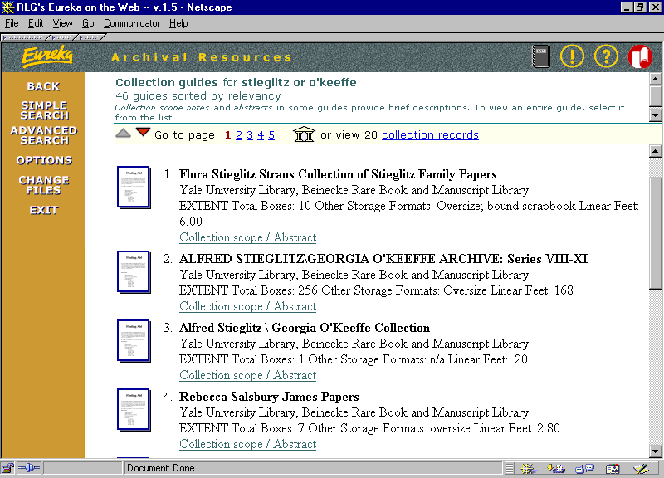
RLG Archival Resources, 1999
Notes:
This is a view of Archival Resources as it looked in 1999.
It was primarily intended to help us better understand how EAD-encoded finding aids could be used as the basis for an aggregated set of archival collection descriptions in a discovery system.
Over time we extended the scope to include finding aids written in HTML and plain text.

Slide 5
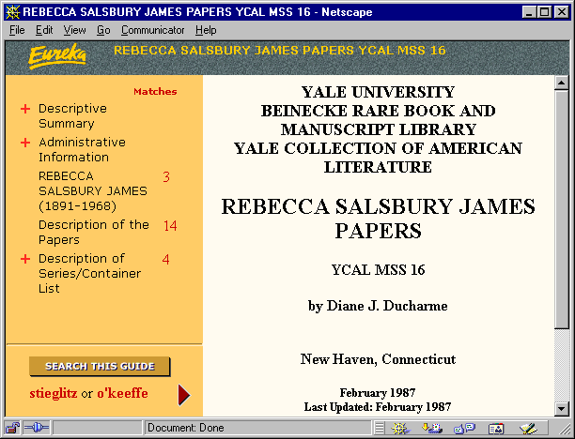
RLG Archival Resources, 1999
Notes:
To give an idea of the state of the art at that time, here’s a look at a finding aid in the viewer we built for Archival Resources. EAD finding aids at that time were written in SGML … XML was just getting developed as a standard at that time, and SGML documents couldn’t be viewed in a web browser without being converted first to HTML.

Slide 6
ArchiveGrid … how it all began
In 2005, RLG re-evaluated Archival Resources
In-depth studies were carried out to learn more about the users and uses of archival collection descriptions
A re-thought and re-branded service, ArchiveGrid, was launched in early 2006

Slide 7
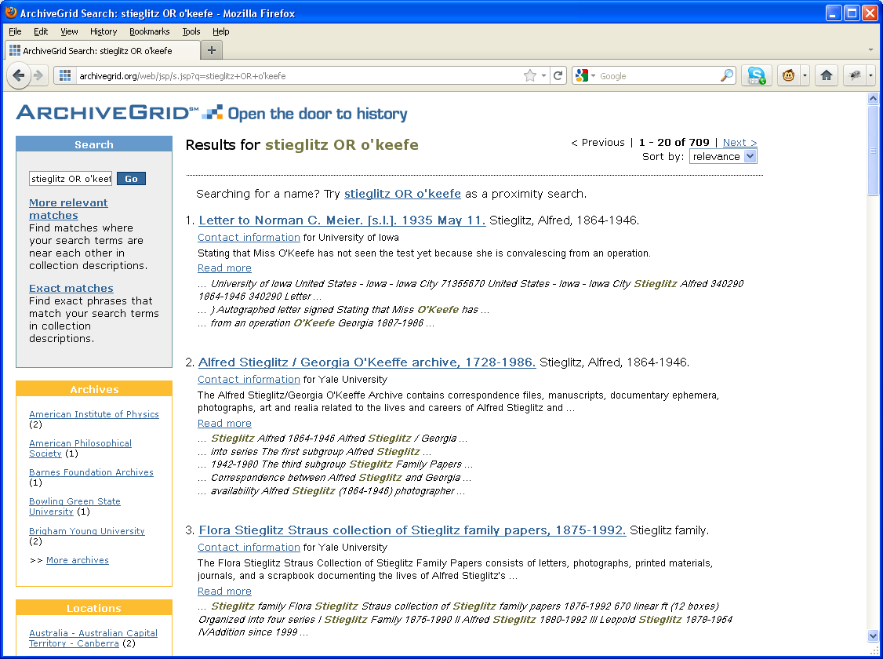
ArchiveGrid, 2006
Notes:
This is a view of ArchiveGrid from 2006, and it looks about same today in its subscription service at http://archivegrid.org.
After RLG’s launch of the service in early 2006 it was offered freely for a few months, and then became a subscription service, just as Archival Resources had been, supported by OCLC.

Slide 8
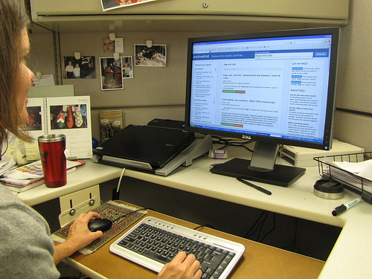
ArchiveGrid’s mission: Connect researchers …

Slide 9
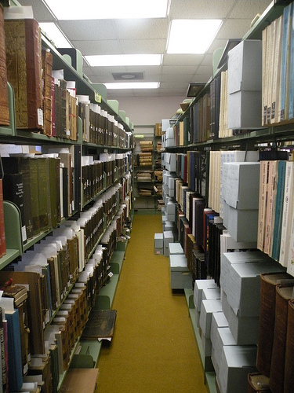
to primary source materials …
“Current Archives” is copyright (c) 2011 Carmichael Library and made available under a Attribution 2.0 license: http://creativecommons.org/licenses/by/2.0/deed.en
Notes:
“Current Archives” is copyright (c) 2011 Carmichael Library and made available under a Attribution 2.0 license: http://creativecommons.org/licenses/by/2.0/deed.en

Slide 10
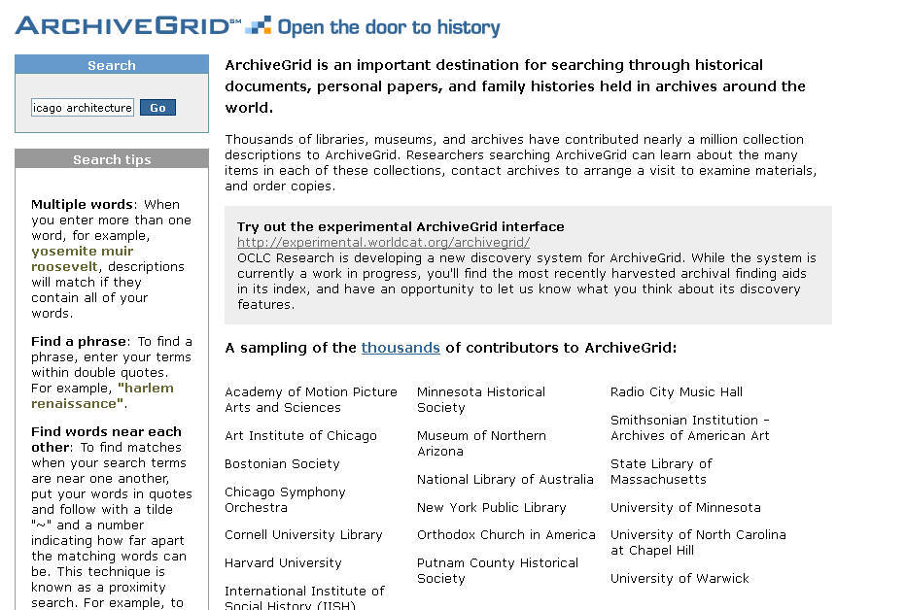
using a powerful search engine …

Slide 11
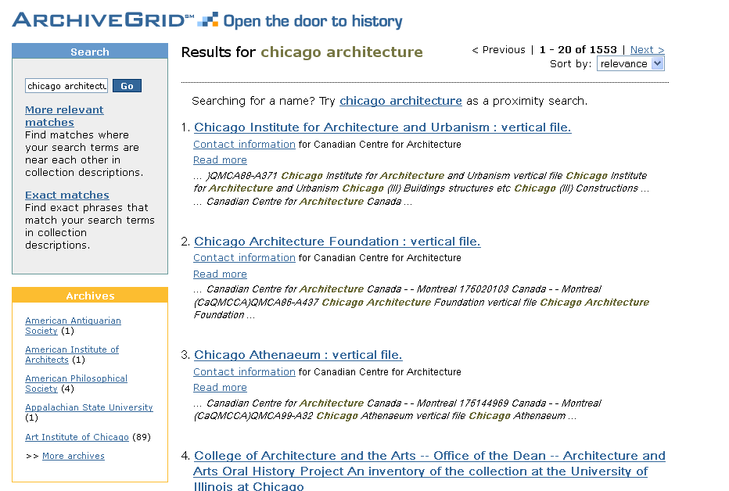
to find collections in archives.

Slide 12
By 2010:
Collection descriptions from more than 2,500 libraries, museums and archives worldwide were discoverable.
ArchiveGrid had over 1 million finding aids and archival descriptions indexed in the system.
A plan to redevelop the system into a subscription-free platform, change its look online, and add more records and contributors was underway.

Slide 13
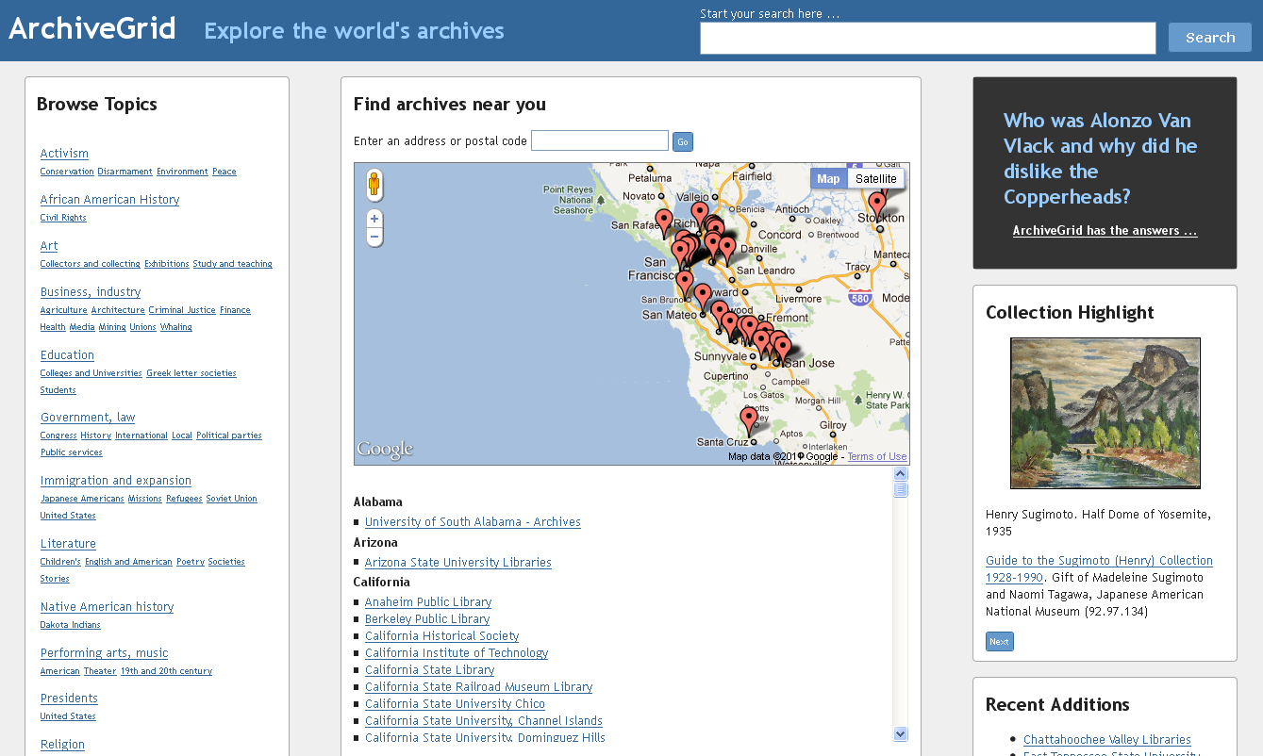
ArchiveGrid today
Notes:
Today we’ll be taking a closer look at new, freely available beta version of ArchiveGrid that we’re building in OCLC Research

Slide 14
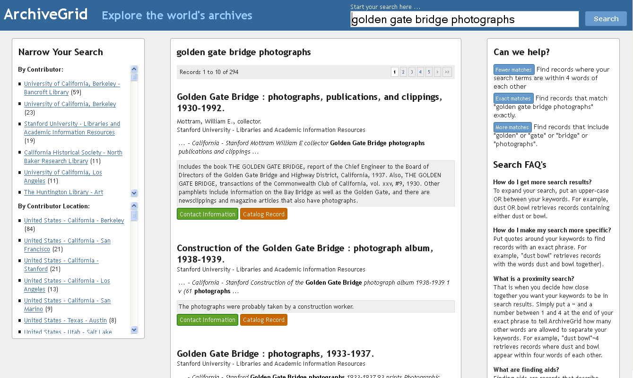
ArchiveGrid today
Notes:
The upcoming demonstration will show all of its features

Slide 15
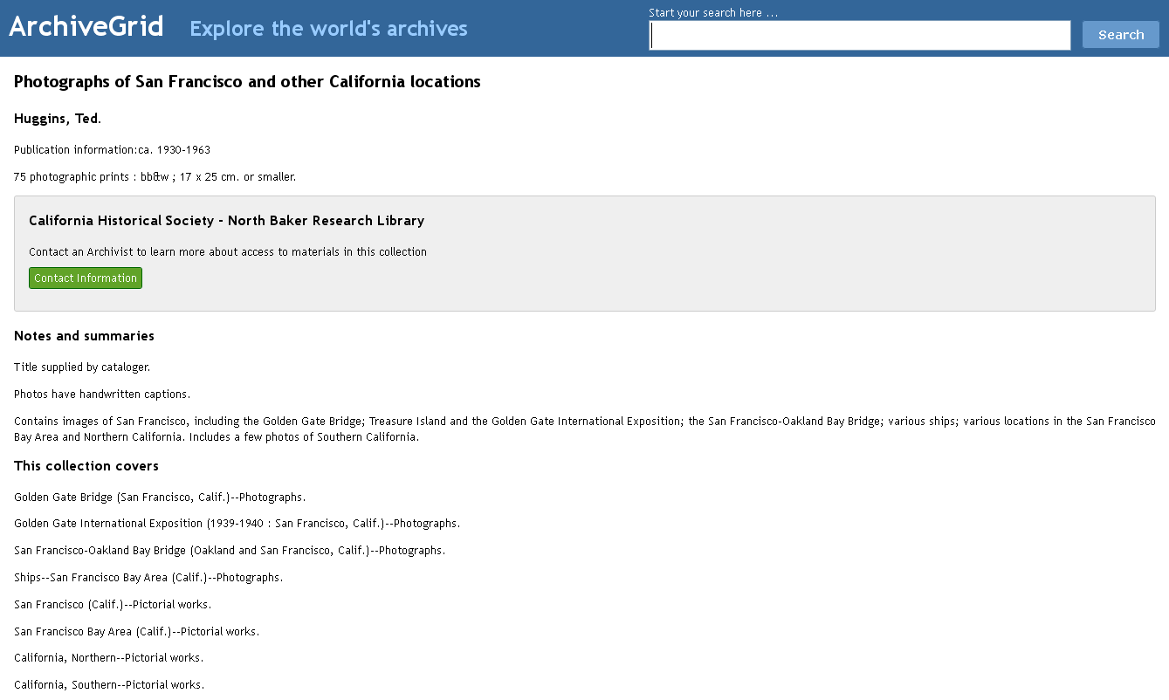
ArchiveGrid today
Notes:
And raise some questions about the current state of the system and future plans

Slide 16
What has changed:
OCLC Research will support ArchiveGrid as a free and open system
New ways to manage contributor information and web content, and new ways to index records into the system, were introduced.
A new homepage and search results screen were designed
And there are more records to be discovered!
Notes:
Rebuilt from the ground up, the OCLC Research version of ArchiveGrid is intended to be a discovery platform for aggregated archival collection descriptions going forward.

Slide 17
http://beta.worldcat.org/archivegrid
Notes:
As Bruce mentioned earlier, we designed the system with several different user groups in mind, and they run the gamut of researchers from people in academia, lifelong learners, genealogists and family historians, students, and other working professionals. This helped keep a goal in mind of designing a simple interface that is easy to use and understand and hopefully inviting as well to get people curious about archives and excited to use ArchiveGrid to discover what’s inside.
To achieve these goals, we included a few different access points into the system on the home page. The first one is the most obvious, and that’s the search box in the upper right hand corner of the screen. There are also two ways to highlight what’s inside some of the archives that people can discover in our system. The question and answer box here highlights exciting information found in the text of some of the collection descriptions, which can be accessed by clicking on the answer to each question. A different question appears each time you visit or refresh the homepage and it’s fun to try and guess the answer. And the image highlights are some of the visual materials one can see attached to some of the collection descriptions, which again can be accessed by clicking on the photo or the credit line. The images change too or you can scroll through all of them by clicking on the next button here.
What is probably the most prominent feature on the home page is a map, which has the physical location of each of our contributors and their repositories plotted on it with these red pins. The advantage of this is that you can search for archives by typing in a zip code or the name of an area here. Then the map goes to that place and you can see what is there. Or, you can also use this alphabetical list of all our contributors to find an archive. When you click on the one you want, its location appears on the map, as well as a link to its contact information, and all of its collection descriptions in the search results page.
We also have a hierarchy of subject terms, and when you click on one of the terms, you go to the search results page and see all the connection descriptions associated with that subject.
Now that you have had a tour of the homepage, I will do a live search so you can see how the system works and the possibilities that ArchiveGrid has for discovery. For this demonstration, I am going to pretend I am a scholar in the San Francisco Bay Area who has done a lot of research already on David Brower, who was a prominent, yet controversial, conservationist in the last century in the Bay Area. When I type in the name David Brower as my search terms, I get 278 records. I can narrow my search by doing a proximity search here, or I can find exact matches by putting my terms in quotes here, or I can broaden my search by using a Boolean search here for David or Brower.
On the left side of the page I can narrow my search by contributor and how many materials related to my search they have. I can do that by where they are located or by their name. Since I am going to pretend I have already researched John Brower in all the prominent archives around the Bay Area, I am going to scroll down and see if there are any archives I haven’t done research at yet that are within driving distance of where I live. It looks like there is a record at the University of Nevada in Reno and it’s nearby. I know David Brower was president of the Sierra Club, so I think I will click on their finding aid for the Sierra Club Collection and see if this collection has anything about him. I’m already curious about this collection because its papers were collected by Richard Sill, who was not friends with David Brower.
When I search for David Brower’s name in the finding aid, I see in the scope and content note that there is a box with materials about him and his wife Anne, and it was restricted until after their death. He died almost 11 years ago, so it looks like I have permission to see these materials. I am going to go back to the search results page, and click on the contact information link to schedule a visit to the archives.
Now that I’m back on the ArchiveGrid website, I am going to conclude this search and take you through one more demonstration, this time a quicker one from the perspective of a family history researcher who may be used to using sites like Ancestry.com, and who may be a first-time ArchiveGrid user.
My ancestors were Oregon Trail pioneers from Decatur County, Ind., and the family name was Robbins, so I am going to start a new search right where I’m at for Robbins, and the city where they first wintered in 1851, which was Oregon City. Right away I get a record for the Robbins family papers, with a data range that includes when my ancestors were active pioneers. There is a finding aid for this collection, but for this demonstration I am going to view the catalog record to show you what archival records from WorldCat look like in our system. In the collection description I see a reference to a Robbins from Decatur County who traveled to Oregon in 1862. Maybe I discovered a distant ancestor I didn’t know I had, so I will contact the Oregon Historical Society about seeing more of this collection, since I don’t live in Oregon.
I hope you enjoyed this tour of the system and please don’t hesitate to post some questions about it, or write if you are interested in having your collection descriptions included in ArchiveGrid.

Slide 18
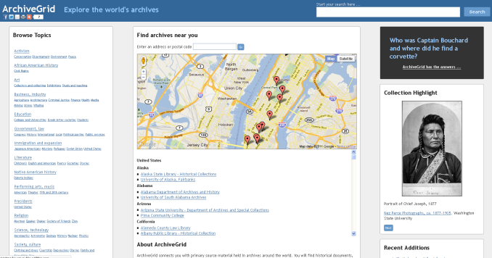
ArchiveGrid Index
Web Crawler
1.3 million WorldCat Archival Collection Records
125,000 Finding Aids
Notes:
The ArchiveGrid index has two main components.
It includes about 1.3 million archival collection descriptions extracted from WorldCat in the form of MARC records.
It also includes about 125,000 finding aids harvested directly from contributor websites. These include EAD, HTML, plain text, and PDF documents.
These descriptions are converted to a common format for supporting indexing and brief record displays, and combined in a single index that is searched through the ArchiveGrid interface.

Slide 19
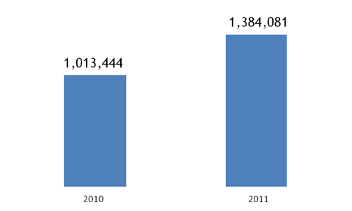
ArchiveGrid is active and growing
Total records
in the system
increased by
27% since 2010.

Slide 20
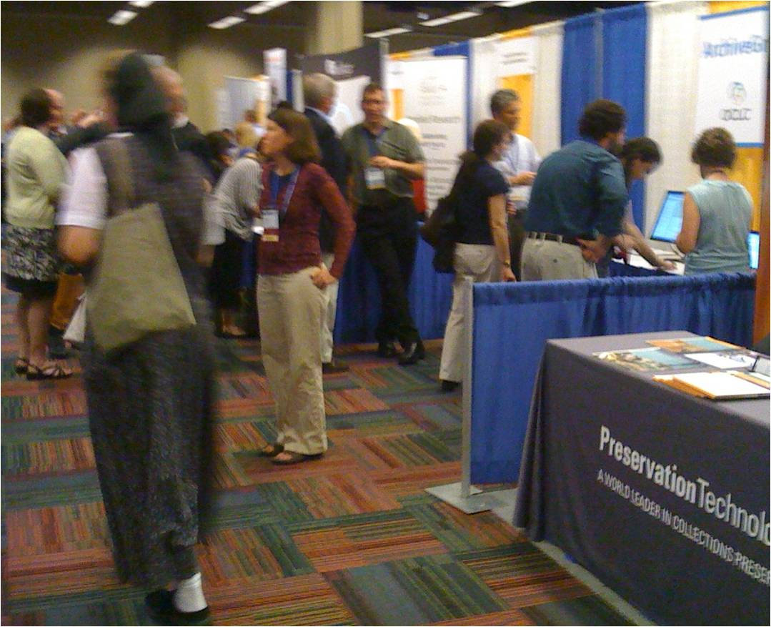
Getting feedback, consulting with the community, and improving ArchiveGrid
Demonstrating ArchiveGrid at SAA

Slide 21
Key Enhancements to ArchiveGrid
Improved ranking of keyword search results
More result set facets, including names found in archival descriptions
An API / web service for searching
Adaptive display for tablets and smartphones
Additional contributors and collections
Updated user and usability studies
Connecting to the Social Graph

Slide 22
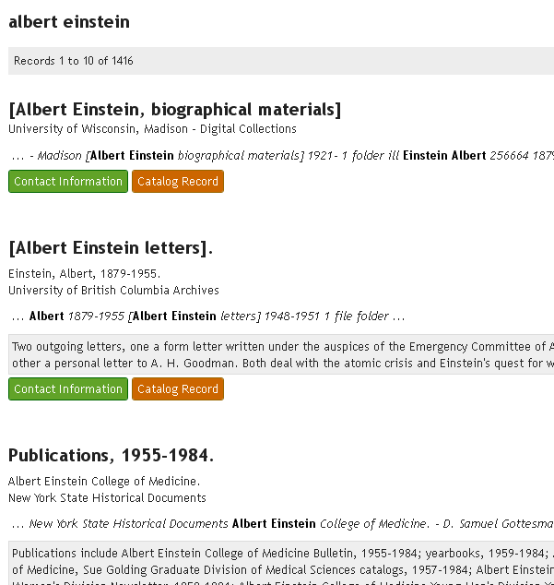
1. Improved ranking of keyword search results
Notes:
Keyword search results in ArchiveGrid are currently ranked primarily by a formula that takes into account the frequency with which the search terms appear in the indexed collection description, and the extent of that description.
That doesn’t always yield the best results. In this example, while the collections that appear near the top of the result are important, there are more comprehensive collections that would be expected to appear first. We’re testing modifications to the ranking formula to help improve ranking.

Slide 23
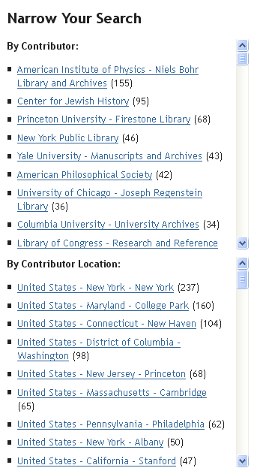
2. More result set facets, including names found in archival descriptions
Notes:
As noted in the ArchiveGrid demonstration, the system offers search facets to quickly narrow a search to collections held by a particular contributor or archives in a certain location.
But we know that names of people, groups, organizations and places are primary access points for discovery in archives, and want to highlight these as well. Other facets to consider include topics, timeframes, and events.

Slide 24

3. An API / web service for searching
ArchiveGrid web service
ArchiveGrid results
Notes:
The ArchiveGrid discovery system uses a web service to interact with the ArchiveGrid index. Others may want to use that web service as well, for example to embed ArchiveGrid search results within a page on their website. So we’ll be looking at finding ways to make the ArchiveGrid web service available. OCLC already offers a wide array of web services and APIs and we’ll want to provide an ArchiveGrid web service that follows standard approaches, both internally to OCLC and externally.

Slide 25

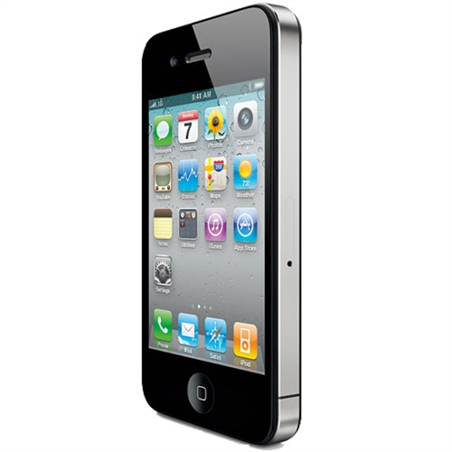
4. Adaptive display for tablets and smartphones
Notes:
Currently we’re seeing very little ArchiveGrid searching carried out by mobile devices. It represents perhaps 1% of ArchiveGrid sessions. But we might expect more of this traffic, as social network connections are made from the system … if you see a Facebook update on your iPad pointing to a page in ArchiveGrid and follow that link, you should expect the user interface to work well on your preferred device.
We’ll be using an approach called an adaptive or responsive design to meet this objective. It’s an increasingly common method employed by sites that have been built using HTML5 and CSS3 frameworks, as ArchiveGrid has. The basic idea is that the same code and features can be provided to any device, and the code can sense the size and capabilities of the device’s display and render the displays appropriately.

Slide 26
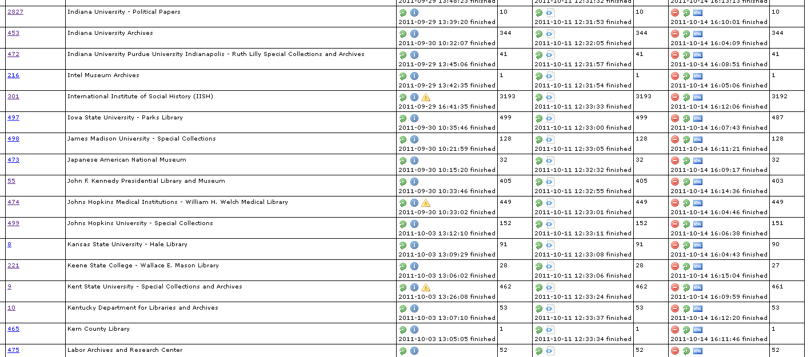
5. Additional contributors and collections
Notes:
This is a snippet view of an internal system we’re using to harvest, convert, and load ArchiveGrid finding aid contributor data.
While adding more contributors and collections might not be considered as an “enhancement”, there is development work to be done to handle more contributors. We’re just now beginning to work with contributors who prefer to provide PDF documents. Some contributors have Word documents to provide, and we’ll want to accept those as well. And as the range of contributors grows, the infrastructure components that were redesigned and rebuilt over the past year will probably need attention to cope with new requirements.

Slide 27
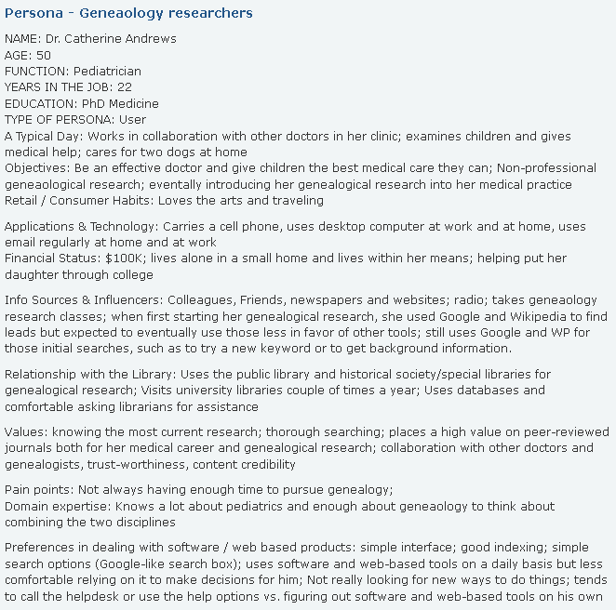
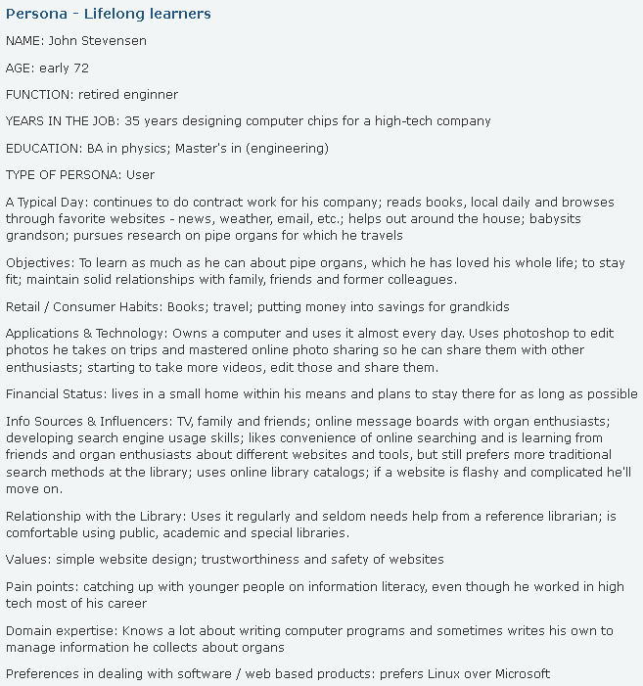
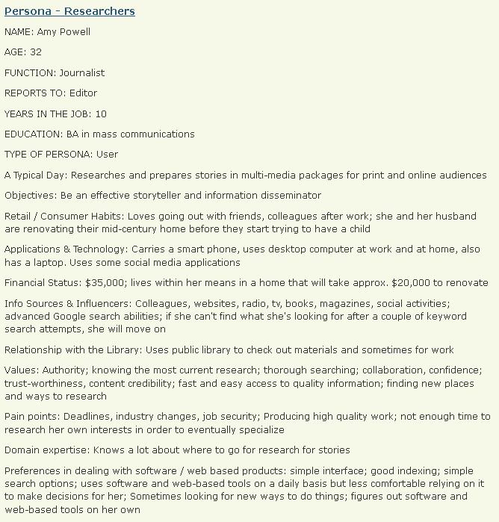
6. Updated user and usability studies
Notes:
We mentioned the user and usability studies that were part of the reassessment of Archival Resources in 2005, and that led to the creation of ArchiveGrid in 2006.
Those were some of the most thorough and revealing studies I’ve been a part of, and yielded some important, formative ideas about the role of an aggregated discovery system like ArchiveGrid and its audience. While there’s reason to believe that many of those findings still hold true, much has changed since then, and it’s important to review and refresh those findings. We’ll have more to say about how we’ll be carrying out that reassessment over the coming months.

Slide 28
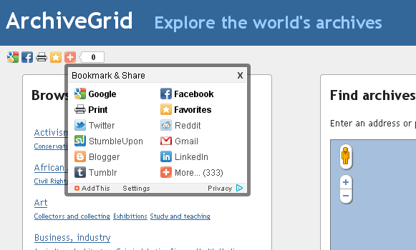
7. Connecting to the Social Graph
“Like” an archive in Facebook
Tweet a discovery of, or a question about, a collection
Recommendations and connections from friends, colleagues, and others with mutual interests
Accept and return user-contributed content
Stories from ArchiveGrid

Slide 29
OCLC Research --
Mobilizing Unique Materials
introducing cooperative models of acquiring, managing and disclosing collections
helping libraries, archives and museums achieve a common understanding of the processes for which they should be responsible
demonstrating these new frameworks through prototypes, and
enabling them through open source code and architectures.
http://www.oclc.org/research/activities/mum.htm

Slide 30
Named Entity Recognition and automated metadata extraction
Mary Frick Jacobs was born Mary Sloan Frick daughter of wealthy Baltimore lawyer William Frederick Frick in 1848 In 1873 she married Robert Garrett son of John Work Garrett and a prominent businessman who served for several years as the president of the B&O Railroad Both Mr and Mrs Garrett were involved in numerous charitable organizations and Mrs Garrett also became quite well known for her skills in entertaining The Garretts owned two homes in Baltimore Uplands a large property on the outskirts of the city and one at Mount Vernon Place (now known as the Engineers Club at the Garrett-Jacobs Mansion) In 1884 as Mr Garrett was working his way up the ranks of B&O executives Mary hired Sanford White to renovate their Mount Vernon Place home and expand it into the house next door which they had also purchased In 1885 Mary had her portrait painted by Alexandre Cabanel in Paris and soon after added several important paintings to her collection By 1887 Mr Garrett was ill and trips to Europe and the art purchases that went along with them came to a halt Mr Garrett died in 1896 after a long battle with his health In 1901 Mrs Garrett hired John Russell Pope who would later design the Baltimore Museum of Art and make further renovations to the Mount Vernon Place house to build a home for her in Newport Rhode Island Mrs Garrett would spend her summers at the estate called Whiteholme until her death It was demolished in 1963 On April 2nd 1902 Mary married physician Dr Henry Barton Jacobs The new Mrs Jacobs had begun collecting art to
Mary Frick Jacobs
Mary Sloan Frick
Robert Garrett
John Work Garrett
William Frederick Frick
Newport Rhode Island
Garrett-Jacobs Mansion
Sanford White
B&O Railroad
Engineers Club
Alexandre Cabanel
Mount Vernon Place
Paris
John Russell Pope
Henry Barton Jacobs
Baltimore Museum of Art
Notes:
Names of people, groups, organizations and places are important access points for archival discovery. Some forms of archival descriptions identify these names through the markup of the record format … a 100 field in a MARC record or a persname element in an EAD file for example.
But ArchiveGrid also includes a significant amount of lightly structured or unstructured text. An HTML, plain text, or PDF text document, for example. Or an EAD XML document that has not employed tags to identify names in lists, in scope and content notes, etc.
OCLC Research has been conducting work in the field of Named Entity Recognition for some time now, and ArchiveGrid’s aggregation of text can provide an interesting test set to work against. The idea behind NER is that software can be trained to recognize names in otherwise unstructured text. Other groups are pursuing similar work, and OCLC Research’s efforts in this area could be compared with others’ results to see what approaches prove to be effective and practical. There is perhaps an opportunity here to return some value back to the contributors of unstructured text.
Godby, Carol Jean, Patricia Hswe, and Judith Klavans, 2009. “Name This! Automating Metadata Extraction through a Named Entity Recognition Tool.” Presented to the Digital Library Federation Spring Forum; Raleigh, North Carolina, USA.
http://old.diglib.org/forums/spring2009/presentations/Godby.pdf

Slide 31
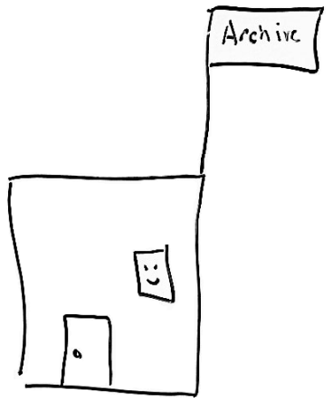
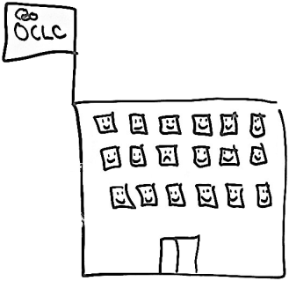
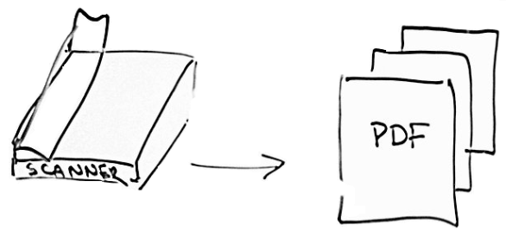
Scanning paper finding aids
Send
OCR
Convert
Index
Retrieve OCR text and metadata
Notes:
We’re thinking about a small-scale experiment in registering paper finding aids in ArchiveGrid.
Take for example a small archive with a small set of paper finding aids. In this example, the paper finding aids have not been digitized, have not been cataloged, and are not described in any form on the web.
If that archive has a flat-bed scanner, they can use it and its software to produce a PDF file.
If OCLC Research provided a website to upload the PDF file, we could apply OCR to the page images and generate text, convert the text (with other information provided by the archive at upload time) to a record for loading into ArchiveGrid, index it, and make it available for discovery on the web.
We could also return the OCR text and minimal metadata generated in our conversion process to the archive, for further modification/cleanup and reloading and/or for local use.
We’ll be looking to try a very small experiment to test some of these ideas over the next few months. If you think your archive would be interested in testing this idea with us, let us know.

Slide 32
What we talked about today
OCLC Research is supporting ArchiveGrid as a free and open system
ArchiveGrid is a growing aggregation
Contact us to have your collections represented
The community will guide our enhancements to the current beta system
ArchiveGrid will support the OCLC Research activity Mobilizing Unique Materials

Slide 33
Time for questions and answers

Slide 34
Thanks for joining us today
Bruce Washburn
washburb@oclc.org
Ellen Ast
aste@oclc.org
http://beta.worldcat.org/archivegrid

