Slide 2
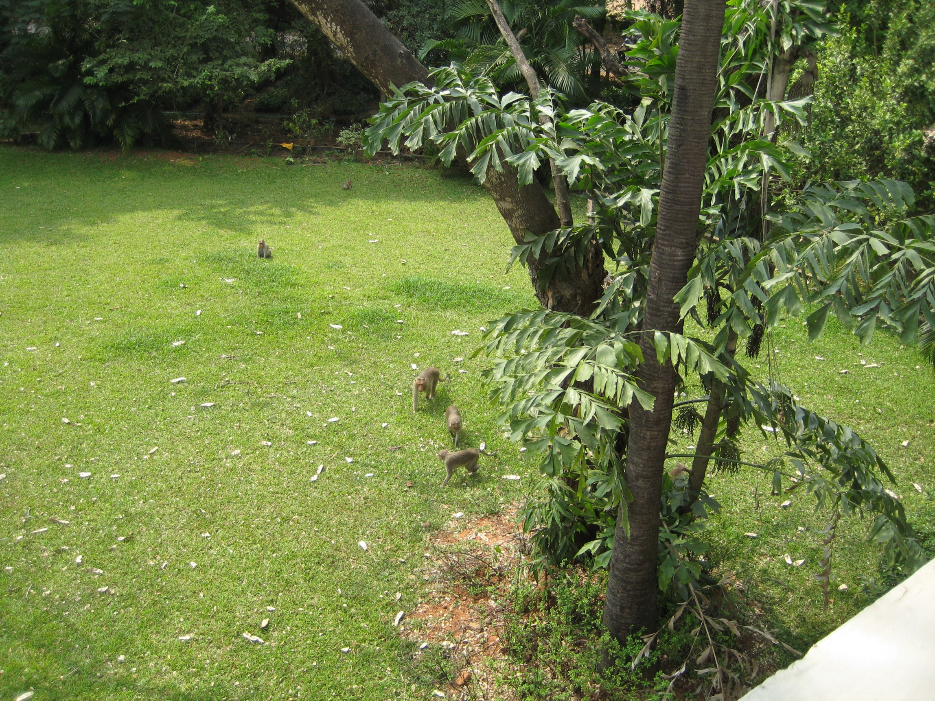

Slide 3


Slide 4
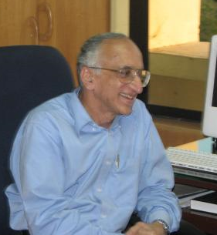

Slide 5
The Big Three
Unprecedented academic mobility
Emergence of global college rankings
Race to create world-class universities

Slide 6
The Big Three
Unprecedented academic mobility
Emergence of global college rankings
Race to create world-class universities

Slide 7
Global Student Mobility

Slide 8

New Zealand’s Student Recruitment Strategy

Slide 9
10 year growth rate in number of foreign students in higher education: 1998-2007
Notes:
9
9

Slide 10
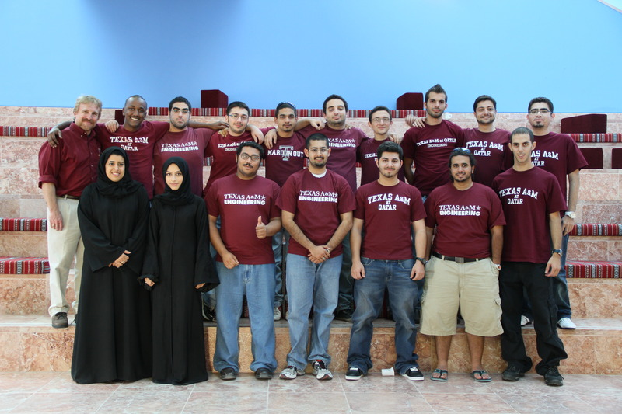
Welcome to Aggieland! Texas A&M – in Qatar

Slide 11
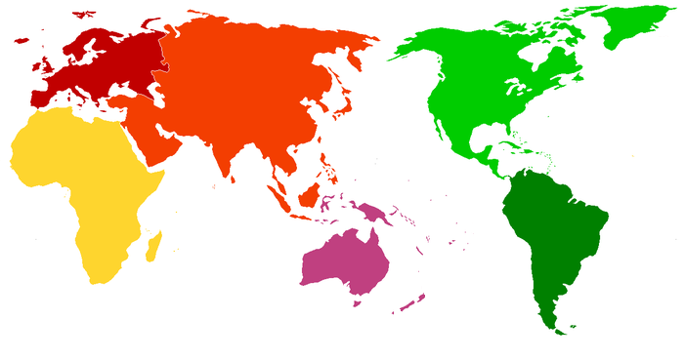
The Travels of Dr. Choon Fong Shih
1
3
2

Slide 12
The Big Three
Unprecedented academic mobility
Emergence of global college rankings
Race to create world-class universities

Slide 13
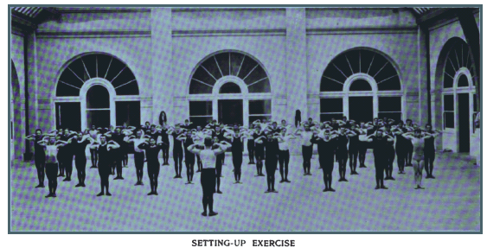
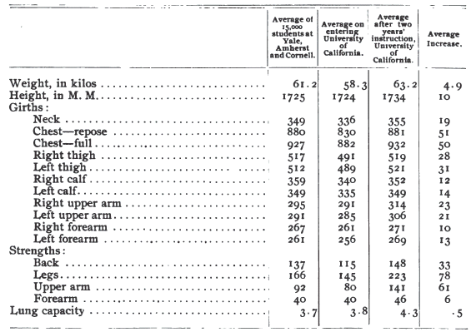
Source: Illustrated History of the University of California, 1868 - 1895
Notes:
13

Slide 14
Top-ranked Global Universities 2010
Shanghai Jiao Tong
Harvard University
University of California, Berkeley
Stanford University
Massachusetts Institute of Technology (MIT)
University of Cambridge
California Institute of Technology
Princeton University
Columbia University
University of Chicago
University of Oxford
Source: http://www.arwu.org/ARWU2010.jsp
Times Higher Education
Harvard University
California Institute of Technology
Massachusetts Institute of Technology (MIT)
Stanford University
Princeton University
University of Cambridge (tie)
University of Oxford (tie)
University of California, Berkeley
Imperial College London
Yale University
Source: http://www.timeshighereducation.co.uk/world-university-rankings/2010-2011/top-200.html

Slide 15

“French do well in French world rankings”
26 October 2008
www.universityworldnews.com

Slide 16
“Human capital, embodied in one’s people,
is the most fundamental part of
the wealth of nations.”
The Race between Education and Technology
(Claudia Goldin and Lawrence Katz)

Slide 17
The Big Three
Unprecedented academic mobility
Emergence of global college rankings
Race to create world-class universities

Slide 18
Global Research: Not a Zero-Sum Game
Source: UNESCO Science Report 2010, http://unesdoc.unesco.org/images/0018/001898/189883E.pdf

Slide 19
The Big Three
Unprecedented academic mobility
Emergence of global college rankings
Race to create world-class universities

Slide 20


www.greatbrainrace.com
@wildavsky facebook.com/greatbrainrace
Chronicle of Higher Education blog: chronicle.com/blogs/worldwise

