Slide 1
Out of the Eddies and into the Mainstream: Making Special Collections Less Special and More Accessible
OCLC Research Library Partnership
8 June 2011
Notes:
With the backlogs and challenges associated with special collections, it sometimes seems like we’re heading into a tunnel and can barely see the light at the other end. But we’re not in there alone. Collaborative investigations, where those who have made progress join with those just setting out, are a great way to advance toward the light.

Slide 2
Overview
2007 essay “Shifting Gears”
Survey of special collections and archives in the US and Canada
A community of practice balancing risk analysis and access, with regard to copyright
Guidance for engaging in public-private partnerships
Investigation of innovative approaches in scaling up capture of non-book formats
Encouraging cameras in reading rooms
Policy issues related to patron-initiated digitization of materials in special collections
Sharing experiences in offering single search
Born-digital ‘baby steps’
Notes:
In OCLC Research, working with staff from partner institutions, we’ve undertaken several efforts to ensure that special collections emerge from the dark into the light of day
The 2007 “Shifting Gears” essay argued for making special collections more radically accessible.
Taking our Pulse is a survey of special collections and archives in North America
The “Undue Diligence” event led to a community of practice for risk analysis regarding rights associated with unpublished collections
Good Terms offered guidance for those engaging in commercial partnerships
Rapid Capture is an investigation of innovative approaches in the capture of non-book formats
An investigation of policies looks at use of special collections
Including Capture and Release, which encourages cameras in the reading rooms
And Scan and Deliver, about patron-initiated digitization
Single Search looks at bringing together our many disjointed access points
And Born Digital will offer suggestions for those just starting to get involved in managing materials that never were in analog form.
We’ll share some highlights from each of these investigations in hopes that we can continue to streamline some of our processes, allowing us to do more with less.

Slide 3
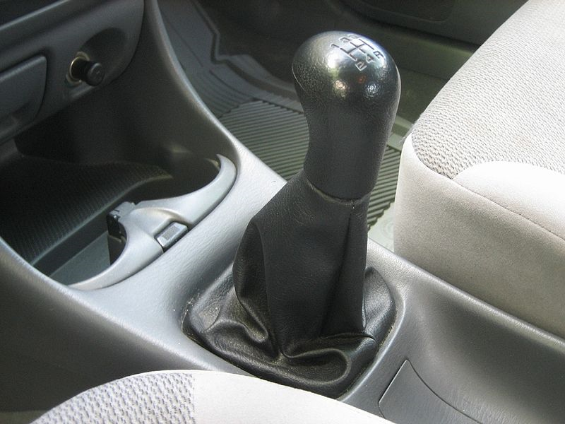
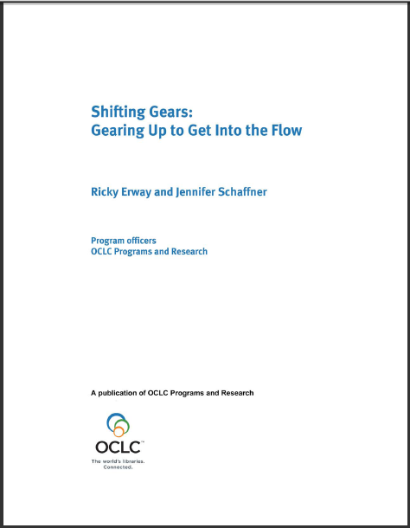

Shifting Gears:
Gearing Up to Get into the Flow
Notes:
“Shifting Gears” argues for scaling up the digitization of special collections, with a particular focus on adopting a “just do it” attitude towards digitization.
Its recommendations are intended to help special collections keep pace with mass digitization of books. As we increasingly share a collective collection of books, it will be our special collections that distinguish cultural repositories. We can hide those treasures in our backlogs or behind custom portals -- or we can push them out into the light of day.
Some of the advice sounds quaint now, but it was important to say – and important for RLG to say, since we had been advocates of the “you only get one chance so scan at the highest quality possible” approach
http://commons.wikimedia.org/wiki/File:Shift_stick.jpg
Gear shift stick of my Mazda Protege SE 1999. Public domain
http://commons.wikimedia.org/wiki/File:MUTCD_W4-3.svg
MUTCD W4-3 merging traffic sign From: Manual on Uniform Traffic Control Devices for Streets and Highways - 2003 Edition. Public domain

Slide 4
Shifting Gears – Recommendations
Access vs. preservation
Selection has already been done
Do it ONCE (then iterate)
Programs not projects
Be informed by archival description practices
Quality vs. quantity
Discovery happens elsewhere
Partnerships and funding
Notes:
These are some of the recommendations
1. Due to the special nature of these often unique materials, we will always preserve the originals to the best of our ability, so why not use digital versions to improve access?
2. Carefully appraised and acquired collections are worthy of digitization, so either scan as materials are accessioned or scan materials that are often requested.
3. High-level description with some representative scans may be enough to determine where to apply further effort. Iterate once you’ve identified high use or high interest materials
4. Early grant-funded digitization often cherry-picked for topical projects. Continuing to give these activities “special project” status implies that providing access is not mission-essential. We need dedicated budget, staffing and infrastructure for digitization.
5. We need to stop obsessing about items. Everything that is digitized does not need to be painstakingly described. Start at the top, at the collection level, then think how to group materials and where further description is needed. Researchers really don’t mind looking through a number of images to find the right ones.
6. Vast quantities of digitized primary materials trump a few superbly crafted special collections. Minimal description and lower quality scanning will not restrict use as much as limiting access to those who can show up in person.
7. Too often we’ve created expensive, but little-used websites. Usage will increase when we expose our content to search engines and aggregators, who are more successful at reaching broad audiences.
8. Work with private partners to developing scanning approaches and industrial strength workflows to suit particular non-book formats. Grant-giving agencies should be encouraged to support projects that put permanent processes in place for ongoing operations.

Slide 5
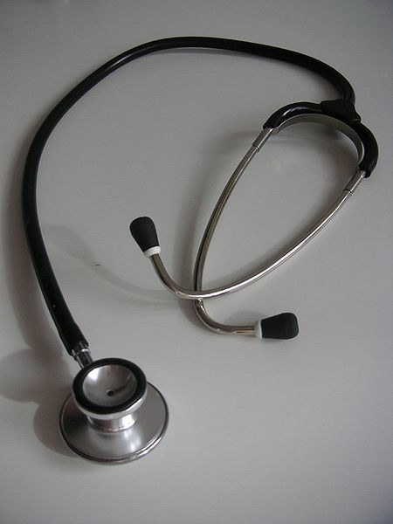
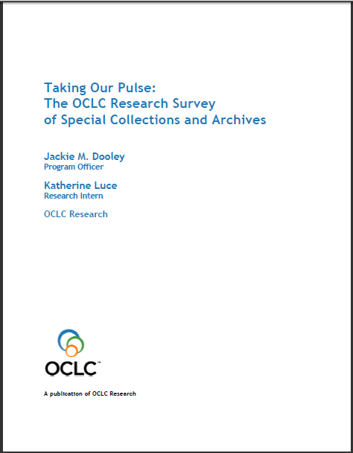
Taking Our Pulse: The OCLC Research Survey of Special Collections and Archives
Notes:
A 2009 survey of special collections and archives in the US and Canada shows that digitization of special collections and increasing user access to those collections are of critical importance to research libraries.
The survey was a follow up to the 1998 ARL survey led directly to many high-profile initiatives to "expose hidden collections.“
We updated ARL’s survey instrument and extended the subject population to encompass the 275 libraries in the following five overlapping membership organizations:
• Association of Research Libraries (124 universities and others)
• Canadian Academic and Research Libraries (30 universities and others)
• Independent Research Libraries Association (19 private research libraries)
• Oberlin Group (80 liberal arts colleges)
• RLG Partnership, U.S. and Canadian members (85 research institutions)
The rate of response was 61% (169 responses).
http://commons.wikimedia.org/wiki/File:Stethoscope_1.jpg
Stethoscope. Public domain.

Slide 6
Taking Our Pulse – Key Findings
The top three “most challenging issues”
  Space
  Born Digital
  Digitization
Tough economy renders “business as usual” impossible
User demand for digitized collections is insatiable
Management of born-digital materials is in its infancy
Notes:
The OCLC report reveals, despite the efforts to uncover hidden collections, much rare and unique material remains undiscoverable, and monetary resources are shrinking at the same time that user demand is growing. The balance sheet is both encouraging and sobering:
• The size of ARL collections has grown dramatically, up to 300% for some formats
• Use of all types of material has increased across the board
• Half of archival collections have no online presence
• While many backlogs have decreased, almost as many continue to grow
• User demand for digitized collections remains insatiable
• Management of born-digital archival materials is still in its infancy
• Staffing is generally stable, but has grown for digital services
• 75% of general library budgets have been reduced
• The current tough economy renders “business as usual” impossible
The top three “most challenging issues” in managing special collections were space (105 respondents), born-digital materials, and digitization.

Slide 7
Taking Our Pulse – Recommendations
Digitization
  Develop models for large scale digitization
User Services
  Promote policies that facilitate (rather than inhibit) access
Born-Digital Archival Materials
  Baby steps approach to creating a program for management
Notes:
Focused on issues that warrant shared action
Assessment
--Develop and promulgate metrics that enable standardized measurement of key aspects of special collections use and management.
Collections
--Identify barriers that limit collaborative collection development.
--Take collective action to share resources for cost-effective preservation of at-risk audiovisual materials.
User Services
--Develop and liberally implement exemplary policies to facilitate rather than inhibit access to and interlibrary loan of rare and unique materials.
Cataloging and Metadata
--Compile, disseminate, and adopt a slate of replicable, sustainable methodologies for cataloging and processing to facilitate exposure of materials that remain hidden and stop the growth of backlogs.
--Develop shared capacities to create metadata for published
--Convert legacy finding aids using affordable methodologies to
Digitization
--Develop models for large-scale digitization of special collections,
--Determine the scope of the existing corpus of digitized rare books,
Born-Digital Archival Materials
--Define the characteristics of born-digital materials that warrant their
management as “special collections.”
--Define a reasonable set of basic steps for initiating an institutional program for responsibly managing born-digital archival materials.
--Develop use cases and cost models for selection, management, and preservation of born-digital archival materials.
Staffing
--Confirm high-priority areas in which education and training

Slide 8
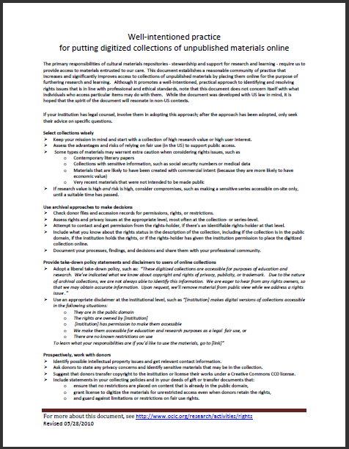
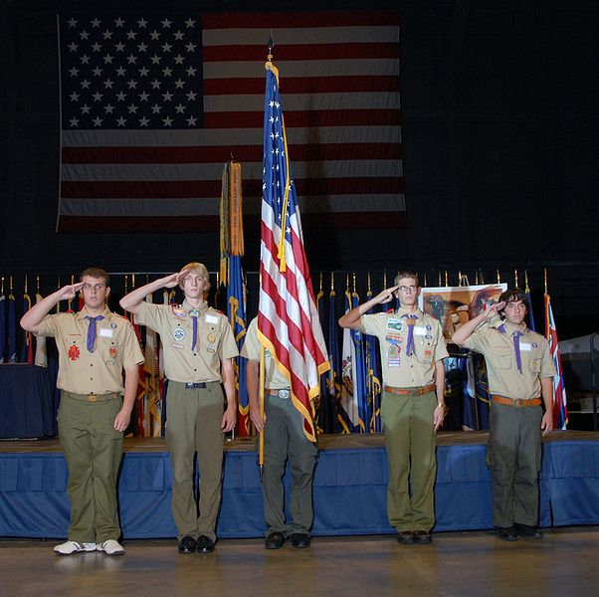
Well-intentioned practice for putting digitized collections of unpublished materials online
United States Air Force. "DAYTON, Ohio (10/27/2009) -- Members of Boy Scout Troop...at the National Museum of the U.S. Air Force“ Public domain
Notes:
Digitization of special collections can be inhibited by concerns about IP or privacy rights. The 2010 “Well-Intentioned Practices” document establishes a community of practice for digitization of unpublished materials based in risk analysis and adoption of fair use.
The primary responsibilities of cultural materials repositories - stewardship and support for research and learning - require us to provide access to materials entrusted to our care. This document establishes a reasonable community of practice that increases and significantly improves access to collections of unpublished materials by placing them online for the purpose of furthering research and learning. Although it promotes a well-intentioned, practical approach to identifying and resolving rights issues that is in line with professional and ethical standards, note that this document does not concern itself with what individuals who access particular items may do with them. While the document was developed with US law in mind, it is hoped that the spirit of the document will resonate in non-US contexts.
If your institution has legal counsel, involve them in adopting this approach; after the approach has been adopted, only seek their advice on specific questions
http://commons.wikimedia.org/wiki/File:Charles_Metcalf_DESA_ceremony.jpg
United States Air Force. "DAYTON, Ohio (10/27/2009) -- Members of Boy Scout Troop 236, Christ United Methodist Church, Kettering, Ohio, post the Colors during the Distinguished Eagle Scout Award presentation at the National Museum of the U.S. Air Force. (U.S. Air Force photo)“ Public domain

Slide 9
Well-Intentioned Practice – Main Points
Select collections wisely
Use archival approaches to make decisions
Provide take-down policy statements and disclaimers to users of online collections
Prospectively, work with donors
Notes:
Select collections wisely
➢ Keep your mission in mind and start with a collection of high research value or high user interest.
➢ Assess the advantages and risks of relying on fair use (in the US) to support public access.
➢ Some types of materials may warrant extra caution when considering rights issues, such as contemporary literary papers or sensitive medical records
➢ If research value is high and risk is high, consider compromises, such as making a sensitive series accessible on-site only, until a suitable time has passed.
Use archival approaches to make decisions
➢ Check donor files and accession records for permissions, rights, or restrictions.
➢ Assess rights and privacy issues at the appropriate level, most often at the collection- or series-level.
➢ Attempt to contact and get permission from the rights-holder, if there’s an identifiable rights-holder at that level.
➢ Include what you know about the rights status in the description of the collection.
➢ Document your processes, findings, and decisions and share them with your professional community.
Provide take-down policy statements and disclaimers to users of online collections
➢ Adopt a liberal take-down policy
➢ Use an appropriate disclaimer at the institutional level
Prospectively, work with donors
➢ Identify possible intellectual property issues and get relevant contact information.
➢ Ask donors to state any privacy concerns and identify sensitive materials that may be in the collection.
➢ Suggest that donors transfer copyright to the institution or license their works under a Creative Commons CC0 license.
➢ Include statements in your collecting policies and in your deeds of gift or transfer documents that:
o ensure that no restrictions are placed on content that is already in the public domain,
o grant license to digitize the materials for unrestricted access even when donors retain the rights,
o and guard against limitations or restrictions on fair use rights.

Slide 10

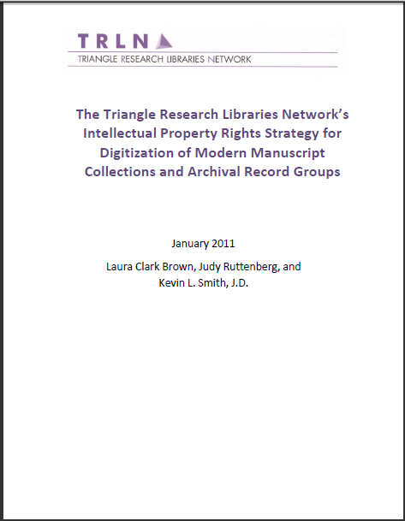




The Triangle Research Libraries Network’s Intellectual Property Rights Strategy for Digitization of Modern Manuscript Collections and Archival Record Groups
Notes:
The principles laid out in WIP have been incorporated into the Triangle Research Library Network’s Intellectual Property Rights Strategy for Digitization of Modern Manuscript Collections and Archival Record Groups.
The “project must proceed on the basis of an intelligent assessment of the potential risks and reasonable efforts to reduce those risks.”
Described the Undue Diligence meeting as “encouraging libraries to leverage the full range of rights management strategies and the strength of the fair use argument in order to realize their missions as teaching and research institutions. … In keeping with [the WIP] and in tandem with the ever‐growing agreement within the profession, TRLN member libraries propose a three‐pronged strategy to promote free and open online access through well‐reasoned risk management.” They conclude that “The risk of conflict over intellectual property rights is small because the challenges will be few, and can be addressed and rectified without litigation. The benefits to education and research are enormous and outweigh the minimal risks.”
http://www.trln.org/IPRights.pdf

Slide 11
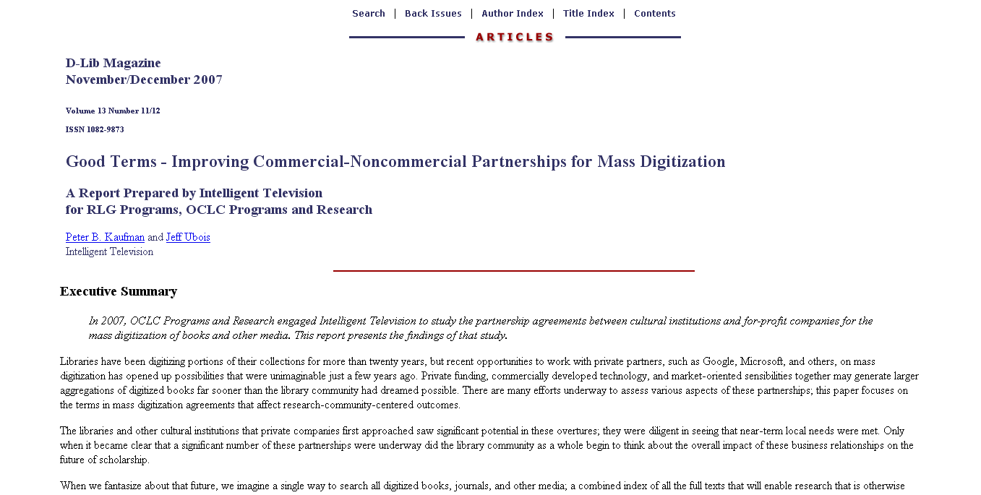
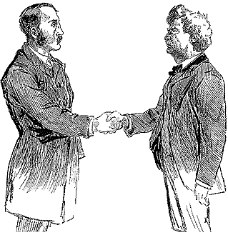
Good Terms: Improving Commercial-Noncommercial Partnerships for Mass Digitization
Detail of illustration by Dan Beard in Cosmopolitan Magazine, December 16, 1893. Public domain
Notes:
Sometimes making progress requires combining forces to get the needed funding and capabilities
Special collections may be attractive to third party, private-sector partners, facilitating digitization that the institution could not otherwise afford. The "Good Terms” report offers guidance for ensuring broad access to collections when working with a commercial partner.
http://commons.wikimedia.org/wiki/File:A_handshake.png
Detail of illustration by Dan Beard in Cosmopolitan Magazine, December 16, 1893. Public domain

Slide 12
Good Terms - Recommendations
Negotiate for
  Limited confidentiality
  More complete deliverables
  More open access allowing the development of new applications.
  Less restricted distribution
  Responsible treatment of usage data
  Limited duration and survivability
Notes:
You need to keep the discussion open so you can consult with peers. Be sensitive to private partner needs to protect business and technology secrets, but insist on your own right to discuss aspects pertaining to your broader community. These deals involve some of the most complex decisions libraries will face, they can be improved through consultations with others.
Collect and Retain All Digitized Data. Librarians must have input into the specifications of quality and formats and be clear about exactly what they will receive and that they will own those deliverables.
Preserve Traditional Freedoms to Support Research and Scholarship. In particular, they should avoid contract terms that make it difficult or impossible to offer scholars the kinds of functionality, including automated or bulk access to collections, that can support innovative research and will allow the development of new applications.
Strive for the Freedom to Aggregate Content. Preserve the right to combine parts or all of their digitized content with collections at other institutions or organizations.
Include Usage Data in Negotiations. Ensure that users' privacy is protected, even while drawing on usage data to enhance services to users.
➔If the above terms cannot be secured, then the consequences of compromises should be fully understood.
This point, however, should be a requirement:
Avoid Contract Exclusivity and Perpetuity. If there must be restrictions on ownership, access, and distribution, it should be time-bounded and should not survive termination of the agreement.

Slide 13
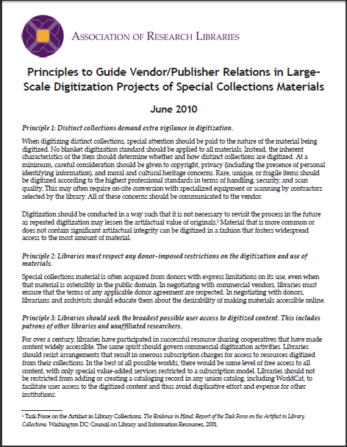
Principles to Guide Vendor/Publisher Relations in Large-Scale Digitization Projects of Special Collections Material
Distinct collections demand extra vigilance in digitization.
Respect donor-imposed restrictions.
Seek the broadest possible user access.
Receive copies of all digital files generated from their collections.
Require sharing of enhancements to digitized content and metadata.
Any restrictions on access should be of limited duration.
Refrain from signing nondisclosure agreements.
Ensure that the confidentiality of users is protected in the vendor’s products.
Refrain from charging fees for access to public domain materials.
Notes:
The Good Terms guidance has since been echoed in a set of 2010 guidelines from ARL, Guide Vendor/Publisher Relations in Large-Scale Digitization Projects of Special Collections Materials
Seek the broadest possible user access.
Receive copies of all digital files.
Restrictions on access should be of limited duration.
Refrain from signing nondisclosure agreements.
Ensure that the confidentiality of users is protected.
http://www.arl.org/bm~doc/principles_large_scale_digitization.pdf

Slide 14
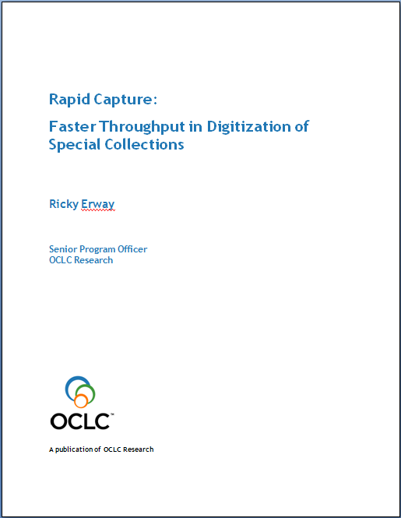
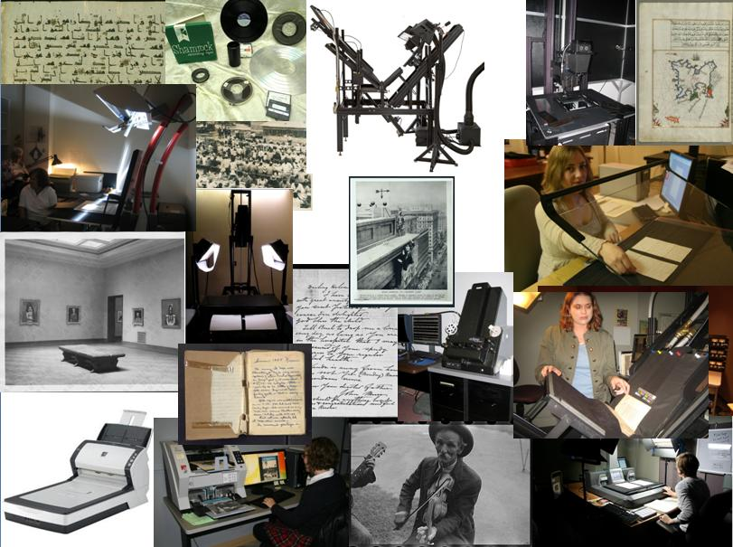
Rapid Capture: Faster Throughput in Digitization of Special Collections
Notes:
Some parts of the process need to be routinized in ways that speed the throughput and allow the overall project to succeed
As institutions begin programmatically digitizing collections, they will want to incorporate innovative approaches. "Rapid Capture” looks at the moment of actual digitization of a variety of formats and highlights approaches that capture at scale.
We identified some innovative ways to accelerate throughput.
There are 9 vignettes + 2 bonus stories. They describe quite succinctly: What they did, how they did it, and the result.
Report came out earlier this month, here are some highlights.
Montage compiled by Ricky Erway from images used with permission.
forthcoming

Slide 15
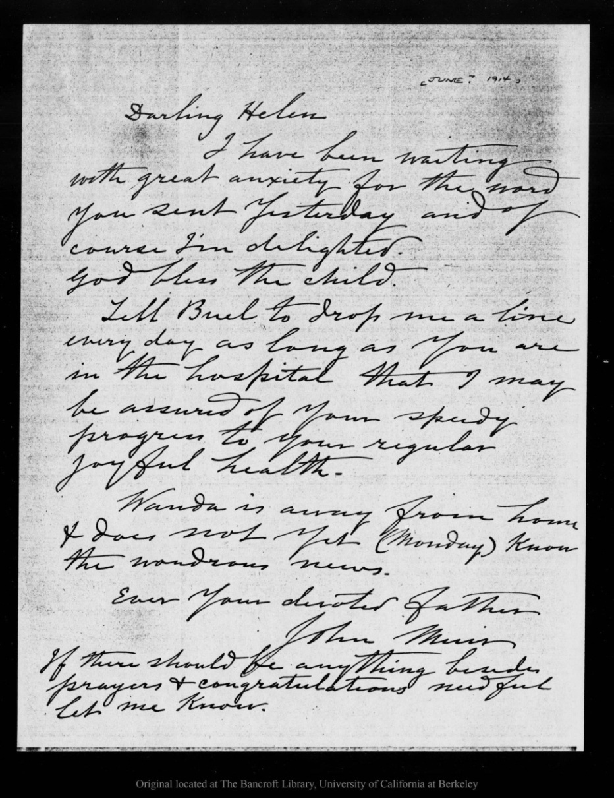
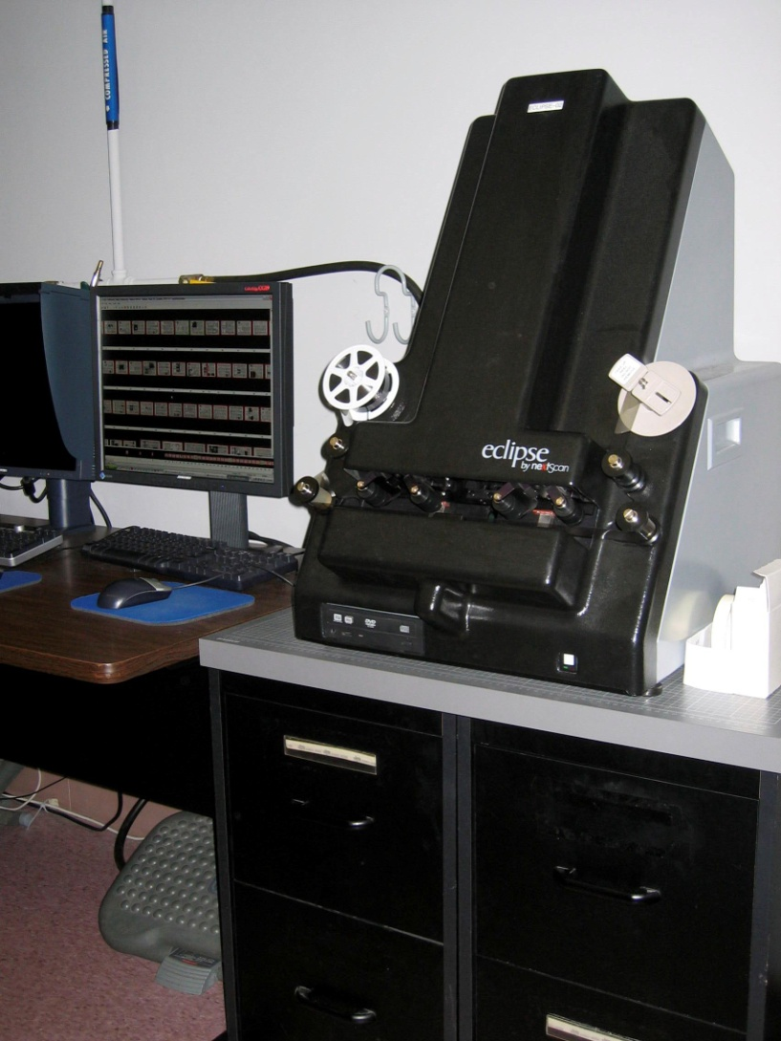
University of California, Berkeley and University of the Pacific
Notes:
The UC Berkeley Bancroft Library digitized John Muir Correspondence by outsourcing the scanning from microfilm to Backstage Library Works.
From 22 reels of microfilm, they captured almost 25,000 image files, with a daily throughput of 4800 images/day
Microfilm reels are not “original” materials, so can be shipped off-site and scanned for a fraction of the cost of doing the work in-house from the originals. Doing work in quantity with materials grouped by size (to preclude frequent adjustments) reduces the overall cost of capture. The Bancroft has successfully reduced costs by 80% and more using this methodology.
Images used with permission.

Slide 16
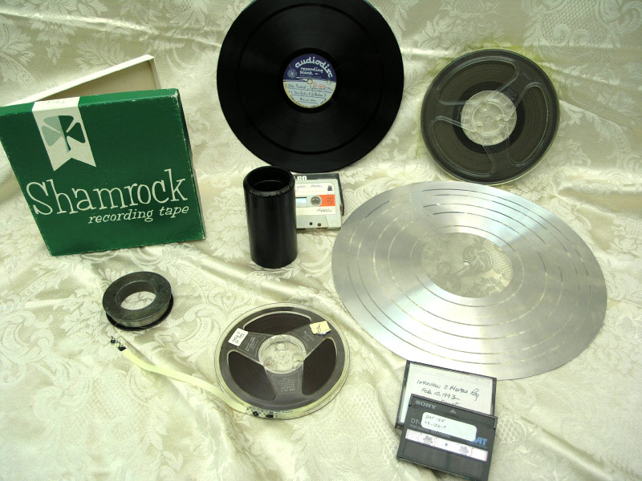
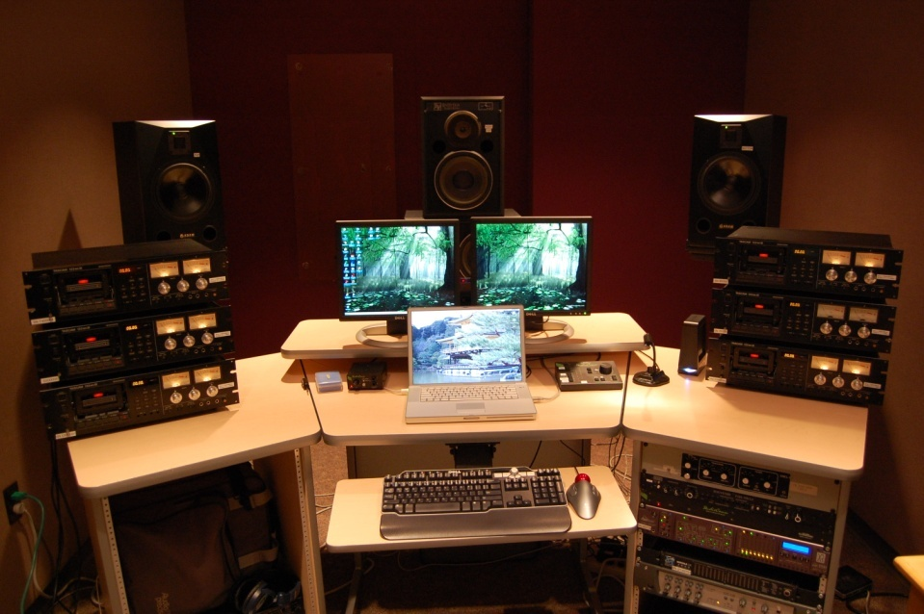
Archives of Traditional Music, Indiana University
Notes:
The Archives of Traditional Music at Indiana University is doing reformatting of audio cassette tapes for preservation and access. Unlike other types of materials, when it comes to sound (and video) recording, there are no acceptable analog formats, so everything must be converted to digital.
The Archives is automating as much of the process as possible, despite the requirement that audio must be digitized at playback speed. They have developed safe practices for parallel transfer, which is the digitization of multiple recordings simultaneously. An audio engineer monitors the audio from three cassette decks at the same time via software that automatically brings each of the sources into primary focus, at a higher volume, for a 10-15 seconds. The technician can always hear all three recordings, so has continuity, but focuses on one at a time. This approach allows comparison from one source to another in batches of similar materials, so the technician can listen for subtle shifts in fidelity.
Images used with permission.

Slide 17
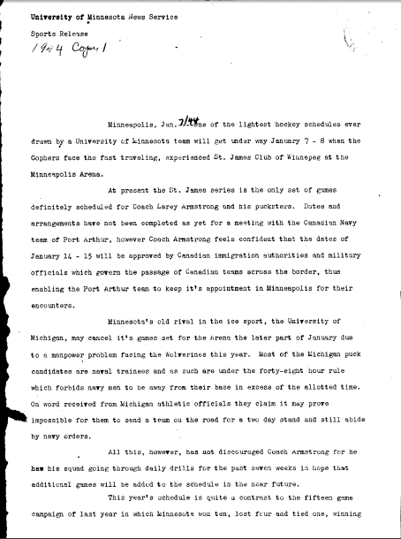
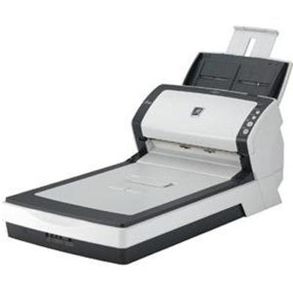
University Archives
University of Minnesota
Notes:
The University Archives at the University of Minnesota is digitizing legacy university publications, averaging 500 pages/hr (scan and OCR)
This is now a routine function for high-use content or items held in duplicate. In the most recent year, they have scanned almost 220,000 pages on a single scanner, incorporated into the duties of student workers, totaling only 15 student hours/wk.
The UM Archives is unusual in that they are, for the most part, scanning and discarding the material. The content has informational, but little artifactual, value. The 219,074 pages scanned last year freed up hundreds of feet of storage space and improved access.
More details in the report.
Images used with permission.

Slide 18

Sharing Special Collections
Advisory group made up of special collections and ILL staff
Streamlining workflows for loan requests
Model policy for loaning special collections
Cayusa. Sharing. 2007. (CC-BY-NC)
Notes:
We wanted to promote ways to get materials more efficiently and effectively into the hands of users. The Sharing Special Collections Advisory Group is made up of both special collections and interlibrary lending staff.
Two main tasks have were identified during discussions: streamlining work flows when handling ILL requests for rare and unique materials, and exploring how best to go about building trust between institutions sufficient to allow the physical lending of special collections materials.
The working group has developed an analysis of more efficient and flexible collaborations between ILL and Special Collections departments. The group has compiled a model policy, synthesized from special collections loan policies from institutions that have long experience.
We are working closely with the ACRL/RBMS Guidelines for Borrowing and Lending Special Collections Materials Task Force.
http://www.flickr.com/photos/cayusa/2050974401/
Cayusa. Sharing. 2007. (CC-BY-NC)

Slide 19
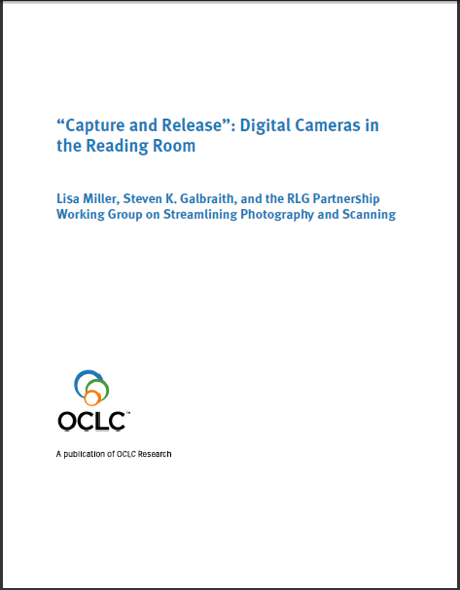
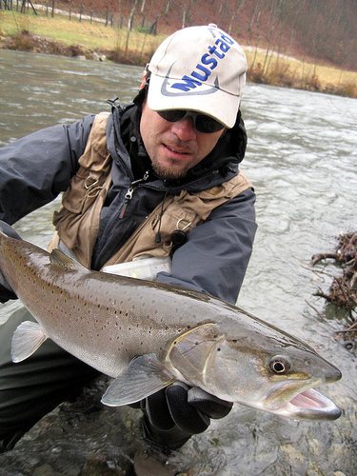
Capture and Release
Helti. mladica / hucho hucho - catch and release. 2008. (CC-BY-NC-ND)
Notes:
There are other ways we can make special collections more accessible. The 2010 "Capture and Release”⁸ argues for allowing, if not encouraging, cameras in the Reading Rooms.
After the travails of landing the big one, the key to catch and release fishing is to take a picture before you release the fish. So it goes when a researcher finally finds the document he’s been seeking, he can capture an image and then return the document to the collection.
Helti. mladica / hucho hucho - catch and release. 2008. (CC-BY-NC-ND)
http://www.flickr.com/photos/helti/2239965082/sizes/m/in/photostream/

Slide 20
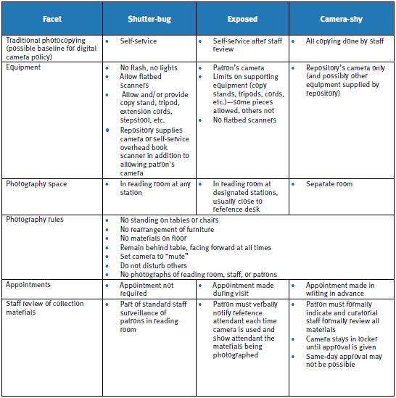
Capture and Release – Benefits
Digital cameras are gentler on collection materials
Digital cameras facilitate use
Digital cameras increase researcher satisfaction
Digital cameras reduce repository workload
Digital cameras enhance security and save reading room checkout time
Digital cameras save paper and photocopy toner
Repositories stay current and resolve an ongoing issue at a time
Digital cameras reduce liability for copyright infringement
Notes:
The report identifies benefits of cameras in the Reading Room:
Most importantly, digital cameras facilitate use—researchers with limited time can cover more collection materials during their visit by photographing relevant materials for in-depth study later. We preserve these materials so that they can be used. More use allows us to report higher reference figures and significant research use to our resource allocators.
Digital cameras increase researcher satisfaction—Researchers must take time from work and school to travel to our reading rooms during our limited business hours, often at great expense. Just as libraries and archives struggle with tighter budgets in these challenging economic times, so, too, do researchers. Digital cameras maximize their precious time in the reading room and end their wait for copies. Depending on the nature of the repository’s camera use policy, patrons may also save money and eliminate time spent on photocopy request paperwork. They may also make copies of a broader universe of materials, like oversize materials and bound volumes that are excluded from the photocopy policies of many repositories, and they can make color copies.
Digital cameras reduce repository workload—Depending on the repository’s photocopy and digital camera policies, allowing personal digital cameras outsources duplication tasks to the user, freeing staff to perform other work in these times of increased demands, expectations, and workloads. In addition, cameras may reduce photocopier maintenance and supplies.
Digital cameras enhance security and save reading room checkout time—Digital cameras decrease the number of photocopies leaving the reading room in the hands of researchers, reducing checkout time and the opportunity for theft. With twentieth- and twenty-first-century collections, it is frequently difficult to distinguish between copies and originals.
Digital cameras save paper and photocopy toner—Photographing materials is an effortless way to reduce our environmental impact.
Repositories stay current and resolve an ongoing issue—Repositories remain largely analog outposts, in contrast to the 24/7 online world that most people live and work in. As much as we would like to deliver collection materials to all online, it is still beyond our grasp. Digital cameras are research tools that reach across this online/offline divide, one researcher at a time.
Digital cameras reduce liability for copyright infringement—Digital cameras lessen the repository’s risk profile, especially if it maintains a “hands-off” approach towards the use of personal cameras. When a repository makes copies of copyrighted documents for users or provides equipment on which users can make their own copies, it runs the risk of engaging in direct and indirect copyright infringement.
Digital cameras are gentler on collection materials—Upending collection materials to position them on a photocopy machine, even when done with the utmost care, risks more damage to materials than photographing them in the reading room while they are face up and appropriately supported. The materials are not subjected to the intense light of a photocopier, but rather are usually easily photographed with ambient lighting. It then goes on to list suggested practices and lays out a grid with a sliding scale of varying levels of accommodation on 15 facets

Slide 21
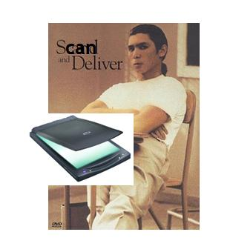
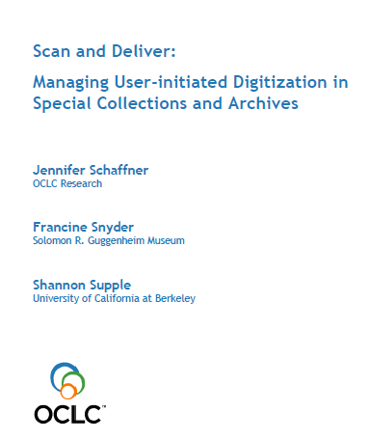
Scan and Deliver: Managing User-Initiated Digitization in Special Collections and Archives
Notes:
"Scan and Deliver“, released last month, ⁹investigates policy issues related to patron-initiated digitization of materials.
Steps in user-initiated digitization – review, decide, scan, and deliver – have a spectrum of tracks for workflow.

Slide 22
Scan and Deliver – tiered workflow
Review
How do users request digital reproductions?
How are requests for copies approved
How many people need to approve?
Have the items already been digitized?
How do you manage copyright & legal issues?
Decide
Will you keep the images?
Is it useful for you to keep the images?
Do you have sufficient resources to keep them?
What resolution is needed for scanning?
Is the request for high-resolution?
What metadata will you create?
Will you scan the whole volume?
Scan
Who digitizes and describes materials?
Will you perform quality control?
Deliver
How do you deliver digital copies to the user?
 | INSIDE TRACK | MIDDLE TRACK | OUTSIDE TRACK
REVIEW
REQUEST | Verbal request | Simple form | Detailed forms
APPROVE | One staff member | Two staff | Three or more staff
SEARCH FOR EXISTING SURROGATE | Don’t take the time | Quick check (local files or online) | Search: Google Books EEBO & ECCO HathiTrust Etc…
RIGHTS | User’s responsibility | User’s responsibility | Search, control, & monitor thoroughly
DECIDE
STAFF | One staff member | Two staff | Multiple specialists: Curator Conservator Metadata creator Image professional Etc…
RESOLUTION | Easiest option | Middling to high quality | High quality
METADATA | None | Filename and keyword or two | Metadata & citation (choose standards)
WHOLE / PART / ITEM | Will scan whole unit if it takes up to “x” minutes | Entire chapter or series | Entire volume or collection (large-scale digitization)
SCAN
STAFF | One staff member | Two staff | Multiple staff
QUALITY CONTROL | Trust your staff! | Quick review | Thorough review by multiple specialists (color-correction, etc.)
DELIVER
DELIVERY METHOD | Deliver forthwith to user | Keep in local files and Web site | Digital library Digital repository DAMS Consortia Aggregations
Figure 1. Tiered Workflow for User-initiated Digitization
Notes:
Review
How do users request digital reproductions? verbal request or a detailed form.
How are requests for copies approved? if the institution owns an item, it warrants digitization.
How many people need to approve materials to be digitized? Minimize the number of people involved or use blanket guidelines
Have the requested items already been digitized? searching can be very time consuming and what you find may not be what’s needed by the user.
How do you manage copyright, privacy, and other legal issues? Place responsibility for rights and privacy issues on the user.
B. Decide
Will you keep the images? Makes an enormous difference in the time and money committed to user-initiated digitization.
Is it useful for you to keep the digitized images? If you do not have resources to tinker with metadata, do not keep digitized images.
Do you have sufficient resources to keep digitized images? Digital infrastructure and metadata creation always require significant resources. On the inside track, do not keep the images. On an intermediate track, digitized images are kept locally (such as on a network drive) for future requests. On the outside track, digitized images are integrated into institutional digital asset management systems (DAMS), consortial repositories, and preservation initiatives. On the middle or outside track, institutions may want to re-use images for projects, such as Web exhibits, Flickr Commons, or links in online finding aids and catalog records.
What resolution is needed for scanning? User needs determine the quality of scans. If you decide to keep copies, you might choose a higher quality.
Is the request for high-resolution? Institutions on the middle track might scan at a high resolution but deliver images with minimal metadata.
What metadata will you create? If you want to keep the images, amount and type of metadata is the biggest hurdle in repurposing scans. An economical tactic is to reuse whatever metadata the user included in the request.
Will you scan the whole volume, folder, or series when the request is for an item or set of items? Sometimes it doesn’t make sense to digitize just one item or page. If taking the middle or outside track, scan the whole unit. (folder or volume or series or collection).
C. Scan
Who digitizes and describes materials and how many steps are involved? Streamline digitization workflow so that only one or two people are involved
Will you perform quality control on the images, metadata or materials? Often a bottleneck in digitization workflows.
D. Deliver
How do you deliver digital copies to the user? Often automated and online. Flickr, CONTENTdm, or a repository. In some cases users can find these images on their own and need not make requests. An online gallery populated with previous users’ requests – “the best of the archives.”or email them or copy them to a CD, FTP site, or flash drive. That’s it.

Slide 23
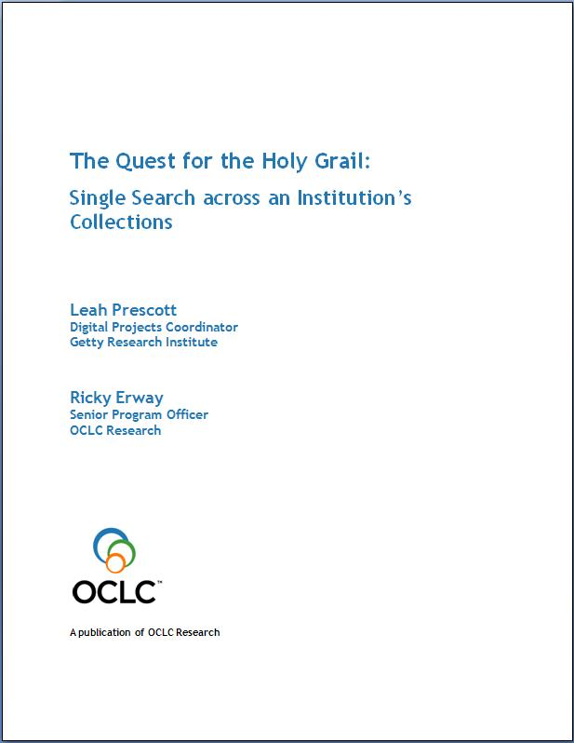
Single Search
Notes:
So now we’ve got a lot of special materials ready to be accessed. [click] We build a portal. Maybe not one for every collection, but chances are we’re still building a number of silos across the libraries, archives and museums on campus. So we now need to offer a single search interface, so users don’t have to guess where to look and then figure out how to navigate each system.

Slide 24
Single Search - Implementers Share Experiences
Heather Caven, Victoria & Albert Museum
Emmanuelle Delmas-Glass, Yale Center for British Art
Youn Noh, Yale University
Paul Pival, Minnesota Historical Society
Francesco Spagnolo, The Magnes Collection of Jewish Art and Life
Leah Prescott, Getty Research Institute
Margaret Savage-Jones, Wellcome Trust
Ching-hsien Wang, Smithsonian Institution
Motivation
Organizational structure
Technical approaches
Crosswalks
Gathering data
Vocabularies
Managing digital assets
Access
Notes:
A group of nine Single Search Implementers is sharing their experiences to encourage others who are on this path. These are some of the topics being covered.
The report will be ready in a month or so
BUT this begs the question, Isn’t each single search implementation still a silo?
In order to get the content into users’ flow, we need to get the content to aggregators and make it crawlable by search engines.

Slide 25
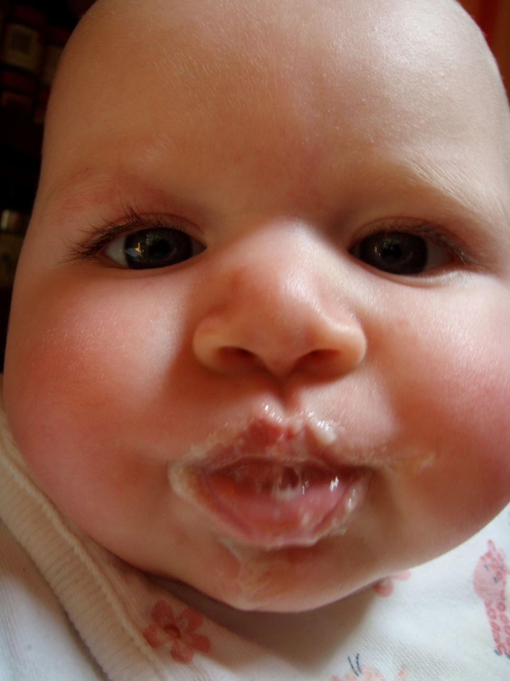
Born Digital
Definition
Archival practices
First steps
Notes:
The Born Digital project is just getting started. Jackie Dooley has the lead on this one.
Focus on enhancing effective management of born-digital materials as they intersect with special collections and archives in research libraries.
First off we attempted a definition of born digital:
Items created and managed in digital form.
Working with a number of advisors, we intend to identify the skills and practices in the archival tradition that will be of value in the preservation of, and access to, materials that were born digital. We’ll also assemble the minimal steps that need to be taken, while ensuring that no harm is done.
Photo by Merrilee Proffitt. CC BY-NC

Slide 26
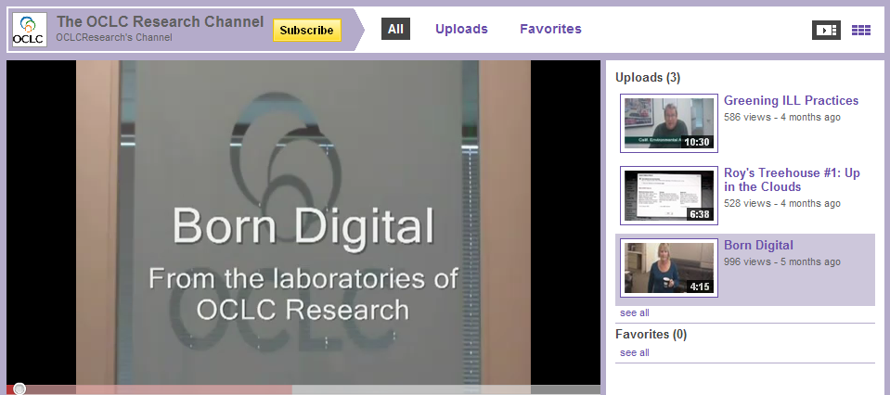
Types of Born-Digital Materials
Digital photographs
Digital documents
Harvested Web content
Digital manuscripts
Electronic records
Static data sets
Dynamic data
Digital art
Digital media publications
Notes:
To start out, we recognized that different people may have entirely different things in mind when they use the term born-digital. So we identified nine different types of born-digital material (you could no doubt, add more). There’s a document, but those of you with short attention spans (or who’d like to see OCLC Research staff make fools of ourselves) may want to view the video on our YouTube channel.

Slide 27
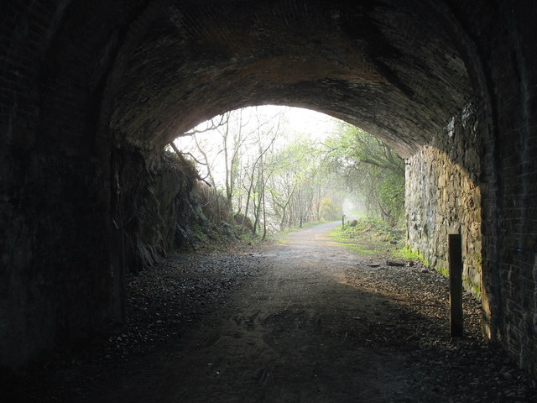
There is light at the end of the tunnel…
Eric Jones. Lon Peris cycle track seen from the other end of the tunnel. 2007. (CC-BY-SA)
Notes:
We’ve just zoomed through a lot of information about increasing access to and use of special collections.
Especially now, when there is increased institutional and user interest in special collections -- coupled with flat or decreasing budgets, finding ways to streamline processes is a good way to enable us to do more with less – and bring those special collections into the light.
http://commons.wikimedia.org/wiki/File:Lon_Peris_cycle_track_seen_from_the_other_end_of_the_tunnel_-_geograph.org.uk_-_401870.jpg
Eric Jones. Lon Peris cycle track seen from the other end of the tunnel. 2007. (CC-BY-SA)

Slide 28
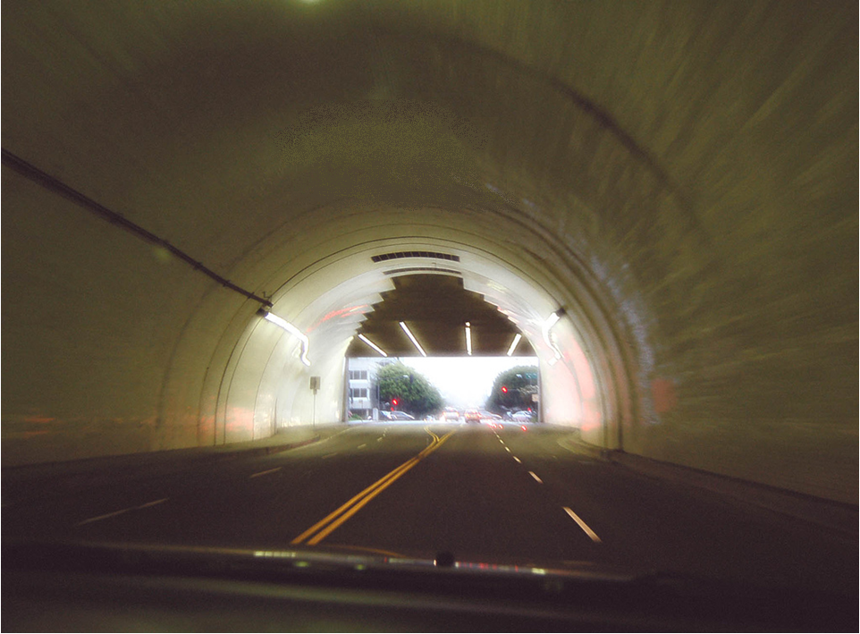
OCLC Research: Mobilizing Unique Materials
Sharing special collections
Capture and Release
Rapid Capture
Scan and Deliver
Good Terms
Single Search
Well-Intentioned Practice
Born Digital
Taking Our Pulse
Sharing Special Collections
Shifting Gears
???
Zeets Jones. Light at the End of the Tunnel. 2007. (CC-BY-NC-ND)
Notes:
A lot has been done to help libraries increase access to their special collections, but we know there’s more.
In the remaining time, I hope you’ll share how any of this might work for you, telling us what other things you’re doing, and imagine next steps.
Http://www.flickr.com/photos/zeetzjones/499517610/sizes/l/in/photostream/
Zeets Jones. Light at the End of the Tunnel. 2007. (CC-BY-NC-ND)

Slide 29
Links and contact info
Shifting Gears http://www.oclc.org/research/publications/library/2007/2007-02.pdf
Taking our Pulse www.oclc.org/research/publications/library/2010/2010-11.pdf
Well-Intentioned Practice http://www.oclc.org/research/activities/rights/practice.pdf
Good Terms http://dlib.org/dlib/november07/kaufman/11kaufman.html
Rapid Capture http://www.oclc.org/research/publications/library/2011/2011-04.pdf
Sharing Special Collections http://www.oclc.org/research/activities/sharing/default.htm
Capture and Release www.oclc.org/research/publications/library/2010/2010-05.pdf
Scan and Deliver http://www.oclc.org/research/publications/library/2011/2011-05.pdf
Single Search – Forthcoming
Born Digital Special Collections http://www.oclc.org/research/activities/borndigital/
Defining “Born Digital” http://www.oclc.org/research/activities/hiddencollections/borndigital.pdf
oclc.org/research/publications
proffitm@oclc.org erwayr@oclc.org schaffnj@oclc.org dooleyj@oclc.org
Notes:
Or just go to oclc.org/research/publications

