Slide 1
SHARES:
The Resource Sharing Consortium for OCLC RLP Institutions
Dennis Massie
Program Officer,
OCLC Research

Slide 2
SHARES Resource Sharing Consortium
88 OCLC symbols as of 6/1/2011
In business since 1982
Expedited delivery
Below market rates
No blanket restrictions
Reciprocal onsite access
Exceptions
Trust
Little tent, big umbrella
Returnables overseas
Share non-circ
Share non-print
Share expertise
Push boundaries
Question processes
Collaborate (w.g.’s)
8 member exec group

Slide 3
SHARES Executive Group
2011
  Terry Dahlin, BYU
  Trevor Dawes, Princeton
  Melanie Emerson, ArtIC
  Catherin Hamer, UT Austin
  Rose Harrington, Stanford
  Lesliediana Jones, GWU Law
  David McCaslin, CIT
  Margarita Moreno, NLA
2010
  Scott Britton, U of Miami
  Melanie Emerson, ArtIC
  Catherin Hamer, UT Austin
  Rose Harrington, Stanford
  Margarita Moreno, NLA
  Francie Mrkich, Columbia
  Matthew Sheehy, NYPL
  Merle Slyhoff, U Penn Law

Slide 4
Sharing Special Collections
Advisory Group
Creating
  Aimee Lind, Getty
  Barbara Coopey, Penn State
  Elizabeth Nielsen, Oregon State
  Laura Carroll, Emory
  Jennifer Block, Princeton
  Sandra Stelts, Penn State
  Scott Britton, U of Miami
Reviewing
  Cristina Favretto, U of Miami
  Eleanor Brown, Cornell
  Margaret Ellingon, Emory
  Paul Constantine, U of Washington
  Shannon Supple, UC Berkeley
  Sue Hallgren, U of Minnesota

Slide 5
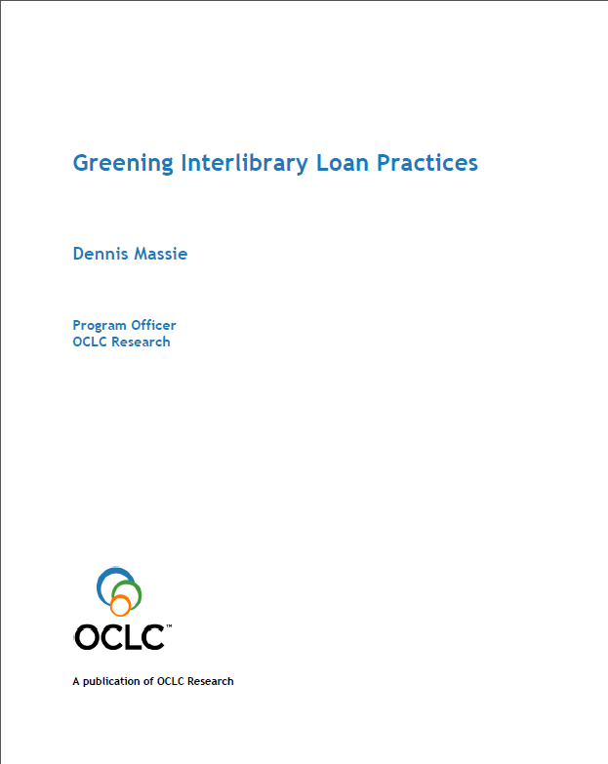
Creating Benefit Beyond SHARES
Inspire and participate in Research studies
Act as beta testers and test bed for Research as well as Delivery Services
Try new models of resource sharing

Slide 6
Current focus: FY11-FY12
Help recruit for OCLC Research Library Partnership
Streamline processing of ILL requests for Special Materials
Engage e-journal publishers in dialogue about license language regarding ILL
Design a cost calculator for ILL services
Engage OCLC enterprise and community in a discussion about the ways resource sharing will evolve throughout the “p” to “e” transition, and explore potential impact on staffing and technical infrastructure requirements

Slide 7
SHARES ILL Statistics – typical month
Borrowing
  31% within group
Lending
  23% within group
10,675 filled req.
  3991 copies (37%)
  6684 loans (63%)
  75 international returnables
45 net borrowers
41 net lenders
2 break even
Biggest credit:
  $3760
Biggest debit:
  $5750
46 under $200

Slide 8
Questions? Suggestions? Discussion?
What resource sharing challenges are your institutions facing?
Are the solutions financial, technical, or behavioral?
Can SHARES help? Can OCLC Research help?
massied@oclc.org

Slide 9
Next Up!
4:00 – 4:50 Project Briefings, Part II
System-wide Organization – Salon B
OCLC Innovation Lab and the OCLC Developer Network – Salon F
Mobilizing Unique Materials – Salon C
5:00 – 6:30 Reception
Leavey Esplanade

