Slide 1
OCLC Research: System-wide Organization
Lorcan Dempsey
Brian Lavoie
Constance Malpas
FutureCast: Shaping Libraries in a Digital Age
Washington, DC
June 8, 2011

Slide 2
Projects (a sample)
Evolving responsibility to the scholarly record
National presence in the global library resource
Ithaka collaboration on print management
Rethinking the boundaries of the academic library
Managing research collections ‘in the cloud’
Shared print collections: modeling infrastructure

Slide 3


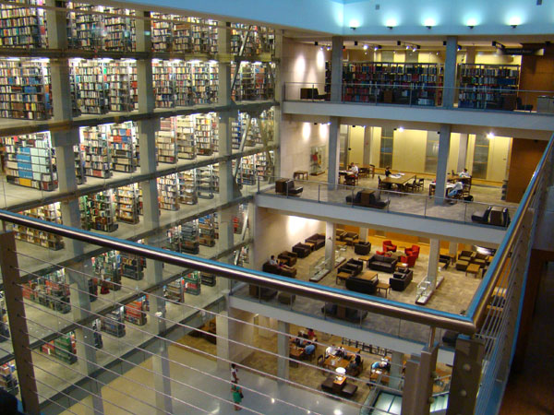
Rethinking the boundaries of the academic library
“Pull” of the Network
“Push” of Economics
Academic Libraries
?

Slide 4

Academic libraries: Coasian interpretation
Framework to organize thinking about shifts in boundaries of academic library …
… in network environment
… lingering climate of austerity
Two questions:
What is an academic library? A bundle of information-related resources and services that a university has chosen to provide internally
What determines the boundaries of the library? Transaction costs
Transaction costs rise:
Internalize
Activity
Transaction costs fall:
Externalize
Organization
External
Provider
Ronald Coase

Slide 5
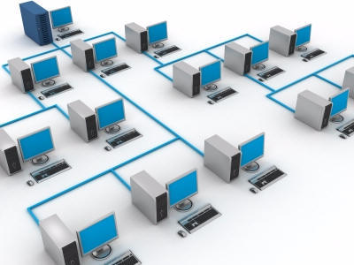

Network is reducing transaction costs …
Computing and network technologies …
… reduce the cost of establishing & managing
interactions with external parties …
… which creates incentive to re-assess mix of
internalized & externalized activities …
… which reconfigures organizational boundaries
(i.e., boundaries of the library)

Slide 6








Examples
Company
Research
Library

Slide 7
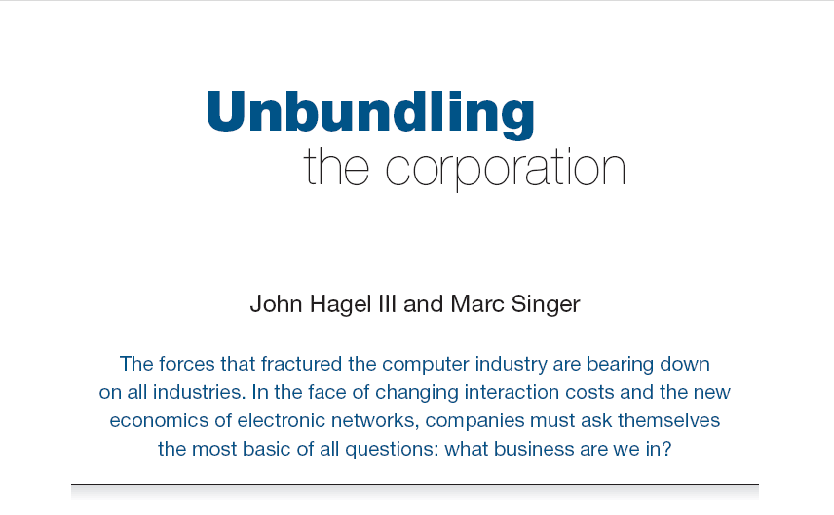
Harvard Business Review (1999)

Slide 8
Unbundling the library
Product Innovation:
Deploy new capacities
Speed, flexibility,
entrepreneurial
Customer Relationship Management:
Service-oriented, customization,
personal engagement
Internalize
more of this
Externalize
more of this
Academic libraries
in the network
environment
Infrastructure:
Back-office capacities, routine workflows

Slide 9
Mechanisms for
externalization
Scaling
Institution
Group
Web
Tripod:
(Tri-college
library catalog)
Collaborative
DSpace
RePEc
Bibliographic
Standards
(LC Classification,
MESH, LCSH)
OhioLink
(resource sharing &
negotiation of
licenses &
subscriptions)
Sourcing
Public
PubMed
VTLS Virtua
(hosted ILS)
JISC Collections
worldcat.org
Third-Party

Slide 10
Google Books/Scholar
Mendeley
Straight
Externalization
Web-scale
Externalization
Third-Party
Licensed e-content
Hosted systems
4
3
Public
Collaborative
Externalization
Sourcing
2
Collaborative
Cooperative cataloging
Resource sharing
Self-
Sufficiency
Internalized
1
Institution
Group
Web
Scaling

Slide 11
Publications
“Rethinking the Boundaries of the Academic Library” (December 2010) OCLC Nextspace
http://www.oclc.org/nextspace/017/research.htm
[brief summary of major concepts]
Full OCLC Research Report forthcoming soon
Contacts:
Lorcan Dempsey: dempseyl@oclc.org
Brian Lavoie: lavoie@oclc.org

Slide 12
Cloud-sourcing Research Collections
Case study in ‘unbundling’ of library operations, externalization of print repository function
NYU, HathiTrust, ReCAP consortium partners – Columbia University, Princeton University, New York Public Library – and OCLC Research
Funded in part by Andrew W. Mellon Foundation
How is the emerging infrastructure for
shared stewardship of the mass-digitized corpus
likely to alter legacy print management strategies
in research libraries?

Slide 13
Key Finding: Mass digitized corpus in Hathi mirrors academic print book collection
A critical mass of retrospective literature in the humanities, social sciences
… 80% or more in copyright
OCLC Research, June 2010.

Slide 14
Key Finding: Mass digitized corpus in Hathi duplicates substantial portion of academic print
Median duplication in December 2010: 33%
Median duplication in June 2010: 31%
Median duplication in June 2009: 19%
OCLC Research, January 2011
Rank in ARL Investment Index (2007-2008)

Slide 15
Key Finding: Mass digitized corpus in Hathi is duplicated in large-scale print storage collections
~75% of mass digitized corpus is ‘backed up’ in one or more shared print repositories
OCLC Research, June 2010

Slide 16
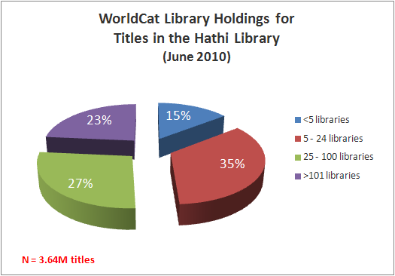
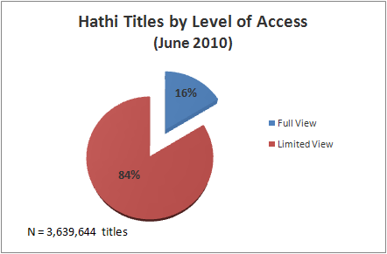
An opportunity and a challenge
An opportunity to rationalize holdings, but…
>50% of titles are ‘widely held’
library print supply chain will be needed for some time
>80% of titles are in copyright
OCLC Research. June 2010

Slide 17
Current Status
Final report published January 2011
www.oclc.org/research/publications/library/2011/2011-01.pdf
Continuing to harvest and process HathiTrust data
Special thanks: Roy Tennant & Bruce Washburn
Focus: monitoring shifts in subject, language and print holdings distribution of aggregate resource; volatility of rights data
Contact:
Constance Malpas (malpasc@oclc.org)

Slide 18
Optimal locus of coordination,
shared service provision may vary
Registry infrastructure
Cooperative platform
Straight
Externalization
Web-scale
Externalization
Third-Party
New England
Regional Depository
4
3
Public
Collaborative
Externalization
Sourcing
WEST
CIC Shared Print
Hathi Print
NN/LM Print Archiving
UK Research Reserve
2
Collaborative
Self-
Sufficiency
University of Chicago
Mansueto Library
Internalized
1
Institution
Group
Web
Scaling

Slide 19
Shared Research Collections in Context
At minimum…
196M WorldCat holdings [12%]
OCLC Research Library Partners
N=111 (June 2011)
and growing
Shared stewardship responsibility
52M publications
[23% of WorldCat]
16M
unique ORLP
holdings
Median WorldCat holdings
OCLC Research Lib. Partners: 1.3M
Median % unique: 6%
OCLC Research. Data current as of June 2011.

Slide 20
N=15,9M unique holdings in OCLC Research Library Partner collections
Special Collections repositories, IRLA,
non-North American universities
Top third ARL
Institutional capacity to uphold
traditional stewardship mission varies across
OCLC Research Libraries Partnership
Mid-tier ARL
Proportion of uniquely-held titles in library collection
OCLC Research. Data current as of June 2011.

Slide 21
Stewardship is an immense privilege . . .
. . . and a considerable institutional investment.
Assuming (improbably) that every ORLP holding in WorldCat represents a single print volume in open stacks:
[196M vols * $4.26] = $ 839M aggregate annual cost*
or at best
[196M vols * $ .86] = $ 232M aggregate annual cost*
if those same volumes are managed in high-density stores
the library system depends on the survivability of this collective resource - a more cost-effective, cooperative strategy is needed
Courant & Nielson “On the cost of keeping a book” (CLIR, 2010)

Slide 22
Libraries in this quadrant likely to exercise greatest pressure?
Median overlap 31%
Median holdings 1.3M
N=~4.3M titles
OCLC Research. Data current as of May 2011.

Slide 23

Houston
Brown
UT Austin
Cornell

Slide 24
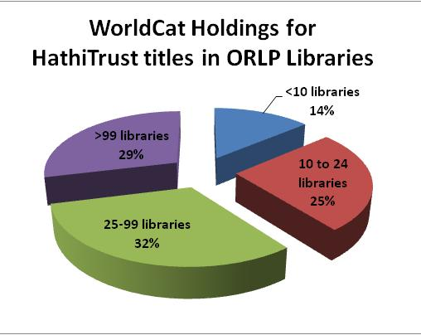
Shared Print management: institutional imperatives may be strong
>60% of mass-digitized titles in OCLC Research Library Partnership are ‘widely-held’
Pull of the network
Push of economic drivers
Combine to create powerful incentives
to externalize print management operations
N=4.3M titles
OCLC Research. Data current as of May 2011.

Slide 25
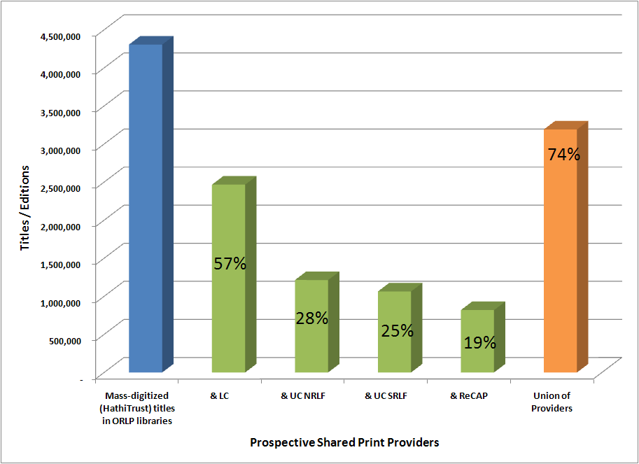
… but core infrastructure is lacking
4.3M titles in OCLC Research Library Partner collections
New policy frameworks; discovery, authentication and delivery services needed to achieve this
OCLC Research. Data current as of May 2011.

Slide 26
Print Archives Pilot project
Collaborative effort - OCLC Cooperative Platform and OCLC Research
Transitioning bibliographic infrastructure built for cooperative cataloging to one adapted for shared resource management
Leveraging Local Holdings Record as item-level holdings registry; 583 Action Note for disclosing retention commitments and condition statements
Participating libraries: Stanford, UCLA, UC San Diego, UC SRLF, University of Oregon, University of Minnesota, University of Indiana, and CRL

Slide 27
Current Status
Draft metadata guidelines in review; sample LHR creation late June; data loading in July; testing in August
Documentation:
Draft metadata guidelines [Google Docs]
Update sessions [SlideShare]
Contacts:
Kathryn Harnish (harnishk@oclc.org)
Constance Malpas (malpasc@oclc.org)
Dennis Massie (massied@oclc.org)

Slide 28
Thanks for your attention.
Lorcan Dempsey (dempseyl@oclc.org)
Brian Lavoie (lavoie@oclc.og)
Constance Malpas (malpasc@oclc.org)

Slide 29
Next Up:
3:00 – 3:50 Project Briefings, Part I Research Information Management – Salon B Metadata Support & Management – Salon C The SHARES Partnership – Salon F
4:00 – 4:50 Project Briefings, Part II System-wide Organization – Salon B OCLC Innovation Lab and the OCLC Developer Network – Salon F Mobilizing Unique Materials – Salon C
5:00 – 6:30 Reception Leavey Esplanade

