Slide 1
Metadata Support and Management
Eric Childress
Karen Smith-Yoshimura
OCLC Research
FutureCast, Washington D.C.
8 June 2011

Slide 2
Long-term, keep doing more with less
OCLC Research. Derived from data reported in NCES Digest of Education Statistics: 2008.
Notes:
A scary picture? Academic libraries are increasing pressure to do more with less.
Trend toward diminished support for academic libraries is not a new phenomenon and it is not merely a knock-on effect of regional or institutional economic pressures. It is a reflection of much broader changes in the higher education environment, including funding mandates that create incentives for increased institutional attention to science and engineering, a decline in the number of students pursuing advanced degrees in the humanities, and new models of educational provisioning -- including distance learning – that are no longer reliant on locally-sourced collections or infrastructure.

Slide 3
A limited population, growing economic pressure
Increasing expense, decreasing purchasing power
OCLC Research. Derived from data reported in NCES Digest of Education Statistics: 2008.
Notes:
Over the same 3 decade period, we’ve seen US academic library spending grow steadily, from just over a billion dollars in the mid ‘70s to about $7 bn in 2008. This is not a reflection of growing library infrastructure – or “new library starts” – since as you can see the total number of academic libraries has remained relatively stable.

Slide 4
In US research libraries, a tipping point …
Majority of research libraries shifting toward
e-centric acquisitions, service model
Center of gravity
Yale
Harvard
Shrinking pool of libraries with mission and resources
to sustain print preservation as a ‘core’ operation
OCLC Research. Derived from ARL Annual Statistics, 2007-2008
Notes:
In the US, a majority of research libraries are already spending more than half of the library materials budget on licensed resources.
Print is no longer at the center.

Slide 5
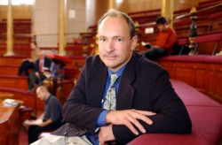
The Semantic Web dream
“I have a dream for the Web [in which computers] become capable of analyzing all the data on the Web – the content, links, and transactions between people and computers.”
—Tim Berners-Lee

Slide 6

Metadata Support and Management
Help define future research services
System-wide efficiencies in library management
Services where library users are
Three broad groups of activities:
Classification & Controlled Vocabularies
Tools and Processes
Works-based and Other Special Views

Slide 7
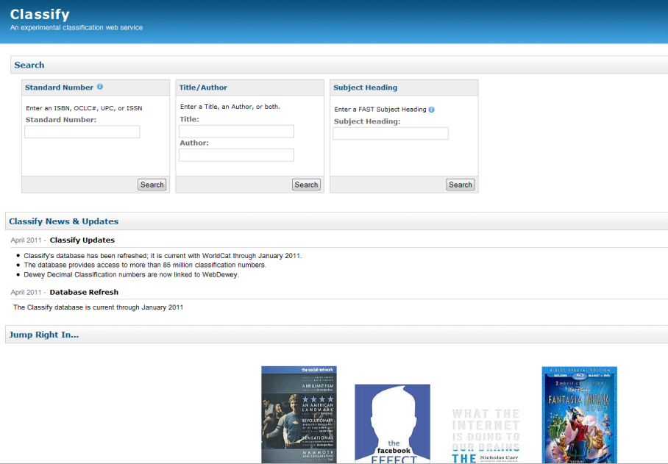
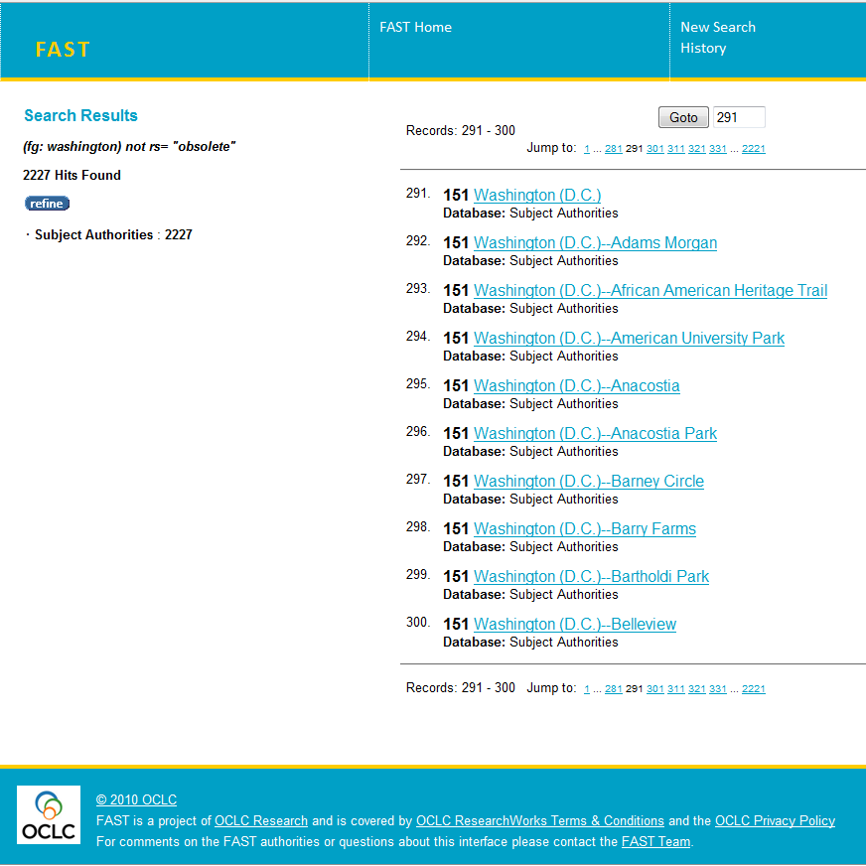
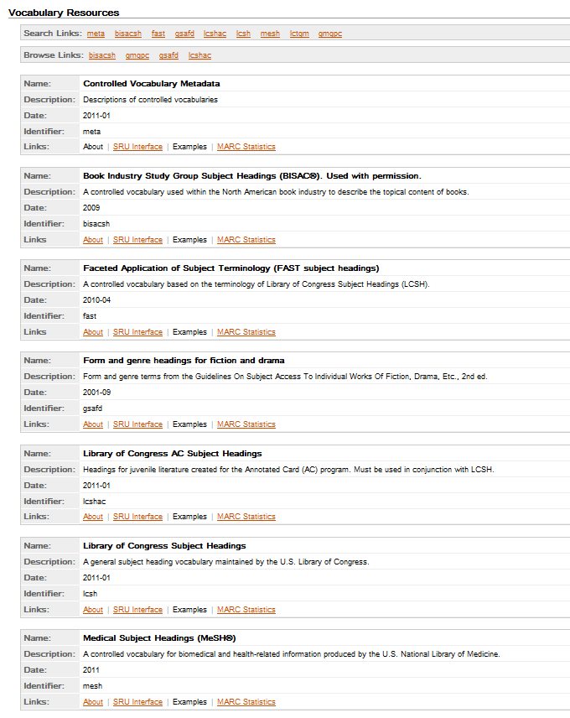
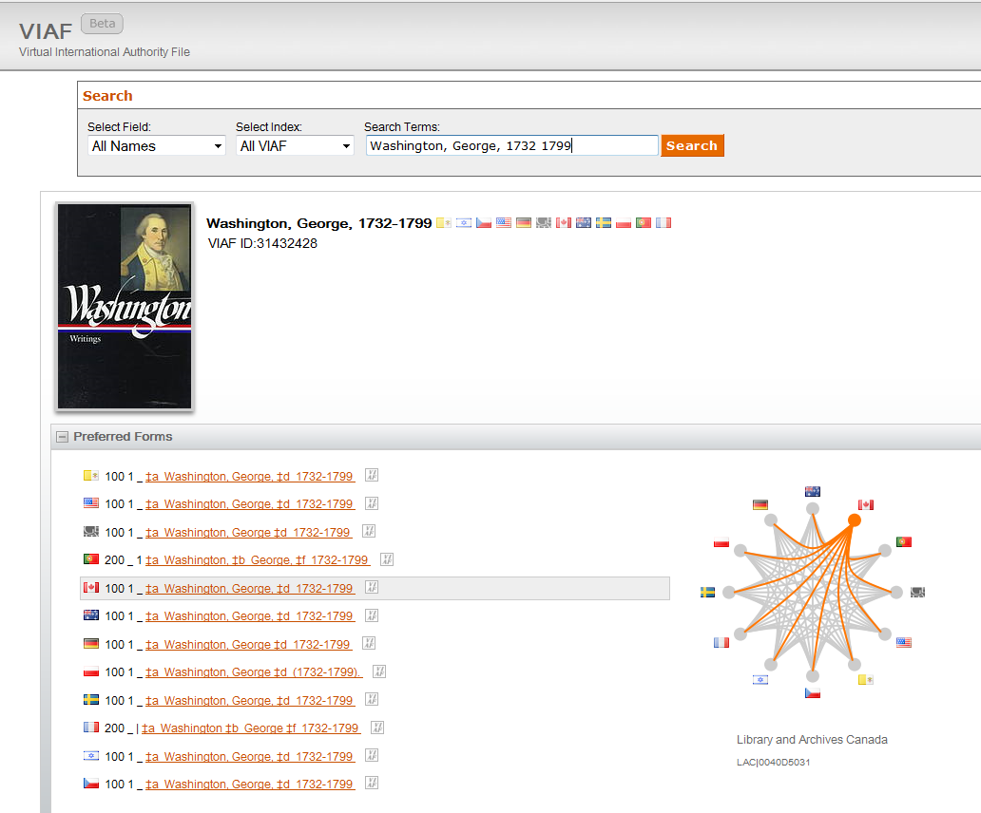
Classification & Controlled Vocabularies
Classify [leveraging WC to support classification assignment]
FAST [LCSH into machine-friendly facets]
Terminology Services [BISAC, MeSH, more vocabs rendered for machines]
VIAF [one file from many national authority files]

Slide 8
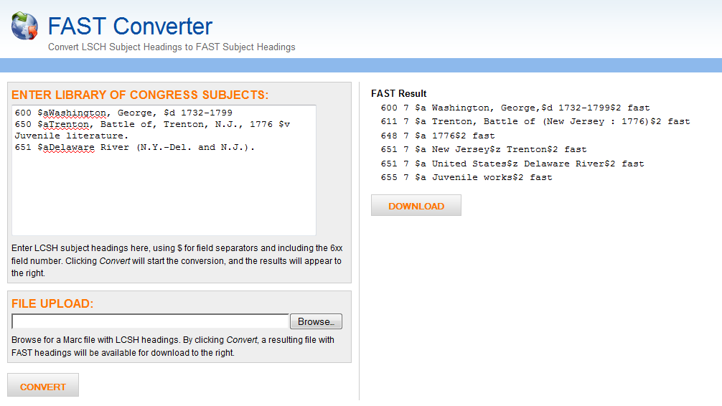
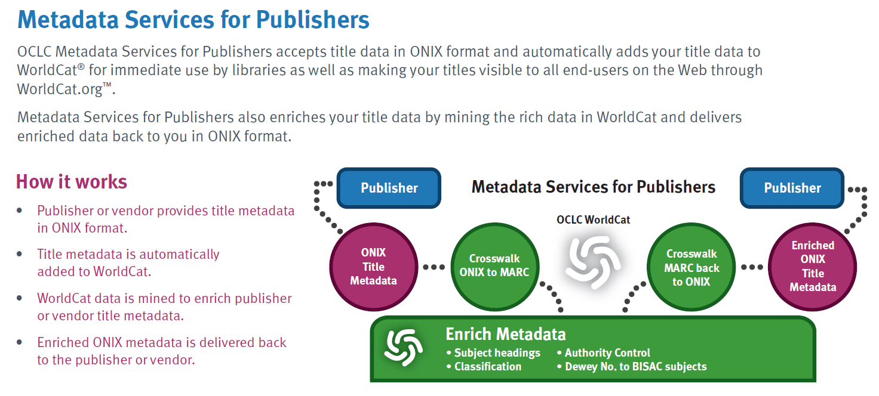
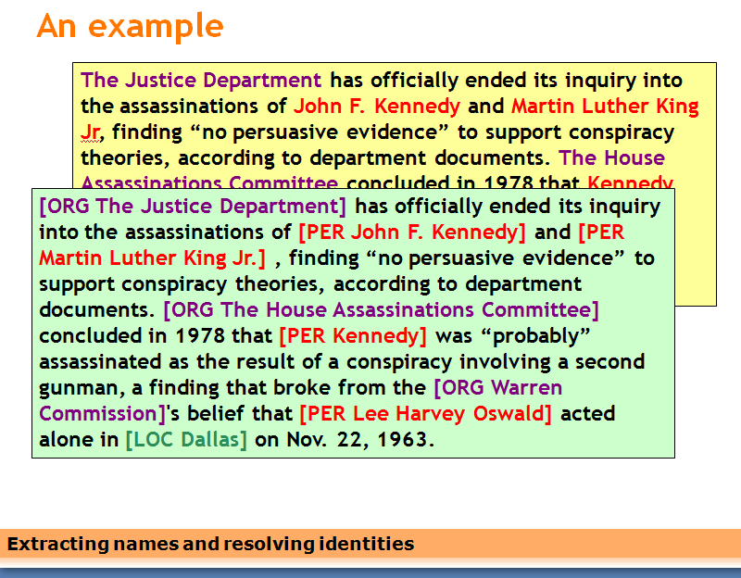
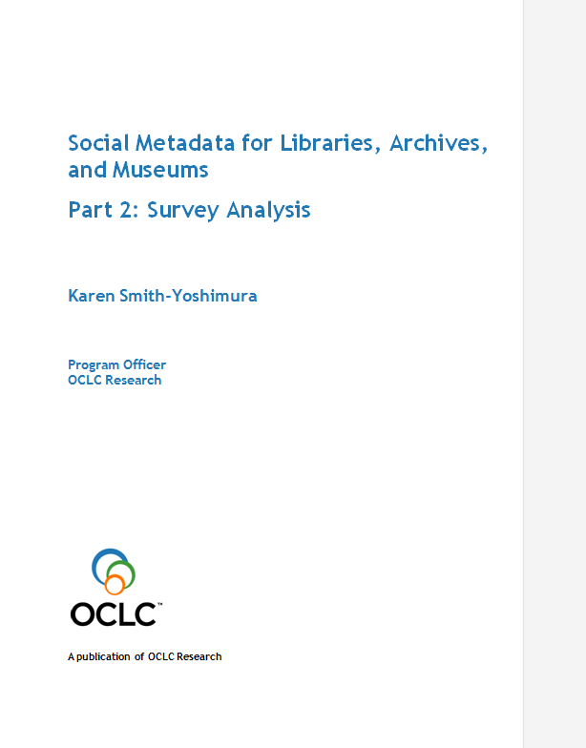
Tools and Processes
FAST Converter [demo tool for LCSH-to-FAST conversion]
Metadata Schema Transformation Services [metadata crosswalking]
Name Extraction [pulling names from text]
Sharing and Aggregating Social Metadata [exploring crowdsourcing]

Slide 9
Works-based and Other Special Views
MapFAST [About-place titles shown on a map]
Work Records in WorldCat [1 rich page per work]
WorldCat Genres [1 rich page per genre]
WorldCat Identities [1 rich page per person/corporate body/fictional character]
WorldCat Publisher Pages [1 rich page per publisher]

Slide 10
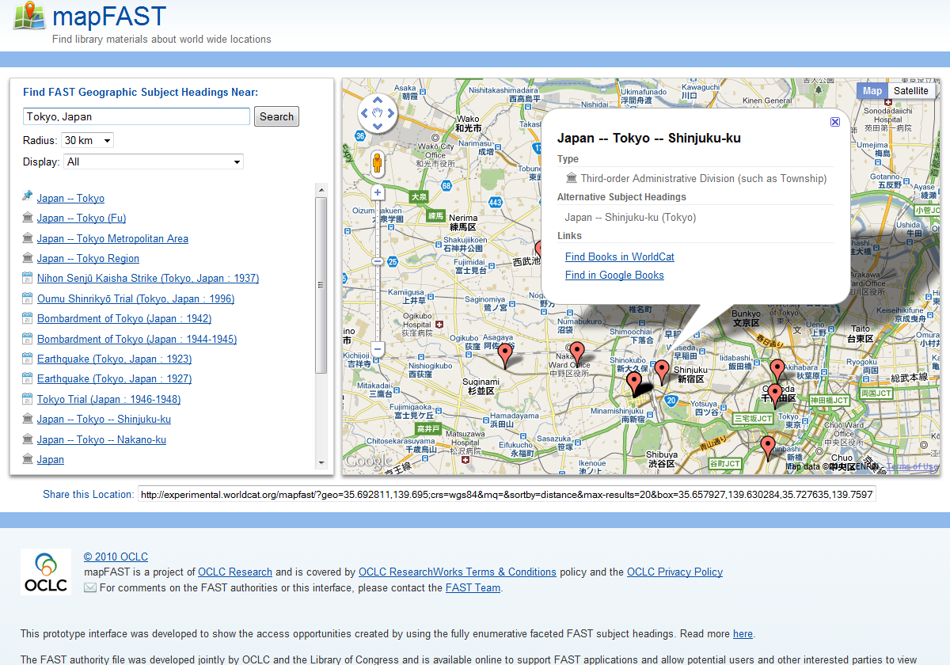
mapFAST

Slide 11
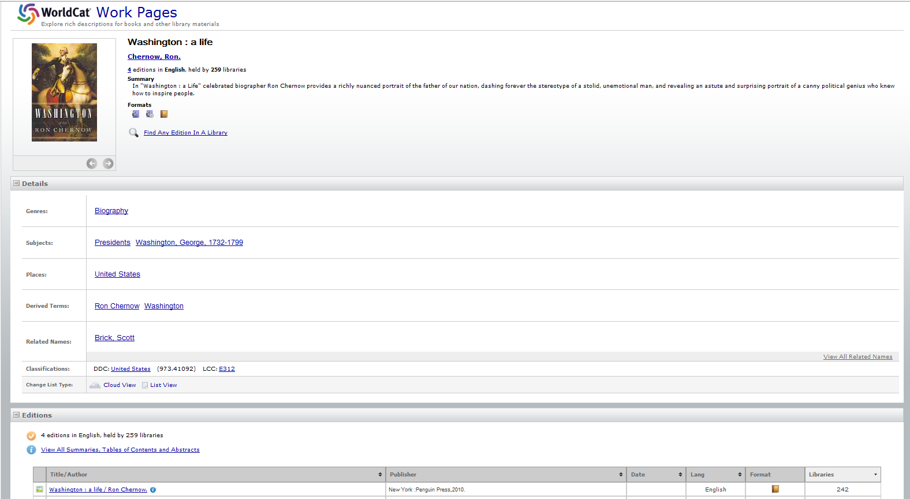
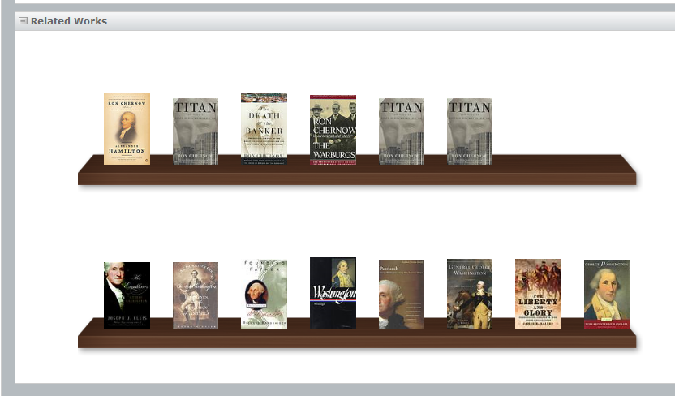
Work Records in WorldCat

Slide 12
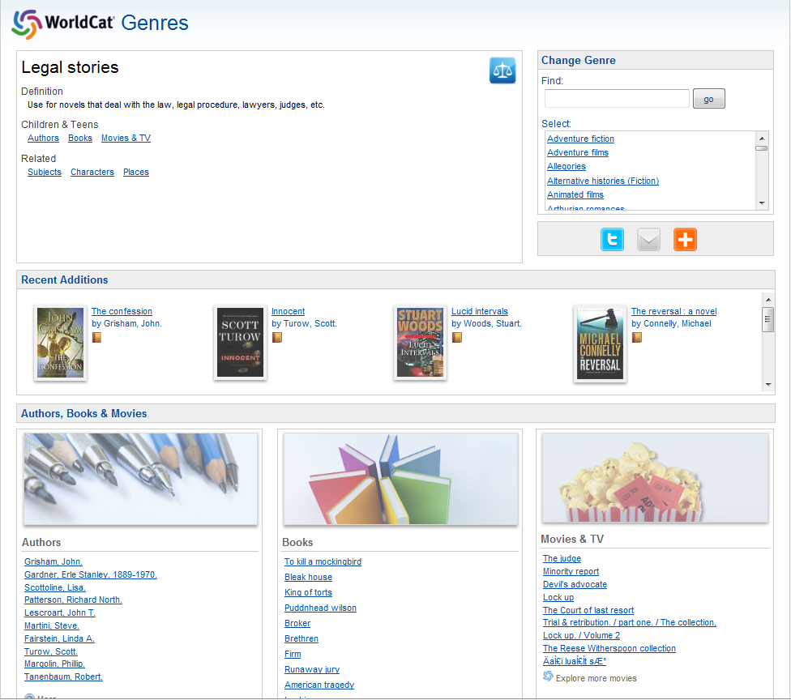
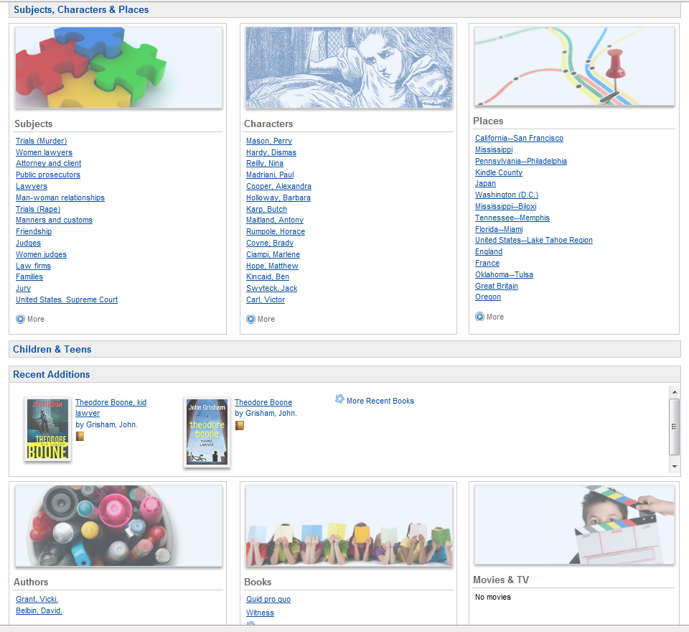
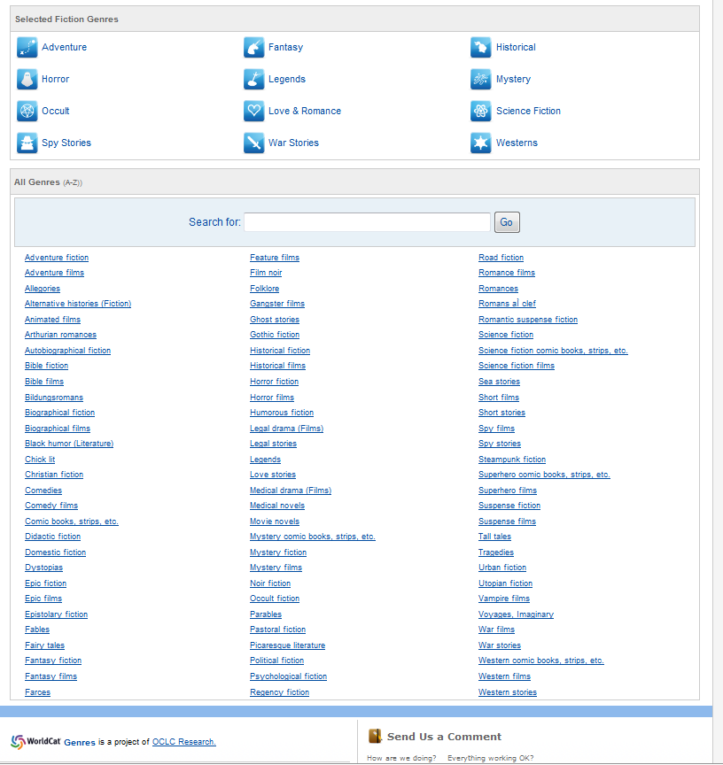
WorldCat Genres

Slide 13
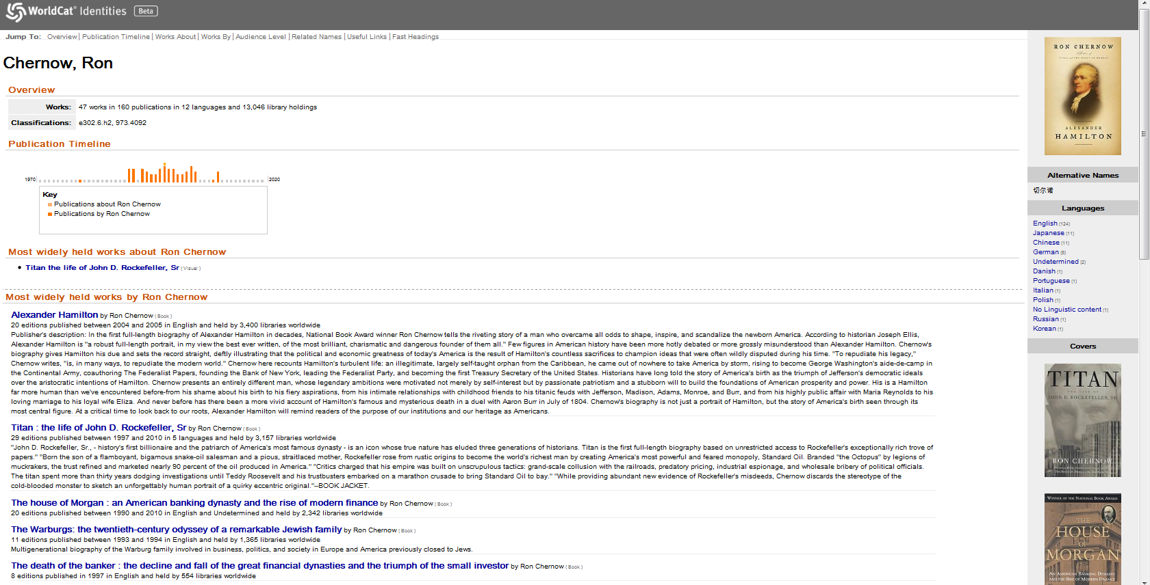
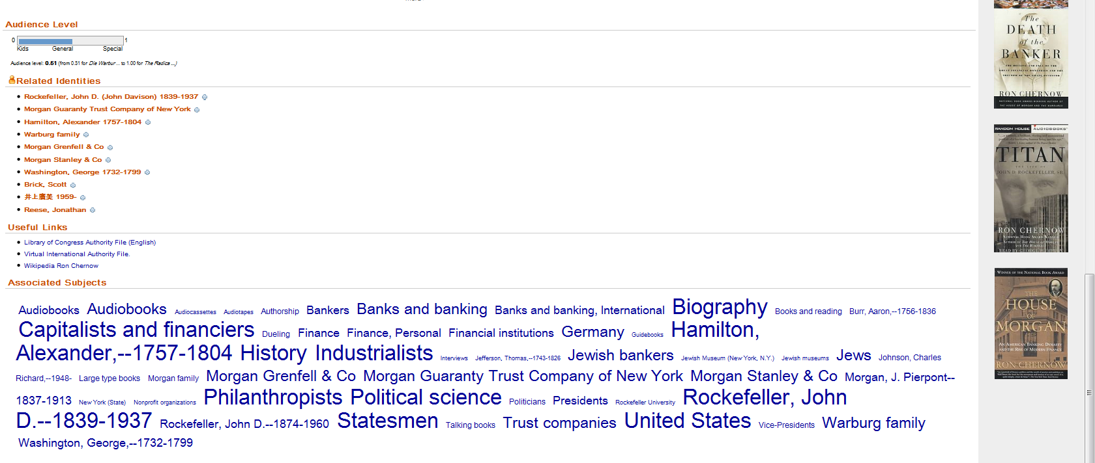
WorldCat Identities
…

Slide 14
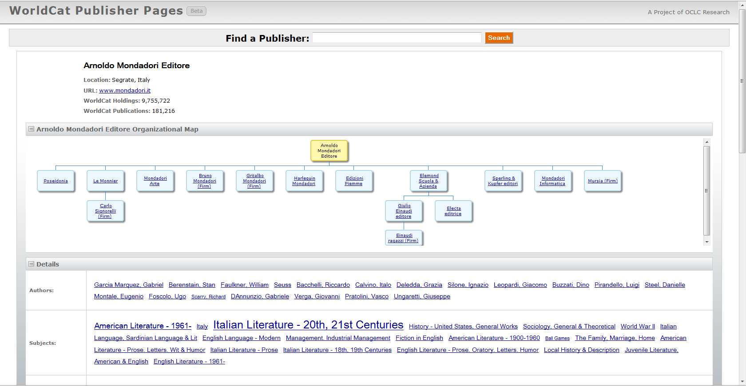
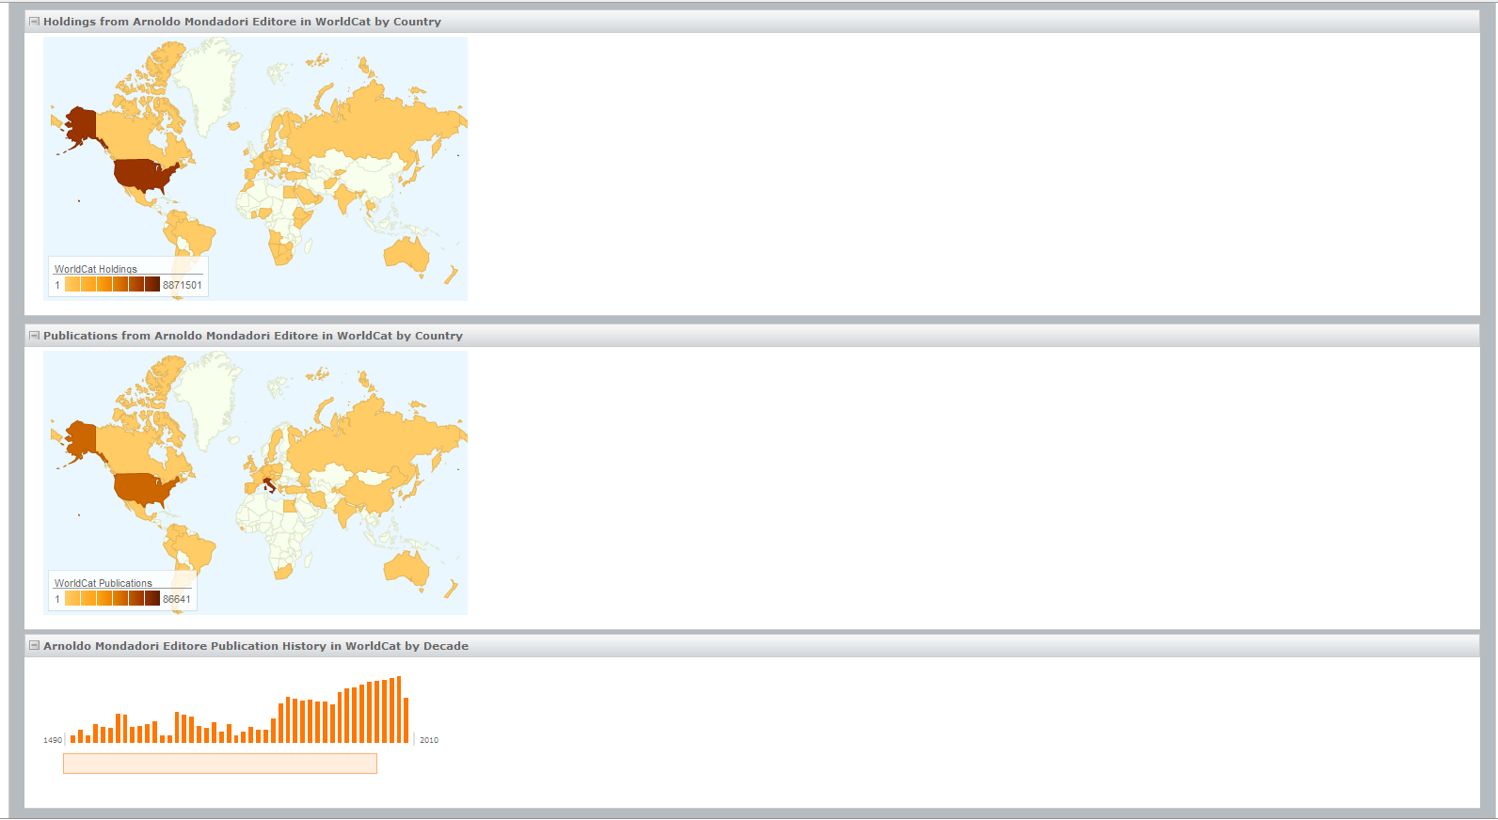
WorldCat Publisher Pages

Slide 15
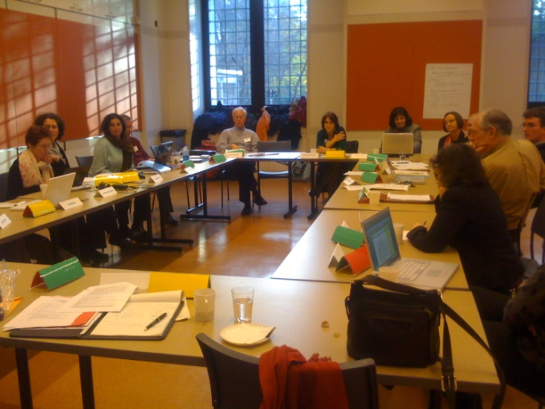
Networking Names
Basis:
Networking Names Advisory Group developed use case scenarios and defined attributes of a “cooperative Identities Hub” (2009)
Reflected in EAC-CPF, NISO’s Institutional Identifiers, UK’s Names Project, WC Identities, VIAF

Slide 16
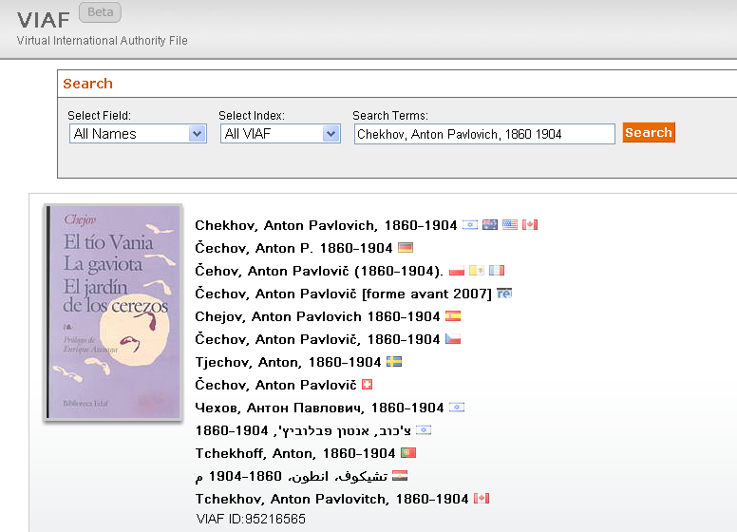
One persona, many representations …
http://viaf.org/viaf/95216565
Notes:
VIAF is all about creating links between existing files of names. The result is a VIAF record that shows information derived from the cluster of linked name records and associated bibliographic records. Here we see the “preferred form” of name from each of the sources.

Slide 17
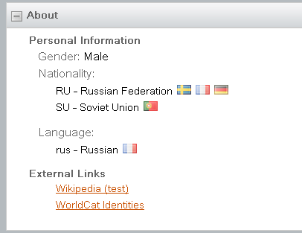
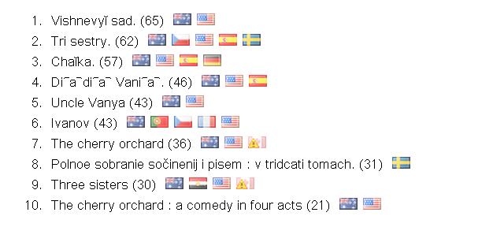
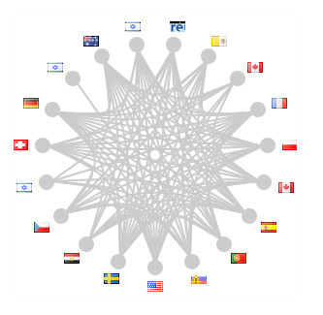
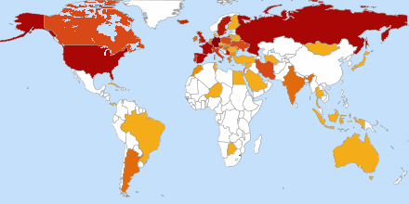
Notes:
The compilation of information from different countries in one place yields quite a bit of information about the names and enables some quite interesting displays. The “about” information allows for multiple nationalities and links to both Wikipedia and WorldCat Identities. We also support exporting VIAF records in Resource Description Framework (RDF) to link different Web resources (the links themselves are described with URLs.)

Slide 18
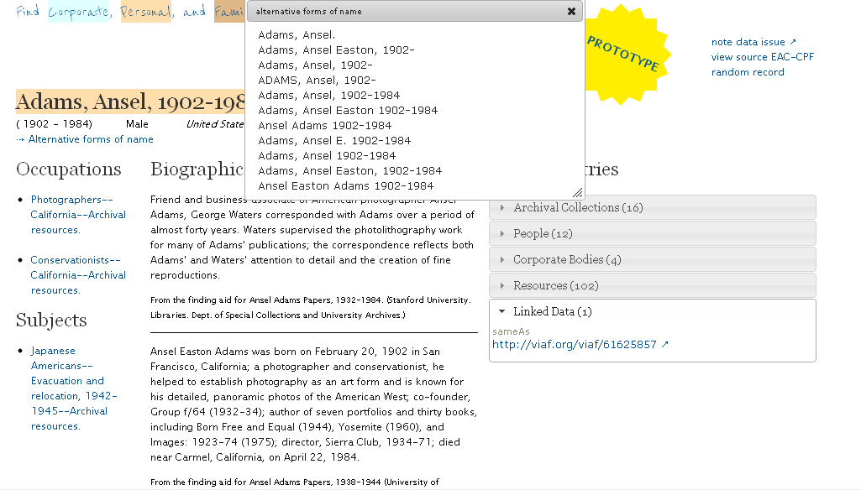
Social Networks and Archival Context
socialarchive.iath.virginia.edu/xtf/search
Notes:
From the SNAC project description at: http://socialarchive.iath.virginia.edu/index.html
The Social Networks and Archival Context Project (SNAC) will address the ongoing challenge of transforming description of and improving access to primary humanities resources through the use of advanced technologies. The project will test the feasibility of using existing archival descriptions in new ways…Archivists have a long history of describing the people who—acting individually, in families, or in formally organized groups—create and collect primary sources. They research and describe the people who create and are represented in the materials comprising our shared cultural legacy. However, because archivists have traditionally described records and their creators together, this information is tied to specific resources and institutions. Currently there is no system in place that aggregates and interrelates those descriptions. Leveraging the new standard Encoded Archival Context-Corporate Bodies, Persons, and Families (EAC-CPF), the SNAC Project will use digital technology to “unlock” descriptions of people from finding aids and link them together in exciting new ways. We will:
Create efficient open-source tools that allow archivists to separate the process of describing people from that of records.
Create a prototype integrated historical resource and access system that will link descriptions of people to one another and to descriptions of resources in archives, libraries and museums; online biographical and historical databases; and other diverse resources.
Note that two members of the EAC-CPF working group also served on the RLG Partners Networking Names Working Group.
Here’s an example of one of the SNAC records. It includes a short biographical history extracted from an archival finding aid. Note that it links to VIAF, and alternate names come from those in the VIAF record.

Slide 19
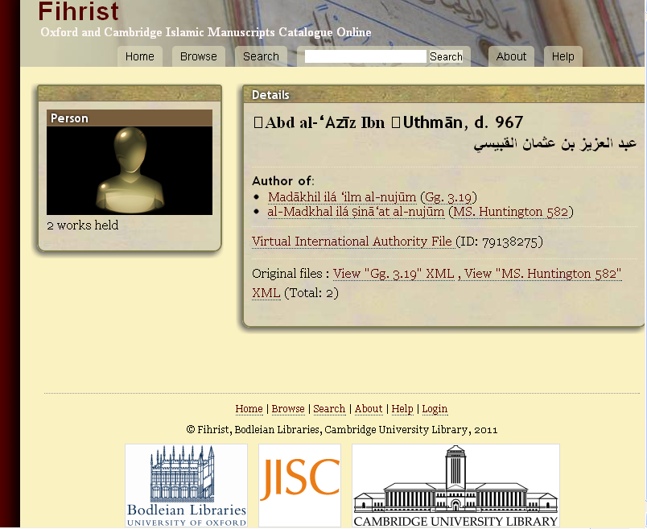
http://www.fihrist.org.uk/
Notes:
The Fihrist catalog of Arabic manuscripts created by the Universities of Oxford and Cambridge and funded by JISC was released just this March and also includes links to VIAF records where there are personal name matches.

Slide 20
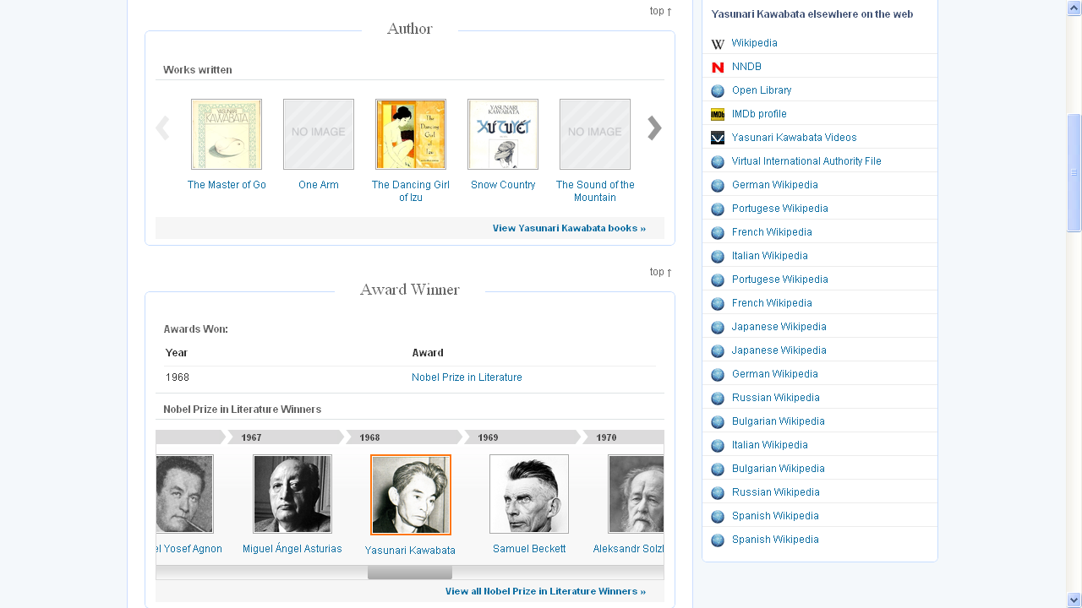
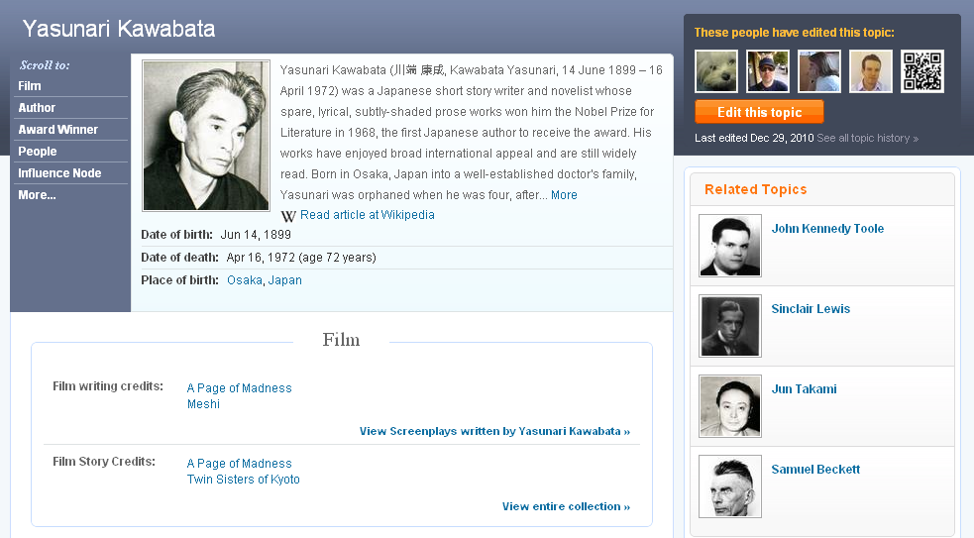
Freebase also uses Linked Data
freebase.com
Notes:
From What is Freebase? http://wiki.freebase.com/wiki/What_is_Freebase%3F
Freebase is an open, Creative Commons licensed repository of structured data of over 20 million entities. Each one has a unique Id, which can help distinguish multiple entities which have similar names, such as Henry Ford the industrialist vs Henry Ford the footballer. All the data contained in Freebase is licensed by a Creative Commons Attribution License (aka CC-BY), which means that it's free for you to browse, query, copy, and even use the data in your own systems or software, even for commercial use; all we ask in return is that you mention that your product, service or even just a little chart uses Freebase data (see attribution)
From the FAQ http://wiki.freebase.com/wiki/FAQ
Freebase is part of the Semantic Web. We emit Linked Open Data (via RDF) for all our entities…Initially, Freebase was seeded by pulling in information from a large number of high-quality open data sources, such as Wikipedia, MusicBrainz, and others.
The Freebase community are data contributors, schema builders, data curators, application developers, and many others who use Freebase.

Slide 21
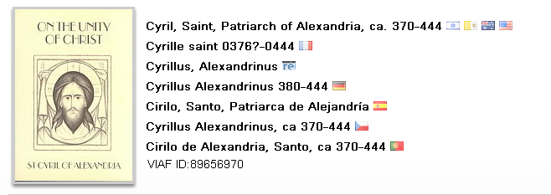
Networking Names
ܩܕܝܫܐ ܩܘܪܝܠܘܣ ܦܛܪܝܪܟܐ ܕܐܠܟܣܢܕܪܝܐ
Looking forward:
Extensible VIAF: Pilot with Syriac studies scholars to edit and add Syriac-script names to VIAF

Slide 22
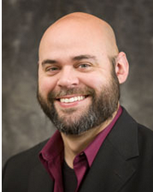
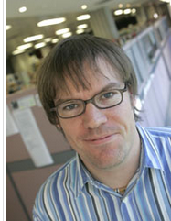
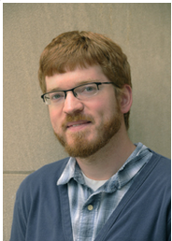
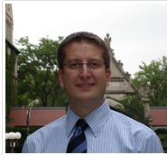
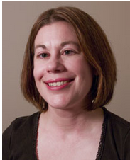
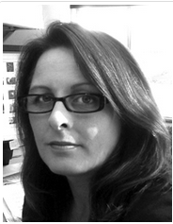
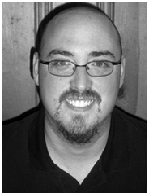
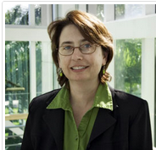
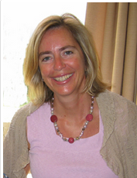
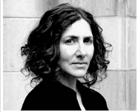
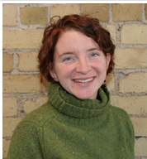
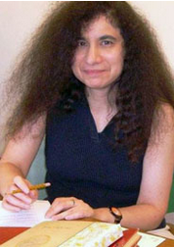
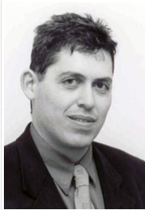
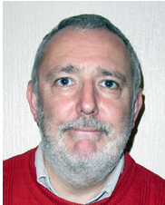
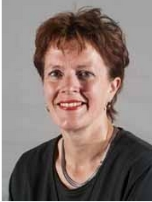
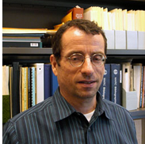
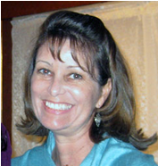
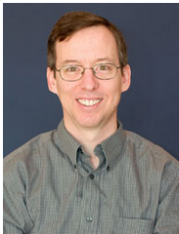
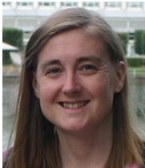
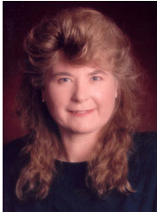

Social Metadata
21-member working group from five countries
Identify success factors for tapping user contributions to augment and provide context to metadata created by libraries, archives, and museums
Reviewed 76 sites supporting social metadata; analyzed responses from 46 site managers to a survey

Slide 23




Some recommendations
Differentiate creating communities around your organization and around your collections.
Leverage users’ enthusiasm to contribute.
Consider the trade-offs in using third-party hosted sites.
Notes:
These are three of the eighteen recommendations that are in the working group’s third report. Cultural heritage organizations have been using social media for public relations and it’s important to establish objectives for creating communities around collections. The Historic Australian Newspapers, a component of the National Library of Australia’s Trove service, is one of the most successful examples of leveraging users’ enthusiasm: more than 30 million lines of OCR’d text have been corrected by volunteers. A number of respondents to our survey use Flickr to reach out to new constituencies and enrich the descriptions they had of their images. Here, the National Library of New Zealand’s early photo of a glazier attracted a view of the same glacier 60 years later, documenting its shrinkage.

Slide 24
Metadata Support and Management
Resourcing: Trends and patterns
Help define future research services
System-wide efficiencies in library management
Services where library users are
Classification & Controlled Vocabularies
Tools and Processes
Crowdsourcing and Collaboration
Works-based and Other Special Views
What would you like OCLC Research and the OCLC Research Library Partnership do next?

