Slide 1
It’s not about digitising special collections, stupid, it’s about research
Kurt De Belder
University Librarian
Director Leiden University Libraries & Leiden University Press
Moving the Past into the Future: Special Collections in a Digital Age
2010 RLG Partnership European Meeting, St-Anne’s College, Oxford University, 12-13 October 2010

Slide 2
Digitisation of special collections (#1)
What do our digitisation projects/programs usually deliver?
Digital images with metadata (incl. EAD records) on a static website, and in the best circumstances the metadata is harvested through aggregators.
What is the value of making special collections available this way?
  Visibility.
  Identification & accessibility.
  Availability 24/7 and beyond library walls.
What perspective on research practice is implied by this approach?
  The scholar does research by reading source materials.

Slide 3
Digitisation of special collections (#2)
Do large, searchable corpora such as EEBO (Early English Books Online), ECCO (Eighteenth Century Collections Online) and Google Books reflect a change in research practice?
Yes
  Testing hypotheses against a body of texts (even unknown ones)
  Q&A that before were almost impossible to pose & obtain
  Increase in speed of research
  Reproducibility of research results

Slide 4
Digitisation of special collections (#2)
Do large, searchable corpora such as EEBO (Early English Books Online), ECCO (Eighteenth Century Collections Online) and Google Books reflect a change in research practice?
But
  Translating concepts/ideas into words (history of ideas)
  Static/fixed environment
    No additions, corrections, enrichment by scholar
    No ‘massaging’ of the data
    Limited tool kit
    One state of the corpus for all disciplines

Slide 5
Digitisation of special collections (#2)
Keith Baker, Inventing the French Revolution
history of ideas / analysis of concepts such as ‘opinion publique’
used the ARTFL database

Slide 6
le citoyen
les gens
le public
le peuple
l’opinion
l’homme sans caractère
l’insecurité
le désordre
anarchie
l’excès
terreurs
le fanatisme
l’anarchie judiciaire

Slide 7
le citoyen
les gens
le public
le peuple
l’opinion
l’opinion publique
l’homme sans caractère
les gens d’esprit
la confiance publique
l’insecurité
les raisons publiques
le désordre
les lois
l’esprit
anarchie
l’excès
l’authorité
terreurs
le désir anonyme de la nation
le fanatisme
l’ordre
l’anarchie judiciaire
lumières sociales

Slide 8
le citoyen
les gens
le public
le peuple
l’opinion
l’opinion publique
l’homme sans caractère
les gens d’esprit
la confiance publique
l’insecurité
les raisons publiques
le désordre
les lois
l’esprit
anarchie
l’excès
l’authorité
terreurs
le désir anonyme de la nation
le fanatisme
l’ordre
l’anarchie judiciaire
lumières sociales
1700
1740
1780
1720
1760
1800

Slide 9
Digitisation of special collections (#2)
The text corpus
"was enormously useful in identifying occurrences of opinion publique in the database for further analysis, in suggesting a tentative chronology for the usage of the term in eighteenth-century France, and in illustrating the traditional associations of opinion with uncertainty, instability, and disorder -- associations that were rapidly changed when mere opinion was transformed (as it was during the third quarter of the eighteenth century) into the rational authority of opinion publique, the new tribunal to which all political actors were compelled to appeal."
Keith Michael Baker about the use of a digital text corpus for his book Inventing the French Revolution (Cambridge UP, 1990)

Slide 10
Characteristics of humanities research
From research project to research programme
From the individual scholar to a group of researchers who are collaborating
From discipline oriented to multi-disciplinary research

Slide 11
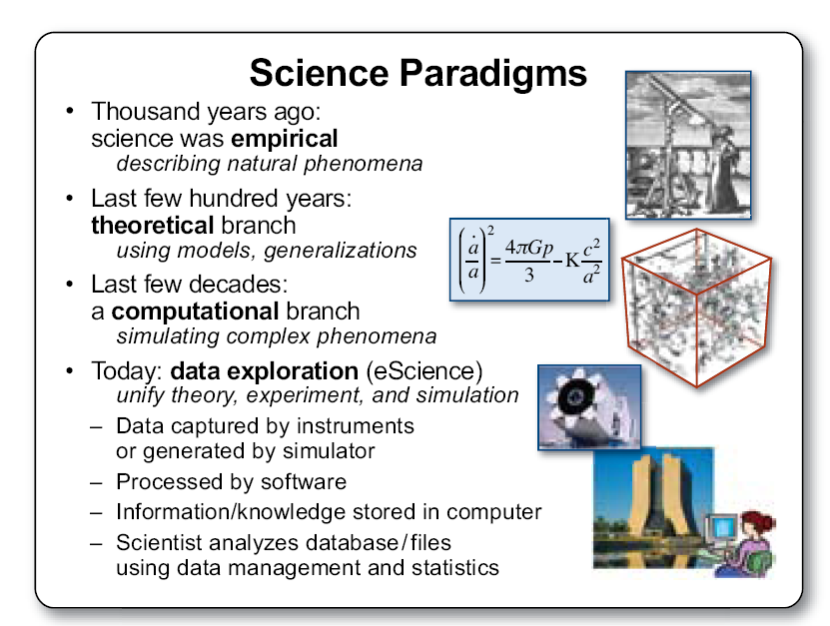
Science paradigms (Jim Gray)
The Fourth Paradigm: Data-Intensive Scientific Discovery, 2009, p. xx

Slide 12
Characteristics of humanities research
From research project to research programme
From the individual scholar to a group of researchers who are collaborating
From discipline oriented to multi-disciplinary research
From the text as book to the text as corpus/database
From the scholar as reader to the computer as reader

Slide 13
Computational or e-humanities
Vasts amount of date are of limited value
  if data mining technologies are not available
  if access is limited
  if the knowledge infrastructure does not exist to create new knowledge from data

Slide 14
Computational or e-humanities
Application in humanities:
  pattern recognition
  sequence analysis in text and historical data
  modelling and simulation
  development of algorithms and the presentation of the results in images and sound
It also includes innovative ways of data acquisition, validation, storage, documentation (annotation), processing and dissemination.

Slide 15
Jim Michalko/Nick Poole debate *
JM: digitise everything, if necessary “quantity wins from quality”
NP: digitise only what is worth while; digitisation-on-demand; cost-of-ownership is unsustainable
JM: access generates interest and use; “discovery happens elsewhere”
NP: access does not automatically lead to ‘value’
JM: digitisation leads to convergence of libraries, museums and archives
NP: museum objects, books and manuscripts are very different and pose different kind of demands
Dutch Digital Heritage Conference, Rotterdam, The Netherlands, December 12-13, 2008 - www.den.nl/docs/20071011154330

Slide 16
What about the research perspective?
Remember: debate in context of cultural heritage!
Digitising everything (JM) just to grant access doesn’t lead to the right type of access.
Applying market forces (NP) will not bring about the research possibilities that we need.

Slide 17
What about the research perspective?
If the possibility of innovative research is the value that is delivered by digitisation
  the traditional models of digitisation do not deliver
  the Google model is insufficient
    + Google’s business model runs counter to the demands of innovative research and digitisation.
    + The necessary investments to upgrade could not be recouped from the consumer market.

Slide 18
What about the research perspective?
NP: “The philosophy of mass-digitisation is based on the principle of the right to access
The right to access is based on a socialist view of public ownership of culture.”
No: the philosophy of mass-digitisation is based on the requirements of science/scholarship

Slide 19
What about the research perspective?
Quantity is essential
Don’t select (has indeed already been done)
Quality can be enhanced
Make tools available for data enrichment, correction, manipulation, mashing, mining, etc.
Make the ‘bare’ data available for scholars.
BTW this is another laboratory just like the Large Hadron Collider

Slide 20
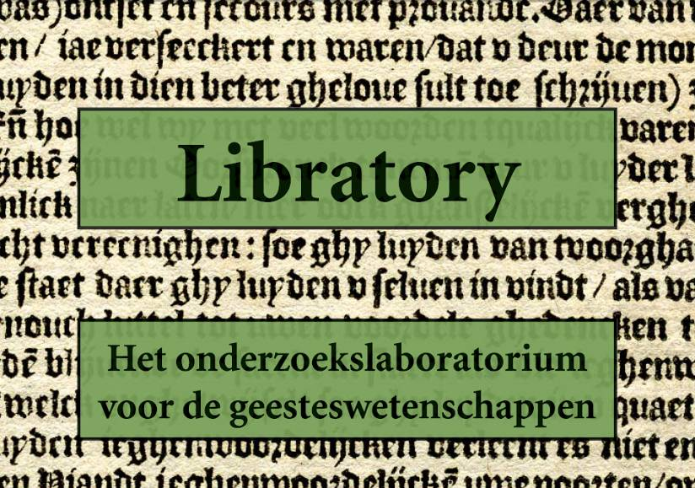
Digitisation of special collections (#3)

Slide 21






Libratory
Libratory: a research laboratory for the humanities
An initiative of:

Slide 22
Three pillars of Libratory
Strives towards a complete corpus based on the special collections of Dutch libraries.
Tools and services that allow for complex searching (e.g. text mining) and results of which can be stored and processed.
Digital work environment for scholars where data can be managed, edited, annotated and results can be shared.

Slide 23
Premises
National project
Enrichment and contextualization by scholars
Machine readable texts/data besides images
Not a static website but interactive web services
Public financing

Slide 24
Content of Libratory
Supply side
  All works printed in the Netherlands up till 1840
  All medieval manuscripts in Dutch collections
Demand side (via digitization-on-demand)
  Other handwritten materials (such as archival materials, letters, manuscripts held in the Netherlands
  International special collections held in the Netherlands
EAD records of the important collections in the Netherlands

Slide 25
Libratory figures
44 million scans
Total costs: M€ 75 (M€ 4.8/yr x 15 yrs)
Structural costs after project: K€ 600/yr

Slide 26
Connections made
Libratory initiative
will collaborate with and serve as content provider for the
Computational Humanities Programme of the Royal Netherlands Academy of Arts and Sciences
and will be connected to the
national e-science infrastructure

Slide 27
Conclusions
It’s not about digitising special collections it’s about research
The research opportunities deliver value
Within this context quantity is essential
Prepare for innovative research and yes e-humanities is at this point still a premise
Collaborate with researchers
Make the connection with the emerging knowledge infrastructure

Slide 28
Thank you for your attention!
k.f.k.de.belder@library.leidenuniv.nl

