Slide 1

Advice for Time Travellers
Richard Ovenden Keeper of Special Collections and Associate Director, Bodleian Libraries

Slide 2
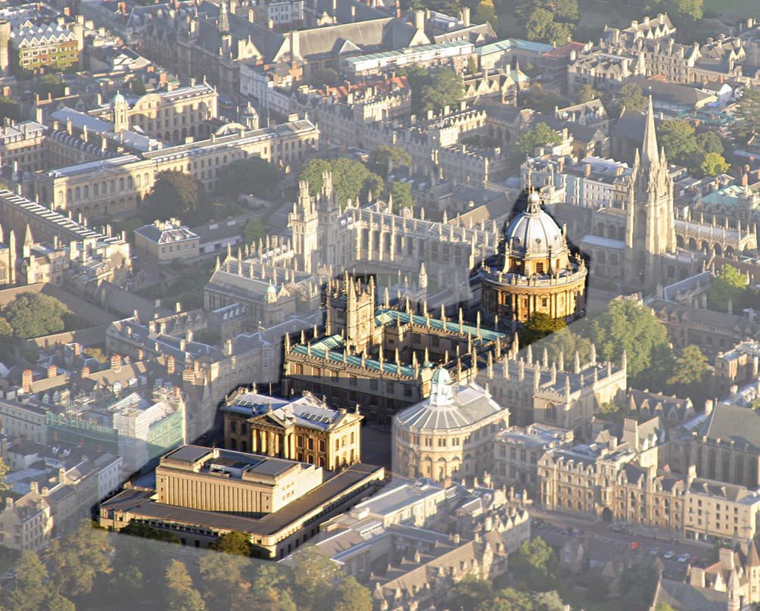

Slide 3
Summary
Content
Digital special collections
Back office versus front of house
Funding
Legal issues
Collaboration and competition

Slide 4
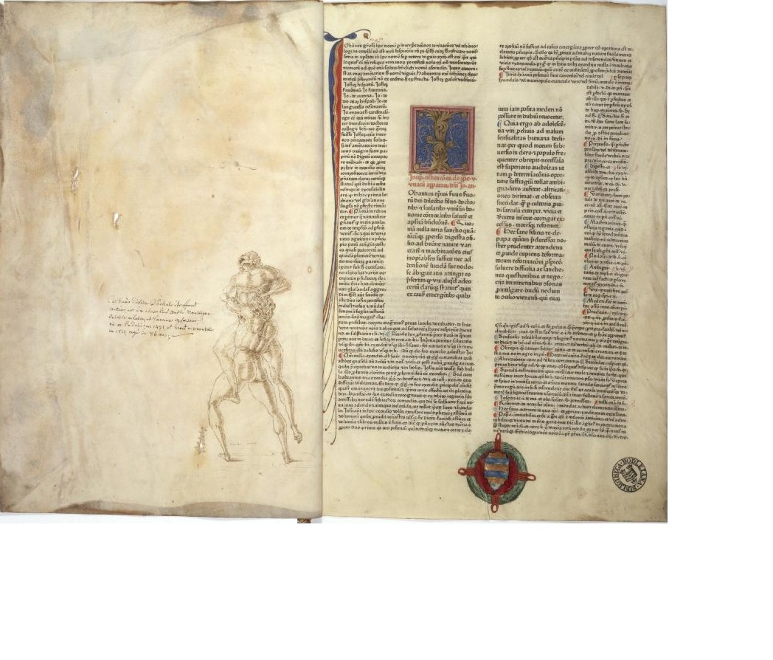
Content
Re-examine traditional rare book collecting
Look for uniqueness?
The scruffy can be more interesting than the beautiful

Slide 5
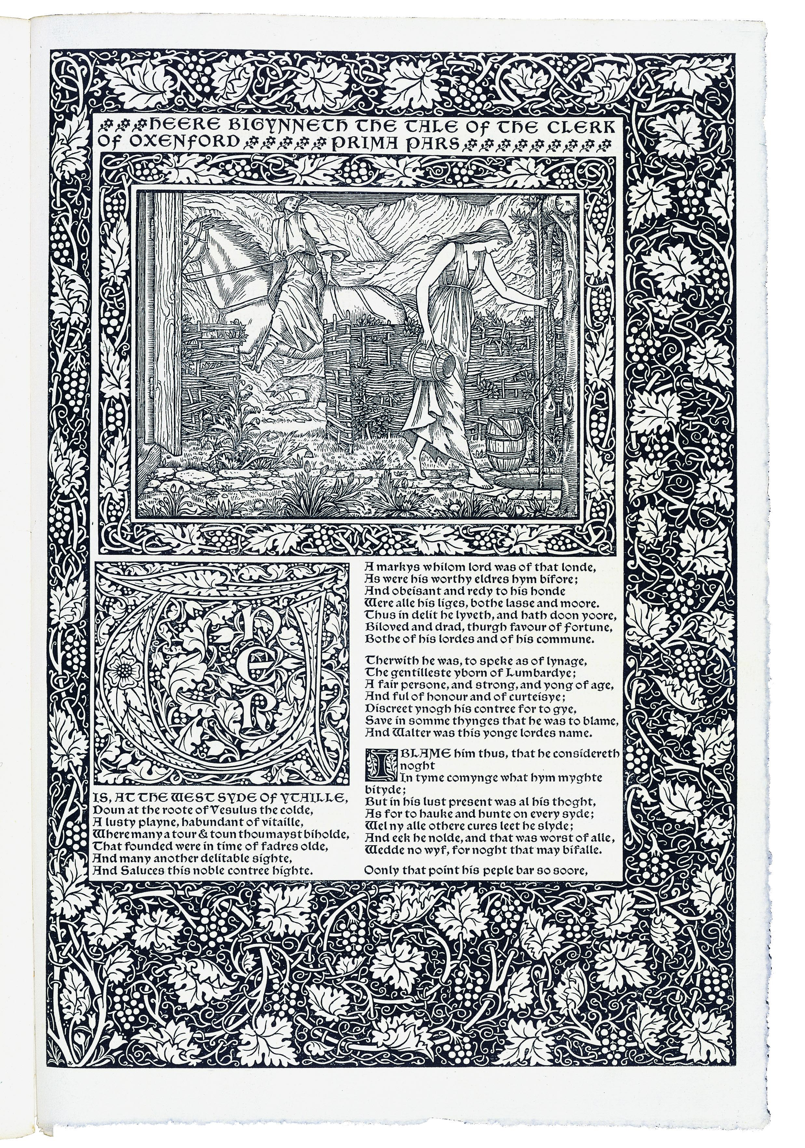

Slide 6
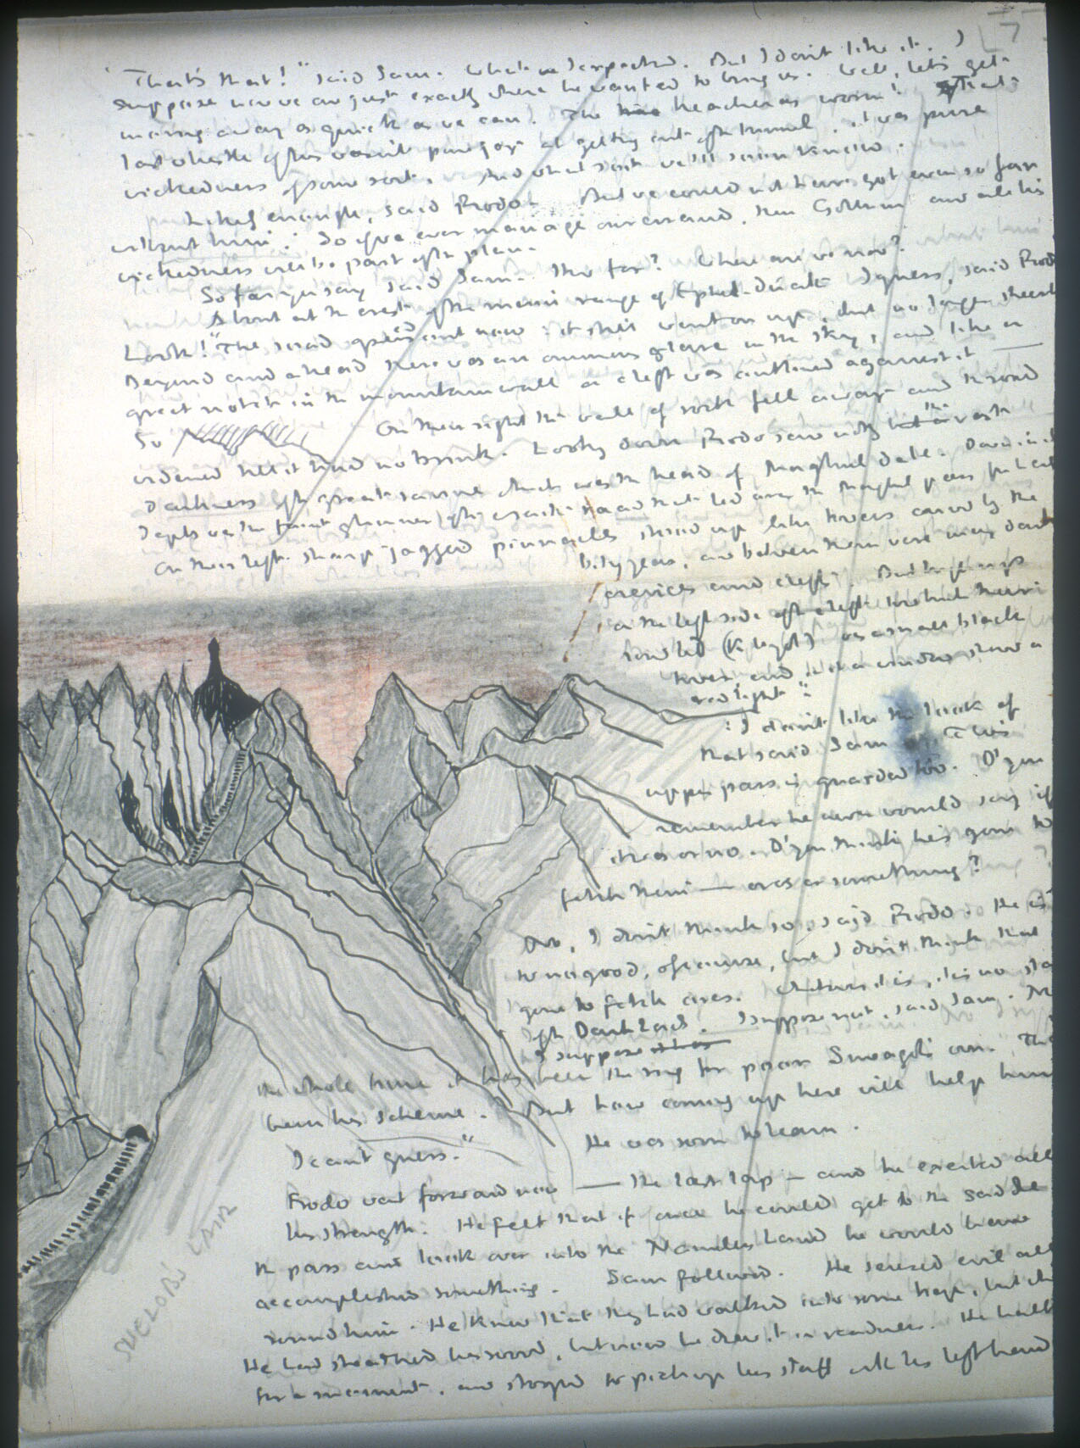

Slide 7
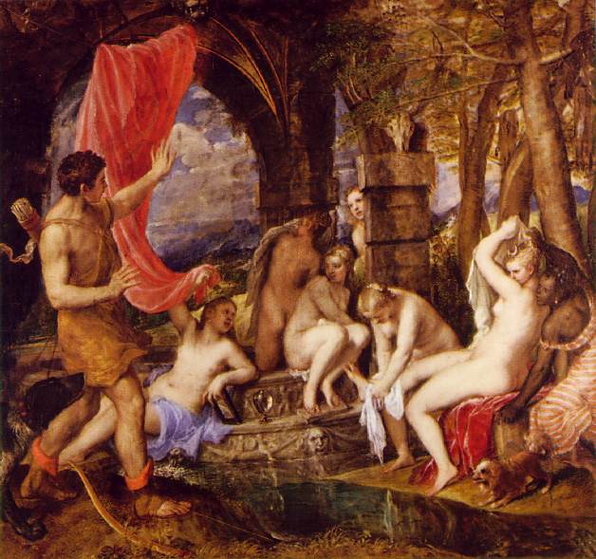
Content
Collect beyond the book
  Archives
  Ephemera
  Visual materials
Share collections?
  Titian
  Three Graces

Slide 8


Slide 9
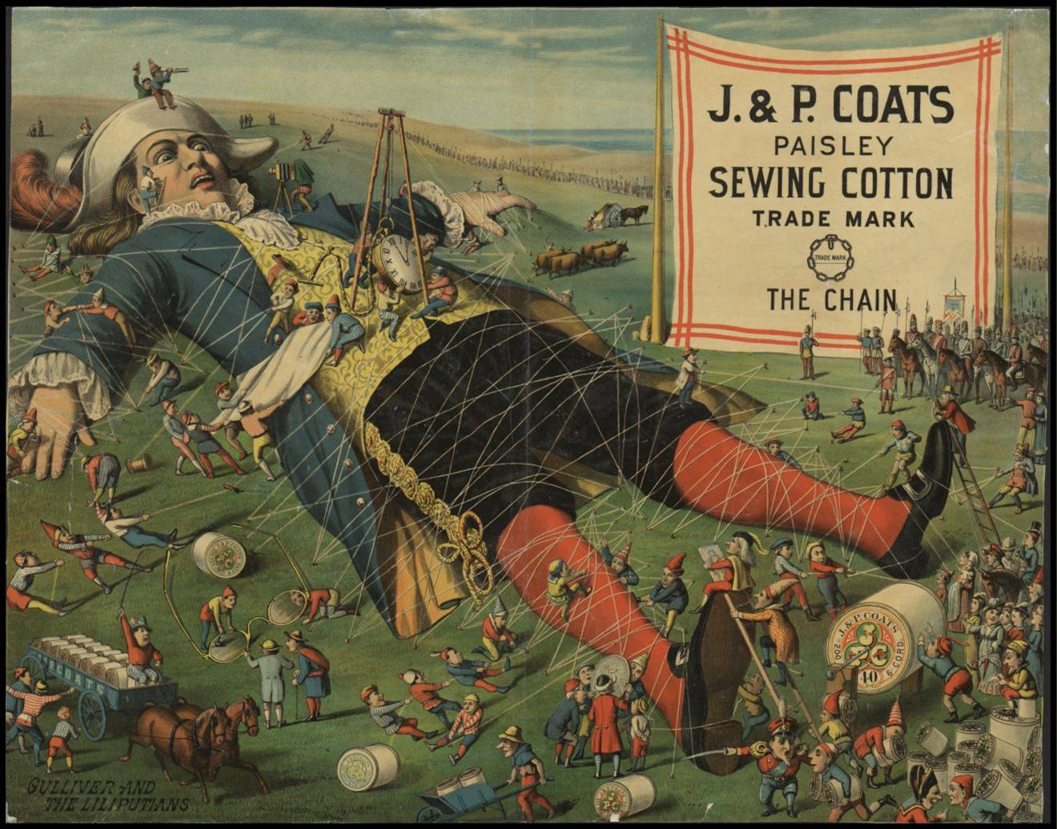

Slide 10
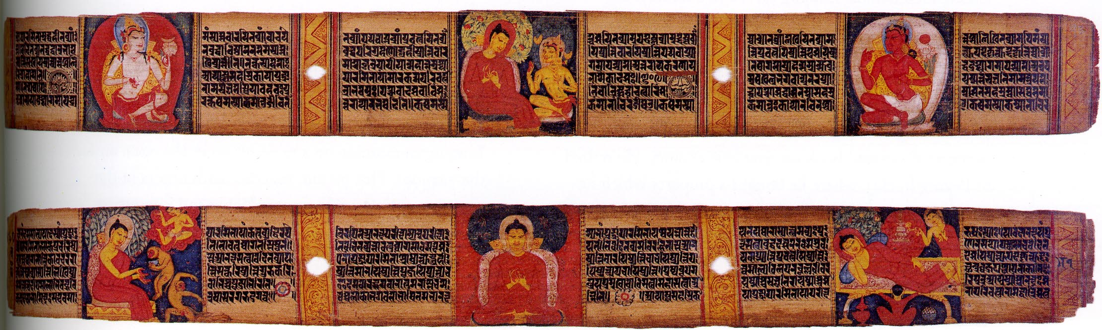

Slide 11
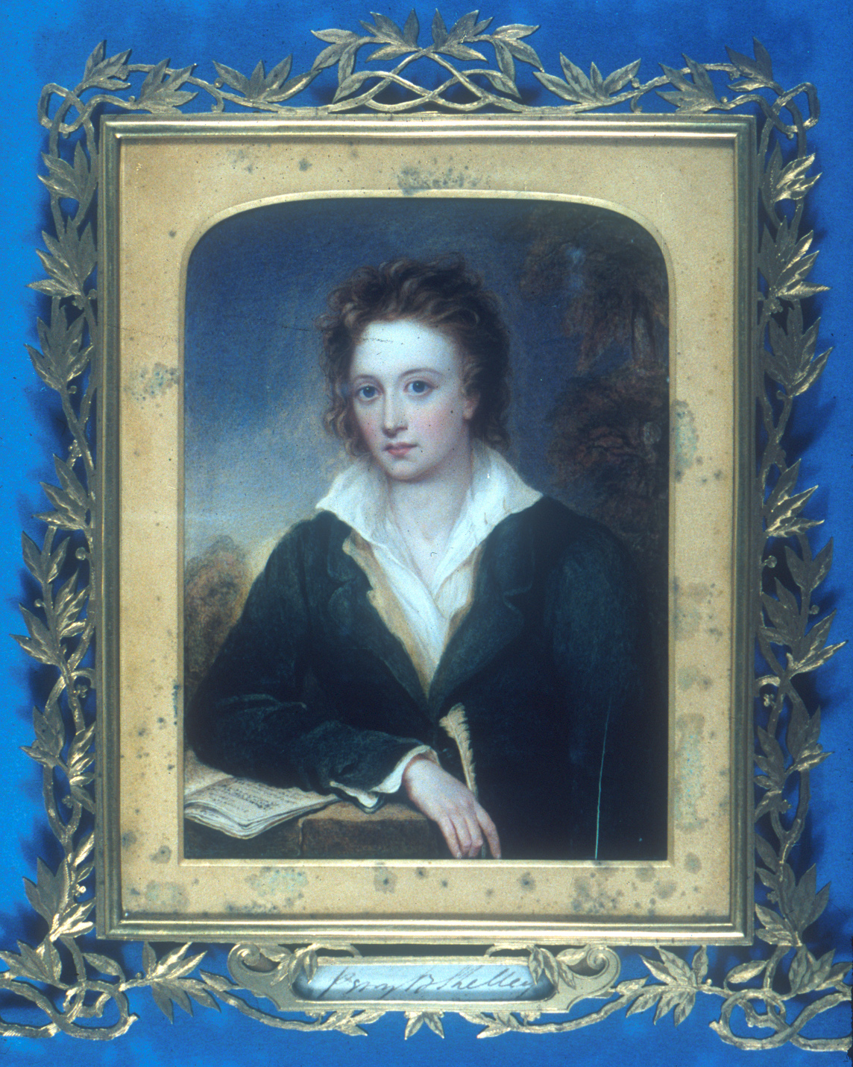

Slide 12
Digitization
Find the right business model(s)
Work at scale
Develop partnerships
Bodleian:
  Now over 150 million pages scanned
  Circa 1 million images
  Text encoding work: 35,000 works (3.3m pages) encoded in joint project with University of Michigan
  14 different international partnerships current

Slide 13
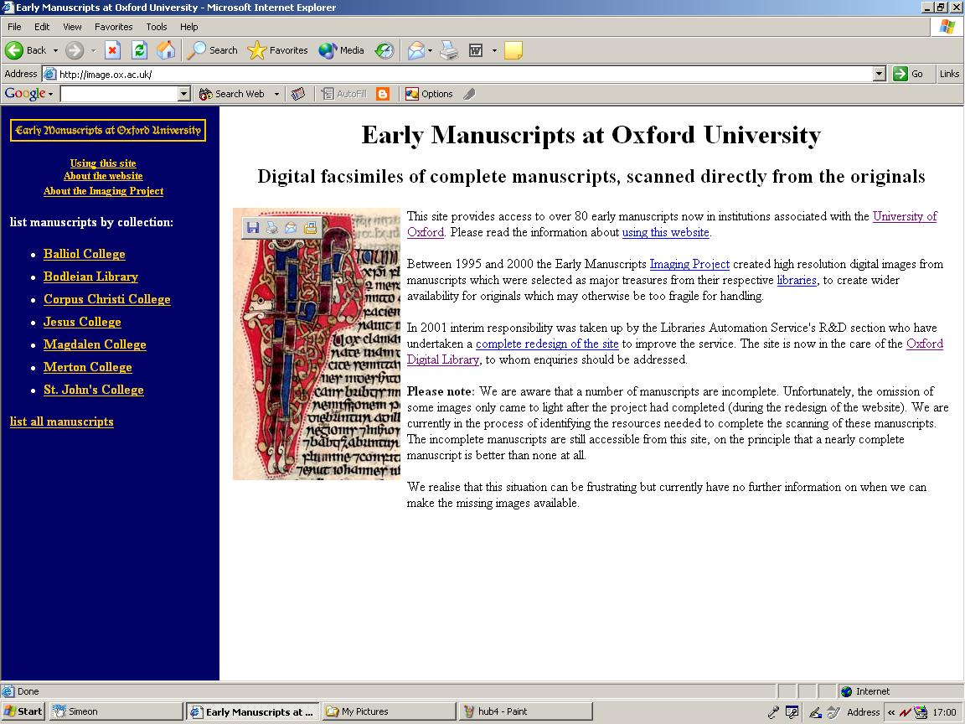

Slide 14
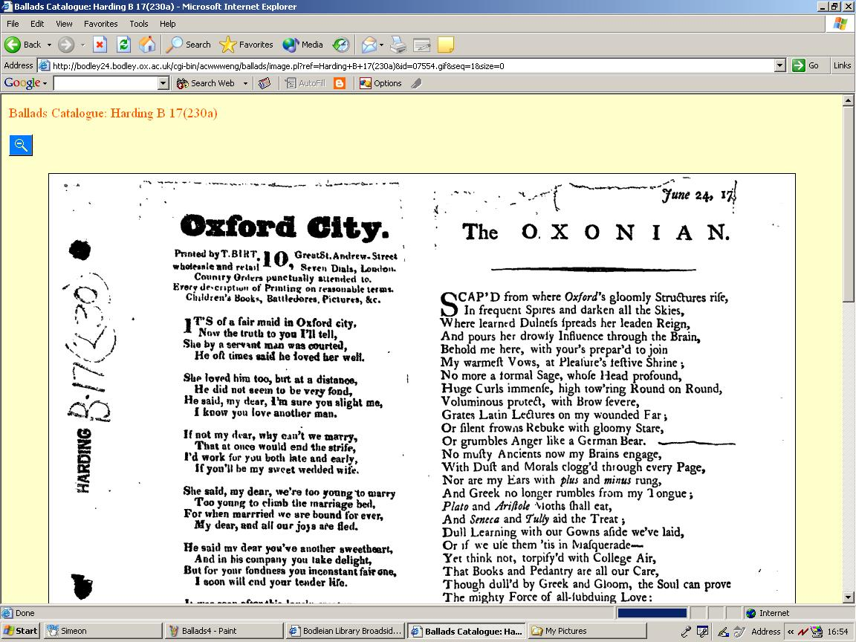

Slide 15



Slide 16
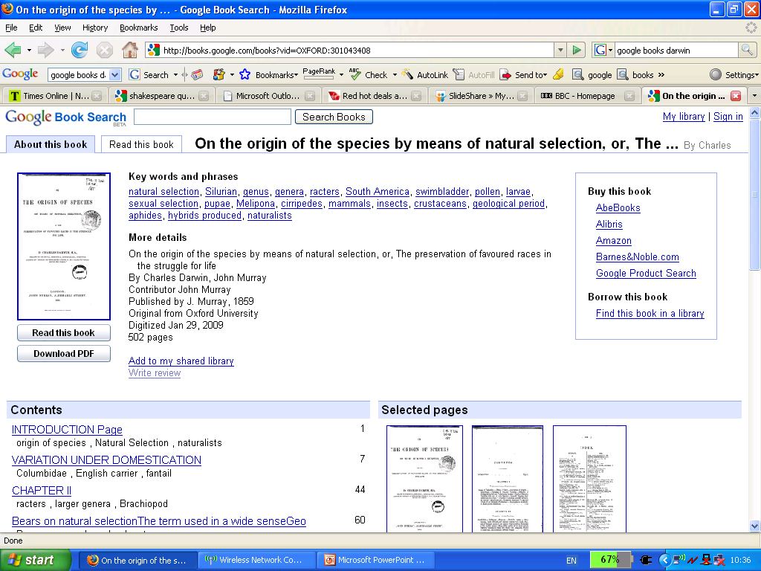

Slide 17
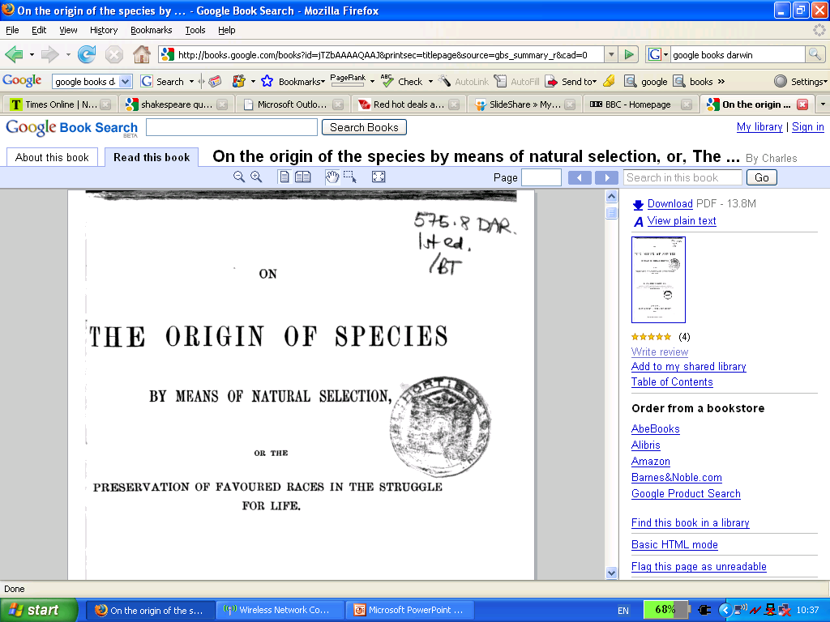

Slide 19
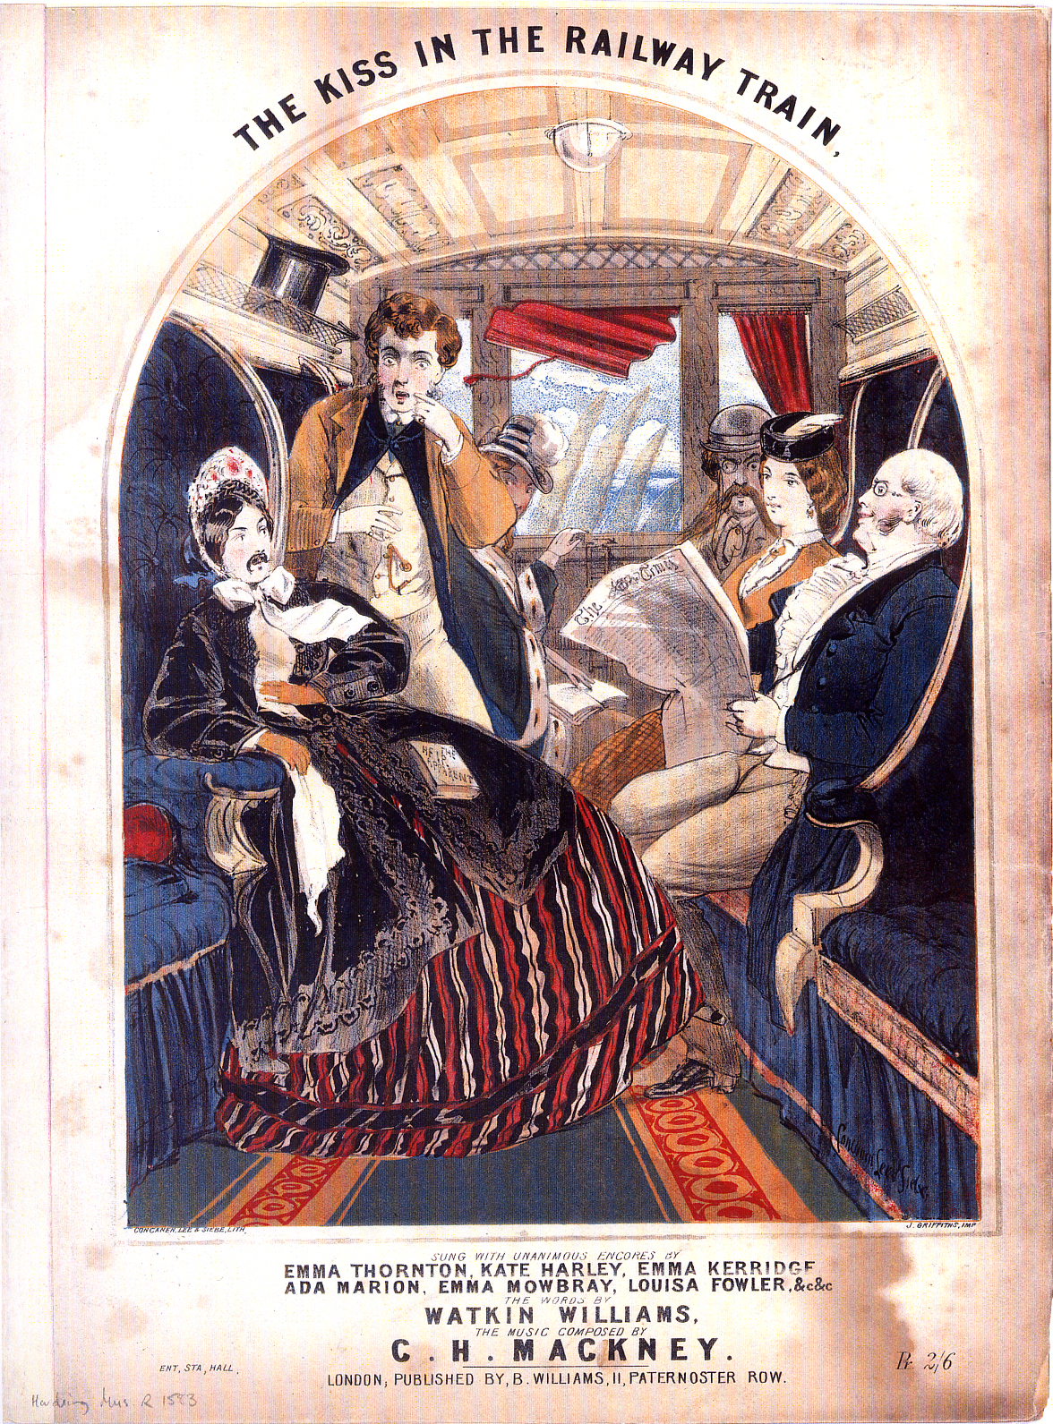

Slide 20
Digital Special Collections
Born digital special Collections will become increasingly important
Increased share of content of new manuscript and archival acquisitions
Require increased resources to cope: new technologies, new skill sets, a lot more work on legal issues

Slide 21
Digital special collections: pay serious attention
Bodleian a major repository of private papers
  Politics: 7 British Prime Ministers, etc
  Literature: Tolkien, Kafka, C S Lewis etc
  Intellectuals: Isaiah Berlin, Bruce Chatwin etc
  Organisations: Conservative Party, Anti-Apartheid Movement etc
Rapid growth in personal media capture: depth and breadth:
  Digital images, video, sound, personal digitization
  Standard ‘Office’ materials: email, word processed files, spreadsheets
  Communication media: webpages, blogs

Slide 22

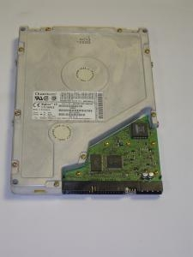
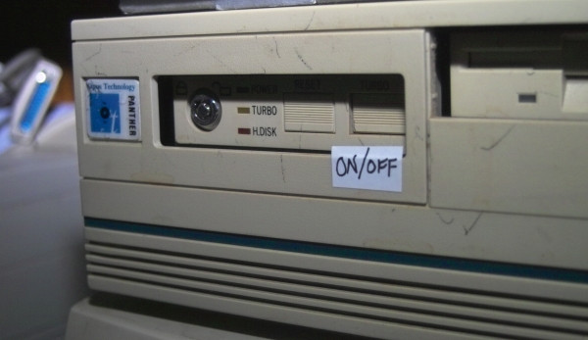
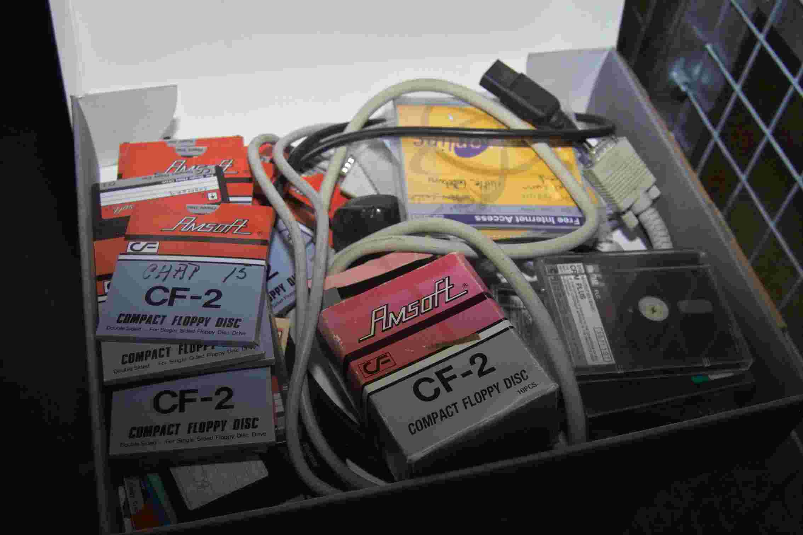
Acquisition from older media
Equipment, software and documentation
  Acquire, store and maintain
Slow, specialist, but small-ish quantities
Draw on enthusiast expertise
Develop and document processes
Processes obliterate metadata

Slide 23
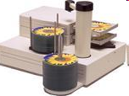
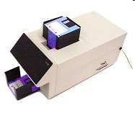
From manual to automated (mass) extraction
Modern offline media in archival collections – more of it.
Currently: imaged disk by disk
Post futureArch:
  En masse forensic imaging
  Error logs
  Hashing
  Analysis of disks
  Operates unattended
Up to 100 discs at once
Up to 150 diskettes at once

Slide 24
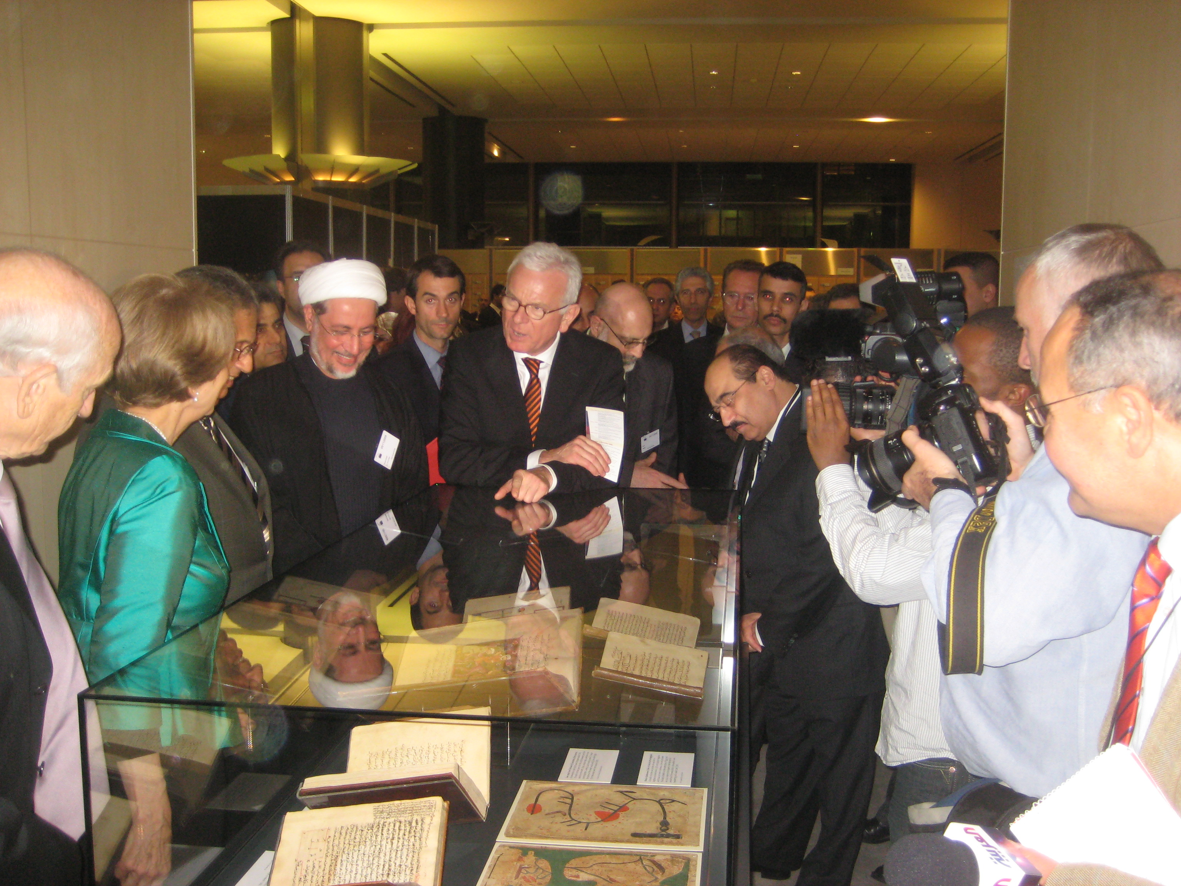
Back office versus front of house
Develop ways of communicating with readers/public/customers/donors more
Develop ways to shift resources from the back office to front of house

Slide 25
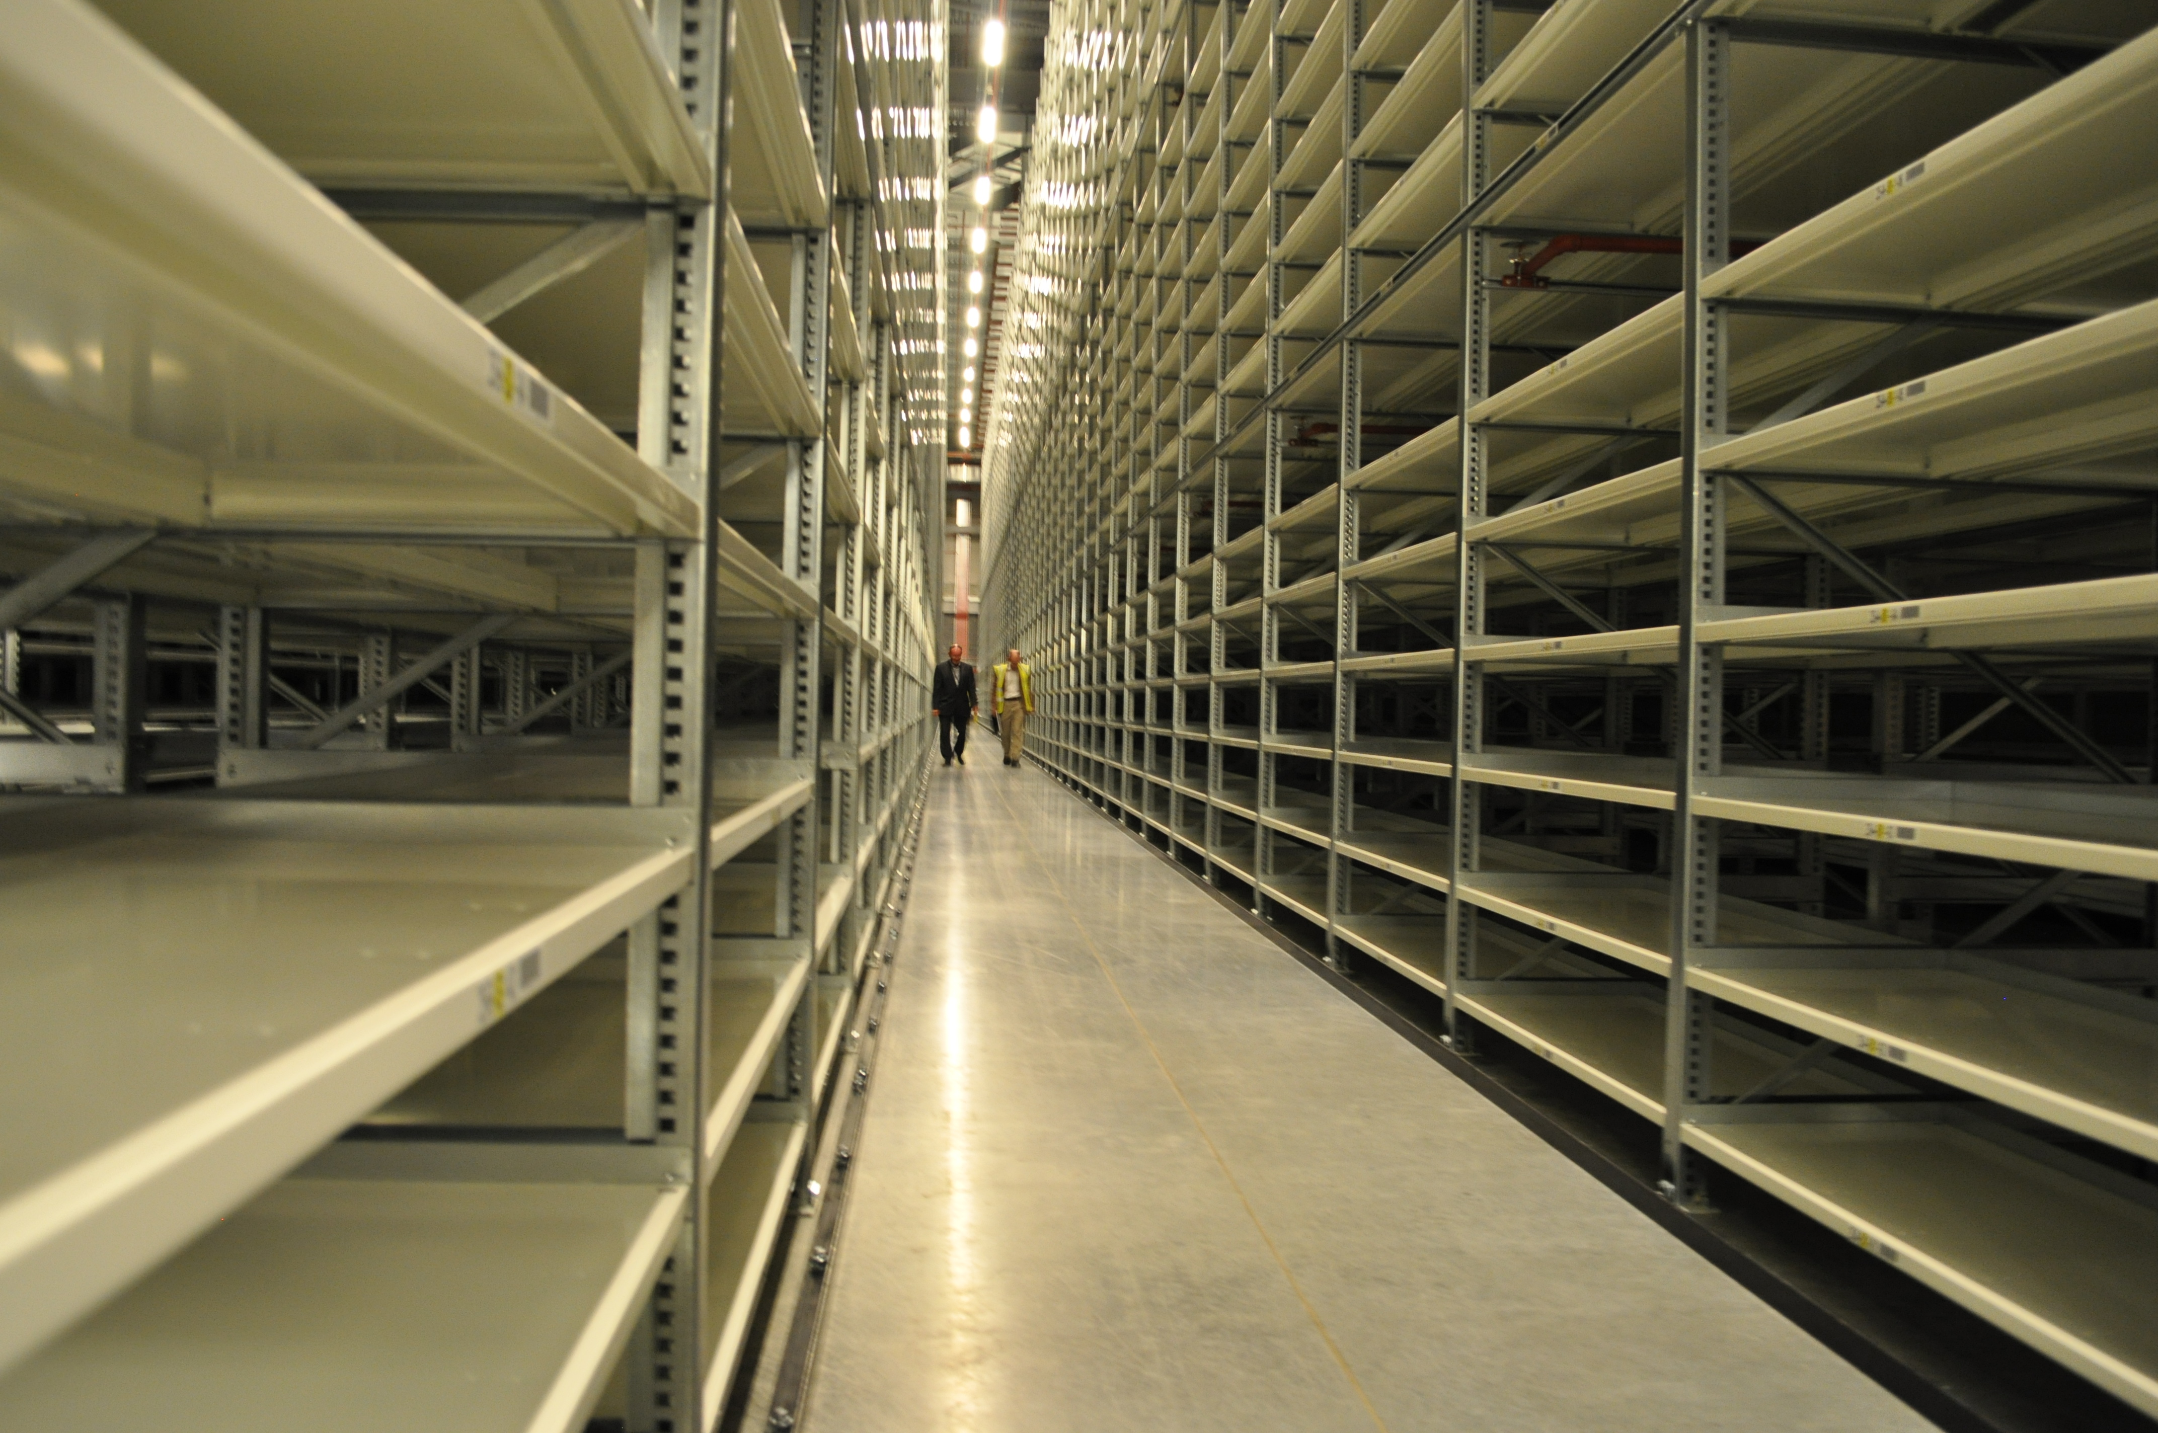

Slide 26
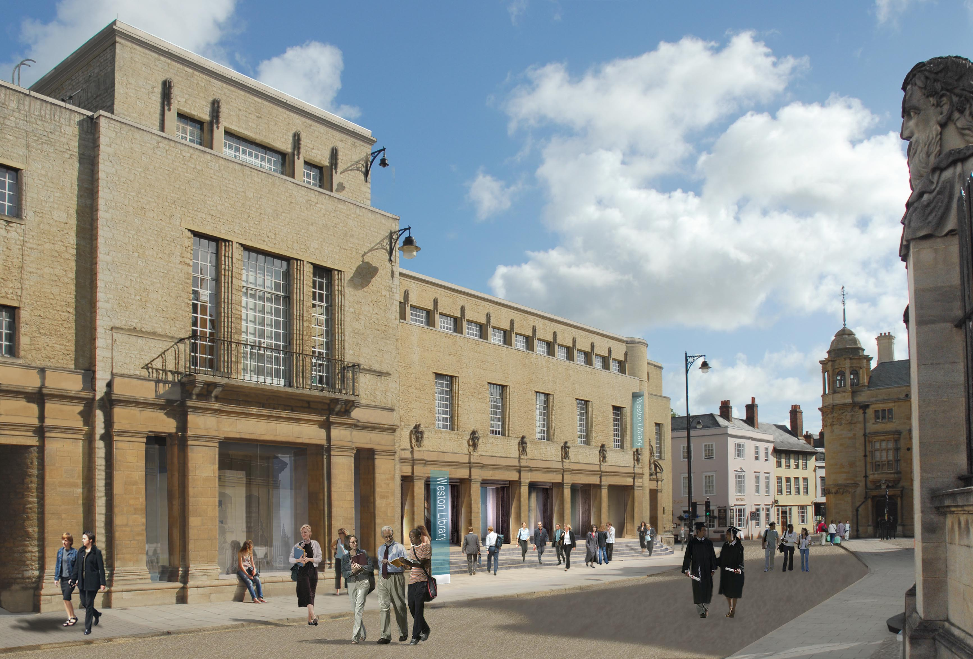
Forming the entrance – Proposed Perspective View from Broad Street - West

Slide 27
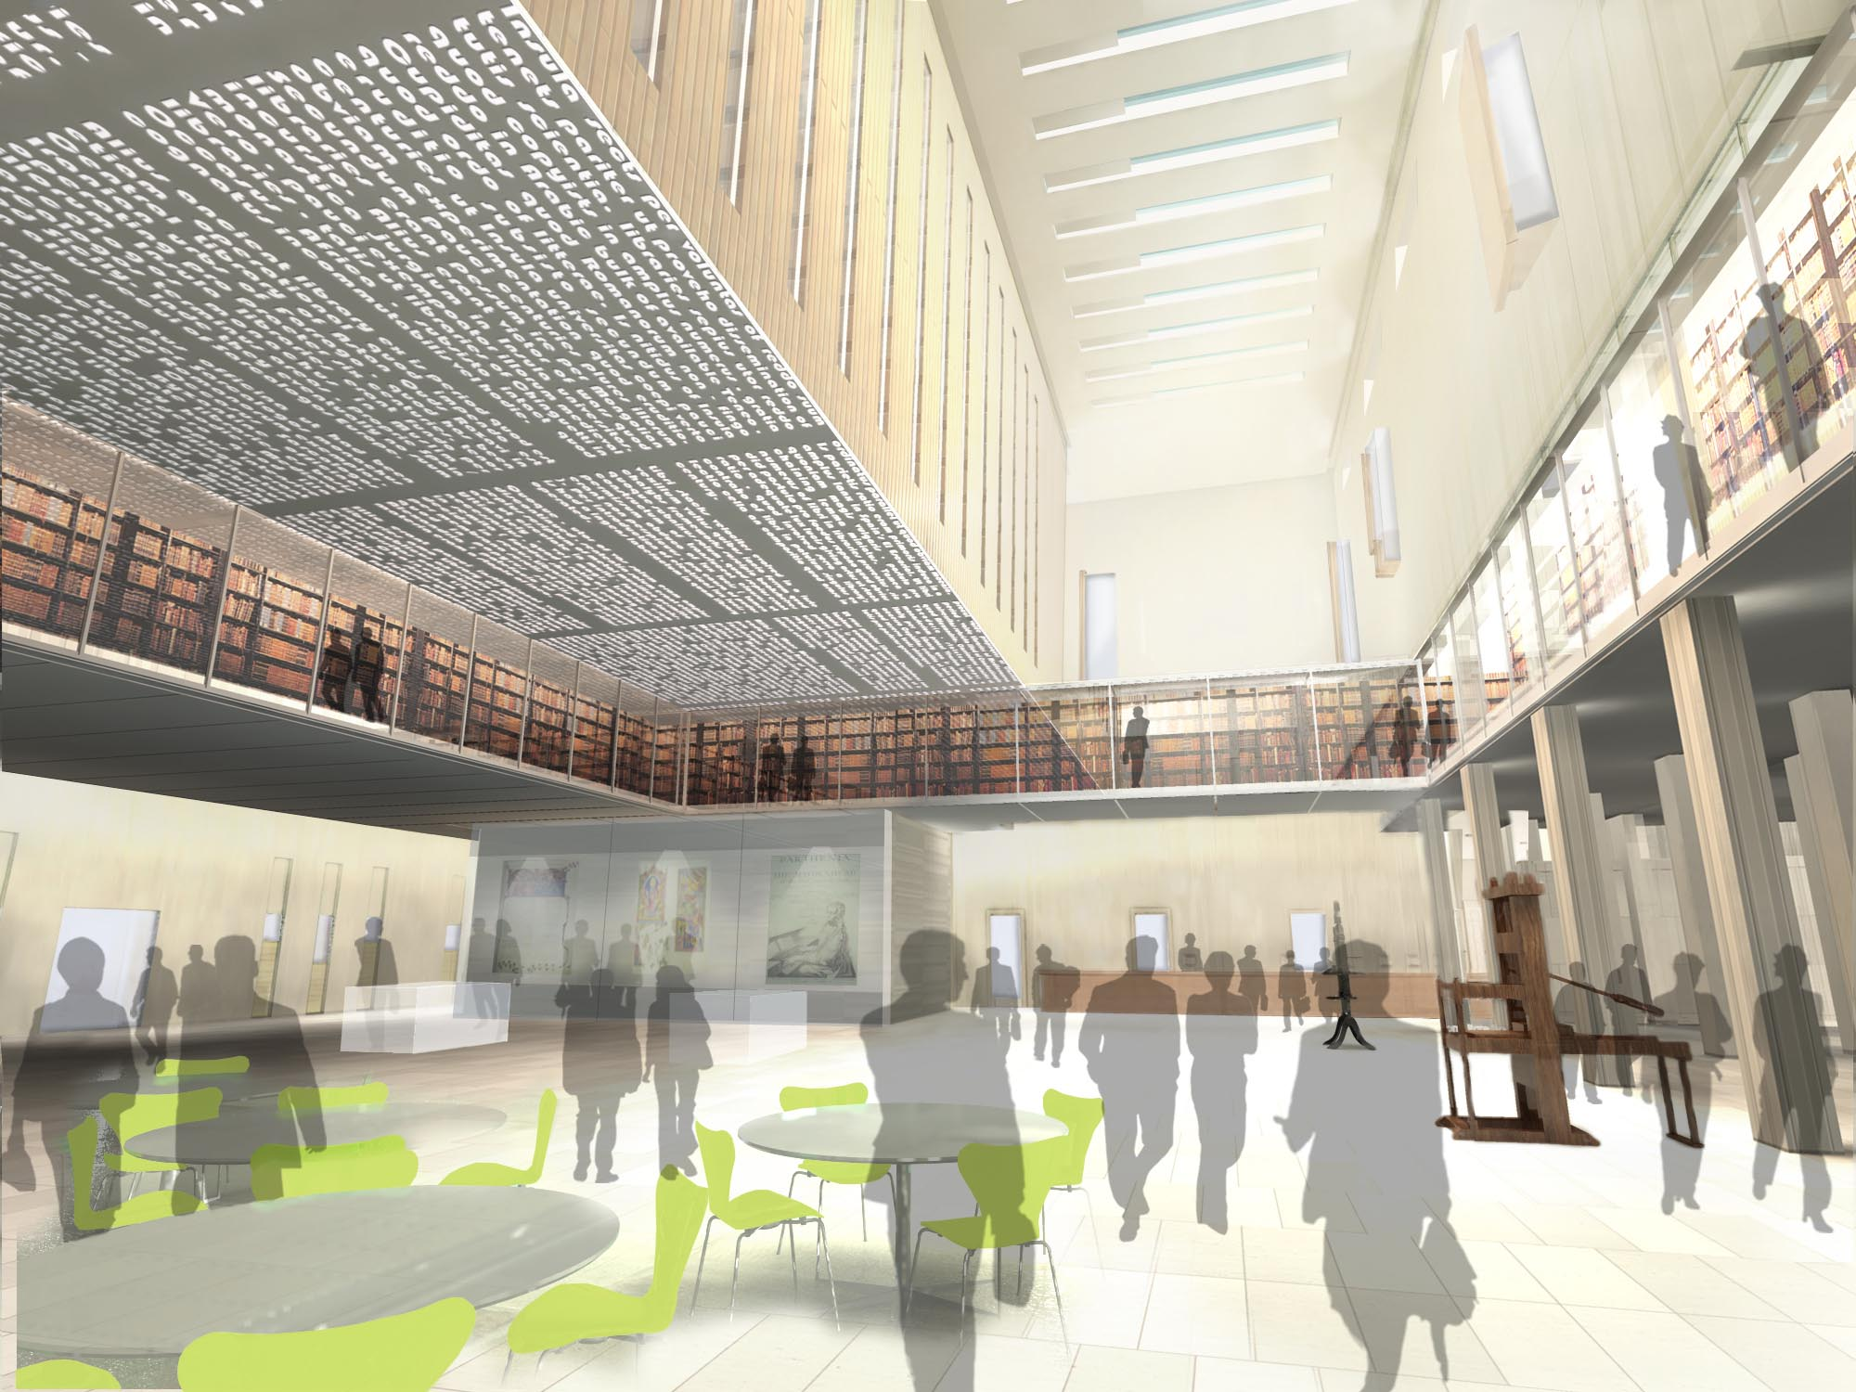
Ground Floor Public Areas – Perspective View of Proposed Entrance Hall
Notes:
WEA note : WORK IN PROGRESS, view 1 option b

Slide 28
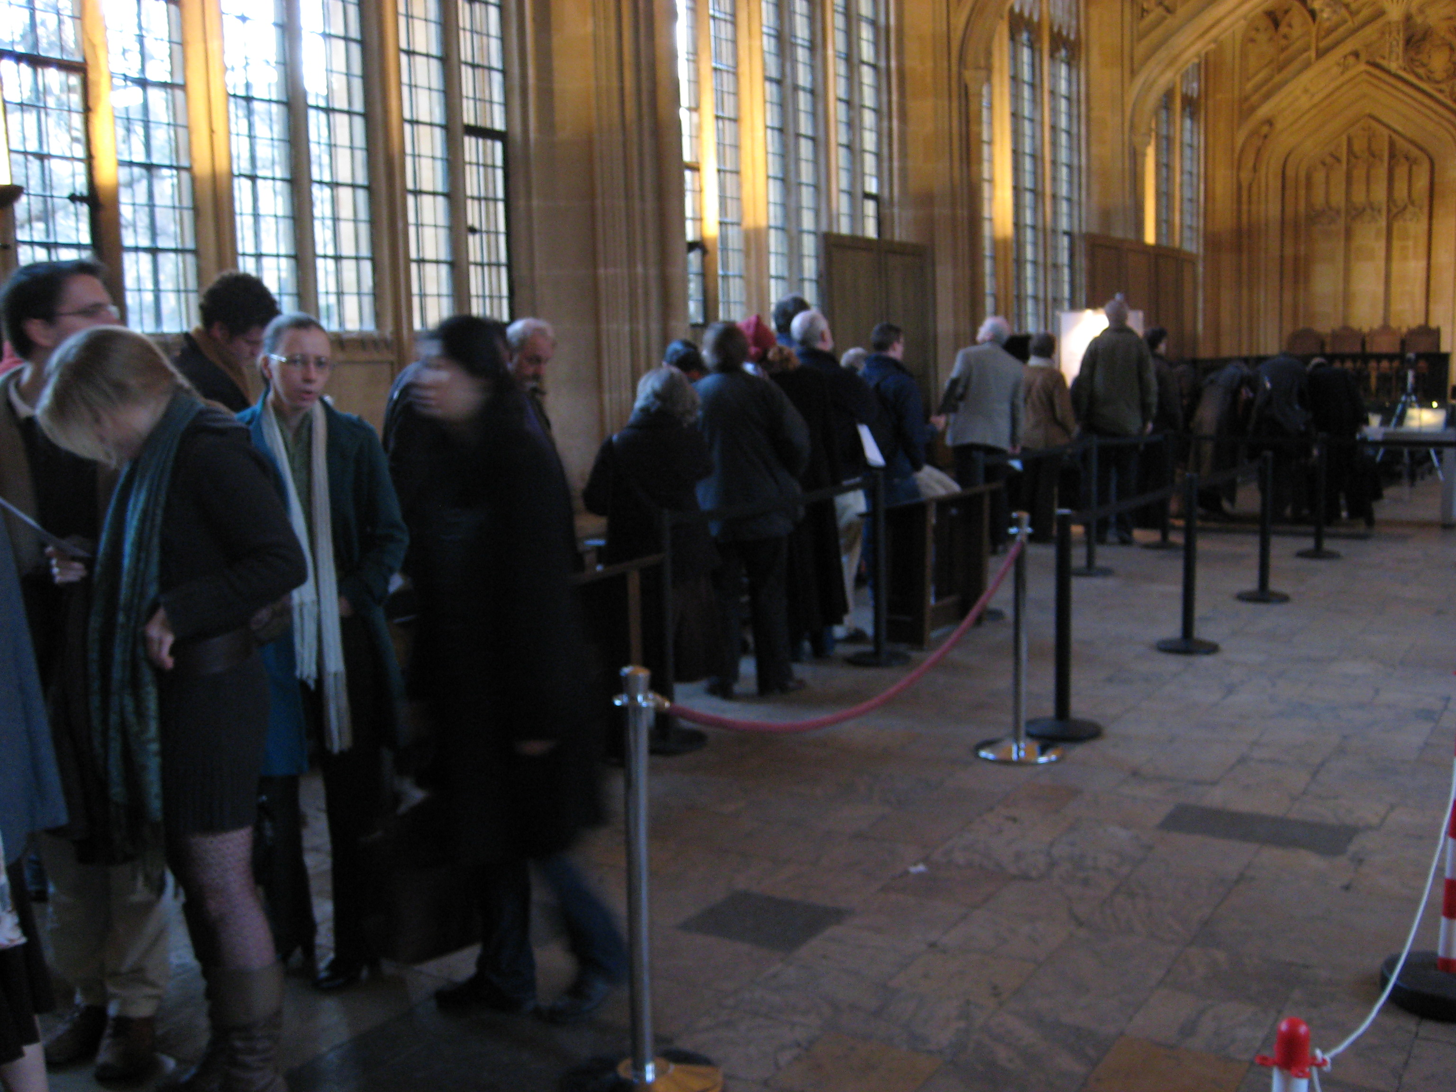
Exhibitions: Magna Carta Day, December 2008

Slide 29
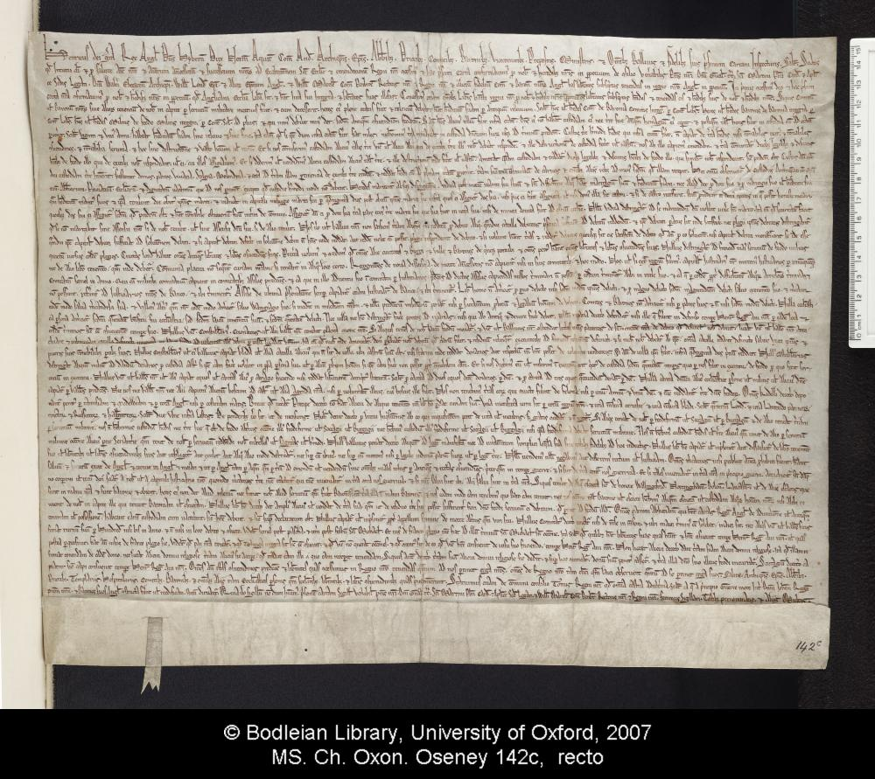

Slide 30
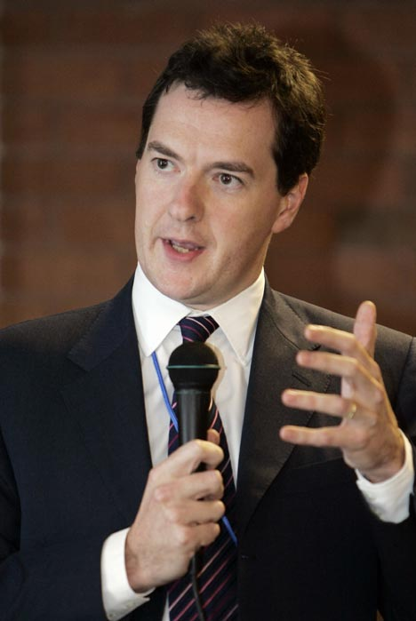
Funding
Look back on October 20 2010 as an opportunity not a threat
  Spec Colls share of core budget: UK average 5-7%, US 8-10%
Bodleian now funded 75% university, 25% endowments, income, fundraising, grants.

Slide 31
Funding
75% of the Bodleian funds come from the University.
University’s funding from the State is under pressure
Bodleian increasingly dependent on its own income:
  Endowments
  Shop and merchandise
  Tours, filming etc
  Digital collections (licensing)
  Fundraising through philanthropy and research grants
2010-12 funds cut by 10%
Bodleian’s own income needs to rise to 35% of total funding

Slide 32

Funding
Increasing emphasis on non-core funding - £350k to the bottom line in 2009-10
  Merchandising
  Imagery
  Publications
  Licensing

Slide 33
Legal issues
Invest more in understanding Legal issues:
Copyright
  Future special collections will be more bound by rights rather than less bound
  Greater awareness of the issues / desire to monetise
Licenses / contracts
  Wider range of income sources, greater need for legal support
Globalisation will further complicate legal issues

Slide 34
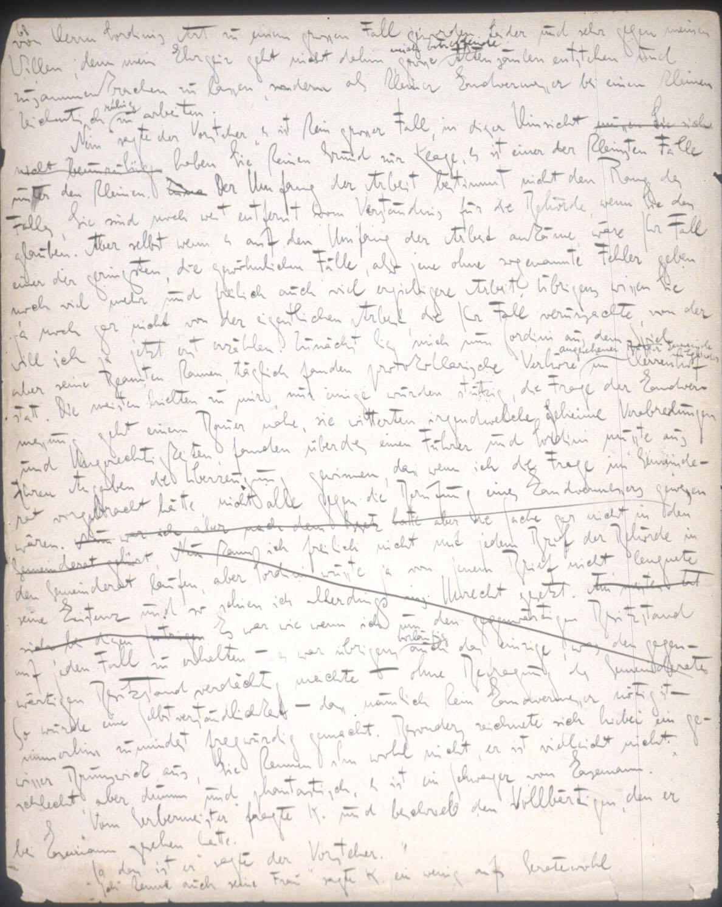

Slide 35

Collaboration vs Competition
Plan your collaborations strategically
Expect mergers and acquisitions / Shared services
Rationalization of library and archival holdings?
  Sion College
  Marconi
  Ushaw College?

Slide 36
New Partnerships

Slide 37
New Partnerships
http://www.nytimes.com/2010/09/26/magazine/26kafka-t.html?pagewanted=1&_r=1

Slide 38
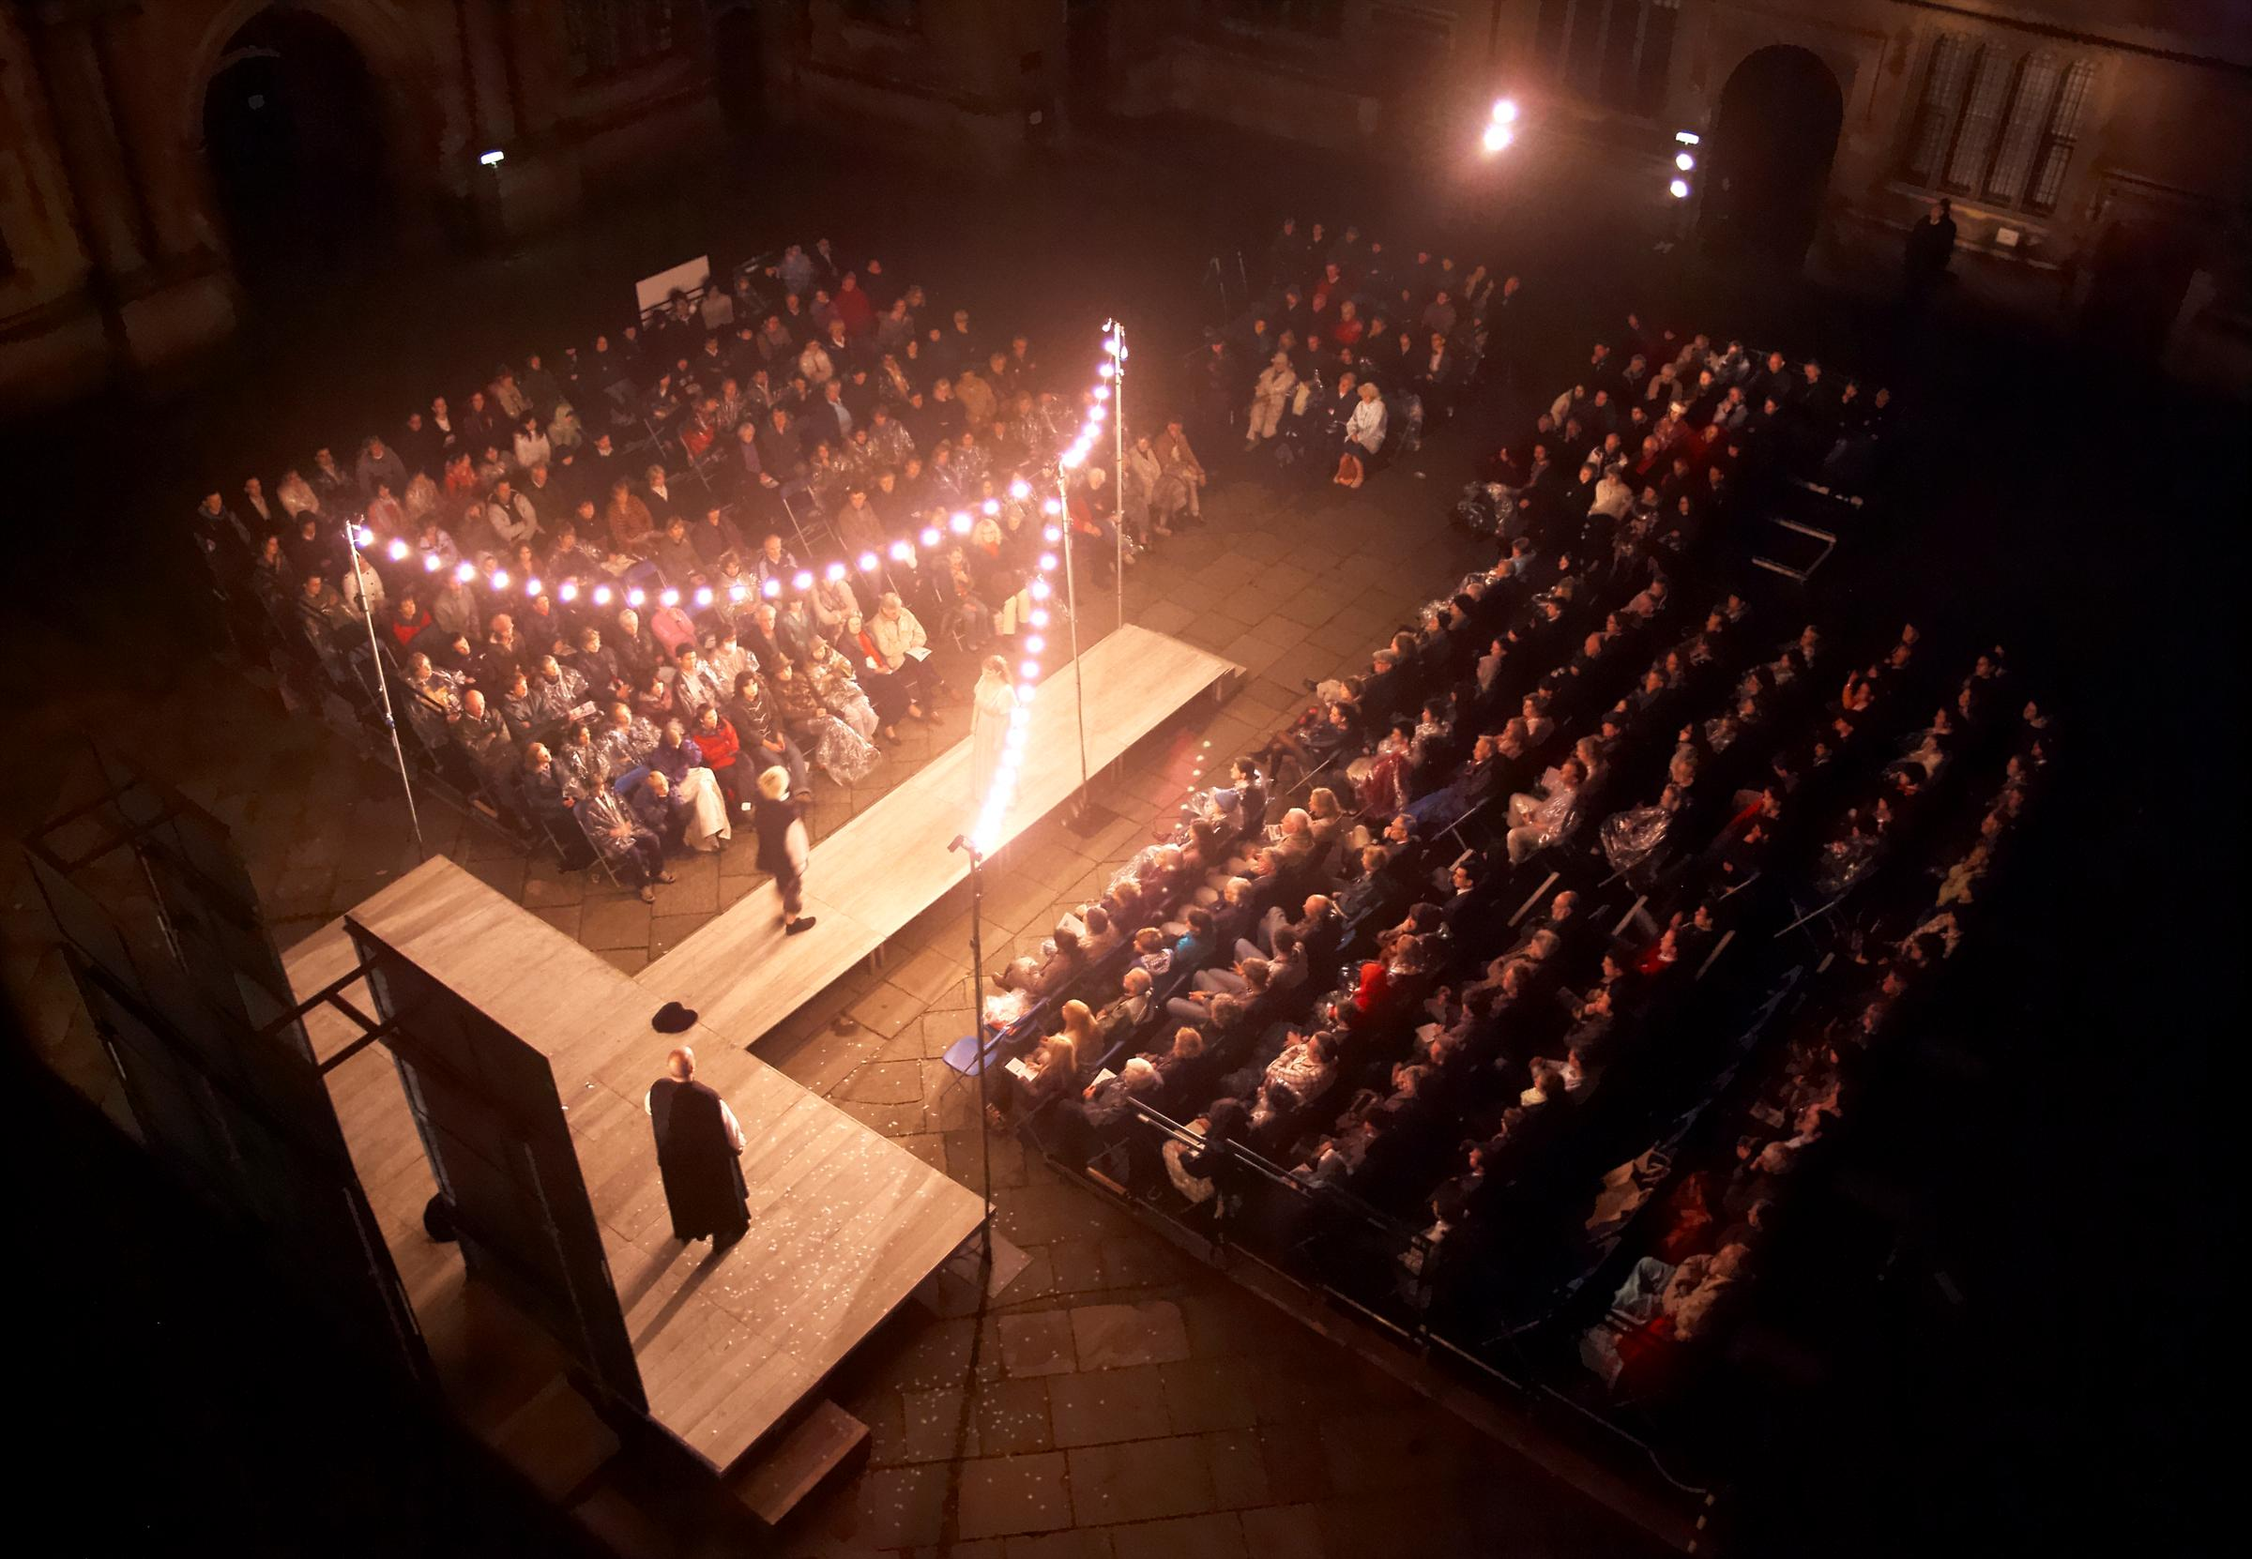

Slide 39
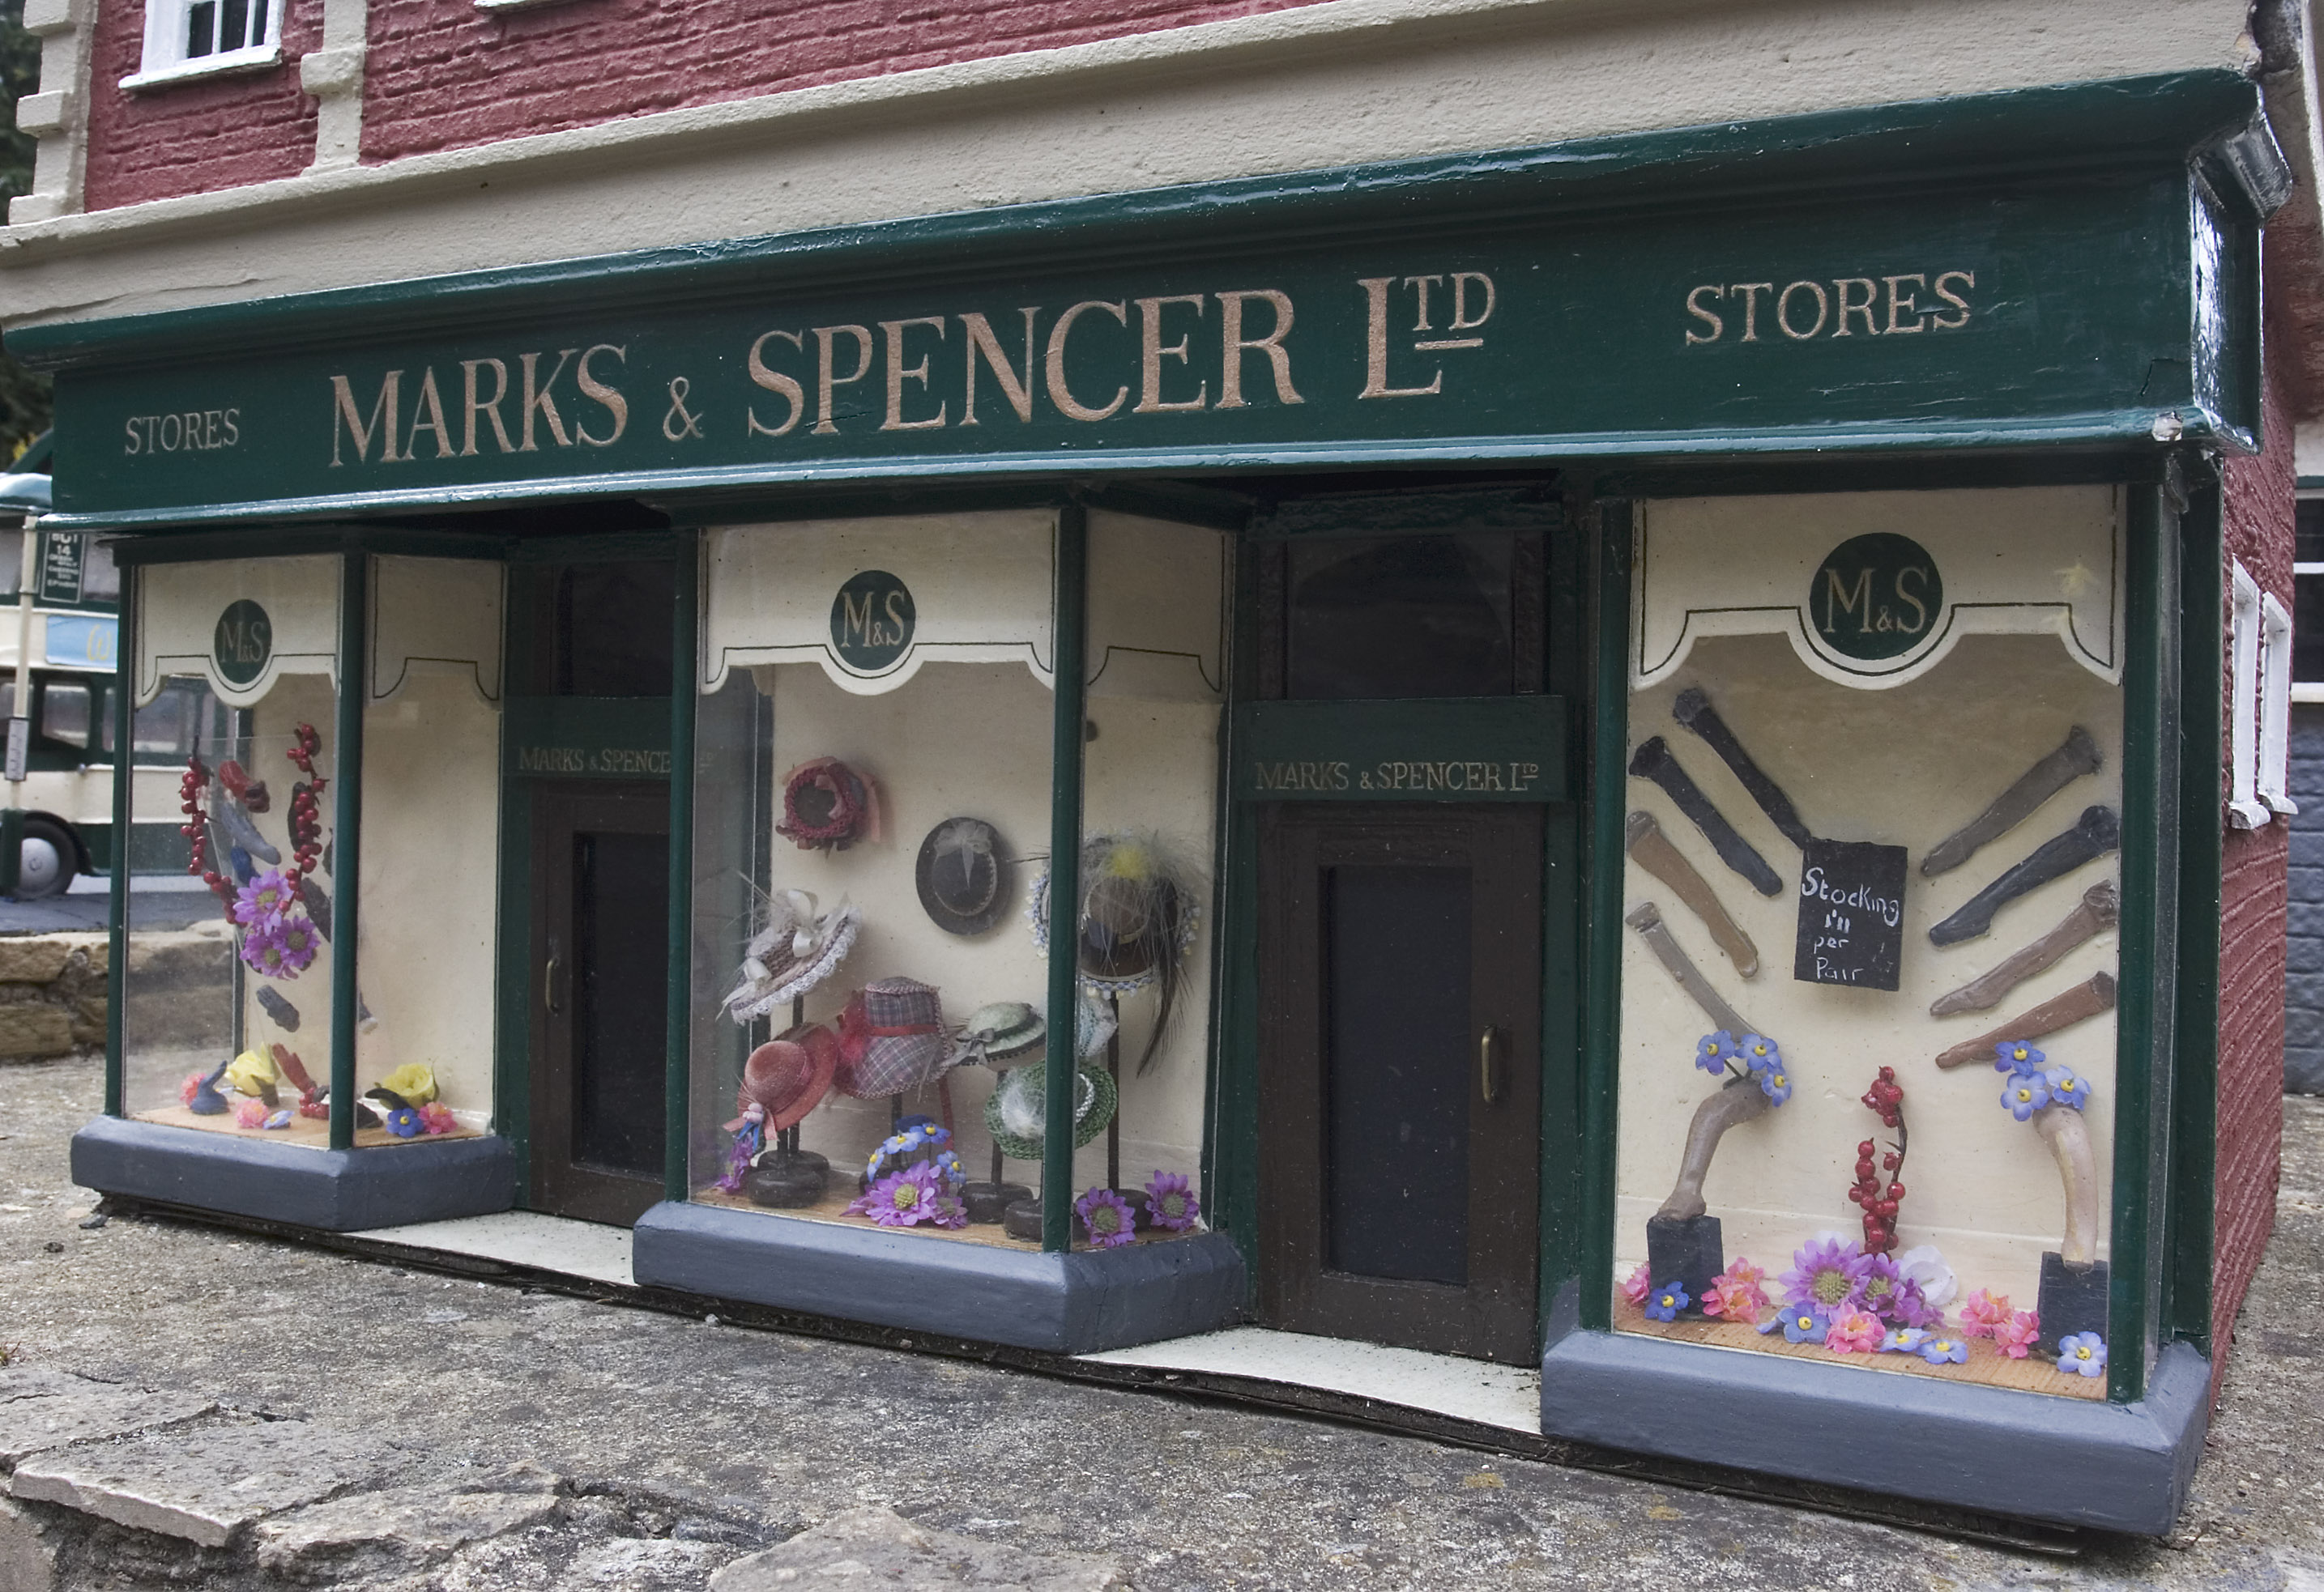
New Partnerships

Slide 40
New initiatives
Coming in 2011:
  BodReader: An eBook reading interface that allows you to call digitised books from the Bodleian ‘stacks’, read, annotate, and save them to you ‘Bod Shelf’.
  Bod Apps: Partnerships with local businesses to allow guided tours of the historic library buildings
  Bodleian publishing will launch first eBooks.

Slide 41


Slide 42

Richard Ovenden
Keeper of Special Collections and Associate Director
richard.ovenden@bodleian.ox.ac.uk
44 1865 2877158

