Slide 1
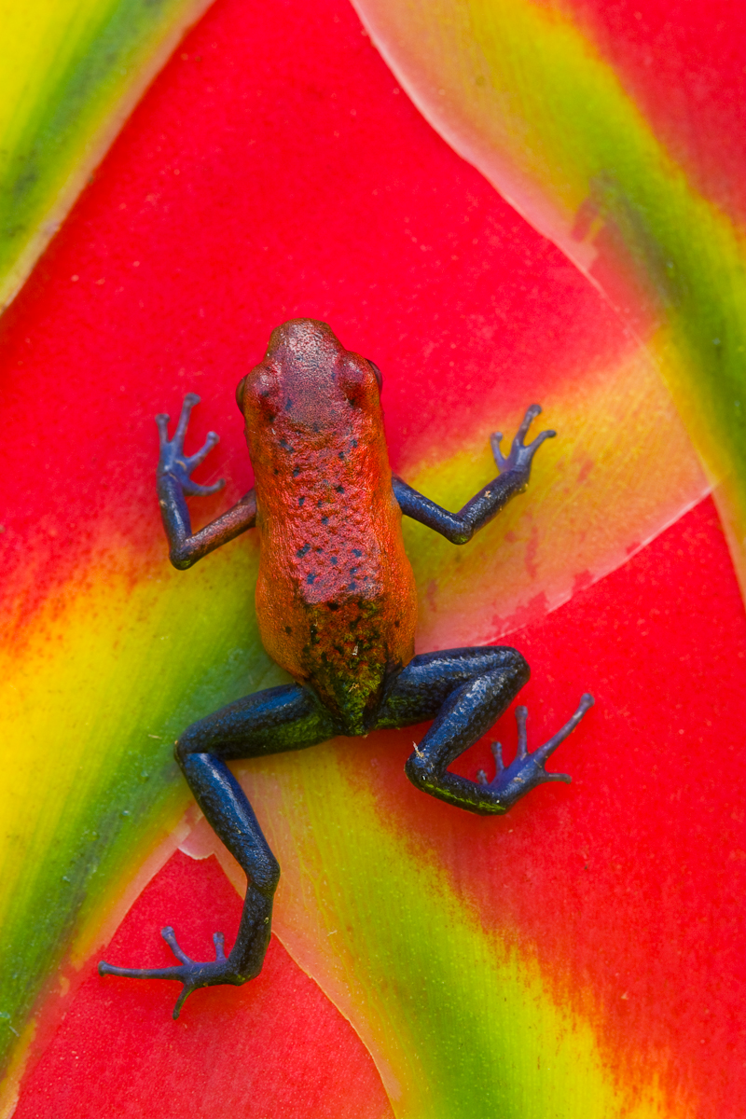

GLOBAL
BIODIVERSITY
INFORMATION
FACILITY
An Inspirational Large Scale International Collaboration
David Remsen
Senior Programme Officer
September 2010
WWW.GBIF.ORG

Slide 2

Outline
Basis of the GBIF Collaboration
  Focus
  Scope
Organisation of the Collaboration
  Social
  Technical
Impacts & Influences on the Collaboration
  Social
  Technical
Impacts & Influences of the Collaboration
  Social
  Technical
Photo by Greg Basco

Slide 3
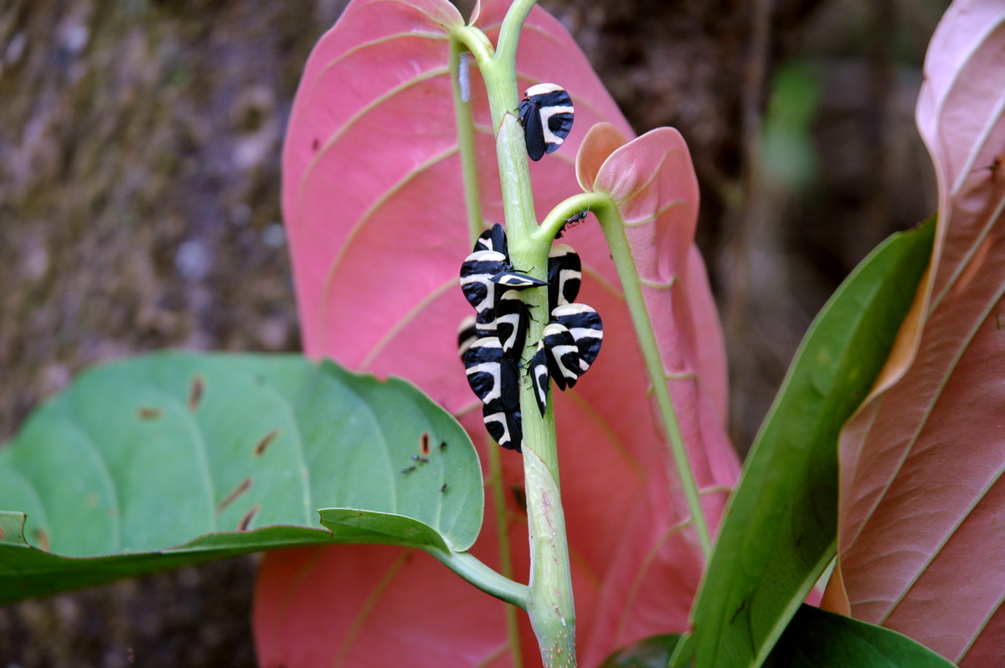
The Basis of the Collaboration
Biodiversity
Photo by David Remsen

Slide 4
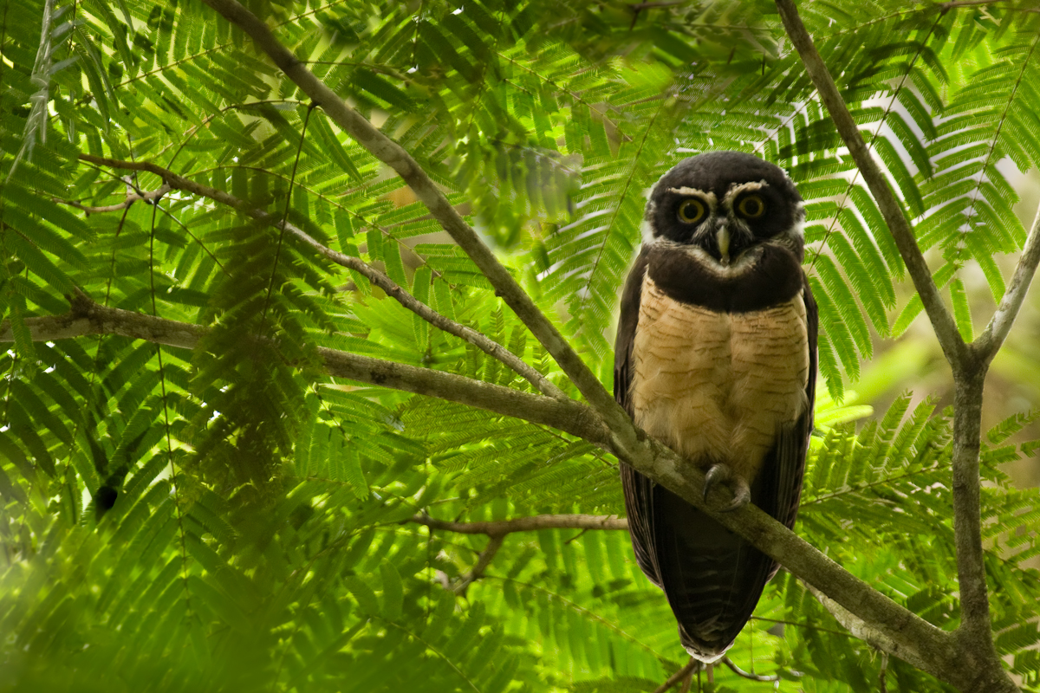
The focus of the Collaboration
Free and open access
To biodiversity data
Photo by Greg Basco

Slide 5
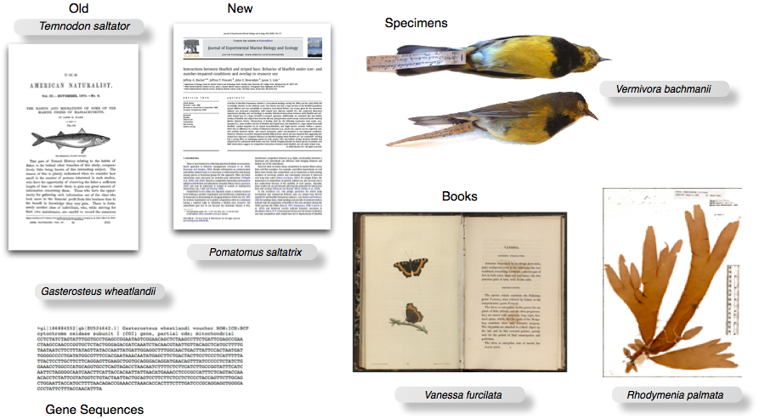
Biodiversity Information
Information or data linked to a scientific name
Notes:
A component of a comprehensive strategy for addressing names as components of biodiversity information. Names in the wild frontiers.

Slide 6
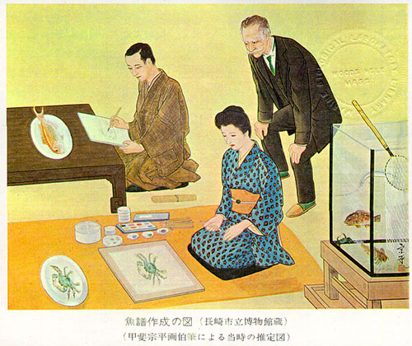
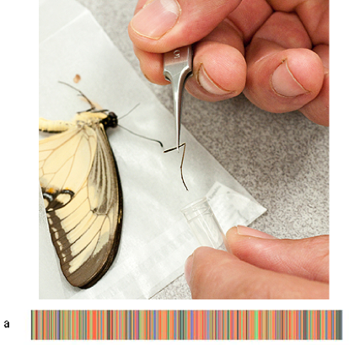
Biodiversity data
Spanning Centuries
International Barcode of Life, 2010
From T.E. Glover, The Fishes of Southwestern Japan, c.1870
Spanning Continents
Notes:
From the past

Slide 7
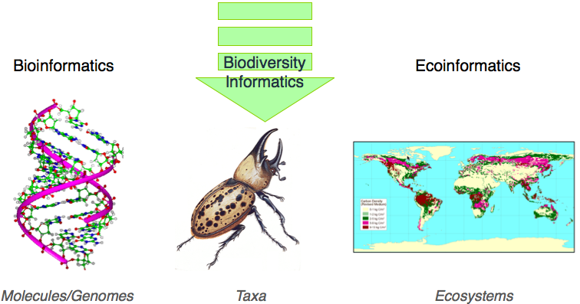
Biodiversity Informatics
Notes:
And it’s delivered by an assortment of interests in biology and information management that have consolidated into something called Biodiversity Informatics – a relatively new domain of biological informatics that fills a gaping hole between traditional bioinformatics with its focus on genomes and Ecoinformatics that looks at entire landscapes and their interaction with the physical world.

Slide 8
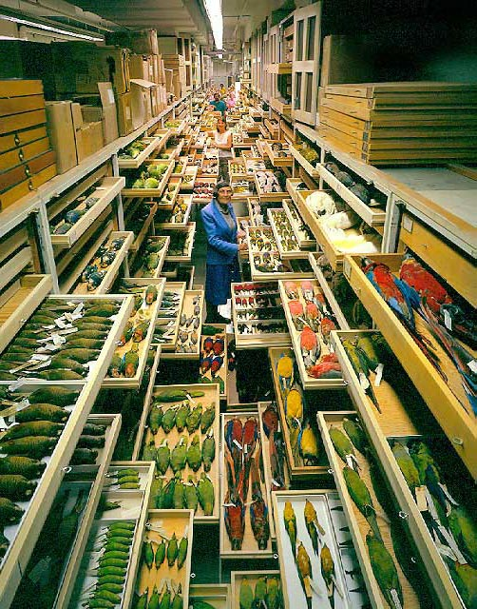
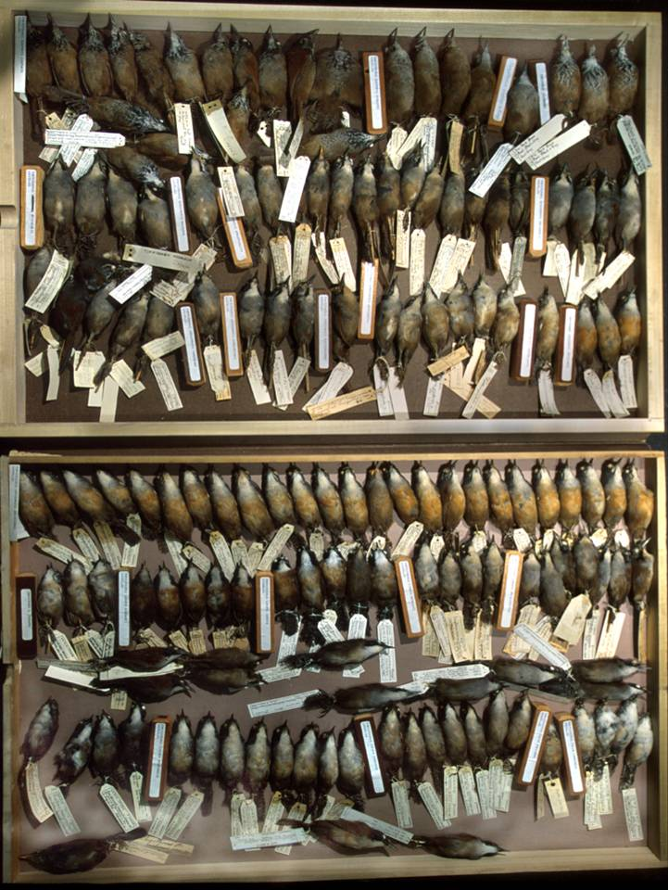
Primary Biodiversity Data
Billions and billions of specimens
Notes:
SCOPE of biodiversity data.

Slide 9
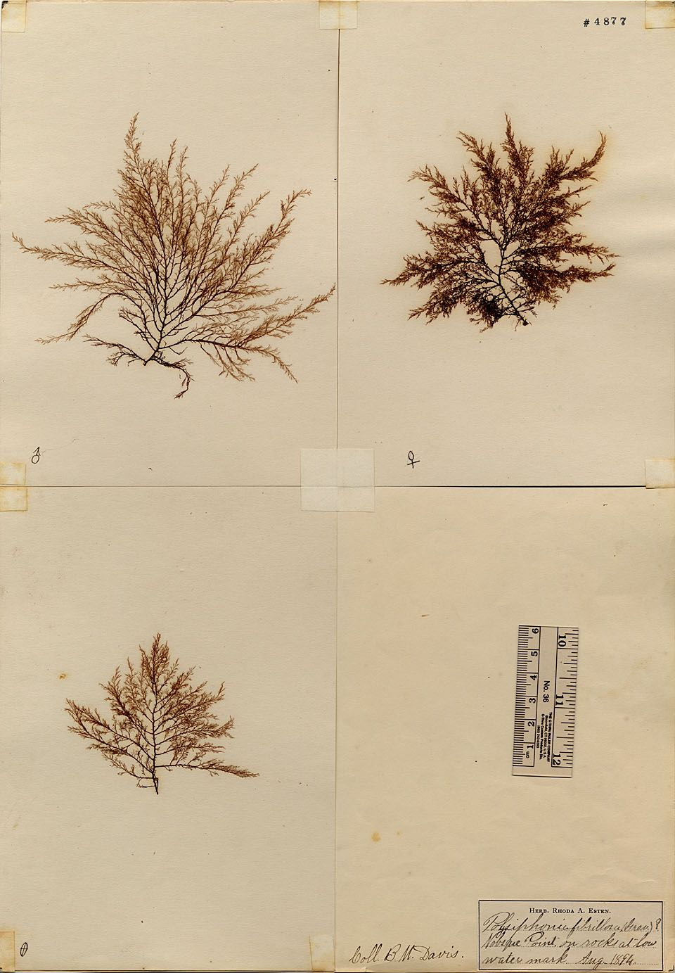
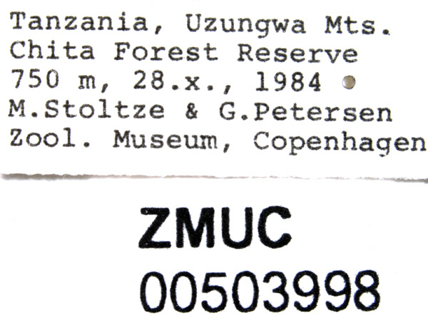
Primary Biodiversity Data
Spans Centuries
Vouchered
1874
Billions and billions of specimens
Notes:
SCOPE of biodiversity data.

Slide 10
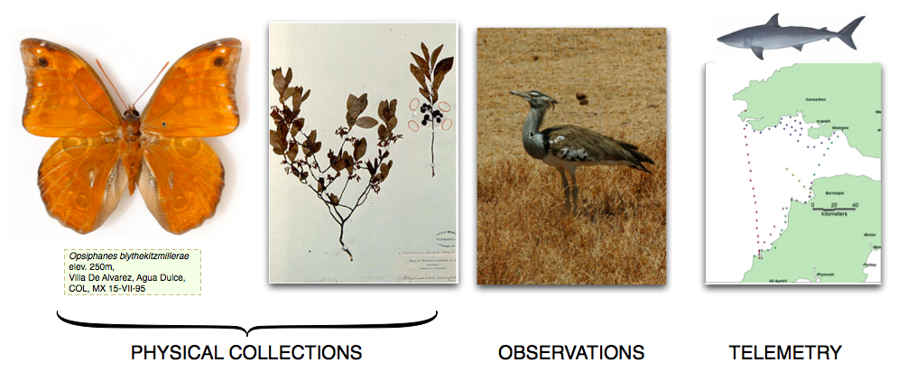
Primary Biodiversity Data
Important focus of biodiversity informatics
Notes:
And Im going to tell you about just a tiny piece of this

Slide 11
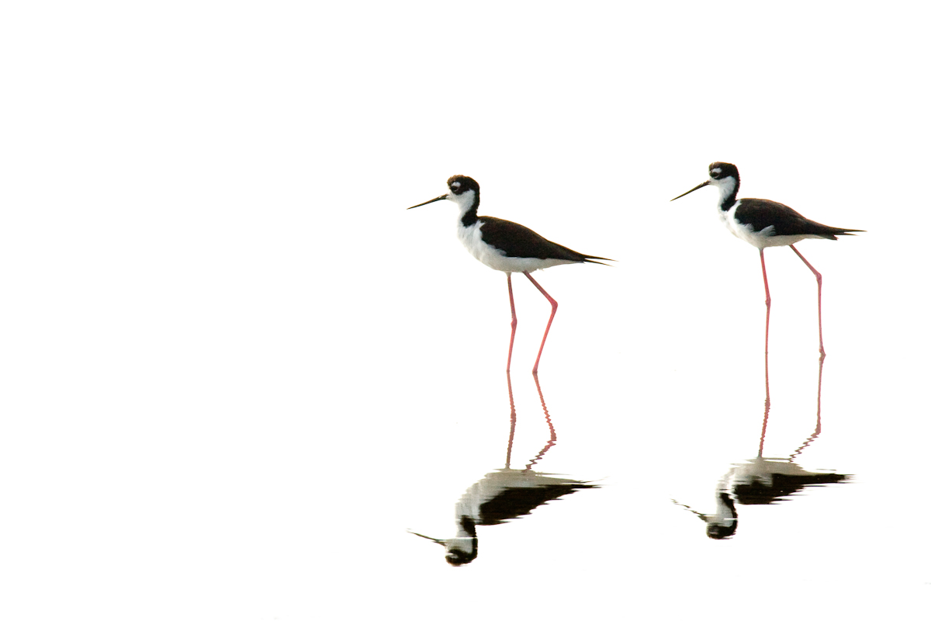
Basis of the Collaboration
History
Photo by Greg Basco
Photo by Christian Lange

Slide 12

History
33 (mostly) developed countries
Megascience Forum est. 1992
  Address the gap between scientists’ perceived future requirements and those of their political authorities

Slide 13
History
1996 Working Group on Biological Informatics
  Biodiversity information is vast and complex
  Existing information is neither accessible nor fully useful
  Recent technological and political developments presented OECD with leadership opportunity

Slide 14
History
Establish a Global Biodiversity Information Facility (GBIF)
  2001 – GBIF Secretariat in Copenhagen
  2002 initiated a work programme

Slide 15

Organisation of the Collaboration
Social
Photo by Greg Basco

Slide 16
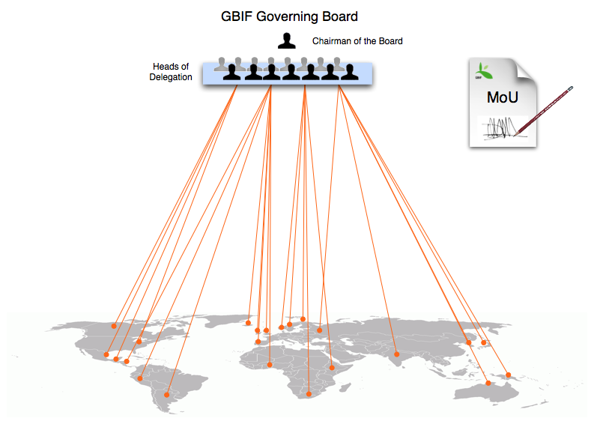
GBIF Organisation

Slide 17
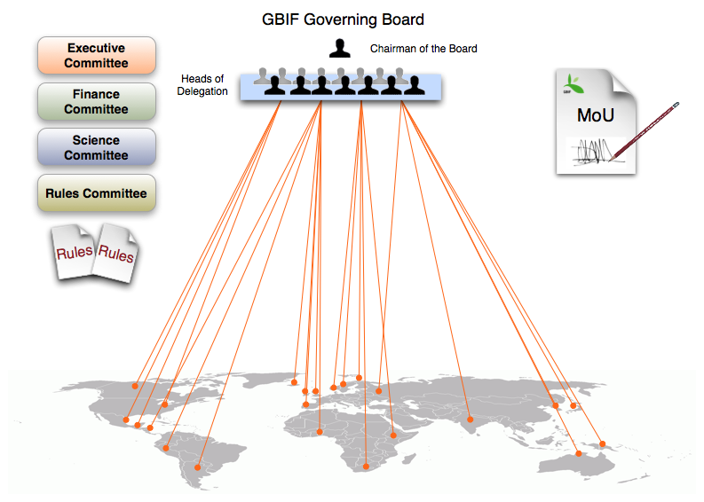
GBIF Organisation

Slide 18
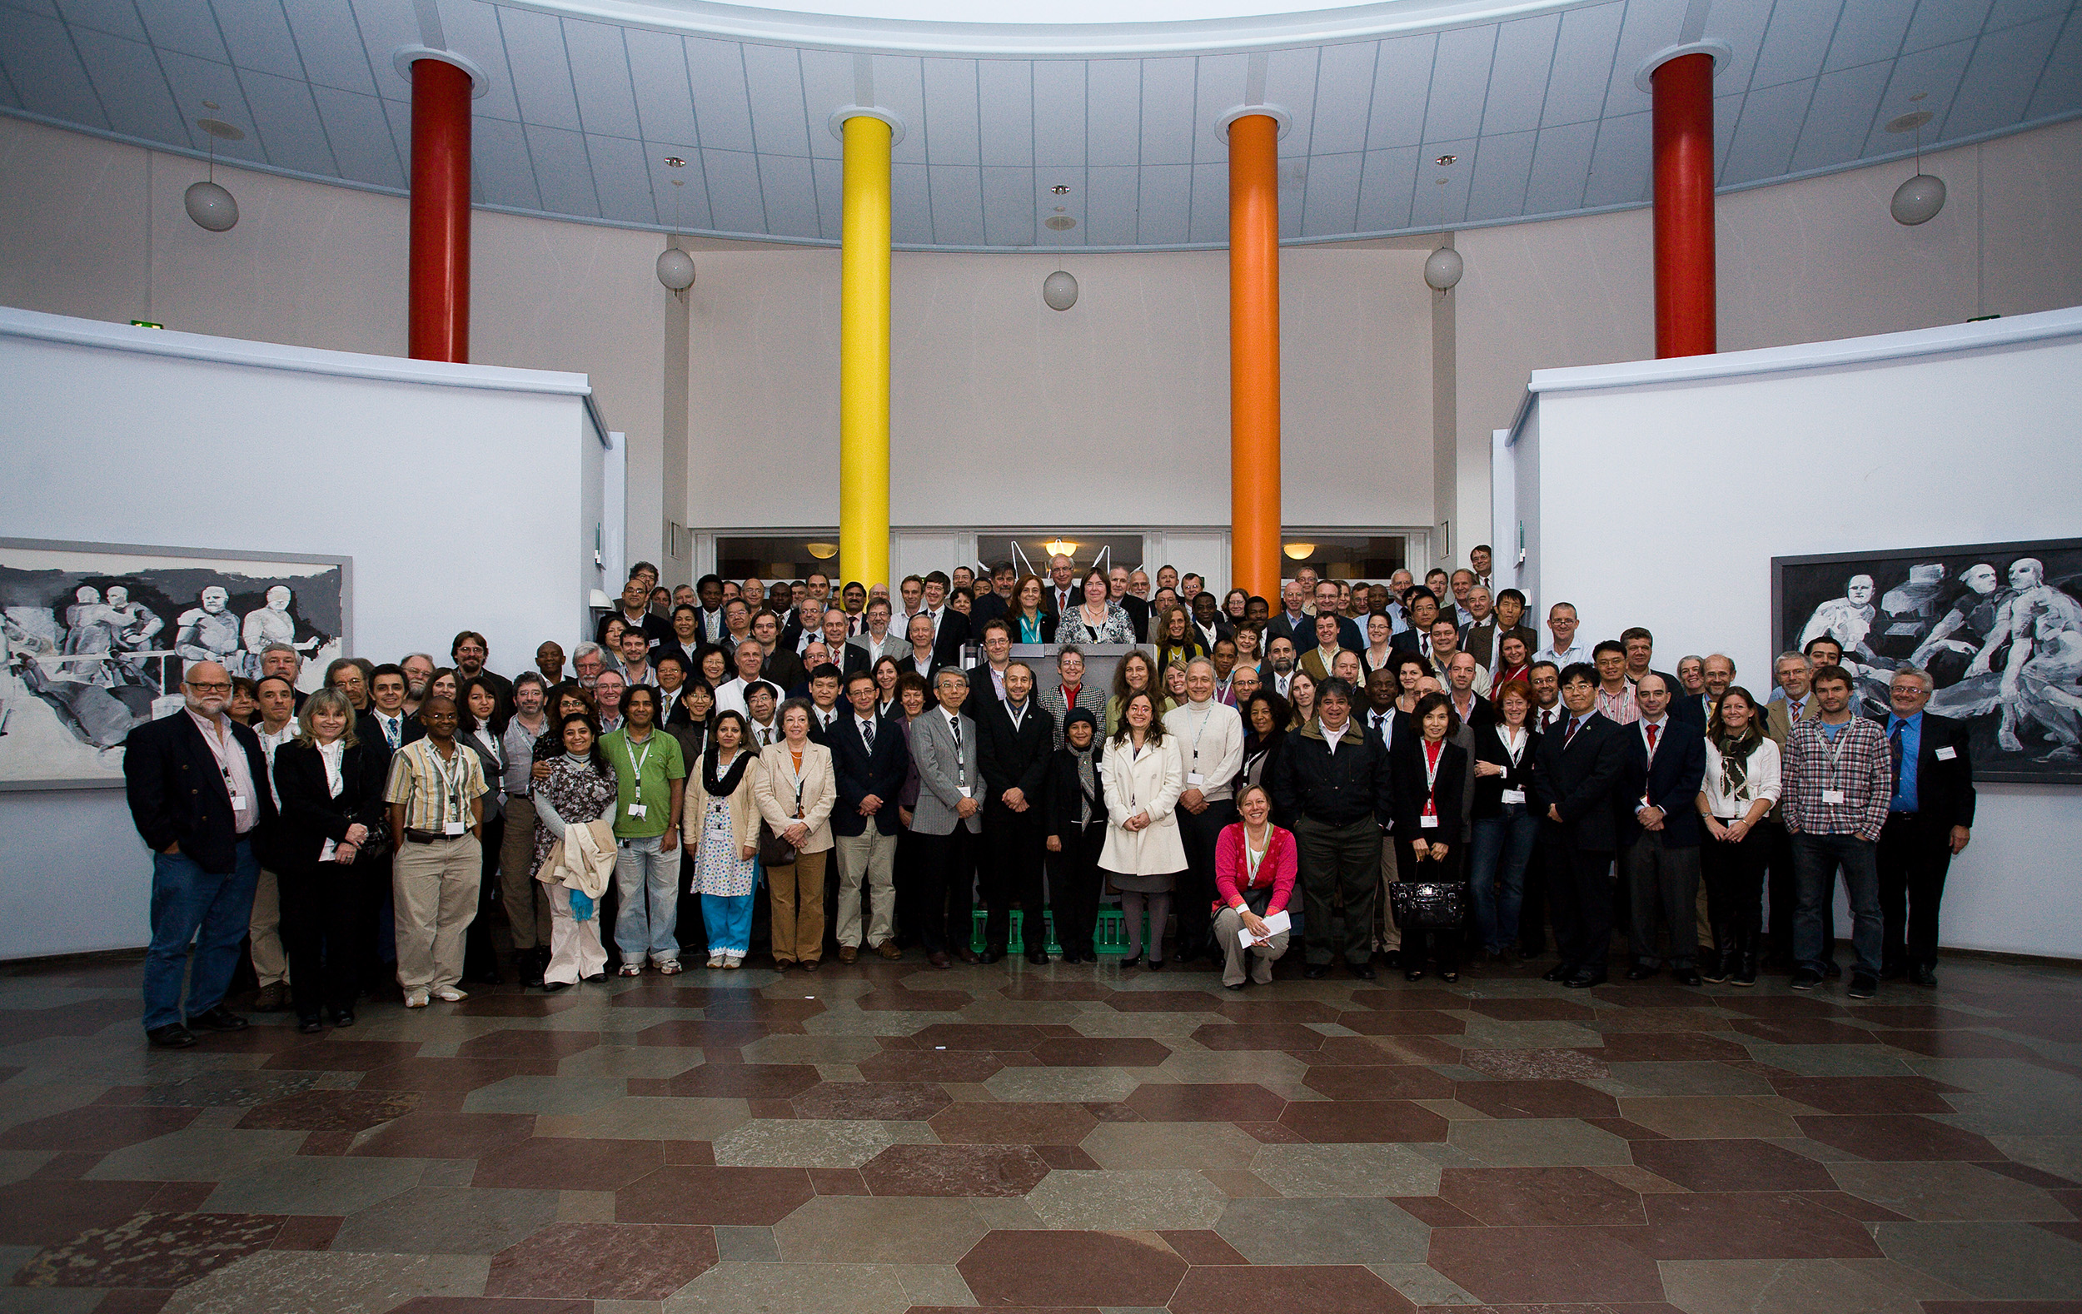
GBIF Governing Board

Slide 19
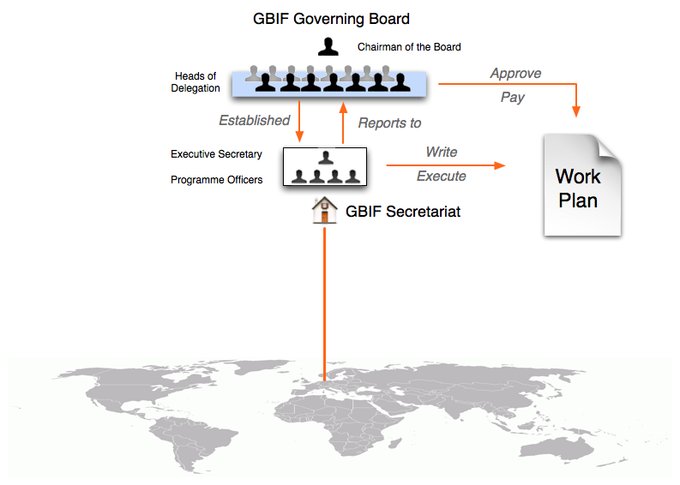
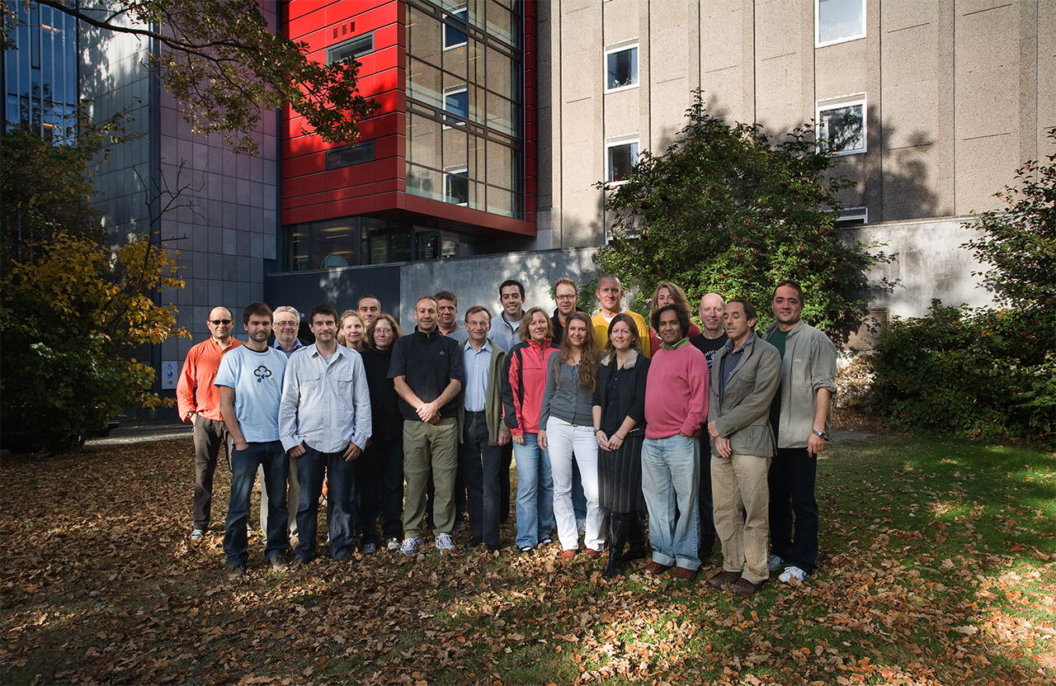
GBIF Organisation

Slide 20
GBIF Funding
If you fund you get a vote on the Gov. Board
World Bank publishes GDP (in billions USD)
Multiplied by
USA 2009 = 14,256 * 153.48 = ~2M
then various allowed adjustments
Year | 2007 | 2008 | 2009 | 2010 | 2011
Factor | 121.00 | 139.15 | 153.48 | 166.22 | 177.36

Slide 21
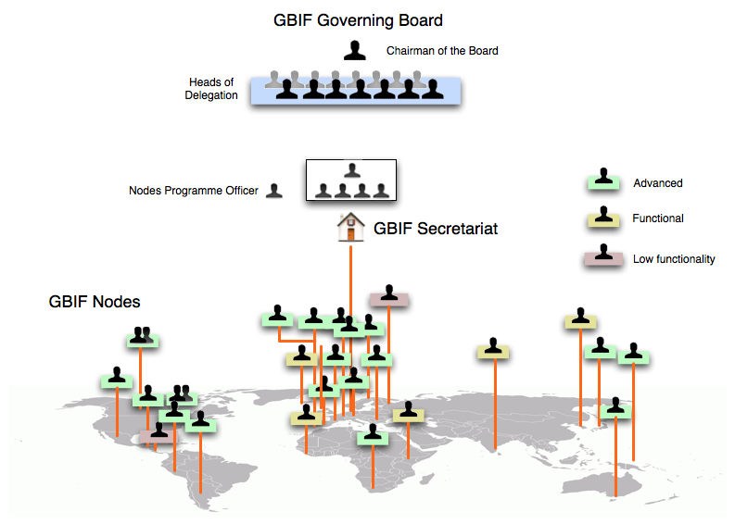
GBIF Participant Countries

Slide 22
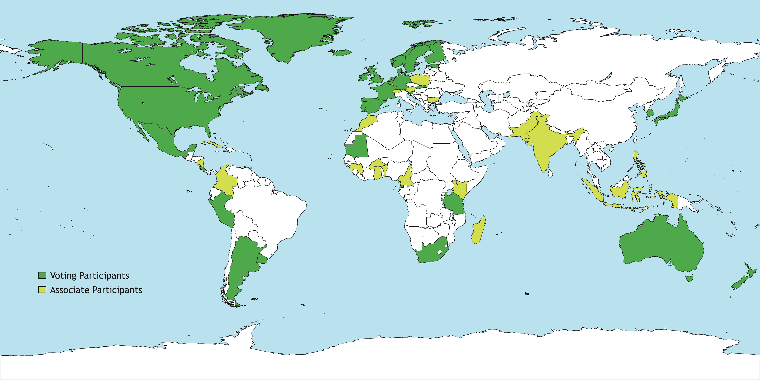
GBIF Organisation
54 Countries (32 Voting/22 Assoc)
45 International Organisations
100s institutions
8000+ databases
Notes:
Update these to current

Slide 23
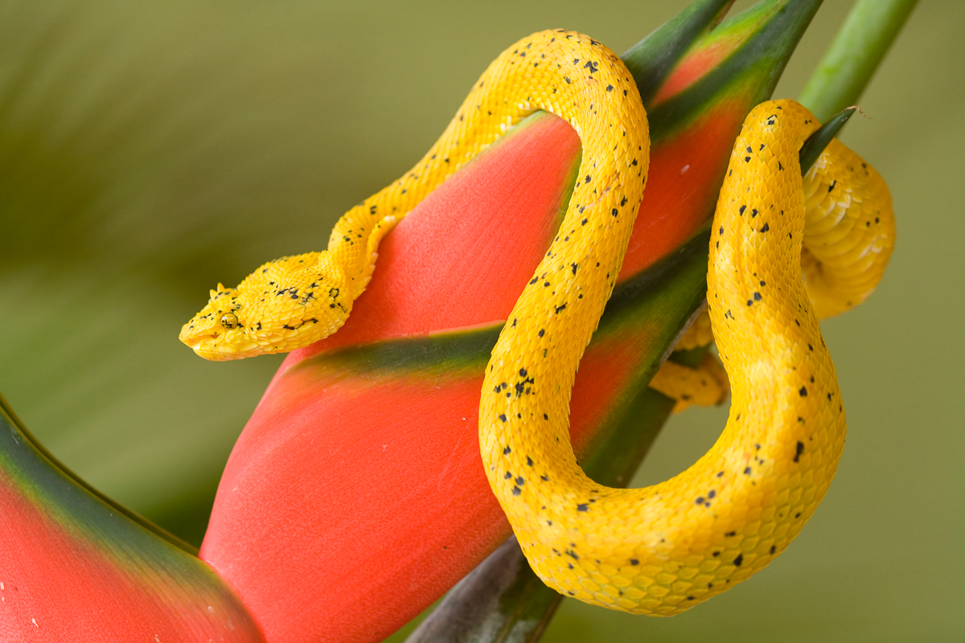
Organisation of the Collaboration
Technical
Photo by Greg Basco

Slide 24

Collaboration: Standards-enabled
Dublin Darwin Core

Slide 25
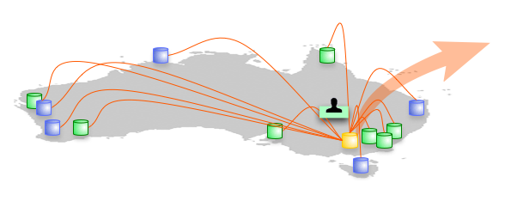
Australia: National-level organisation
Australian Virtual Herbarium
Atlas of Living Australia

Slide 26
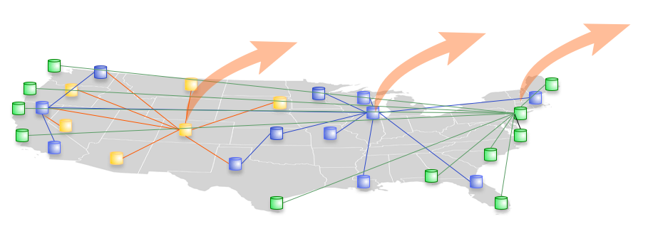
USA: Network of networks
MANIS
VertNet
NBII
ORNIS
eBIRD
NatureServe
Personal Trust

Slide 27
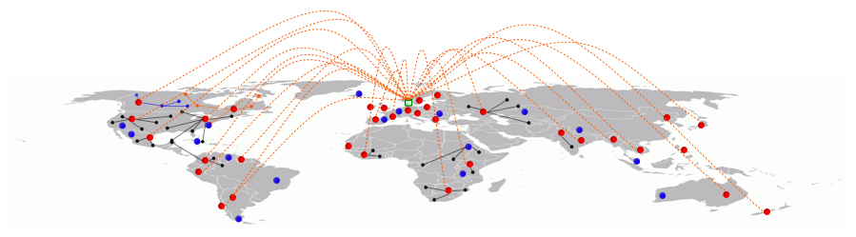
GBIF Network: Global Discovery
Personal Trust

Slide 28
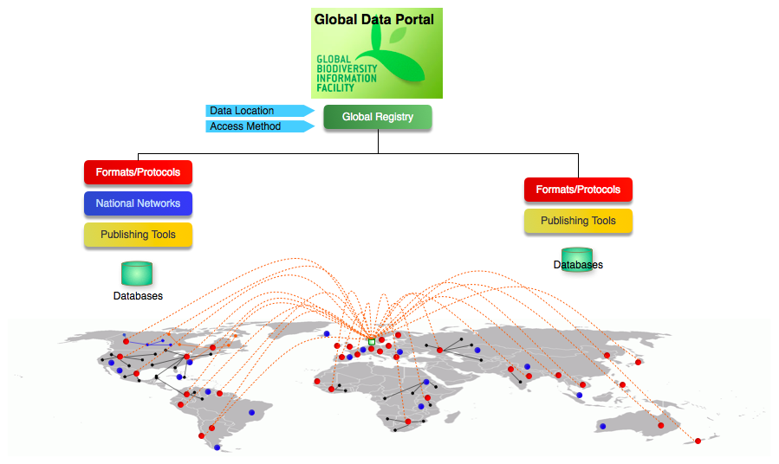
GBIF Network: Global Discovery
Personal Trust

Slide 29
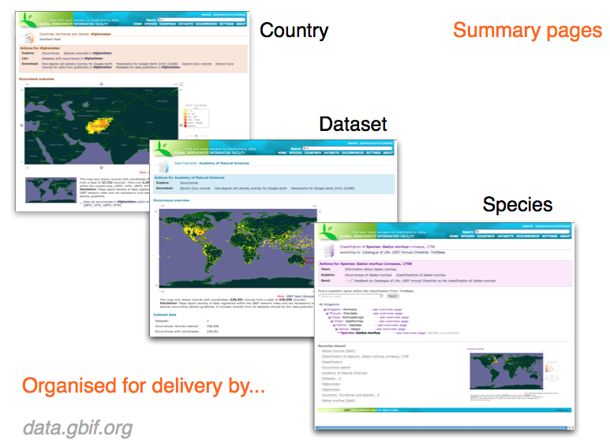
Global Discovery: data portal

Slide 30
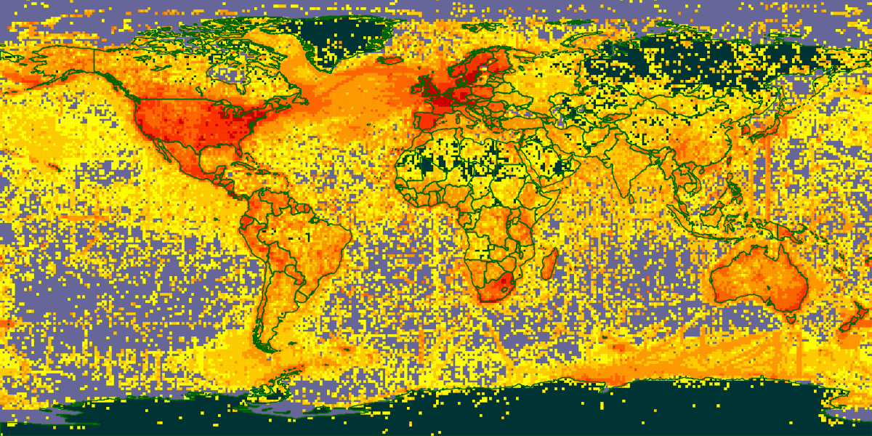
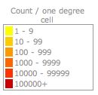
216 million biodiversity data records

Slide 31
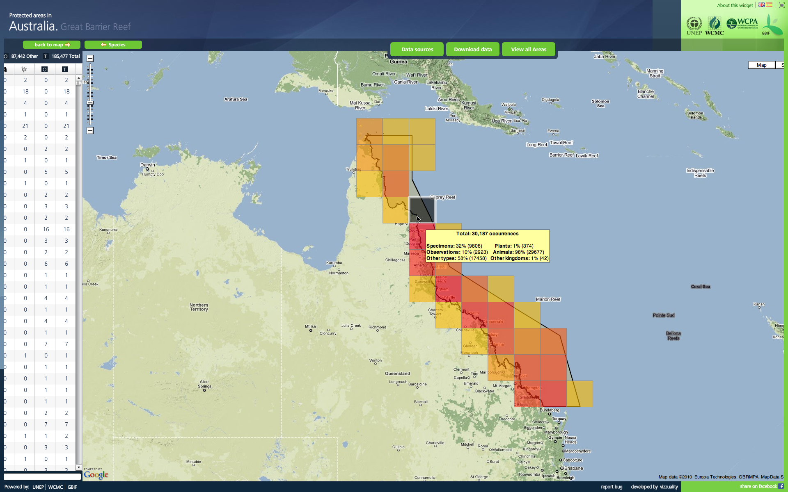
Using biodiversity data: Interoperability

Slide 32
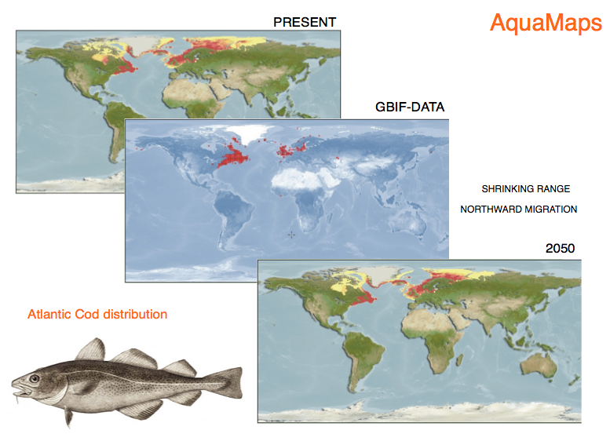
Using biodiversity data

Slide 33
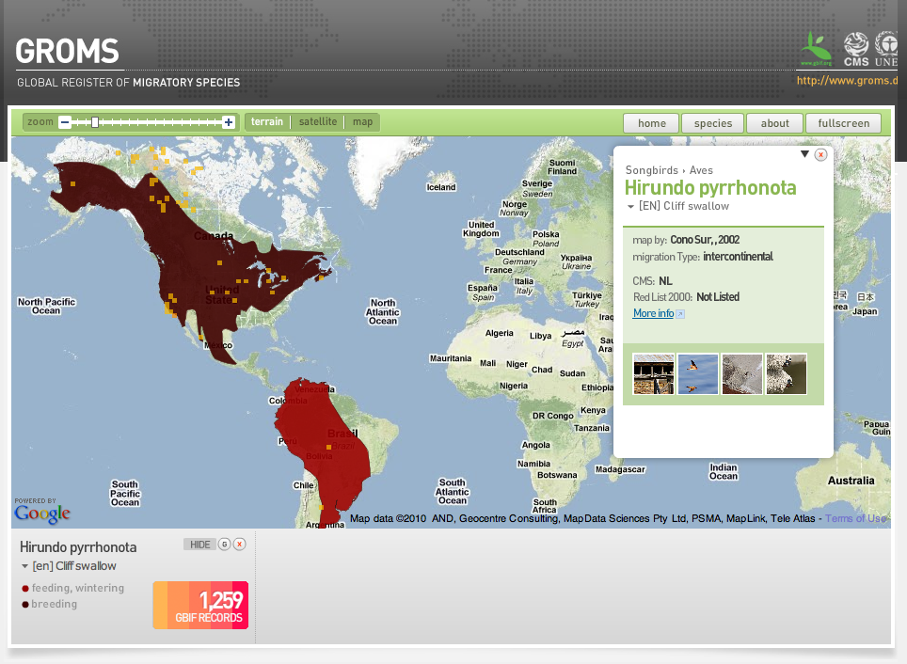
Using biodiversity data
Reveal & verify migration trends/patterns
Trans-boundary issues

Slide 34
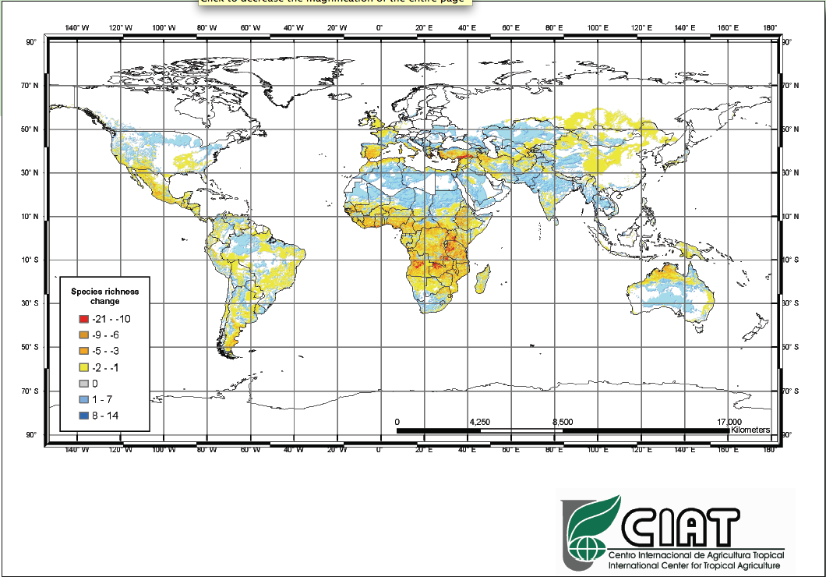
Using biodiversity data
Crop wild relatives
Changes in species richness under climate change scenarios

Slide 35
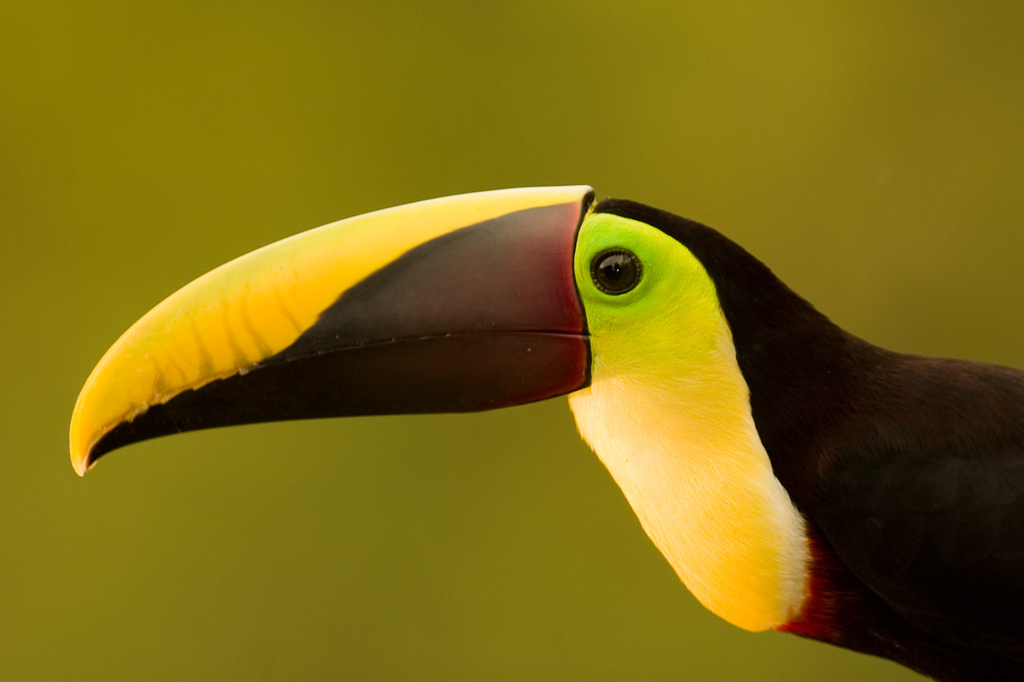
Impacts on the Collaboration
Social Impacts
Trust
Coordination
Photo by Greg Basco

Slide 36
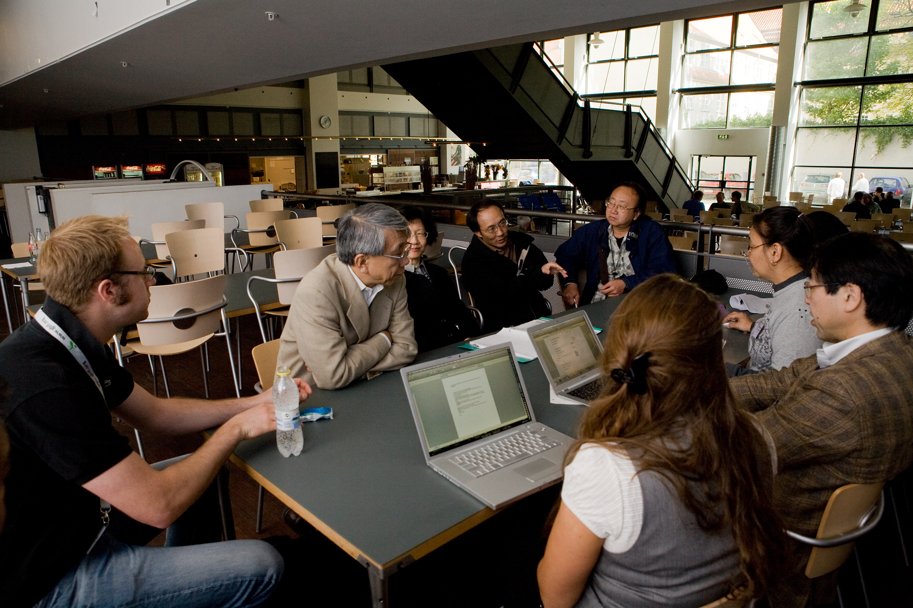
Personal Trust: Data in
Facetime is critical
Recognition - citation/attribution
Personally-Enabled

Slide 37
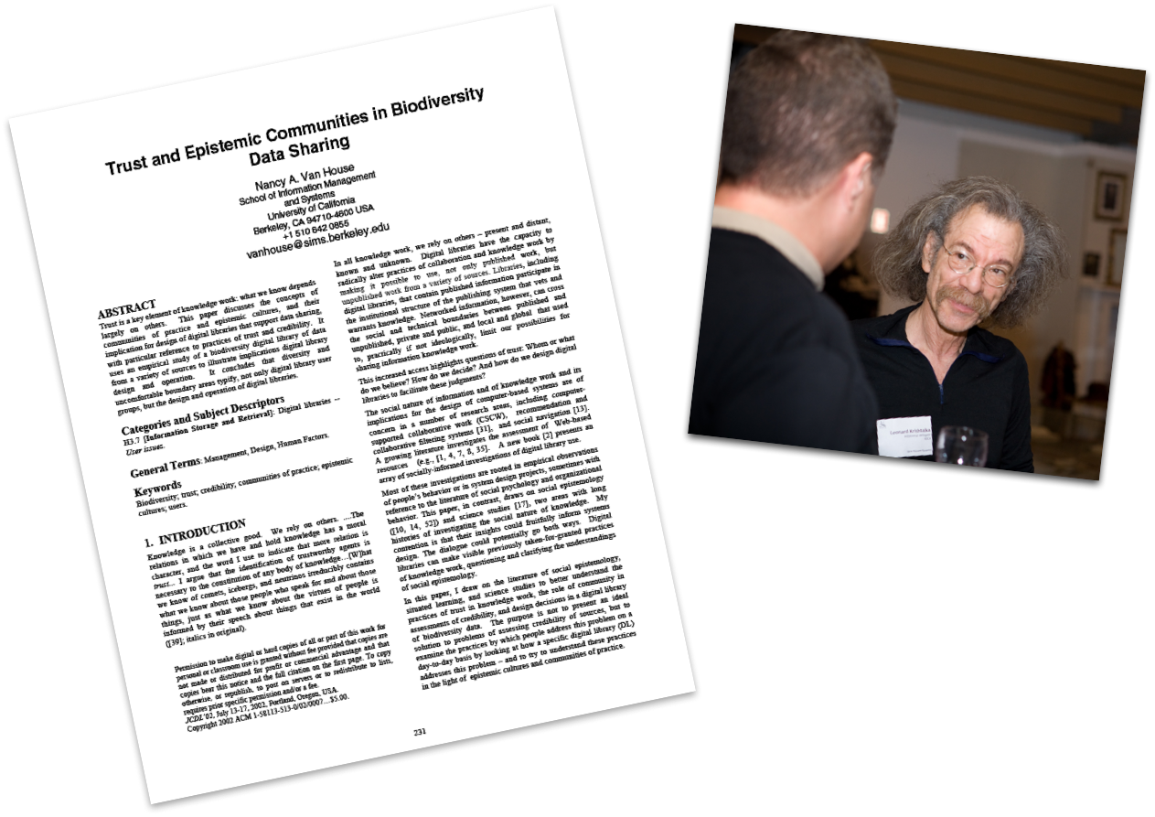
Personal Trust: Data Out
Documentation
Annotation
Standards
Technically-enabled
Social
Photo by David Remsen
Notes:
Picture of a regional meeting or people here.

Slide 38
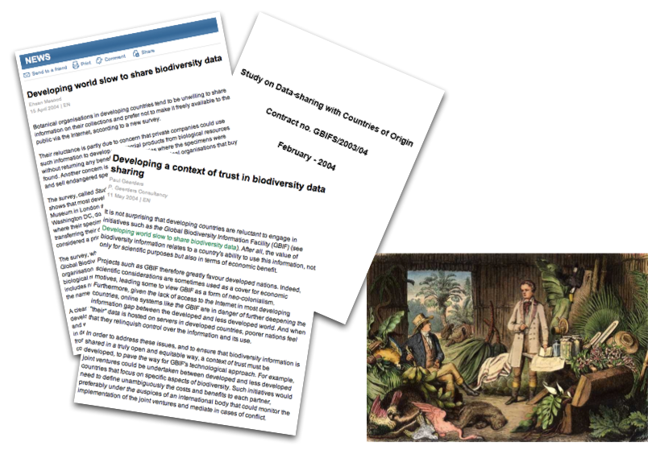
National Trust
A History of Exploitation
North/South divide
Notes:
National Level vs Personal

Slide 39
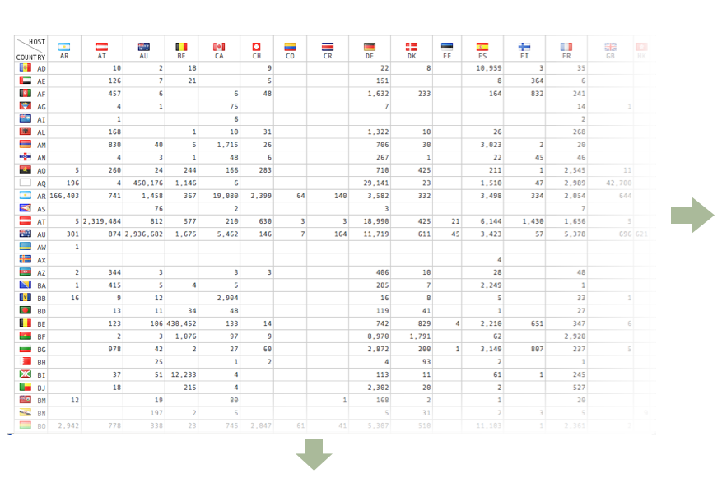
Data Repatriation

Slide 40

Coordination
Design by Committee
The defining characteristics of "design by committee" are needless complexity, internal inconsistency, logical flaws, banality, and the lack of a unifying vision.
TO BE AVOIDED (BUT HARDER THAN IT SEEMS)

Slide 41
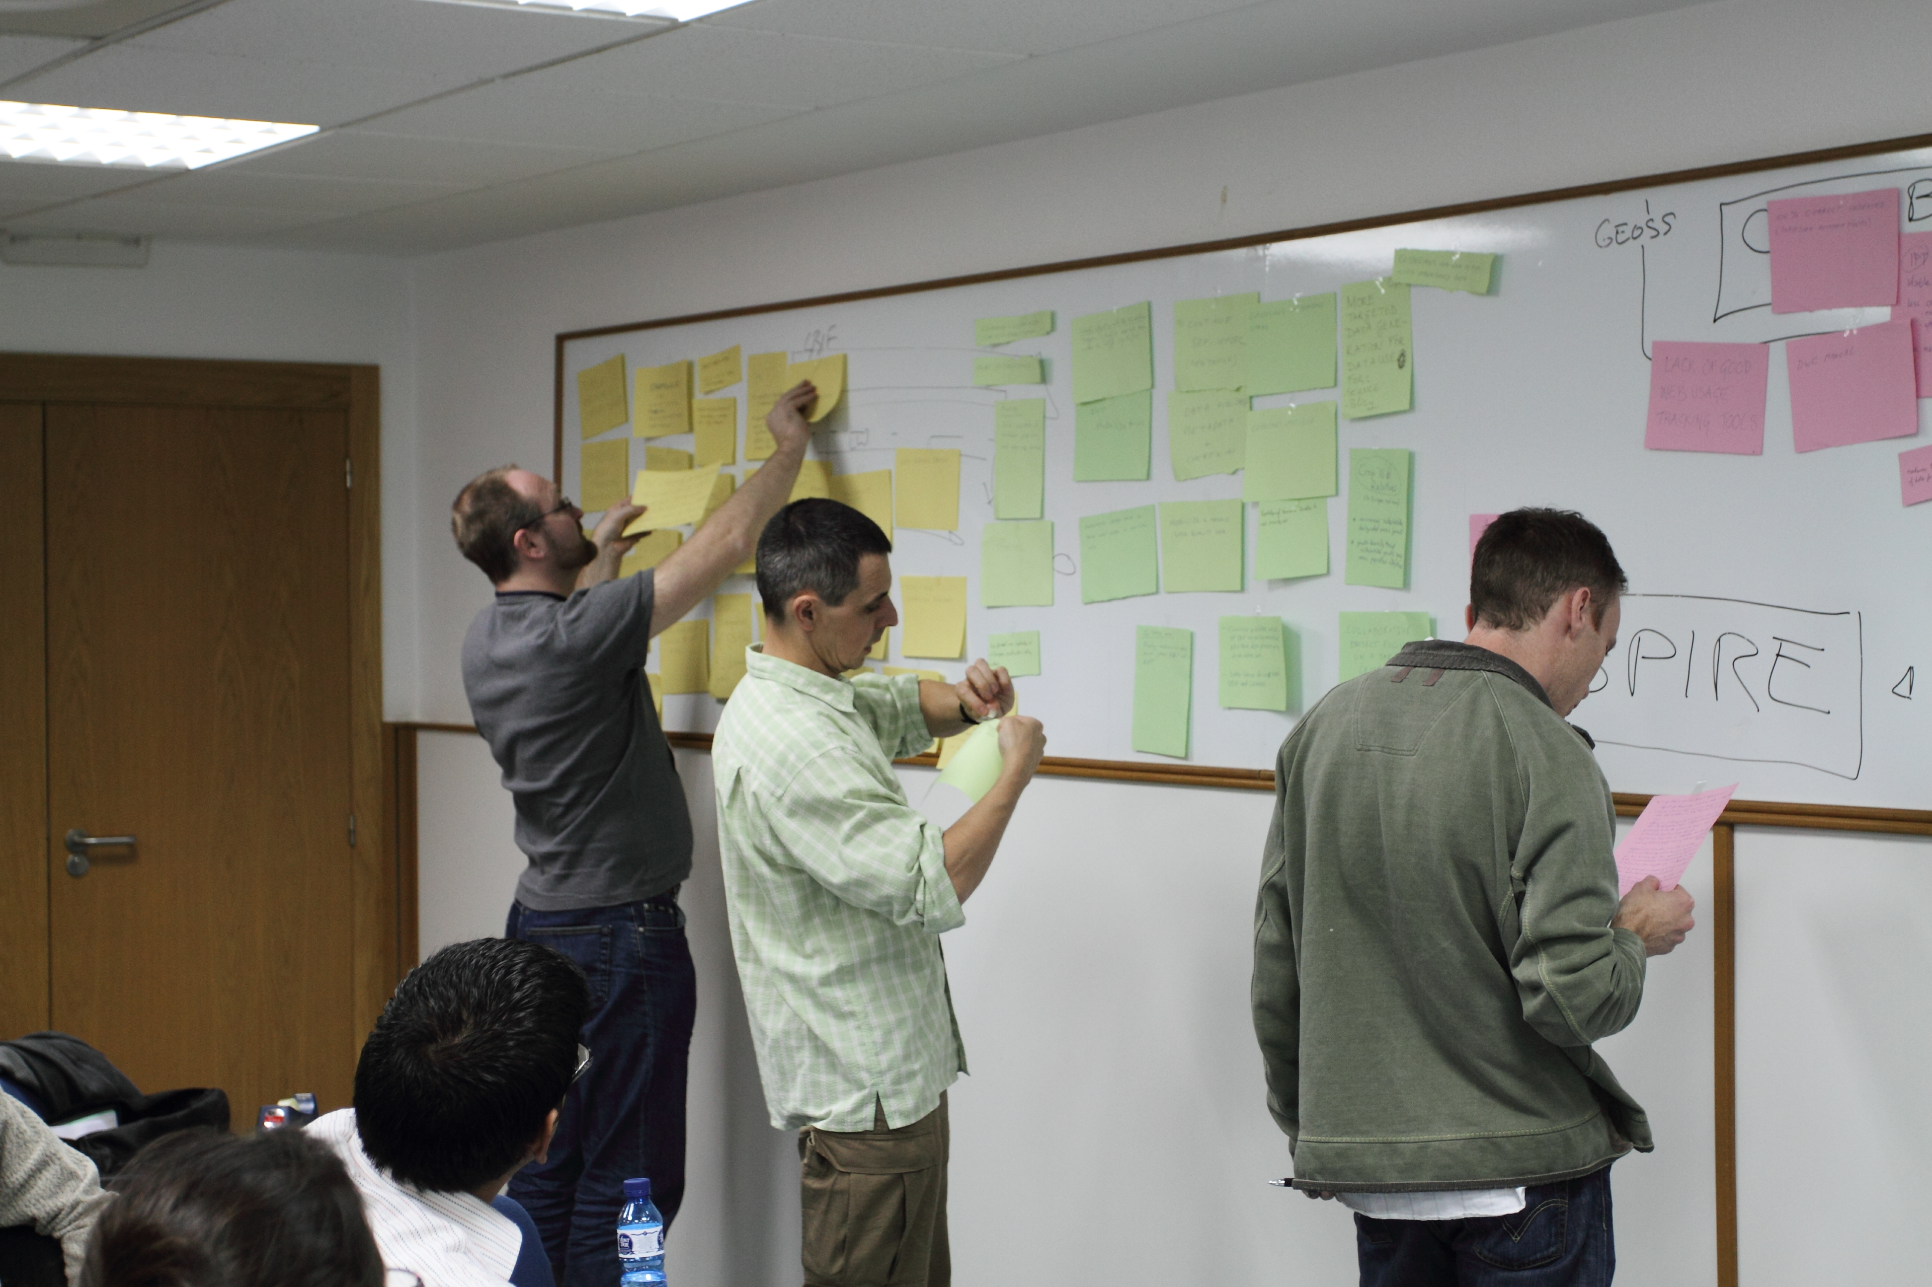
Collaborative Requirements Capture
Core Implementation
Notes:
Don’t want their problems/ challenges solved for them. Lessons from Entebbe. Development of regional centers and independence from the central GBIFS.

Slide 42
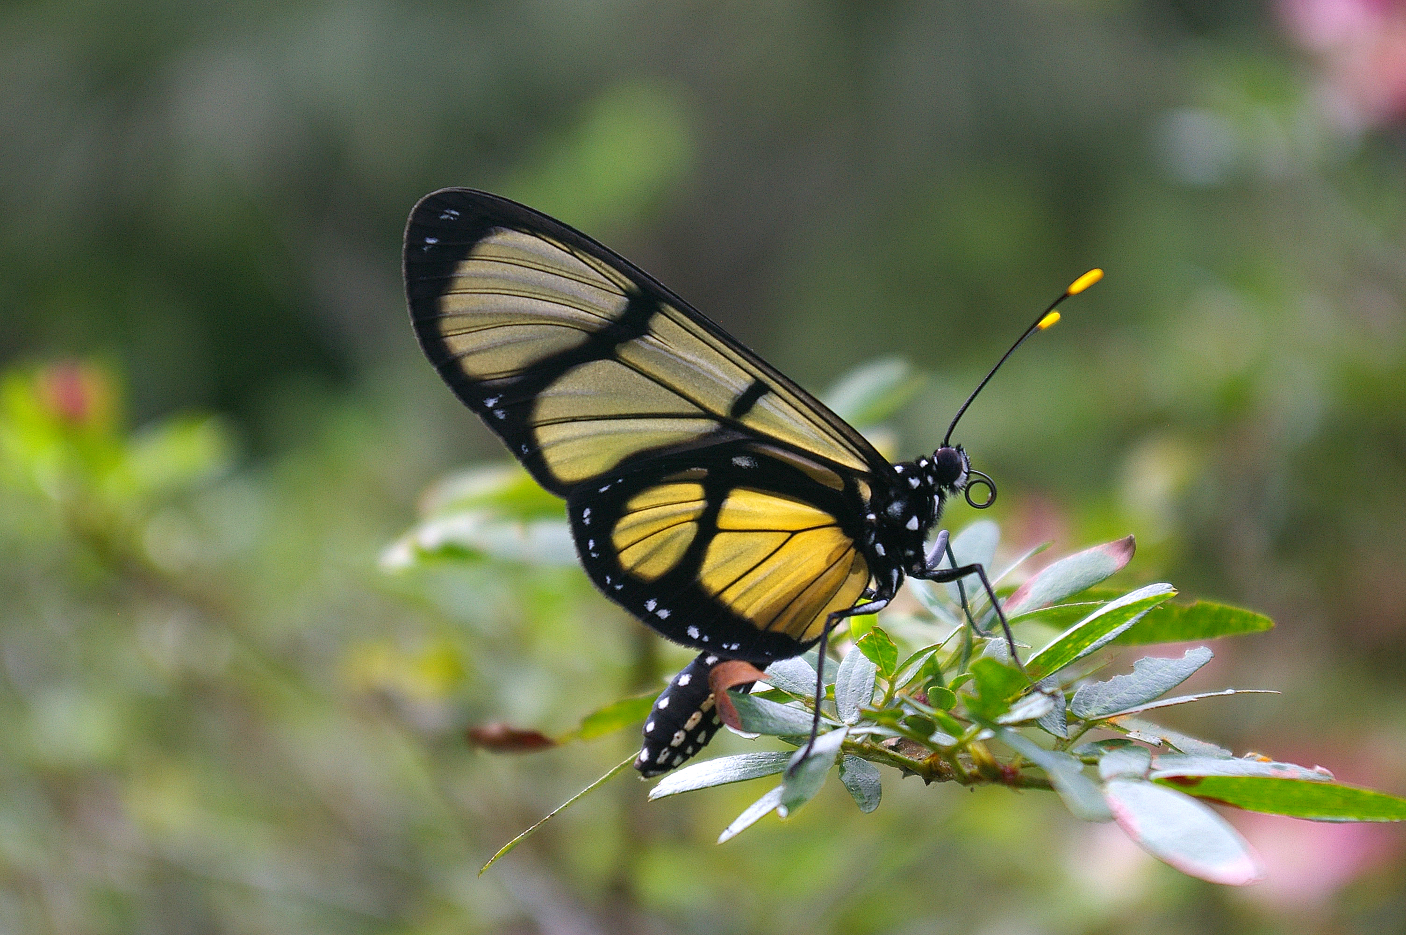
Impacts & Influences on the Collaboration
Technical Impacts
Some lessons learned
Photo by Christian Lange

Slide 43
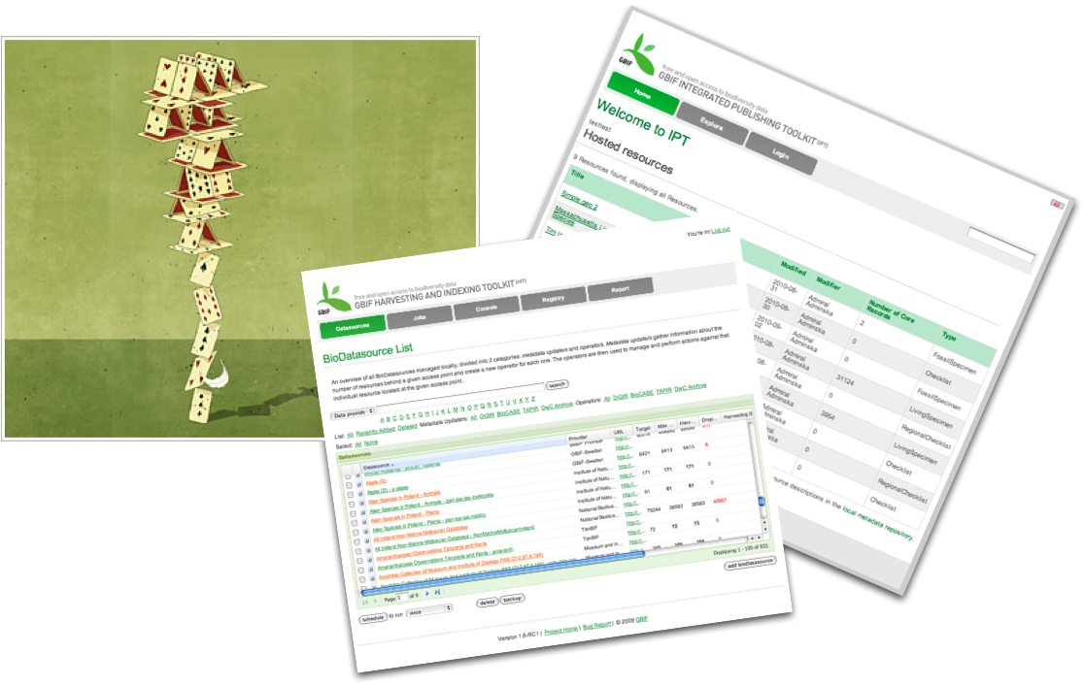
Impacts on the Collaboration
Don’t build your network on a house of cards
Photo by Greg Basco

Slide 44
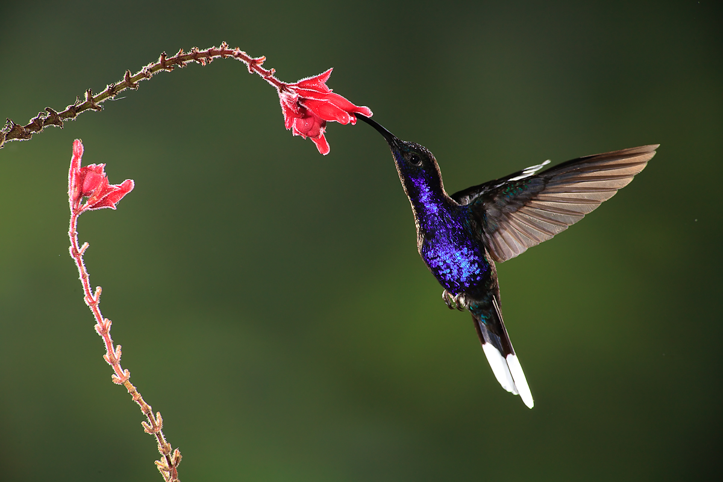
Impacts on the Collaboration
Put the burden on the
infrastructure
Not the users
Photo by Greg Basco

Slide 45

Gauging measures of success
The best network
is the one you don’t see
Data record numbers – tip of the iceberg

Slide 46

Impacts of the Collaboration
Social Impacts
Photo by Greg Basco

Slide 47
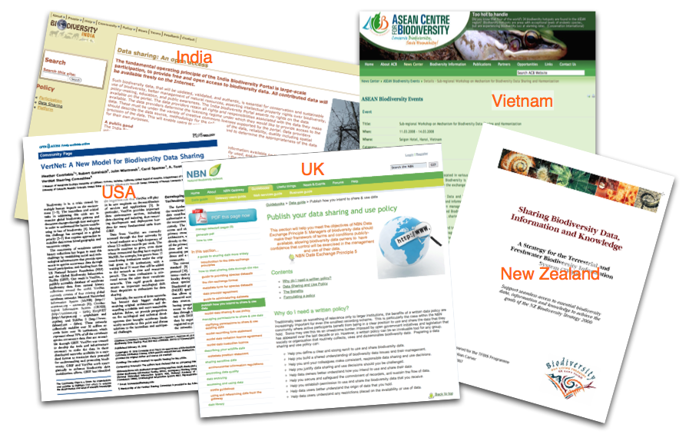
Mainstreaming Data Sharing
Mediation
Notes:
Don’t want their problems/ challenges solved for them. Lessons from Entebbe. Development of regional centers and independence from the central GBIFS.

Slide 48
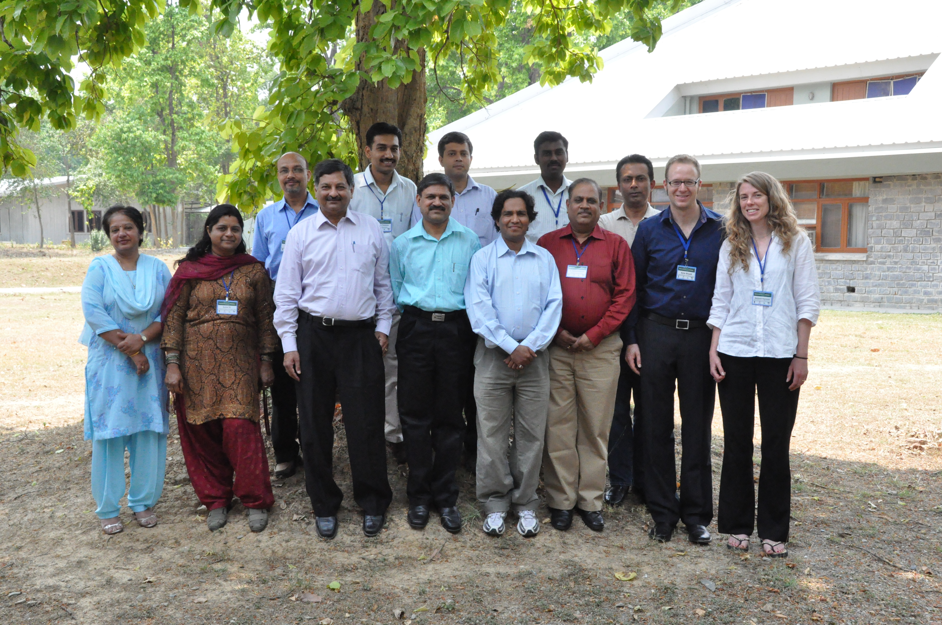
Enabling regionalisation
Decentralised use of the infrastructure
Notes:
Don’t want their problems/ challenges solved for them. Lessons from Entebbe. Development of regional centers and independence from the central GBIFS.

Slide 49
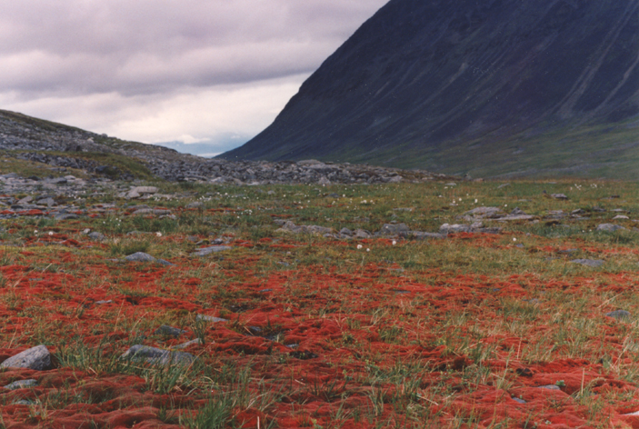
Impacts of the Collaboration
Technical Impacts
The consequences of Scale

Slide 50

Consequences of Scale
Social sharing is progressive
But may impact Trust

Slide 51

Consequences of Scale
Data sharing is conservative
even regressive
  Federated Search
Databases to indexes
XML to CSV
Complex Protocols to good old HTTP
LifeWatch & staying grounded

Slide 52

The Global Biodiversity Information System
Thank you
David Remsen
dremsen@gbif.org

