Slide 1
Adventures in Collaboration: Orbis Cascade Alliance,
NWDA, and WEST
Leadership Through Collaboration
September 20-21, 2010
Smithsonian Institution
John F. Helmer
Executive Director
Orbis Cascade Alliance

Slide 2

Outline
Projects
  Orbis Cascade Alliance
  Northwest Digital Archives
  WEST: The Western Regional Storage Trust
  Lessons learned
  People
  Organization
  Economics
  Zeitgeist
Final thoughts

Slide 3
Orbis Cascade Alliance
Consortium of academic libraries in Oregon & Washington
Private & Public, 2-year & 4-year
Colleges, Universities, Community Colleges
600 – 44,000 students
Notes:
Early 1990’s Orbis & Cascade
2004 Merger

Slide 4
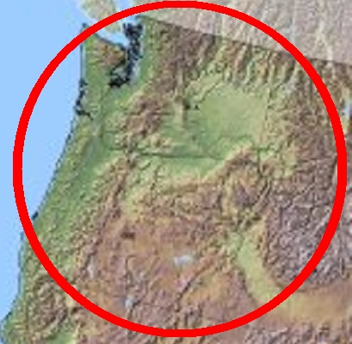
36 Member Libraries in Two States
serving 280 libraries, archives, museums in five states
Central Oregon Comm. College
Central Washington University
Chemeketa Community College
Clark College
Concordia University
Eastern Oregon University
Eastern Washington University
George Fox University
Lane Community College
Lewis & Clark College
Linfield College
Mt. Hood Community College
Oregon State University
Oregon Health & Science Univ.
Oregon Institute of Technology
Oregon State University
Pacific University
Portland Community College
Portland State University
Reed College
Saint Martin’s College
Seattle Pacific University
Seattle University
Southern Oregon University
The Evergreen State College
University of Oregon
University of Portland
University of Puget Sound
University of Washington
Walla Walla College
Warner Pacific College
Washington State University
Western Oregon University
Western Washington University
Whitman College
Willamette University
7
Members
5
Members
2
Members
20
Members
2
Members
Notes:
Orbis Cascade Alliance
www.orbiscascade.org
4

Slide 5
Alliance: Major Programs
Conferences & Workshops
Cooperative Collection Development
Courier Service
Electronic Resources
Northwest Digital Archives
Summit Resource Sharing System
Strategic Agenda: six initiatives

Slide 6
Alliance: Strategic Agenda
Cooperative Collection Development
Regional Library Services Cooperative
Future of Integrated Library Systems
Collaborative Technical Services
Digital Initiatives
Discovery

Slide 7

Northwest Digital Archives
Enhanced access to archival and manuscript materials through a union database of Encoded Archival Description (EAD) finding aids.
5,600 finding aids for archives and manuscripts collections in Washington, Oregon, Idaho, Montana, and Alaska.
Jodi Allison-Bunnell
NWDA Program Manager
Orbis Cascade Alliance
jodiab@uoregon.edu
406.829.6528
Notes:
2002
Founded with grants from the National Endowment for the Humanities, Division of Preservation and Access and the National Historical Publications and Records Commission
2002-2004
Phase 1: $350,000 NEH grant and $138,000 NHPRC grant
2005-2007
Phase 2: Grants of $300,000 from NEH and $178,000 from NHPRC
July 2007
NWDA became a permanent program of the Orbis Cascade Alliance

Slide 8
NWDA: Members
Public and Private, Five States, Non-Alliance members
Historical Societies, Municipal Archives, Academic Libraries (2-year, 4-year, research)
Alaska State Library, Historical Collections
Central Washington University
Central Oregon Community College
Eastern Washington University
Gonzaga University
Idaho State Historical Society
Lane Community College
Lewis & Clark College
Montana Historical Society
Eastern Washington State Historical Society
Northwest Museum of Arts & Culture
Oregon Health & Science University
Oregon Historical Society
Oregon Institute of Technology
Oregon State University
Pacific Lutheran University
Portland State University
Seattle Municipal Archives
Seattle Museum of History & Industry
University of Alaska Fairbanks
University of Idaho
University of Montana
University of Oregon
University of Washington
Washington State University
Western Oregon University
Western Washington University
Whitman College
Whitworth University
Willamette University

Slide 9
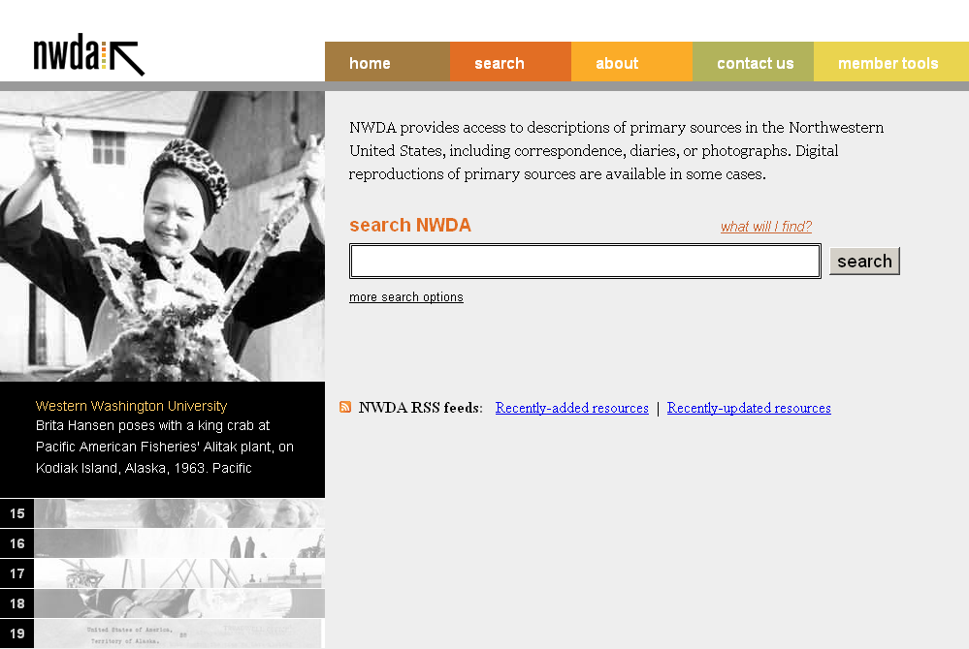
NWDA: Database

Slide 10
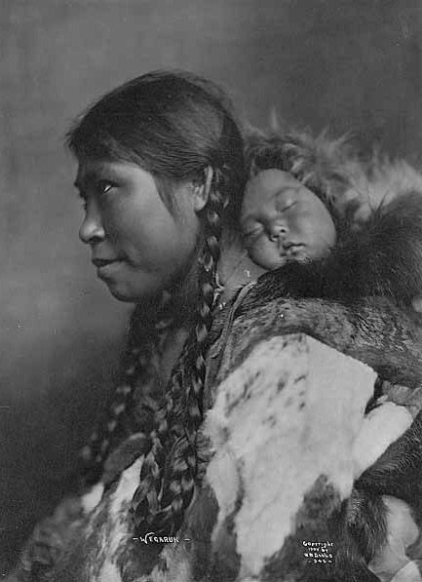
NWDA: Selected topics
Arts & Humanities
Business, Industry & Labor
City & Town Life
Colleges & Universities
Environment
Natural Resources
Ethnic and Religious Groups
Government & Politics
Home & Family
Native Americans
Pioneers
Sexuality
…and more!
Inuit mother named Wegaruk, carrying sleeping baby on her back, 1905, by B. B. Dobbs. AWC0043, University of Washington Special Collections.

Slide 11
NWDA: Major new initiatives
NHPRC grant received for 2010‐2012
  Add six new members
  Consulting Archivist will assist seven small liberal‐arts colleges with archival program development and collection description.
NEH grant application
  If awarded, will assist three current members and add three new ones.
  Digital Services Team
  NWDA staff and members are active participants in the Alliance team investigating a broad range of digital initiatives including digital preservation, cross search utility, institutional repositories, etc.

Slide 12
WEST: Western Regional Storage Trust
Planning a distributed, retrospective print journal repository program that will transform the manner in which print journal collections are housed and managed.
Reclaim and reallocate library space
Reduce cost of print collection management
Preserve the scholarly record
Serve as a national model and collaborate with other regional initiatives
Funded by the Andrew W. Mellon Foundation

Slide 13
WEST: Western Regional Storage Trust
Planning activities
Selection criteria
Technological needs for disclosure and collection analysis
Governance
Business model
Legal status
Roles of participants and consortia
2009 Summer: planning starts
2011 January: project expected to start

Slide 14
WEST: Planning Partners
University of California Libraries
Leadership, principle investigator, and administrative host
Arizona State University
California Digital Library
California Institute of Technology
California Polytechnic Institute
Claremont Colleges
Getty Research Library
Huntington Library
Occidental College
Oregon State University
Stanford University
University of Arizona
University of California, Berkeley
University of California, Los Angeles
University of California, San Diego
University of Oregon
University of Washington
Washington State University
Consortia:
  Orbis Cascade Alliance
  SCELC
  GWLA

Slide 15
WEST: Additional participants
Baylor University
Brigham Young University
California State University – Fullerton
California State University – Long Beach
Iowa State University
Kansas State University
Oklahoma State University
Rice University
San Francisco State University
Southern Illinois University – Carbondale
Texas A& M University
Texas Tech University
University of Arkansas – Fayetteville
University of California – Davis
University of California – Irvine
University of California – Merced
University of California – Riverside
University of California – Santa Barbara
University of California – Santa Cruz
University of California – San Francisco
University of Colorado – Boulder
University of Colorado – Denver
University of Denver
University of Hawaii – Manoa
University of Idaho
University of Kansas
University of Missouri – Columbia
University of Nebraska
University of Nevada – Las Vegas
University of New Mexico
University of Oklahoma
University of Texas – Austin
University of Utah
University of Wyoming
Utah State University
Washington University in St Louis
Additional institutions will participate via
  Orbis Cascade Alliance
  Statewide California Electronic Library Consortium

Slide 16
Lessons learned from Alliance, NWDA, WEST
  People
  Organization
  Economics
  Zeitgeist

Slide 17
  People
  Expertise, reputation, attitude, time, organization, intelligence, follow-through, sitzfleisch, firepower
  Individuals often trump institution type
  Difficulty of representation
    A new role for some
    Impact on the institution
    Reward structures: is collaboration an “extra”
  Differing values and knowledge
    Vertical: admin & staff
    Horizontal: colleagues
  The value of a good emergency
Notes:
People make things happen
Institutions make it sustainable

Slide 18
  Organization
  Making use of existing organizations
    Merging or “de-duping” programs and organizations
    Consortia or participating institutions as home?
    Fears: bureaucracy=slow, loss of control, cost, entanglement
    Advantages: lower overhead, expertise, diversity, buy-in by new players, reputation, stability
  Project staff
    Energy, accountability, focus
    Value of having capable staff with no horse in the race
  Keep it simple and compelling
  Avoid legal complexity (trust vs. contract)
  Scale: how big is big enough? Is diversity good? Is bigger always better?
Notes:
Orbis/Portals er program
Orbis/Cascade
Orbis Cascade/NWDA
CDL & CRL/WEST

Slide 19
  Geography
  Scale: how big is big enough? Is diversity good? Is bigger always better?
  When is proximity important?
    Experience of participants
    Clarity of concept
    Regional subject matter
    Traditional alliances
    Existing relationships
    Logistics
    Law
    Funding source
  In support of face-to-face meetings
  Danger of geographic limitation
Notes:
Scale: OCLC, Orbis Cascade Alliance merger
Bigger is not always better
Bigger: good and bad, what is in it for current participants?
Why “statewide?”
Northwest example (Or/Wa, e/w, n/s, State of Jefferson, Canada, Idaho)
Logistics: moving people or materials

Slide 20
  Economics
  Controlling externalities
  Budgetary silos
  Cost Models
    What is “fair?”
    Simplicity
    Predictability
    Stability
    Cost of size vs. individuality
    Sustainability, making a “profit”
  Source of funding
    Start-up grants: catalyst vs. dependence
    Recurring: importance of buy-in
Notes:
New: requires time & money
Legacy reform: requires change, Alliance TCO project
Sustainability is never done

Slide 21
  Zeitgeist: the spirit of our time
  Chemistry
  “The time was somehow just right”
  Being ahead of the curve
  Attraction of “new”
  Potential to build relationships and organizations for the future
  Motivation to “do what is right” if the price is right

Slide 22
  Final thoughts
  The institutional umbrella
  Reforming legacy operations
  Evolution of services from many in isolation to one

Slide 23
  Final thoughts
  Deeper collaborations under an institutional umbrella?
  “we expected that we would be able to find … deeper collaborations under an institutional umbrella than among institutions that don’t have an administrative structure in common”
    -- Waibel, Günter. 2010. Collaboration Contexts: Framing Local, Group and Global Solutions. Report produced by OCLC Research. http://www.oclc.org/research/publications/library/2010/2010-09.pdf
Notes:
New collaboration as pseudonym
Freedom from ingrained structural and personnel problems
You can choose your friends but you can’t choose your family.

Slide 24
  Final thoughts
  Reforming legacy operations
  New is attractive and often easier
  Reform is necessary and often harder
  Doing what we know needs to be done but would prefer to avoid
  Don’t shoot the messenger: collaboration is not the problem it may be a solution
Notes:
New: no precedent, grants available, people interested
Legacy: overcome ingrained positions and thinking but many resources available
Orbis Cascade Alliance TCO study
Poverty (ideally) encourages creativity and cooperation on difficult projects

Slide 25
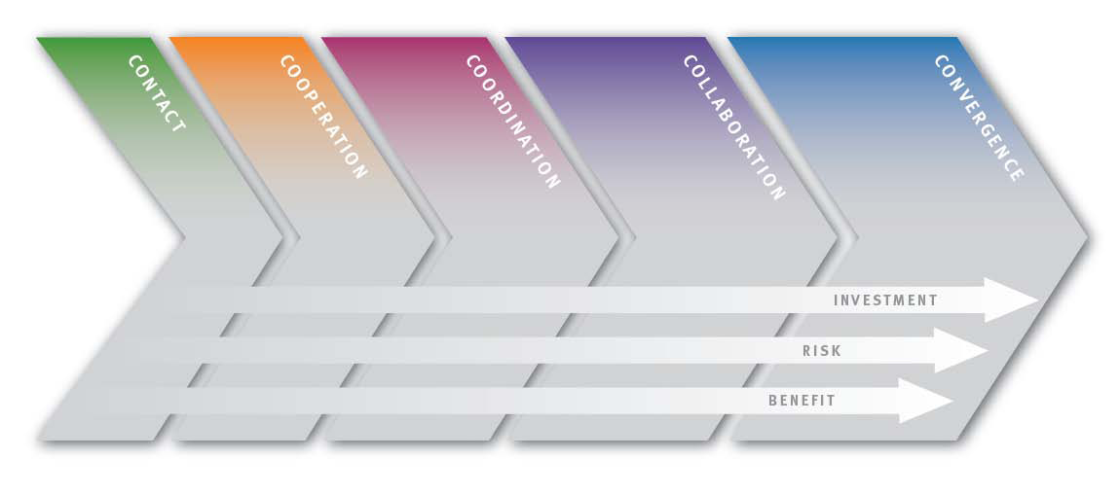
  Final thoughts
  Evolution of services from many in isolation to one
Resource
Sharing
Example
Isolation
Cooperate
Collaborate
Behave as one
Not sharing
Interlibrary loan
Consortial borrowing
Hold/deliver
Collection
Development
Example
Uncoordinated
Shared information
Coordinated purchasing
One collection
Notes:
Apology for library examples

Slide 26
Adventures in Collaboration:
Orbis Cascade Alliance,
NWDA, and WEST
John F. Helmer
Executive Director
Orbis Cascade Alliance
jhelmer@uoregon.edu
541.346.1835
www.orbiscascade.org

