Slide 1
Collaboration Trials and Triumphs
Steve.museum, ArtBabble and Other Collaborative Ventures
Robert Stein
Chief Information Officer
Indianapolis Museum of Art
rstein@imamuseum.org
@rjstein

Slide 2
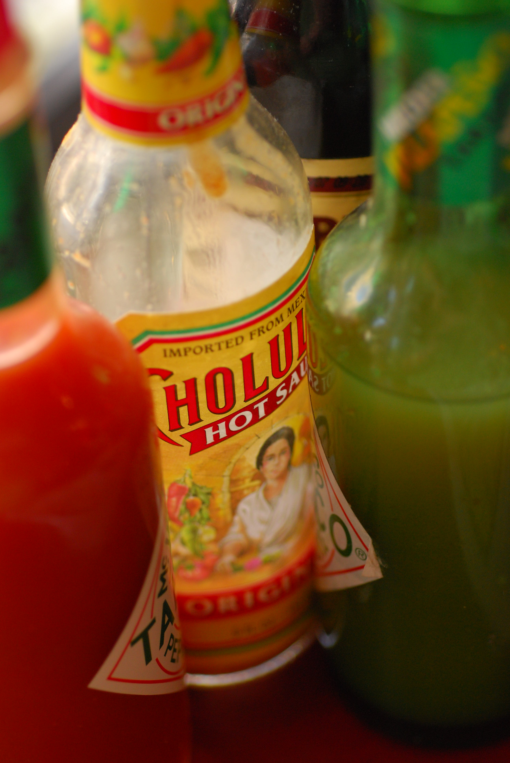
WHAT’S THE
SECRET SAUCE?
Flickr Credit ~ericinsf

Slide 3
AMBITION
POWER
PROMOTION
PROFIT

Slide 4
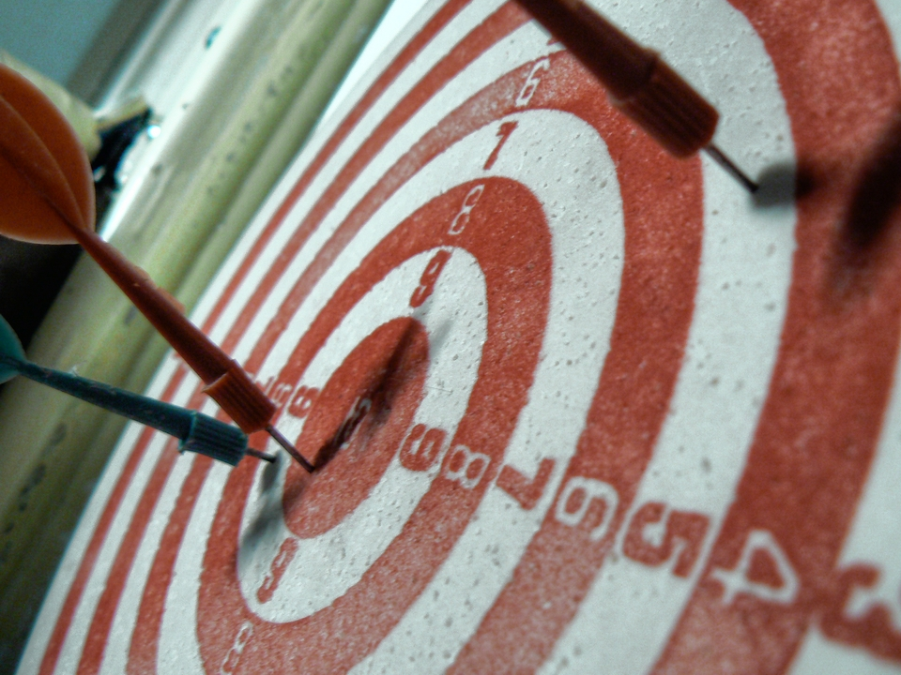
What’s the Target
of Your Ambition?
Flickr Credit ~bogdansuditu

Slide 5
IMPACT
MAKE A DIFFERENCE
CHANGE THE WORLD

Slide 6
colla
bora
tion
Common Interest
Culture Shift
Leadership
Unique Synergies
Ideological Change
Common Platforms
Accepting New Ideas
Building Best Practice

Slide 7
SOME EXAMPLES
Let’s Checkout…

Slide 8
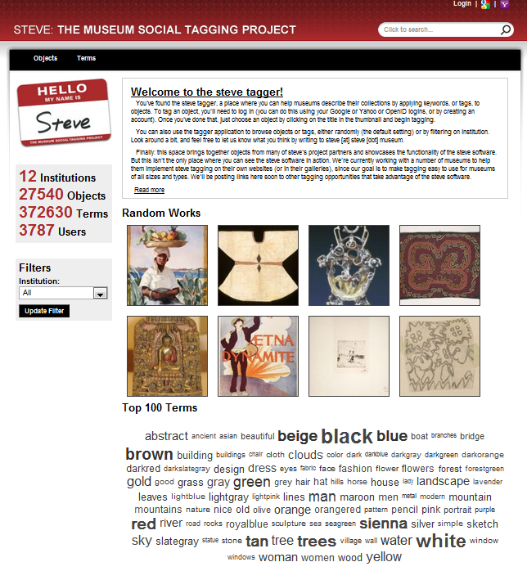
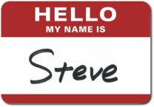

Steve.Museum
Exploring Applications of Social Tagging for Museums
2006 – 2008 Steve Research Grant
2008 – 2011 Steve In Action
2008 – 2011 T3: Text, Tags, Trust
Generously supported by the IMLS
Open source software supporting tagging in museums

Slide 9
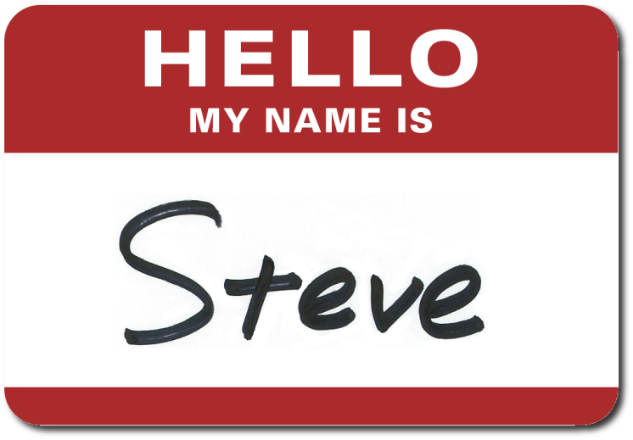
Motivation
Steve Research
  Answering Common Questions
  Defining Best Practices
Steve in Action
  Building Common Platforms / Tools
  Applying Lessons Learned
T3 Research
  Answering NEW Questions
  Bridging Two Communities
  Applying New Methods

Slide 10
Take-Aways
A Diversity of Partners
Pairing of Different Skill-sets and Sizes
Using Well Defined Frameworks
Difficult to Keep Long-Term Engagement
Easy to Under Estimated Time (especially for research)
Practical Deliverables Help Engagement

Slide 11
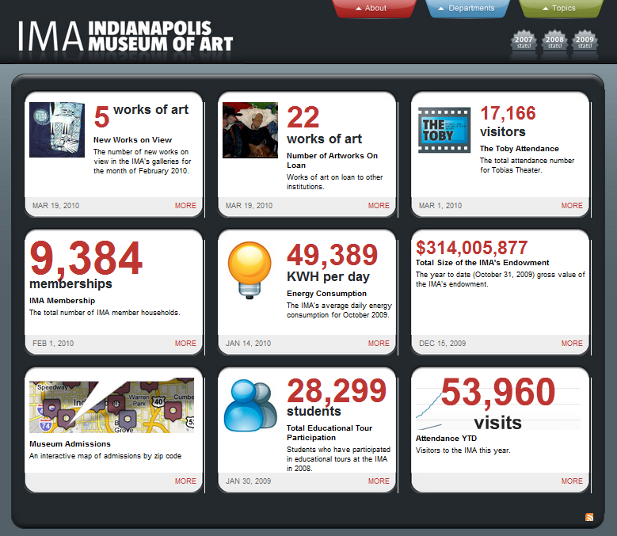
IMA Dashboard
Performance Metrics for IMA
More than 3 years of data actively updated by dozens of staff members across all departments of the museum
Designed to increase staff engagement with core museum data
Released as an open-source tool for any museum to use to enhance transparency of operations

Slide 12
Motivation
Culture Shift
  Measurement leads to better performance
Ideological Change
  Exposing less-than-ideal performance is OK
Leadership
  Setting an example for our peers about statistical reporting
Best Practices
  Giving it away and asking for input

Slide 13
Take-Aways
Make it Easy
  Numerous small contributions make a big difference
Keeping Heads in the Game
  Involving many in review provides peer reinforcement
Evolve
  Don’t be afraid to change directions

Slide 14
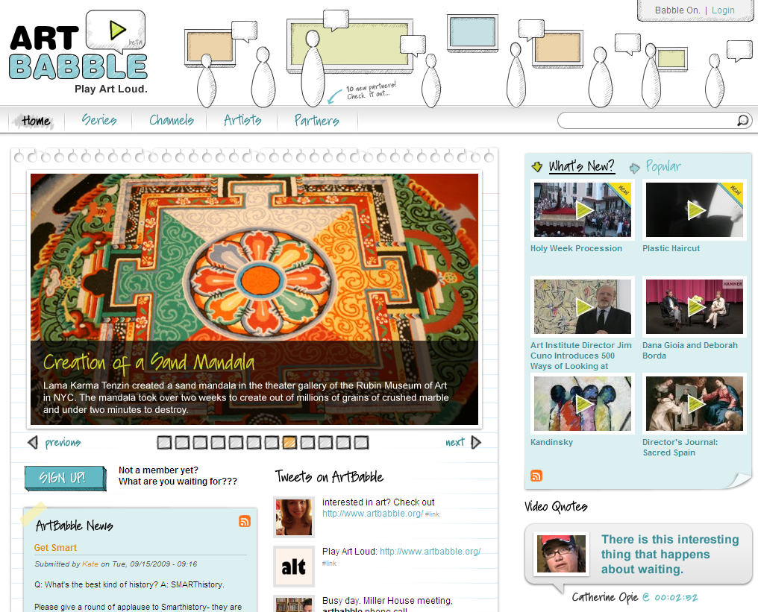
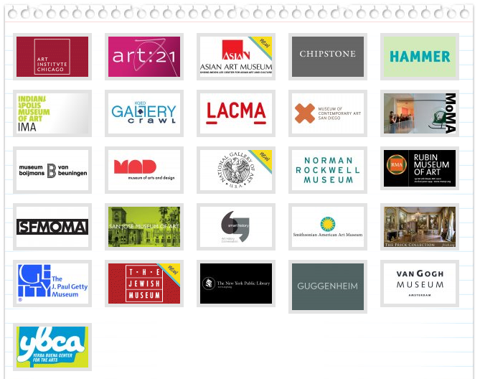
ArtBabble
A Collaborative Video Platform about Art and Artists
An open platform seeking to gather video from a wide range of partners in a single location
Current partnerships with 26 important cultural organizations

Slide 15
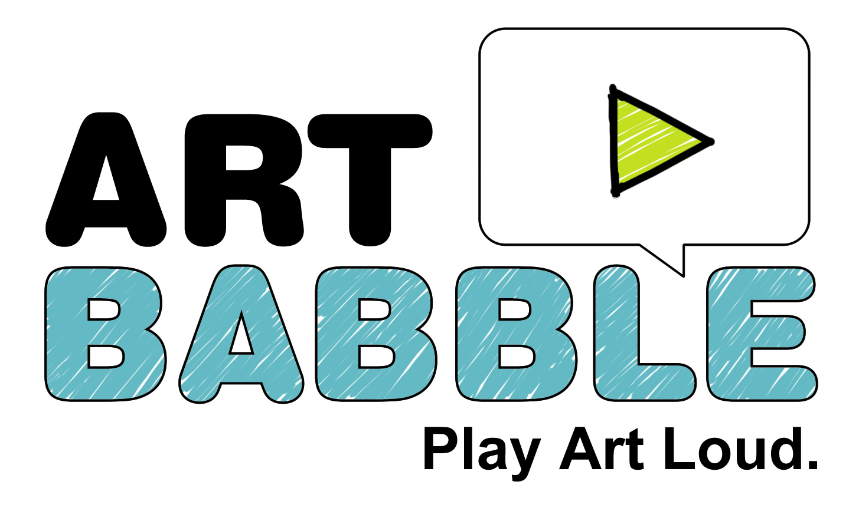
Motivation
Unique Synergy
  Shared content builds audiences across institution
Culture Shift
  Collaborating around content will be a powerful model for new platforms
Common Platform
  Consistent experience for
  users

Slide 16
Take-Aways
Collaborate Around Content
Niche Content Portals Work
Make it Free
  Free projects can skip the budget hurdles
Make it Easy
  Even small effort can derail
  progress
Lead

Slide 17
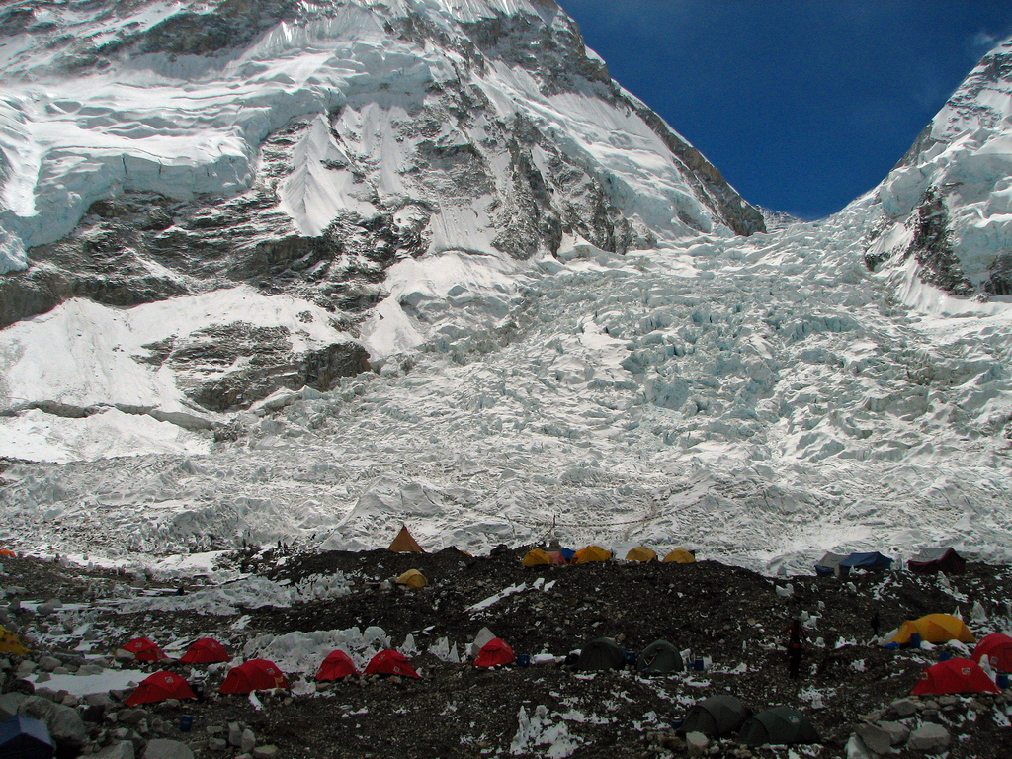
CHALLENGES OF COLLABORATION
Management Costs are High
Set Expectations and Develop a Firm Framework
Flickr Credit ~mckaysavage

Slide 18
CHALLENGES OF COLLABORATION
Long-Term Engagement is Elusive
Create Inter-Dependent Teams with Simple Deliverables
Flickr Credit ~mckaysavage

Slide 19
CHALLENGES OF COLLABORATION
Benefits are Indirect or Delayed
Educate Senior Management About What to Look For
Flickr Credit ~mckaysavage

Slide 20
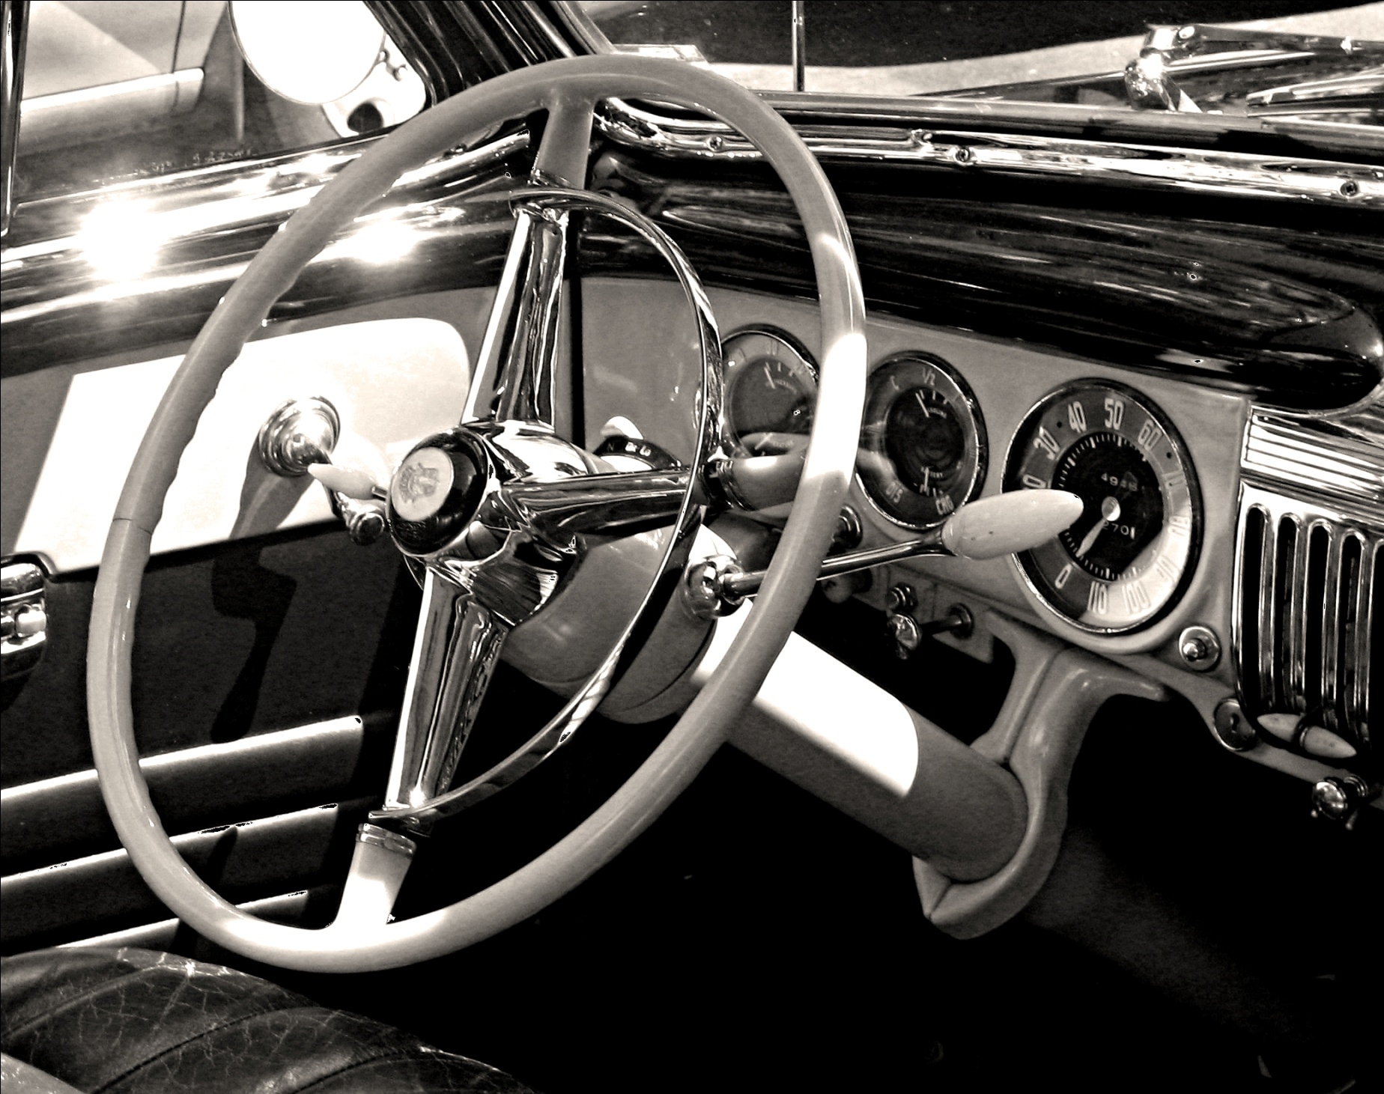
Successful Collaborations Require…
COLLABORATIVE LEADERS
Steering the car with no hands on the wheel
Flikr Credit ~professorbop

Slide 21
Qualities of…
COLLABORATIVE LEADERS
An ambition for impact
A belief in synergy
A sober appreciation of individual limitations
Flikr Credit ~professorbop

Slide 22
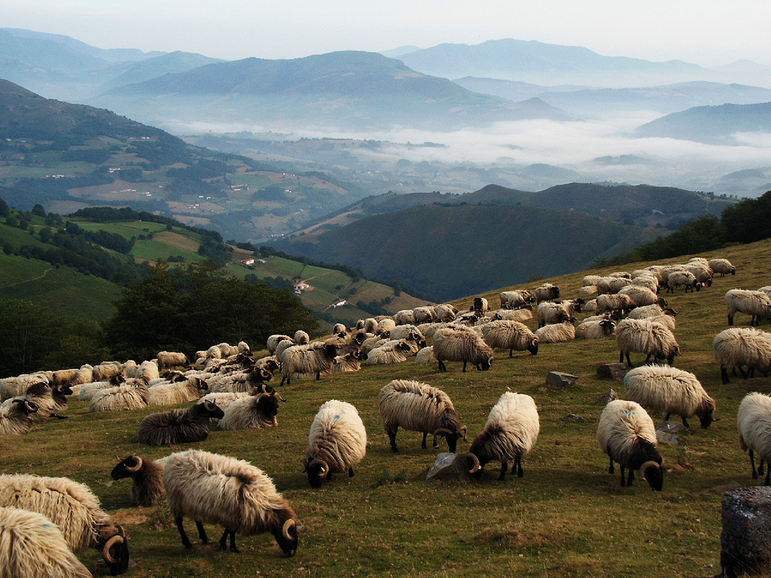
Tips for Collaborative Leaders
Be ready to give more to the group than you receive in return
Flickr Credit ~jule_berlin

Slide 23
Tips for Collaborative Leaders
Be absolutely transparent about how you are benefitting from collaboration
Flickr Credit ~jule_berlin

Slide 24
Tips for Collaborative Leaders
Expect to learn something you don’t already know
Flickr Credit ~jule_berlin

Slide 25
Tips for Collaborative Leaders
Expect failure
If I can do it on my own, then I don’t need you!
Flickr Credit ~jule_berlin

Slide 26
Thank You!
Questions?

