Slide 1
Yours, Mine, Ours
Leadership Through Collaboration
OCLC Forum
Meg Bellinger
September 2010

Slide 2
Agenda
Yale
ODAI
Strategies for collaboration

Slide 3
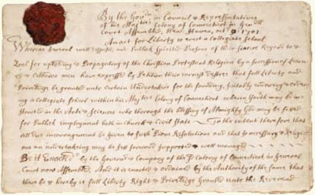
1701
“Publick employment both in Church & Civil State”
Notes:
An institution older than the republic, founded on a donation of books and goods,
Yale University comprises three major academic components: Yale College (the undergraduate program), the Graduate School of Arts and Sciences, and the 13 professional schools. In addition, Yale encompasses a wide array of centers and programs, libraries, museums, and administrative support offices. Approximately 11,250 students attend Yale.
Professional Schools
School of Architecture
School of Art
Divinity School
School of Drama
School of Engineering & Applied Science
School of Forestry & Environmental Studies
Law School
School of Management
School of Medicine
School of Music
School of Nursing
School of Public Health
Institute of Sacred Music

Slide 4
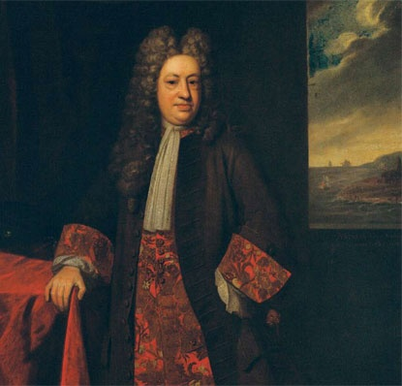
1701
“Publick employment both in Church & Civil State”
1718
The Collegiate School renamed Yale College in recognition of Elihu Yale’s donation of books and goods.
Notes:
An institution older than the republic, founded on a donation of books and goods,
Yale University comprises three major academic components: Yale College (the undergraduate program), the Graduate School of Arts and Sciences, and the 13 professional schools. In addition, Yale encompasses a wide array of centers and programs, libraries, museums, and administrative support offices. Approximately 11,250 students attend Yale.
Professional Schools
School of Architecture
School of Art
Divinity School
School of Drama
School of Engineering & Applied Science
School of Forestry & Environmental Studies
Law School
School of Management
School of Medicine
School of Music
School of Nursing
School of Public Health
Institute of Sacred Music

Slide 5
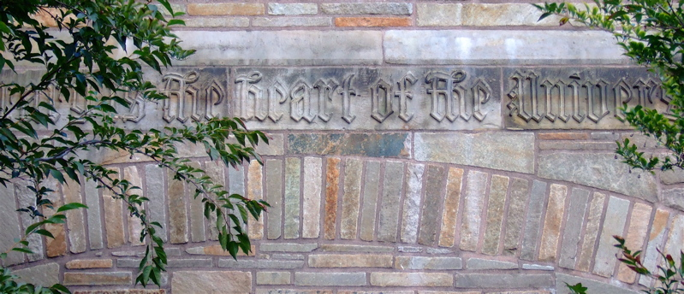
1701
“Publick employment both in Church & Civil State”
The Library is the heart of the University
Notes:
An institution older than the republic, founded on a donation of books and goods,
Yale University comprises three major academic components: Yale College (the undergraduate program), the Graduate School of Arts and Sciences, and the 13 professional schools. In addition, Yale encompasses a wide array of centers and programs, libraries, museums, and administrative support offices. Approximately 11,250 students attend Yale.
Professional Schools
School of Architecture
School of Art
Divinity School
School of Drama
School of Engineering & Applied Science
School of Forestry & Environmental Studies
Law School
School of Management
School of Medicine
School of Music
School of Nursing
School of Public Health
Institute of Sacred Music

Slide 6
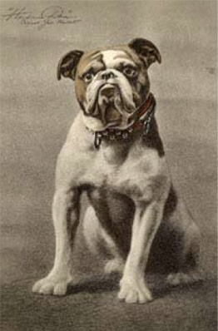
Handsome Dan (XVI) has continued to lead the cheers on the football field since 1889 when Yale students adopted the first college mascot.
Notes:
11,250 students attend
Yale College (the undergraduate program),
Graduate School of Arts and Sciences
13 professional schools.
Avail themselves of 22 libraries and 4 museums

Slide 7
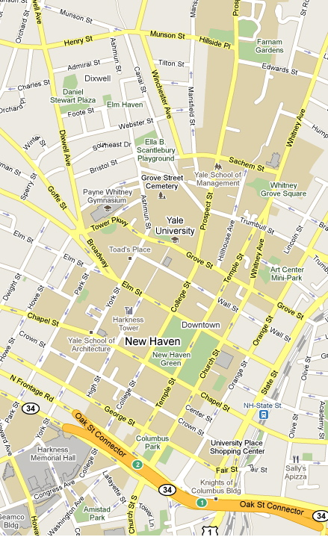
School of Forestry &
Environmental Studies
Institute of Sacred Music
Divinity School
School of Engineering
& Applied Science
Peabody Museum
YALE COLLEGE
School of Mgmt
Collection of Musical
Instruments
Law School
Beinecke Rare Book
& Manuscript Library
Sterling Memorial
Library
School of Music
GRADUATE SCHOOL
OF ARTS & SCIENCES
Art Gallery
Center for British Art
Schools of
Arts,
Architecture,
Drama
Schools of
Medicine,
Nursing,
Public Health

Slide 8
Some aspects of the University’s administrative structure present challenges for LAM collaborations. For these collaborations to be sustainable, the following need to be recognized:
1. The University’s funding approach is decentralized and based largely on donor/funder loyalties to specific departments, programs, and collections.
2. The University’s organizational hierarchy makes the decision-making process difficult to navigate across reporting lines.
3. University committees act independently, yet their agendas often overlap.

Slide 9
Timeline of Digital Management Planning
ODAI
2002 | 2003 | 2004 | 2005 | 2006 | 2007 | 2008 | 2009
U. Council Committee
on Digital Yale
Digital Dissemination Task Force
Office of Digital Dissemination
LAM
Collections Collaborative
Provost’s Digital
Inventory
Library Integrated Access Program
ITS Digital Landscapes Group
Provost’s Advisory Committee
On Digital Landscapes

Slide 10

A New Model

Slide 11
ODAI Mission
Drawing upon the extensive faculty and staff resources of the campus, accelerate the development of Yale’s digital content and infrastructure into a world-class resource that ensures Yale's digital assets will be discoverable and accessible for teaching and research both now and in the future and that provides a platform for disseminating the University's intellectual digital assets.
Notes:
Launched in October 2008 Collaborative endeavor to bring together Yale departments engaged in life0cycle management of digital content.

Slide 12
Digital Ecosystem at Yale
Content
Policy
& Shared
Practice
Technology
Community
Infrastructure
SUSTAINABILITY
Notes:
So what is infrastructure? It is a digital ecosystem that balances four critical, interlocking/interwoven areas of concentration and dependencies. The Digital Ecosystem can be sustained through a new a kind of digital environmentalism that values reuse and sharing of scarce resource to leverage university investment in the management of digital assets from creation through to selective preservation in support of teaching, learning, and research.
Infrastructure is not just technology: We see four major parts of the digital ecosystem that constitute sustainable infrastructure.
First it is based on digital content (data, images, audio, video, and metadata) in various domains, and ultimately the user’s needs associated with this content.
Technology to support these data has traditionally been built and supported in separate systems.
The creation of policy and practice in such areas as intellectual property mgmt and descriptive metadata practices are essential yet lacking in any comprehensive or shared way.
Community of practitioners in the libraries and museums and creators of digital content are managing data throughout campus departments. Brought together, we create partnerships and increased capacity based on common needs and goals.
Sustainability = Digital Environmentalism
Conserve and reuse digital content
Share scarce resources
Build community engagement
Provide incentives for collaboration
Leverage digital content investment
Avoid wasteful duplication of effort

Slide 13
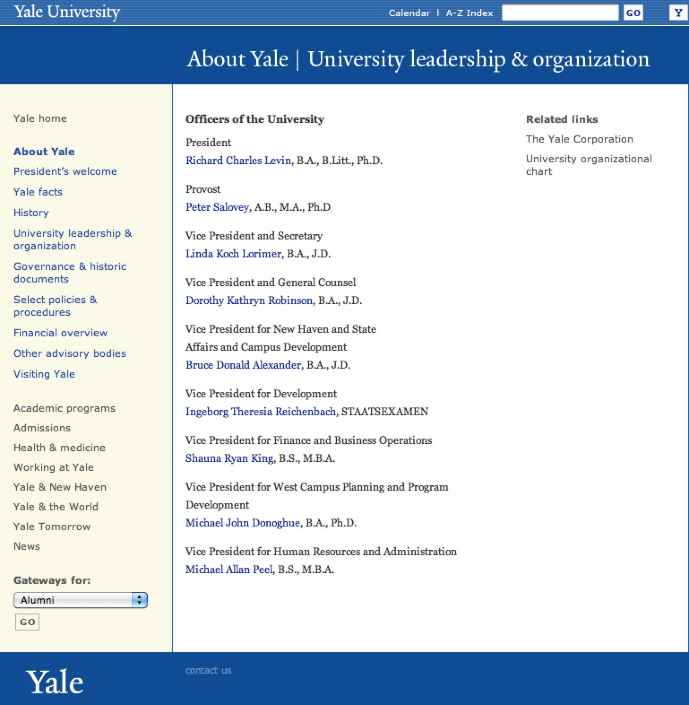
Reporting
Provost
Deputy for Academic Resources
VP & Secretary
Deputy for Arts
Deputy for Sciences & Tech.

Slide 14
ODAI Advisory Committee
Faculty
ODAI
Yale Library
Yale Press
Peabody Museum
Digital
Research
Teaching
Learning Dissemination
General Counsel
Beineke Rare Book Library
ITS
Center For British Art
Art Gallery

Slide 15
Digital Asset Infrastructure Strategy
Strategic priorities, resource identification,
and policy approval.
ODAI Advisory Committee
POLICY
Prioritizes work &
appoints WG.
Write/commissions
policy
recommendations
Tactical priorities.
Represents dept goals.
Aligns with campus goals.
IDs project teams.
Steering Committee on Policy & Shared Practice
Advisory Committee Yale Digital Commons
Working group
Library-YDC SC
Working group
Working group
Collections Collaborative Redux
Planning Committee for Digital Preservation
YDC users’ group
Collections and Educational Technology
Project Teams
Project Teams
Project Teams
Organizing for Collaboration
Notes:
ODAI Advisory Committee = Digital Asset Infrastructure Strategy
Strategic priorities, resource identification, and policy approval.
Yale Digital Commons = Shared services, tools, platforms, content.
Advisory committee develops and supports tactical priorities for the YDC. Communicates departmental needs and works with ODAI to develop campus-wide shared goals and action items. Aligns departmental digital infrastructure goals. Advises ODAI on YDC architecture. Reviews YDC project proposals. Proposes projects to further shared goals. Communicates progress and needs back to individual department directors. Identifies policy and practice needs and communicates them to the Steering Committee on Policy and Shared Practice. Acts as an advocacy group for the concept of the Yale Digital Commons. YDC members communicate to ODAI about their department decisions about team membership. ODAI forms cross-domain project teams with YDC Committee advice. Membership requires that the department has joined the YDC as a full partner. Department appoints representative with recommendations as-needed from ODAI.
Steering Committee on Policy and Shared practice = Develops framework for policies and practices needed to support a shared digital content infrastructure and to optimize resources for the life cycle management of digital content. Appoints task specific working groups to develop shared practices. Reviews and vets practices with YDC Advisory Committee. Develops, vets, and/or commissions policy development for recommendation to the ODAI Advisory Committee.
Shared Practice working group – formed by the Steering Committee to develop specific shared practices.
Planning Committee for Digital Preservation – appointed by ODAI for long-term planning and coordination with YDC. Develops policies and shared practice associated with digital preservation .
YDC users’ group – loosely formed large-group of participants from the YDC partners meets periodically to discuss and share information on technical issues associated with the YDC. Forum for existing and past project teams. Project partners and potential YDC partners may also participate.
Project Teams – Address discrete development projects. Members appointed by their department. Teams formed and led by ODAI.

Slide 16
Core Principles of Yale Digital Commons
Encourage appropriate sharing of digital content across the university
Respect domain differences while sharing common infrastructure
Identify shared outcomes requiring digital content management infrastructure through collaboration and produce them
Support common needs and share best practices
Inform Yale’s long-term planning for digital content management
Improve sustainability of technical solutions through larger-scale adoptions
Eliminate redundant efforts
Ensure end-of-life migration plans

Slide 17
YDC Components
iTunesU
You
Tube
Content
DAM
Export
Images
A/V
Drupal
Web
Persistent Linking
Fedora/ preservation metadata repository
Collection
Management
Systems
ORBIS
eMU
TMS
Kaltura
CDN
E-Catalog
ContentDM
Messaging
Data
Warehouse
Reporting
Cross Collection Discovery
Search
OAI
M
M
M
M
M
M
M
M
M
M
Metadata
Aggregate
Isilon Mass Storage
Notes:
The value chain of academic information links disciplinary domains, local scholar's workbenches, and global dissemination.
<Click>
Institutional stewardship requires infrastructure to fully complete the value chain and in so doing, support the full lifecycle of digital information.
<Click>
Different types of digital assets require different management environments. Digital media, has different requirements to gene sequencing data, has different requirements to web content. Therefore, a modular approach with different management environments can be expected.
<Click>
Standardized packaging, information, and messaging provide the connective tissue between these environments.
<Click>
Discreet services and processes can be provided within management environments or independently.
<Click>
All of this is layered atop a robust hard infrastructure of network, processing, and storage.

Slide 18
People
.
Define what is an “asset” of the University.
Identify the volume, cost, and liability associated with the vast majority of digital content at Yale that is not managed.
Conduct data assessments to determine the volume of current and future data creation.
Determine the total cost of ownership for digital data.
Develop policy on University retention.
Identify for consolidation the current range of independent asset management solutions across campus.
Prioritize the development of shared tools for data management.

Slide 19
Combine strategy with tactics
(implementation is critical).
.
Define what is an “asset” of the University.
Identify the volume, cost, and liability associated with the vast majority of digital content at Yale that is not managed.
Conduct data assessments to determine the volume of current and future data creation.
Determine the total cost of ownership for digital data.
Develop policy on University retention.
Identify for consolidation the current range of independent asset management solutions across campus.
Prioritize the development of shared tools for data management.
Notes:
Be both a strategic and a tactical leader (implementation is critical).
For example, the DAM
Needed to build the community of practioners – create the bonds of mutual effort and dependancies

Slide 20
Respect domains of practice
but privilege none.
.
Define what is an “asset” of the University.
Identify the volume, cost, and liability associated with the vast majority of digital content at Yale that is not managed.
Conduct data assessments to determine the volume of current and future data creation.
Determine the total cost of ownership for digital data.
Develop policy on University retention.
Identify for consolidation the current range of independent asset management solutions across campus.
Prioritize the development of shared tools for data management.

Slide 21
Engage all levels of the communities but determine clear lines of decision-making.
Develop policy and practice to apply value to data for selective retention.
Establish standards for content management to reduce overall costs of retention.
Lead the departments to abandon unnecessary and costly customizations.
Obtain agreement on tool and platform investments from the directors and negotiate for best prices.
Build upon investment in the DAM and storage to develop a hybrid digital preservation repository.
Maintain persistent linking
Deliver Cross-Collection Discovery services
Act as the central point of contact for content management services to reduce overhead for ITS.

Slide 22
Create a shared identity.
.
Define what is an “asset” of the University.
Identify the volume, cost, and liability associated with the vast majority of digital content at Yale that is not managed.
Conduct data assessments to determine the volume of current and future data creation.
Determine the total cost of ownership for digital data.
Develop policy on University retention.
Identify for consolidation the current range of independent asset management solutions across campus.
Prioritize the development of shared tools for data management.

